Slide 1

RSA Encryption
Thomas McAloon
33618177

Slide 2
Overview
What is RSA Encryption?
How does RSA Encryption work?
Generating Public & Private Keys
Encryption & Decryption
Java RSA Program
- RSA encryption algorithm implementation
- Key Generation
- Message Encryption
- Message Decryption
- Error Handling
- Summary

Slide 3

What is RSA Encryption?
RSA is a public-key cryptosystem that was invented by Ron Rivest, Adi Shamir, and Leonard Adleman (RSA) in 1977
RSA is widely used today for secure data transmission over the internet.
It is used in various applications, such as online banking, email encryption, and secure file transfers.

Slide 4
How does RSA Encryption work?
RSA works by utilizing the mathematical properties of large prime numbers.
It involves the generation of two prime numbers, p and q, whose product, n, is the public key used for encryption.
The security of RSA encryption is based on the fact that it is difficult to factorize the product of two large prime numbers, making it practically impossible to determine the factors of the public key.

Slide 5
Generating Public & Private Keys
1
Generate two large prime numbers, p and q.
2
Calculate n = p * q, which is the modulus for the public key.
3
Calculate the Euler totient function of n, φ(n) = (p-1) * (q-1).
4
Choose an integer e, such that 1 < e < φ(n) and e is co-prime to φ(n).
5
Calculate d, the modular multiplicative inverse of e, such that (d * e) mod φ(n) = 1.
This value is the private key.
This value is the public key.

Slide 6

Encryption & Decryption
Encryption is performed by the sender by taking the recipient’s public key (n, e) and converting the message to an integer.
The sender then raises the message to the power of e and takes the result modulo n.
The resulting value is the encrypted message that can only be decrypted using the corresponding private key (d).
Decryption is performed by the recipient by taking the encrypted message, raising it to the power of d, and taking the result modulo n.
The resulting value is the original message sent by the sender.

Slide 7
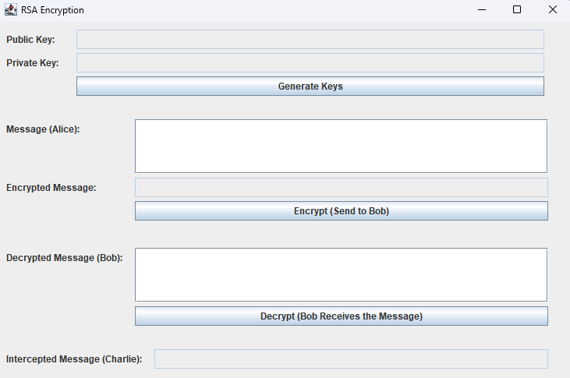
Java RSA Program
The Java code implements a graphical user interface (GUI) for the RSA encryption and decryption algorithm
The program simulates a communication scenario, where Alice sends an encrypted message to Bob, and Bob decrypts the ciphertext to read the message.
Charlie also intercepts the data flow and obtains unauthorised information.

Slide 8

RSA encryption algorithm implementation
The RSA encryption algorithm is implemented using the BigInteger class.
The program generates a random prime number, and then computes the public and private key pair based on that number.
The program then uses the public key to encrypt the message, and the private key to decrypt the message.

Slide 9
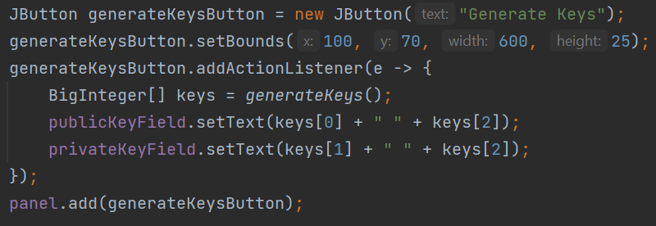
Key Generation
When the user clicks the Generate Keys button, the actionPerformed method is called, which generates a public and private key using the generateKeys method.
The generateKeys method uses the BigInteger class to generate two large prime numbers (p and q) of 512 bits each.
The method then computes the public and private keys using the extended Euclidean algorithm and the modular inverse.
The public key is a pair of (e, n), and the private key is a pair of (d, n), where n = p * q.
The generateKeys method returns an array of BigIntegers containing the public and private keys, which are then displayed in their respective JTextFields in the GUI.

Slide 10
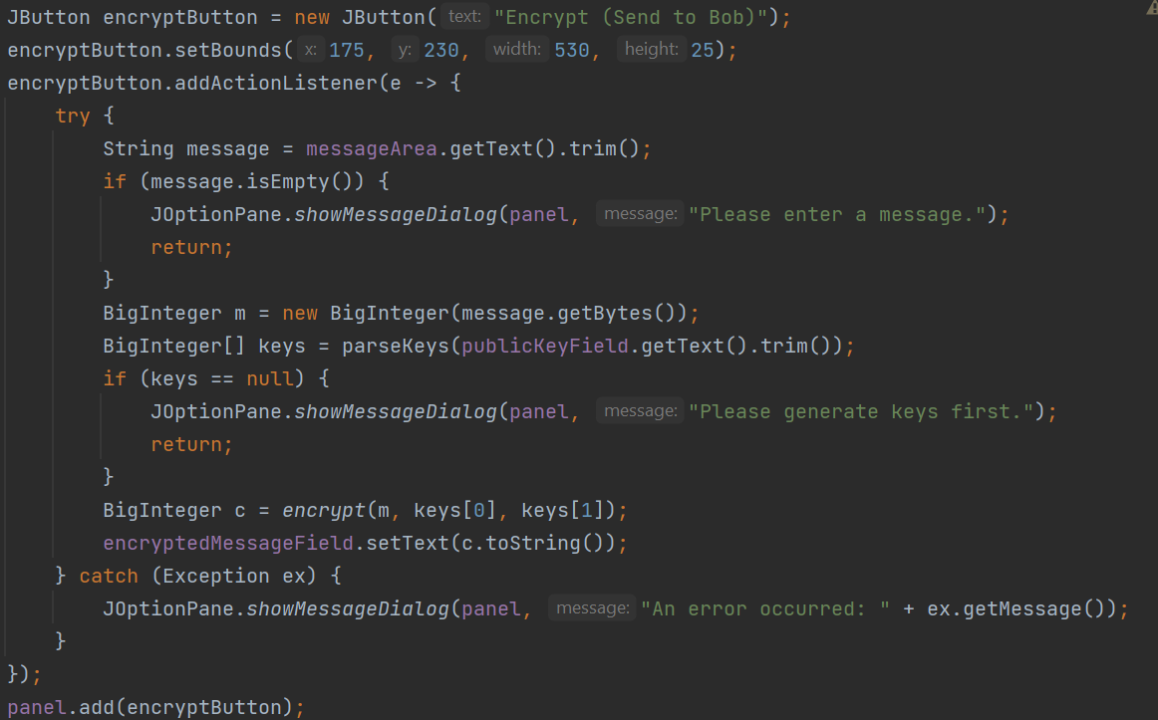
Message Encryption
When the user clicks the Encrypt button, the actionPerformed method is called, which encrypts the message entered in the messageArea using the public key.
First, the method checks if a message is entered. If not, it displays a message dialog requesting the user to enter a message.
Then the method converts the message into a BigInteger using the getBytes() method of the String class. The method then parses the public key from the publicKeyField and checks if the key is generated. If not, it displays a message dialog requesting the user to generate keys first.
Finally, the method encrypts the message using the encrypt method and displays the encrypted message in the encryptedMessageField.

Slide 11
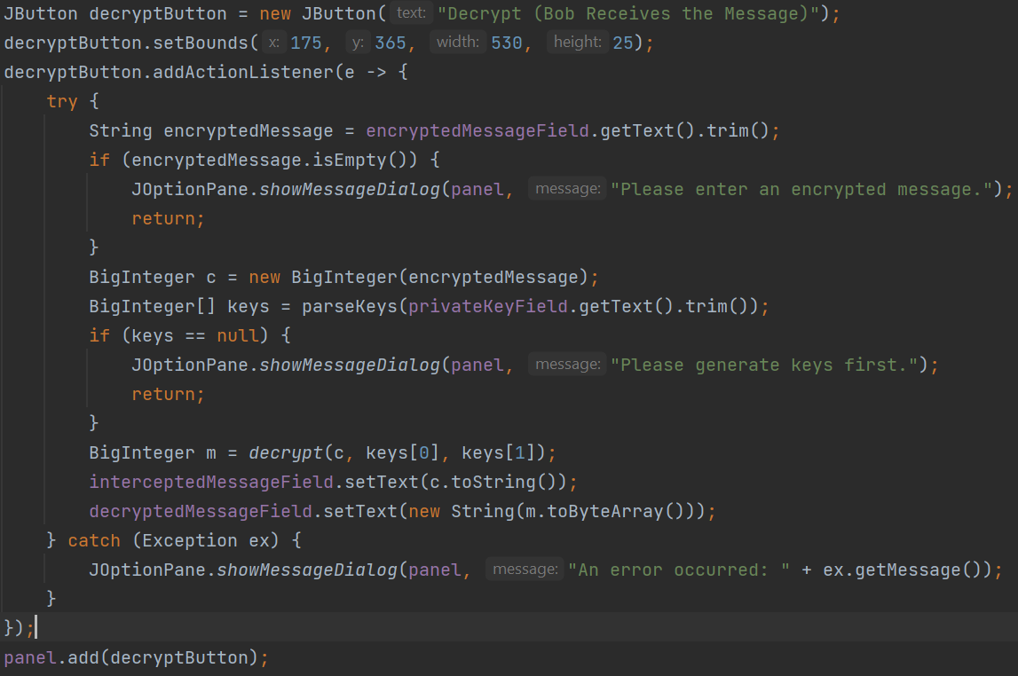
Message Decryption
When the user clicks the Decrypt button, the actionPerformed method is called, which decrypts the message entered in the encryptedMessageField using the private key.
First, the method checks if an encrypted message is entered. If not, it displays a message dialog requesting the user to enter an encrypted message.
Then the method converts the encrypted message into a BigInteger. The method then parses the private key from the privateKeyField and checks if the key is generated. If not, it displays a message dialog requesting the user to generate keys first.
Finally, the method decrypts the message using the decrypt method and displays the decrypted message in the decryptedMessageField.

Slide 12

Error Handling
The program checks that the user has entered a valid message before attempting to encrypt it, and it displays an error message if an exception occurs during the encryption or decryption process.

Slide 13
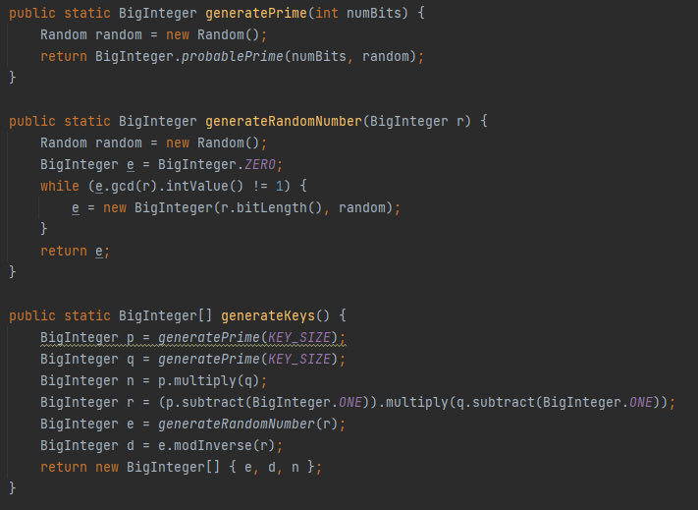
generateKeys method
The generateKeys method generates a pair of RSA keys consisting of a public key and a private key.
The keys are generated using the java.util.Random class to ensure that they are unpredictable.
The method returns an array of two BigInteger objects, where the first element is the public key and the second element is the private key.

Slide 14
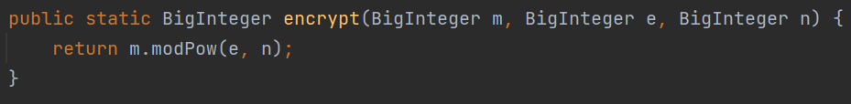
Encrypt Method
The encrypt method takes a message (represented as a BigInteger object), the public key, and the private key, and returns the encrypted message as another BigInteger object.
The encryption process involves raising the message to the power of the public key modulo the product of two large prime numbers, which is also part of the public key.
The resulting number is the encrypted message.

Slide 15
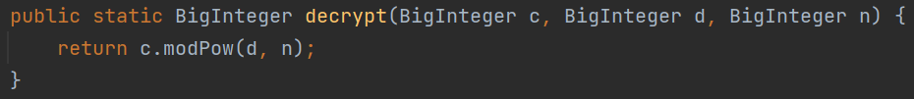
Decrypt Method
The decrypt method takes the encrypted message (represented as a BigInteger object), the public key, and the private key, and returns the decrypted message as another BigInteger object.
The decryption process involves raising the encrypted message to the power of the private key modulo the same product of prime numbers used in the encryption process.
The resulting number is the decrypted message.

Slide 16
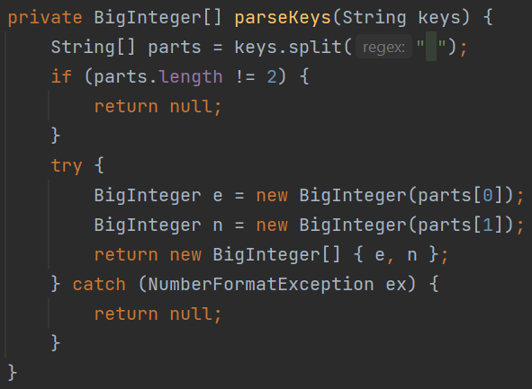
ParseKeys MEthod
The parseKeys method takes a string representation of a public or private key, and returns an array of two BigInteger objects representing the key.
The method expects the key string to contain two space-separated integers, where the first integer is the key value and the second integer is the value of the product of the two prime numbers used in the key.

Slide 17
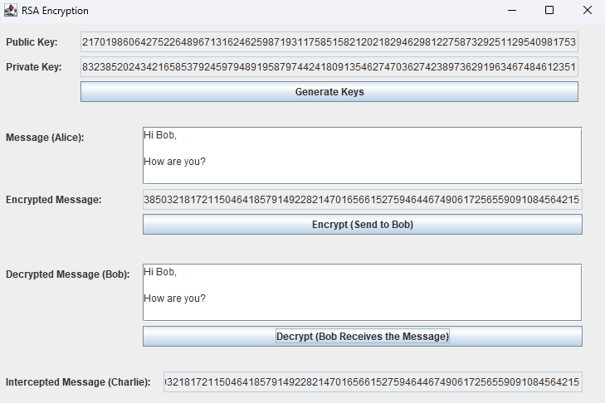
Summary

Slide 18
Thank you
Thomas McAloon
tmcal001@gold.ac.uk
33618177
18

