Slide 1

RSA Encryption
Thomas McAloon
33618177

Slide 2
Overview
What is RSA Encryption?
How does RSA Encryption work?
Topic three
Topic four

Slide 3

What is RSA Encryption?
RSA is a public-key cryptosystem that was invented by Ron Rivest, Adi Shamir, and Leonard Adleman (RSA) in 1977
RSA is widely used today for secure data transmission over the internet.
It is used in various applications, such as online banking, email encryption, and secure file transfers.

Slide 4
How does RSA Encryption work?
RSA works by utilizing the mathematical properties of large prime numbers.
It involves the generation of two prime numbers, p and q, whose product, n, is the public key used for encryption.
The security of RSA encryption is based on the fact that it is difficult to factorize the product of two large prime numbers, making it practically impossible to determine the factors of the public key.

Slide 5
Generating Public & Private Keys
1
Generate two large prime numbers, p and q.
2
Calculate n = p * q, which is the modulus for the public key.
3
Calculate the Euler totient function of n, φ(n) = (p-1) * (q-1).
4
Choose an integer e, such that 1 < e < φ(n) and e is co-prime to φ(n).
5
Calculate d, the modular multiplicative inverse of e, such that (d * e) mod φ(n) = 1.
This value is the private key.
This value is the public key.

Slide 6

Encryption & Decryption
Encryption is performed by the sender by taking the recipient’s public key (n, e) and converting the message to an integer.
The sender then raises the message to the power of e and takes the result modulo n.
The resulting value is the encrypted message that can only be decrypted using the corresponding private key (d).
Decryption is performed by the recipient by taking the encrypted message, raising it to the power of d, and taking the result modulo n.
The resulting value is the original message sent by the sender.

Slide 7
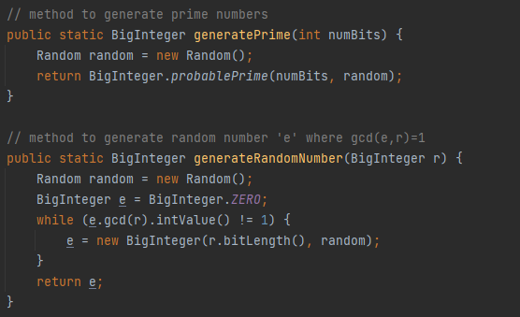
The method ‘generatePrime’ generates prime numbers.
This is done using the ‘probablePrime’ method and a random number generator.
Next, the method ‘generateRandomNumber’ generates a random number 'e' where gcd(e,r)=1.
This is done using a while loop and a random number generator.

Slide 8
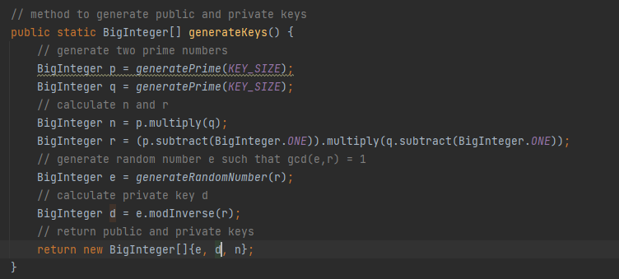
The ‘generateKeys’ method, which generates both the public and private keys.
The method generates two prime numbers, calculates n and r, generates a random number e such that gcd(e,r) = 1, and then calculates private key d.
The method then returns the public and private keys.

Slide 9
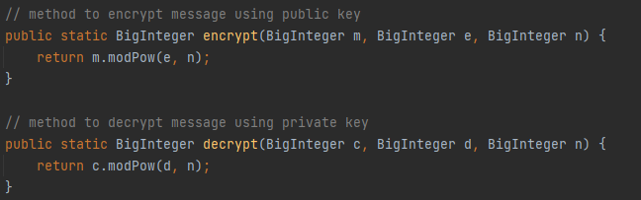
Encryption & Decryption
The “encrypt” method encrypts the message using the public key
The “decrypt” method decrypts the message using the private key

Slide 10
The main method prompts the user to enter a message to encrypt, generates public and private keys, encrypts the message, and then simulates an interception by a third party. The user is then prompted to decrypt the message. The program also demonstrates a problematic case where the prime factors of n are small and are not kept secret, making it easy for an attacker to factor n and break the encryption.

Slide 11
flow between Alice, Bob, and Charlie
Alice generates a message and encrypts it using Bob's public key.
Alice sends the encrypted message to Bob.
Charlie intercepts the encrypted message sent by Alice to Bob.
Charlie may attempt to decrypt the message using his own private key, which is not possible in this case because he does not have Bob's private key.
Bob receives the encrypted message from Alice.
Bob decrypts the message using his private key.
Bob reads the decrypted message sent by Alice.

Slide 12
Thank you
Thomas McAloon
tmcal001@gold.ac.uk
33618177

