Slide 1
Diagnosis via capsule network and transformer

Slide 2
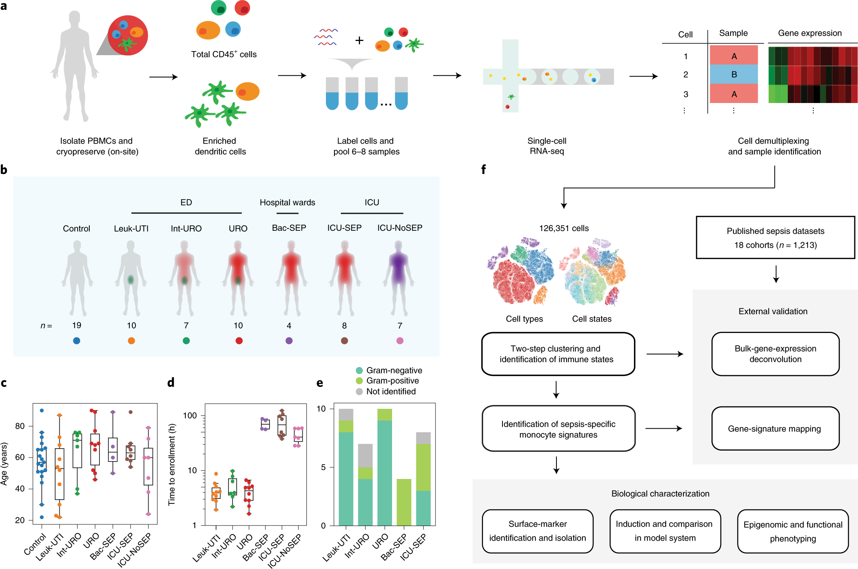
Single cell sepsis
https://www.nature.com/articles/s41591-020-0752-4

Slide 3
Data Preprocessing
Sepsis

Slide 4
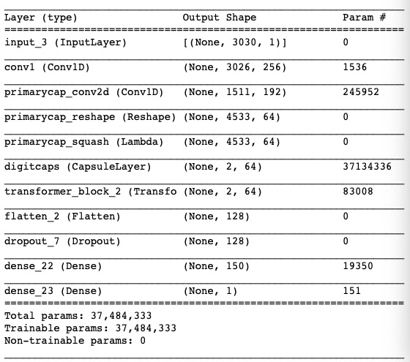
Data Preprocessing
Remove sparse records with sparsity > 90%
Select differential RNA
with FDR > 0.005
Split 90% training + 10% testing

Slide 5
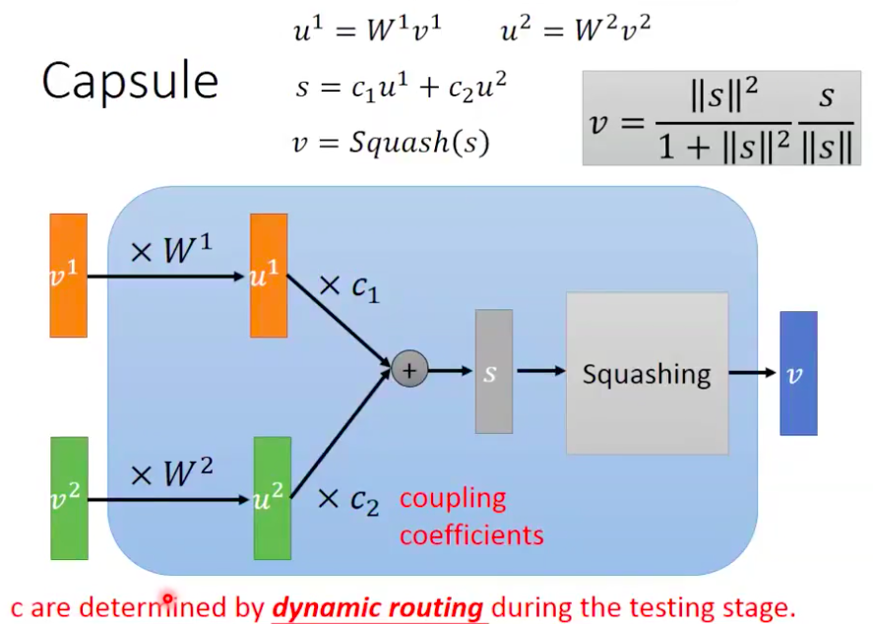
Capsule Network for feature conformity
Notes:
Dynamic Routing Between Capsules , NIPS
https://www.bilibili.com/video/BV1eW411Q7CE

Slide 6
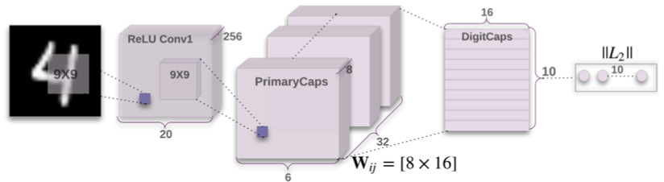
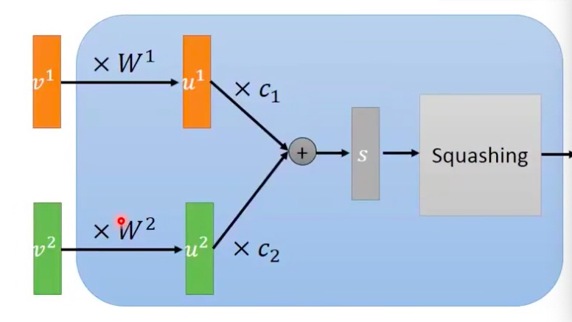
Capsule Network
Gene1
Gene2
Notes:
Dynamic Routing Between Capsules , NIPS
https://www.bilibili.com/video/BV1eW411Q7CE

Slide 7
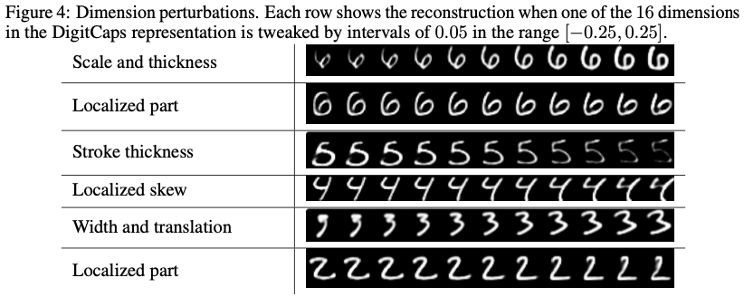
Each dimension represent a
How to obtain label for the decoder?

Slide 8
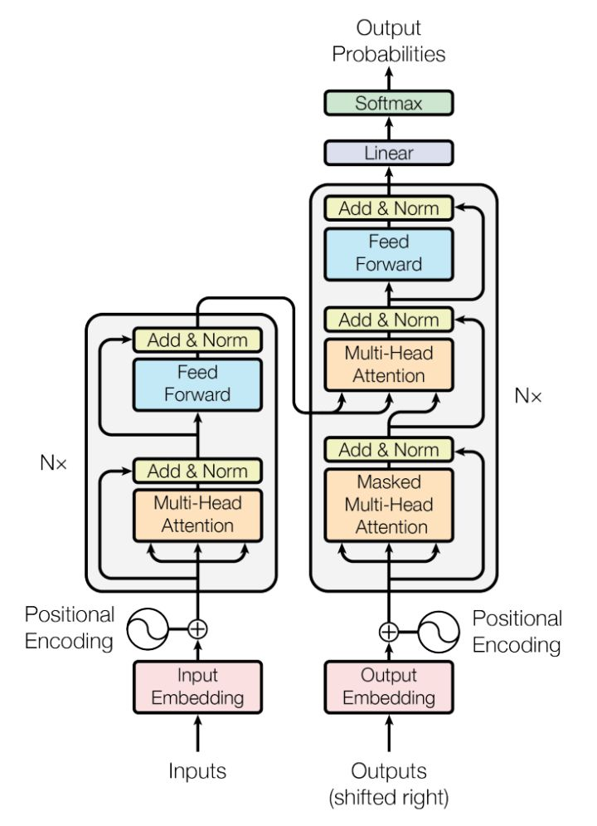
Transformer
…

Slide 9
Result in single cell
Model | AUROC | AUPRC | Accuracy | Specificity | Sensitivity
CapsuleNet+Transformer | 0.93 | 0.92 | 84.43%
CapsuleNet
Transformer
1dCNN
Model | AUROC | AUPRC | Accuracy | Specificity | Sensitivity
CapsuleNet+Transformer
FAIM3/PLAC8
SeptiCyte Lab
sNIP score

Slide 10
Result in single cell
AUROC and AUPRC graph

Slide 11
For Bulk Data
AUROC | CapsuleNet+ Transformer | FAIM3/PLAC8 | SeptiCyte Lab | sNIP score
GSE95233
GSE57065
GSE28750
GSE8121
GSE9692
GSE13904
GSE26378
GSE4607
GSE26440

Slide 12
For Bulk Data
AUPRC | CapsuleNet+ Transformer | FAIM3/PLAC8 | SeptiCyte Lab | sNIP score
GSE95233
GSE57065
GSE28750
GSE8121
GSE9692
GSE13904
GSE26378
GSE4607
GSE26440

Slide 13
For Bulk Data
AUROC and AUPRC graph

Slide 14
