Slide 1
Windows
A Software Engineering Odyssey
Mark Lucovsky
Distinguished Engineer
Microsoft Corporation

Slide 2
Agenda
History of NT
Design Goals/Culture
NT 3.1 Development vs. Windows 2000 Development
Development for the next 10 years

Slide 3
NT Timeline first 10 years
2/89 Coding Begins
7/93 NT 3.1 Ships
9/94 NT 3.5 Ships
5/95 NT 3.51 Ships
7/96 NT 4.0 Ships
12/99 NT 5.0 a.k.a. Windows 2000 ships

Slide 4
Unix Timeline first 20 years
’69 Coding Begins
’71 First Edition – PDP 11/20
’73 Fourth Edition – Rewritten in C
’75 Fifth Edition – Leaves Bell Labs, basis for BSD 1.x
’79 Seventh Edition – One of the best
’82 System III
’84 4.2 BSD
’89 SVR4 Unification of Xenix, BSD, System V
  NT development begins

Slide 5
History of NT
Team forms November 1988
Six guys from DEC
One guy from Microsoft
Build from the ground up
  Advanced PC Operating System
  Designed for for desktops and servers
  Secure, scalable SMP design
  All new code
Schedule: 18months (only missed our date by 3 years)

Slide 6
History of NT (cont.)
Initial effort targeted at Intel i860 code-named N10, hence the name NT which doubled as N-Ten and New Technology
Most development done on i860 simulator running on OS/2 1.2 (took about 30 minutes)
Microsoft built a single board i860 computer code named Dazzle including the supporting chipset and actually ran a full kernel, memory management, etc on the machine.
Compiler came from Metaware with weekly UUCP updates sent to my Sun-4/200.
Microsoft wrote a PE/Coff linker as well as a graphical cross debugger

Slide 7
Design Longevity
OS Code has a long lifetime
You have to base your OS on solid design principles
You have to set goals, and not everything can be at the top of the list
You have to design for evolution in hardware, usage patterns, etc.,
Only way to succeed is base your design on a solid architectural foundation
Development environments never get enough attention…

Slide 8
Goal Setting
First job was to establish high level goals.
  Portability – Ability to target more than one processor, avoid assembler, abstract away machine dependencies. We purposely started the i386 port very late in order to avoid falling into a typical, Microsoft, x86 centric design.
  Reliability – Nothing should be able to crash the OS. Anything that crashes the OS is a bug. Very radical thinking inside of Microsoft considering Win16 was cooperative multi-tasking in a single address space, and OS/2 had many similar attributes with respect to memory isolation
  Extensibility – Ability to extend the OS over time
  Compatibility – With DOS, OS/2, POSIX, or other popular runtimes. This is the foundation work that allowed us to invent windows two years into NT OS/2 development.
  Performance – All of the above are more important than raw speed!

Slide 9
NT OS/2 Design Workbook
Design of executive captured in functional specs
Written by engineers, for engineers
Every functional interface was defined and reviewed
Small teams can do this efficiently,
  making this process scale is an almost impossible challenge
  Senior developers are inundated with spec reviews and the value of their feedback becomes meaningless
  You have to spread review duties broadly, and everyone must share the “culture”

Slide 10
Developing a Culture
To scale a development team, you need to establish a culture
  Common way of evaluating designs, making tradeoffs, etc.
  Common way of developing code and reacting to problems (build breaks, critical bugs, etc.)
  Common way of establishing ownership of problems
Goal setting can be the foundation for the culture
Keeping a culture alive as a team grows is a huge challenge

Slide 11
The NT Culture
Portability, Reliability, Security, and Extensibility ingrained as the teams top priority
  Every decision was made in the context of these design goals
Everyone owns all the code, so whenever something is busted anyone has a right and a duty to fix it
  Works in small groups (< 150 people) where people cover for each other
  Fails miserably in large groups
Sloppiness is not tolerated
  Great idea, but very difficult to nurture as group grows
  Abuse and intimidation gets way out of control, can’t keep calling people stupid and expect them to listen
A successful culture has to accept that mistakes will happen

Slide 12
Development Environment
NT 3.1 vs. Windows 2000
  Development Teams
  Source Code Control System
  Process Management
  Serialized Development
  Defects

Slide 13
Development Team
NT 3.1
  Starts very small (6), grows very slowly to 200 people
  NT Culture was commonly understood by all
Windows 2000
  Mass assimilation of other teams into the NT team
  NT 4.0 had 800 developers, Windows 2000 had 1400
  Original NT culture practiced by the old timers in the group, but keeping the culture alive was very difficult due to growth, physical separation, etc.
    Diluted culture leads to much conflict
      Accountability: I don’t “own” the code that is busted, see Markl
      reliability vs. new features
      64-bit portability vs. new features

Slide 14
Source Code Control System (NT 3.1)
Internally developed, maintained by a non-NT tools team
  No branch capability, but with small team, it was not needed
10-12 well isolated source “projects”, 6M LOC
Informal project separation worked well
  minimal obscure source level dependencies
Small hard drive could easily hold entire source tree
Developer could easily stay in synch with changes made to the system

Slide 15
Source Code Control System (Windows 2000)
Windows team takes ownership of source code control system which at this point is on life support
Branch capability sorely needed, tree copies used as substitute, so merging is a nightmare
180 source “projects” 29M LOC
No project separation, reaching “up and over” was very common as developers tried to minimize what they had to carry on their machines to get their jobs done
Full source base required about 50Gb of disk space
To keep a machine in synch was a huge chore (1 week to setup, 2 hours per-day to synchronize)

Slide 16
Process Management (NT 3.1)
Safe synch period in effect for ~4 hours each day, all other times the rule is check-in when ready
Build lab synchs during morning safe synch period, and starts a complete build.
  Build breaks are corrected manually during the build process (1-2 breaks was normal)
Complete build time is 5 hours on ~486/50
Build is boot tested with some very minimal testing before release to stress testing
  Defects corrected with incremental build fixes
4pm, stress testing on ~100 machines begins

Slide 17
Process Management (Windows 2000)
Developers are not allowed to change the source tree without explicit, email/written permission
  Build lab manually approves each check-in using a combination of email, web, and bug tracking database
Build lab approves about 100 changes each day and manually issues the appropriate synch and build commands
  Build breaks are corrected manually, and when they occur, all further build processing is halted
  A developer that mistypes a build instruction can stop the build lab, which in turn stops over 5,000 people
Complete build time is 8 hours on 4 way PIII Xeon 550 with 50Gb disk and 512k RAM
Build is boot tested and assuming we get a boot, extensive baseline testing begins
  Testing is a mostly manual, semi-automated process
  Defects occurring in the boot or test phase must be corrected before build is “released” for stress testing
4pm, stress testing on ~1000 machines begins

Slide 18
Team Size
Product | Dev Team Size | Test Team Size
NT 3.1 | 200 | 140
NT 3.5 | 300 | 230
NT 3.51 | 450 | 325
NT 4.0 | 800 | 700
Win2k | 1400 | 1700

Slide 19
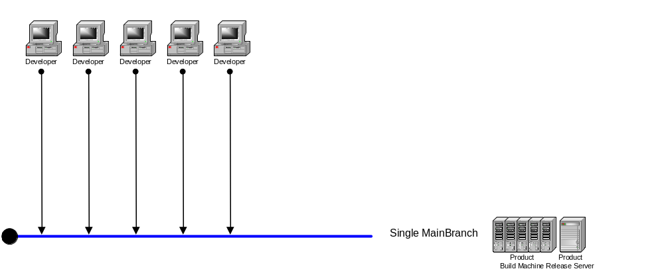
Serialized Development
The model from NT 3.1 -> Windows 2000
All developers on team check-in to a single main line branch
Master build lab synchs to main branch and builds and releases from that branch
Checked in defect affects everyone waiting for results

Slide 20
Defect Rates and Serialization
Compile time or run time bugs that occur in a developers office only affect that developer
Once a defect is checked-in, the number of people affected by the defect increases
Best developers are going to check-in a runtime or compile time mistake at least twice each year
Best developers will be able to cope with a checked-in compile time or run time break very quickly (about 20 minutes end-to-end)
As the code base gets larger, and as the team gets larger, these numbers typically double

Slide 21
Defect Rates Data
With serialized development:
  Good, small teams operate efficiently
  Even the absolute best large teams are always broken, and always serialized
Product and Team Size | Defects: Per year Per Dev | Time to Fix: Per Defect | Defects: Per Day | Total Defect Fix Time
NT 3.1, 200 | 2 | 20 minutes | 1 | 20 minutes
NT 3.5, 300 | 2 | 25 minutes | 1.6 | 41 minutes
NT 3.51, 450 | 2 | 30 minutes | 2.5 | 1.2 hours
NT 4.0, 800 | 3 | 35 minutes | 6.6 | 3.8 hours
Win2k, 1400 | 4 | 40 minutes | 15.3 | 10.2 hours

Slide 22
Development Environment Summary
NT 3.1
  Fast and loose development, lots of fun, lots of energy
  Few barriers to getting your work done
  Defects serialized parts of the process, but didn’t stop the whole machine, minimal down time
Windows 2000
  Source code control system bursting at the seams
  Excessive process management serialized the entire development process, 1 defect stops 1400 devs, 5000 team members!
  Resources required to build a complete instance of NT were excessive giving few developers a way to be successful

Slide 23
Focused Fixes
Source Code Control System
Source Code Restructuring
Make the large team work like a set of small teams
  Windows is already organized into reasonable size development teams
  Goal is to allow these teams to work as a team when contributing source code changes rather than as a group of individuals that happen to work for the same VP
    Parallel Development, Team Level Independence
Automated Builds

Slide 24
Source Code Control System
New source code control system identified 3/99 (SourceDepot)
Native branch support
Scalable, high speed, client server architecture
New machine setup 3 hours vs. 1 week
Normal synch 5 minutes vs. 2 hours

Slide 25
Source Code Control System (cont.)
Transition to SourceDepot done on LIVE Win2k code base
Hand built SLM -> SourceDepot migration system allowed us to keep in synch with the old system while transitioning to SourceDepot and changing the source code layout

Slide 26
Source Code Restructuring
16 Depots for covering each major area of source code
Organization is focused on:
  minimizing cross project dependencies to reduce defect rate
  Sizing projects to compile in a reasonable amount of time
  To build a project, all you need is the code for that project, AND the public/root project
  Cross project sharing is explicit

Slide 27
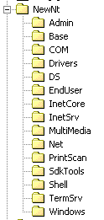
New Tree Layout
The new tree layout features
  Root project houses public
  15 Additional projects hang off of the Root
  No nested projects
  All projects build independently
  Cross project dependencies resolved via Public, Public\internal using checked in interfaces

Slide 28
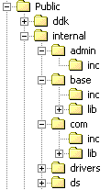
Explicit Internal Interface Sharing
The Admin Project internal interfaces exposed here
The Base Project internal interfaces exposed here

Slide 29
Team Level Independence
Each team determines its own check-in policy, enable rapid, frequent check ins
Teams are isolated from mistakes made by other teams
  When errors occur, only the team causing the error is affected
  A build, boot, or test break only affects a small subset of the product group
Each team has their own view of the source tree, their own mini build lab, and builds an entire installable build
Any developer with adequate resources can easily duplicate a mini build lab
  build and release a completely installable Windows System

Slide 30
Parallel Development (cont.)
Robs team checks into his own branch without affecting Main, or Debbl
Debbl’s team makes similar check-ins without impacting Rob or Main
Robs Base Branch
Debbl’s Windows Branch
QFE/SP Branch
Main Build Lab Branch
During test, more changes are needed to make system work well. When done, integration into main build lab branch occurs. During this period, robs team continues to check-in to their branch
Rob builds resulting tree, tests tree and then integrates to the main branch
Rob integrates build lab changes to his tree
Team branches have their own check-in policy.
Team members check-in to their branch, not the main branch
Each team branch has their own mini-build lab that produces full builds for that team
Debbl makes a few changes then integrates from the main build lab branch
Main branch is built by the master build lab.
Quality is always high because only well tested complete group check-ins are done here
N+1 Dev Branch
At RTM, a QFE/SP branch is created. N+1 Branch integrates from main, then integrates their branch into main
N+1 Team checks into their branch and periodically integrates from main

Slide 31
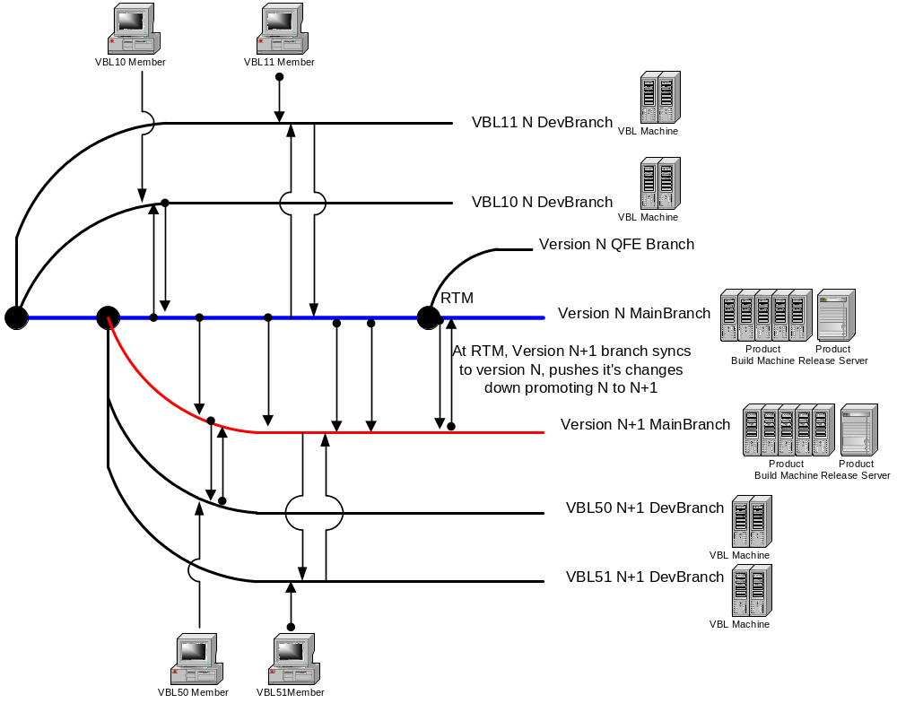
Parallel Development

Slide 32
Team Level Independence (cont.)
Teams integrate their changes into the “main” trunk one at a time, so there is a high degree of accountability when something goes wrong in “main”
Build breaks will happen, but they are easily localized to the branch level, not the main product codeline
Teams are isolated from mistakes made by other teams
  When errors occur, they affect smaller teams
  A build, boot, or test break only affects a small subset of the windows development team
Each team has their own view of the source tree and their own mini build lab
  I.e. Each team’s lab is enlisted in ALL projects and builds ALL projects
  Each team needs resources able to build an NT system
Each team’s build lab builds, tests, and mini-bvt’s a complete standalone system

Slide 33
Automated Builds
Build lab runs 100% hands off
10am and 10pm full synch and full build
  Build failures are auto detected and mailed to the team
  Successful builds are automatically released with automatic notification to the team
  Each VBL can build:
    4 platforms (x86 fre/chk, ia64 fre/chk) = 8 builds each day, 56 each week
    No manual steps at all. 100% Hands off automatic
    7 VBLs in Win2k Group
    Majority of builds work, but failures when they occur are isolated to a single team

Slide 34
Productivity Gains
Developers can easily switch from working on release N to release N+1
Developers in one team will not be impacted by mistakes/changes made by other teams
Developers have long, frequent checkin windows (Base team has a 24x7 open checkin window, vs. 2-3 hour per day checkin window with manual approval used during W2K
Source code control system is fast and reliable
Testing is done on complete builds instead of assorted collections of private binaries
  What is in the source code control system is what is tested

Slide 35
How is it working?
Source code control system is working very well
  No scaling problems, easily handling 5100 total user enlistments and 411,000 files
Source code restructuring is working well
  No new depots added, explicit sharing between projects still the rule
Parallel Development is working very well
  Teams feel independent and able to control their own destiny
  Per-team serialization only occurs when a team “reverse integrates” their changes into the main branch

Slide 36
Summary
The initial NT development environment and culture worked well for the first few years
Ten years of team and code growth forced a major re-design of the development environment and culture
With the new environment in place, the team is working a lot like they did in the NT 3.1 days with a small, fast moving, development team

Slide 37

Questions

