Slide 1
BACKWARD SEARCH
FM-INDEX
(FULL-TEXT INDEX IN MINUTE SPACE)
Paper by
Ferragina & Manzini
Presentation by
Yuval Rikover

Slide 2

Combine Text compression with indexing
(discard original text).
Count and locate P by looking at only a small portion of the compressed text.
Do it efficiently:
  Time: O(p)
  Space: O(n H_{k}(T)) + o(n)

Slide 3

Exploit the relationship between the Burrows-Wheeler Transform and the Suffix Array data structure.
Compressed suffix array that encapsulates both the compressed text and the full-text indexing information.
Supports two basic operations:
  Count – return number of occurrences of P in T.
  Locate – find all positions of P in T.

Slide 4



Process T[1,..,n] using Burrows-Wheeler Transform
  Receive string L[1,..,n] (permutation of T)
Run Move-To-Front encoding on L
  Receive [1,…,n]
Encode runs of zeroes in using run-length encoding
  Receive
Compress using variable-length prefix code
  Receive Z (over alphabet {0,1} )

Slide 5


Every column is a permutation of T.
Given row i, char L[i] precedes F[i] in original T.
Consecutive char’s in L are adjacent to similar strings in T.
Therefore – L usually contains long runs of identical char’s.
F
L
mississippi#
# mississipp i
ississippi#m
i #mississip p
ssissippi#mi
i ppi#missis s
sissippi#mis
i ssippi#mis s
issippi#miss
Sort the rows
i ssissippi# m
ssippi#missi
m ississippi #
sippi#missis
ippi#mississ
ppi#mississi
pi#mississip
i#mississipp
#mississippi
p i#mississi p
p pi#mississ i
s ippi#missi s
s issippi#mi s
s sippi#miss i
s sissippi#m i

Slide 6
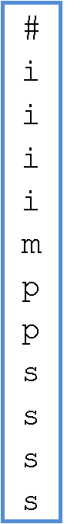
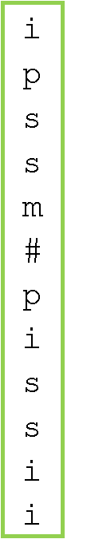
Reminder: Recovering T from L
F
L
Find F by sorting L
First char of T? m
Find m in L
L[i] precedes F[i] in T. Therefore we get mi
How do we choose the correct i in L?
  The i’s are in the same order in L and F
  As are the rest of the char’s
i is followed by s: mis
And so on….

Slide 7


Replace each char in L with the number of distinct char’s seen since its last occurrence.
Keep MTF[1,…,|Σ|] array, sorted lexicographically.
Runs of identical char’s are transformed into runs of zeroes in
L
i | p | s | s | m | # | p | i | s | s | i | i
1
3
4
0
4
4
3
4
4
0
1
0
Bad example
For larger, English texts, we will receive more runs of zeroes, and dominancy of smaller numbers.
The reason being that BWT creates clusters of similar char’s.
# | i | m | p | s
0 | 1 | 2 | 3 | 4
i | # | m | p | s
0 | 1 | 2 | 3 | 4
And so on…
p | i | # | m | s
0 | 1 | 2 | 3 | 4
s | p | i | # | m
0 | 1 | 2 | 3 | 4

Slide 8




i | p | s | s | m | # | p | i | s | s | i | i
Replace any sequence of zeroes with:
  (m+1) in binary
  LSB first
  Discard MSB
Add 2 new symbols – 0,1
is defined over
{ 0,1,1,2,…,|Σ|}
L
i | p | p | p | s | s | m | e | i | p | # | i | s | s | i | i
2 | 4 | 0 | 0 | 5 | 0 | 5 | 5 | 4 | 4 | 5 | 2 | 5 | 0 | 1 | 0
1
3
4
0
4
4
3
4
4
0
1
0
2 | 4 | 1 | 5 | 0 | 5 | 5 | 4 | 4 | 5 | 2 | 5 | 0 | 1 | 0
To give a meatier example (not really), we’ll change our text to:
T = pipeMississippi#
Example
0 → 1+1 = 2 → 10 → 01 → 0
00 → 2+1 = 3 → 11 →11 → 1
000 → 3+1 = 4 → 100 → 001 → 00
0000 → 4+1 = 5 → 101 → 101 → 10
00000→ 5+1 = 6 → 110 → 011 → 01
000000 → 6+1 = 7 → 111 → 111 → 11
0000000 → 7+1 = 8 → 1000 → 0001→000

Slide 9





How to retrieve m
given a binary number
Replace each bit with a sequence of zeroes
10 → Zeroes
Replace any sequence of zeroes with:
  (m+1) in binary
  LSB first
  Discard MSB
Add 2 new symbols – 0,1
is defined over
{ 0,1,1,2,…,|Σ|}
Example
0 → 1+1 = 2 → 10 → 01 → 0
00 → 2+1 = 3 → 11 →11 → 1
000 → 3+1 = 4 → 100 → 001 → 00
0000 → 4+1 = 5 → 101 → 101 → 10
00000→ 5+1 = 6 → 110 → 011 → 01
000000 → 6+1 = 7 → 111 → 111 → 11
0000000 → 7+1 = 8 → 1000 → 0001→000

Slide 10












011 00101 11 00110 10 00110 00110 00101 00101 00110 011 00110 10 010 10
Compress as follows,
over alphabet {0,1}:
1 → 11 0 → 10
For i = 1,2,…, |Σ| - 1
  zeroes
  Followed by binary representation of i+1
  which takes 1+
  For a total of 1+2
  bits
L
i | p | p | p | s | s | m | e | i | p | # | i | s | s | i | i
2 | 4 | 0 | 0 | 5 | 0 | 5 | 5 | 4 | 4 | 5 | 2 | 5 | 0 | 1 | 0
2 | 4 | 1 | 5 | 0 | 5 | 5 | 4 | 4 | 5 | 2 | 5 | 0 | 1 | 0
Example
i=1 → 0’s, bin(2) → 010
i=2 → 0’s, bin(3) → 011
i=3 → 0’s, bin(4) → 00100
i=4 → 0’s, bin(5) → 00101
i=5 → 0’s, bin(6) → 00110
i=6 → 0’s, bin(7) → 00111
i=7 → 0’s, bin(8) → 0001000

Slide 11



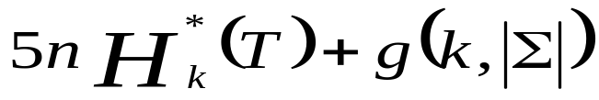
In 1999, Manzini showed the following upper bound for BWT compression ratio:
The article presents a bound using :
  Modified empirical entropy
  The maximum compression ratio we can achieve, using for each symbol a codeword which depends on a context of size at most k (instead of always using a context of size k).
In 2001, Manzini showed that for every k, the above compression method is bounded by:

Slide 12


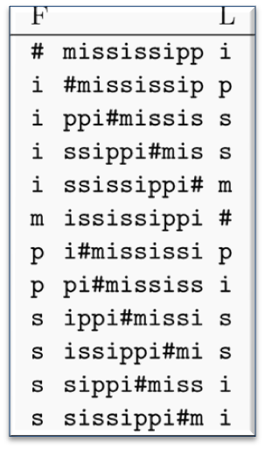

Backward-search algorithm
Uses only L (output of BWT)
Relies on 2 structures:
  C[1,…,|Σ|] : C[c] contains the total number of text chars in T which are alphabetically smaller then c (including repetitions of chars)
  Occ(c,q): number of occurrences of char c in prefix L[1,q]
Example
C[ ] for T = mississippi#
occ(s, 5) = 2
occ(s,12) = 4
    Occ Rank
1
2
3
4
5
6
7
8
9
10
11
12
1 | 5 | 6 | 8
i m p s

Slide 13

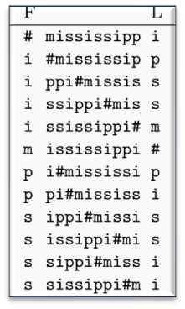
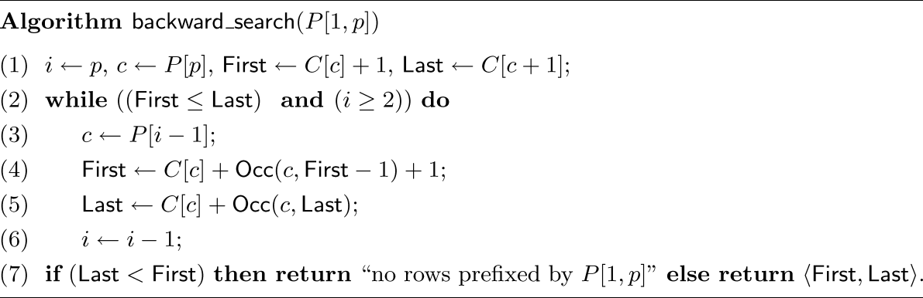
Works in p iterations, from p down to 1
Remember that the BWT matrix rows = sorted suffixes of T
  All suffixes prefixed by pattern P, occupy a continuous set of rows
  This set of rows has starting position First
  and ending position Last
  So, (Last – First +1) gives total pattern occurrences
At the end of the i-th phase, First points to the first row prefixed by P[i,p], and Last points to the last row prefiex by P[i,p].
i = 3
i = 2
i = 1
P = msi
msi
msi
msi
c = ‘i’
c = ‘s’
c = ‘m’

Slide 14
SUBSTRING SEARCH IN T (COUNT THE PATTERN OCCURRENCES)
P[ j ]
C
Paolo Ferragina, Università di Pisa
P = si
# 1
i 2
m 7
p 8
S 10
Available info
First step
L
unknown
#mississipp
i#mississip
ippi#missis
issippi#mis
ississippi#
mississippi
pi#mississi
ppi#mississ
sippi#missi
sissippi#mi
ssippi#miss
ssissippi#m
i
p
s
s
m
#
p
i
s
s
i
i
rows prefixed
by char “i”
fr
s
s
lr
Inductive step: Given fr,lr for P[j+1,p]
mississippi
Take c=P[j]
Find the first c in L[fr, lr]
Find the last c in L[fr, lr]
fr
L-to-F mapping of these chars
occ=2
[lr-fr+1]
lr
Occ() oracle is enough

Slide 15


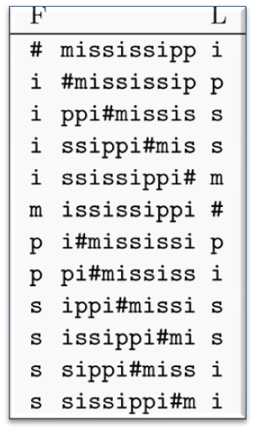
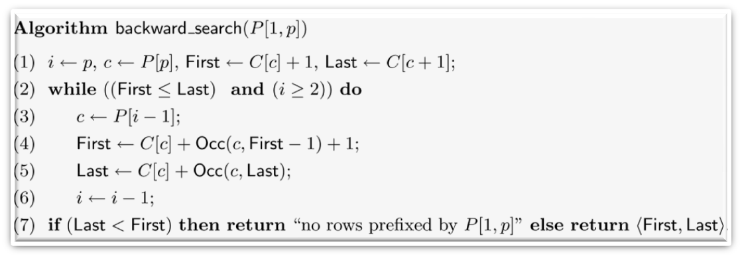
P = pssi
  i =
  c =
  First =
  Last =
  (Last – First + 1) =
1
2
3
4
5
6
7
8
9
10
11
12
First
4
3
Last
‘i’
‘s’
C[‘i’] + 1 = 2
C[‘s’] + Occ(‘s’,1) +1 = 8+0+1 = 9
C[‘i’ + 1] = C[‘m’] = 5
C[‘s’] + Occ(‘s’,5) = 8+2 = 10
4
2
C[ ] =
1 | 5 | 6 | 8
i m p s

Slide 16
P = pssi
  i =
  c =
  First =
  Last =
  (Last – First + 1) =
1
2
3
4
5
6
7
8
9
10
11
12
3
2
‘s’
C[‘s’] + Occ(‘s’,1) +1 = 8+0+1 = 9
C[‘s’] + Occ(‘s’,8) +1 = 8+2+1 = 11
First
C[‘s’] + Occ(‘s’,5) = 8+2 = 10
C[‘s’] + Occ(‘s’,10) = 8+4 = 12
Last
2
C[ ] =
1 | 5 | 6 | 8
i m p s

Slide 17
P = pssi
  i =
  c =
  First =
  Last =
  (Last – First + 1) =
1
2
3
4
5
6
7
8
9
10
11
12
2
1
‘s’
‘p’
C[‘s’] + Occ(‘s’,8) +1 = 8+2+1 = 11
C[‘p’] + Occ(‘p’,10) +1 = 6+2+1 = 9
C[‘s’] + Occ(‘s’,10) = 8+4 = 12
C[‘p’] + Occ(‘p’,12) = 6+2 = 8
First
2
0
Last
C[ ] =
1 | 5 | 6 | 8
i m p s

Slide 18

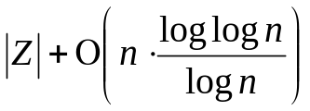
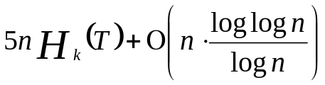
Backward-search makes P iterations, and is dominated by Occ( ) calculations.
Implement Occ( ) to run in O(1) time, using bits.
  So Count will run in O(p) time, using bits.
We saw a partitioning of binary strings into Buckets and Superblocks for answering Rank( ) queries.
  We’ll use a similar solution
  With the help of some new structures
General Idea: Sum character occurrences in 3 stages
Compressed text
Superblock
Bucket
Intra-bucket

Slide 19




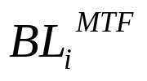


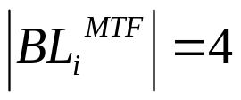
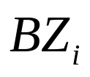



Buckets
  Partition L into substrings of chars each, denoted
  This partition induces a partition on , denoted
  Applying run-length encoding and prefix-free encoding on each bucket will result in n/log(n) variable-length buckets, denoted
  T = pipeMississippi# |T| = |L| = 16
L
i | p | p | p | s | s | m | e | i | p | # | i | s | s | i | i
2 | 4 | 0 | 0 | 5 | 0 | 5 | 5 | 4 | 4 | 5 | 2 | 5 | 0 | 1 | 0
2 | 4 | 1 | 5 | 0 | 5 | 5 | 4 | 4 | 5 | 2 | 5 | 0 | 1 | 0
011 00101 11 | 00110 10 00110 00110 | 00101 00101 00110 011 | 00110 10 010 10

Slide 20



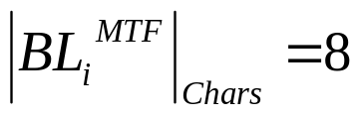

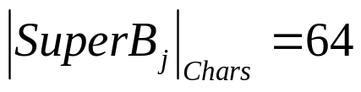










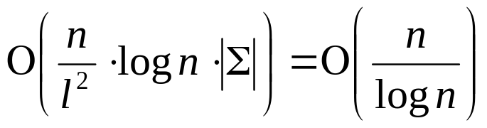


Superblocks
  We also partition L into superblocks of size each.
  Create a table for each superblock, holding for each character c Є Σ, the number of c’s occurrences in L, up to the start of the specific superblock.
    Meaning, for , store occurrences of c in range
128
192
136
144
152
160
168
176
184
c1,..,c8
c1,..,c8
c1,..,c8
c1,..,c8
c1,..,c8
c1,..,c8
c1,..,c8
c1,..,c8
c1,..,c8
c1,..,c8
a | 32
b | 25
: | :
z | 7
a | 55
b | 38
: | :
z | 8

Slide 21


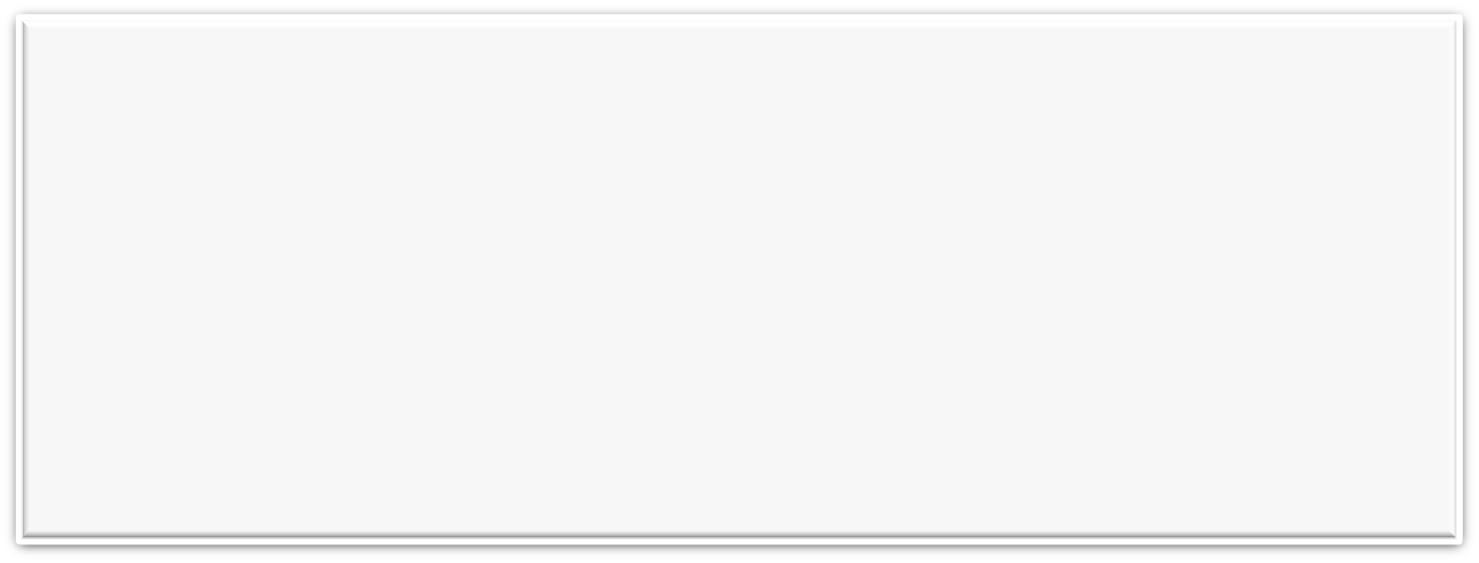





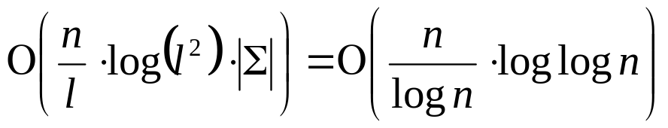



Back to Buckets
  Create a similar table for buckets, but count only from current superblock's start. Denote tables as
Only thing left is searching inside a bucket.
  For example, Occ(c,164) will require counting in
  But we only have the compressed string Z.
  Need more structures
128
192
136
144
152
160
168
176
184
c1,..,c8
c1,..,c8
c1,..,c8
c1,..,c8
c1,..,c8
c1,..,c8
c1,..,c8
c1,..,c8
c1,..,c8
c1,..,c8
a | 32
b | 25
: | :
z | 7
a | 2
b | 1
: | :
z | 0
a | 2
b | 1
: | :
z | 1
a | 21
b | 13
: | :
z | 1
a | 23
b | 13
: | :
z | 1
a | 55
b | 38
: | :
z | 8
. . . . . . . . .

Slide 22

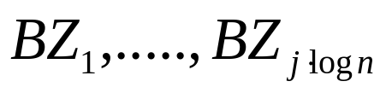





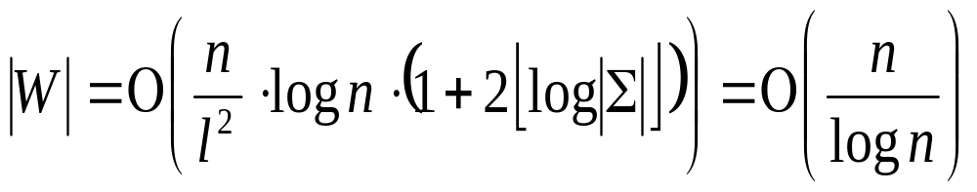
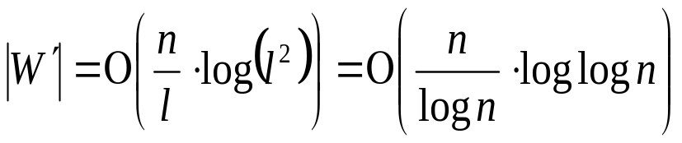
Finding ‘s starting position in Z, part 1
  Array keeps for every , the sum of the sizes
  of the compressed buckets (in bits).
  Array keeps for every bucket , the sum of bucket sizes up to it (including), from the superblock’s beginning.
10 | 13 | 12 | 13 | 16 | 11
011 00101 11 | 00110 10 00110 | 00101 00101 011 | 00110 10 010 10 | 00110 10 00110 | 00101 00101 011
23 | 48 | 75

Slide 23




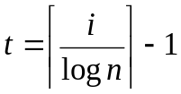














Occ(k,166)
Finding ‘s starting position in Z, part 2
  Given Occ(‘c’,q)
    Find i of :
166/8 = 20.75
→ i = 21
Find character in to count up to:
h = 166 – 20*8
→ h = 6
Find superblock of
(21/8) = 2.625
→ t = 2
Locate position of in Z:
Compressed bucket is at
W[2]+W`[20]+1
011 00101 11 | 00110 10 00110 | 00101 00101 011 | 00110 10 010 10 | 00110 10 00110 | 00101 00101
128
192
136
144
152
160
168
176
184
c1,..,c8
c1,..,c8
c1,..,c8
c1,..,c8
c1,..,c8
c1,..,c8
c1,..,c8
c1,..,c8
c1,..,c8
c1,..,c8

Slide 24


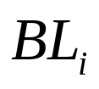
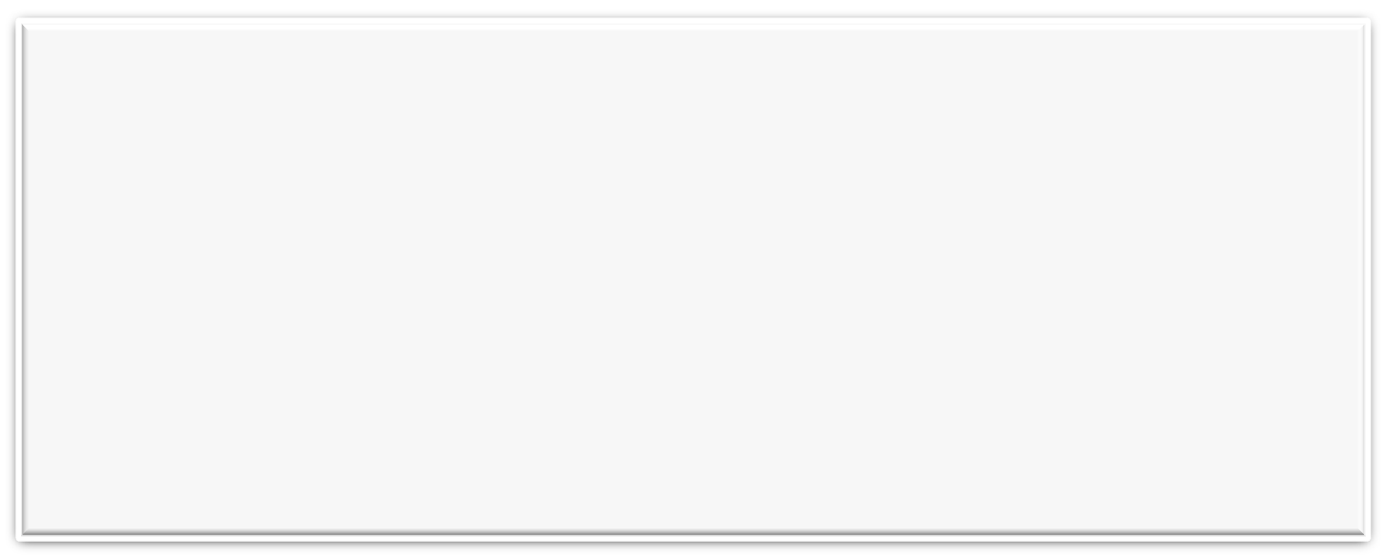




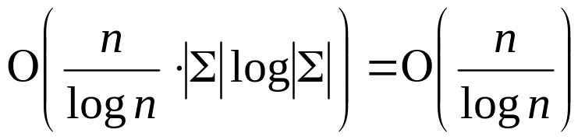
| 011 00101 11 |
We have the compressed bucket
  And we have h (how many chars to check in ).
  But contains compressed Move-To-Front information…
  Need more structures!
For every i, before encoding bucket with Move-To-Front, keep the state of the MTF table
h
  T = pipeMississippi# |T| = |L| = 16
L
i | p | p | p | s | s | m | e | i | p | # | i | s | s | i | i
2 | 4 | 0 | 0 | 5 | 0 | 5 | 5 | 4 | 4 | 5 | 2 | 5 | 0 | 1 | 0
# | e | i | m | p | s
p | i | # | e | m | s
e | m | s | p | i | #
i | # | p | e | m | s

Slide 25

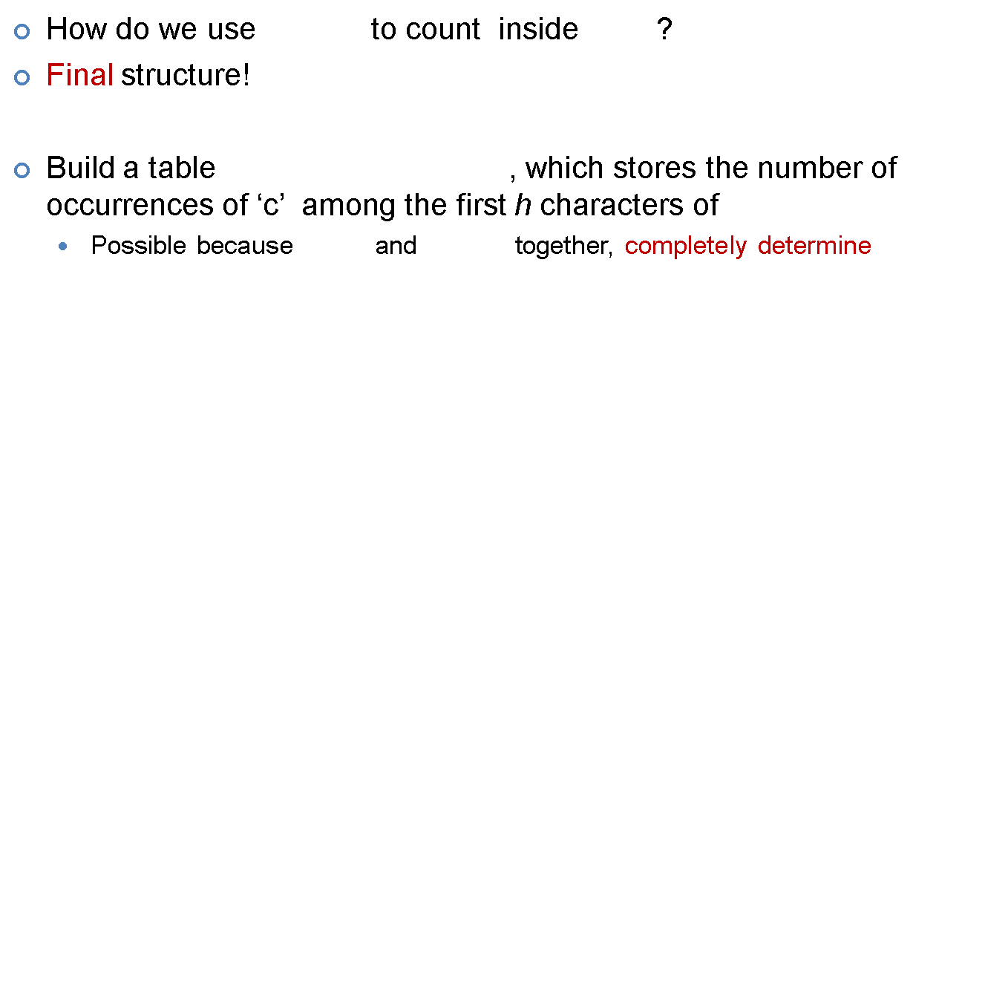



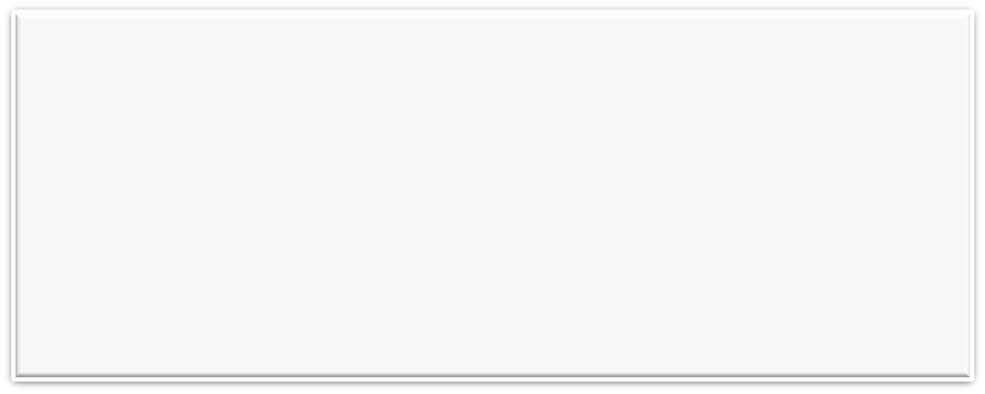




| 011 00101 11 |
h
# | e | i | m | p | s
| 011 0010 11 |
| 010 00101 011 0010|
| 00111 00101 00111 00110|
s
 | 1 | 2 | … | logn
a
b
.
.
z
# | e | i | m | p | s
# | i | e | p | m | s
s | p | i | m | e | #
s | p | m | e | i | #

Slide 26
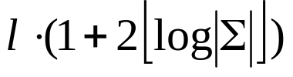
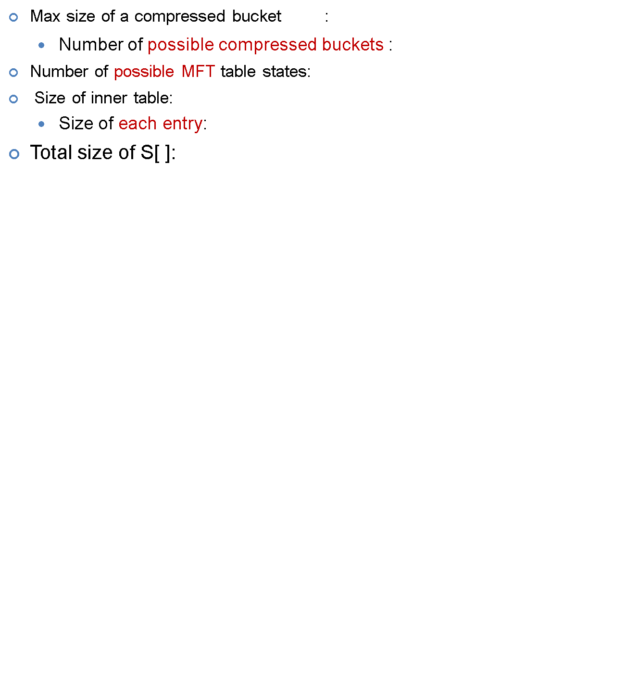









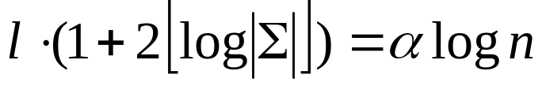



| 011 0010 11 |
| 010 00101 011 0010|
| 00111 00101 00111 00110|
But – having a linear sized index is bad for practical uses when n is large.
We want to keep the index size sub-linear, specifically:
Choose bucket size , such as:
We get →
s
 | 1 | 2 | … | logn
a
b
.
.
z
# | e | i | m | p | s
# | i | e | p | m | s
s | p | i | m | e | #
s | p | m | e | i | #

Slide 27

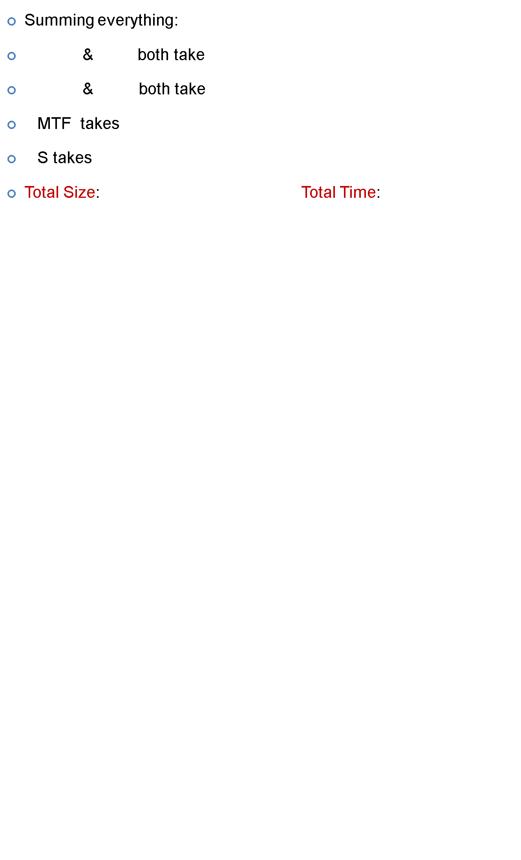
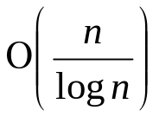




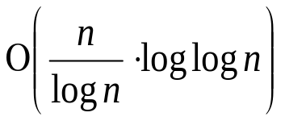

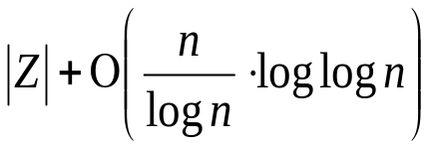




# | e | i | m | p | s
10 | 13 | 12 | 13 | 16 | 11
011 00101 11 | 00110 10 00110 | 00101 00101 011 | 00110 10 010 10 | 00110 10 00110 | 00101 00101 011
a | 23
b | 13
: | :
z | 1
a | 55
b | 38
: | :
z | 8
23 | 48 | 75

Slide 28

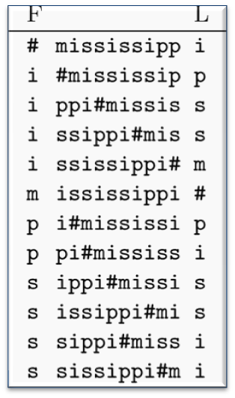




We now want to retrieve the positions in T of the (Last – First+1) pattern occurrences.
  Meaning: for every i = first, first+1,…,Last
  Find position in T of the suffix which prefixes the i-th row.
  Denote the above as pos(i)
We can’t find pos(i) directly, but we can do:
Given row i (9) , we can find row j
(11) such that pos(j) = pos(i) – 1
This algorithm is called backward_step(i)
  Running time O(1) Uses previous structures
1
2
3
4
5
6
7
8
9
10
11
12
  pos(9) = 7
m | i | s | s | i | s | s | i | p | p | i | #
1 | 2 | 3 | 4 | 5 | 6 | 7 | 8 | 9 | 10 | 11 | 12
P = si

Slide 29



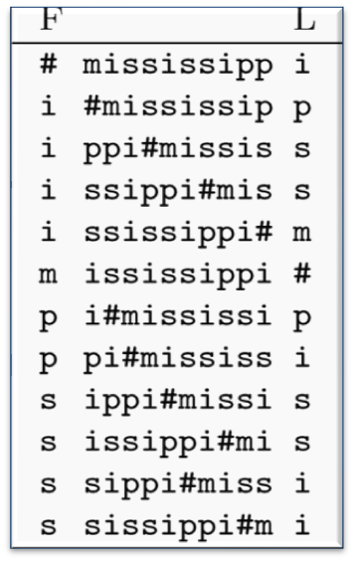
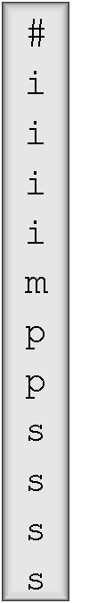
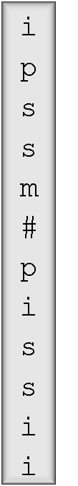



L[i] precedes F[i] in T.
All char’s appear at the same order in L and F.
So ideally, we would just compute Occ(L[i],i)+C[L[i]]
F
L
1
2
3
4
5
6
7
8
9
10
11
12
1
2
3
m | i | s | s | i | s | s | i | p | p | i | #
1 | 2 | 3 | 4 | 5 | 6 | 7 | 8 | 9 | 10 | 11 | 12
P = si
i = 9
P = si

Slide 30





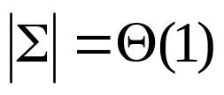


L
Solution:
  Compare Occ(c,i) to Occ(c,i-1) for every
  Obviously, will only differ at c = L[i].
  Now we can compute Occ(L[i],i)+C[L[i]].
Calling Occ() is O(1)
Therefore backward_step takes O(1) time.
Occ(c,8)
Occ(c,9)
m | i | s | s | i | s | s | i | p | p | i | #
1 | 2 | 3 | 4 | 5 | 6 | 7 | 8 | 9 | 10 | 11 | 12
P = si
i = 9

Slide 31

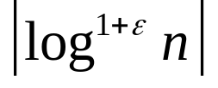
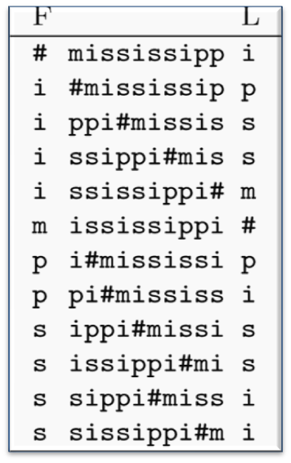




Now we are ready for the final algorithm.
First, mark every character from T
and its corresponding row (suffix) in L.
For each marked row , store its position
Pos( ) in data structure S.
For example, querying S for Pos( ) will return 8.
1
2
3
4
5
6
7
8
9
10
11
12
first
last
m | i | s | s | i | s | s | i | p | p | i | #
1 | 2 | 3 | 4 | 5 | 6 | 7 | 8 | 9 | 10 | 11 | 12
P = si
i = 9

Slide 32


Given row index i, find Pos(i) as follows:
If is a marked row, return Pos(i) from S. DONE!
Otherwise - use backward_step(i) to find i’ such
that : Pos(i’) = Pos(i) – 1
  Repeat t times until we find a marked row.
  Then – retrieve Pos(i’) from S and compute Pos(i)
  by computing: Pos(i’) + t
1
2
3
4
5
6
7
8
9
10
11
12
first
last
m | i | s | s | i | s | s | i | p | p | i | #
1 | 2 | 3 | 4 | 5 | 6 | 7 | 8 | 9 | 10 | 11 | 12
P = si
i = 9

Slide 33




Example – finding “si”
For i = last = 10
  is marked – get Pos(10) from S :
  Pos(10) = 4
For i = first = 9
  isn’t marked. → backward_step(9)
  backward_step(9) = ( t = 1)
  isn’t marked either. → backward_step(11)
  Backward_step(11) = ( t = 2)
1
2
3
4
5
6
7
8
9
10
11
12
first
last
m | i | s | s | i | s | s | i | p | p | i | #
1 | 2 | 3 | 4 | 5 | 6 | 7 | 8 | 9 | 10 | 11 | 12
P = si
i = 9

Slide 34
Example – finding “si”
For i = last = 10
  is marked – get Pos(10) from S :
  Pos(10) = 4
For i = first = 9
  isn’t marked. → backward_step(9)
  backward_step(9) = ( t = 1)
  isn’t marked either. → backward_step(11)
  Backward_step(11) = ( t = 2)
  isn’t marked either. → backward_step(4)
  Backward_step(4) = ( t = 3)
  is marked – get Pos(10) from S. Pos(10) = 4
  Pos(9) = Pos(10) + t = 4 + 3 = 7
1
2
3
4
5
6
7
8
9
10
11
12
first
last
m | i | s | s | i | s | s | i | p | p | i | #
1 | 2 | 3 | 4 | 5 | 6 | 7 | 8 | 9 | 10 | 11 | 12
P = si
i = 9

Slide 35



A marked row will be found in at most iterations.
Each iteration uses backward_step, which is O(1).
So finding a single position takes
Finding all occ occurrences of P in T takes:
  but only if querying S for membership is O(1)!!
1
2
3
4
5
6
7
8
9
10
11
12
first
last
m | i | s | s | i | s | s | i | p | p | i | #
1 | 2 | 3 | 4 | 5 | 6 | 7 | 8 | 9 | 10 | 11 | 12
P = si
i = 9

Slide 36





Partition L’s rows into buckets of rows each.
For each bucket
  Store all marked rows in a Packed-B-Tree (unique for each row),
  Using their distance from the beginning of the bucket
  as the key. (also storing the mapping)
A tree will contain at most keys, of size
bits each.
→ O(1) access time
1
2
3
4
5
6
7
8
9
10
11
12
3
4
1
6
m | i | s | s | i | s | s | i | p | p | i | #
1 | 2 | 3 | 4 | 5 | 6 | 7 | 8 | 9 | 10 | 11 | 12
P = si
i = 9

Slide 37

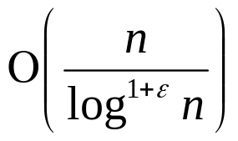

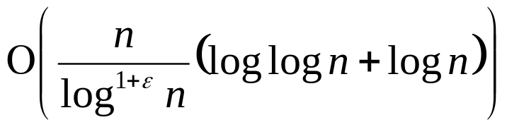

The number of marked rows is
Each key encoded in a tree takes bits,
and we need an additional O(logn) bits to keep
the Pos(i) value.
So S takes
The structure we used to count P, uses
bits, so choose ε between 0 and
1 (because going lower than doesn’t
reduce the asymptotic space usage.)
1
2
3
4
5
6
7
8
9
10
11
12
m | i | s | s | i | s | s | i | p | p | i | #
1 | 2 | 3 | 4 | 5 | 6 | 7 | 8 | 9 | 10 | 11 | 12
P = si
i = 9

