Slide 1
Using non-volatile memory (NVDIMM-N) as byte-addressable storage in Windows Server 2016
Tobias Klima
Program Manager

Slide 2
The Case for Byte-Addressability
Problem
Storage Class Memory (NVDIMM-N) performance is not optimal in block mode (software overhead)
Opportunity
Utilize NVDIMM-N in byte-addressable (DAX) mode to achieve full performance potential
Approach
Memory-Map files on DirectAccess (DAX) volumes
NVDIMM-N supported in WS 2016
Exposes Block Interface (like a Disk), as well as byte-addressability option (DAX Volume)
SCM
NVDIMM-N
Memory
CPU
Traditional
Storage
AHCI
HBA
NVMe
PCIe
SATA
SAS

Slide 3
DirectAccess Architecture
Overview
App has direct access to SCM via existing memory-mapping semantics
Updates directly modify SCM, Storage Stack not involved
DAX volumes identified through new flag
Characteristics
True device performance (no software overhead)
Byte-Addressable
Filter Drivers relying on I/O may not work or attach – no I/O, new volume flag
AV Filters can still operate (Windows Defender already updated)
Block Mode Application
DirectAccess Application
Memory Mapped Region
Application requests memory-mapped file
Load/Store
Operations
Standard File API
User Mode
Kernel Mode
DirectAccess Setup Path
SCM-Aware File System (NTFS - DAX)
DirectAccess Data Path
SCM Bus Driver
Enumerates NVDIMM
SCM Disk Driver
Load/Store
Operations
Memory Mapped Region
SCM

Slide 4
Using DAX in WS 2016
DAX Volume Creation
Format n: /dax /q
Format-Volume –DriveLetter n –IsDAX $true
DAX Volume Identification
Is it a DAX volume?
call GetVolumeInformation(“C:\”, ...)
check lpFileSystemFlags for FILE_DAX_VOLUME (0x20000000)
Is the file on a DAX volume?
call GetVolumeInformationByHandleW(hFile, ...)
check lpFileSystemFlags for FILE_DAX_VOLUME (0x20000000)

Slide 5
Using DAX in WS 2016
Memory Mapping
HANDLE hMapping = CreateFileMapping(hFile, NULL, PAGE_READWRITE, 0, 0, NULL);
LPVOID baseAddress = MapViewOfFile(hMapping, FILE_MAP_WRITE, 0, 0, size);
memcpy(baseAddress + writeOffset, dataBuffer, ioSize);
FlushViewOfFile(baseAddress, 0);
OR … use non-temporal instructions for NVDIMM-N devices for better performance
HANDLE hMapping = CreateFileMapping(hFile, NULL, PAGE_READWRITE, 0, 0, NULL);
LPVOID baseAddress = MapViewOfFile(hMapping, FILE_MAP_WRITE, 0, 0, size);
RtlCopyMemoryNonTemporal(baseAddress + writeOffset, dataBuffer, ioSize );

Slide 6
Efficiency Gains with DAX Volumes
Outdated Assumptions
Storage is no longer “slow”
Creating, Tracking, Queueing, Completing I/O costs CPU cycles (context switches)
Past tricks to speed up storage (caching, async I/O, queues), now slow us down
Direct Access
NTFS Volume Mode (Regular vs. DAX) decided at Format Time
No I/O, no queueing, no async reads/writes – just load/stores
Flush user data via existing memory mapping APIs (FlushViewOfFile)
… Or – use non-temporal instructions on NVDIMM-N
Efficiency from DAX
Less context switches on highly contested data structures
Additional CPU cycles for more useful work

Slide 7

NVDIMM-N Block vs. DAX Performance
Tobias Klima
Hardware Provided By:

Slide 8
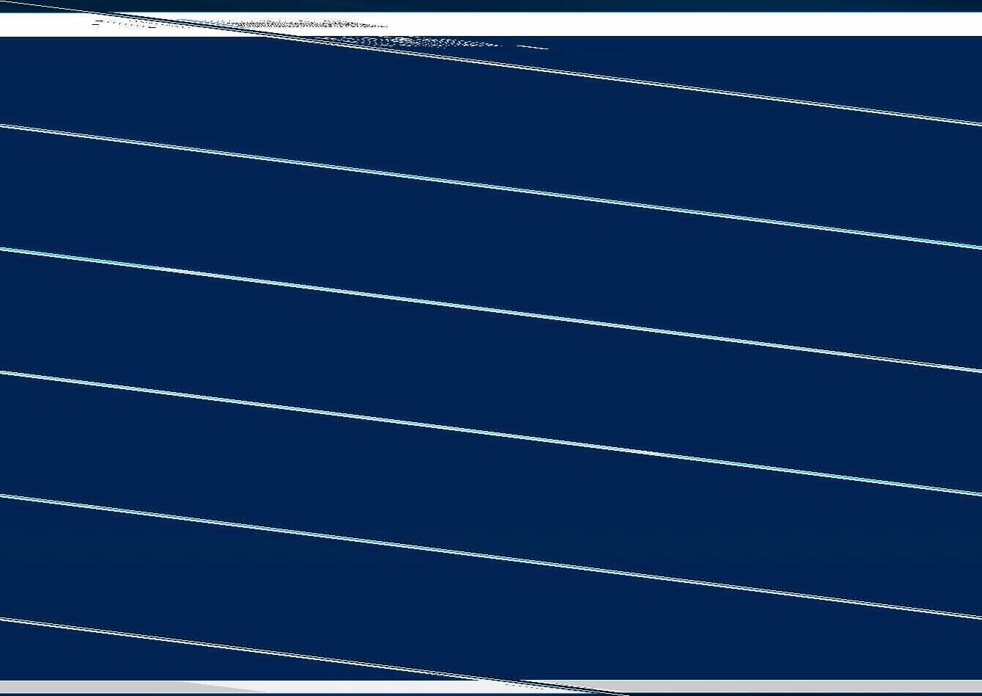

Slide 9
Adapting Apps for DAX – NVML
Overview
Helper Library making use of SCM easier
Maintained on GitHub, http://pmem.io/
Abstracts OS specific dependencies
Provides: key/value stores, logs, flushing, persistent heap, …
Use Case
Alternative to handling flushing or creating SCM-aware data structures yourself
NVML on Windows
Work underway to port NVML to Windows

Slide 10
Call to Action
Consider memory-mapped I/O on NVDIMM-N
How would you change your app, if you could do fast, reliable, synchronous updates?
What data(structures) do your apps use frequently? Which need the lowest possible access latencies?
Technical Resources
Memory Mapping - https://msdn.microsoft.com/en-us/library/ms810613.aspx
GetVolumeInformation - https://msdn.microsoft.com/en-us/library/windows/desktop/aa364993(v=vs.85).aspx
GetVolumeInformationByHandleW - https://msdn.microsoft.com/en-us/library/windows/desktop/aa964920(v=vs.85).aspx
Re-visit Build on Channel 9.
Continue your education at Microsoft Virtual Academy online.

