Slide 1
Steganography
By Theresa Nguyen

Slide 2
Steganography vs Cryptography
Both protect information
Cryptology aims to scramble the information so it cannot be understood
Steganography hides information so that it cannot be seen

Slide 3
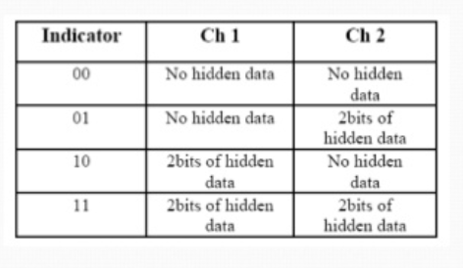
My project
LSB Steganography
LSB = Least Significant Bit substitution
Results in a very minor distortion in the original photos
Uses the least two significant bits of one of the channels to indicate existence of data in the other two channels

Slide 4
http://hareenlaks.blogspot.com/2010/05/what-is-steganography.html

