Slide 1

Meeting 1 of 7 · September 15, 2026
Retrospective reconstruction · prepared October 2026
RESEARCH PROPOSAL
When is quantum error mitigation worth its cost?
Research proposal: noise in quantum machine learning, the cost of mitigation, and a cost-aware decision layer
Reconstructed in Oct 2026 from the project record, which begins Oct 6. It preserves the pre-October project as a generic QML study (Iris, QM9, WDBC) with a mitigate-or-not decision. No results existed on this date.
Mayank Kumar Pokhriyal · Tushar Poonia
M.S. in Artificial Intelligence capstone · Katz School of Science and Health, Yeshiva University
Retrospective deck · proposed split: Mayank (slides 1–3) · Tushar (slides 4–5) · about 5 minutes
Sep 15
Proposal
Sep 29
Design
Oct 13
Implementation
Oct 27
Noise & mitigation
Nov 10
Policy selection
Nov 24
Final findings
Dec 8
Final defense
Notes:
[Mayank · 0:00–0:33]
Good afternoon. We are Mayank and Tushar, and this is our research proposal. One note first: this version of the deck was reconstructed in October from our project record, so it shows the proposal stage and nothing later.
Quantum machine-learning models run on noisy hardware, and error mitigation can correct some of that noise, at a price. Our question is simple to state: when is that price worth paying, and can a decision layer tell the difference?
Key points: proposal stage: no results; noise → mitigation → cost; question: when is mitigation worth its cost, and can a decision layer decide?.

Slide 2
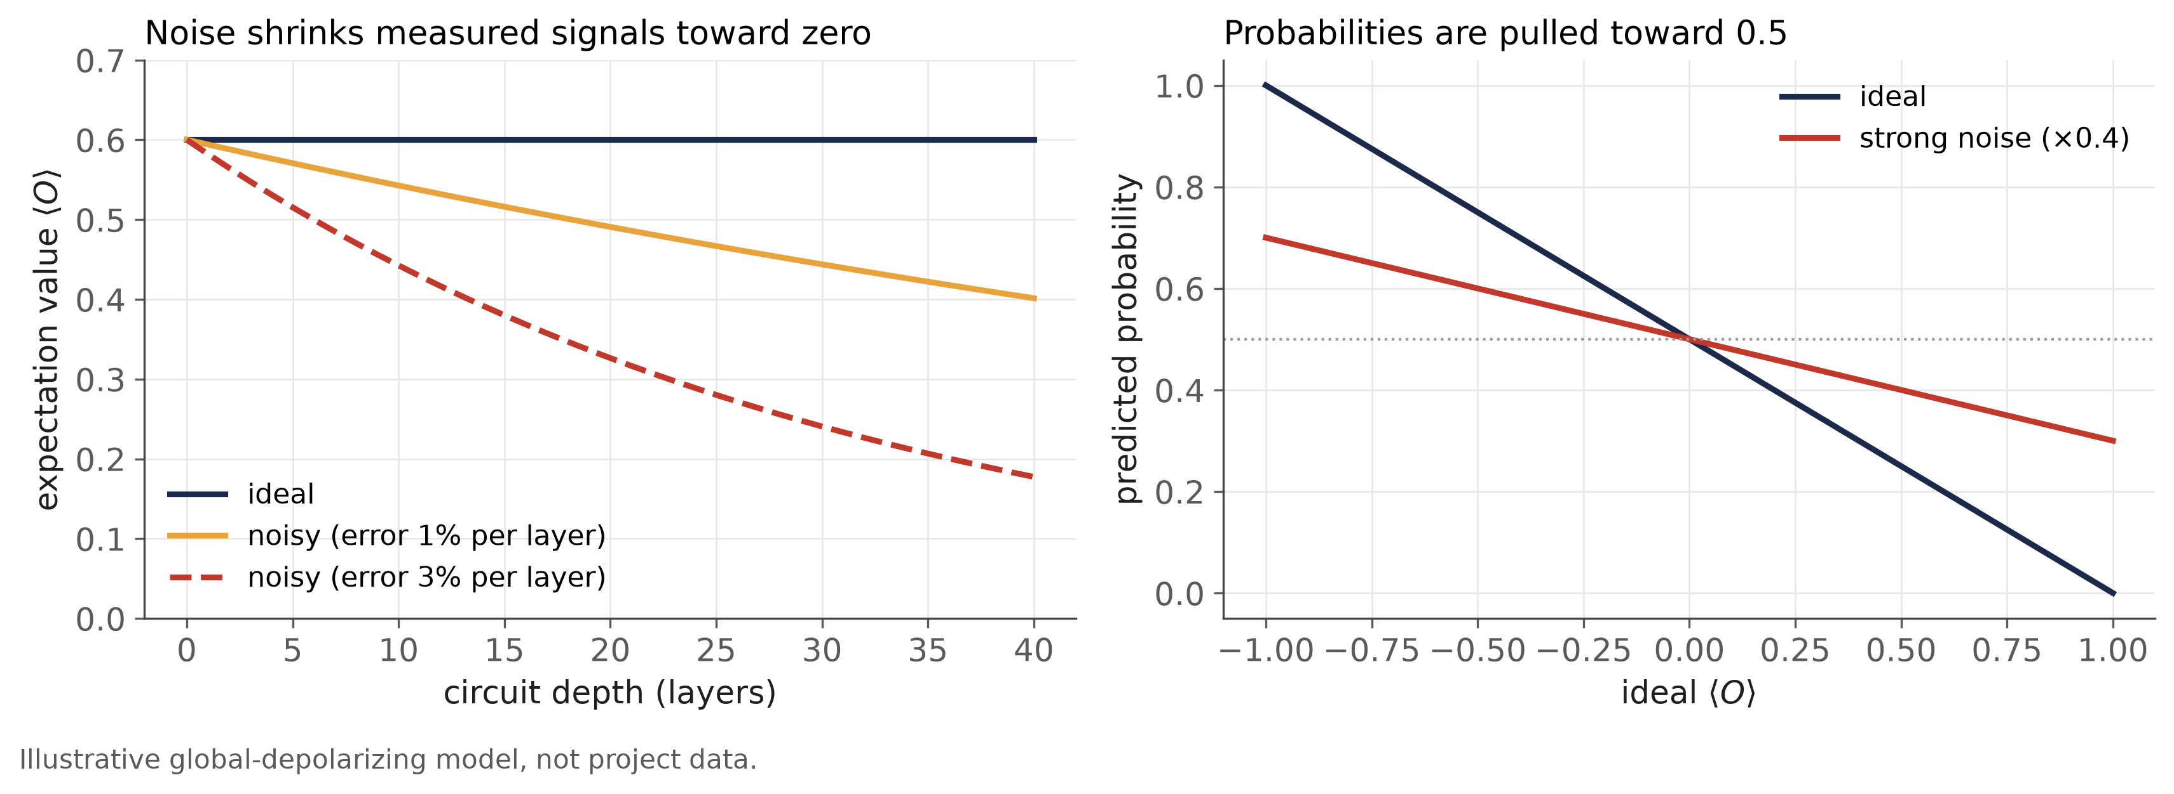

Why quantum noise matters
BACKGROUND FROM THE LITERATURE · NO PROJECT DATA
In brief
NISQ processors are noisy
Noise shrinks the expectation values a QML model outputs
Probabilities drift toward 0.5, so threshold decisions can flip
Noise changes what a quantum model tells us, not only how the hardware behaves.
Source: Preskill (2018), Quantum 2:79. Illustrative model only; no project data.
Notes:
[Mayank · 0:33–1:30]
Today's quantum processors are noisy, the so-called NISQ era described by Preskill.
A quantum machine-learning model produces its output from measured expectation values. Gate errors, decoherence and imperfect measurement pull those values toward zero, and the effect grows with circuit depth. The left panel shows this for a simple illustrative noise model.
For a classifier, the result is that its probabilities drift toward one half. A decision that depends on those probabilities, such as an alert above a threshold, can then change even if the underlying model is good. So noise is not only a hardware problem; it changes what the model tells us. And the damage is not the same everywhere: it depends on the circuit, the type of noise and its strength. That variation is what makes a context-dependent decision worth studying.
Key points: NISQ hardware is noisy (Preskill 2018); noise shrinks expectation values, more with depth; probabilities drift toward 0.5 → threshold decisions change.
Sources: Preskill (2018) Quantum 2:79. Figure: illustrative global-depolarizing model, not project data.

Slide 3
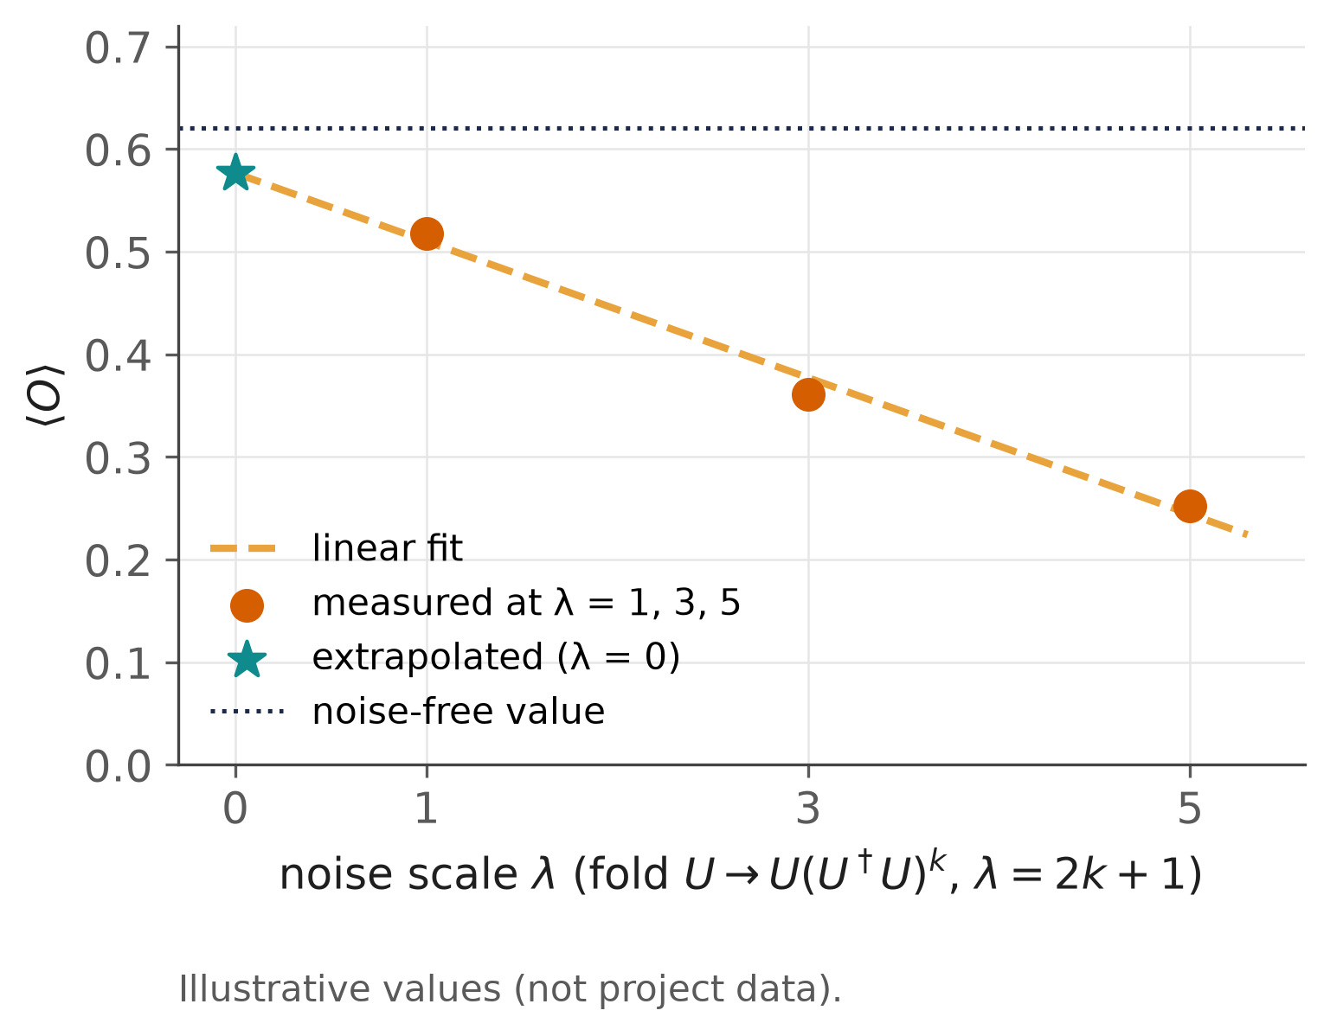

Why error mitigation is expensive
BACKGROUND FROM THE LITERATURE · NO PROJECT DATA
Zero-noise extrapolation (ZNE)
Run the circuit at several amplified noise levels, then extrapolate to zero noise (Temme et al. 2017; Kandala et al. 2019; Giurgica-Tiron et al. 2020).
The cost
ZNE: several circuits instead of one. Readout mitigation: a few calibration circuits (Bravyi et al. 2021).
The benefit is not guaranteed
Beneficial on average but strongly platform-dependent (Russo et al. 2023).
Mitigation buys accuracy with extra quantum resources, so whether to use it is a real decision.
Source: Temme 2017 · Kandala 2019 · Giurgica-Tiron 2020 · Bravyi 2021 (PRA 103:042605) · Russo 2023 (IEEE TQE 4). Curve illustrative.
Notes:
[Mayank · 1:30–2:17]
Error mitigation reduces the bias that noise introduces, without full error correction. Two widely used techniques matter here.
Zero-noise extrapolation, or ZNE, runs the same circuit at several deliberately amplified noise levels, for example by folding gates, and extrapolates the results back to zero noise, as shown on the right. That means extra circuits: more shots, and more exposure to two-qubit gates. Readout mitigation is cheaper: it corrects measurement errors using a few calibration circuits.
And the benefit is not guaranteed. A resource-normalized evaluation across hardware platforms found mitigation beneficial on average but strongly platform-dependent. Applying it everywhere, every time, can waste resources. Tushar will describe what we propose.
Key points: ZNE: amplify noise, extrapolate to zero (Temme 2017; Kandala 2019; Giurgica-Tiron 2020); readout mitigation: calibration-based, cheaper (Bravyi 2021); benefit is platform-dependent (Russo 2023).
Sources: Temme et al. (2017) PRL 119:180509; Kandala et al. (2019) Nature 567:491; Giurgica-Tiron et al. (2020) IEEE QCE; Bravyi et al. (2021) PRA 103:042605; Russo et al. (2023) IEEE TQE 4:1–18. Figure: illustrative.

Slide 4

Proposed approach: Q-TRACE
PROPOSAL AS RECORDED · GENERIC QML BENCHMARKS, MITIGATE-OR-NOT DECISION
QML model
on a benchmark task
Noisy execution
simulated with Qiskit Aer
Q-TRACE decides
benefit − cost > 0 ?
Mitigate or not
ZNE / readout mitigation
Benchmarks named in the record
Iris
small classification benchmark
WDBC
breast-cancer classification
QM9
molecular-property regression
Compared with three simple policies: never mitigate, always mitigate, and a fixed rule.
Recorded in docs/DECISIONS.md (Q1) and the early-October research plan's description of the deck of that time. The fraud application came later, on Oct 6, 2026.
Notes:
[Tushar · 2:17–2:57]
We propose Q-TRACE, a decision layer that sits on top of a quantum machine-learning model.
For each run, Q-TRACE decides whether mitigation is worth applying, using a simple principle: mitigate only when the expected benefit outweighs the extra cost. The mitigation techniques are zero-noise extrapolation and readout mitigation, and the models are simulated with Qiskit Aer.
As recorded, the benchmarks were standard tasks: Iris and the Wisconsin breast-cancer data for classification, and QM9 for molecular properties. And Q-TRACE would be compared with three simple policies: never mitigate, always mitigate, and a fixed rule.
Key points: decision layer on a QML model: mitigate only if benefit exceeds cost; mitigation: ZNE and readout; simulation: Qiskit Aer; benchmarks: Iris, WDBC, QM9; compared with Never / Always / Fixed.
Sources: docs/DECISIONS.md Q1; docs/PROJECT_SPEC.md §2; docs/research/deep-research-report.md (description of the pre-October deck).

Slide 5

Research questions and planned method
RECONSTRUCTED AT THE LEVEL THE RECORD SUPPORTS
RQ1
When does error mitigation improve a quantum model's output enough to justify its extra cost?
RQ2
Can Q-TRACE's benefit-versus-cost decision beat never, always, or a fixed rule?
1. Simulate
noisy QML models (Qiskit Aer)
2. Measure
benefit and cost of mitigating vs not
3. Decide
weigh benefit against cost
4. Compare
vs never / always / fixed rule
Note added in October 2026. On Oct 6 the scope was narrowed to credit-card fraud detection, with several mitigation actions, label-free decision inputs and pre-registered phases (docs/DECISIONS.md: Q1, A01, A12). Later meetings report that study.
A practical question: spend quantum resources on mitigation only when it pays.
Source: Reconstructed from docs/DECISIONS.md (Q1) and docs/research/deep-research-report.md (pre-October deck); wording is ours.
Notes:
[Tushar · 2:57–3:45]
We have two research questions. First, when does error mitigation improve a quantum model's output enough to justify its extra cost? Second, can Q-TRACE's benefit-versus-cost decision do better than never mitigating, always mitigating, or a fixed rule?
Our plan has four steps. We simulate noisy quantum models on the benchmark tasks. For each setting we measure what mitigation changes and what it costs. Q-TRACE then decides by weighing benefit against cost. And we compare it with the three simple policies.
For the record: this deck was reconstructed in October. The project was narrowed on October 6 to credit-card fraud detection with several mitigation actions, which is what the following meetings report. Thank you.
Key points: RQ1: when is mitigation worth its cost?; RQ2: can the benefit-vs-cost decision beat never / always / fixed?; plan: simulate → measure benefit and cost → decide → compare; note: scope narrowed Oct 6 (fraud, several actions).
Sources: Reconstructed from docs/DECISIONS.md Q1 and the research plan's description of the pre-October deck; wording is ours.

