Slide 1
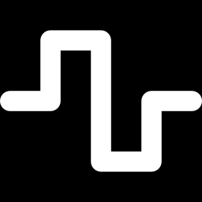
Meeting 4 of 7 · October 27, 2026
NOISE AND MITIGATION
Noise breaks calibration; mitigation repairs it
Noise models · calibration vs discrimination · readout mitigation · zero-noise extrapolation · resource-matched tests
Deeper analysis of Phases 3B and 4 (completed Oct 7, 2026). Noise damaged calibration and threshold decisions, not discrimination. Mitigation repaired calibration; three times the shots did not.
Mayank Kumar Pokhriyal · Tushar Poonia
M.S. in Artificial Intelligence capstone · Katz School of Science and Health, Yeshiva University
Proposed split: Tushar (slides 1–3) · Mayank (slides 4–5) · about 5 minutes
Sep 15
Proposal
Sep 29
Design
Oct 13
Implementation
Oct 27
Noise & mitigation
Nov 10
Policy selection
Nov 24
Final findings
Dec 8
Final defense
Notes:
[Tushar · 0:00–0:24]
Good afternoon. Today we go deeper into two completed phases of Q-TRACE: how simulated noise affects our quantum fraud classifier, and what error mitigation does about it.
Both phases were completed on October 7. In short: noise damaged calibration and threshold decisions, not discrimination. Mitigation repaired calibration, and simply buying three times the shots did not.
Key points: Phases 3B and 4, completed Oct 7; noise damaged calibration, not discrimination; mitigation repaired calibration; extra shots did not.

Slide 2
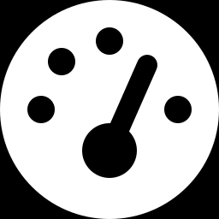
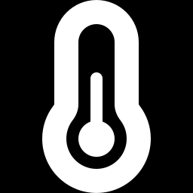
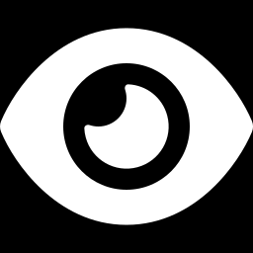
How we simulated noise
PHASE 3B · EXACT DENSITY-MATRIX SIMULATION · COMPLETED OCTOBER 7, 2026
Depolarizing
Thermal relaxation
Readout confusion
after every 1- and 2-qubit gate
during 35 ns and 300 ns gates
bit flips at measurement
low · medium · high
low · medium · high
low · medium · high
two-qubit error 0.005 · 0.010 · 0.020
T₁ 200 · 100 · 50 µs
flip probability 0.005 · 0.02 · 0.05
12 anchor conditions
3 sources × 3 severities + 3 combined
Exact simulation
Qiskit Aer density matrices
Finite shots
1,024 shots × 20 replicates
Negative control passed
symmetric readout: ranking metrics unchanged (Δ = 0)
Plus 3 synthetic asymmetric-readout stress profiles (mean error 0.005–0.05). These are an assumption, not device calibration data.
Exact simulation at the registered anchor severities: effects come from the noise model, not from sampling.
Source: configs/noise/anchors_rr_v1.yaml, p3b_noise_matrix.csv, p3b_negative_control.csv
Notes:
[Tushar · 0:24–1:21]
We simulate the frozen classifier exactly, with Qiskit Aer density matrices, so every effect we see comes from the noise model and not from sampling.
There are three noise sources. Depolarizing errors follow one- and two-qubit gates. Thermal relaxation acts during 35-nanosecond and 300-nanosecond gates. Readout confusion flips measured bits. Each source has low, medium and high anchors, and a combined profile uses all three, which gives twelve conditions. Finite-shot experiments then use 1,024 shots and 20 replicates per condition.
Symmetric readout noise also serves as a negative control: in theory it is an exact rescaling of parity scores, so it cannot change their ranking, and in simulation the ranking metrics did not change at all. Three asymmetric readout profiles are synthetic stress tests, not device data.
Key points: Qiskit Aer density matrices: exact; depolarizing, thermal relaxation, readout; low/medium/high + combined = 12 anchors; symmetric readout negative control passed (ranking change 0; affine residual ≤ 4.4e-16); asymmetric profiles are synthetic.
Sources: configs/noise/anchors_rr_v1.yaml; p3b_noise_matrix.csv; p3b_negative_control.csv.

Slide 3
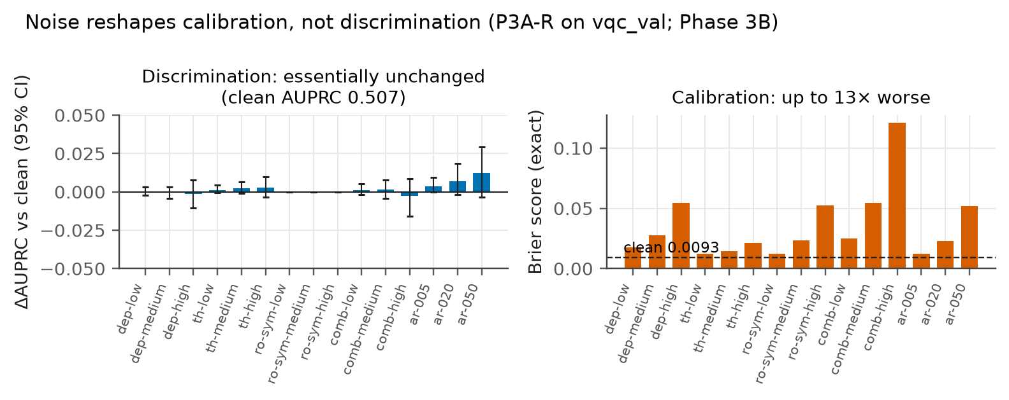
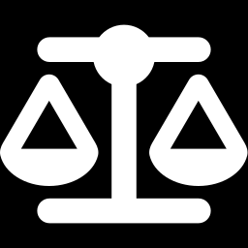
Noise damages calibration, not discrimination
PHASE 3B · FROZEN P3A-R MODEL, VALIDATION PARTITION · COMPLETED OCTOBER 7, 2026
≤ 0.003
change in AUPRC; ≥ 46 of 47 top frauds kept
0.0093 → 0.121
Brier score, combined-high noise (13×)
0.083 → 0.346
expected calibration error
0.53 → 0.03
precision at the frozen alert threshold
Mitigation's job here is calibration and threshold decisions, not discrimination.
Source: p3b_exact_metrics.csv (P3A-R, exact simulation), p4_exact_diagnostics.csv
Notes:
[Tushar · 1:21–2:25]
Here is the main characterization result. On the left, AUPRC barely moves under any anchor condition: at most 0.003, and every interval contains zero. At least 46 of the 47 top-ranked frauds stay on top.
On the right, calibration collapses. Under combined high noise the Brier score rises from 0.0093 to 0.121, about thirteen times worse, and expected calibration error rises from 0.083 to 0.346. Noise pulls the scores toward one half. Because fraud alerts fire at a fixed threshold, precision falls from 0.53 to 0.03.
So the problem mitigation must solve is calibration, not discrimination. Noise does reorder some legitimate transactions, with Kendall tau between 0.96 and 0.99, but the frauds at the top survive. Mayank will now explain the two mitigation tools.
Key points: ΔAUPRC ≤ 0.003, all CIs contain 0; ≥ 46 of 47 top frauds kept; Brier 0.0093 → 0.121; ECE 0.083 → 0.346; precision 0.53 → 0.03; some bulk reordering (Kendall τ 0.96–0.99).
Sources: p3b_exact_metrics.csv (model p3a_r); p4_exact_diagnostics.csv (clean precision 0.532).

Slide 4
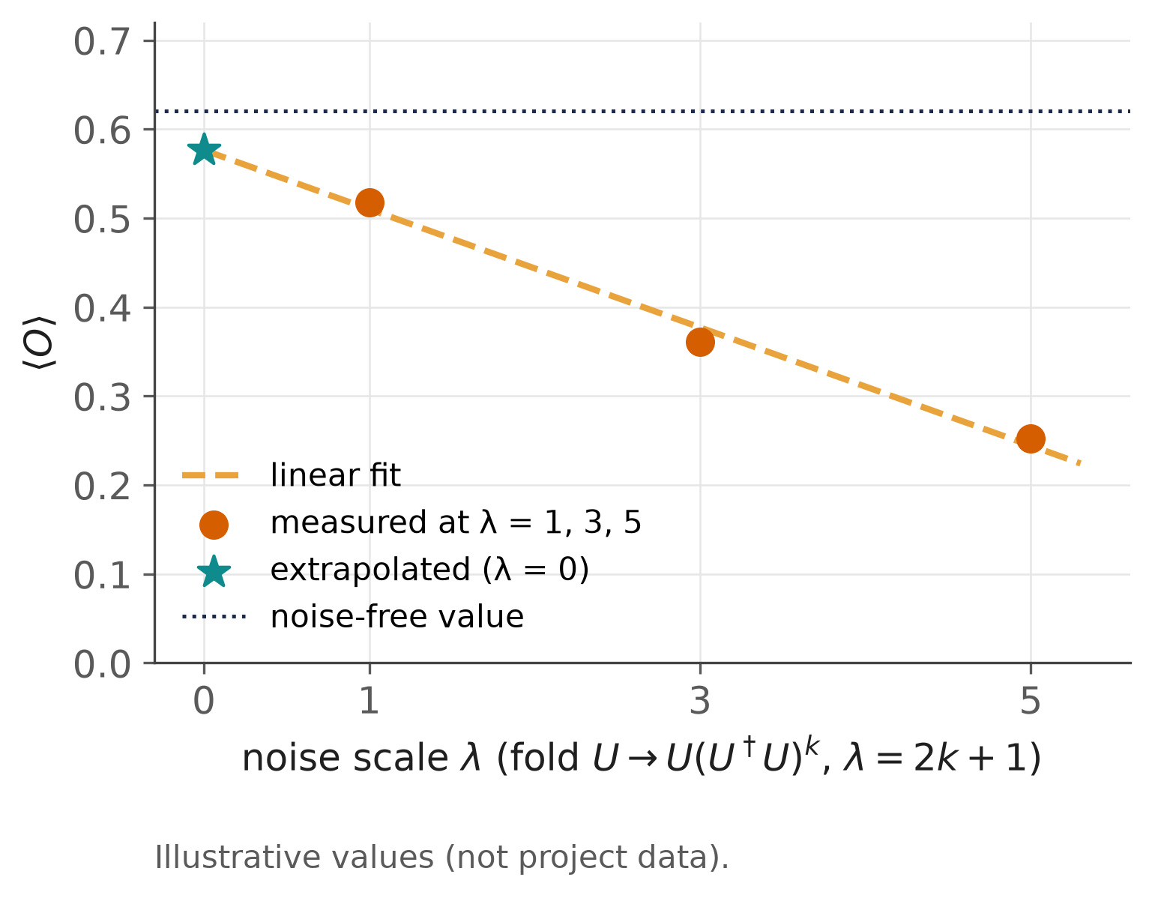
Two mitigation tools, very different costs
PHASE 4 · PRE-REGISTERED · COMPLETED OCTOBER 7, 2026
Readout mitigation (A1)
2 calibration circuits per batch: |0000⟩ and |1111⟩
per-qubit confusion matrices from counts → tensored inverse
project negative quasi-probabilities onto the simplex
ZNE (A2)
fold the circuit: λ = 1, 3, 5
linear fit to λ = 0
A3 = readout mitigation at every scale, then ZNE
Action | What it does | Shots per inference | Two-qubit-gate exposure
A0 | nothing | S | 1×
A1 | readout mitigation | S + 2S/N | 1×
A4 | three times the shots, unmitigated | 3S | 3×
A2 | zero-noise extrapolation | 3S | 9×
A3 | readout mitigation + ZNE | 3S + 2S/N | 9×
S = shots per circuit · N = transactions per batch · the extrapolation curve is illustrative
Source: configs/mitigation/*.yaml, p4_costs.csv
Notes:
[Mayank · 2:25–3:19]
We compare two standard mitigation techniques, and their combination.
Readout mitigation runs two calibration circuits per batch, all zeros and all ones. From their counts it estimates each qubit's confusion matrix, inverts it, and projects the result back onto valid probabilities. Once calibrated, it is almost free.
Zero-noise extrapolation, or ZNE, deliberately amplifies gate noise by folding the circuit, running it at noise scales one, three and five, and extrapolating linearly back to zero noise. That costs three times the shots and nine times the two-qubit-gate exposure. The combined action applies readout mitigation at every noise scale before extrapolating.
The fair comparison for ZNE is therefore not "no mitigation" but the same three-times shot budget spent on the unmitigated circuit. We call that the extra-shots action.
Key points: readout: 2 calibration circuits per batch, tensored inverse + simplex projection; ZNE: global folding λ = 1, 3, 5, linear extrapolation: 3× shots, 9× CX exposure; fair baseline: same 3× shots, unmitigated.
Sources: configs/mitigation/*.yaml; p4_costs.csv; zne_schematic is illustrative (labelled).

Slide 5
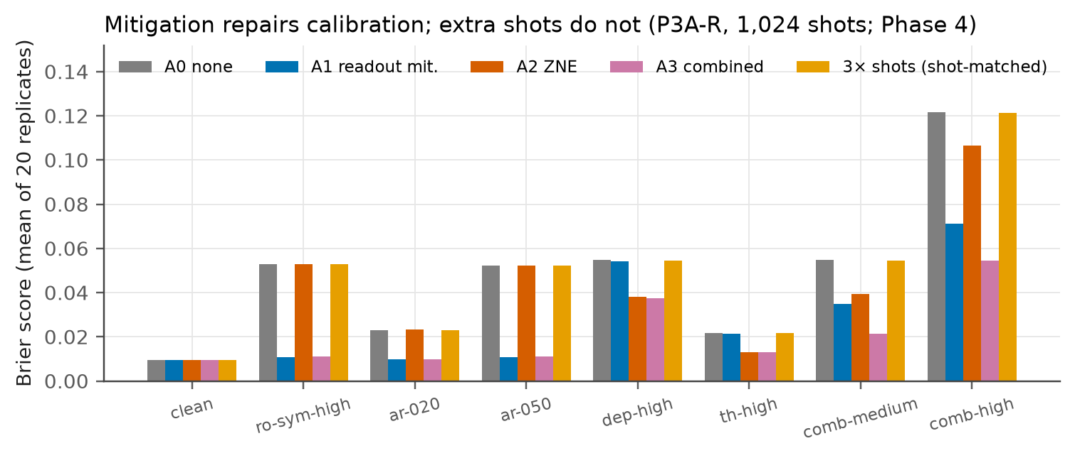
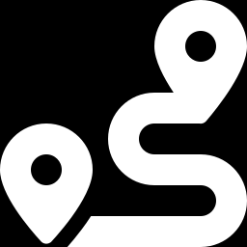
Mitigation repairs calibration; extra shots do not
PHASE 4 · 8 CONDITIONS × 2 SHOT BUDGETS × 20 REPLICATES · COMPLETED OCTOBER 7, 2026
Brier (1,024 shots) | None | Best | Action | 3× shots
Readout noise, high | 0.053 | 0.011 | A1 readout | 0.053
Depolarizing, high | 0.055 | 0.038 | A2 ZNE | 0.055
Combined, high | 0.122 | 0.054 | A3 both | 0.121
What it means
Three times the shots: Brier unchanged (shots cut variance, not bias)
No action improved AUPRC over its resource-matched comparator
Linear ZNE recovered 13–70% of the exact Brier gap
The best action depended on the noise type
Mitigation removes a bias that extra shots cannot. Which action pays depends on the noise type, which is the Nov 10 topic.
Source: p4_summary.csv (1,024 shots), p4_resource_matched.csv, p4_best_action.csv
Notes:
[Mayank · 3:19–4:21]
Here is the resource-matched comparison at 1,024 shots.
Mitigation restores calibration where its noise type is present. Readout mitigation cuts the Brier score from 0.053 to 0.011 under high readout noise. ZNE cuts it from 0.055 to 0.038 under high depolarizing noise. Combined mitigation cuts it from 0.122 to 0.054 under combined high noise. Three times the shots leaves it at 0.121, because shots reduce variance, not bias.
Mitigation never improved AUPRC beyond its shot-matched comparator, which fits the previous slide.
And the best action depended on the noise type: none, readout mitigation, ZNE or both. That made selective mitigation look like a real decision. Whether that decision needs to be learned is the topic of our next meeting. Thank you.
Key points: Brier 0.053 → 0.011 (readout), 0.055 → 0.038 (ZNE), 0.122 → 0.054 (both); 3× shots 0.121; no AUPRC gain over the resource-matched comparator; best action depends on the noise type → selection question (Nov 10).
Sources: p4_summary.csv (s1024); p4_resource_matched.csv; p4_best_action.csv.

