Slide 1

Meeting 5 of 7 · November 10, 2026
POLICY SELECTION
Does choosing mitigation need a learned controller?
Learned-controller hypothesis · 64-model pool · label-free probes · categorical and continuous noise · gates
Phases 5A–5C (completed Oct 7–8, 2026). Two pre-registered gates found no material structure left for a learned controller, so none was trained. A two-threshold probe rule emerged instead.
Mayank Kumar Pokhriyal · Tushar Poonia
M.S. in Artificial Intelligence capstone · Katz School of Science and Health, Yeshiva University
Proposed split: Mayank (slides 1–3) · Tushar (slides 4–5) · about 5 minutes
Sep 15
Proposal
Sep 29
Design
Oct 13
Implementation
Oct 27
Noise & mitigation
Nov 10
Policy selection
Nov 24
Final findings
Dec 8
Final defense
Notes:
[Mayank · 0:00–0:24]
Good afternoon. Today's question is the heart of our original proposal: does deciding when and how to mitigate need a learned controller?
This covers Phases 5A to 5C, completed on October 7 and 8. Two pre-registered gates found no material structure left for a learned controller, so none was trained. A simple two-threshold probe rule emerged instead.
Key points: Phases 5A–5C, completed Oct 7–8; two gates found no material residual; no controller trained; a two-threshold rule emerged.

Slide 2

The decision we proposed to learn
ORIGINAL HYPOTHESIS · EACH STAGE REGISTERED BEFORE ITS OWN OUTCOMES · OCTOBER 6–8, 2026
Context
model · noise · shot budget · batch
Label-free probes
measured every batch
Policy
learned controller or simple rule
Action A0–A4
none · readout · ZNE · both · 3× shots
H-control (original)
A learned controller (Q-TRACE) using only label-free probes beats fixed policies and a fairly tuned threshold rule.
The alternative we committed to report
A simple threshold rule matches the learned controller. Formalized for the sealed test as: the rule is near the cost-aware Oracle.
Oracle and failure (evaluation only)
Oracle: cheapest action within 10% of the best Brier
Failure: any disagreement with the Oracle
Material: Brier > 1.2 × best, or ≥ 1 extra shot-set
Registered rule: train a controller only if a gate finds material structure that a simple rule misses.
Source: docs/PREREG_P5B.md, docs/PREREG_P5C.md, configs/mixed_noise_study/p5c_v1.yaml
Notes:
[Mayank · 0:24–1:28]
For every context, meaning a model, a noise environment and a shot budget, the system must pick one of five actions: nothing, readout mitigation, ZNE, both, or three times the shots.
Our original hypothesis was that a learned controller, Q-TRACE, could make this choice from cheap label-free probes better than fixed policies and a fairly tuned threshold rule. From the start we committed to report it as a result if a simple threshold rule matched the learned controller.
The Oracle is evaluation-only. It picks the cheapest action whose Brier score is within ten percent of the best. A failure is any disagreement with it. A failure is material when the Brier score is more than twenty percent above the best, or when it costs at least one extra shot-set. And we committed to train a controller only if a gate found material structure that a simple rule missed.
Key points: context → probes → policy → one of A0–A4; H-control vs the committed alternative (a simple rule suffices); Oracle: cheapest within 10% of best Brier; material failure defined in advance; train a controller only if the gate passes.
Sources: docs/PREREG_P5B.md, docs/PREREG_P5C.md; configs/mixed_noise_study/p5c_v1.yaml (ε = 0.10, material multiple 2, overspend 1·S).

Slide 3
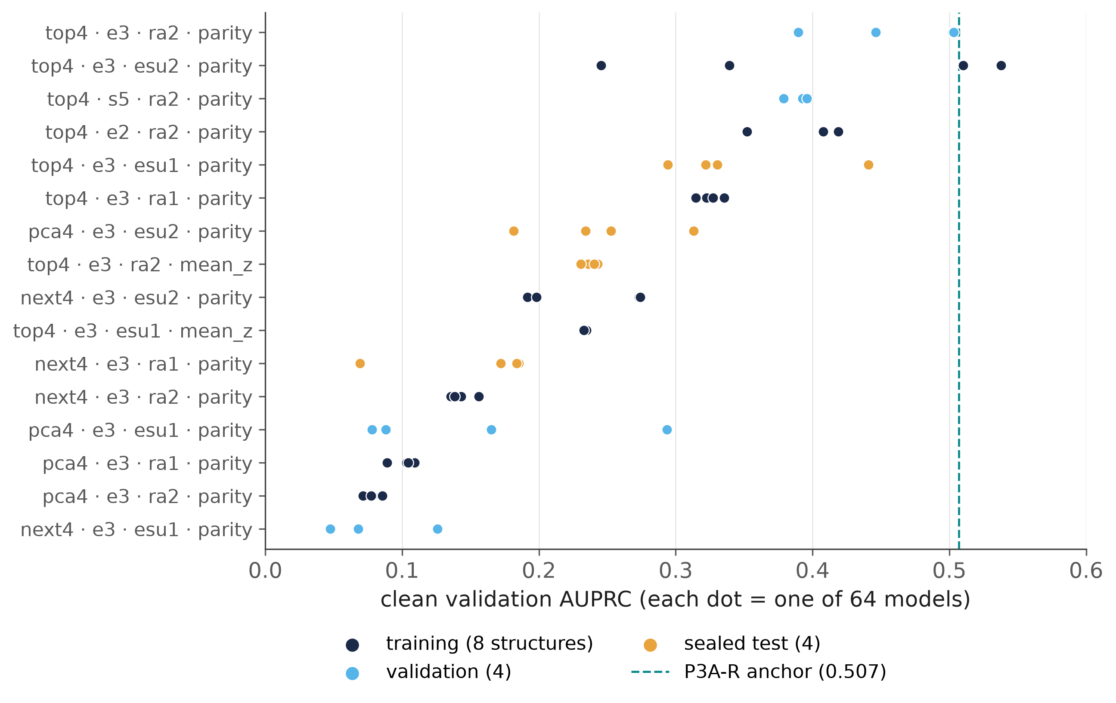

64 independent models and two cheap probes
PHASES 5A–5C · POOL FROZEN OCTOBER 7, 2026
Readout probe
The 2 calibration circuits readout mitigation already needs. Tracks the true mean readout error: Spearman ρ = 0.999.
Gate probe
32 fixed synthetic inputs at fold factors 1 and 3. Contraction tracks depolarizing noise (ρ = −0.89) but barely thermal noise (ρ = −0.12).
Cost and inputs
66 circuits (66·S shots) per batch · 16 static descriptors + 11 probe features
True noise parameters, labels and identifiers never enter a policy, as enforced by a feature registry and tests.
Source: p5a_pool_metrics.csv, p5b_split.csv, p5b_feature_definitions.csv, p5c_probe_validity.csv
Notes:
[Mayank · 1:28–2:25]
To make models, not transactions, the unit of analysis, we trained 64 quantum classifiers: 16 structures times four seeds. Structures vary the features, the encoding, the ansatz and the readout. All 64 qualified on clean data, with a median AUPRC of 0.235. Structures were split eight, four and four into training, validation and sealed test models.
A policy sees only static model descriptors and two label-free probes. The readout probe is the pair of calibration circuits that readout mitigation needs anyway. The gate probe runs 32 fixed synthetic inputs at fold factors one and three. Together they cost 66 circuits per batch. The readout probe tracks the true readout error almost perfectly, and the gate probe tracks depolarizing noise, but it barely sees thermal noise.
Key points: 64 VQCs = 16 structures × 4 seeds; median AUPRC 0.235 (0.047–0.538); split 8/4/4 by structure; test sealed; readout probe ρ = 0.999; gate probe ρ = −0.89 (depolarizing), −0.12 (thermal); 66 circuits per batch.
Sources: p5a_pool_metrics.csv; p5b_split.csv; p5b_feature_definitions.csv; p5c_probe_validity.csv (train, all budgets).

Slide 4
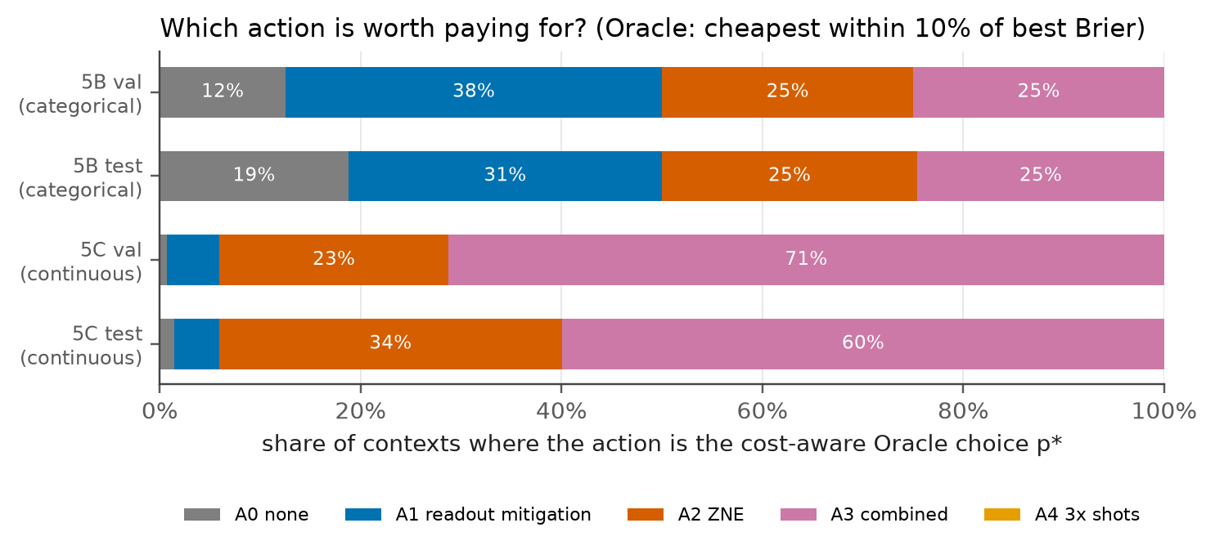
Categorical, then continuous joint noise
PHASE 5B (COMPLETED OCT 7) · PHASE 5C (COMPLETED OCT 8, 2026)
Phase 5B design
8 near-categorical conditions · 1,024 and 4,096 shots · 20 replicates
Phase 5C design
17 gate settings (one gate-free) × 4 readout settings = 68 points · 256–4,096 shots
0.33%
67–71%
< 3%
0%
5B: category rule wrong (validation)
5C: combined mitigation is the Oracle's choice
contexts where the shot budget changes the choice
contexts where 3× shots is the Oracle's choice
Test bars come from the one-time sealed test (the Nov 24 topic).
Source: p5b_metadata.json, p5c_metadata.json, p5c_budget_effect.csv, p5c_design.csv, final_metadata.json
Notes:
[Tushar · 2:25–3:25]
We ran every model under every action in two noise environments.
In Phase 5B, with eight near-categorical noise conditions, the best action was simply a lookup on the noise type, and a four-cell probe rule was wrong in only 0.33 percent of validation cases.
We then asked whether that was too easy, and in Phase 5C varied readout, depolarizing and thermal noise continuously and jointly, across 68 noise points and three shot budgets. That removed most of the choice. In our design, 16 of 17 gate settings carry gate noise, and combined mitigation was the Oracle's choice in 67 to 71 percent of contexts and ZNE in 23 to 27 percent. The shot budget changed the choice in fewer than three percent of cases, and three times the shots was never chosen.
Key points: 5B: best action = lookup on noise type; 4-cell rule wrong in 0.33% (best single action wrong in 62.5%); 5C: 68 points × 3 budgets; A3 67–71%, A2 23–27%; budget changes choice < 3%; A4 never preferred; 16 of 17 gate settings carry gate noise (design).
Sources: p5b_metadata.json (category rule val failure 0.00332, best single 0.625); p5c_metadata.json (preferred_shares); p5c_budget_effect.csv; p5c_design.csv.

Slide 5

Both gates failed, and a simple rule emerged
GATES G3B AND G3C · PRE-REGISTERED · DECIDED OCTOBER 7–8, 2026
The probe rule R_thr (fitted on training models only)
G3B · categorical noise → FAIL
4-cell category rule wrong in 0.33% of validation cases (gate threshold: 5%).
Gate probe
contraction ≤ t_g (≈ 0.97–0.98)?
yes
Readout probe
error ≥ t_r (≈ 0.4%)?
no
yes
no
G3C · continuous joint noise → FAIL
Best rule: 9.6% disagreement, but only 2.0% [1.6, 2.7] material (threshold: 5%); Brier regret +0.3%.
A1 readout mitigation
A0 at 256 shots if readout is also low
A3
combined
A2
ZNE
One readout-probe and one gate-probe threshold per shot budget. Thresholds are specific to this simulated 4-qubit setting.
Bias, not variance
shots cannot fix it, so the budget rarely matters
One question decides
in our design: is gate noise present?
Residual structure
Detectable (mutual information 0.08 and 0.04 nats), mostly mean-Z readouts, but not material.
As registered, no learned controller was trained. Fixed learned comparators were evaluated on the sealed test instead (run Oct 8; Nov 24 topic).
Source: p5b_metadata.json (g3b), p5c_metadata.json (g3c, R_thr cells and thresholds, structure association), p5c_policy_eval.csv
Notes:
[Tushar · 3:25–4:27]
Both gates failed, as defined in advance.
Under categorical noise the category rule was nearly perfect. Under continuous noise the best rule, shown here, disagreed with the Oracle in 9.6 percent of validation decisions, but only 2.0 percent were material, well below the five percent gate. The remaining structure, mostly from mean-Z readouts, was statistically detectable but small.
The rule is two thresholds per shot budget. If the gate probe detects gate noise, use ZNE, and add readout mitigation when the readout probe exceeds about 0.4 percent error. Otherwise use readout mitigation alone. It works because mitigation removes a bias that shots cannot, and because in our design the material question is simply whether gate noise is present.
As registered, we trained no controller. Next time: the sealed-test results, from the test we ran on October 8. Thank you.
Key points: G3B: 0.33% < 5% → fail; G3C: material 2.0% [1.6, 2.7] < 5% → fail; residual detectable (MI 0.08 / 0.04 nats) but not material; rule: gate probe → ZNE; readout probe ≥ ~0.4% → add readout mitigation; no controller trained; fixed comparators evaluated on the sealed test (run Oct 8; presented Nov 24).
Sources: p5b_metadata.json (g3b); p5c_metadata.json (g3c, rules/R_thr, structure_association); p5c_policy_eval.csv.

