Slide 1

Meeting 6 of 7 · November 24, 2026
FINAL EXPERIMENTAL FINDINGS
One sealed test: the simple rule held
Sealed held-out evaluation · rule vs learned comparators · reliability–resource trade-offs · limits · publication
The one-time sealed test (Oct 8, 2026) supported all four pre-registered hypotheses: the probe rule was near-Oracle on unseen models, and fixed learned comparators did not reduce material errors. Only four structures were held out.
Mayank Kumar Pokhriyal · Tushar Poonia
M.S. in Artificial Intelligence capstone · Katz School of Science and Health, Yeshiva University
Proposed split: Tushar (slides 1–3) · Mayank (slides 4–5) · about 5 minutes
Sep 15
Proposal
Sep 29
Design
Oct 13
Implementation
Oct 27
Noise & mitigation
Nov 10
Policy selection
Nov 24
Final findings
Dec 8
Final defense
Notes:
[Tushar · 0:00–0:28]
Good afternoon. Today we report the final experimental findings of Q-TRACE: the one-time sealed held-out test, which we ran on October 8.
All four pre-registered hypotheses were supported. The two-threshold probe rule was near the Oracle on unseen models, and fixed learned comparators did not reduce material errors. Only four structures were held out, so we will also be careful about what these results cannot show.
Key points: one-time sealed test, Oct 8; H1–H4 supported; only four held-out structures.

Slide 2
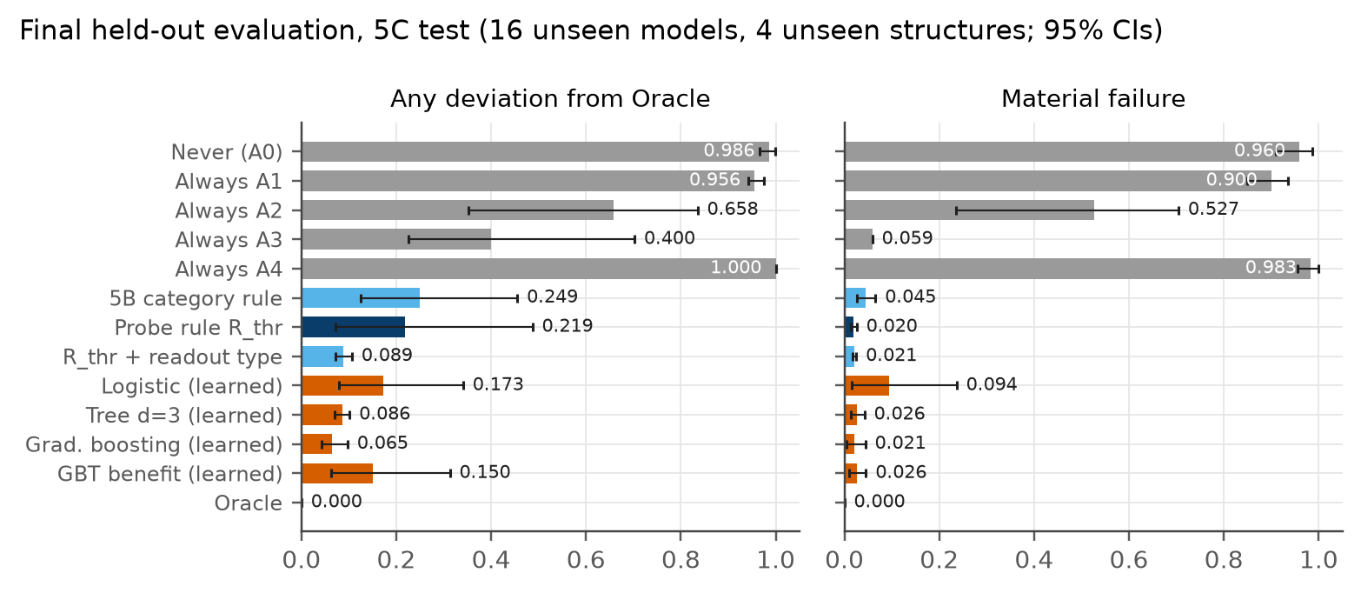
The one-time sealed evaluation
FINAL TEST · UNLOCKED ONCE, OCTOBER 8, 2026 (21:28 UTC)
Freeze
rule + 4 learned comparators
Fingerprint
hash of every frozen decision
Push protocol
hypotheses, metrics, statistics
Unlock once
guard refuses a second unlock
Evaluate
16 unseen models · reads logged
2.0%
material errors, 95% CI 1.4–2.6% (4 held-out structures; likely too narrow)
−0.03% · +0.6%
Brier regret vs Oracle · shots vs Oracle
8.8%
material errors, categorical test (bound: 10%)
H1 supported
H2 supported
H3 supported
H4 supported
16 unseen models from 4 never-used structures
Source: final_metadata.json, final_policies_5c_test.csv, final_policies_5b_test.csv
Notes:
[Tushar · 0:28–1:21]
The test used 16 models from four structures that no policy had ever seen, including one with a mean-Z readout.
Before opening it, we froze the rule and four learned comparators, recorded fingerprints of their decisions, and pushed the full protocol. A guard then allowed exactly one unlock and logged every read. The stored outcomes matched their committed hashes.
Under continuous joint noise, the rule made material errors in 2.0 percent of decisions, with a confidence interval of 1.4 to 2.6 percent. Its Brier score was within 0.03 percent of the Oracle's, at 0.6 percent more shots. Under categorical noise its material errors were 8.8 percent, inside the pre-registered ten-percent bound.
Key points: 16 unseen models, 4 structures (one mean-Z); frozen + fingerprinted + pushed, then one guarded unlock; material 2.0% [1.4, 2.6]; Brier −0.03%; +0.6% shots; 5B 8.8% ≤ 10%.
Sources: final_metadata.json (unlock record, hypotheses); final_policies_5c_test.csv and final_policies_5b_test.csv (R_thr, arm all).

Slide 3
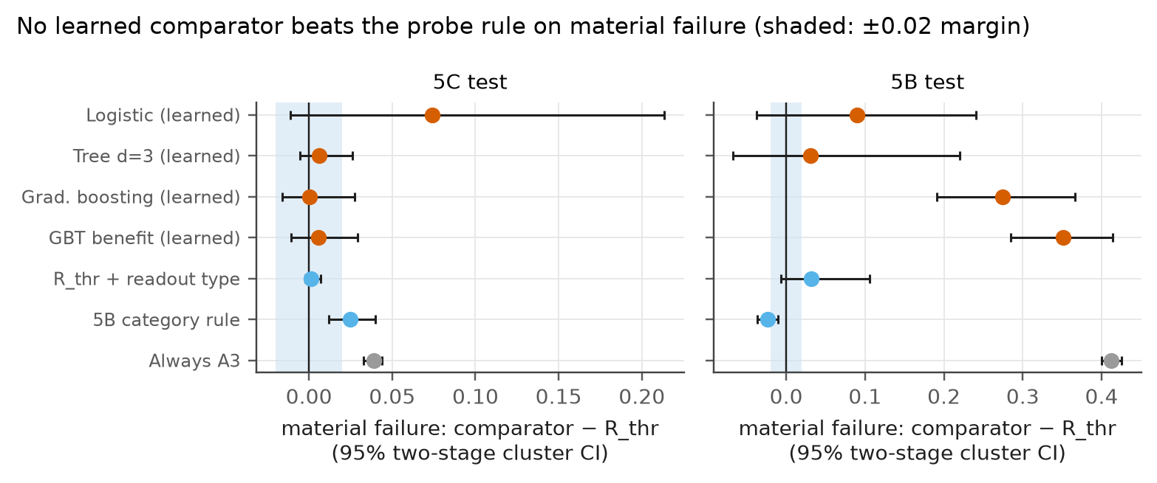

The rule versus learned comparators
FINAL TEST, OCTOBER 8, 2026 · PAIRED, TWO-STAGE CLUSTER BOOTSTRAP OVER 4 HELD-OUT STRUCTURES
Registered endpoint: material errors
Best learned (gradient boosting) 2.1% vs rule 2.0%; difference +0.0005 [−0.016, +0.027]. 4 structures: intervals likely too narrow.
Any disagreement with the Oracle
Gradient boosting 6.5% vs rule 21.9%, mostly on the unseen mean-Z structure, where the rule's extra choices cost 2 calibration circuits: not material.
Stability
Gradient boosting: 10.7% material on validation vs 2.1% on test. Rule: 2.0% on both.
Overall, learning did not reduce material errors: fewer on the three parity structures, more on the unseen mean-Z one.
Source: final_paired_vs_rthr_5c_test.csv, final_paired_vs_rthr_5b_test.csv, final_policies_5c_test.csv, p7_policies_5c_val.csv
Notes:
[Tushar · 1:21–2:27]
Here are paired differences between each comparator and the rule. Positive values favour the rule; the shaded band is the pre-registered margin.
On the registered endpoint, material errors, the best learned comparator, gradient boosting, tied the rule: 2.1 versus 2.0 percent. Its interval excludes an advantage as large as the margin.
But we want to be precise. On any disagreement with the Oracle, gradient boosting was better: 6.5 percent against 21.9 percent. Most of the rule's extra disagreements came from the unseen mean-Z structure and cost only two calibration circuits per batch, so they were not material. Structure by structure, gradient boosting made fewer material errors on the three parity structures and more on the mean-Z one. The learned models were also unstable: gradient boosting made 10.7 percent material errors on validation. Under categorical noise, learned models reached 12 to 44 percent.
Key points: material: GBT 2.1% vs 2.0%, diff +0.0005 [−0.016, +0.027] → H2 non-superiority; raw disagreement: GBT 6.5% vs rule 21.9% (mostly mean-Z; cheap, not material); learned unstable: GBT 10.7% on validation; 12–44% under categorical noise.
Sources: final_paired_vs_rthr_5c_test.csv, final_paired_vs_rthr_5b_test.csv; final_policies_5c_test.csv (failure); p7_policies_5c_val.csv (L_gbt 0.107).

Slide 4
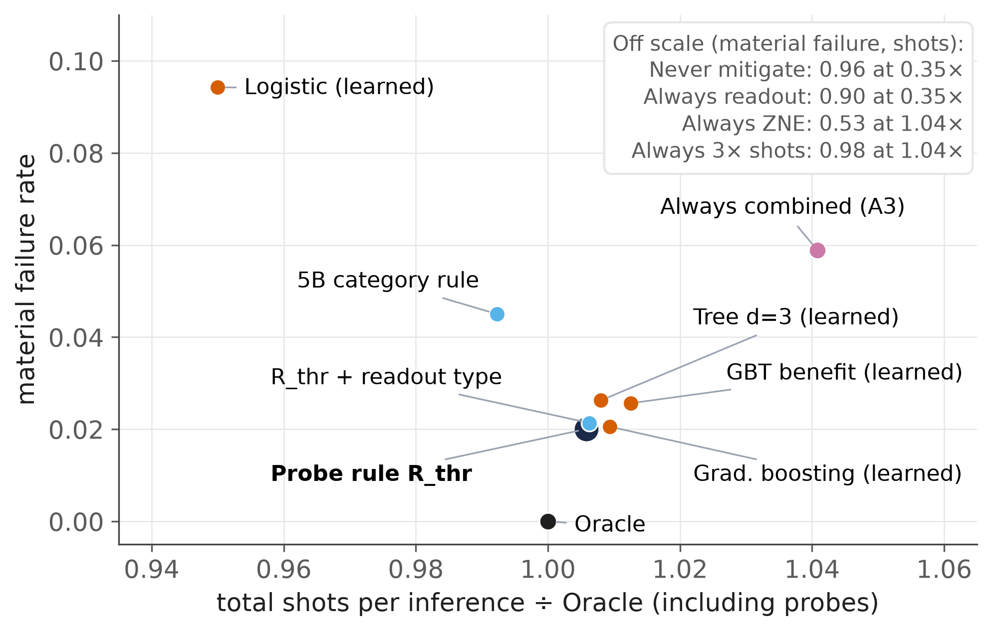
Reliability, resources, and what the test cannot show
FINAL TEST, OCTOBER 8, 2026 · COST ACCOUNTING AND STATISTICAL LIMITS
What the test cannot show
Always-combined's 5.9% = the 1 gate-free setting in 17: the saving depends on the design
Only 4 held-out structures: intervals likely too narrow
H2 is non-superiority on material errors, not proof learning cannot help
Simulation only · 4 qubits · gate probe nearly blind to thermal noise
+0.6%
−3.4%
0.35×
shots vs Oracle
shots vs always-combined
shots, never mitigate (96% material)
Source: final_policies_5c_test.csv, p5c_design.csv, p5c_probe_validity.csv
Notes:
[Mayank · 2:27–3:27]
This chart puts reliability against cost. Never mitigating uses about a third of the shots but makes material errors almost everywhere. Always using combined mitigation is reliable but overspends. The rule sits next to the Oracle: 0.6 percent more shots and 3.4 percent fewer than always-combined.
Now the limits. Always-combined's 5.9 percent material errors equal exactly the one gate-free setting in our seventeen, so the saving depends on how often batches are gate-free. Only four structures were held out, so the intervals are probably too narrow. H2 is a non-superiority result on material errors, not proof that learning cannot help. And everything is simulated, at four qubits, with a gate probe that barely sees thermal noise. We state these limits next to every headline number, in the paper and in the report.
Key points: rule: +0.6% shots vs Oracle, −3.4% vs always-combined; never-mitigate 0.35× shots, 96% material errors; always-A3 5.9% = 1/17 gate-free design share; 4 structures → CIs too narrow; H2 is non-superiority; simulation only; thermal blind spot.
Sources: final_policies_5c_test.csv (mean_total_shots_per_inference, material_failure; chart: semester cost_reliability_slide); p5c_design.csv (17 gate settings, one gate-free); p5c_probe_validity.csv.

Slide 5

Contribution and the path to publication
MANUSCRIPT AND PACKAGE PREPARED OCTOBER 8, 2026 · NOTHING SUBMITTED
1. Characterization
Noise damaged calibration, not discrimination; mitigation repaired it; extra shots did not.
Status
Manuscript (LaTeX, 18 pp) and capstone report: complete drafts for review
References checked against publisher records; team confirmation pending
Nothing submitted · no acceptance claimed
2. Benchmark
Leakage-safe counterfactual benchmark: 64 VQCs × noise × budget × 5 actions.
Recommended route (authors decide)
arXiv
needs an endorser
TMLR
claims vs evidence · no fees
If needed
IEEE QCE27 or QMI
3. Pre-registered test
In this setting, a simple probe rule performed competitively with learned comparators.
Pending author decisions: references, author order, venue, arXiv endorser, AI-use disclosure.
In the studied setting, a simple observable probe rule was enough. No quantum advantage is claimed.
Source: deliverables/README.md, deliverables/submission/VENUES.md, deliverables/submission/SUBMISSION_PLAN.md
Notes:
[Mayank · 3:27–4:21]
Our contribution has three parts. First, a characterization showing that noise damaged calibration, not discrimination, and that mitigation repaired it while extra shots could not. Second, a leakage-safe counterfactual benchmark across 64 models. Third, a pre-registered test of learning against simple rules, which found that, in this setting, a simple probe rule performed competitively with learned comparators.
The manuscript and capstone report are complete drafts for review, built from the same verified numbers as these slides; nothing has been submitted. Our recommended route is an arXiv preprint and then TMLR, which judges whether claims match the evidence and charges no fees. IEEE Quantum Week and Quantum Machine Intelligence are alternatives. Remaining decisions are ours: confirm the references, author order, venue and an arXiv endorser. Thank you.
Key points: three contributions; no quantum-advantage claim; manuscript + report drafted; nothing submitted; plan: arXiv → TMLR; alternatives QCE27, QMI; author decisions pending.
Sources: deliverables/README.md; deliverables/submission/VENUES.md and SUBMISSION_PLAN.md.

