Slide 1

Big Mountain Ski Resort – Pricing Strategy
Thomas Poozhikala
Springboard Data Science Career Track
https://github.com/tpoozhikala
Slide template provided by Sacramento State University

Slide 2
Introduction of Problem & Objective
Problem
Big Mountain Resort is a ski resort located in Montana that has access to 105 trails and about 350,000 people ski or snowboard at the resort. However, the company has installed another chair lift increasing their operating costs to $1,540,000 this season. Is there a more sufficient pricing strategy to help recoup the operational costs?
Objective: Recommend a business strategy for recouping the increased operational cost of $1.54MM for installing a new chair lift this season, while keeping the profit margins at 9.2% as well as provide insights on annual revenue for the season over the next year.

Slide 3
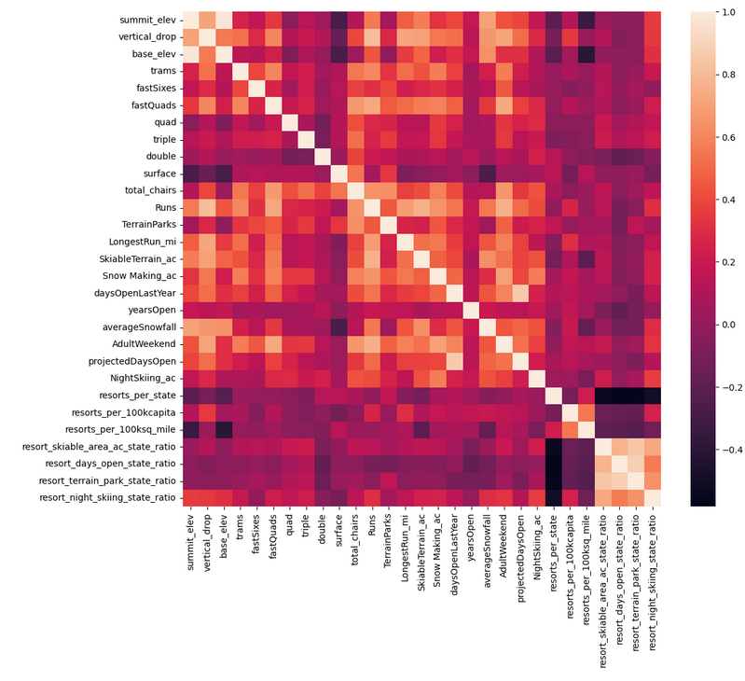
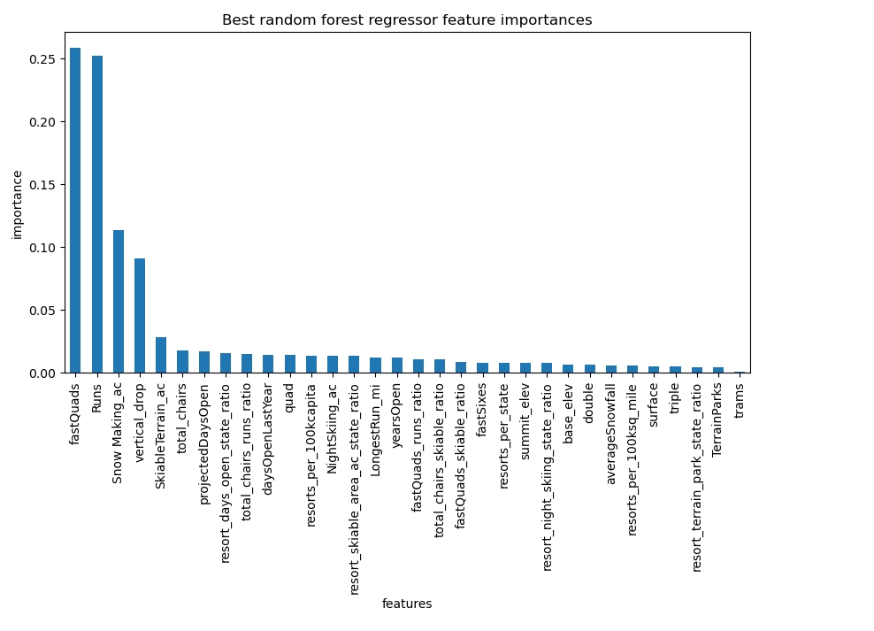
Recommendation & Key Findings
*Correlation Heatmap showcasing correlations among values in dataset
*Key features identified from random forest regressor model
Recommended Pricing Strategy: Big Mountain Ski Resort in adding another chair lift for their resort should also increase their price to $90.90 per ticket while also adding another run and increasing the vertical drop distance by 150 feet as well as increasing the snow making machine coverage by 2 acres.

Slide 4
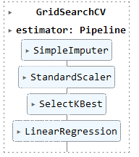
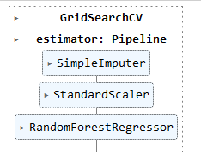
Establishing a Predictive Model
Mean Absolute Error used as key metric to compare different predictive models.
Mean of AdultWeekend price column lead to predictions being off by $19 from actual.
Linear Regression model had an increased accuracy of prediction by being off by $11.80.
Random Forest Regressor model lead to greater accuracy of being off about $9.50 from actual.
*Algorithms framework of respective linear regression model and Random Forest Regressor model

Slide 5
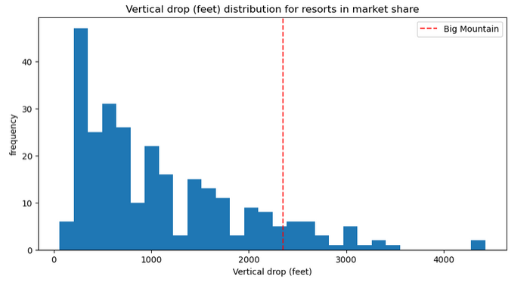
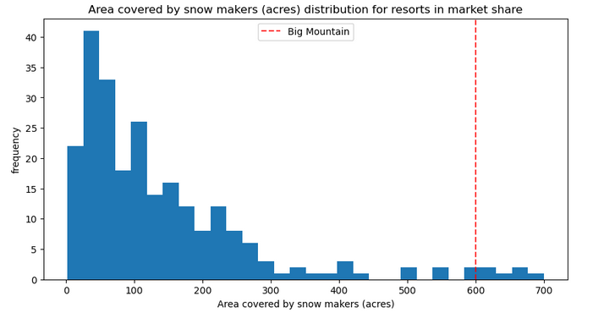
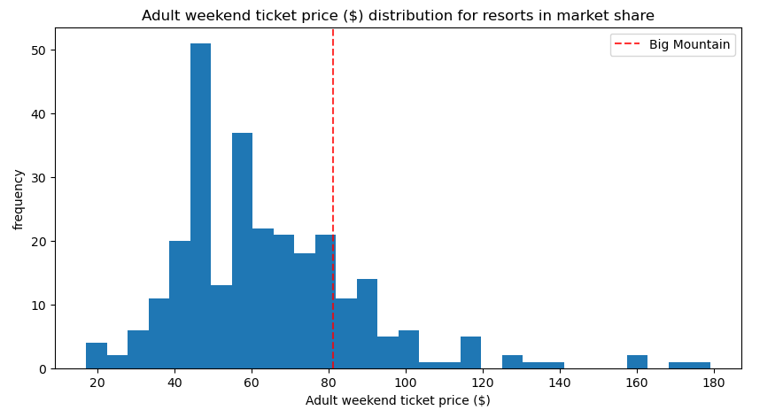
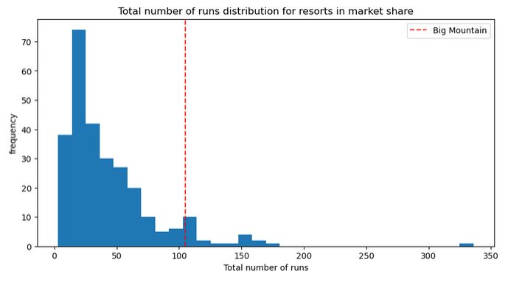
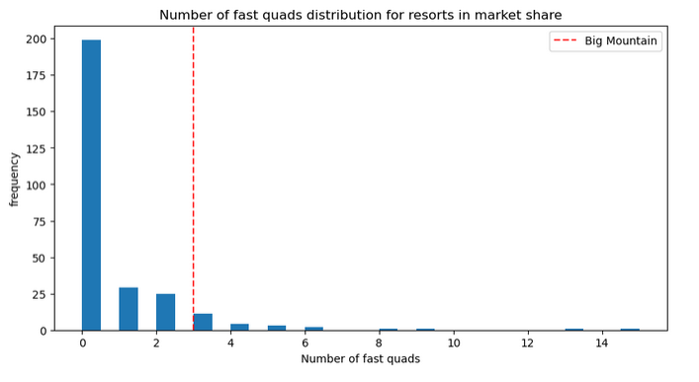
Random Forest Regressor Model Insight
Big Mountain Ski Resort seems to be underselling their resort as the predicted price is about $95 when the actual price in the AdultWeekend price column is $81 compared with other resorts of its caliber.
*AdultWeekend Ticket price of Big Mountain with entire market share
*Big Mountain Ski Resort feature behavior compared with entire market share

Slide 6
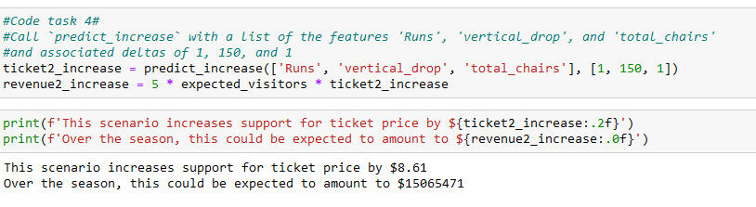
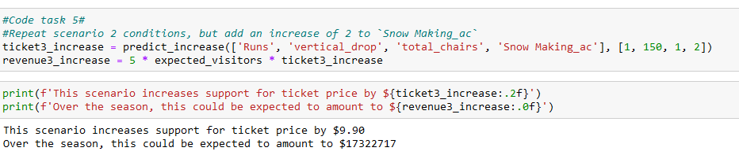
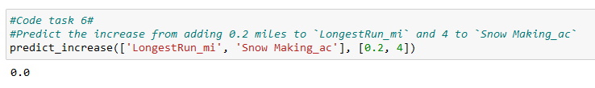
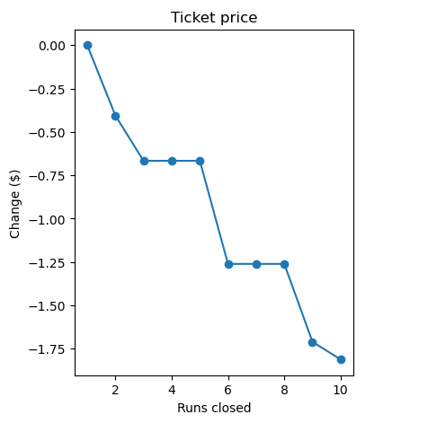
Examining Business Strategies
*Business Case 1: Increase Runs, Vertical Drop Distance, and total chairs at a resort
*Business Case 2: Increase Runs, Vertical Drop Distance, snow making machine area, and total chairs at a resort
*Business Case 3: Increase miles for the longest run and snow making machine area
*Business Case 4: Determining number of run closure and predicted ticket markdown price
Out of the business strategies tested, if a resort adds a chair lift, it would be in best interest if the resort also adds another run as well as a vertical drop distance of 150 feet and increases their snow covered by snow making machines by 2 acres. This leads to a ticket support price of $9.90 dollars which still gives Big Mountain Ski Resort a competitive market price.

Slide 7
Summary
The analysis and design of the random forest regressor model provided a key insight as per highlighting top features that seem to significantly affect AdultWeekend column ticket price namely fastQuads, Runs, area covered by snow making machines, and vertical drop.
The pricing strategy of increasing ticket price by 12% for installing a new chair lift as well as adding another run and increasing the vertical drop distance by 150 feet and increasing the area covered by snow making machines by 2 acres, will hopefully recoup the costs of adding another ski lift for the resort and hopefully keep the profit margins within 9.2% for the next open season while still keeping Big Mountain Ski Resort in a competitive price point.

Slide 8
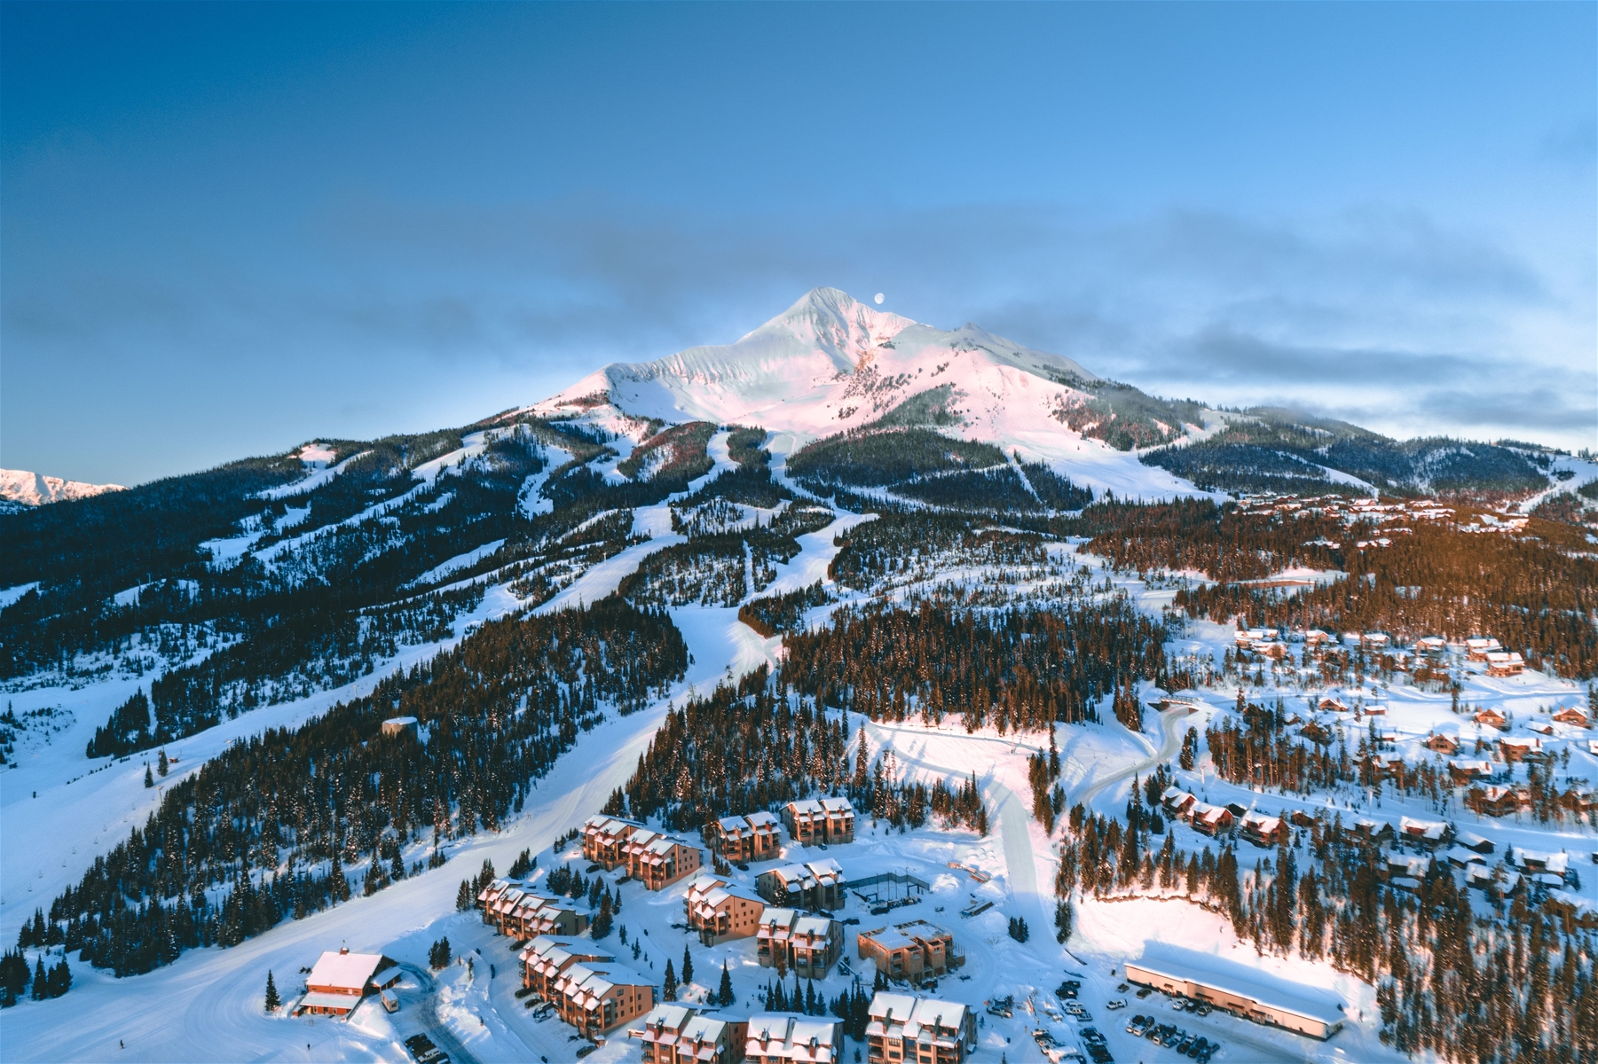
Thank You! Questions?
https://github.com/tpoozhikala/DataScienceGuidedCapstone/tree/master/Notebooks

