Slide 1

Deep Learning Classification – Model Overview
Thomas Poozhikala
Springboard Data Science Career Track
https://github.com/tpoozhikala
Slide template provided by Sacramento State University
Acknowledgement to Eric Callahan for guidance and support

Slide 2
Introduction of Problem & Objective
Problem
Family Friendly Productions, a recent 2-year startup movie production company, saw a loss of profits in movie revenue in the past 2023 financial cycle. This decline is potentially caused by lingering feelings from the COVID-19 as well as not capitalizing or marketing quick enough to their more avid movie goers.
Objective: Potential strategy to implement in the 2024 financial year is to design a deep learning neural network image classification model to predict future Family Friendly Production movie genres based on the movie posters before the movies hit market.

Slide 3
Current Model Status & Improvement
Keras Image Classification Model:
F1 Score: 0.253
ROC AUC Comedy: 0.498
ROC AUC Adventure: 0.492
ROC AUC Drama: 0.493
ROC AUC Documentary: 0.503
Steps to Improve:
Enlarge sample size
Increase computational resources
5-fold cross validation
Optimal model layering
Expose more hyperparameters in GridSearch
Notes:
After spending the last 4 months designing and developing the model, the best performer as according to the data gathered from IMDb was a model performing with a f1_score of 0.25 and the best ROC AUC value of 0.508 meaning slightly above the base of 50/50 random guessing for each genre. Understandably not very high confidence in the model thus far, but I see where this model can improve so we can get a better working model before production. Some steps I see are enlarging our sample size, having more computational resources to perform a 5-fold cross validation instead of a 3-fold as well as to tune the different layers of the model to be more optimial and exposing the model to more hyperparameters when performing a GridSearch.

Slide 4
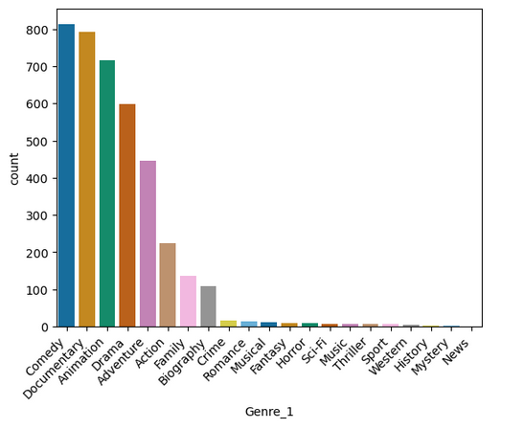
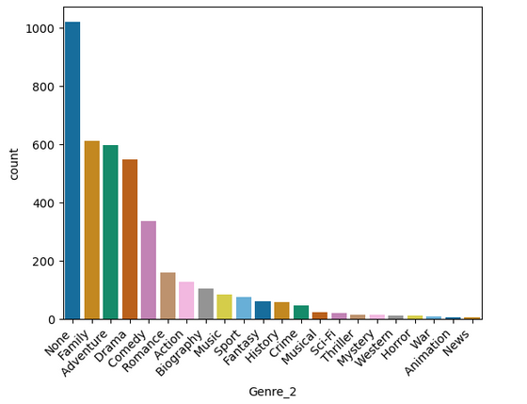
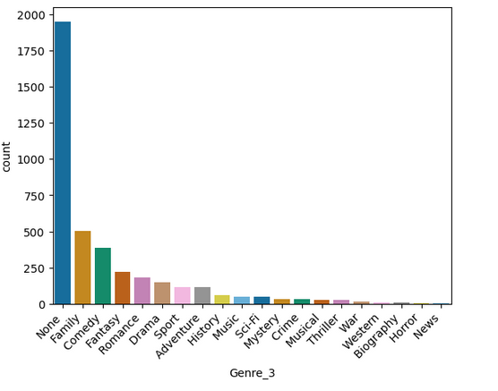
Assessing Genre Class
G and PG Movies from 1990 – 2023 retrieved through paid IMDb API
21 Unique Genre Classes Retrieved aside from ‘None’

Slide 5
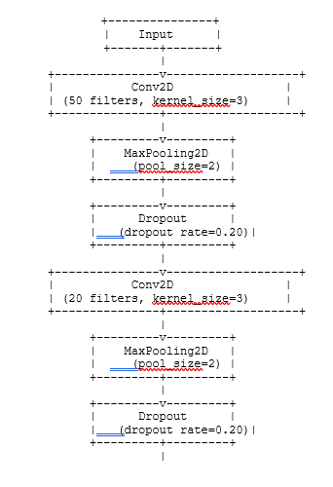
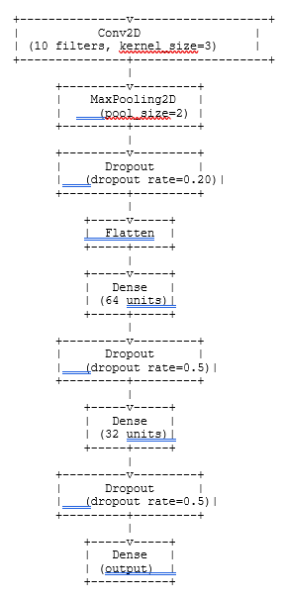
Image Classifier Model Build
RGB Input Array: (200,200, 3)
Classification of Genre Class(es)
*Model layer overview provided by chatGPT

Slide 6
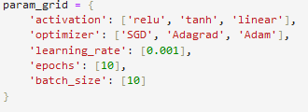
Image Classifier Model Results
Image Classifier model trained with an 80/20 split and 3-fold Cross Validated for compiler and activation functions
Best parameters SGD compiler and ‘relu’ activation function
Model performance assessed based on f1_score and best model performer ROC AUC values for different genres assessed.
*Current model GridSearchCV Param Grid
Model Name | F1_Score | ROC_AUC_Comedy | ROC_AUC_Adventure | ROC_AUC_Drama | ROC_AUC_ Documentary
Keras Image Classification Model | 0.25258895 | 0.4978308 | 0.49173069 | 0.49308443 | 0.503067484
*Table Displaying Model Results f1_score and respective ROC AUC for few genres

Slide 7
Model Results Key Takeaways
F1_score of 0.25 means there are improvements to be made prior to deploying the model to production
Reasons for model underperformance:
Imbalance of genres within initial dataset
Number of layers or filters within the model might not be most optimal for generalizability of the model
3-fold cross validation not best method to generalize the model
More hyperparameters will need to be tested within GridSearchCV (learning rate, activation functions, model compilers, etc.)

Slide 8
Future Improvements
Increase sample size of movie genres
Include PG-13 movies and movies dating from 1980s to 2024
Augment current movie poster images
Increase computational resources
Perform 5-fold cross validation instead of 3-fold
Optimize the convolutional and dense layers for appropriate filter numbers and kernel window
Expose current model’s GridSearchCV to more hyperparameters (learning rate, activation functions, and model compilers)

Slide 9
Summary
Current Keras Image Classification model requires improvements before deploying to production.
Suggested improvements include:
Enlarge movie genre sample size
Include PG-13 movies and movies from 1980s to present
Augment current movie poster images
Increase computational resources
5-fold cross validation instead of 3-fold
Optimize different model layers
Expose current model to increased GridSearch parameters (learning rate, model compiler, activation functions, etc.)

Slide 10
Thank You! Questions?
https://github.com/tpoozhikala/IMDB_Classification

