Slide 1

Deep Learning Classification – Model Overview
Thomas Poozhikala
Springboard Data Science Career Track
https://github.com/tpoozhikala
Slide template provided by Sacramento State University
Acknowledgement to Eric Callahan for guidance and support

Slide 2
Introduction of Problem & Objective
Problem
Family Friendly Productions, a recent 2-year startup movie production company, saw a loss of profits in movie revenue in the past 2023 financial cycle. This decline is potentially caused by lingering feelings from the COVID-19 as well as not capitalizing or marketing quick enough to their more avid movie goers.
Objective: Potential strategy to implement in the 2024 financial year is to design a deep learning neural network image classification model to predict future Family Friendly Production movie genres based on the movie posters before the movies hit market.

Slide 3
Current Model Status & Improvement
Keras Image Classification Model:
F1 Score Micro: 0.02
ROC AUC Adventure: 0.503
ROC AUC Action: 0.504
ROC AUC Biography: 0.506
ROC AUC Comedy: 0.501
ROC AUC Documentary:0.504
Steps to Improve:
Enlarge sample size
Increase computational resources (ex. Cloud)
Validate with standard but computationally intensive approach
Optimize model configuration
Expose more parameters for the model
Test other predictive models
*If the model metrics above were closer to 1, this would indicate a strong performing model
Notes:
After spending the last 4 months designing and developing the model, the best performer as according to the data gathered from IMDb was a model performing with a f1_score of 0.25 based on test or unseen data and the best ROC AUC value of 0.508 meaning slightly above the base of 50/50 random guessing for each genre. Understandably not very high confidence in the model thus far, but I see where this model can improve so we can get a better working model before production. Some steps I see are enlarging our sample size, having more computational resources to perform a 5-fold cross validation instead of a 3-fold as well as to tune the different layers of the model to be more optimial and exposing the model to more hyperparameters when performing a GridSearch.

Slide 4
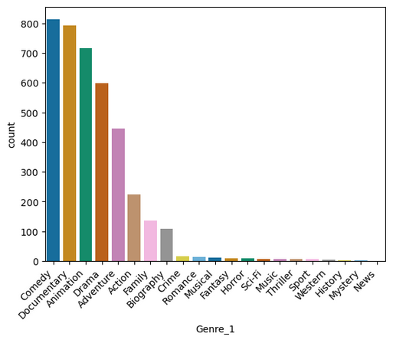
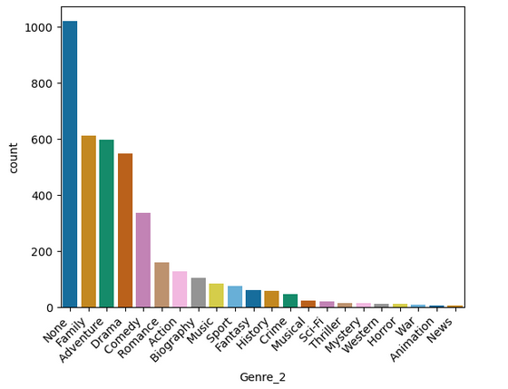
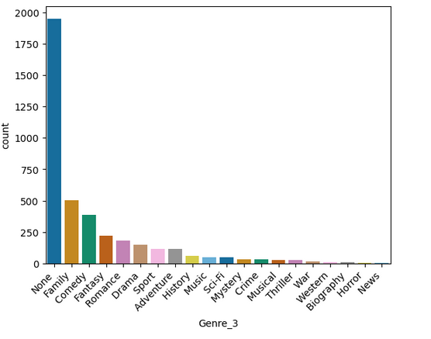
Assessing Genre Class
G and PG Movies from 1990 – 2023 retrieved through paid IMDb API
21 Unique Genre Classes retrieved aside from ‘None’
Clear imbalance of genres with the current dataset, so the model has a hard time learning to predict the different genres!
Notes:
For sake of model building, since the order of what Genre the movie is categorized does not matter, I then transformed the dataset to just be a sparse one-hot encoded dataset where each of the genres were different columns and removed ‘None’ aspect since after receiving some advice saw that this might confuse the model

Slide 5
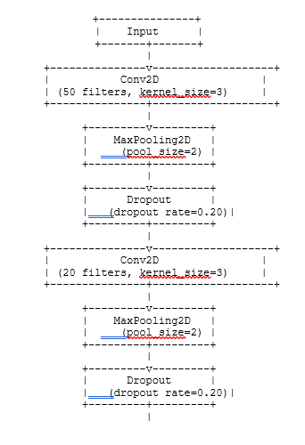
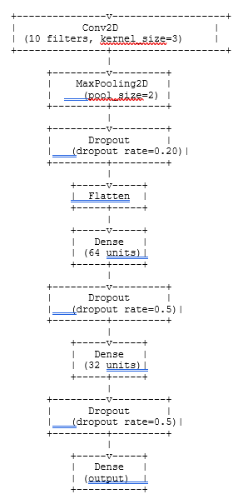

Image Classifier Model Build
RGB Input Array: (200,200, 3)
Image then is converted to a 1D array in where in the subsequent layers the model learns the features of this 1D array and then makes its prediction of genres of movies in output layer
Model learns the different features of the image after each convolutional layer and then MaxPooling retrieves the most important aspects of the image
Classification of Genre Class(es):
*Model layer overview provided by chatGPT
Comedy, Crime, Drama
Notes:
Depending on acitivaiton functions affect how the model classifies or generates an output to each subsequent layer
CNNS key for gridlike data such as images to learn features of different aspects of the grid, learning hiercarchial representation of features of input data
Flatten then add dense layers to start making classification for the images of the data (added other dense layers to continue leaerning the features of the data once flattened)
Configure the learning process before training (compiling), optimizer(function to update parameters of weights of model in training to minimize loss funciton), loss(loss functions being used), metrics(evaluate performance of model during trnaing), different activation functions affect how the model learns, optimiaer min loss so that the model can make accurate predictions on unseen data to match true labels

Slide 6
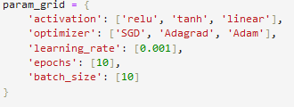
Image Classifier Model Results
80% of the data used for training, 20% used for testing
Model validated with slightly less computationally intensive approach
Best parameters: SGD optimizer and ‘relu’ activation function
F1_Score micro indicates how well (from a scale of 0 to 1) the model is able to predict genres. ROC AUC tells how well is the model able to predict the different genres compared to just a 50/50 random guess.
*Again, if the below model metrics were closer to 1, this would indicate a strong performing model
*Current model GridSearchCV Param Grid
Model Name | F1_Score Micro | ROC_AUC_Adventure | ROC_AUC_Action | ROC_AUC_Biography | ROC_AUC_ Comedy | ROC_AUC_Documentary
Keras Image Classification Model | 0.0186766 | 0.5028001 | 0.5041314 | 0.5062588 | 0.5012803 | 0.5037350
*Table Displaying Model Results f1_score and respective ROC AUC for few genres
Notes:
Different activation functions affect how the model classifies the data. A model optimizer provides functions that minimize the loss function during training of the model by adjusting the parameters during trainig

Slide 7
Model Results Key Takeaways
F1_score of 0.25 means there are improvements to be made prior to deploying the model to production
Reasons for model underperformance:
Not enough different genre data for the model to learn
Overall configuration (layers, filters) of the model needs fine tuning
Need to validate the model’s effectiveness with the standard but more computationally intensive approach
More parameters need to be tested to get best performing model (learning rate, activation functions, model optimizers, etc.)

Slide 8
Future Improvements
Increase sample size of movie genres
Include PG-13 movies and movies dating from 1980s to 2024
Increase computational resources (ex. Cloud computing)
Perform the standard but more computationally intensive approach to validate the model
Optimize the overall configuration of the model
Expose current model to more parameters (learning rate, activation functions, and model optimizers)
Develop and Test other predictive models based on IMDb dataset

Slide 9
Summary
Current Keras Image Classification model requires improvements before deploying to production.
Suggested improvements include:
Enlarge movie genre sample size
Include PG-13 movies and movies from 1980s to present
Increase computational resources (ex. Cloud computing)
Perform the standard but more computationally intensive approach to validate the model
Optimize overall model configuration
Expose current model to increased parameters (learning rate, model optimizer, activation functions, etc.)
Develop and Test other predictive models based on IMDb dataset

Slide 10
Thank You! Questions?
https://github.com/tpoozhikala/IMDB_Classification

