Slide 1

Average UK Borough Price Increase from
2004 to 2023
Thomas Poozhikala
Springboard Data Science Career Track
tpoozhikala@gmail.com
Resources Provided by London Datastore: a free, open-source data-sharing portal for London-oriented datasets

Slide 2
Introduction of Problem & Objective
Problem
Which boroughs of London have seen the greatest increase in housing prices, on average, over the last two decades?
Objective: Determine the average price increase ratio between 2004 and 2023 for the London Datastore dataset.

Slide 3
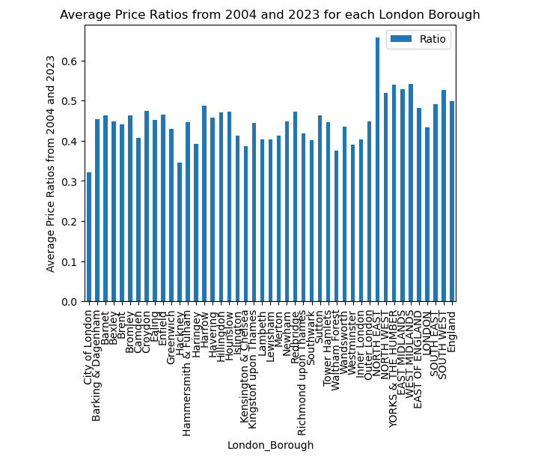
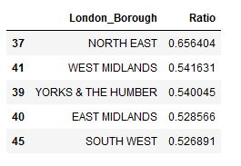
Plot & Observations
Data for analysis provided by London Datastore

Slide 4
Summary
Top 5 analysis shows that North East Borough, West Midlands, Yorks & the Humber, East Midlands, and South West had the largest price increase from 2004 to 2023, with North East Borough being the highest.

Slide 5

Thank You! Questions?
https://github.com/tpoozhikala/Springboard/blob/main/UK_House_Prices_Challenge/Unit_4_Challenge_-_Tier_3.ipynb

