Slide 1

Average UK Borough Price Increase from
2003 to 2023
Thomas Poozhikala
Springboard Data Science Career Track
https://github.com/tpoozhikala
Resources Provided by London Datastore: a free, open-source data-sharing portal for London-oriented datasets
Code to assist in completing this project provided by Tier 1 Project Platform and websites such as Stack Overflow and statology.org
List of London Boroughs provided by https://www.londononline.co.uk/boroughs/enfield/
Slide template provided by Sacramento State University

Slide 2
Introduction of Problem & Objective
Problem
Which boroughs of London have seen the greatest increase in housing prices, on average, over the last two decades?
Objective: Determine the average price increase ratios for each London Borough from 2003 and 2023 for the London Datastore dataset.

Slide 3
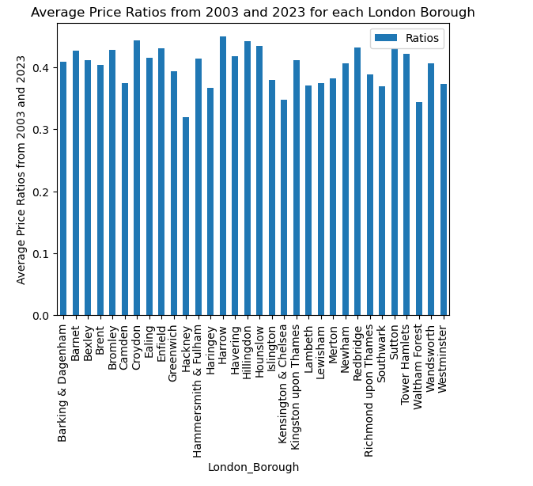

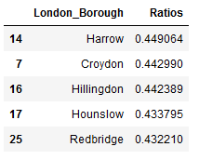
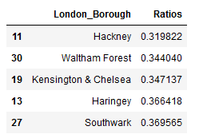
Plot & Observations
Data for analysis provided by London Datastore

Slide 4
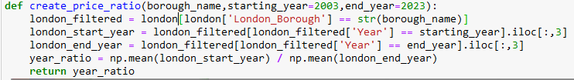
Create_Price_Ratio()
Function first filters dataset for specific borough name
Function then further filters to retrieve the ‘Average Prices’ column for the year specified
Function then performs a ratio calculation dividing the mean of the starting year ‘Average Price’ column with the mean of the ending year ‘Average Price’ column

Slide 5
Summary
Top 5 analysis shows that Harrow, Croyden, Hillingdon, Hounslow, and Redbridge were the highest in terms of average price ratio, therefore experienced the greatest price increase from 2003 and 2023.
Hackeny, Waltham Forest, Kensington & Chelsea, Haringey, and Southwark experienced the least change in price difference from 2003 and 2023.

Slide 6

Thank You! Questions?
https://github.com/tpoozhikala/Springboard/blob/main/UK_House_Prices_Challenge/Unit_4_Challenge_-_Tier_3.ipynb

