Slide 1

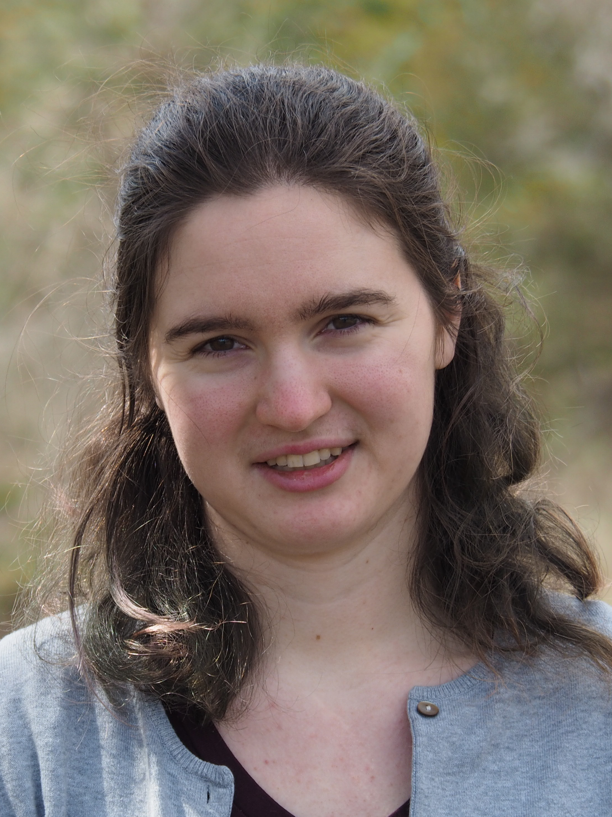

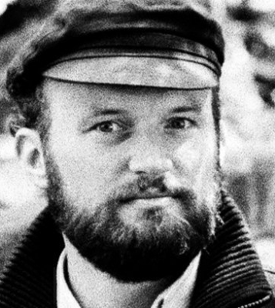

Bias against “she” pronouns can be rapidly overcome by changing event expectations
Till Poppels
Université de Paris
Veronica Boyce
Stanford University
Chelsea Ajunwa
MIT
Titus von der Malsburg
University of Potsdam
Roger Levy
MIT

Slide 2
Bias against “she” pronouns can be rapidly overcome by changing event expectations

Slide 3
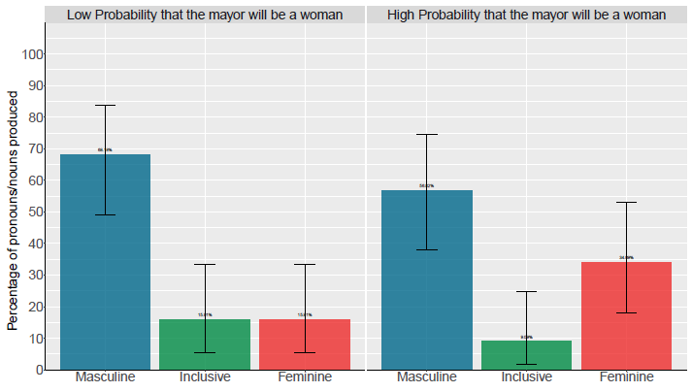
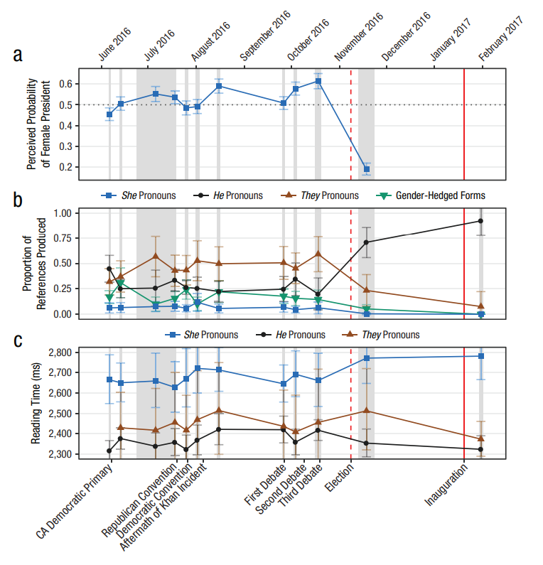
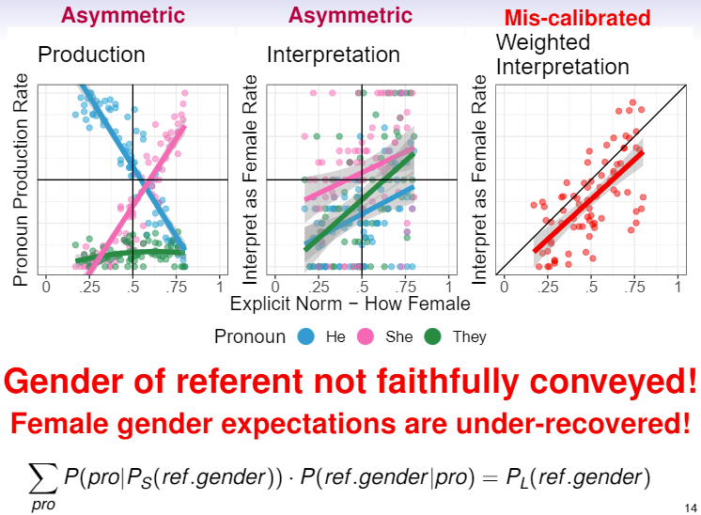
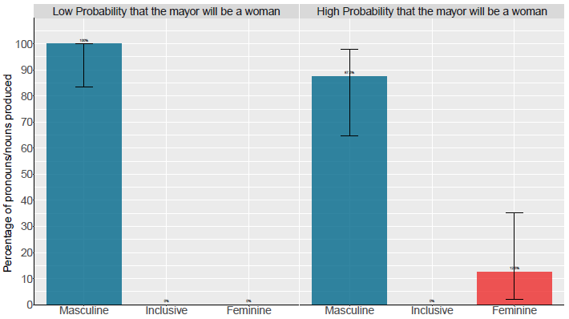
Bias against “she” pronouns
von der Malsburg, Poppels, Levy
(2020, Psych Science)
Boyce, von der Malsburg, Poppels, Levy
(2019, CUNY)
Pozniak & Burnett
(accepted, Glossa)

Slide 4
Bias against “she” pronouns
von der Malsburg, Poppels, Levy
(2020, Psych Science)

Slide 5
von der Malsburg, Poppels, Levy (2020, Psych Science)
Event expectation task
Production task
Comprehension task

Slide 6
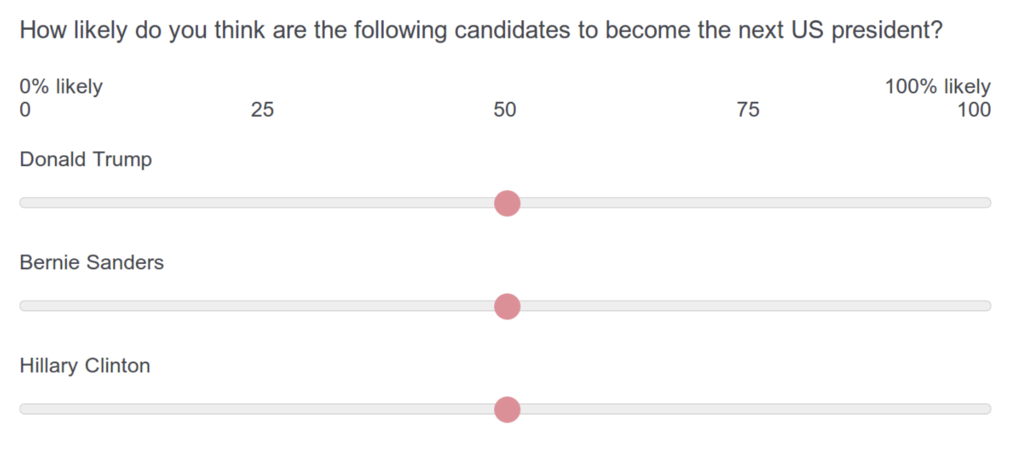
von der Malsburg, Poppels, Levy (2020, Psych Science)
Event expectation task

Slide 7
von der Malsburg, Poppels, Levy (2020, Psych Science)
Event expectation task
Production task
Comprehension task

Slide 8
von der Malsburg, Poppels, Levy (2020, Psych Science)
Production task
The next US president will be sworn into office in January 2017. After moving into the Oval Office, one of the first things that [_____________________________].

Slide 9
von der Malsburg, Poppels, Levy (2020, Psych Science)
Event expectation task
Production task
Comprehension task

Slide 10
von der Malsburg, Poppels, Levy (2020, Psych Science)
Comprehension task
The next US president will be sworn into office in January 2017. After moving into the Oval Office, one of the first things that she will do is hold a staff briefing.

Slide 11
von der Malsburg, Poppels, Levy (2020, Psych Science)
Event expectation task
Production task
Comprehension task

Slide 12
Bias against “she” pronouns
von der Malsburg, Poppels, Levy
(2020, Psych Science)
Boyce, von der Malsburg, Poppels, Levy
(2019, CUNY)
Pozniak & Burnett
(accepted, Glossa)

Slide 13
Bias against “she” pronouns
von der Malsburg, Poppels, Levy
(2020, Psych Science)

Slide 14
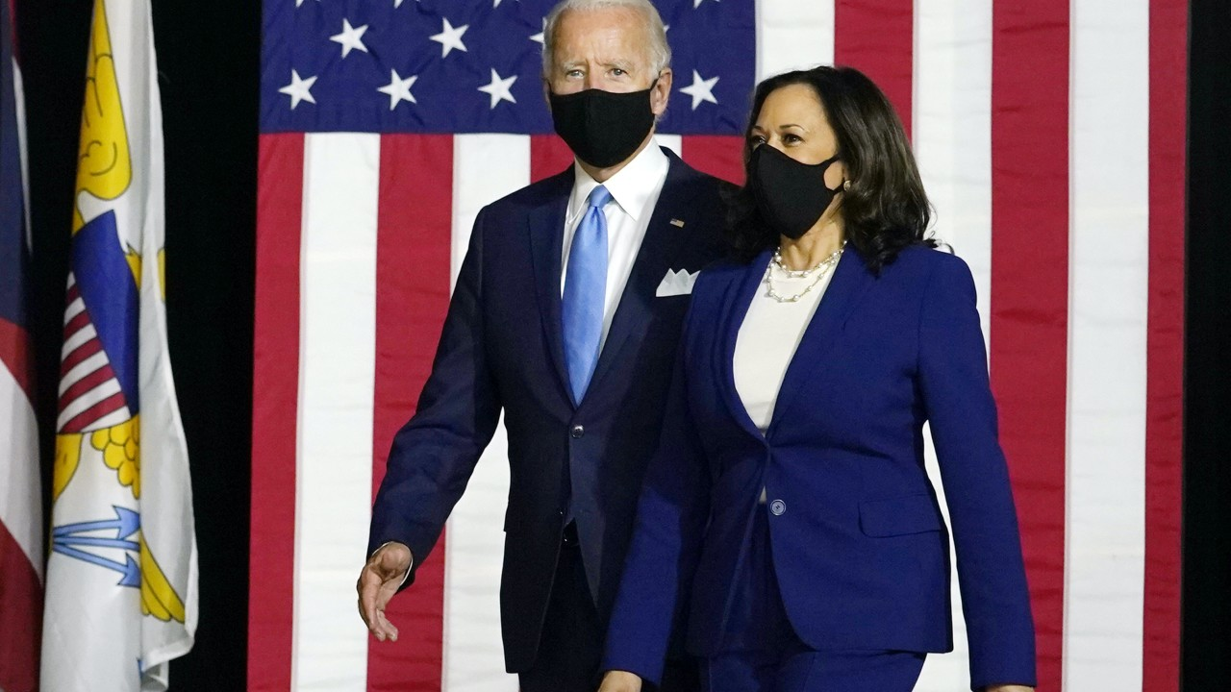
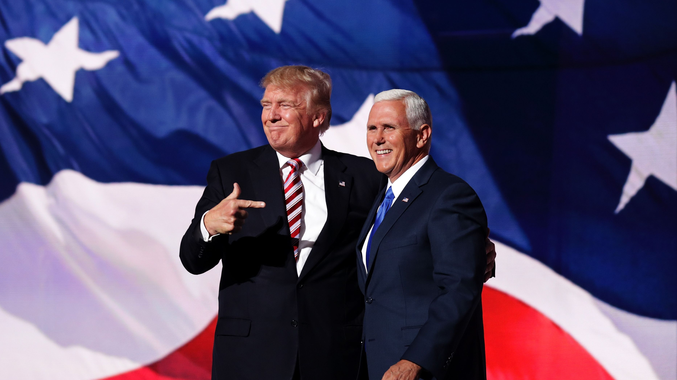
Bias against “she” pronouns can be rapidly overcome by changing event expectations

Slide 15
410
Cloze task
Event
expectation
SPR task: moving-window self-paced reading (comprehension)
Maze task: A-maze measure of decision times between correct word and high-surprisal foil
Cloze task: passage completion to elicit pronoun use in same contexts as
“Mazerace” task: A-maze measure with sentence referencing VP race
306
Maze task
Event
expectation
388
SPR task
Event
expectation
338
“Mazerace”
task
Event
expectation
2196 AMT participants
225
Event
expectation
Cloze task
Election Outcome
Preference
Demographics
Age
Gender
Home state
Education
US citizenship
Native language
US residency
Bot-screening task
171
Event
expectation
Maze task
News consumption
Event
expectation
SPR task
Recall task
197
161
Event
expectation
“Mazerace”
task

Slide 16
410
Cloze task
Event
expectation
SPR task: moving-window self-paced reading (comprehension)
Maze task: A-maze measure of decision times between correct word and high-surprisal foil
Cloze task: passage completion to elicit pronoun use in same contexts as
“Mazerace” task: A-maze measure with sentence referencing VP race
306
Maze task
Event
expectation
388
SPR task
Event
expectation
338
“Mazerace”
task
Event
expectation
2196 AMT participants
225
Event
expectation
Cloze task
Election Outcome
Preference
Demographics
Age
Gender
Home state
Education
US citizenship
Native language
US residency
Bot-screening task
171
Event
expectation
Maze task
News consumption
Event
expectation
SPR task
Recall task
197
161
Event
expectation
“Mazerace”
task

Slide 17
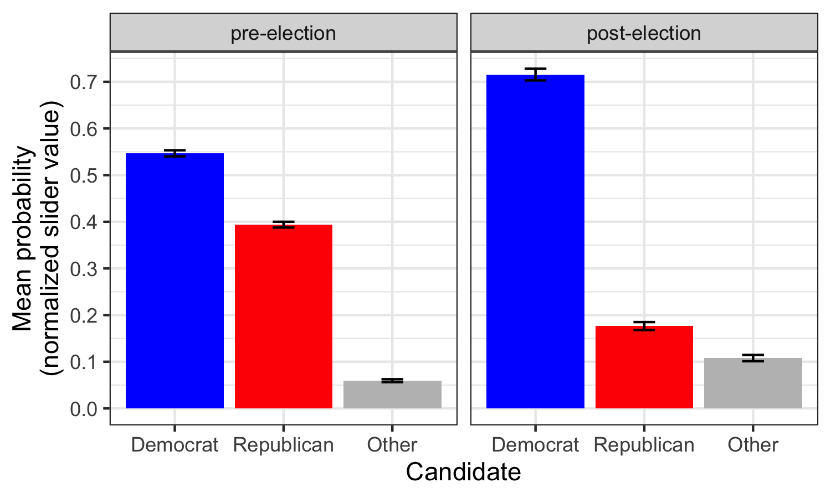
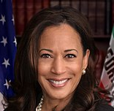
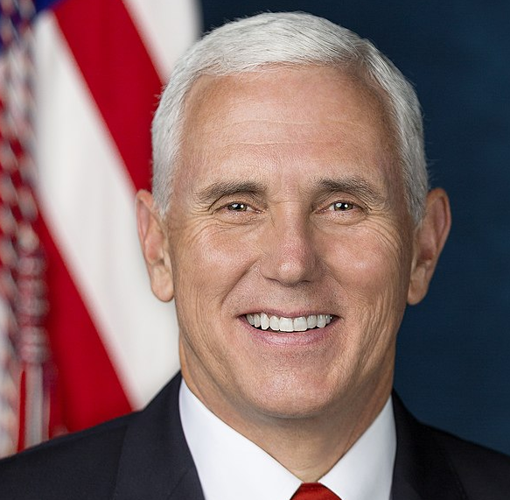
Event expectations
Immediately after major media outlets projected a Biden/Harris victory

Slide 18
410
Cloze task
Event
expectation
SPR task: moving-window self-paced reading (comprehension)
Maze task: A-maze measure of decision times between correct word and high-surprisal foil
Cloze task: passage completion to elicit pronoun use in same contexts as
“Mazerace” task: A-maze measure with sentence referencing VP race
306
Maze task
Event
expectation
388
SPR task
Event
expectation
338
“Mazerace”
task
Event
expectation
2196 AMT participants
225
Event
expectation
Cloze task
Election Outcome
Preference
Demographics
Age
Gender
Home state
Education
US citizenship
Native language
US residency
Bot-screening task
171
Event
expectation
Maze task
News consumption
Event
expectation
SPR task
Recall task
197
161
Event
expectation
“Mazerace”
task

Slide 19
410
Cloze task
Event
expectation
SPR task: moving-window self-paced reading (comprehension)
Maze task: A-maze measure of decision times between correct word and high-surprisal foil
Cloze task: passage completion to elicit pronoun use in same contexts as
“Mazerace” task: A-maze measure with sentence referencing VP race
306
Maze task
Event
expectation
388
SPR task
Event
expectation
338
“Mazerace”
task
Event
expectation
2196 AMT participants
225
Event
expectation
Cloze task
Election Outcome
Preference
Demographics
Age
Gender
Home state
Education
US citizenship
Native language
US residency
Bot-screening task
171
Event
expectation
Maze task
News consumption
Event
expectation
SPR task
Recall task
197
161
Event
expectation
“Mazerace”
task

Slide 20
Production
January 20, 2021, is the start of the next presidential and vice-presidential term in the United States.
Because the vice president breaks ties in the US Senate, if there is a 50–50 party split in 2021 then [_________________].

Slide 21
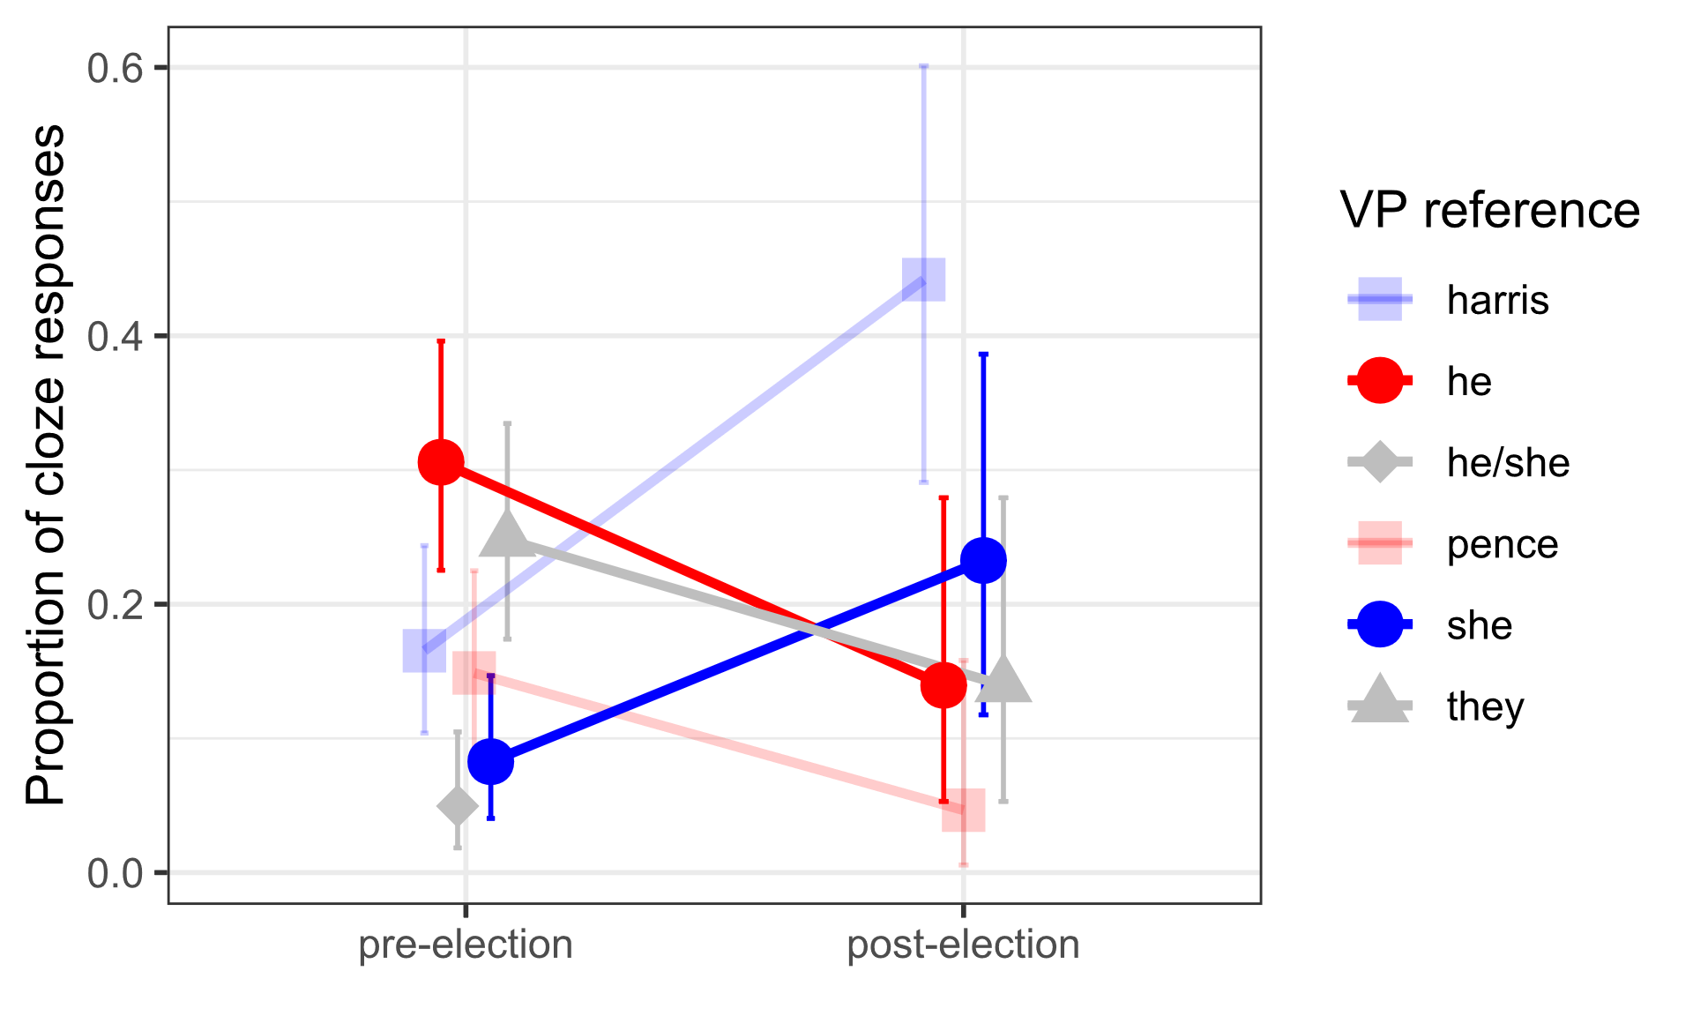
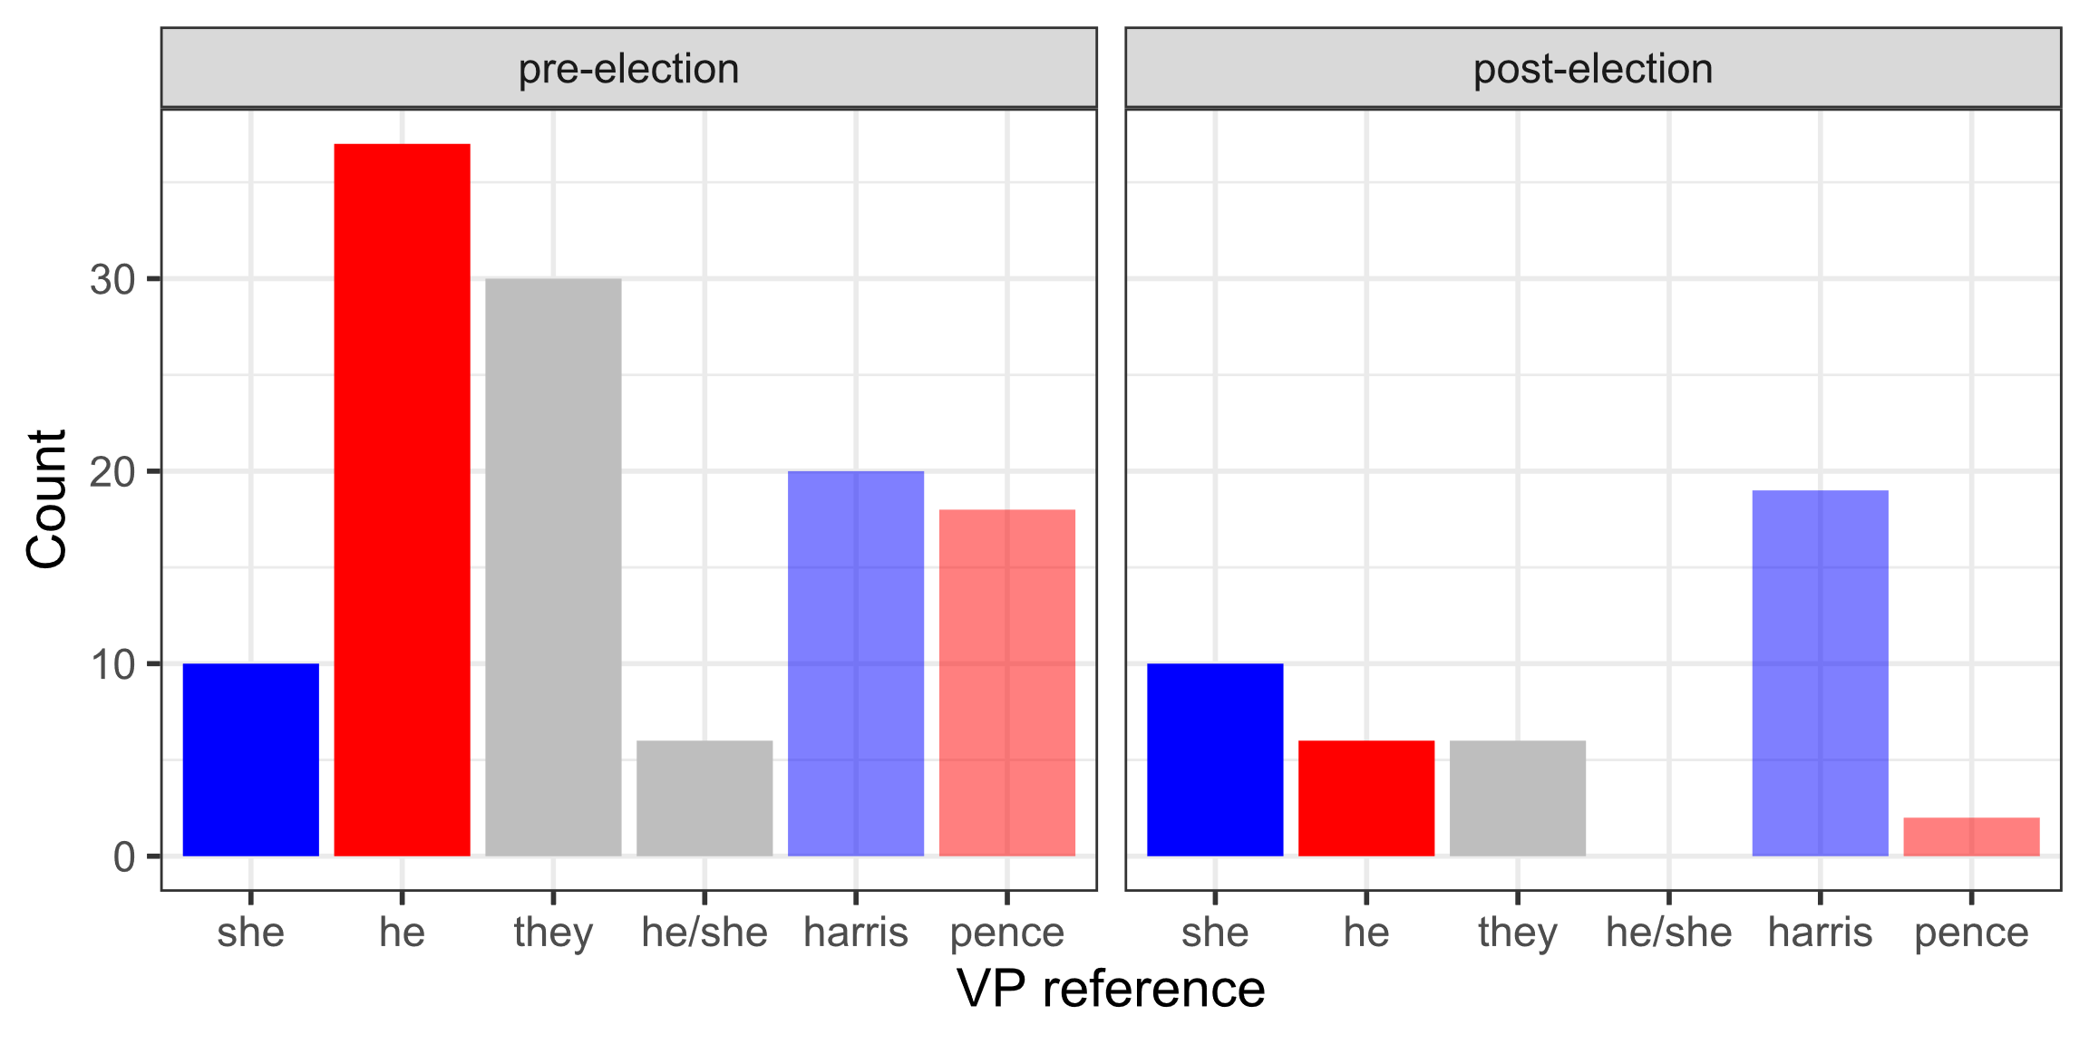
Production
January 20, 2021, is the start of the next presidential and vice-presidential term in the United States.
Because the vice president breaks ties in the US Senate, if there is a 50–50 party split in 2021 then [_________________].
he
she
he
she

Slide 22
410
Cloze task
Event
expectation
SPR task: moving-window self-paced reading (comprehension)
Maze task: A-maze measure of decision times between correct word and high-surprisal foil
Cloze task: passage completion to elicit pronoun use in same contexts as
“Mazerace” task: A-maze measure with sentence referencing VP race
306
Maze task
Event
expectation
388
SPR task
Event
expectation
338
“Mazerace”
task
Event
expectation
2196 AMT participants
225
Event
expectation
Cloze task
Election Outcome
Preference
Demographics
Age
Gender
Home state
Education
US citizenship
Native language
US residency
Bot-screening task
171
Event
expectation
Maze task
News consumption
Event
expectation
SPR task
Recall task
197
161
Event
expectation
“Mazerace”
task

Slide 23
410
Cloze task
Event
expectation
SPR task: moving-window self-paced reading (comprehension)
Maze task: A-maze measure of decision times between correct word and high-surprisal foil
Cloze task: passage completion to elicit pronoun use in same contexts as
“Mazerace” task: A-maze measure with sentence referencing VP race
306
Maze task
Event
expectation
388
SPR task
Event
expectation
338
“Mazerace”
task
Event
expectation
2196 AMT participants
225
Event
expectation
Cloze task
Election Outcome
Preference
Demographics
Age
Gender
Home state
Education
US citizenship
Native language
US residency
Bot-screening task
171
Event
expectation
Maze task
News consumption
Event
expectation
SPR task
Recall task
197
161
Event
expectation
“Mazerace”
task

Slide 24
Comprehension
The A-Maze task
Boyce, Futrell, & Levy (2020, JML)

Slide 25
Comprehension
The A-Maze task
Since
x-x-x
Boyce, Futrell, & Levy (2020, JML)

Slide 26
Comprehension
The A-Maze task
the
etc
Boyce, Futrell, & Levy (2020, JML)

Slide 27
Comprehension
The A-Maze task
glad
vice
Boyce, Futrell, & Levy (2020, JML)

Slide 28
Comprehension
The A-Maze task
president
concerned
Boyce, Futrell, & Levy (2020, JML)

Slide 29
Comprehension
The A-Maze task
nice
is
Boyce, Futrell, & Levy (2020, JML)

Slide 30
Comprehension
The A-Maze task
guess
first
Boyce, Futrell, & Levy (2020, JML)

Slide 31
Comprehension
The A-Maze task
in
oh
Boyce, Futrell, & Levy (2020, JML)

Slide 32
Comprehension
The A-Maze task
died
line
Boyce, Futrell, & Levy (2020, JML)

Slide 33
Comprehension
The A-Maze task
of
lake
Boyce, Futrell, & Levy (2020, JML)

Slide 34
Comprehension
The A-Maze task
succession
altogether
Boyce, Futrell, & Levy (2020, JML)

Slide 35
Comprehension
The A-Maze task
to
eat
Boyce, Futrell, & Levy (2020, JML)

Slide 36
Comprehension
The A-Maze task
guys
the
Boyce, Futrell, & Levy (2020, JML)

Slide 37
Comprehension
The A-Maze task
presidency,
recovering,
Boyce, Futrell, & Levy (2020, JML)

Slide 38
Comprehension
The A-Maze task
hit
in
Boyce, Futrell, & Levy (2020, JML)

Slide 39
Comprehension
The A-Maze task
an
pick
Boyce, Futrell, & Levy (2020, JML)

Slide 40
Comprehension
The A-Maze task
emergency
transport
Boyce, Futrell, & Levy (2020, JML)

Slide 41
Comprehension
The A-Maze task
wonder
during
Boyce, Futrell, & Levy (2020, JML)

Slide 42
Comprehension
The A-Maze task
this
goes
Boyce, Futrell, & Levy (2020, JML)

Slide 43
Comprehension
The A-Maze task
next
cars
Boyce, Futrell, & Levy (2020, JML)

Slide 44
Comprehension
The A-Maze task
hurt
term
Boyce, Futrell, & Levy (2020, JML)

Slide 45
Comprehension
The A-Maze task
she
anti
Boyce, Futrell, & Levy (2020, JML)

Slide 46
Comprehension
The A-Maze task
china
might
Boyce, Futrell, & Levy (2020, JML)

Slide 47
Comprehension
The A-Maze task
need
feet
Boyce, Futrell, & Levy (2020, JML)

Slide 48
Comprehension
The A-Maze task
to
miss
Boyce, Futrell, & Levy (2020, JML)

Slide 49
Comprehension
The A-Maze task
assume
turkey
Boyce, Futrell, & Levy (2020, JML)

Slide 50
Comprehension
The A-Maze task
photographer
presidential
Boyce, Futrell, & Levy (2020, JML)

Slide 51
Comprehension
The A-Maze task
decision
happened
Boyce, Futrell, & Levy (2020, JML)

Slide 52
Comprehension
The A-Maze task
making
mobile
Boyce, Futrell, & Levy (2020, JML)

Slide 53
Comprehension
The A-Maze task
remind.
powers.
Boyce, Futrell, & Levy (2020, JML)

Slide 54
Comprehension
Sample item
January 20, 2021, is the start of the next presidential and vice-presidential term in the United States.
x-x-x ways, soul, guys cent speak tell ago whom accidentally nor congratulations fear glad god Expect Itself.
Since the vice president is first in line of succession to the presidency, in an emergency during this next term
x-x-x etc glad concerned nice guess oh died lake altogether eat guys recovering, hit pick transport wonder goes cars hurt
he|she|they might need to assume presidential decision making powers.
anti china feet miss turkey photographer happened mobile remind.
Because the vice president breaks ties in the US Senate, if there is a 50–50 party split in 2021 then
x-x-x lord whom advantage deeper drew park yeah OH Miller, eat china holy walk enjoy loved woods dad miss port
he|she|they may cast many tie-breaking votes.
walks wall mini dear civilization mercy.

Slide 55
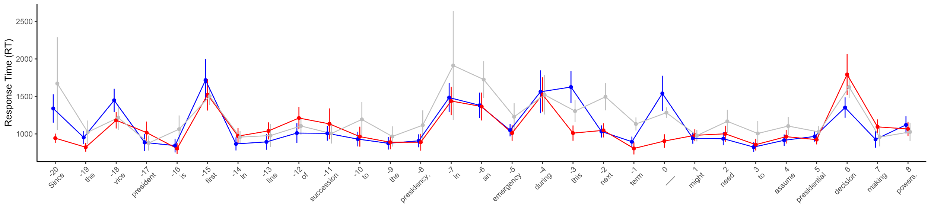
Comprehension
Sentence 1 (pre-election)
she
they
he

Slide 56
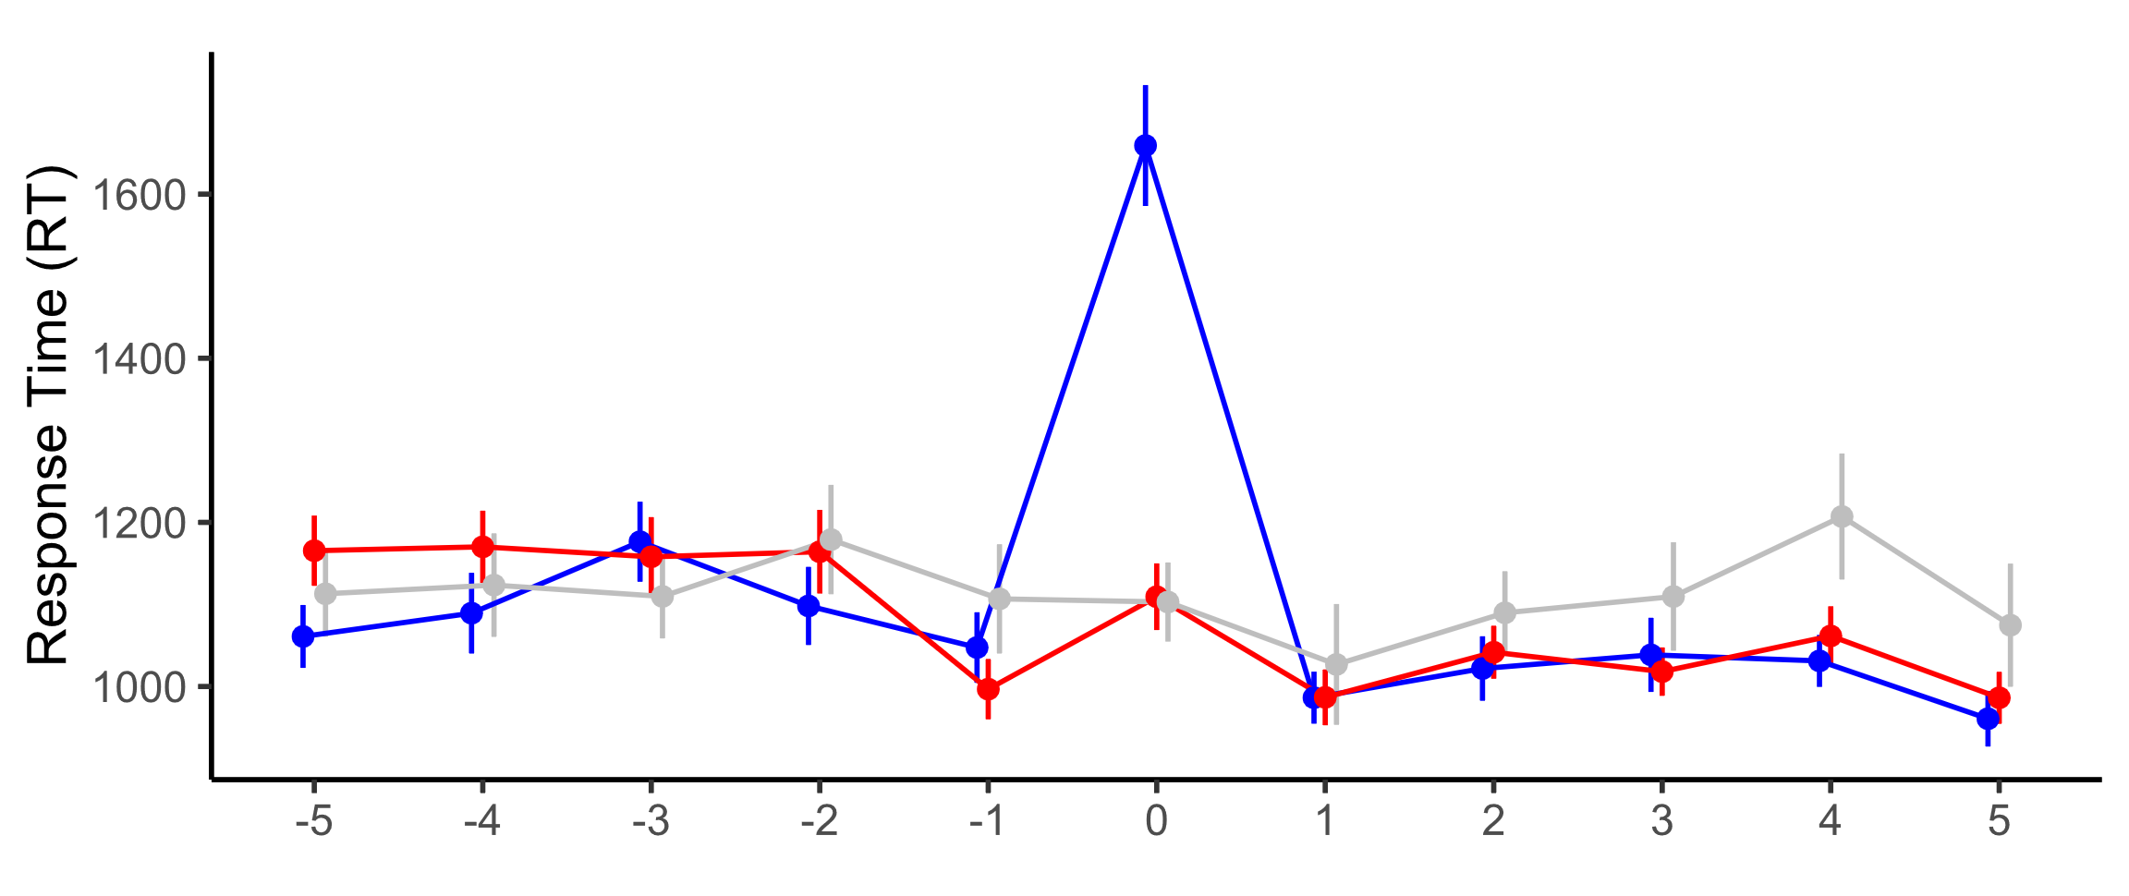
Comprehension
Sentence 1 (pre-election)
she
they
he

Slide 57
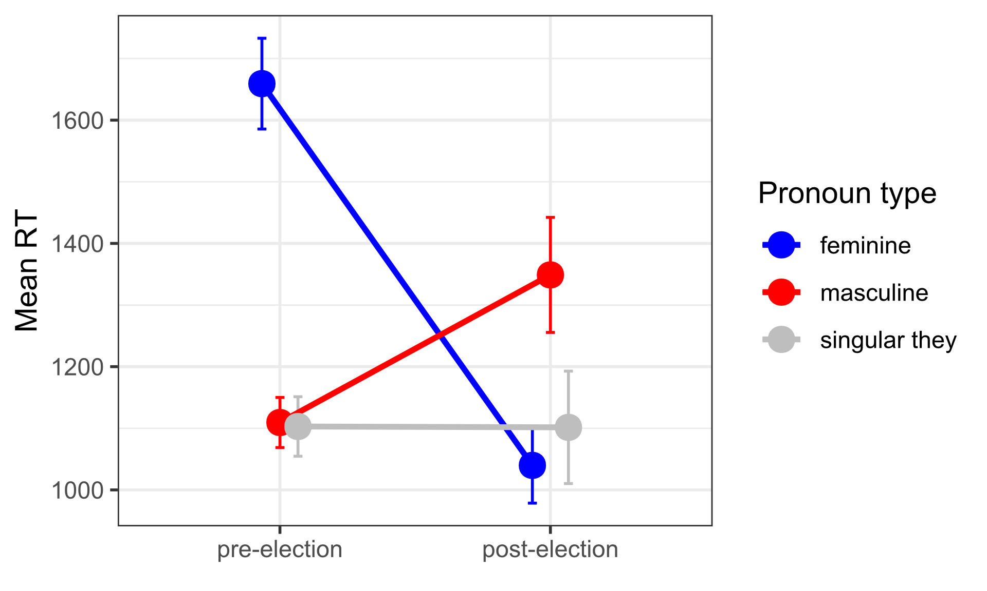
Comprehension
Sentence 1 (pre- vs. post-election)
she
he
he
they
they
she

Slide 58
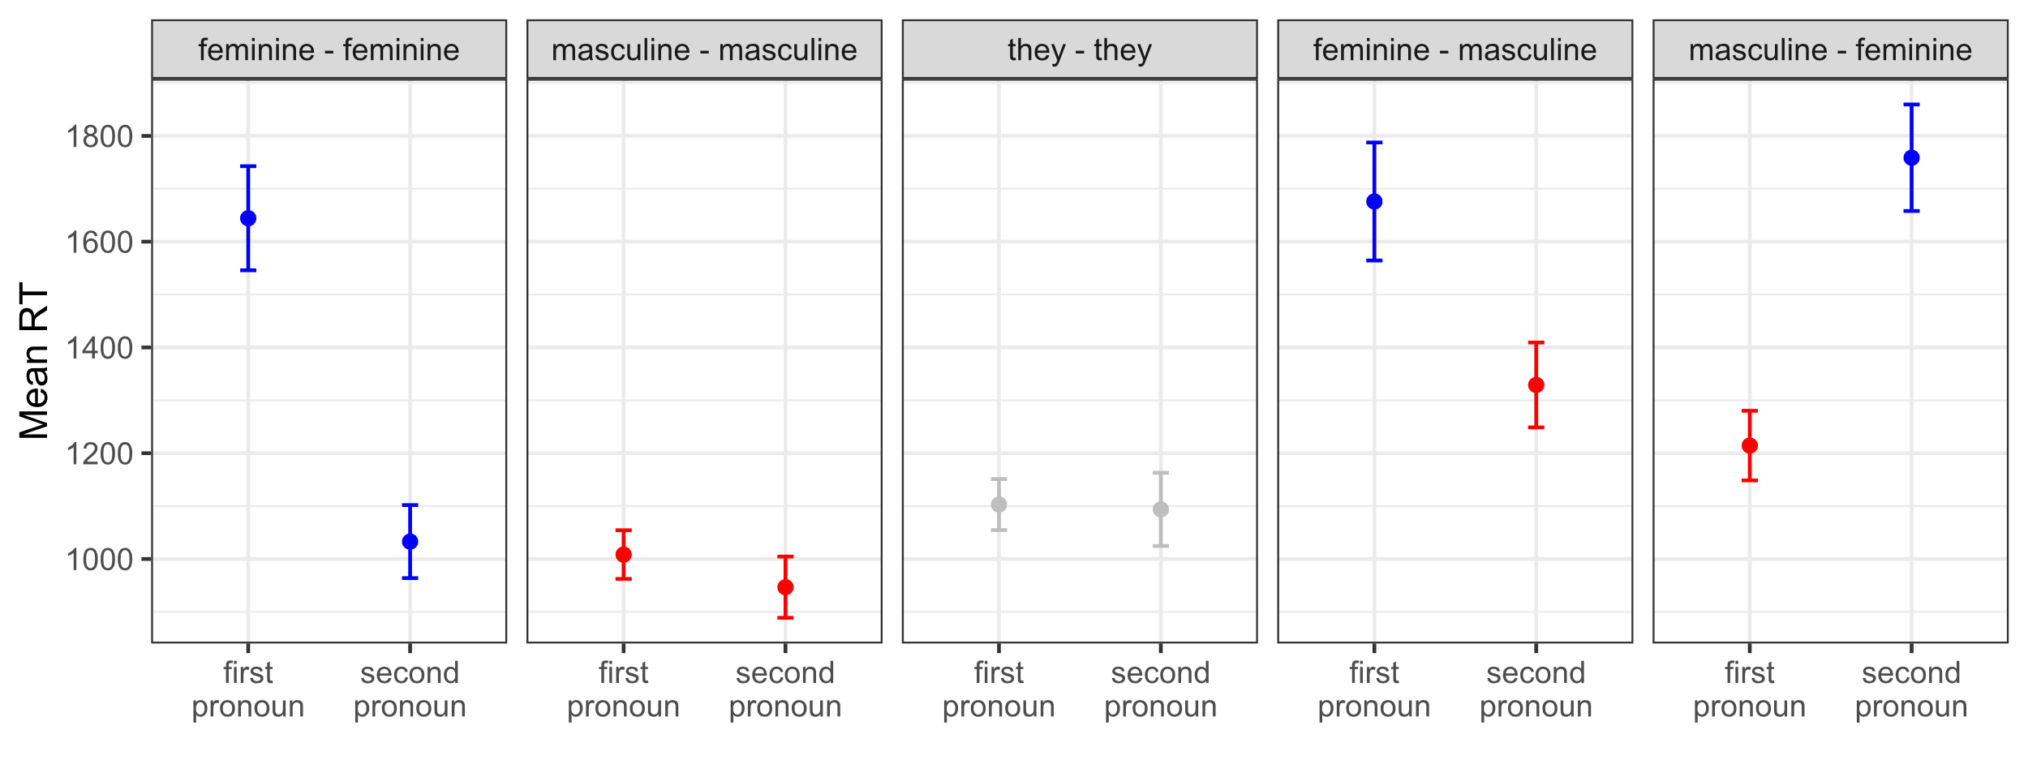
Comprehension
Sentence 1 & 2 (pre-election)

Slide 59
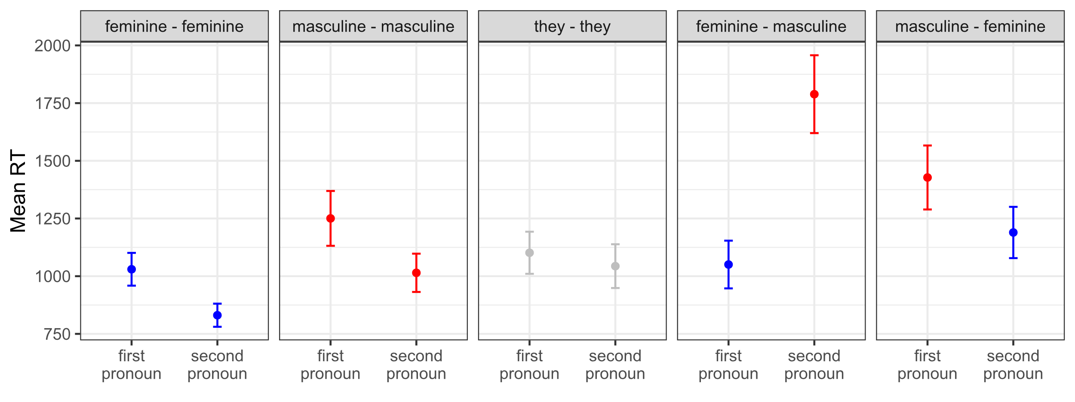
Comprehension
Sentence 1 & 2 (post-election)

Slide 60
Bias against “she” pronouns can be rapidly overcome by changing event expectations

Slide 61
Bias against “she” pronouns can be rapidly overcome by changing event expectations
he
she
he
she

Slide 62
Thank you.
Veronica Boyce
Stanford University
Chelsea Ajunwa
MIT
Titus von der Malsburg
University of Potsdam
Roger Levy
MIT

Slide 63
Experimental items
January 20, 2021, is the start of the next presidential and vice-presidential term in the United States.
Because the vice president breaks ties in the US Senate, if there is a 50–50 party split in 2021 then he|she|they may cast many tie-breaking votes.
Since the vice president is first in line of succession to the presidency, in an emergency during this next term he|she|they might need to assume presidential decision making powers.
The vice president holds nuclear launch codes, which will be a great responsibility for him|her|them to carry as the second in command for the country.
The vice president often represents the US government on international trips, so in February 2021 and later months he|she|they may meet with various heads of state.
Both during travel and at home, the mission of the Secret Service will include protecting the vice president and his|her|their family to ensure their safety.
Air Force Two, the aircraft that transports the vice president, will be well-equipped to guarantee his|her|their safety on both domestic and international flights.

Slide 64
Experimental items (cont’d)
January 20, 2021, is the start of the next presidential and vice-presidential term in the United States.
Because the vice president's role in governance has grown considerably in recent decades, it is likely that during the upcoming term he|she|they will have a lot of work to do in setting priorities.
Since the vice president will serve as a liaison to Congress, we can expect him|her|them to meet frequently with House leadership.
The vice president may or may not make many public appearances in February or March 2021, but surely he|she|they will be very busy in helping set government policy.
Whether or not the vice president gives many speeches during the first months of this term starting in January 2021, it is likely that he|she|they will be closely scrutinized by the media.
It is difficult to predict how coronavirus will affect the vice president's activities in February and March 2021, but he|she|they will likely be involved in the national pandemic response.
If a crisis arises in spring or summer 2021 that requires the vice president's intervention, then he|she|they will need to act quickly and decisively.

Slide 65
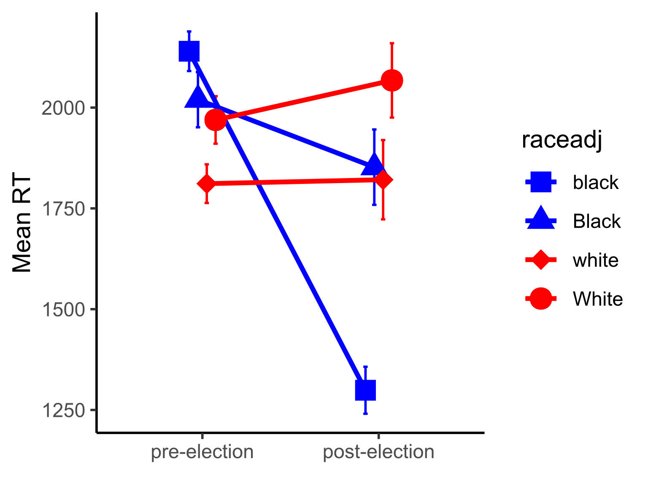
“Mazerace” task: items & results
January 20, 2021, is the start of the next presidential and vice-presidential term in the United States.
The vice president will be black|white|Black|White and this is likely to be mentioned in discussions of US race relations.
The vice president will be a black|white|Black|White person and this is likely to be mentioned in discussions of US race relations.

Slide 66
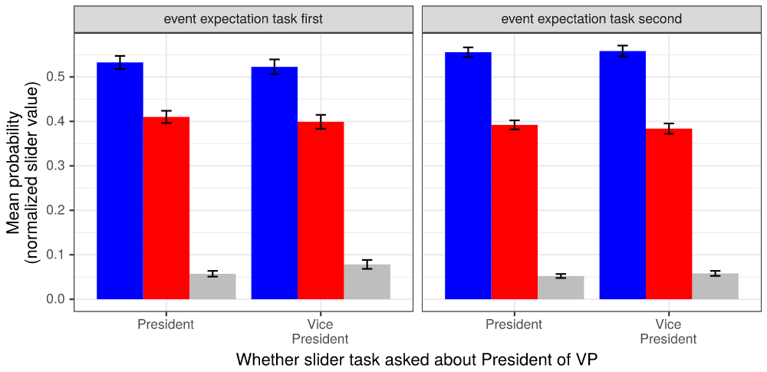
Event expectations (pre-election) by task order & question type
Event expectations by task order & question (pre-election)

Slide 67
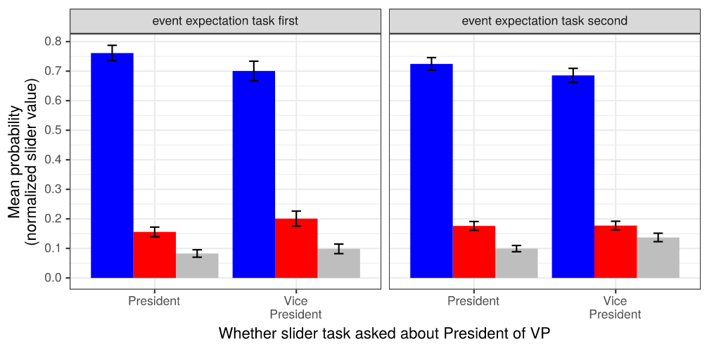
Event expectations (post-election) by task order & question type
Event expectations by task order & question (post-election)

Slide 68
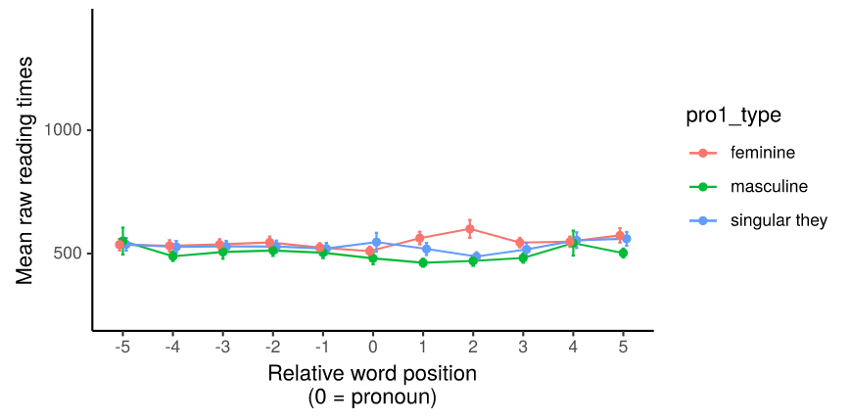
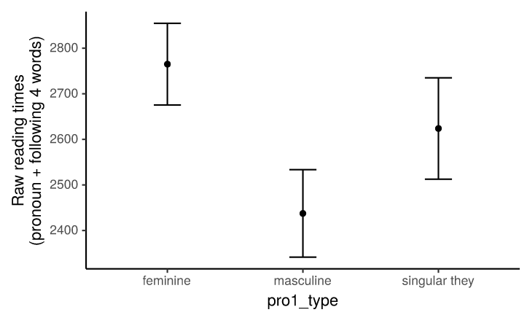
Self-paced reading results (sentence 1, pre-election)

Slide 69
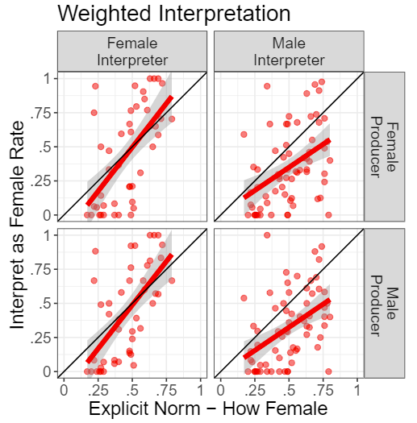
More from Boyce et al. (2019)

Slide 70
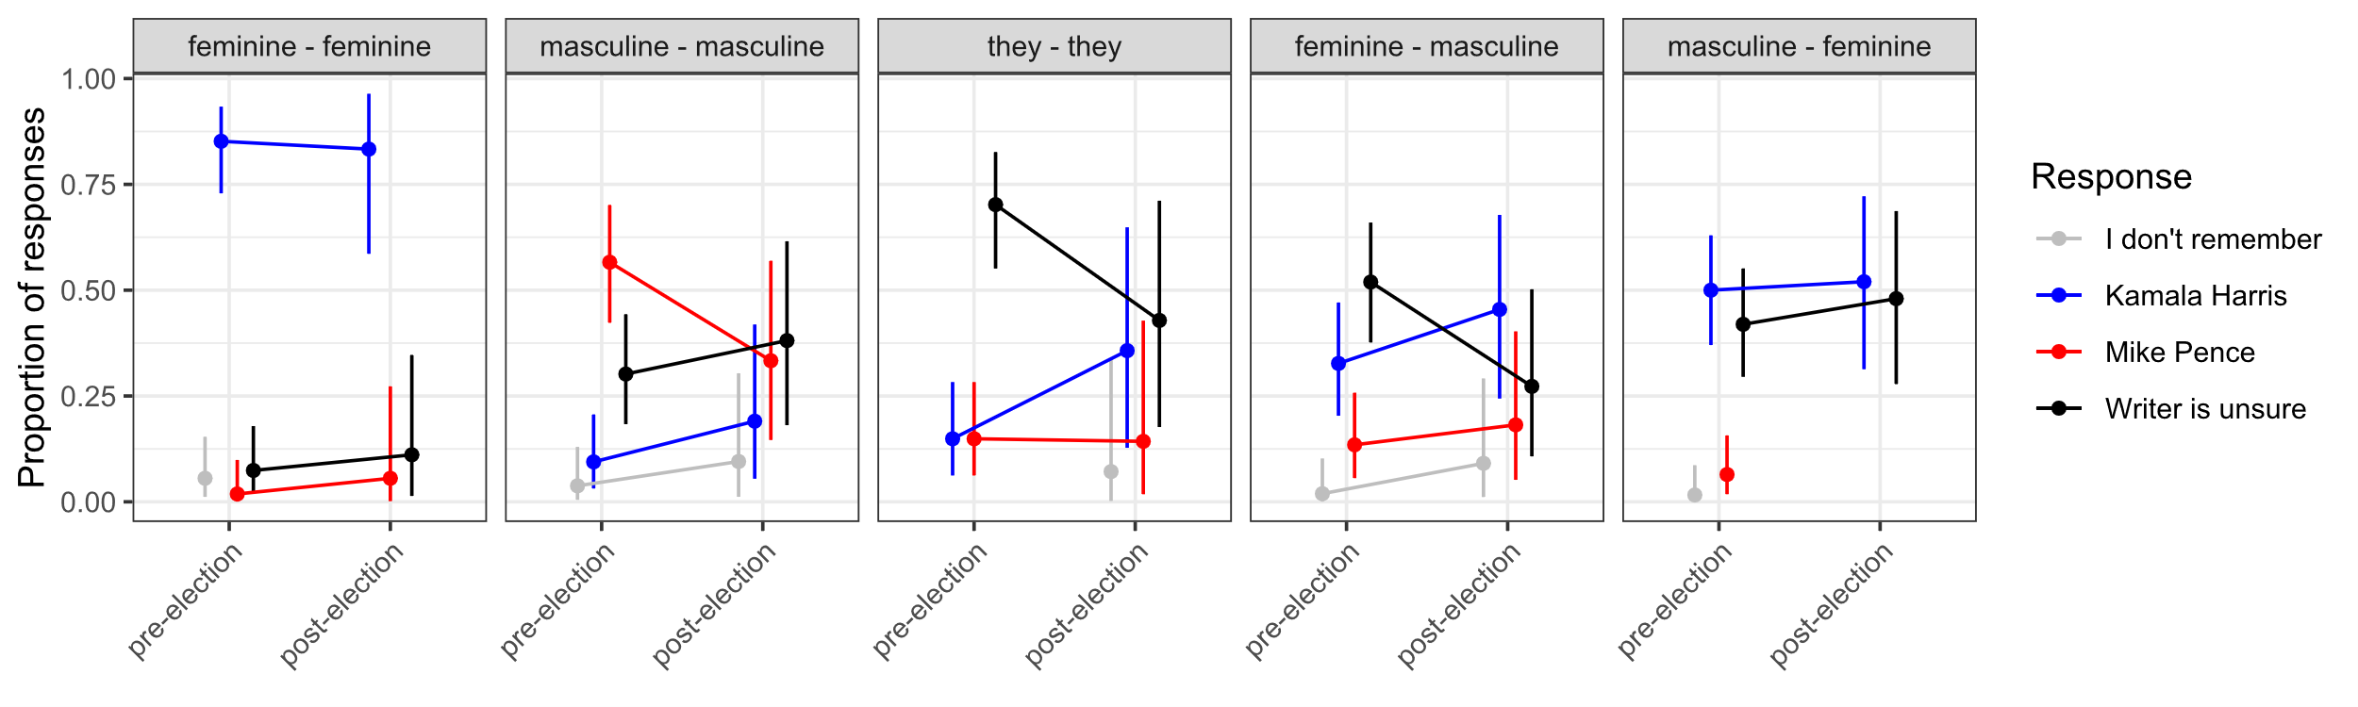
Recall results

