Slide 1

Automated Payroll
Taylor Poulsen | Poulsen Concrete Contractors

Slide 2
The Problem
Collect hours as accurately as possible → group text
Reported daily
Reported to multiple sources for accuracy
Inputs validated and sanitized
Keep track of hours → database
Easy and clean way to view them and/or extract them later for report generation
Generate and send timecards weekly or bimonthly → bash/java program
Gives employees a chance to verify data integrity before direct deposit submission

Slide 3
The Old Way
Receive group texts
Manually look at each of the texts, extract data, put into excel spreadsheet
Each week: copy, paste, text picture of “timecard”
Submit data to payroll company for direct deposit

Slide 4
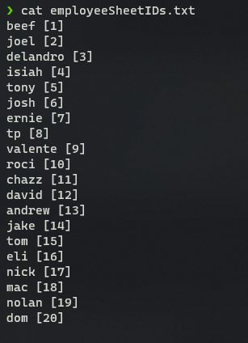
The Current Way
Designed and developed over Christmas break of 2020
Technologies
Bash
xlsx2csv
ssmtp
Java
Excel
My own key-value map for sheet IDs →

Slide 5
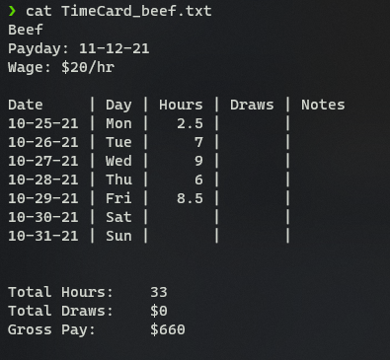
The Current Way
Usage: $0 '<start date> <payday> <# of days in pay period>’
Order of operations
Create new directory for all timecards associated with that payday
Request user input for names of employees to receive timecards (separated by spaces) and store the set in an array
Loop through the array, generating and sending timecards to each person specified:
Get their sheet id number from the map using grep
Convert their sheet, from the excel spreadsheet, to a temporary csv file
Feed the csv to the java program to generate the timecard and write it to a text file →
Convert the timecard to base64 and build the template for ssmpt
Pull a few pieces of data out of the text file for sending the emails
Delete all the temporary files to clean up for next iteration
Send the email and print confirmation to console

Slide 6
The New Way
Current problems and improvements:
I still manually read through dozens of text messages, extract relevant data, and type it into an excel file every week
I want to automate this process using Twilio. A platform that would allow me to purchase a phone line and automate sending and receiving messages from that line using its API
I would also use a different database system as my program pulls data from Twilio. I’m thinking about using postgres and hosting the whole system on Heroku for free as a web app, but am open to other options...
Automate the generation and sending of the timecards according to dates and employee types
It would be nice if I didn’t have to manually get on my computer every weekend and run my program. It could be running all the time and know when certain days are hit that it needs to pull data from the database, build timecards, and send them.
Whenever those days are hit, it would need to send a separate report to me that I would validate and then give to the payroll company to do the direct deposit.
Add lots of error handling and better documentation for the system as a whole

Slide 7
This Is The Way

