Slide 1

K. S. R. College of Engineering (Autonomous) Affiliated to Anna University, Chennai & Approved by AICTE, Delhi Accredited by NAAC with ‘A’ Grade and Accredited by NBA K.S.R. Kalvi Nagar, Tiruchengode – 637215, Namakkal Dt. Tamilnadu.
B. E. - Computer Science and Engineering
BANDWIDTH ENERGY EFFICIENT IMAGE SHARING USING CBRD APPROACH
Presented by Praveen Kumar T P
Project Guide
Mrs.M.K.Nivodhini

Slide 2
ABSTRACT
Traditional techniques for image retrieval are not supported for the ever expansive image database.
These downsides can be removed by utilizing contents of the image for image retieval.
This sort of image retrieval is called as Cross Batch Redundancy Detection (CBRD).
BEES is works with CBRD is focused around the visual features like shape, color and texture.
The Density- Bandwidth Energy Efficient Sharing(BEES) is a stand out amongst the most locally feature detector and descriptors which is utilized as a part of the majority of the vision programming.
We focus texture ,color , shape ,size , string based image matching with better accuracy.
These features include Texture, Color, Shape and Region.
It is a hot research area and researchers have developed many techniques to use these feature for accurate retrieval of required images from the databases.

Slide 3
EXISTING SYSTEM
This is the most common form of text search on the Web. Most search engines do their text query and retrieval using keywords.
The keywords based searches they usually provide results from blogs or other discussion boards.
The user cannot have a satisfaction with these results due to lack of trusts on blogs etc. low precision and high recall rate.
The existing methods mainly focus on evaluating the similarities between a reference image and its non-geometrically variation versions, such as decompressed and brightness/contrast-enhanced versions.
Image Quality of a test image is strongly related to the virtual information present in the image.

Slide 4
ADVANTAGE OF EXISTING SYSTEM
The information can be quantified to measure the similarity between the test image and its reference image.
User intention identification plays an important role in the intelligent semantic search engine.
The similarity assessment is fundamentally important to many multimedia information processing systems and applications such as compression , restoration, enhancement and copy detection etc.,

Slide 5
DISADVANTAGE OF EXISTING SYSTEM
Loss of Global Weighting.
Predefined fixed weights are adopted to fuse the distances of different low-level visual features.
Loss of Adaptive Weighting adaptive weights for query images to fuse the distances of different low-level visual features.
It is adopted by Bing Image Search.
For our new approaches, two different ways of computing semantic signatures are compared.
Not Visual Query-specific visual semantic space using Reciprocal Hash Maps. For an image, a single semantic signature is computed from one SVM classifier trained by combining all types of visual features.

Slide 6
PROPOSED SYSTEM
The proposed system Cross Batch Redundancy Detection (CBRD) uses BEES algorithm the visual contents of an image such as color, shape, texture, and spatial layout to represent and index the image.
Active research in CBRD is geared towards the development of methodologies for analyzing, interpreting cataloging and indexing image databases.
In addition to their development, efforts are also being made to evaluate the performance of image retrieval systems.
The quality of response is heavily dependent on the choice of the method used to generate feature vectors and similarity measure for comparison of features.

Slide 7
ADVANTAGE OF PROPOSED SYSTEM
It Represent all of the descriptors of an image via sparse representation and assess the similarity between two images via sparse coding technique.
The main advantage is, a feature descriptor is sparsely represented in terms of a Dictionary Score or transferred as a linear combination of Dictionary Score atoms, so as to achieve efficient feature representation and robust image similarity assessment.
Best Results.
High accuracy.
High performance in search of related image re-ranking.

Slide 8
ALGORITHMS USED
Cross Batch Redundancy Detection (CBRD)

Slide 9
SYSTEM REQUIREMENTS
HARDWARE REQUIREMENTS:
Processor Type ` : Pentium i3
Speed : 3.40GHZ
RAM : 4GB DD2 RAM
Hard disk : 500 GB
Keyboard : 101/102 Standard Keys
Mouse : Optical Mouse
SOFTWARE REQUIREMENTS:
Operating System : Windows 10
Front end : Netbeans IDE / jdk
Coding Language : Java
Tools : Weka Tools

Slide 10
ARCHITECTURE DIAGRAM
Reference Image
Test Image
Feature Extraction using SIFT
Feature Extraction using SIFT
Scale Space Extrema Detection
Scale Space Extrema Detection
Key Point Localization
Key Point Localization
Orientation Assignment
Orientation Assignment
Descriptor Generation
Descriptor Generation
Dictionary Learning
Dictionary Learning
Sparse Coding Stage
Sparse Coding Stage
Dictionary Update Stage
Dictionary Update Stage
Dictionary Atoms
Information Extraction by
FBSR Similarity Value

Slide 11
LIST OF MODULES
IMAGE PREPROCESSING AND FEATURE EXTRACTION
BEES FEATURE EXTRACTION FOR REFERENCE AND TEST IMAGES
IMAGE ANALYSIS
IMAGE RETERIVAL
Shape Retrieval
SIZE AND TEXTURE SIMILARITY MEASURE

Slide 12
MODULE DESCRIPTION
IMAGE PREPROCESSING AND FEATURE EXTRACTION
In the input module, the feature vector from the input image is extracted and that input image is stored in the image dataset.
The feature vector of each image in the dataset is also stored in the dataset whereas in the second module i.e. query module, a query image is inputted.
After that the extraction of its feature vector is done. During the third module i.e. in the process of retrieval, comparison is performed.
The feature vector of the query image is compared with the each vector stored in the dataset. The features which are widely used involve: texture, color, local shape and spatial information.
There is very high demand for searching image datasets of ever-growing size, this is reason why CBRD is becoming very popular.
BEES FEATURE EXTRACTION FOR REFERENCE AND TEST IMAGES:
BEES transforms image data into scale-invariant coordinates virtual to local features and generates large numbers of features that compactly cover the image over the full range of scales and locations.
Shape is an important visual feature and it is one of the basic features used to describe image content.
However, shape representation and description is a difficult task.
This is because when a 3-D real world object is projected onto a 2-D image plane, one dimension of object information is lost. As a result, the shape extracted from the image only partially represents the projected object.
To make the problem even more complex, shape is often corrupted with noise, defects, arbitrary distortion and occlusion. Further it is not known what is important in shape.

Slide 13
CONT.,
IMAGE ANALYSIS:
In this module that have two functions as below
Scale-space extrema detection
Searches over all scales and image locations.
A difference-of-Gaussian function to identify potential interest points that are invariant to scale and orientation.
Key point localization
A key point has been found by comparing a pixel to its neighbors and is to perform a detailed fit to the nearby data for location, scale, and ratio of key curvatures.
The low contrast points or poorly localized along an edges are removed by key point localization.
IMAGE RETERIVAL:
The key points are transformed into a representation that allows for significant levels of local shape distortion and change in illumination.
The descriptor representation approach assessing the similarity between BEES feature descriptors can be measured by matching their corresponding image by color,shape,size,texture and it will be displayed.

Slide 14
CONT.,
Shape Retrieval
The proposed shape retrieval system based on the automatic segmentations process to get approximate information about the shape of an object.
It begins by segmenting the image into 5 classes depending on their brightness.
Then three attributes: Mass,Centroid and Dispersion for each class are calculated and stored as the shape vector.
For retrieval the vectors of the query image and database images are compared and the most matching images are short listed as results.

Slide 15
CONT.,
SIZE AND TEXTURE SIMILARITY MEASURE
In this algorithm we propose that matching is done on color by color basis. By analyzing histograms, first calculate the number of colors in both query image and database image.
Then both the images are matched by seeing if the proportions of a particular color in both the images are comparable.
The image which satisfies most of the conditions is the best match.
Retrieval result is not a single image but a list of images ranked by their similarities with the query image since CBRD is not based on exact matching.
If I is the database image and I‟ is the query image, then the similarity measure is computed as follows,
1. Calculate histogram vector vI = [vI1, vI2, ….vIn] and ccv vector cI = [cI1, cI2, ….cIn] of the database images.
2. Calculate the vectors vI‟ and cI‟ for the query image also.
3. The Euclidean distance between two feature vectors can then be used as the similarity measurement:
4. If d ≤ τ (threshold) then the images match.
5. From all the matching images we display top 24 images as a result.

Slide 16
INPUTS AND OUTPUTS
INPUT
Input as Image dataset.
OUTPUT
Output as to detect scheduled graph in bit calculation and performance.

Slide 17
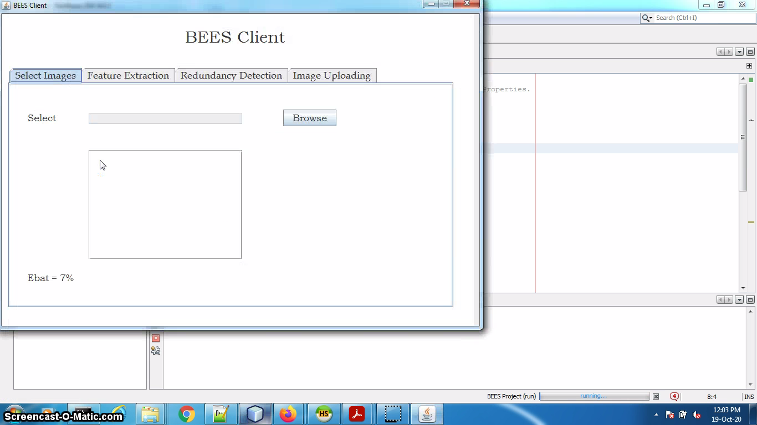
Sample Input

Slide 18
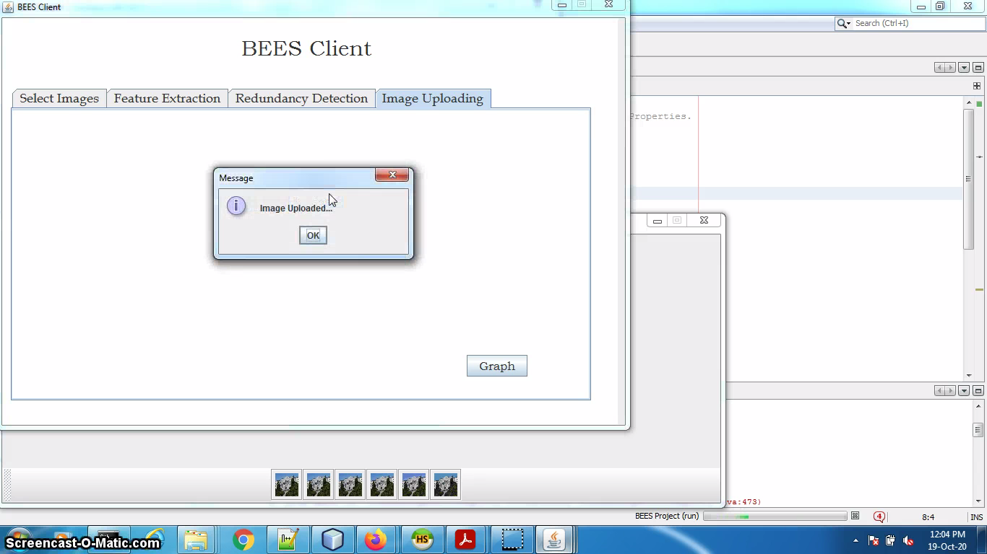

Slide 19
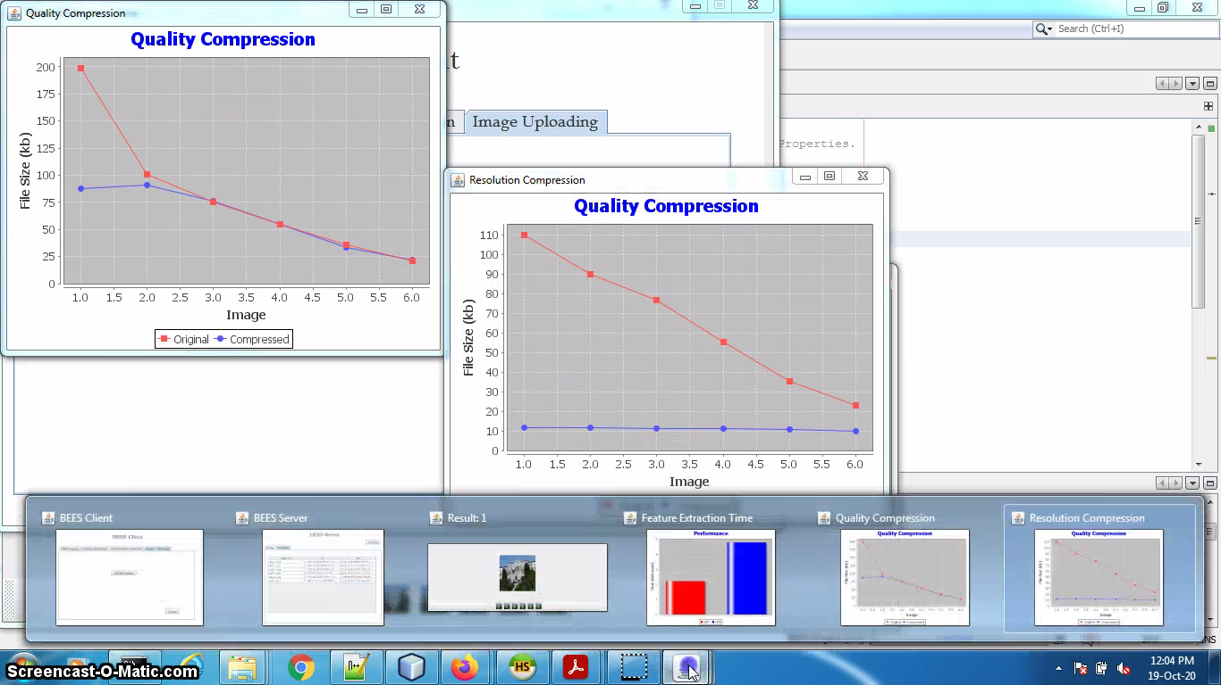
Sample Output

Slide 20
Conclusion and Future Enhancement
In the BEES feature extraction ,BEES transforms image data into scale-invariant coordinates virtual to local features and generates large numbers of features that compactly cover the image over the full range of scales and locations. Thus different redundancy ratios of uploaded images produce different energy overheads. Therefore, we capture the energy overheads when the uploaded images are at different redundancy ratios. The redundancy ratio is defined as the ratio of the number of redundant images in the uploaded images to the total number of uploaded images.We select an image batch with 100 images from the disaster image set as the uploaded images and store the images in the smartphone. We set different cross-batch redundancy ratios 0%; 25%; 50%; and 75%, by adding and removing the redundant images (similar to the uploaded images) into the servers.

Slide 21
References
Li-Wei Kang, Member, IEEE, Chao-Yung Hsu, Hung-Wei Chen, Chun- Shien Lu, Member, IEEE, Chih-Yang Lin, Member, IEEE, and Soo-Chang Pei, (2011) “Feature-Based Sparse Representation for Image Similarity Assessment”, IEEE Transactions on Multimedia, vol. 13, no. 5.
Sivic J and Zisserman A, (2003) “Video Google: A text retrieval approach to object matching in videos,” in Proc. IEEE Int. Conf. Computer Vision, Nice, France, vol. 2, pp. 1470–1477.
]C. Kim, “Content-based image copy detection,” Signal Process.: ImageCommun., vol. 18, pp. 169–184, 2003
Lowe D. G, (2004) “Distinctive image features from scale-invariant keypoints,”Int. J. Comput. Vision, vol. 60, no. 2, pp. 91–110
Ke Y., Sukthankar R and Huston L, (2004) “Efficient near-duplicate detection and sub-image retrieval,” in Proc. ACM Multimedia

Slide 22
Thank You

