Slide 1
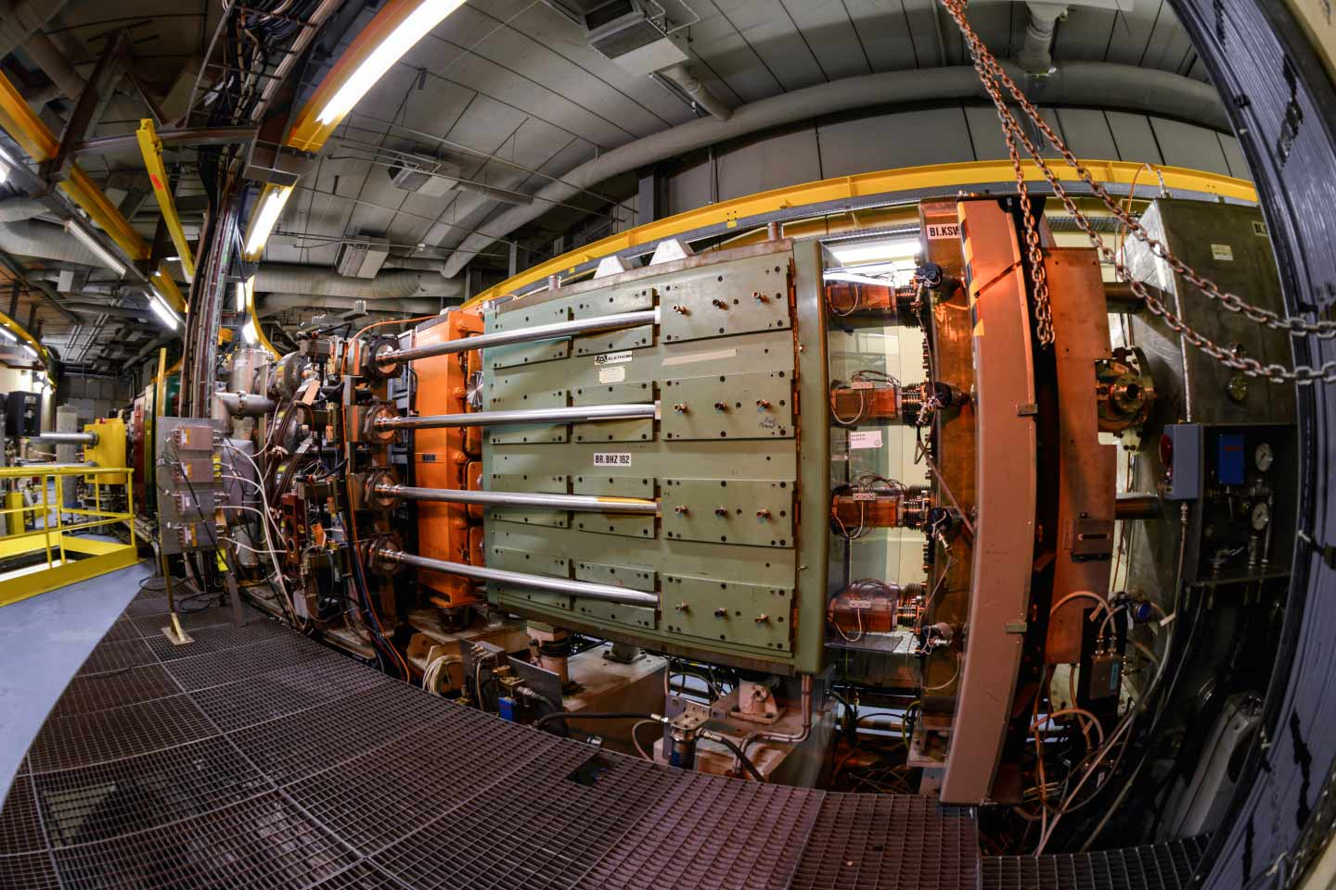
PSB MD studies
F. Asvesta, T. Prebibaj
03-07/06/2024
Advanced Training School on Operation of Accelerators
EURO-LABS Training Sessions @ CERN Facilities

Slide 2
Beam preparation
1) A fixed target experiment is requiring an unbunched beam at 160 MeV with 19-20e10 particles per pulse (ppp) and a vertical normalized emittance of ~0.82-0.87 mm mrad.
Produce a such a beam in the PSB by making use of the charge-exchange multi-turn injection system, the effect of the foil scattering.
Verify the beam parameters near the extraction of the PSB using the available instrumentation.
ATSOA 2024
tirsi.prebibaj@cern.ch

Slide 3
Tune measurement and correction
2) Beam Loss Monitor (BLM) values are relatively high inside the ring. Try to optimize the betatron tunes throughout the PSB cycle.
Set the betatron tunes constant at a resonance free region (e.g. Qx=4.17, Qy=4.23) using the tune application.
Measure the tunes using the Base-Band-Q (BBQ) system. How different is the measured from the set tune? Why do you think that is?
Correct the tune to the set value using the tune correction application. Verify your correction.
ATSOA 2024
tirsi.prebibaj@cern.ch

Slide 4
Bunching and longitudinal parameters
3) The experiment requires a bunched beam instead of an unbunched, with the same beam characteristics and a horizontal emittance of ~1.3 mm mrad.
Enable the RF cavities to capture the beam.
Verify that the beam is bunched using the Tomoscope application and then, measure the longitudinal beam parameters (dp/p, energy spread, bunch length, bunching factor).
Measure the horizontal emittance near extraction of the PSB. Subtract the dispersive part by using the measured RMS momentum spread (dp/p).
Is there a difference in the horizontal/vertical emittance when bunched and unbunched (assuming the same dp/p).
ATSOA 2024
tirsi.prebibaj@cern.ch

Slide 5
Resonance compensation
4) To accumulate the large space charge tune spread, and the interaction with the strongly excited integer resonance, the tune near injection needs to be moved at higher values and then dynamically ramped down to the resonance free region. This results in the crossing of higher order, relatively weaker (but not negligible), resonances. These need to be corrected using higher order multipole magnets.
Program a very slow tune ramp to cross the resonance xx. Do you observe the losses? What kind of errors can excite such a resonance?
Write a script with pyjapc to vary the strengths of the multipole correctors and monitor the losses.
Analyze the data to find the optimal configuration of the multipoles that compensates the resonance.
Apply the settings in the machine and verify that the transmission is much better.
Make the tune crossing faster? Do the losses disappear completely?
ATSOA 2024
tirsi.prebibaj@cern.ch

Slide 6
Chromaticity measurement
5) Correct the vertical chromaticity in the PSB.
Measure the horizontal and vertical chromaticity in the PSB using the BBQ application.
Calculate the RMS chromatic tune spread using the dp/p measured previously.
Use the PSB simulation model in Xsuite to predict a correction of the vertical chromaticity. Apply this correction to the sextupoles of the PSB.
Verify that the chromaticity has been corrected using the BBQ application.
ATSOA 2024
tirsi.prebibaj@cern.ch

Slide 7
Beta-beating measurement
6) Beta-beating measurement at injection. Beta-function measurement at QDE3?
ATSOA 2024
tirsi.prebibaj@cern.ch

