Slide 1
Board Game Recommender
Thomas Prich

Slide 2
FEATURES OF THIS TOPIC
1. How it was Built
2. Fun Facts
3. The App
4. Going Forward
From gathering the data to how it chooses games.
What do the top 1,000 board games look like?
Hello, I want to play a game.
To infinity, and beyond!

Slide 3
How it was Built
Gathering the data from BoardGameGeek:
Scraped for top 1,000 board games
User Reviews - GeekDo API (2 weeks)
11,170,197 total reviews
Scraped for Categorical Data (3 hours)

Slide 4
User-based Recommender
02
Sparse Matrix
Generate sparse matrix and calculate cosine similarities
03
01
Recommender
Combine CSVs
Create dataframe of similarities and create function to query dataframe.
Merge individual game CSVs and create a pivot table

Slide 5
Categorical Filter
03
Filter Function
01
Clean the Data
Create a function to filter games dataframe to get results
Clean data and fix any nulls or incorrect scapes.
02
Get Ranges/Lists
Determine the range of values and lists of all data that can be used to filter the games by

Slide 6
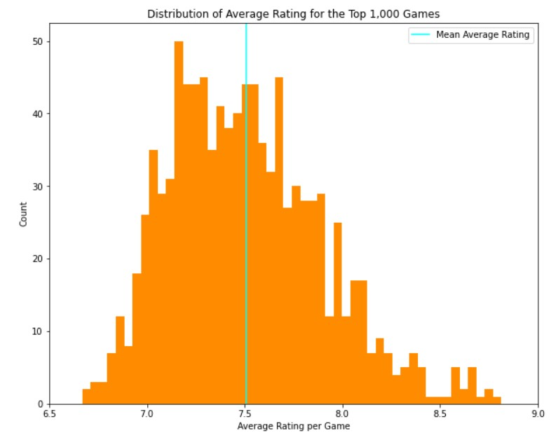
Fun Facts

Slide 7
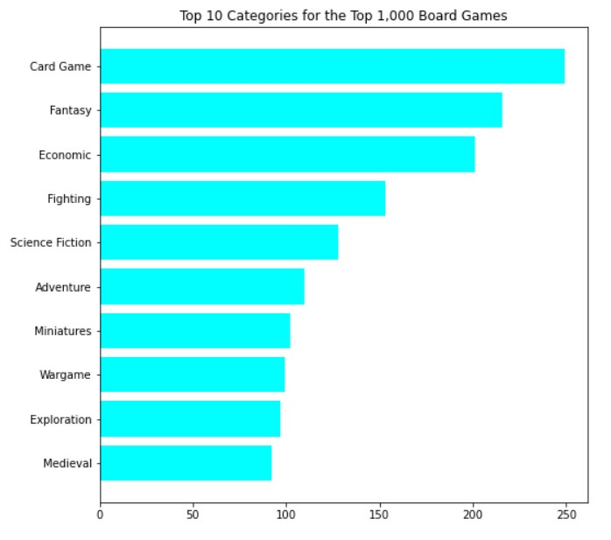

Slide 8
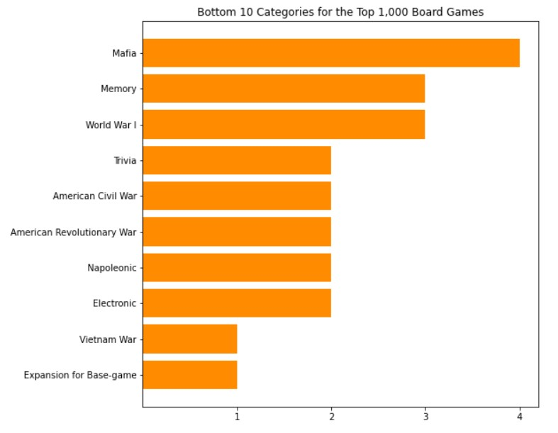

Slide 9
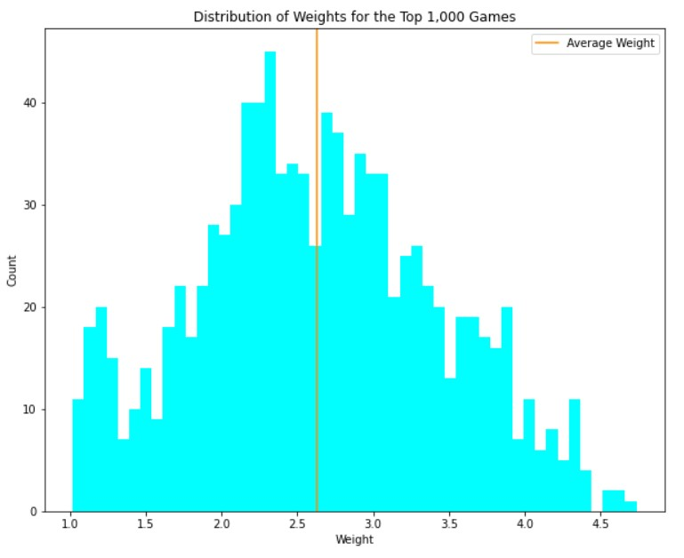

Slide 10
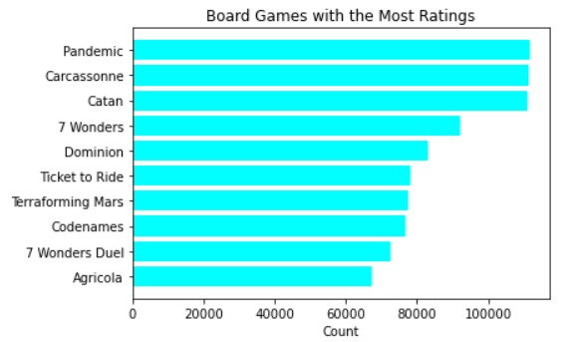

Slide 11
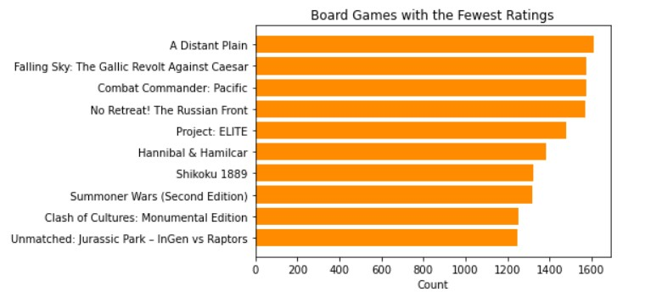

Slide 12
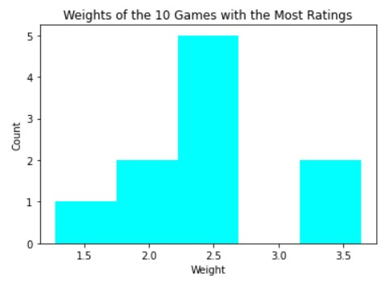
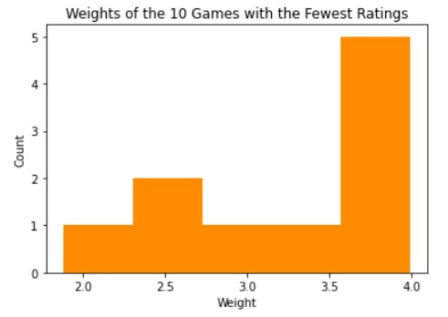
Average Rating
7.69
Average Rating
8.13

Slide 13
LET’S PLAY A GAME!

Slide 14
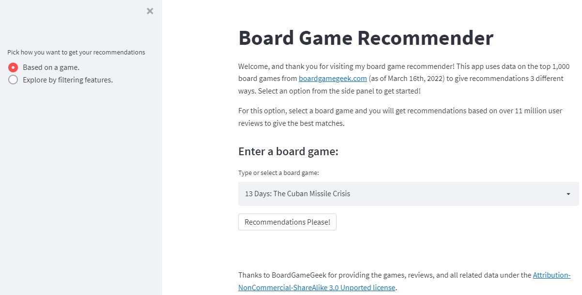
The App
https://share.streamlit.io/tprich/board_game_recommender/main/streamlit_app/recommender_app.py

Slide 15
Going Forward
Add in Mechanics to the filter
Add section to both filter and search by game
More games!
Fine tune the app to be more efficient.

Slide 16
THANKS!
Thanks to BoardGameGeek for providing the games, reviews, and all related data under the Attribution-NonCommercial-ShareAlike 3.0 Unported license.
Do you have any questions?
Email: thomasprich.datascience@gmail.com
LinkedIn: https://www.linkedin.com/in/thomas-prich

