Slide 1

This is a cover with photos for large companies
You can have subtitle Presentation on many lines.

Slide 2
A concrete application of a custom OTA system upgrade
And a state of the art of the available open sources solution
Meetup – 16/01/2018

Slide 3
1 Who am I?
2 What does Sigfox do?
3 What is a base station?
4 What are the base station constraints?
5 Why we choose to implement a custom solution?
6 How our update system works
7 Issues of our solution
8 Quick comparison with open sources solutions

Slide 4
1
Who am I?

Slide 5
Who am I?
A Sigfox employee for three years
My main activities:
  New platform integration
  Build system
  Board support packages
  Core system features (e.g OTA, measured boot, encryption…)
Free software enthusiast
Contributor in my free time

Slide 6
2
What does Sigfox do?

Slide 7
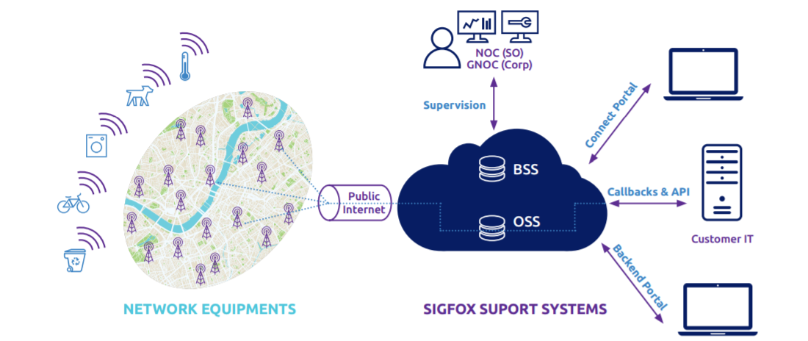
What does Sigfox?
Deploy a worldwide IoT network
  Several thousand of base stations
  +36 countries
Offer data services
Etc.

Slide 8
3
What is a Sigfox base station?

Slide 9
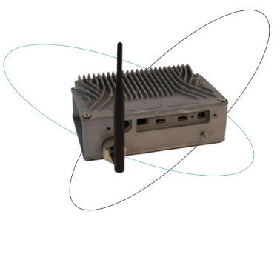
What is a Sigfox base station ?
Access point which receive messages from devices to send them to our cloud.
Hardware
  CPU X86-64 / ARMv7 / ARMv8
  RAM >= 1GBytes
  Watchdog
  SSD / eMMC / NAND >= 1GBytes
  RADIO USB / SPI
  Dual connectivity
  TPM
Software
  Measured boot
  Verified boot
  Full encrypted
  Fallback mechanism
  Strongswan IPSec
  Monitoring

Slide 10
4
What are the base station constraints?

Slide 11
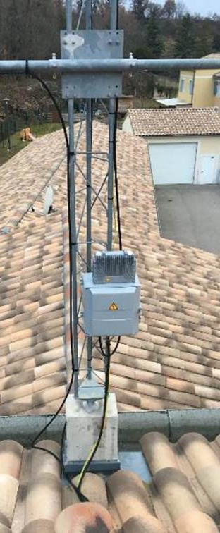
What are the base station constraints?
Can be upgradable without human intervention => Over the air upgrade
Service availability should be maximum => Upgrade should be symmetric
Lightweight Payloads usage => partial image based, tiny image size
Failure resilience => Upgrade must be restarted at last step reached
Configuration files can evolve => Require two persistent data partitions
Failsafe upgrade => Fallback mechanism, slot must be functionally validated
Security => Integrity verification, full encrypted filesystem
Performance => System loaded in RAM
NB. A base station update may take several days when the connection is very slow.

Slide 12
5
Why we choose to implement a custom solution?

Slide 13
Why we choose to implement a custom solution?
6 years ago, there was no viable open source solution
First implementation in base station prototype, had to be maintained
  Using a custom Slack distribution
  In inaccessible places
  Without rollback mechanism
  Need to quickly put in place a solution
Now
  Using OE build system
  ~3K lines of code

Slide 14
6
How our upgrade system works

Slide 15
How our system upgrade works
Use rsync over SSH:
Make a local rsync
Make a remote rsync through a ssh connection to our infrastructure
Create a compressed squash image of the rootfs
Encrypts this squash image using a unique key through the TPM
Re-encrypt the data partition associated at this new version
Update bootloader flags
Reboot
Run post-upgrade tasks at boot
Validate functionally the slot after few minutes

Slide 16
7
Issues of our solution

Slide 17
Issues of our solution
Upgrade is not atomic
  Persistent data partitions patch/merge at first boot after update
Custom integrity solution
  We would replace it by IMA/EVM
Cannot stores file security labels in xattrs
  Required to enable access control security policies (e.g SELinux...)
Downgrade is not possible
Use file-level incremental synchronization
  We would to use block-level incremental synchronization instead.

Slide 18
8
Quick comparison with opensource solutions

Slide 19
Why we like to use an open source solutions?
In order to:
improve portability and maintainability
contribute and benefit from help of the community

Slide 20
Quick comparison with open sources solutions
Name | fallback | symmetric | atomic | technique | Data partition | bootloader | Type | Comm. | Verification
Sigfox Update | Yes | Yes | No | Partial image | 2 | Grub / Barebox / U-boot | File-based | http2 + ssh | Custom TPM integrity verification
Mender | Yes | Yes | Both | Full image | 1 | U-boot | Block-based | https enforced | Signed
Ostree | Yes | Yes | No | Docker file delta | 1 | Grub / U-boot | File-based | https | Signed
RAUC | Yes | Both | Both | Full image | 1 | Grub / Barebox / U-boot | Block-based / File-based | https / ssh | x509
swupdate | No | Both | No | Full image | 1 | Grub / U-boot | Block-based / File-based | https | Signed / encrypted
swupd | No | No | No | Full image | 1 | Grub | File-based | https | IMA / Signed / Smack / SELinux...
resin | Yes | Yes | Yes | Docker file delta | 1 | Grub / U-boot | File-based | https | Two-factor /

Slide 21
Questions ?

Slide 22
Thank you!

