Slide 1
SELLING PROFESSIONAL DEVELOPMENT TECHNIQUES AT A HOSTILE SHOP
#SA1D, Process & Tools
Terrence Ryan
www.numtopia.com/terry

Slide 2
Introduction

Slide 3

About The Problem
Change your organization
Accept Status Quo
Find a new job
Notes:
You’ve drank the koolaide.
But your co-workers won’t.
You have three choices…
CF.Objective() 2008
Author Name, Company & Website/Email

Slide 4

About Me
Terrence Ryan
  Formerly Manager of Web Application Environment for the Wharton School
  Responsible for hardware, server configuration, code review process, best practices, boilerplates… etc.
Notes:
CF.Objective() 2008
Author Name, Company & Website/Email

Slide 5
About My Employer
Wharton School of Business
    #1 business school in the world
    Use technology as our competitive advantage
    Have won Adobe MAX awards
    Still have these issues from time to time
Your organization isn’t lost just because you have these issues

Slide 6
About My Employer
Wharton School of Business
    #1 business school in the world
    Use technology as our competitive advantage
    Have won Adobe MAX awards
    Still have these issues from time to time
Your organization isn’t lost just because you have these issues

Slide 7
Two Notes
Before we get started, there are two things to acknowledge

Slide 8
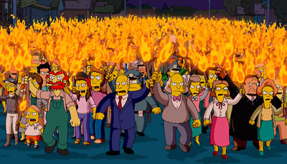
It is NOT Hostility

Slide 9
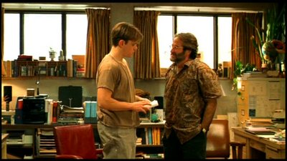
It is NOT a technical problem

Slide 10
The Techniques
Just what do you mean by Professional Development Techniques?

Slide 11
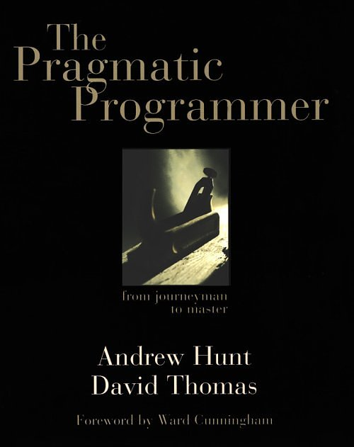
Short Definition
  Anything you would find mentioned in “The Pragmatic Programmer”

Slide 12
Longer Definition
Any technique that speeds up coding, reduces bugs, standardizes code, etc.
Company Wide Standards
Source Control
Object Oriented Coding
Design Patterns
Code Generation
Frameworks
Unit Testing
Automation

Slide 13
How difficult are they to sell?
Easier
  Source Control
  Company Wide Standards
Middle of the Road
  OO
  Design Patterns
  Code Generation
  Automation
  Frameworks
  Code Reviews
Hardest
  Unit Testing

Slide 14
The Process
How do you do this thing?

Slide 15
Overview of the Process
  Identify the Cast of Personas
  Match Personas to Tactics
  Apply tactics in broader Strategy

Slide 16
The Personas
Who are the people in your neighborhood?

Slide 17
Personas
The Uniformed
The Herd
The Healthy Cynic
The Time Crunched
The Burned
The Boss
The Hostile

Slide 18
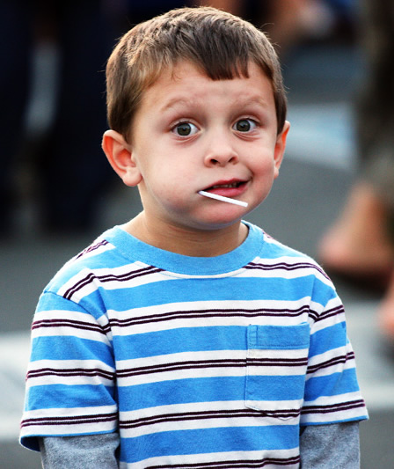
The Uninformed
Symptoms
  Don’t know
Cause
  Never came across it
Prognosis
  Easy to change
  Initial change likely to be other persona

Slide 19
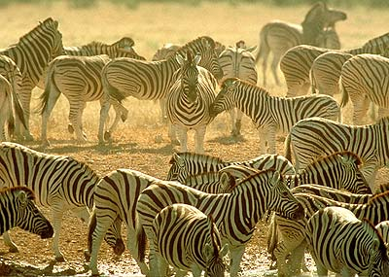
The Herd
Symptoms
  “No one told us to use the technique.”
  “Are we allowed to do that?”
Cause
  Look to a strong leader to tell them what to do
Prognosis
  Easiest to change
  You have to be willing to lead

Slide 20

The Healthy Cynic
Symptoms
  Have not tried technique
  Question effectiveness
  Question degree of effectiveness
Cause
  Do not believe
  Doubt without proof.
Prognosis
  They can be converted with miles and miles of proof

Slide 21
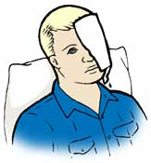
The Burned
Symptoms
  Had past failures with technique.
Cause
  Umm… Past failures
Prognosis
  Hard to change
  Can be done if you prove previous implementation was
    misapplied
    flawed
    deficient
Notes:
Tell fusebox story
CF.Objective() 2008
Author Name, Company & Website/Email

Slide 22

The Time-Crunched
Symptoms
  “I don’t have time for it”
Cause
  Do not believe they can afford the time to learn and implement
Prognosis
  They can be converted if you prove that technique will save them time

Slide 23
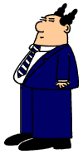
The Boss (Management)
Symptoms
  Don’t care about this level of detail
Cause
  Not really their bailiwick
Prognosis
  Hit or miss
  Make your solution a fix to their problems
Notes:
CF.Objective() 2008
Author Name, Company & Website/Email

Slide 24

The Hostile
Symptoms
  Aggressively fight any attempts to introduce method
  Hides as another type
  Brings up objections that don’t conform with previous behavior
Cause
  internal politics
  control issue
  interpersonal problems.
  Your best guess
Prognosis
  Cannot be reasoned with, cannot be bargained with, and they absolutely will not stop until your excitement is dead.

Slide 25

The Converted
Symptoms
  Nod vigorously when you suggest something
Cause
  Intelligence
  Wisdom
  Charisma
Prognosis
  Will definitely roll d20
  Might evolve into glowing energy beings

Slide 26
The Tactics
What do we focus on?

Slide 27
Focus on Self
Use these techniques for yourself
Don’t wait for your organization
Gain an expertise not just a familiarity
Notes:
Example: Don’t say “we should use Fusebox.” become a local expert on Fusebox, the details of using it, and the possible pitfalls. That way when others are learning, they are less likely to fall off the learning curve because of an obstacle.
CF.Objective() 2008
Author Name, Company & Website/Email

Slide 28
Focus on Self - Example
Tim wanted his team to use source control. They refused, so he did it for himself and himself only. The shared development server suffered a disk failure and had to be restored from a backup. At the response meeting the next day everyone reported they were a day behind due to the failure - except Tim.
People started asking Tim about this source control thing….
Notes:
CF.Objective() 2008
Author Name, Company & Website/Email

Slide 29
Focus on Self - Personas
Effective on:
Uninformed
Herd
Healthy Cynic
Notes:
Example: Don’t say “we should use Fusebox.” become a local expert on Fusebox, the details of using it, and the possible pitfalls. That way when others are learning, they are less likely to fall off the learning curve because of an obstacle.
CF.Objective() 2008
Author Name, Company & Website/Email

Slide 30
Focus on Delivery
Be passionate
Don’t be zealous
“Have you tried…” vs “You should…”
Notes:
The only people that like zealots are other zealots who believe exactly the same thing.
Say it in a sentence that cannot be disagreed with.
“Have you tried Unit Testing for this problem?” is harder to knee jerk disagree with than “You should use Unit Testing”
Therefore it helps with the hostile, in that it blocks them from getting uppity.
CF.Objective() 2008
Author Name, Company & Website/Email

Slide 31
Focus on Delivery - Example
Patrick uses CFUnit. Upon discovering Patrick used CFUnit, John launched into a diatribe about how CFCUnit is so much better, and he thinks CFUnit’s code base is inferior and etc…
Patrick resisted using CFCUnit for months. When forced to because of a client, it turned out he much preferred it.
Notes:
The only people that like zealots are other zealots who believe exactly the same thing.
Say it in a sentence that cannot be disagreed with.
“Have you tried Unit Testing for this problem?” is harder to knee jerk disagree with than “You should use Unit Testing”
Therefore it helps with the hostile, in that it blocks them from getting uppity.
CF.Objective() 2008
Author Name, Company & Website/Email

Slide 32
Focus on Delivery - Personas
Effective on:
Uninformed
Healthy Cynic
Hostile
Notes:
The only people that like zealots are other zealots who believe exactly the same thing.
Say it in a sentence that cannot be disagreed with.
“Have you tried Unit Testing for this problem?” is harder to knee jerk disagree with than “You should use Unit Testing”
Therefore it helps with the hostile, in that it blocks them from getting uppity.
CF.Objective() 2008
Author Name, Company & Website/Email

Slide 33
Focus on the Problem
Abandon specific solutions
Examine problem in context of your environment
Notes:
Don’t push ModelGlue when what you need an MVC framework
Don’t push Transfer when what you need is an ORM
CF.Objective() 2008
Author Name, Company & Website/Email

Slide 34
Focus on the Problem - Example
Group needed Source Control
Andy had his heart set on using Subversion
The rest of the group resisted
After some digging Andy discovered that most of his team had experience with Visual Studio
Andy tried recommending VSS
Group took to it
Group is now using Source Control
Notes:
Don’t push ModelGlue when what you need an MVC framework
Don’t push Transfer when what you need is an ORM
CF.Objective() 2008
Author Name, Company & Website/Email

Slide 35
Focus on the Problem - Personas
Effective on:
Healthy Cynic
Burned
Notes:
Don’t push ModelGlue when what you need an MVC framework
Don’t push Transfer when what you need is an ORM
CF.Objective() 2008
Author Name, Company & Website/Email

Slide 36
Focus on Demonstration
Show, don’t tell
Write an application in a weekend
Solve a group problem
Notes:
Improv Story
Conducted story
Tim was sad
Vs
Tim shuffled down the street, his shoulders slumped. He lazily kicked at a rock, while staring at a wallet picture of Claire, the red-headed girl who just dumped him.
One is telling you he is sad, one is showing you he is sad. Which one is more compelling?
This method works really well with productivity boosters like code generators, frameworks, and some automation.
Probably the single most important thing to do.
This method works really well on the Time-Crunched and Healthy Cynics
Mention holding onto constraints can boost creativity according to some industry experts. (37 Signals)
Mention the 48 hour film project. There are a few crazy coding contests like that.
CF.Objective() 2008
Author Name, Company & Website/Email

Slide 37
Focus on Demonstration - Example
Ed had created a code generation scheme that allowed him to whip up applications lightning fast.
His boss never supported his efforts to develop it.
One Friday, Ed’s boss floated an idea about an internal application past him. Ed created it over the weekend with his code creation tool, while watching a Law & Order marathon.
On Monday, Ed showed his boss the new application. He was stunned.
Ed’s boss no longer questions Ed spending time on his code generator
Notes:
This method works really well with productivity boosters like code generators, frameworks, and some automation.
Probably the single most important thing to do.
This method works really well on the Time-Crunched and Healthy Cynics
Mention holding onto constraints can boost creativity according to some industry experts. (37 Signals)
Mention the 48 hour film project. There are a few crazy coding contests like that.
CF.Objective() 2008
Author Name, Company & Website/Email

Slide 38
Focus on Demonstration - Personas
Effective on:
Uninformed
Herd
Time Crunched
Healthy Cynic
Burned
Management
Notes:
This method works really well with productivity boosters like code generators, frameworks, and some automation.
Probably the single most important thing to do.
This method works really well on the Time-Crunched and Healthy Cynics
Mention holding onto constraints can boost creativity according to some industry experts. (37 Signals)
Mention the 48 hour film project. There are a few crazy coding contests like that.
CF.Objective() 2008
Author Name, Company & Website/Email

Slide 39
Focus on Compromise
Remove restrictions in return for using technique
Especially if technique obviates restriction
Notes:
CF.Objective() 2008
Author Name, Company & Website/Email

Slide 40
Focus on Compromise - Example
Joe discovered and fell in love with Reactor.
Joe’s company had that pesky “stored procedure rule.” It was due to issues with SQL injection they had a few years ago.
Joe suggested that they drop the stored procedure only rule for projects using Reactor, since under the covers it uses cfqueryparam which delivers the same benefits.
Joe’s happy using Reactor, as are developers who hated writing stored procedures
Notes:
CF.Objective() 2008
Author Name, Company & Website/Email

Slide 41
Focus on Compromise - Personas
Effective on:
Time Crunched
Notes:
CF.Objective() 2008
Author Name, Company & Website/Email

Slide 42
Focus on Synergy
Connect implementing your technique with a larger concern
  Security
  Regulations Compliance

Slide 43
Focus on Synergy - example
Bob was trying to encourage the use of Coldspring
A new edict came down that all database reads and writes in a particular application had to be logged.
Bob convinced people to accomplish this through the Aspect Oriented Programming side of ColdSpring instead of re-writing entire application

Slide 44
Focus on Synergy - Personas
Effective on:
Management

Slide 45
Focus on Pressure
Network Externalities
  Electronic peer pressure
  Create a solution that people really need that relies on your technique

Slide 46
Focus on Pressure - Example
Charles used SVN + ANT for his builds but no one else would.
He developed a killer set of components for laying out a site according to the company template
People wanted to use it.
Charles let them, as long as they pulled down the changes from SVN. Oh and by the way, this ANT script makes this really easy….

Slide 47
Focus on Pressure - Personas
Effective on:
Uninformed
Herd
Time Crunched
Healthy Cynic
Burned

Slide 48
Focus on Bridging
Create something enticing that is halfway between where you are and where you want to be
  Bridging Framework

Slide 49
Focus on Bridging - Example
I wanted to use ModelGlue 2 for scaffolding.
I got a lot of resistance
I built Squidhead
  Same
    Scaffolding
    DAO/Gateways
  Different
    Not MVC
    Stored Procedures
    Foreign Keys

Slide 50
Focus on Bridging - Personas
Effective on:
Time-Crunched
Herd

Slide 51
Focus on Publicity
Get your code reviewed
Open Source your solution
Apply for awards

Slide 52
Focus on Publicity - Example
Jim wasn’t getting any traction internally for his bug tracking system.
He open sourced it.
The small subset of users around the world that wanted to track bugs like Jim used it, loved it, and blogged about it
When word got back to management that Jim’s solution was being used world-wide the question was - why weren’t they using it.

Slide 53
Focus on Publicity - Personas
Effective on:
Uninformed
Healthy Cynic
Burned
Management

Slide 54
Strategy
What do we do big picture?

Slide 55
Simple, not Easy
Ignore the Hostile
Target the Willing
Harness the Converted
Sell to Management
Notes:
CF.Objective() 2008
Author Name, Company & Website/Email

Slide 56
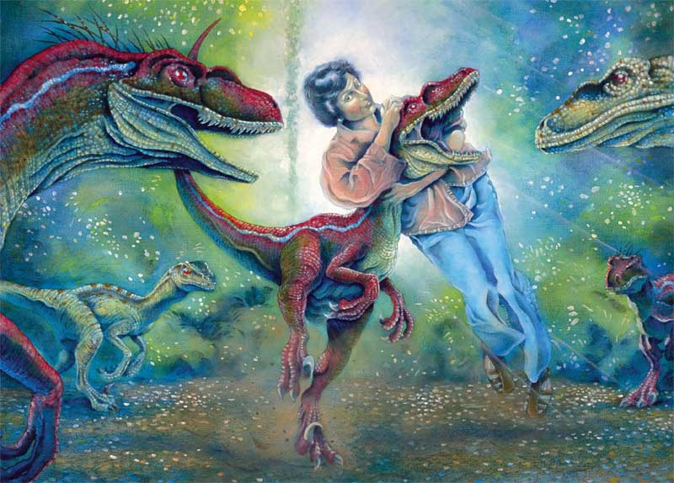
Ignore the Hostile
Notes:
It’s like explaining this picture the effort to results ratio means it’s just not worth it.
CF.Objective() 2008
Author Name, Company & Website/Email

Slide 57
Target the willing
Easiest to convert
  Uninformed
  Herd
Next group
  Time Crunched
  Cynical
  Burned
Finally
  Management
Notes:
CF.Objective() 2008
Author Name, Company & Website/Email

Slide 58
Harness the Converted
Steal attention from non converts
Repeat the story
Get converts to repeat the story
Tie their successes to your methods
Notes:
CF.Objective() 2008
Author Name, Company & Website/Email

Slide 59
Sell to Management
Focus on cost benefit
Focus on personnel benefits
Provide case studies
Get mandate
Notes:
CF.Objective() 2008
Author Name, Company & Website/Email

Slide 60
Final Thoughts
Where do you go from here

Slide 61
The Process in Review
  Identify the Cast of Personas
  Match Personas to Tactics
  Apply tactics in broader Strategy

Slide 62
Lather, Rinse, Repeat
Progress is iterative…
… and slow
Notes:
Not a bad thing, just set your expectations correctly.
CF.Objective() 2008
Author Name, Company & Website/Email

Slide 63
Be prepared to start again
Every advancement begins with all players at “uninformed.”

Slide 64
Final Thought
You might not get the perfect shop where your fellow developers run a one click ANT script that pulls down your framework driven application for code review before pushing it out to a production server...
But between where you are and where you want to be there are many, many better places.

Slide 65
Questions
  Terrence Ryan
  terry@numtopia.com
  http://www.numtopia.com/terry

