Slide 1

Emotion Detection From Text using
Data Mining and Text mining

Slide 2
Emotion Detection From Text
Based on research paper published by Faculty of Engineering, The University of Tokushima at IEEE 2007 we build an intelligent system under the title Emotelligence on Text to recognize human emotion from textual contents.
i.e. if you give an input string , our system would possibly able to say the emotion behind that textual content.

Slide 3
Emotion Detection From Text
Approach the problem
Step 1 : what are the emotions we are interested in.
Step 2 : how to collect corpus or input data set.
Step 3 : How to process and find the emotion.

Slide 4
Emotion Detection From Text
Step 1 : what are the emotions we are interested in.
On our investigation and research it has been found that, a human can express 16 types of emotion with the help of body gesture and speech.
Since we are indented to find emotion from textual content ,we reduce our scope to find 8 basic emotion that are commonly seen in human expressed language.

Slide 5
Emotion Detection From Text
8 basic emotion :
Joy, Trust, Fear, Surprise, Sadness, Disgust, Anger, Anticipate.
8 basic emotion will act as base to find other advance emotions.
Eg : Basic Emotion + Basic Emotion = Advance Emotion
Joy + Trust = Love

Slide 6
Emotion Detection From Text
Step 2 : What type of input we are going to give.
It is clear that our input are going to be a text but text could be on any language. we decided to go for English language, the only reason is that we have to finish our project in short span of time. Considering other language will consume more time in understanding the language structure and it is difficult to apply NLP techniques to unknown language. (other details are covered in step 3)

Slide 7
Emotion Detection From Text
Step 3 : How do we going to find the emotion
The idea is to treat 8 emotions as 8 different class for classifier.
Train the classifier with the good training sets and then go for Testing.
The result of classier will point to a class which is nothing but a expect emotion.

Slide 8
Emotion Detection From Text
Training phase : Proper data set should be collected, inputs have to be sent to training phase of classifier.
Training phase include two modules (I) Keyword extracting (II) Keyword conversion.

Slide 9
Emotion Detection From Text
Keyword extraction : Unlink other native classification problems direct use of data set will not be useful to us. We need to identify the key terms that are useful for classifier from the in-putted data set.
And Noun , Verb , Adverb , Adjective are the useful key terms to find emotion from text.
In order to find them we applied POS tagger ( Part-of-speech tagging is the process of assigning a part-of-speech like noun, verb, pronoun, preposition, adverb, adjective or other lexical class marker to each word in a sentence.) and extracted words are the key terms that we want.

Slide 10
Emotion Detection From Text
Example:
Data Set : My brother was happy after passing the examination.
POS Tagging : My/PRP$ brother/NN was/VBD happy/JJ after/IN passing/VBG the/DT examination/NN ./.
Keywords extracted : brother was happy passing examination

Slide 11
Emotion Detection From Text
Keyword conversion : We just implemented our own keyword conversion logic that convert the extracted keywords into numeric format that is accepted for our now implement classifier( NB Classifier ).
Eg :
Keywords extracted : brother was happy passing examination
Text data is converted in to numerical data something similar as given below.
Keyword Conversion : 3# 2:1 4:1 5:2 7:1 ……..

Slide 12
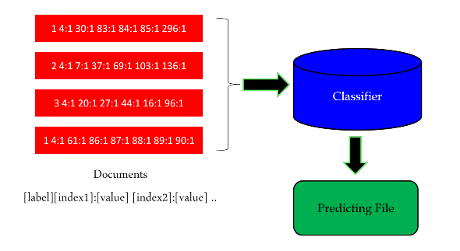
Emotion Detection From Text
Abstract view towards the problem

Slide 13
Emotion Detection From Text
Data set collection :
We really showed our innovations in data set collection also. A good and proper dataset have to be collected . First question came to our mind is how to find dataset that are related to emotion and where to find them. Then we focused on the statement (English sentence that talk about emotion ) , we start our haunting on different blogs sites , we searched for English quotes , short poems etc.
Then moved our search to social sites like twitter, face books to hunt for the emotional messages that shared among the friends etc. , we also collected news headlines and SMS as they also bring the emotional feel in ourself when we read them. In short Data set collection was a tough and we enjoy that also.

Slide 14
Emotion Detection From Text
Testing phase : In testing phase also Keywords extraction and keyword conversion occurs then testing set subject to predicting part of the classifier to predict the class. We test few data set to measure the accuracy of the system and below table shows our accuracy results.

Slide 15
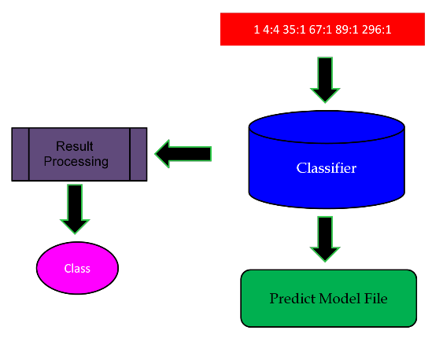
Emotion Detection From Text

Slide 16
Emotion Detection From Text
Data set collection :
We really showed our innovations in data set collection also. A good and proper dataset have to be collected . First question came to our mind is how to find dataset that are related to emotion and where to find them. Then we focused on the statement (English sentence that talk about emotion ) , we start our haunting on different blogs sites , we searched for English quotes , short poems etc.
Then moved our search to social sites like twitter, face books to hunt for the emotional messages that shared among the friends etc. , we also collected news headlines and SMS as they also bring the emotional feel in ourself when we read them. In short Data set collection was a tough and we enjoy that also.

Slide 17
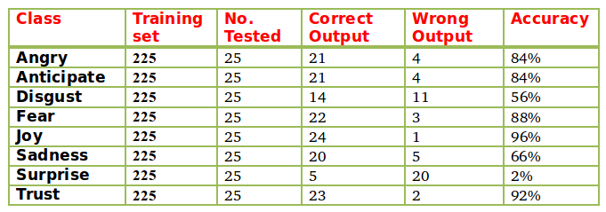
Emotion Detection From Text
Results of our model

Slide 18
Emotion Detection From Text
Accuracy results of our model
No of corpus we user for Training : 1800
No of corpus we user for Testing : 200
Over all accuracy of the model : 71 %
Highest individual class accuracy : 96 % for joy
Lowest individual class accuracy : 2 % for surprise

Slide 19
Thank you
If like the presentation...
I would like to know your insert on endorsing me for my skills on my linkedin profile page.
I would greatly appreciate If you could endorse me for Data mining, Text mining, Big Data, Machine Learning, Algorithms, and Mongodb.
http://www.linkedin.com/profile/view?id=48289105

Slide 20
Thank you
For more details on Emotion Detection
http://shakthydoss.com/3-idiots-project/
Sakthi Dasan
http://shakthydoss.com
Twitter : @shakthydoss

