Slide 1
Customer Churn Prediction & Business Intelligence System
(End-to-End Data Processing, EDA & ML Pipeline)
Domain: Business – Data Science Telecom Analytics
Under the Guidance of
MR. Biksham
Dept. of Data Science
Team No: 8
Bekkem Kalyan (23EG110C09)
Eramolla Aryan Preetham (23EG110C21)
Tirumala Peddinty Vijaya Krishna Sreekar(23EG110C60)

Slide 2
Abstract
Customer churn is a major challenge for telecom companies as losing subscribers directly impacts recurring revenue and business growth. This project develops an end-to-end Customer Churn Prediction & Business Intelligence System driven by Exploratory Data Analysis (EDA) and Machine Learning. The pipeline ingests the IBM Telco Churn dataset (7,043 records), performs data cleaning and feature engineering (ChargesPerTenure, ServiceCount, RiskScore), applies SMOTE to address severe class imbalance (73:27 ratio), and trains predictive classifiers (Logistic Regression, Random Forest, XGBoost). Integrated with a SQL analytics database and a 5-page Streamlit web dashboard, the system identifies $138,529/month in revenue at risk and empowers managers to execute proactive retention interventions.

Slide 3
Introduction
Problem Context & Industry Challenge
• Telecom service providers experience heavy revenue loss due to customer contract cancellations (churn).
• Manual identification of at-risk customers is ineffective due to complex, multi-dimensional customer behavioral patterns.
• Unaddressed churn results in high acquisition overheads, reduced Customer Lifetime Value (CLV), and diminished market share.
End-to-End Data & ML Pipeline Flow
• Data Ingestion → Data Preprocessing & Cleaning → Exploratory Data Analysis (EDA) → Feature Engineering & SMOTE → Multi-Model ML Training → SQL BI Analytics → Streamlit Dashboard.
• Enables telecom managers to proactively intervene with targeted discounts, tenure perks, and service upgrades before churn occurs.

Slide 4
Objectives
1. Dataset Ingestion & Data Preprocessing: Clean, format, and scale the IBM Telco dataset (7,043 rows), handling missing TotalCharges and encoding categorical features.
2. Exploratory Data Analysis & Feature Engineering: Analyze churn distributions across tenure and contract cohorts, engineering composite RiskScore and applying SMOTE resampling.
3. Predictive Model Optimization: Train and validate Machine Learning classifiers (Logistic Regression, Random Forest, XGBoost) achieving high ROC-AUC (83.62%) and Recall (70.43%).
4. SQL Cohort Analytics & Web Dashboard: Build a SQL analytics engine calculating monthly revenue at risk ($138K/mo) with a real-time interactive Streamlit web interface.

Slide 5
Literature Survey
S.No | Author & Year | Method Used | Proposed Model | Drawbacks | Source
1 | Ning Lu et al. (2014) | Boosting with Customer Segmentation | Telecom churn prediction via Boosting | High computational cost; lacks real-time UI | IEEE Trans. Ind. Inf.
2 | A. K. Ahmad et al. (2019) | ML + Social Network Analysis | DT, Random Forest, XGBoost | Requires heavy infrastructure & big data pipelines | J. of Big Data
3 | Irfan Ullah et al. (2019) | Random Forest + K-Means | RF with customer clustering | Complex multi-stage setup; no SQL cohort engine | IEEE Access
4 | Shimaa Ouf et al. (2024) | Hybrid ML Framework | Ensemble Stacking Classifiers | High inference latency; no interactive retention UI | Springer
5 | Rohit Sharma et al. (2025) | EDA + Multi-Model ML | RF, SVM, Logistic Regression | Single dataset evaluation; no business risk quantification | IEEE ICONAT

Slide 6
Existing Work and Limitations
Current / Existing Industry Approaches
• Traditional Rule-Based Analytics: Many telecom providers rely on static heuristic threshold rules (e.g., flag accounts after 2 missed bills).
• Isolated Model Experiments: Prior studies focus exclusively on model training accuracy without deploying end-to-end usable business applications.
Key Limitations of Existing Systems
• Neglect of Class Imbalance: Churn datasets typically have a ~73:27 majority-minority split, causing standard models to be biased toward non-churners.
• Lack of Revenue Quantification: Existing solutions predict binary labels (0/1) but fail to quantify the direct financial revenue at risk ($/month).
• Absence of Real-Time Decision Support: Most models operate in offline batch scripts without an accessible web interface for customer support teams.

Slide 7
Proposed Work and Advantages
Our Proposed Data & ML Pipeline Methodology
• End-to-End Automated Pipeline: Comprehensive orchestration from raw CSV ingestion to automated EDA, SMOTE balancing, SQL storage, and Streamlit UI.
• Domain-Specific Feature Engineering: Creation of key metrics including ChargesPerTenure, ServiceCount, and a composite RiskScore metric.
• Rigorous EDA & Model Benchmarking: Detailed exploratory visualizations and comparative evaluation of Logistic Regression, Random Forest, and XGBoost.
Key Advantages of the Proposed System
• High Predictive Reliability: Achieved 83.62% ROC-AUC and 70.43% churn recall, effectively capturing at-risk subscribers.
• Quantified Financial Impact: SQL analytics calculates exact monthly revenue at risk ($138,529/mo) to prioritize retention efforts.
• Operational Readiness: Intuitive Streamlit web dashboard allowing non-technical managers to run instant real-time predictions (< 50ms).

Slide 8
Software and Hardware Requirements
Software Requirements
• Operating System: Windows 10 / 11 / Linux
• Programming Language: Python 3.9+
• ML & Data Libraries: Scikit-learn, XGBoost, Imbalanced-learn (SMOTE), Pandas, NumPy
• Database Engine: SQLite3 & SQLAlchemy
• Visualization & Web UI: Streamlit, Matplotlib, Seaborn, Plotly
• Documentation & Reports: python-pptx, python-docx, ReportLab
Hardware Requirements
• Processor: Intel Core i5 / AMD Ryzen 5 or higher
• RAM: Minimum 8 GB (16 GB Recommended)
• Storage: 500 MB free disk space for dataset, database & models
• Display: Standard Full HD (1920x1080) resolution
• Connectivity: Active Internet connection for initial package installation and data retrieval

Slide 9
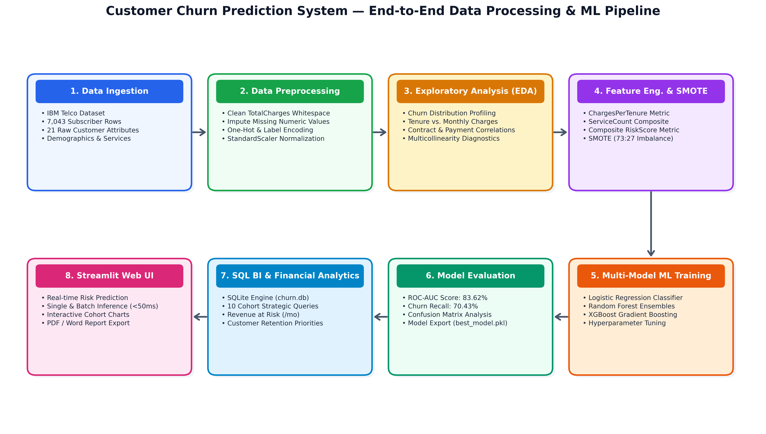
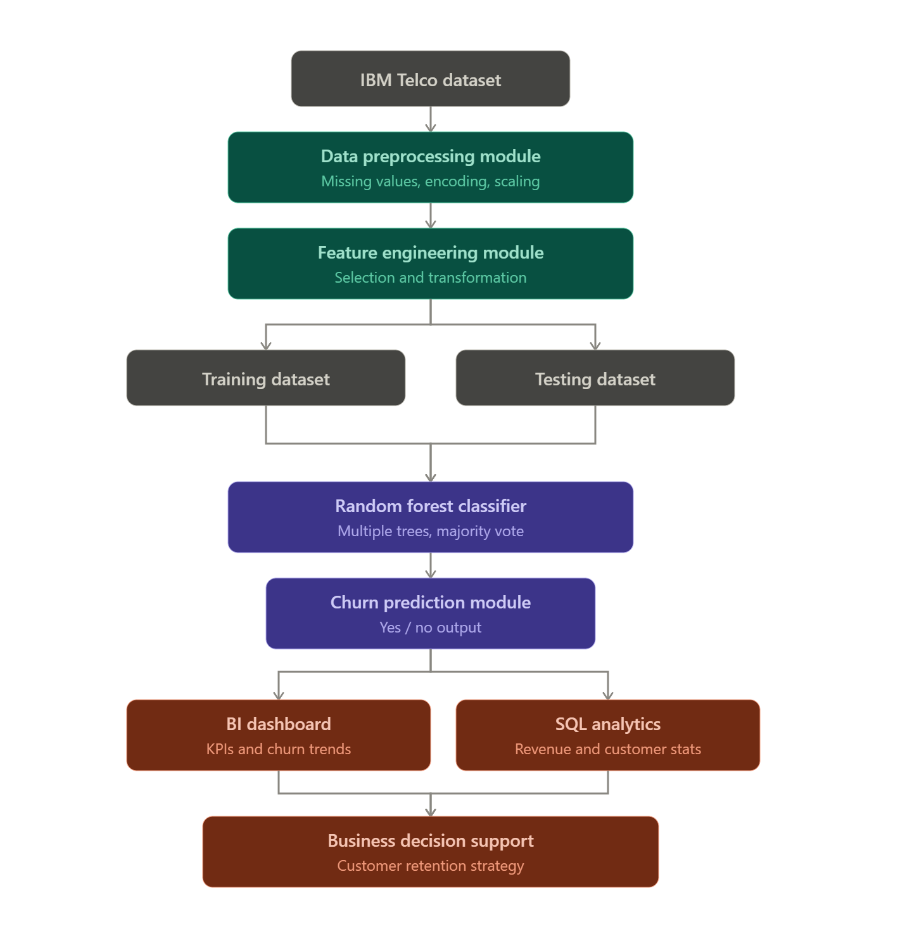
End-to-End Data Processing & ML Pipeline

Slide 10
Modules
• Module 1: Data Ingestion & Preprocessing: Handles raw CSV ingestion (7,043 rows), cleans whitespace/missing TotalCharges, encodes categorical variables, and applies StandardScaler.
• Module 2: Exploratory Data Analysis & Feature Engineering: Performs univariate/bivariate EDA, derives domain features (ChargesPerTenure, ServiceCount, RiskScore), and balances minority churn cases via SMOTE.
• Module 3: Model Training & Evaluation Engine: Trains Logistic Regression, Random Forest, and XGBoost with hyperparameter tuning; exports evaluation metrics (AUC 83.62%, Recall 70.43%).
• Module 4: SQL Business Intelligence & Cohort Analytics: Stores cleaned data into SQLite (churn.db) and executes 10 strategic SQL queries to evaluate cohort churn and calculate revenue at risk ($138K/mo).
• Module 5: Interactive Web Dashboard (Streamlit): Provides a 5-page interactive web UI for real-time customer risk prediction (<50ms), live database exploration, interactive charts, and PDF/Word report exports.

Slide 11
System Design & Workflow
Functional Pipeline Workflow & Layered Architecture
• Data Preparation Layer: Ingestion of Telco CSV, whitespace cleaning, missing value imputation, one-hot encoding, and StandardScaler normalization.
• Exploratory & Feature Layer: Univariate/bivariate EDA profiling, engineering ChargesPerTenure & RiskScore, and SMOTE oversampling for balanced class distribution.
• Modeling & Analytics Layer: Multi-model training (Logistic Regression, RF, XGBoost) combined with SQLite cohort queries to quantify $138K/mo revenue at risk.
• Presentation Layer: Streamlit Dashboard UI displaying interactive risk predictions, cohort charts, and automated PDF/Word executive report generation.
Design Specifications & Quality Attributes
• High Reproducibility & Modularity: Decoupled pipeline stages allowing independent EDA visualization or model tuning.
• Sub-50ms Prediction Latency: Real-time scoring for single customer profiles.
• Business Impact Driven: Direct integration between ML predictions and financial revenue risk quantification.

Slide 12
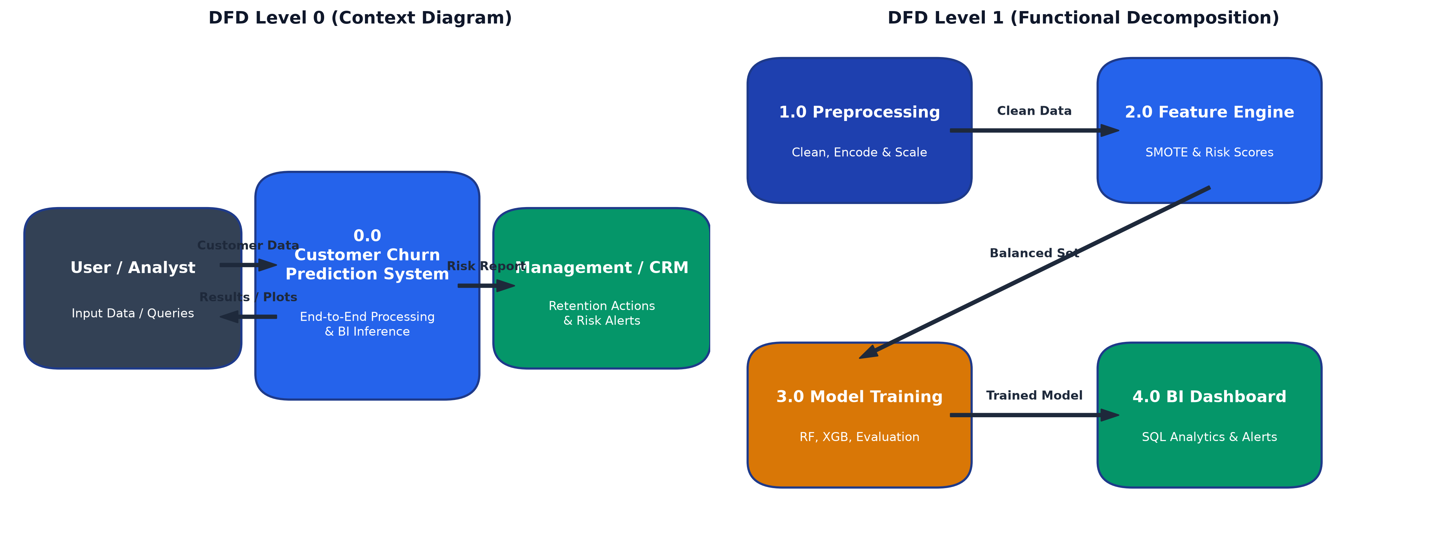
Data Flow Diagram (DFD Level 0 & Level 1)
• Level 0 Context Diagram: Models external boundary interactions between Telecom Administrators / Support Agents and the Churn System.
• Level 1 Process Breakdown: Decomposes data movement into 4 sub-processes: Preprocessing (1.0), Feature Eng (2.0), Inference (3.0), SQL BI (4.0).
• Data Store Transformations: Reads raw Telco CSV records from disk and transforms subscriber attributes into serialized predictions and SQL tables.

Slide 13
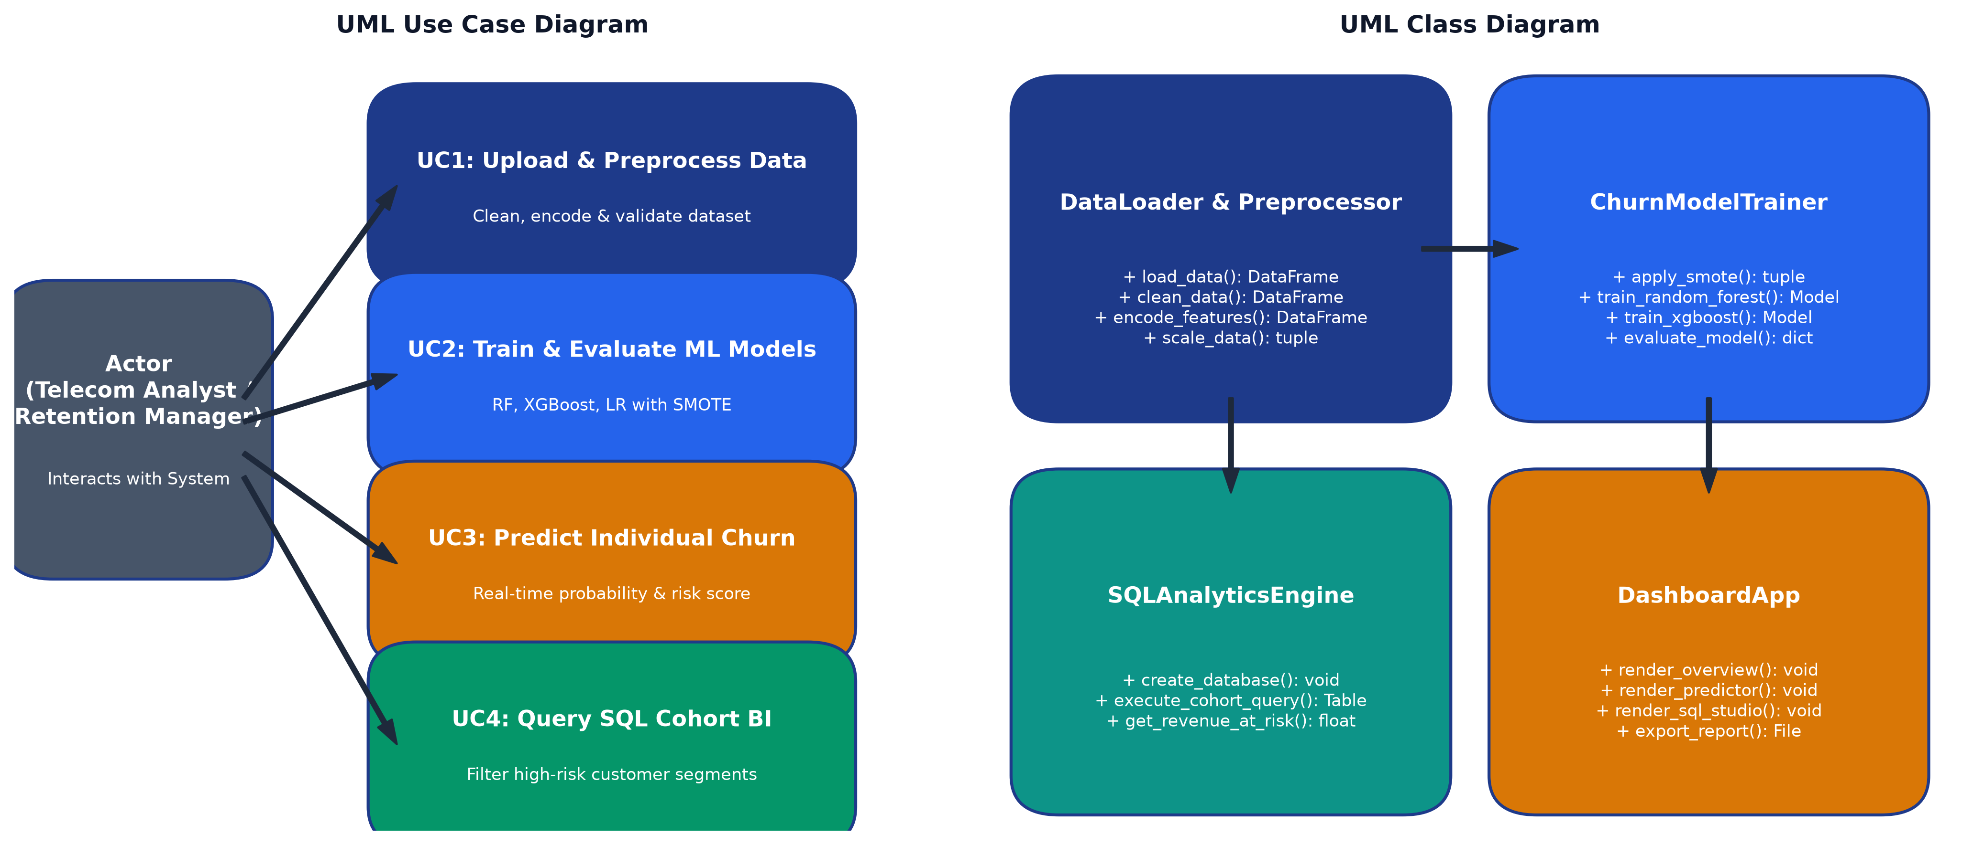
UML Use Case & Class Diagram
• Use Case Interactions: Maps core actor workflows: Upload Dataset, Trigger SMOTE Training, Query Cohort Revenue & Predict Single Risk.
• Object-Oriented Architecture: Defines modular classes: DataPreprocessor, FeatureEngine, ModelTrainer, SQLAnalyticsEngine & StreamlitUI.
• Loose Coupling & Reusability: Decouples data pipeline components from UI presentation, allowing independent model updates or database swaps.

Slide 14
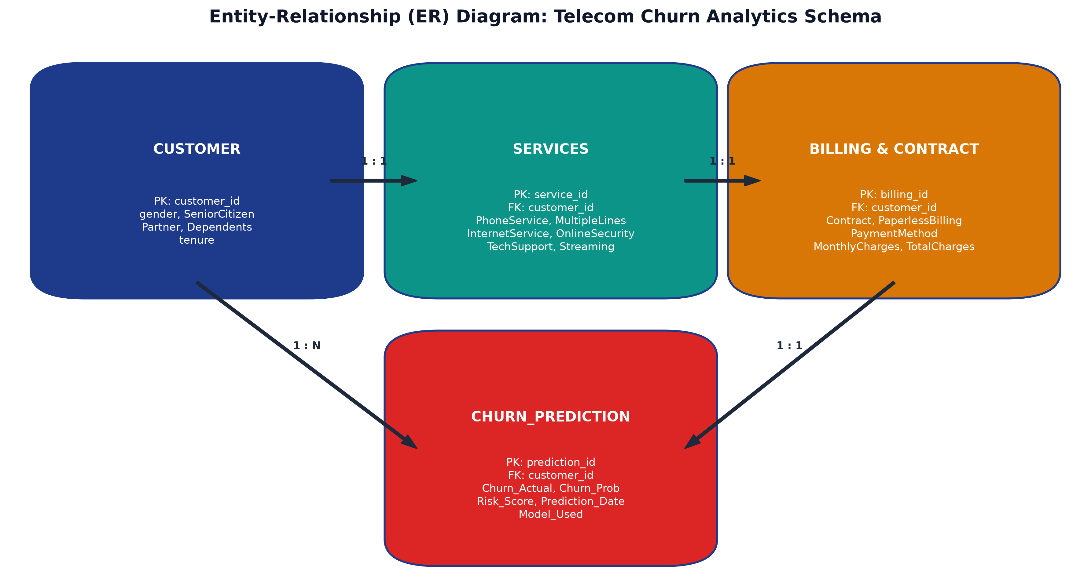
Entity-Relationship (ER) Diagram
• Relational Schema Design: Defines structured entities for Customers, ServiceContracts, BillingDetails, ChurnPredictions & RevenueMetrics.
• Central Primary Key Mapping: CustomerID serves as the central foreign key connecting subscriber demographic profiles, services & billing history.
• Cohort Analytics Support: Structured relational schema enables fast SQL aggregations to calculate churn rates by contract & payment method.

Slide 15
Thank You!
Questions & Feedback
Team No: 8 | Department of Data Science | Anurag University

