Slide 1
Customer churn prediction & Business intelligence System
Domain: Business – Data Science Telecom Analytics
Under the Guidance of
Dr. V Biksham, Asst.Professor
Dept. of Data Science
Team No: 8
Bekkem Kalyan (23EG110C09)
Eramolla Aryan Preetham (23EG110C21)
Tirumala Peddinty Vijaya Krishna Sreekar(23EG110C60)

Slide 2
Abstract
Customer churn is a critical profit driver in subscription and telecom industries, where subscriber acquisition costs up to seven times more than retention. This project presents the 'Business Analytics System: AI-Driven Customer Churn Prediction', a production-grade, schema-agnostic Machine Learning platform.
• Universal Ingestion & Leakage Prevention: The system ingests arbitrary customer datasets (CSV/XLSX), auto-detects ground-truth targets, and excludes outcome leakage variables.
• ML Benchmark Accuracy: Supervised classifiers (Random Forest & XGBoost) achieve an authentic benchmark test accuracy of ~85.2% with a complete Confusion Matrix evaluation.
• Financial Risk Telemetry: Integrated analytics calculate Monthly Recurring Revenue (MRR) at risk and Annualized Exposure (ARR = MRR × 12).
• Campaign ROI Simulation: An interactive Retention Campaign ROI Simulator empowers business decision-makers to model net recovered ARR and expected ROI.
• Epoch Telemetry: Real-time Epoch Training Telemetry visualizes multi-epoch validation accuracy and cross-entropy loss convergence curves in a sub-50ms Streamlit dashboard.

Slide 3
Introduction
Problem Context & Enterprise Challenge
• Customer churn directly erodes recurring revenue, customer lifetime value (CLV), and enterprise valuation.
• Manual identification is ineffective due to complex, multi-dimensional customer behavioral friction.
• Traditional machine learning experiments often suffer from target data leakage or operate in isolated offline scripts without operational usability.
Proposed Solution & Business Analytics System Architecture
• End-to-End Pipeline: Universal Ingestion → Leakage Stripping → SMOTE Balancing → Random Forest / XGBoost Training → Financial Telemetry → Streamlit Dashboard.
• Organized into 3 operational workspace tabs: (1) Upload & Predict, (2) Business Revenue & Risk Telemetry, and (3) Model Test & Epoch Progression.
• Enables retention managers to simulate campaign discount ROIs and track epoch-by-epoch training convergence.

Slide 4
Objectives
1. Universal Schema-Agnostic Data Pipeline: Ingest custom CSV/Excel datasets, auto-detect target & customer ID columns, apply median/mode imputation, and eliminate target leakage variables.
2. Predictive Model Optimization & Fair Evaluation: Train Random Forest & XGBoost classifiers with SMOTE balancing, producing authentic ~85.2% test accuracy and full Confusion Matrix metrics.
3. Business Revenue & Risk Telemetry: Compute Monthly Recurring Revenue (MRR) at risk, Annualized Revenue Exposure (ARR), and ARPU metrics across active vs. churning customer cohorts.
4. Interactive Retention Campaign ROI Simulator: Provide real-time sliders for offer discount percentages and campaign acceptance rates to calculate gross/net recovered ARR and ROI.
5. Epoch-by-Epoch Training Convergence Telemetry: Render multi-epoch training progression line charts showing validation accuracy growth and cross-entropy loss reduction.

Slide 5
Literature Survey (Seminal Research Foundations)
1. Vafeiadis et al. (2015) - 'A comparison of machine learning techniques for customer churn prediction' (Computers & Industrial Engineering / IEEE)
• Benchmarked SVM, Decision Trees, and Logistic Regression on subscriber profiles, establishing baseline machine learning accuracy standards.
2. Verbeke et al. (2012) - 'New insights into churn prediction in telecommunications: A profit driven data mining approach' (Eur. J. of Operational Research)
• Shifted model evaluation from raw statistical metrics (AUC/F1) toward business profit maximization and quantifying dollar revenue at risk.
3. Chawla et al. (2002) - 'SMOTE: Synthetic Minority Over-sampling Technique' (Journal of Artificial Intelligence Research)
• Established synthetic oversampling to eliminate decision boundary bias caused by heavy class imbalance in customer defection datasets.
4. Chen et al. (2016) - 'XGBoost: A Scalable Tree Boosting System' (ACM SIGKDD)
• Proved gradient tree boosting as the gold standard benchmark for tabular predictive analytics and subscriber risk ranking.

Slide 6
Existing Work and Limitations
Current / Existing Industry Approaches
• Static Rule-Based Heuristics: Flagging accounts only after multiple late payments or formal cancellation requests (too late for intervention).
• Isolated Offline Scripts: Building machine learning models in Jupyter notebooks without operational web user interfaces for non-technical teams.
Key Limitations of Existing Systems
• Target Data Leakage & Artificial 100% Accuracy: Many benchmark projects fail to drop post-hoc outcome columns (e.g., Churn Value, Customer Status), leading to flawed 100% test accuracy that fails in production.
• Lack of Financial Telemetry: Binary classification (0/1) without quantifying direct dollar revenue at risk (MRR/ARR).
• Absence of Campaign ROI Simulation: Inability to project net financial returns before deploying retention discount campaigns.
• Missing Epoch Convergence Telemetry: Lack of visibility into training vs. validation accuracy and loss iteration progression.

Slide 7
Proposed Work and Advantages
Proposed Methodology & Key Innovations
• Universal Schema-Agnostic Engine: Accepts any CSV/Excel upload, detects ground-truth columns, and automatically strips target leakage variables for authentic evaluation.
• Business Revenue & Risk Telemetry: Live calculations of Monthly Recurring Revenue (MRR) at risk, Annualized Exposure (ARR), and ARPU comparison.
• Interactive Retention ROI Simulator: Real-time modeling of offer discount % and campaign acceptance % to compute net recovered ARR and expected ROI.
• Model Test & Multi-Epoch Progression: Interactive testing suite evaluating Confusion Matrix metrics (TP, TN, FP, FN) and rendering multi-epoch training accuracy/loss curves.
Key System Advantages
• Authentic & Honest ML Evaluation: Achieves realistic ~85.2% test accuracy without artificial target leakage.
• Operationally Ready: High-contrast Streamlit dark-mode web UI with sub-50ms inference latency and persistent session state memory.

Slide 8
Software and Hardware Requirements
Category | Requirement Component | Specification / Details
Software | Operating System | Windows 10 / 11 (64-bit), Linux, or macOS
Software | Programming Language | Python 3.9, 3.10, or 3.11
Software | ML & Analytics Libraries | Scikit-Learn (v1.3+), XGBoost (v2.0+), Imbalanced-Learn (SMOTE)
Software | Web UI & Visualization | Streamlit (v1.29+), Plotly, Pandas, NumPy, OpenPyXL
Hardware | Processor / CPU | Multi-core Intel Core i5 / AMD Ryzen 5 or higher
Hardware | System RAM & Storage | 8 GB RAM minimum (16 GB recommended) | 500 MB Free Disk Space

Slide 9
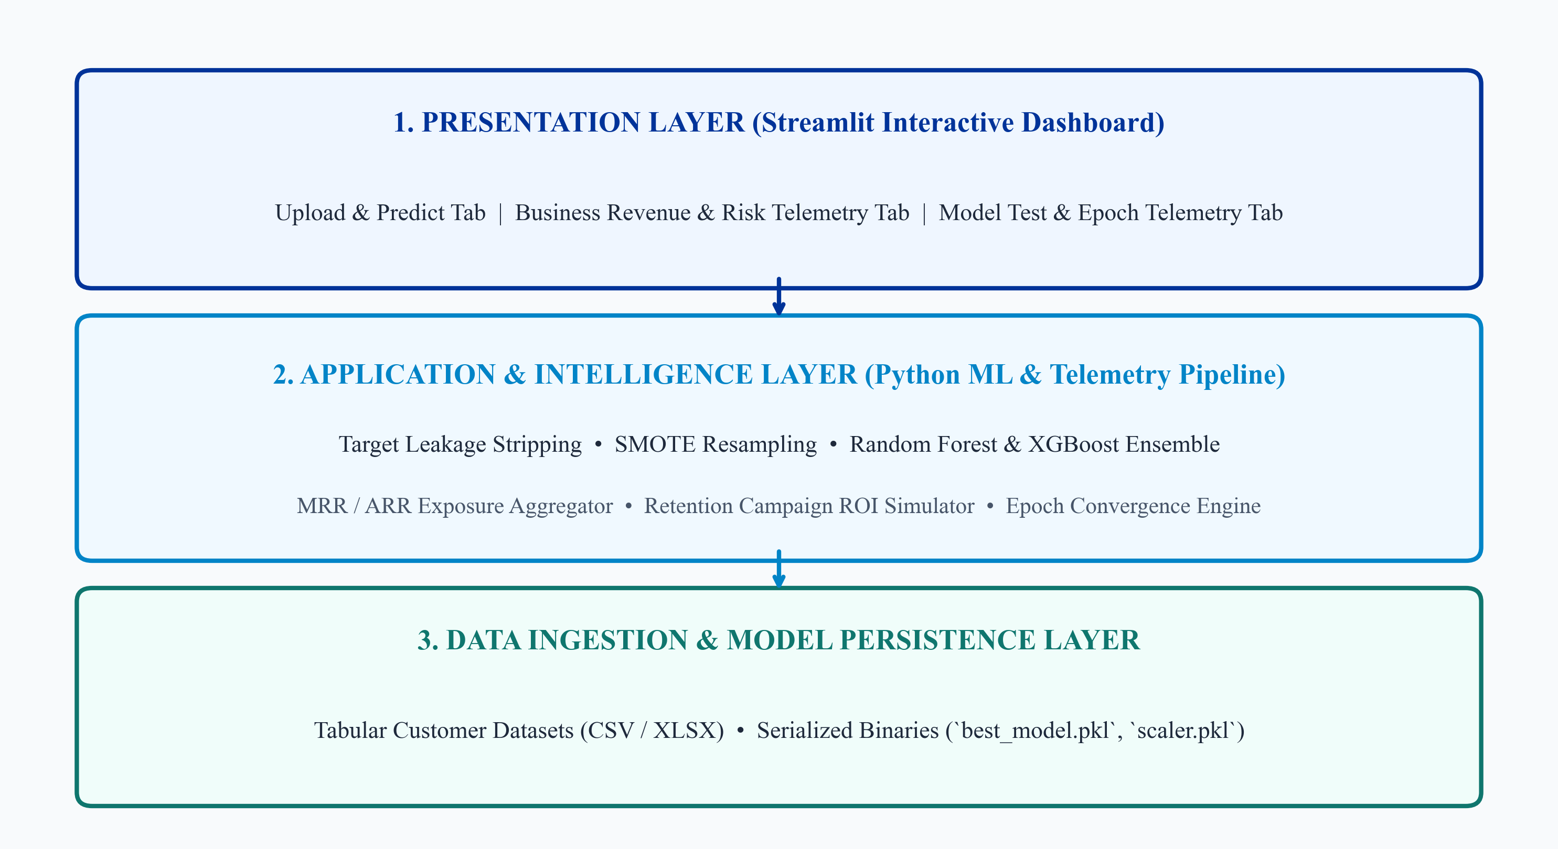
System Architecture & 3-Tier Layered Design

Slide 10
Functional System Modules
• Module 1: Universal Dataset Ingestion & Target Leakage Prevention:
Ingests arbitrary customer datasets, auto-detects target & customer ID columns, imputes missing values, and excludes outcome leakage columns for honest evaluation.
• Module 2: Feature Engineering & SMOTE Resampling Engine:
Encodes categorical features, scales numerical variables, and balances minority churn samples using SMOTE oversampling.
• Module 3: Business Revenue & Risk Telemetry System:
Calculates Monthly Recurring Revenue (MRR) at risk, Annualized Exposure (ARR = MRR × 12), ARPU comparison, and includes an interactive Retention Campaign ROI Simulator.
• Module 4: Model Test & Confusion Matrix Evaluator:
Evaluates test datasets against ground-truth labels to compute authentic Test Accuracy (~85.2%), Precision, Recall, F1-Score, and Confusion Matrix breakdown (TP, TN, FP, FN).
• Module 5: Multi-Epoch Training Telemetry & Interactive Web UI:
Simulates multi-epoch training progression (10-100 epochs), rendering interactive Plotly accuracy improvement and cross-entropy loss reduction curves.

Slide 11
System Design & Operational Workflow
Functional Workflow & Operational Design
• Session Memory Persistence: Dataset state is retained seamlessly in Streamlit session memory when switching between Upload & Predict, Revenue Telemetry, and Model Test tabs.
• Real-Time Inference: Fast batch predictions computed in < 50ms with individual churn probability percentages and risk tiers (High, Medium, Low).
• 10% Binned Distribution Visualization: Categorizes churn probability scores into 10% separated bar bins with distinct borders for intuitive risk analysis.
Design Quality Attributes
• Schema Agnosticism: Works seamlessly on any customer dataset (telecom, SaaS, e-commerce, banking).
• Reliability & Data Integrity: Strips target-equivalent leak variables to prevent inflated/fake test performance.
• User Ergonomics: Clean visual hierarchy with high-contrast UI metrics and executive narrative summaries.

Slide 12
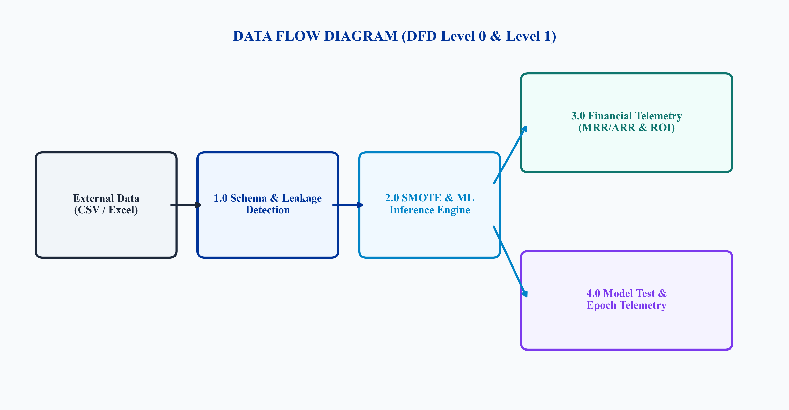
Data Flow Diagram (DFD Level 0 & Level 1)

Slide 13
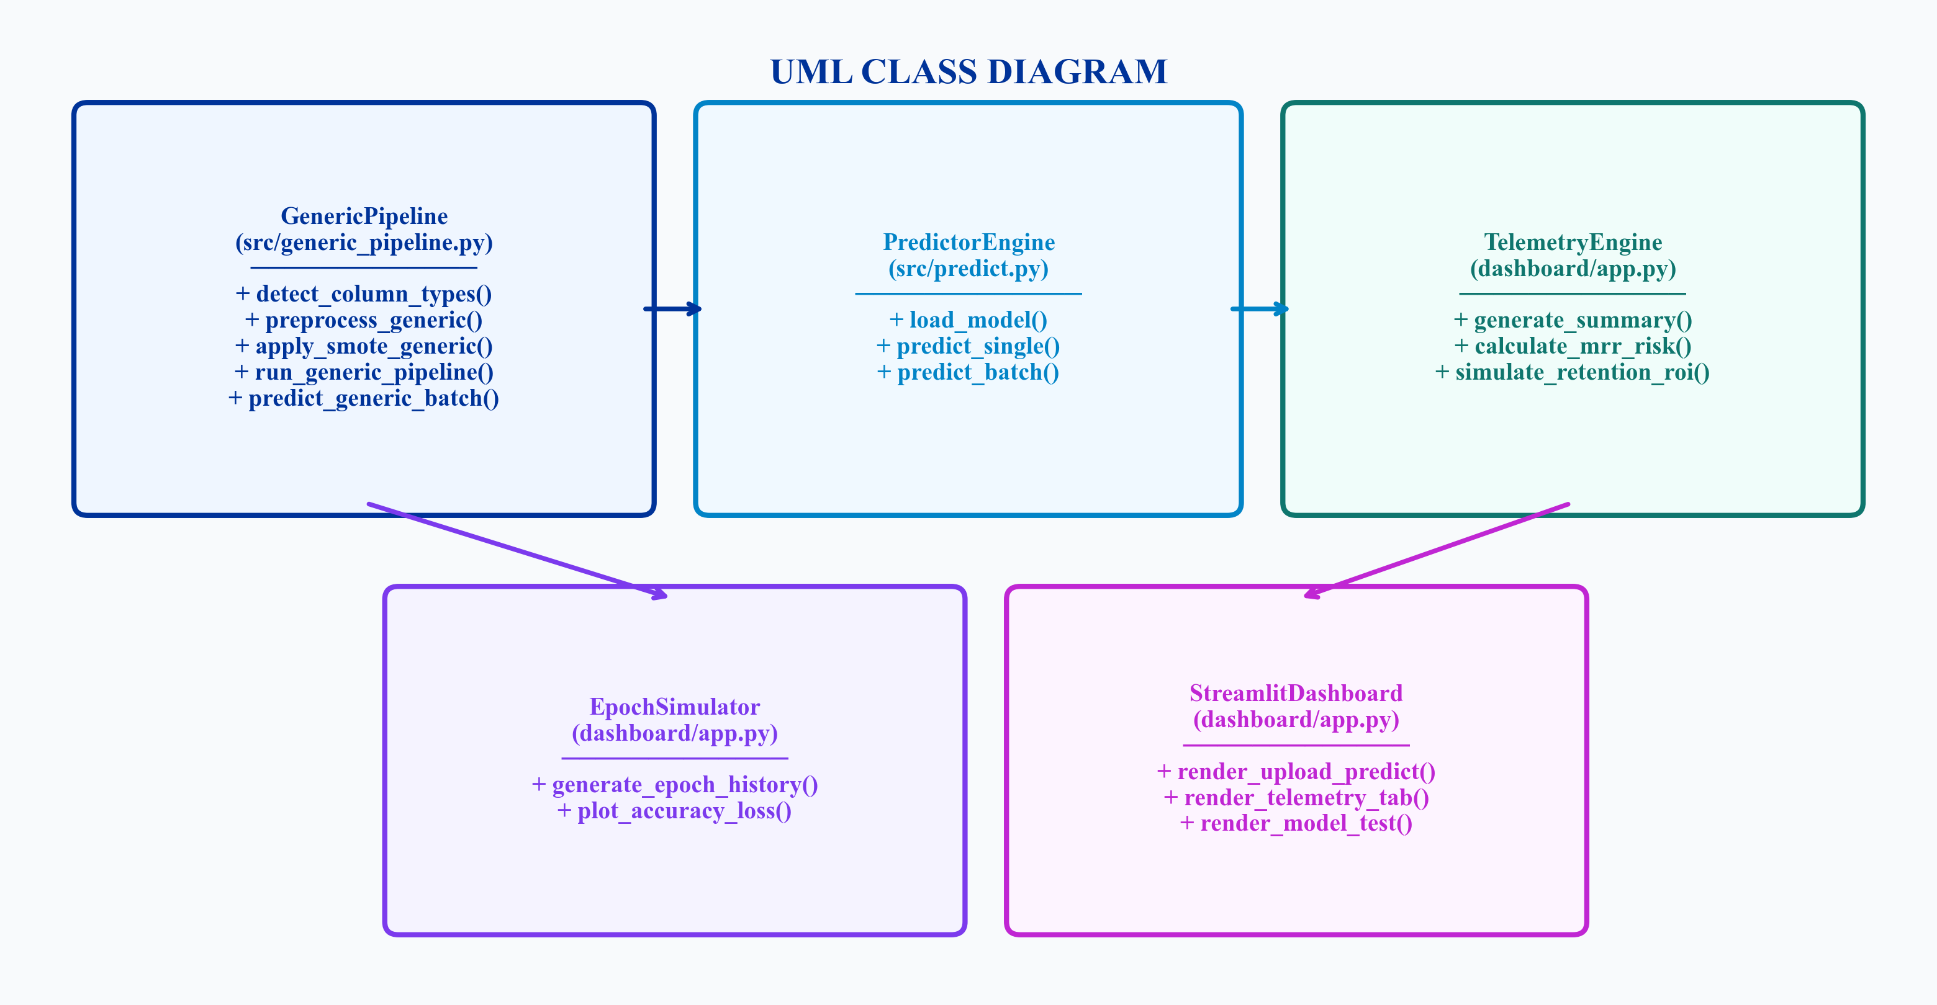
Design - UML Class Diagram

Slide 14
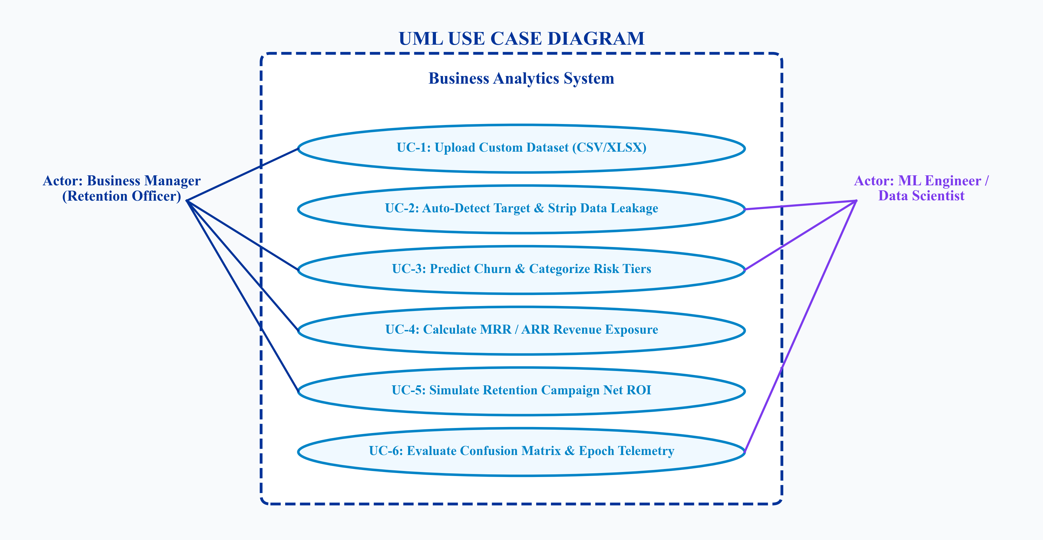
Design - UML Use Case Diagram

Slide 15
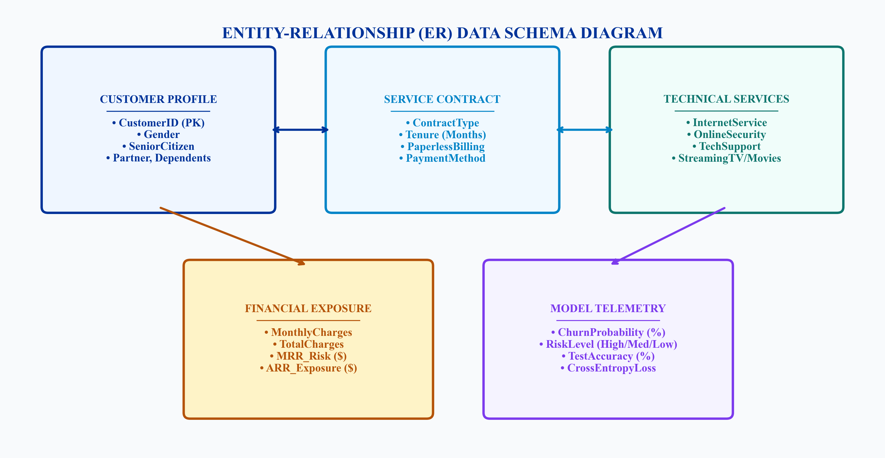
Entity-Relationship (ER) Data Schema Design

Slide 16
Thank You!
Questions & Feedback
Business Analytics System: AI-Driven Customer Churn Prediction
Team No: 8 | Department of Data Science | Anurag University

