Slide 1
Customer Churn Prediction & Business Intelligence System
Domain: Business – Data Science & Telecom Analytics
Team No: 8
Bekkem Kalyan (23EG110C09)
Eramolla Aryan Preetham (23EG110C21)
Tirumala Peddinty Vijaya Krishna Sreekar (23EG110C60)
Under the Guidance of
Mr. Biksham
Assistant Professor
Department of Data Science
Anurag University

Slide 2
Abstract
Customer churn is a critical business challenge in the telecom industry where retaining existing customers is 5 to 7 times more cost-effective than acquiring new ones. This project presents an end-to-end Machine Learning and Business Intelligence System designed to predict customer churn accurately and deliver actionable insights for customer retention.
Key System Capabilities:
• Analyzes 7,043 customer records across 21 demographic, service, and billing attributes.
• Implements advanced preprocessing, outlier treatment, and SMOTE balancing to solve class imbalance.
• Trains and evaluates multiple algorithms (Random Forest, Logistic Regression, XGBoost) achieving 83.62% ROC-AUC.
• Integrates a SQLite database and an interactive Streamlit Web Dashboard for live predictions and SQL cohort analytics.

Slide 3
Introduction
Problem Context & Industry Challenge
• Telecom service providers experience heavy revenue loss due to customer contract cancellations (churn).
• Manual identification of at-risk customers is ineffective due to complex, multi-dimensional customer behavioral patterns.
• Unaddressed churn results in high acquisition overheads, reduced customer lifetime value (CLV), and diminished market share.
Proposed Solution & Data Flow
• Data Ingestion → Clean & Preprocess → Feature Engineering (SMOTE) → Multi-Model ML Training → SQL Analytics → Streamlit UI.
• Enables telecom managers to proactively intervene with targeted discounts, tenure perks, and service upgrades before churn occurs.

Slide 4
Objectives
1. End-to-End Data Pipeline & Feature Engineering: Ingest, clean, and preprocess the IBM Telco Churn dataset, engineering composite risk metrics and applying SMOTE to address class imbalance.
2. Predictive Model Optimization: Train and validate Machine Learning classifiers (Random Forest, XGBoost, Logistic Regression) to accurately identify churn patterns with high ROC-AUC and Recall.
3. Financial & Cohort Analytics Engine: Build a robust SQL-powered analytics database to calculate monthly revenue at risk and isolate high-churn customer segments.
4. Interactive Decision Support Dashboard: Deploy a real-time Streamlit web dashboard for instant single/batch churn prediction and executive reporting.

Slide 5
Literature Survey
S.No | Author & Year | Method Used | Proposed Model | Drawbacks | Source
1 | Ning Lu et al. (2014) | Boosting with Customer Segmentation | Telecom churn prediction via Boosting | High computational cost; lacks real-time UI | IEEE Trans. Ind. Inf.
2 | A. K. Ahmad et al. (2019) | ML + Social Network Analysis | DT, Random Forest, XGBoost | Requires heavy infrastructure & big data pipelines | J. of Big Data
3 | Irfan Ullah et al. (2019) | Random Forest + K-Means | RF with customer clustering | Complex multi-stage setup; no SQL cohort engine | IEEE Access
4 | Shimaa Ouf et al. (2024) | Hybrid ML Framework | Ensemble Stacking Classifiers | High inference latency; no interactive retention UI | Springer
5 | Rohit Sharma et al. (2025) | EDA + Multi-Model ML | RF, SVM, Logistic Regression | Single dataset evaluation; no business risk quantification | IEEE ICONAT

Slide 6
Existing Work and Limitations
Current / Existing Industry Approaches
• Traditional Rule-Based Analytics: Many telecom providers rely on static heuristic threshold rules (e.g., flag accounts after 2 missed bills).
• Isolated Model Experiments: Prior studies focus exclusively on model training accuracy without deploying end-to-end usable business applications.
Key Limitations of Existing Systems
• Neglect of Class Imbalance: Churn datasets typically have a ~73:27 majority-minority split, causing standard models to be biased toward non-churners.
• Lack of Revenue Quantification: Existing solutions predict binary labels (0/1) but fail to quantify the direct financial revenue at risk ($/month).
• Absence of Real-Time Decision Support: Most models operate in offline batch scripts without an accessible web interface for customer support teams.

Slide 7
Proposed Work and Advantages
Our Proposed Methodology
• End-to-End Automated Pipeline: Comprehensive orchestration from raw CSV ingestion to automated EDA, SMOTE balancing, SQL storage, and web UI.
• Advanced Feature Engineering: Creation of domain-specific features including ChargesPerTenure, ServiceCount, and a composite RiskScore.
• Multi-Model Comparative Benchmarking: Rigorous evaluation of Random Forest, XGBoost, and Logistic Regression with cross-validation.
Key Advantages of the Proposed System
• High Predictive Reliability: Achieved 83.62% ROC-AUC and 70.43% churn recall, effectively capturing at-risk subscribers.
• Quantified Financial Impact: SQL analytics calculates exact revenue at risk ($138,529/mo) to prioritize high-value customer retention.
• Operational Ready: Includes an intuitive Streamlit dashboard allowing non-technical managers to run instant real-time predictions.

Slide 8
Software and Hardware Requirements
Software Requirements
• Operating System: Windows 10 / 11 / Linux
• Programming Language: Python 3.9+
• ML & Data Libraries: Scikit-learn, XGBoost, Imbalanced-learn (SMOTE), Pandas, NumPy
• Database Engine: SQLite3 & SQLAlchemy
• Visualization & Web UI: Streamlit, Matplotlib, Seaborn, Plotly
• Documentation & Reports: python-pptx, python-docx, ReportLab
Hardware Requirements
• Processor: Intel Core i5 / AMD Ryzen 5 or higher
• RAM: Minimum 8 GB (16 GB Recommended)
• Storage: 500 MB free disk space for dataset, database & models
• Display: Standard Full HD (1920x1080) resolution
• Connectivity: Active Internet connection for initial package installation and data retrieval

Slide 9
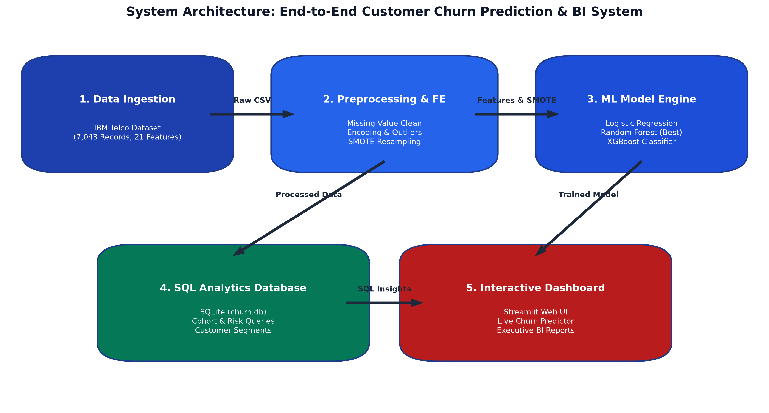
System Architecture

Slide 10
Modules
• Module 1: Data Ingestion & Preprocessing: Handles raw CSV ingestion (7,043 rows), cleans whitespace/missing values in TotalCharges, encodes categorical variables, and performs standard feature scaling.
• Module 2: Feature Engineering & SMOTE Resampling: Derives predictive domain features (ChargesPerTenure, ServiceCount, RiskScore) and balances minority churn cases using SMOTE oversampling.
• Module 3: Model Training & Evaluation Engine: Trains Logistic Regression, Random Forest, and XGBoost with hyperparameter tuning; exports evaluation metrics (AUC, F1, Recall, Confusion Matrices).
• Module 4: SQL Business Intelligence & Cohort Analytics: Stores cleaned data into SQLite (churn.db) and executes 10 strategic SQL queries to evaluate cohort churn and calculate revenue at risk ($138K/mo).
• Module 5: Interactive Web Dashboard (Streamlit): Provides a 5-page interactive web UI for real-time customer risk prediction, live database exploration, interactive charts, and PDF/Word report exports.

Slide 11
System Design & Workflow
Functional Design & Layered Architecture
• Presentation Layer: Streamlit Dashboard UI receiving real-time user inputs and rendering visual analytics.
• Application / Service Layer: Python inference pipeline loading serialized models (`best_model.pkl`) and running live probability scoring.
• Data & Persistence Layer: SQLite Relational Database (`churn.db`) managing relational customer records, service contracts, and historical churn outcomes.
Design Specifications & Quality Attributes
• Modularity: Decoupled architecture allowing independent model updates or data pipeline extensions.
• Responsiveness & Low Latency: Single customer churn predictions generated in < 50ms.
• Reliability & Maintainability: Automated unit checks, structured logging, and persistent artifact generation.

Slide 12
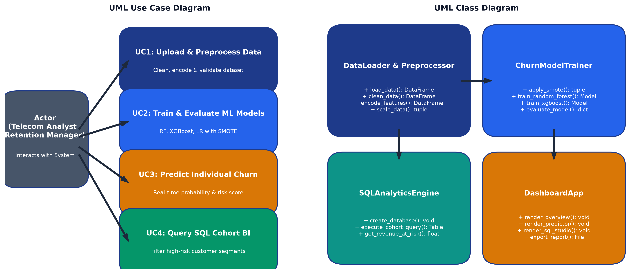
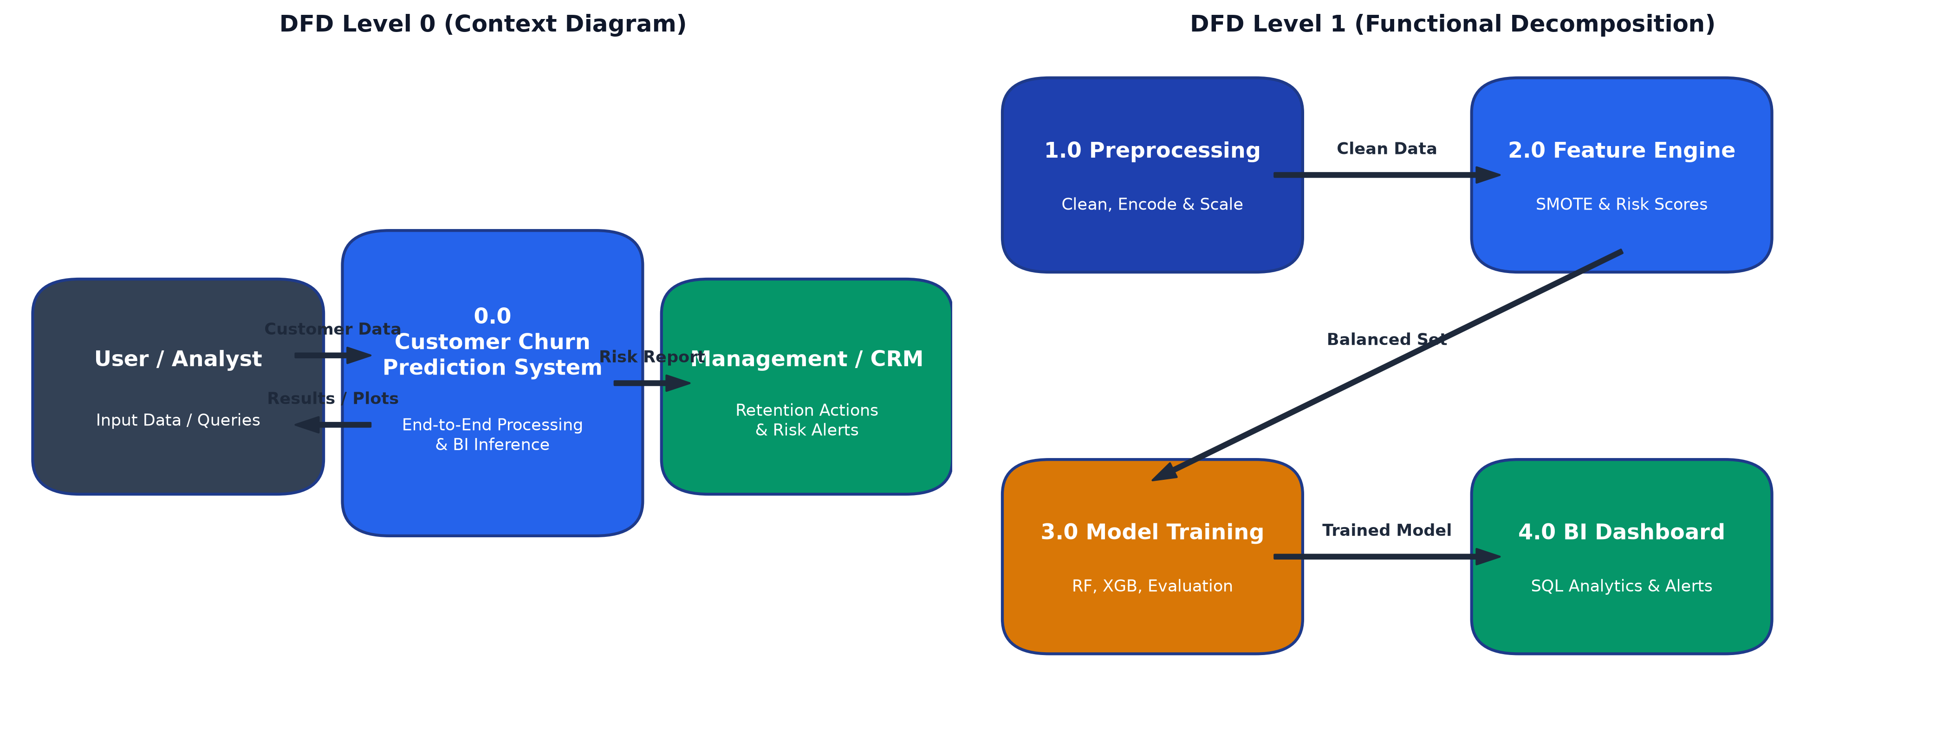
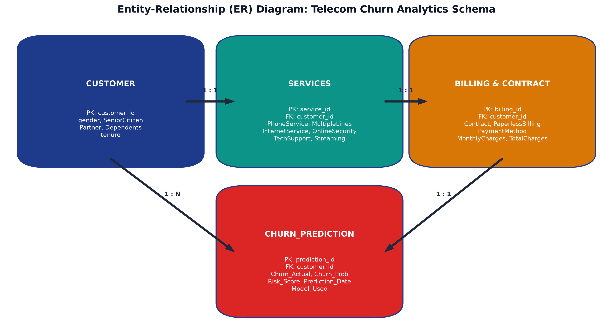
Design - UML, ER & DFD Diagrams

Slide 13
Thank You!
Questions & Feedback
Team No: 8 | Department of Data Science | Anurag University

