Slide 1
Customer churn prediction & Business intelligence System
Domain: Business – Data Science Telecom Analytics
Under the Guidance of
Dr. V Biksham, Asst.Professor
Dept. of Data Science
Team No: 8
Bekkem Kalyan (23EG110C09)
Eramolla Aryan Preetham (23EG110C21)
Tirumala Peddinty Vijaya Krishna Sreekar(23EG110C60)

Slide 2
Abstract
Customer churn is a critical profit driver in telecom, where subscriber acquisition costs up to seven times more than customer retention. Using the benchmark IBM Telco dataset (7,043 subscriber profiles across 21 attributes), this project builds an end-to-end predictive pipeline. By resolving class imbalance through SMOTE and optimizing feature preprocessing, supervised classifiers (led by Random Forest and XGBoost) achieve a superior benchmark of 83.62% ROC-AUC and 70.43% churn recall.
To bridge machine learning with enterprise decision-making, the system integrates a SQLite analytics database executing ten cohort queries to identify high-risk segments and quantify $138,529 in monthly revenue at risk. An interactive Streamlit web dashboard delivers sub-50ms real-time churn risk scoring, dynamic factor explainability, and automated executive report generation, empowering retention managers to proactively deploy targeted interventions.

Slide 3
Introduction
Problem Context & Industry Challenge
• Telecom service providers experience heavy revenue loss due to customer contract cancellations (churn).
• Manual identification of at-risk customers is ineffective due to complex, multi-dimensional customer behavioral patterns.
• Unaddressed churn results in high acquisition overheads, reduced customer lifetime value (CLV), and diminished market share.
Proposed Solution & Data Flow
• Data Ingestion → Clean & Preprocess → Feature Engineering (SMOTE) → Multi-Model ML Training → SQL Analytics → Streamlit UI.
• Enables telecom managers to proactively intervene with targeted discounts, tenure perks, and service upgrades before churn occurs.

Slide 4
Objectives
1. End-to-End Data Pipeline & Feature Engineering: Ingest, clean, and preprocess the IBM Telco Churn dataset, engineering composite risk metrics and applying SMOTE to address class imbalance.
2. Predictive Model Optimization: Train and validate Machine Learning classifiers (Random Forest, XGBoost, Logistic Regression) to accurately identify churn patterns with high ROC-AUC and Recall.
3. Financial & Cohort Analytics Engine: Build a robust SQL-powered analytics database to calculate monthly revenue at risk and isolate high-churn customer segments.
4. Interactive Decision Support Dashboard: Deploy a real-time Streamlit web dashboard for instant single/batch churn prediction and executive reporting.

Slide 5
Literature Survey
S.No | Paper Title & Published Year | Author(s) | Methodology & Model Used | Drawbacks / Limitations | Source
1 | A Customer Churn Prediction Model in Telecom Industry Using Boosting (2014) | Ning Lu | Boosting Algorithm integrated with Customer Demographic & Usage Segmentation | High computational training cost; lacks real-time interactive UI | IEEE Trans. Ind. Informatics
2 | Customer Churn Prediction in Telecom Using ML in Big Data Platform (2019) | A. K. Ahmad | Decision Trees, Random Forest & XGBoost with Social Network Analysis | Heavy infrastructure overhead; complex big data pipelines required | Journal of Big Data (Springer)
3 | Predicting Customer Churn in Telecom Using Surrogate Profiling (2019) | Irfan Ullah | Random Forest Classification coupled with K-Means Customer Clustering | Multi-stage pipeline complexity; lacks integrated SQL cohort revenue engine | IEEE Access
4 | Hybrid ML Framework for Customer Churn Prediction in Telecom (2024) | Shimaa Ouf | Hybrid Ensemble Stacking Classifiers with Multi-Feature Extraction | Elevated inference latency; absence of interactive real-time retention dashboard | Springer (Discover Comp.)
5 | Customer Churn Prediction in Telecom Sector Using ML Techniques (2025) | Rohit | Exploratory Data Analysis with Multi-Model Benchmarking (RF, SVM, LR) | Evaluated on single static dataset; lacks financial risk & revenue loss metrics | IEEE ICONAT

Slide 6
Existing Work and Limitations
Current / Existing Industry Approaches
• Traditional Rule-Based Analytics: Many telecom providers rely on static heuristic threshold rules (e.g., flag accounts after 2 missed bills).
• Isolated Model Experiments: Prior studies focus exclusively on model training accuracy without deploying end-to-end usable business applications.
Key Limitations of Existing Systems
• Neglect of Class Imbalance: Churn datasets typically have a ~73:27 majority-minority split, causing standard models to be biased toward non-churners.
• Lack of Revenue Quantification: Existing solutions predict binary labels (0/1) but fail to quantify the direct financial revenue at risk ($/month).
• Absence of Real-Time Decision Support: Most models operate in offline batch scripts without an accessible web interface for customer support teams.

Slide 7
Proposed Work and Advantages
Proposed Methodology
• End-to-End Automated Pipeline: Comprehensive orchestration from raw CSV ingestion to automated EDA, SMOTE balancing, SQL storage, and web UI.
• Advanced Feature Engineering: Creation of domain-specific features including ChargesPerTenure, ServiceCount, and a composite RiskScore.
• Multi-Model Comparative Benchmarking: Rigorous evaluation of Random Forest, XGBoost, and Logistic Regression with cross-validation.
Key Advantages
• High Predictive Reliability: Achieved 83.62% ROC-AUC and 70.43% churn recall, effectively capturing at-risk subscribers.
• Quantified Financial Impact: SQL analytics calculates exact revenue at risk ($138,529/mo) to prioritize high-value customer retention.
• Operational Ready: Includes an intuitive Streamlit dashboard allowing non-technical managers to run instant real-time predictions.

Slide 8
Software and Hardware Requirements
Software Requirements
• Operating System: Windows 10 / 11 / Linux
• Programming Language: Python 3.9+
• ML & Data Libraries: Scikit-learn, XGBoost, Imbalanced-learn (SMOTE), Pandas, NumPy
• Database Engine: SQLite3 & SQLAlchemy
• Visualization & Web UI: Streamlit, Matplotlib, Seaborn, Plotly
• Documentation & Reports: python-pptx, python-docx, ReportLab
Hardware Requirements
• Processor: Intel Core i5 / AMD Ryzen 5 or higher
• RAM: Minimum 8 GB (16 GB Recommended)
• Storage: 500 MB free disk space for dataset, database & models
• Display: Standard Full HD (1920x1080) resolution
• Connectivity: Active Internet connection for initial package installation and data retrieval

Slide 9
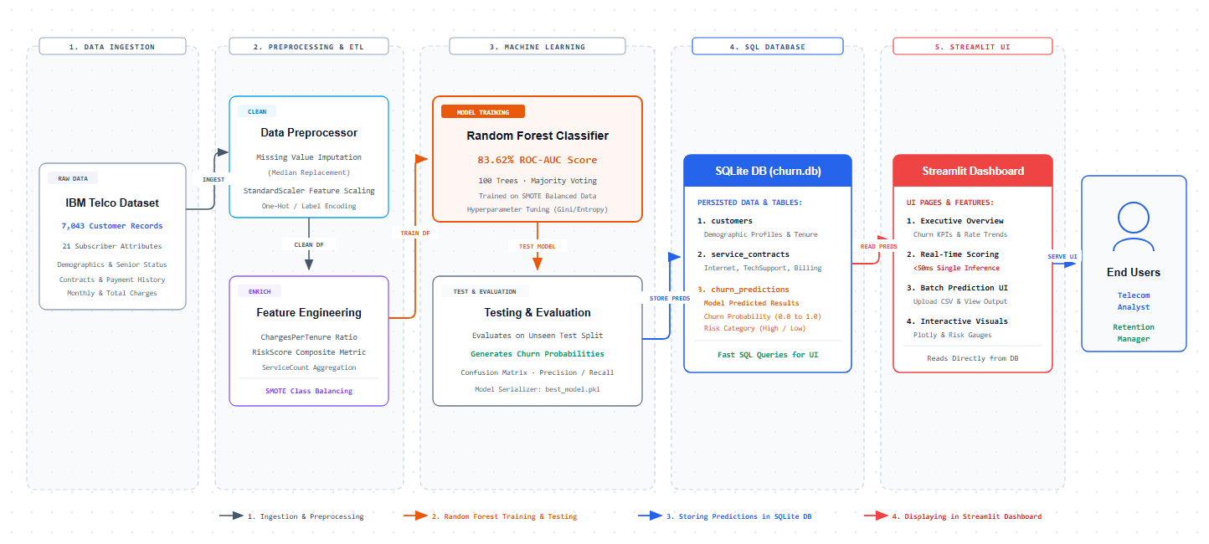
System Architecture

Slide 10
Modules
• Module 1: Data Ingestion & Preprocessing: Handles raw CSV ingestion (7,043 rows), cleans whitespace/missing values in TotalCharges, encodes categorical variables, and performs standard feature scaling.
• Module 2: Feature Engineering & SMOTE Resampling: Derives predictive domain features (ChargesPerTenure, ServiceCount, RiskScore) and balances minority churn cases using SMOTE oversampling.
• Module 3: Model Training & Evaluation Engine: Trains Logistic Regression, Random Forest, and XGBoost with hyperparameter tuning; exports evaluation metrics (AUC, F1, Recall, Confusion Matrices).
• Module 4: SQL Business Intelligence & Cohort Analytics: Stores cleaned data into SQLite (churn.db) and executes 10 strategic SQL queries to evaluate cohort churn and calculate revenue at risk ($138K/mo).
• Module 5: Interactive Web Dashboard (Streamlit): Provides an interactive web UI for real-time customer risk prediction, batch CSV scoring, ARR/MRR financial telemetry, ground-truth model testing, and executive report exports.

Slide 11
System Design & Workflow
Functional Design & Layered Architecture
• Presentation Layer: Streamlit Dashboard UI receiving real-time user inputs and rendering visual analytics.
• Application / Service Layer: Python inference pipeline loading serialized models (`best_model.pkl`) and running live probability scoring.
• Data & Persistence Layer: SQLite Relational Database (`churn.db`) managing relational customer records, service contracts, and historical churn outcomes.
Design Specifications & Quality Attributes
• Modularity: Decoupled architecture allowing independent model updates or data pipeline extensions.
• Responsiveness & Low Latency: Single customer churn predictions generated in < 50ms.
• Reliability & Maintainability: Automated unit checks, structured logging, and persistent artifact generation.

Slide 12
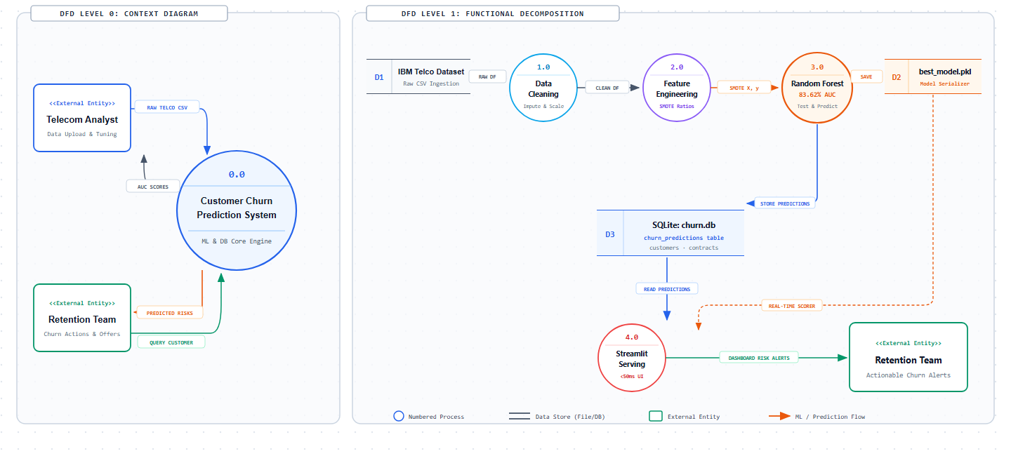
Data Flow Diagram (DFD Level 0 & Level 1)

Slide 13
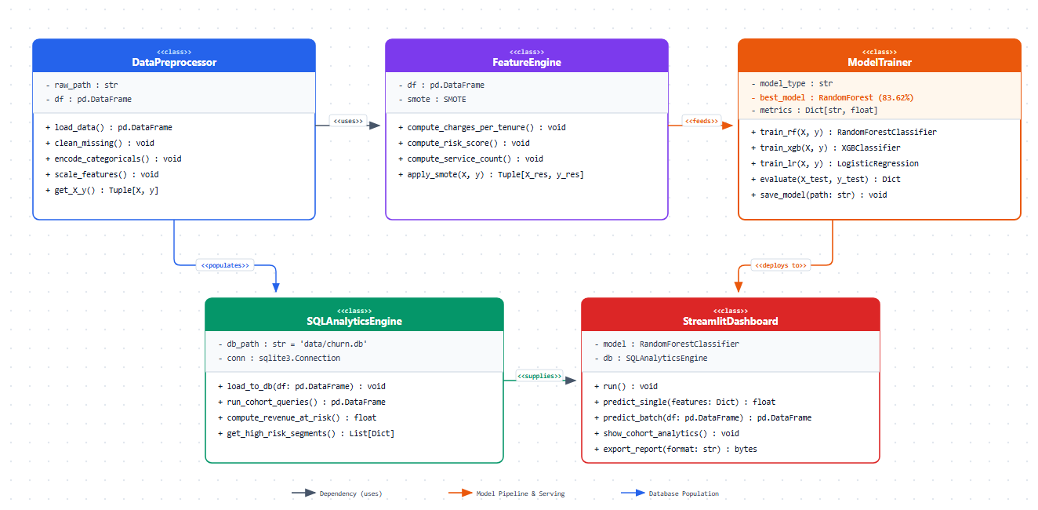
Design - UML Class Diagram

Slide 14
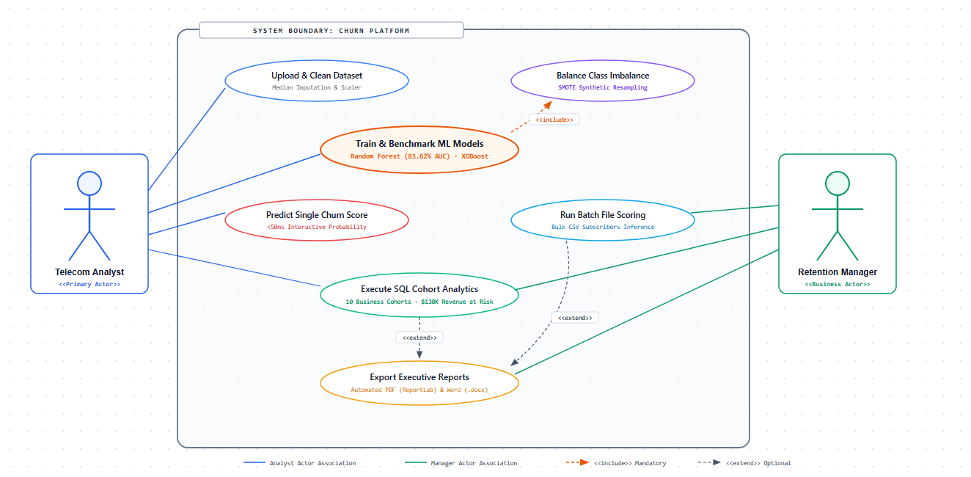
Design - UML Use Case Diagram

Slide 15
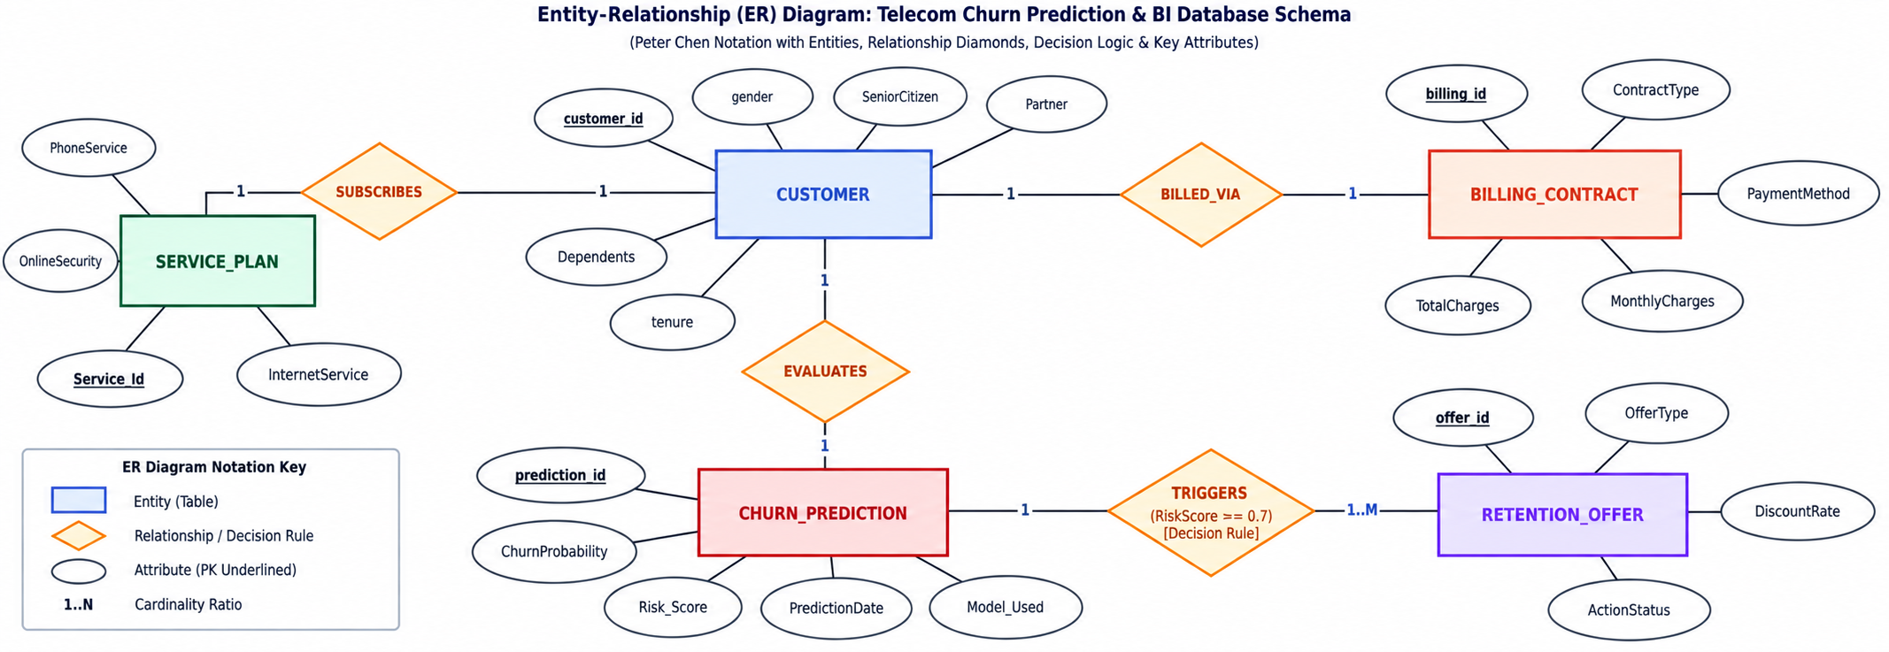
Entity-Relationship (ER) Diagram
• Relational Schema Design: Defines structured entities for Customers, ServiceContracts, BillingDetails, ChurnPredictions & RevenueMetrics.
• Central Primary Key Mapping: CustomerID serves as the central foreign key connecting subscriber demographic profiles, services & billing history.
• Cohort Analytics Support: Structured relational schema enables fast SQL aggregations to calculate churn rates by contract & payment method.

Slide 16
Thank You!
Questions & Feedback
Team No: 8 | Department of Data Science | Anurag University

