Slide 1

GNN IN RECOMMENDER SYSTEM
Trinh Quang Anh - ITCSIU21164
Thesis presntation
Goal: learn preference, not exposure
Notes:
[Sources]
- Background image (Unsplash): https://unsplash.com/photos/network-connection-big-data-visualisation-abstract-digital-background-technology-backdrop-uEGPW7Q6Uhc
[/Sources]

Slide 2

Recommender Systems: Back ground
Context
The era of information explosion
Video feeds are unlimited, but user time is finite
Modern platforms deliver massive amounts of content
Users are exposed to far more items than they can consume.
Reduce information over load and persionalize content
Notes:
[Sources]
- Tenrec dataset overview (multi-feedback, true negatives): https://proceedings.neurips.cc/paper_files/paper/2022/hash/4ad4fc1528374422dd7a69dea9e72948-Abstract-Datasets_and_Benchmarks.html
- Exposure bias discussion (survey reference): https://www.sciencedirect.com/science/article/pii/S1566253523002221
[/Sources]

Slide 3

Recommender Systems: Back ground
Context
Noisy user interaction
User interactions í mótly implicit and noisy
Dificult to ìner true preference
Mostly implicit feedback (click/watch) → noisy
Exposure bias: not-click ≠ dislike
Clicking does not mean liking,
and not clicking does not mean not liking
Notes:
[Sources]
- Tenrec dataset overview (multi-feedback, true negatives): https://proceedings.neurips.cc/paper_files/paper/2022/hash/4ad4fc1528374422dd7a69dea9e72948-Abstract-Datasets_and_Benchmarks.html
- Exposure bias discussion (survey reference): https://www.sciencedirect.com/science/article/pii/S1566253523002221
[/Sources]

Slide 4
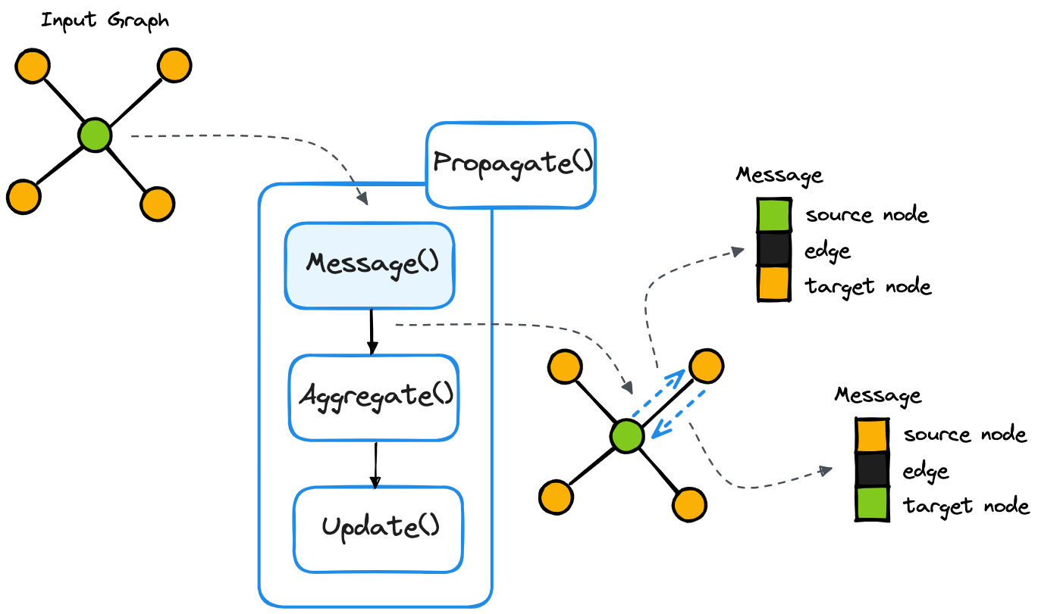
Models today
Background
GNN
High order
LightGCN
user–item–user
item–user–item
Strong, simple baseline for graph collaborative filtering
Message passing
Improves representations when data is sparse
Notes:
[Sources]
- NGCF (graph CF with embedding propagation): https://arxiv.org/abs/1905.08108
- LightGCN (simplified graph CF): https://arxiv.org/abs/2002.02126
[/Sources]

Slide 5
Why GNN/LightGCN still needs improvement
Gap
LightGCN is strong… but it learns from what we feed it
Common assumptions (problematic in feeds)
Our stance
Observed interaction = positive
Unobserved item = negative (random sampling)
All positives have same strength (click ≈ like)
Before changing the GNN architecture, fix the training signal:
Use multi-behavior to separate strong vs weak positives
Mine true negatives when possible
Use a non-linear reranker to fuse metadata + embeddings
Result
Graph contains many weak/noisy edges ⇒ message passing spreads noise ⇒ embeddings misaligned with true preference.
Key thesis message
Shift from modeling exposure → modeling preference.
Notes:
[Sources]
- LightGCN paper (assumptions & simplification): https://arxiv.org/abs/2002.02126
- Tenrec has multi-feedback and true negatives: https://proceedings.neurips.cc/paper_files/paper/2022/hash/4ad4fc1528374422dd7a69dea9e72948-Abstract-Datasets_and_Benchmarks.html
[/Sources]

Slide 6
What breaks in practice
Problem
Implicit feedback is noisy
In feed recommendation, a click often means “exposed”, not “liked”.
Click noise
False negatives
Multi-behavior gap
Accidental taps, quick scrolls, very short watches ⇒ many “weak positives”.
Unobserved ≠ disliked. User may never see the item (exposure bias).
Like/share/follow are sparse but much stronger preference signals.
If we build the graph from noisy clicks, message passing spreads noise and distorts embeddings.
We need to improve the training signal *before* graph learning.
Notes:
[Sources]
- Tenrec motivation (multi-feedback, true negatives): https://proceedings.neurips.cc/paper_files/paper/2022/hash/4ad4fc1528374422dd7a69dea9e72948-Abstract-Datasets_and_Benchmarks.html
- Exposure bias concept (survey reference): https://www.sciencedirect.com/science/article/pii/S1566253523002221
[/Sources]

Slide 7


Dataset
Tenrec
Tenrec dataset
Why Tenrec
user
profiles
Real-world data from Tencent platforms
Multi-behavior signals
Explicit exposure-based negatives
QK-platform
actions
video
attributes
Actions:
click
like
share
follow
Profiles:
age
gender
Attributes:
Video category
Watching time
Click/like/share/ follow count

Slide 8
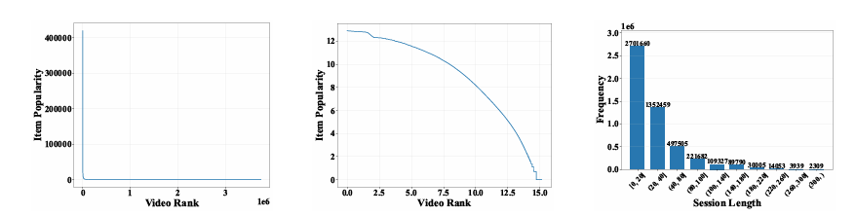
Dataset
Tenrec
Tenrec dataset
Long tail challenge
Few popular items dominate interactions
Most items are rarely interacted

Slide 9
Proposed Solution
Hybrid Cascade
Hybrid Cascaded Framework (high level)
1) RF Denoise
2) LightGCN
3) RF Rerank
Use strong signals
(like/share/follow)
→ pseudo-label clicks
Learn embeddings on
cleaner graph
+ hybrid negatives
Fuse embeddings +
metadata + stats
→ better ordering
What makes it “hybrid”?
• GNN captures collaborative structure (high-order signals)
• Random Forest is strong for noisy, heterogeneous features
• Cascade lets each stage fix a specific failure mode

Slide 10
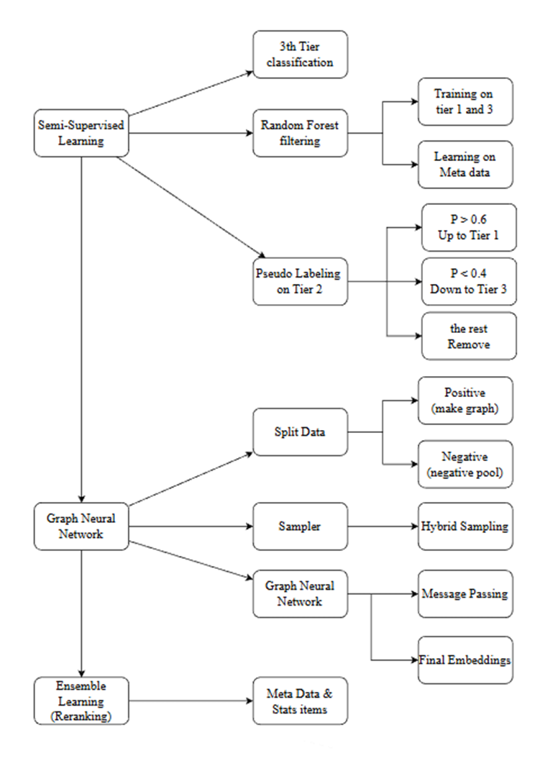
End-to-end Pipeline
Architecture
From preprocessing
↓
denoising
↓
graph learning
↓
reranking
One sentence: Clean the labels → learn embeddings → rerank with metadata.
Notes:
[Sources]
- Diagram created by the author (thesis pipeline).
[/Sources]

Slide 11
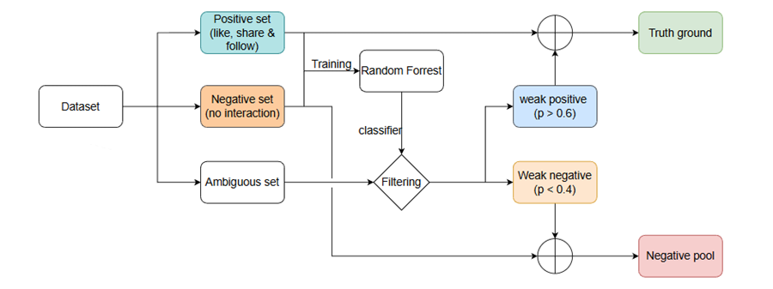
Stage 1 — Interaction denoising
RF Teacher
Goal: separate strong preference from weak clicks
Train a small Random Forest on high-confidence signals, then pseudo-label ambiguous cases.
Output of denoising
• Positive set: strong positives + high-confidence “weak positives”
• Negative pool: exposed-but-ignored / low-confidence interactions
• Remove uncertain cases to reduce noise
Notes:
[Sources]
- Diagram created by the author (tiered denoising / pseudo-labeling).
[/Sources]

Slide 12
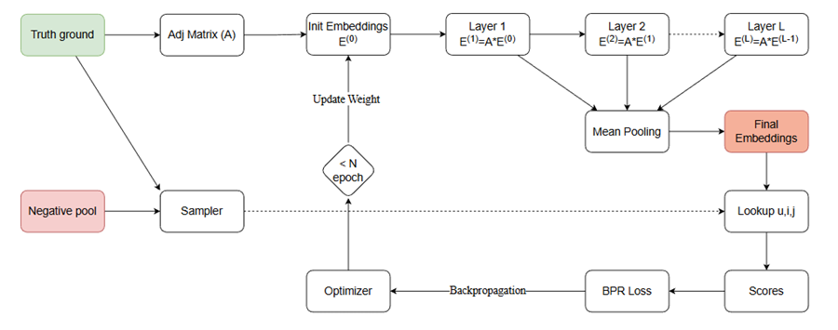
Stages 2–3 — LightGCN + Reranking
Training
Learn embeddings, then improve ordering with metadata
LightGCN (graph learning)
RF Reranking (non-linear)
• Train on cleaned graph
• BPR loss (u, pos, neg)
• Negative sampling: hybrid(true-neg + random)
• Input: embeddings + metadata
• Capture non-linear patterns
• Improves NDCG by reordering top-N
Notes:
[Sources]
- LightGCN paper: https://arxiv.org/abs/2002.02126
- Diagram created by the author (training flow).
[/Sources]

Slide 13
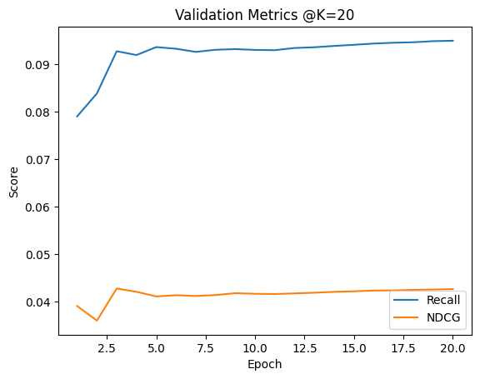
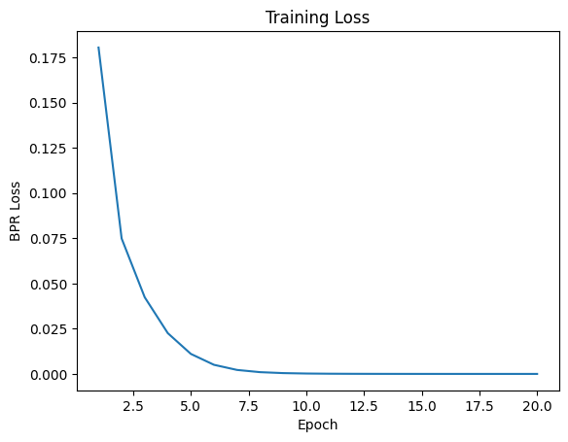
Results snapshot
Evidence
Hybrid improves ranking quality (NDCG) and discrimination (AUC)
Example (QB-video)
Training behavior (example)
Model
Recall
NDCG
AUC
LightGCN
0.317
0.107
—
+ Rerank
0.326
0.150
—
Full hybrid
0.40
0.2145
0.70
Interpretation
We improve ordering (NDCG) and preference separation (AUC). Recall can trade off depending on how strict denoising is.
Notes:
[Sources]
- Curves and results are from the author's experiments.
[/Sources]

Slide 14
Ablation: what helps / what hurts
Diagnosis
Key finding: reranking is consistently helpful
Some denoise + true-neg settings underperform because evaluation uses click-only positives.
How to read this
• A1 > A0: reranking improves ordering
• A2 < A0: denoise removes many click-positives
• A3/A4: true-neg is “too strict” under click-only evaluation
• Takeaway: preference-aware learning needs aligned evaluation (e.g., like/share targets).
Positive message
Even when denoising is imperfect, reranking remains a strong, reliable gain.
Notes:
[Sources]
- Ablation numbers are from the author's experiments.
[/Sources]

Slide 15
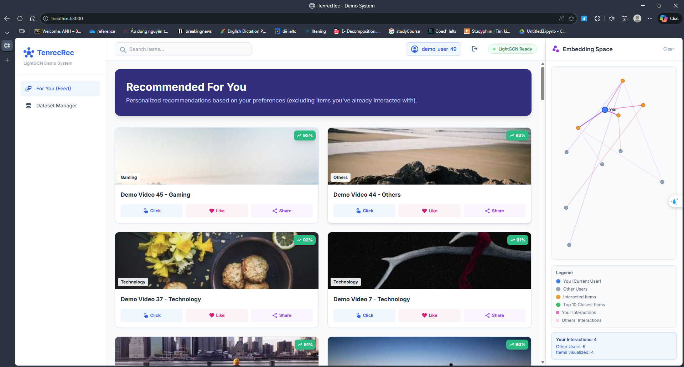
Demo (friendly website)
Live
Goal of demo: make the pipeline understandable, not just numbers.

Slide 16
Conclusion
Conclusion
What this thesis contributes
Preference-aware denoising: use multi-behavior (like/share/follow) to re-label weak clicks
Cleaner graph for LightGCN: reduce noisy edges so message passing learns better embeddings
Non-linear reranking: RF fuses embeddings + metadata → better top-N ordering
Final message
To improve GNN recommenders in real feeds, we must improve the *training signal* (preference) and then improve the *ranking* (rerank).
Next steps: evaluate using preference targets (like/share), run full ablation, and deploy the demo for user study.
Notes:
[Sources]
- LightGCN: https://arxiv.org/abs/2002.02126
- Tenrec dataset: https://proceedings.neurips.cc/paper_files/paper/2022/hash/4ad4fc1528374422dd7a69dea9e72948-Abstract-Datasets_and_Benchmarks.html
[/Sources]

Slide 17
THANK YOU
Time for Q&A

