Slide 1
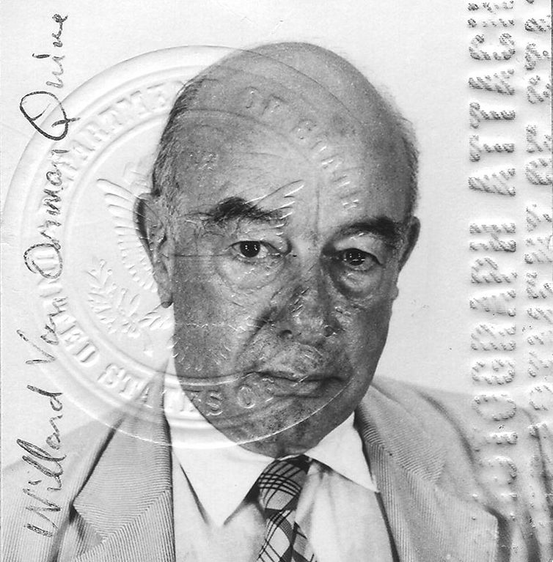
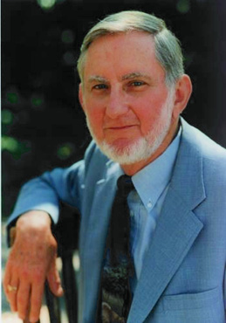
Quine – McCluskey Logic Optimization
William Van Orman Quine 1908 - 2000
Edward J. McCluskey 1929 - 2016

Slide 2
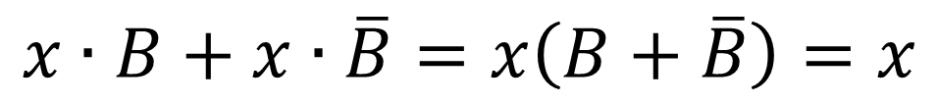
Quine – McCluskey Logic Optimization
$$x∙B+x∙\overline{B}=x\left(B+\overline{B}\right)=x$$
Notes:
E.g. a function f =xy+yz+w
minterm := a product term of a function; e.g. xy, yz, w
Cube := is the {0,1,-} representation of a minterm; e.g. „-11-“ represents xy with the ordering „wxyz“
Implicant := is a minterm that „implies“ the function, i.e. when implicant p=1 => f=1.
e.g. xy, xyz, wxyz are all implicants
Prime implicant := is an implicant that cannot further be reduced; e.g. xy is a prime implicant because neither x nor y is an implicant.
But xyz is not a prime implicant because xy is also an implicant
Essential prime implicant := is a prime implicant that covers a minterm that no other prime implicant covers.
E.g. xy, yz, and w are all essential prime implicants.
Prime implicant table := Rows are the prime implicants; columns are the minterms; the cell gets an ‚X‘ if a prime implicant covers a minterm
https://en.wikipedia.org/wiki/Implicant
https://en.wikipedia.org/wiki/Quine%E2%80%93McCluskey_algorithm

Slide 3
Terminology
Literals: variables, uncomplemented and complemented
Minterm, Maxterm
Implicant: A product term for which f=1
Prime implicant: An implicant, that cannot be reduced
Essential prime implicant: A prime implicant, which is the only prime implicant that covers a specific minterm
Cover: A set of implicants that account for all valuations for which f=1
Cost: Cost(gate) = 1+ # of inputs

Slide 4
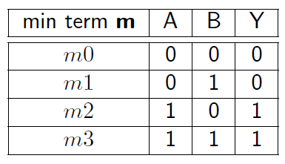
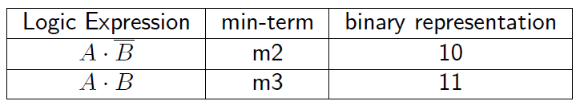
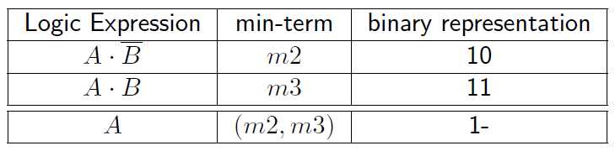
QM – Example 1

Slide 5


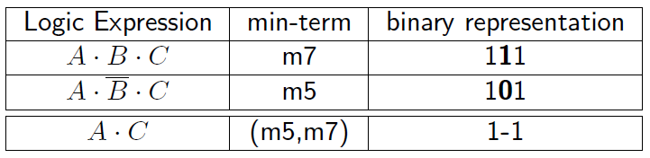

QM – Example 2

Slide 6
QM – Example 2
¬ C |  | C
0 | 0 | 1 | 0 | ¬ B
0 | 0 | 1 | 0 | B
¬ A | A |  | ¬ A

Slide 7
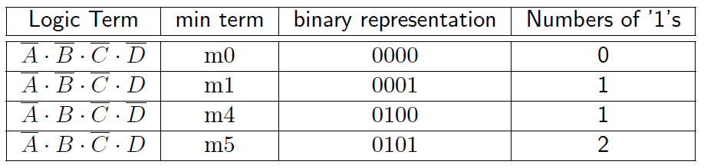
QM – Example 3
 | ¬ D |  | D
¬ A | 1 | 1 | 1 | 1 | ¬ C
A | 0 | 0 | 0 | 0
 | 0 | 0 | 0 | 0 | C
¬ A | 0 | 0 | 0 | 0
 | ¬ B | B |  | ¬ B

Slide 8
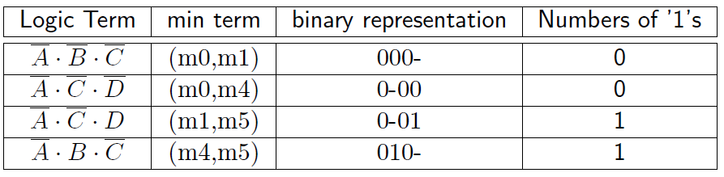
QM – Example 3

Slide 9
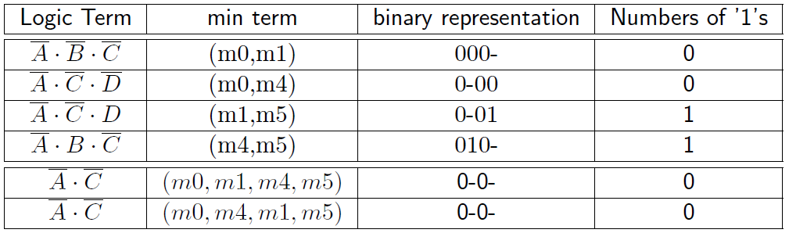
QM – Example 3

Slide 10
QM – Merging of Terms
Terms that can be combined must meet these criteria:
They differ by only one bit
They contain the same domain of variables

Slide 11
QM – Merging of Terms Procedure
Count the number of 1‘s and sort the rows accordingly
Terms with n number of 1‘s can only be combined with terms with n+1 number of 1‘s
Resulting terms will have n number of 1‘s
Merged terms must have the ‘-‘ aligned (Same domain)

Slide 12
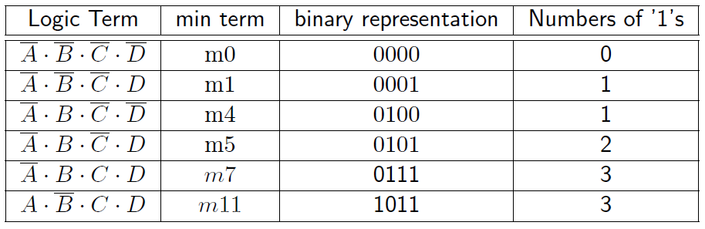
QM – Example 4

Slide 13
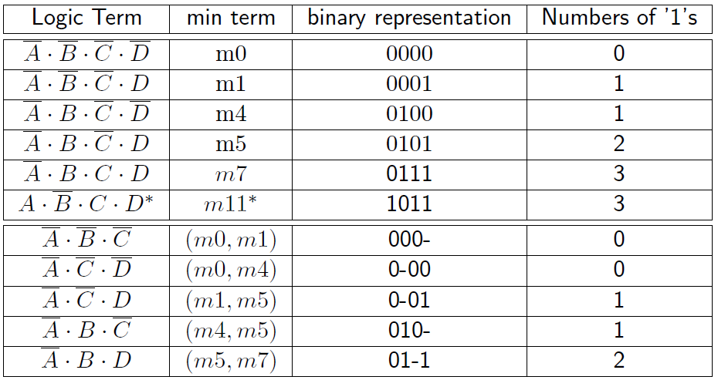
QM – Example 4

Slide 14
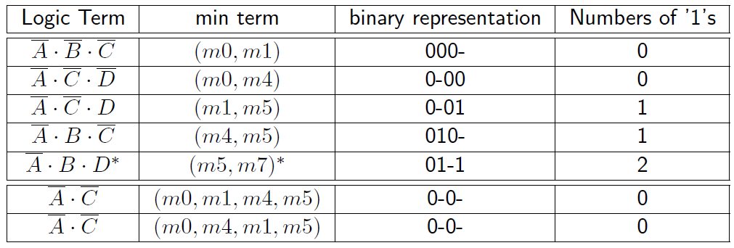
QM – Example 4

Slide 15
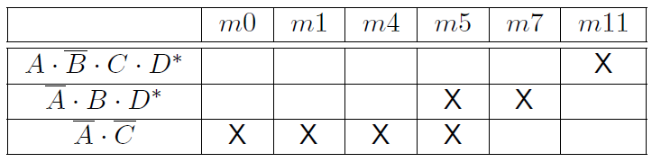

QM – Example 4
Optimized:
Original:

Slide 16
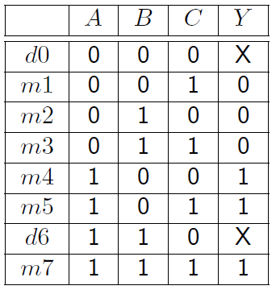
QM – Example 5: With Don‘t cares
¬ C |  | C
X | 1 | 1 | 0 | ¬ B
0 | X | 1 | 0 | B
¬ A | A |  | ¬ A

Slide 17
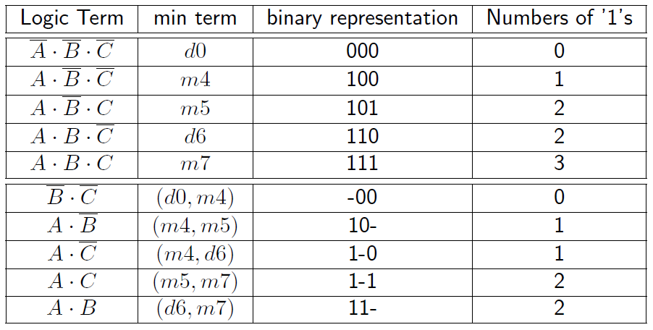
QM – Example 5: With Don‘t cares

Slide 18
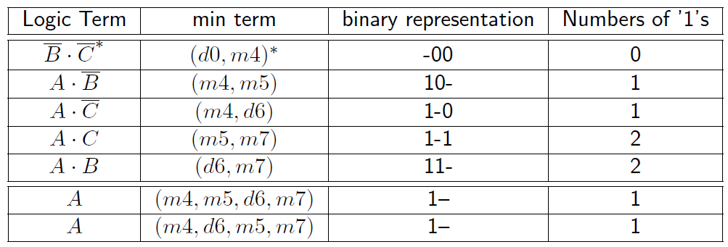
QM – Example 5: With Don‘t cares

Slide 19
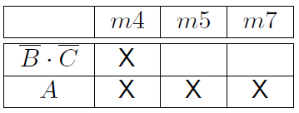
QM – Example 5: With Don´t cares
Table of essential terms:
Only onset terms are included, not don´t cares;
m5 and m7 are covered only by the term A, which means that A is compulsory;
All essential minterms are covered by A (m4,m5, d6,m7) so no other terms are needed;
d6 is used, but not d0, because B ʌ C (d0,m4) is not needed

Slide 20
QM – Example 6: Multiple Solutions
 | A | B | C | D | Y
m0 | 0 | 0 | 0 | 0 | 0
m1 | 0 | 0 | 0 | 1 | 0
m2 | 0 | 0 | 1 | 0 | 0
m3 | 0 | 0 | 1 | 1 | 0
m4 | 0 | 1 | 0 | 0 | 1
m5 | 0 | 1 | 0 | 1 | 0
m6 | 0 | 1 | 1 | 0 | 0
m7 | 0 | 1 | 1 | 1 | 0
m8 | 1 | 0 | 0 | 0 | 1
m9 | 1 | 0 | 0 | 1 | x
m10 | 1 | 0 | 1 | 0 | 1
m11 | 1 | 0 | 1 | 1 | 1
m12 | 1 | 1 | 0 | 0 | 1
m13 | 1 | 1 | 0 | 1 | 0
m14 | 1 | 1 | 1 | 0 | x
m15 | 1 | 1 | 1 | 1 | 1

Slide 21
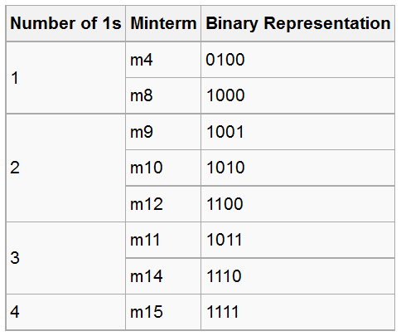
QM – Example 6: Multiple Solutions

Slide 22
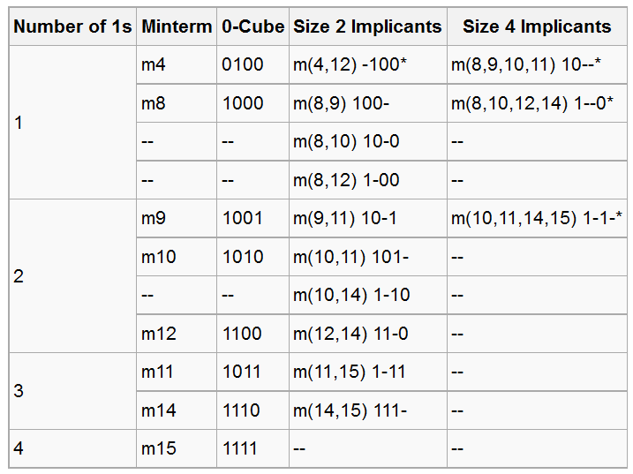
QM – Example 6: Multiple Solutions

Slide 23
QM – Example 6: Multiple Solutions
Prime Implicant Cover Table
 | m4 | m8 | m10 | m11 | m12 | m15
m(4,12) | X |  |  |  | X
m(8,9,10,11) |  | X | X | X
m(8,10,12,14) |  | X | X |  | X
m(10,11,14,15) |  |  | X | X |  | X
Rows: Prime Implicants
Columns: On-Set terms
X: A term is covered by a prime implicant

Slide 24
QM – Example 6: Multiple Solutions
Prime Implicant Cover Table
 | m4 | m8 | m10 | m11 | m12 | m15
m(4,12) | X |  |  |  | X
m(8,9,10,11) |  | X | X | X
m(8,10,12,14) |  | X | X |  | X
m(10,11,14,15) |  |  | X | X |  | X
Only covered by 1 implicant
Essential Prime Implicants
If there is a single X In a column, the corresponding prime implicant is an essential prime implicant

Slide 25
QM – Example 6: Multiple Solutions
Prime Implicant Cover Table
 | m4 | m8 | m10 | m11 | m12 | m15
m(4,12) * | X |  |  |  | X
m(8,9,10,11) |  | X | X | X
m(8,10,12,14) |  | X | X |  | X
m(10,11,14,15) * |  |  | X | X |  | X
Eliminate all columns covered by essential primes.

Slide 26
QM – Example 6: Multiple Solutions
Prime Implicant Cover Table
 | m4 | m8 | m10 | m11 | m12 | m15
m(4,12) * | X |  |  |  | X
m(8,9,10,11) |  | X | X | X
m(8,10,12,14) |  | X | X |  | X
m(10,11,14,15) * |  |  | X | X |  | X
Find minimum set of rows that cover the remaining columns.

Slide 27
QM – Example 6: Multiple Solutions
Prime Implicant Cover Table
 | m4 | m8 | m10 | m11 | m12 | m15
m(4,12) * | X |  |  |  | X
m(8,9,10,11) |  | X | X | X
m(8,10,12,14) |  | X | X |  | X
m(10,11,14,15) * |  |  | X | X |  | X
Find minimum set of rows that cover the remaining columns.

Slide 28

QM – Example 6: Multiple Solutions
Prime Implicant Cover Table
 | m4 | m8 | m10 | m11 | m12 | m15
m(4,12) * | X |  |  |  | X
m(8,9,10,11) |  | X | X | X
m(8,10,12,14) |  | X | X |  | X
m(10,11,14,15) * |  |  | X | X |  | X
Optimized:
Original:

Slide 29
QM – Example 7: Multiple Solutions
A | B | C | Y
0 | 0 | 0 | 1
0 | 0 | 1 | 0
0 | 1 | 0 | 1
0 | 1 | 1 | 1
1 | 0 | 0 | 1
1 | 0 | 1 | 1
1 | 1 | 0 | 0
1 | 1 | 1 | 1

Slide 30
QM – Example 7: Multiple Solutions
¬ C |  | C
1 | 1 | 1 | 0 | ¬ B
1 | 0 | 1 | 1 | B
¬ A | A |  | ¬ A
¬ C |  | C
1 | 1 | 1 | 0 | ¬ B
1 | 0 | 1 | 1 | B
¬ A | A |  | ¬ A

Slide 31
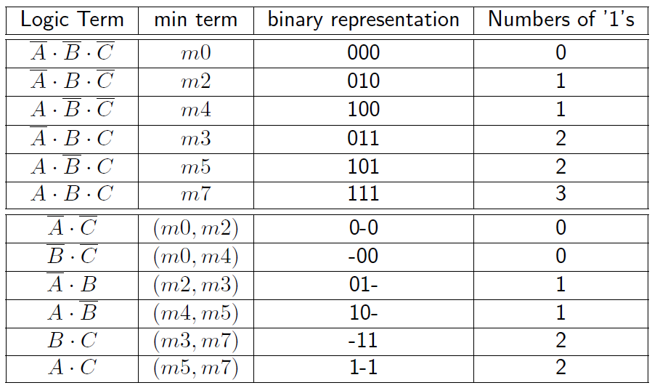
QM – Example 7: Multiple Solutions

Slide 32
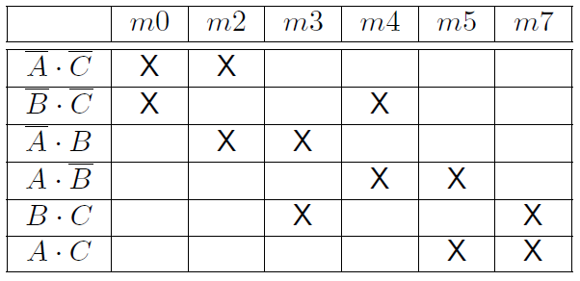
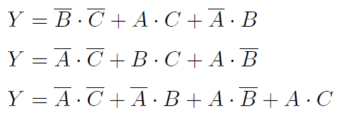
QM – Example 7: Multiple Solutions
Some possible solutions:

Slide 33
Minimal Cover
Identification of Essential Primes
Removing essential primes and covered minterms
a) Elimination of dominated rows b) Elimination of dominating columns
Selection of remaining primes for a minimal cover

Slide 34
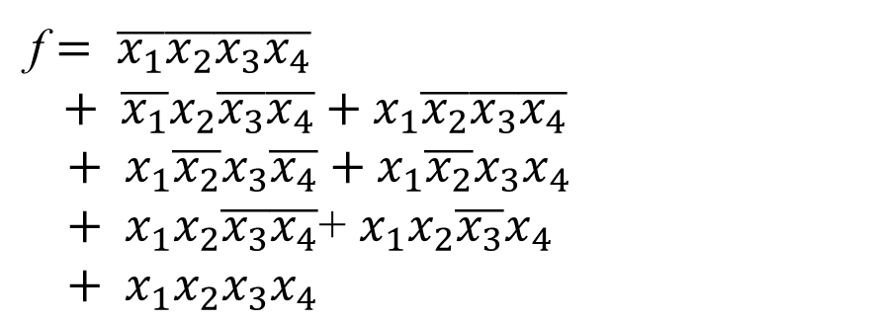
Example 8
x₁ | x₂ | x₃ | x₄ | f
0 | 0 | 0 | 0 | 1 | m0
0 | 0 | 0 | 1 | 0 | m1
0 | 0 | 1 | 0 | 0 | m2
0 | 0 | 1 | 1 | 0 | m3
0 | 1 | 0 | 0 | 1 | m4
0 | 1 | 0 | 1 | 0 | m5
0 | 1 | 1 | 0 | 0 | m6
0 | 1 | 1 | 1 | 0 | m7
1 | 0 | 0 | 0 | 1 | m8
1 | 0 | 0 | 1 | 0 | m9
1 | 0 | 1 | 0 | 1 | m10
1 | 0 | 1 | 1 | 1 | m11
1 | 1 | 0 | 0 | 1 | m12
1 | 1 | 0 | 1 | 1 | m13
1 | 1 | 1 | 0 | 0 | m14
1 | 1 | 1 | 1 | 1 | m15
f $= \overline{x_{1}}\overline{x_{2}}\overline{x_{3}}\overline{x_{4}}$
$$+ \overline{x_{1}}x_{2}\overline{x_{3}}\overline{x_{4}}+x_{1}\overline{x_{2}}\overline{x_{3}}\overline{x_{4}}$$
$+ x_{1}\overline{x_{2}}x_{3}\overline{x_{4}}+x_{1}\overline{x_{2}}x_{3}x_{4}$
$+{ x}_{1}x_{2}\overline{x_{3}}\overline{x_{4}}$+ $x_{1}x_{2}\overline{x_{3}}x_{4}$
$+ { x}_{1}x_{2}x_{3}x_{4}$

Slide 35
Sort lists by number of 1s
0-cubes
1-cubes
2-cubes
Prime implicants P = {10x0, 101x,110x, 1x11, 11x1, xx00}
= {p₁, p₂, p₃, p₄, p₅, p₆}

Slide 36
p6 is essential
Prime
Minterm
implicant
0
4
8
10
11
12
13
15
p
1
0
x
0
1
p
1
0
1
x
2
p
1
1
0
x
3
p
1
x
1
1
4
p2 dominates p1
p
1
1
x
1
5
p
x
x
0
0
6
p5 dominates p3
Initial prime implicant cover table
Prime
Minterm
implicant
10
11
13
15
Prime
Minterm
p
implicant
10
11
13
15
1
p
p
2
2
p
p
3
4
p
4
p
p
5
5
After the removal of essential prime implicants
After the removal of dominated rows

Slide 37
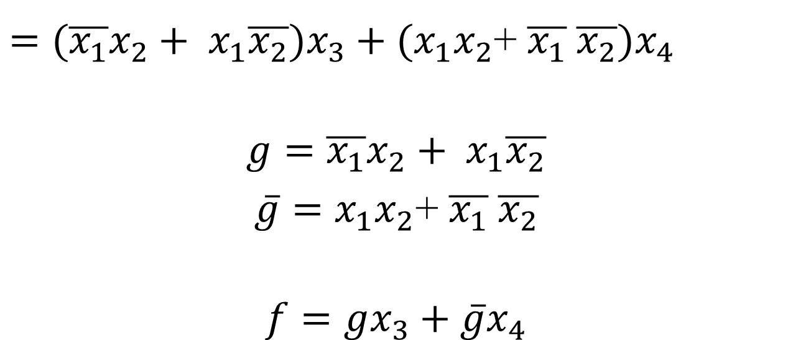
Cover: C = {p₂, p₅, p₆} = {101x, 11x1, xx00}
$f= x_{1}\overline{x_{2}}x_{3}+x_{1}x_{2}x_{4}+\overline{x_{3}}$ $\overline{x_{4}}$
original function:
f $= \overline{x_{1}}\overline{x_{2}}\overline{x_{3}}\overline{x_{4}}+\overline{x_{1}}x_{2}\overline{x_{3}}\overline{x_{4}}+x_{1}\overline{x_{2}}\overline{x_{3}}\overline{x_{4}}+x_{1}\overline{x_{2}}x_{3}\overline{x_{4}}+x_{1}\overline{x_{2}}x_{3}x_{4}+x_{1}x_{2}\overline{x_{3}}\overline{x_{4}}$+ $x_{1}x_{2}\overline{x_{3}}x_{4}+x_{1}x_{2}x_{3}x_{4}$

Slide 38

Example 9 with Don‘t Cares
x₁ | x₂ | x₃ | x₄ | f
0 | 0 | 0 | 0 | 1 | m0
0 | 0 | 0 | 1 | d | m1
0 | 0 | 1 | 0 | 1 | m2
0 | 0 | 1 | 1 | 0 | m3
0 | 1 | 0 | 0 | 0 | m4
0 | 1 | 0 | 1 | 1 | m5
0 | 1 | 1 | 0 | 1 | m6
0 | 1 | 1 | 1 | 1 | m7
1 | 0 | 0 | 0 | 1 | m8
1 | 0 | 0 | 1 | 1 | m9
1 | 0 | 1 | 0 | 0 | m10
1 | 0 | 1 | 1 | 0 | m11
1 | 1 | 0 | 0 | d | m12
1 | 1 | 0 | 1 | 1 | m13
1 | 1 | 1 | 0 | 0 | m14
1 | 1 | 1 | 1 | d | m15
$$f=\sum{m\left(0,2,5,6,7,8,9,13\right)+D(1,12,15)}$$

Slide 39
Prime implicants P = {00x0, 0x10, 011x, x00x, xx01, 1x0x, x1x1}
= {p₁, p₂, p₃, p₄, p₅, p₆ , p₇}

Slide 40
p7 dominates p5
Prime
Minterm
m9 dominates m8
implicant
0
2
5
6
7
8
9
13
Prime
Minterm
implicant
0
2
5
6
7
8
p
0
0
x
0
p
0
0
x
0
1
1
p
0
x
1
0
p
0
x
1
0
2
2
p
p
0
1
1
x
3
0
1
1
x
3
p
x
0
0
x
p
x
0
0
x
4
4
p
x
x
0
1
p
x
x
0
1
5
5
p
1
x
0
x
p
1
x
0
x
6
6
p
x
1
x
1
7
p
x
1
x
1
7
p4 dominates p6
Initial prime implicant cover table;
No essential primes!
No dominated rows!
After the removal of dominating
columns 9 and 13
m13 dominates m5
Prime
Minterm
p4 and p7 are essential
implicant
2
6
Prime
Minterm
implicant
0
2
5
6
7
8
p
p2 dominates p1 and p3
1
p
p
1
2
p
2
p
p
3
3
p
4
p
After including P₄ and P₇ in the cover
7
After the removal of dominated rows P₅ and P₆

Slide 41
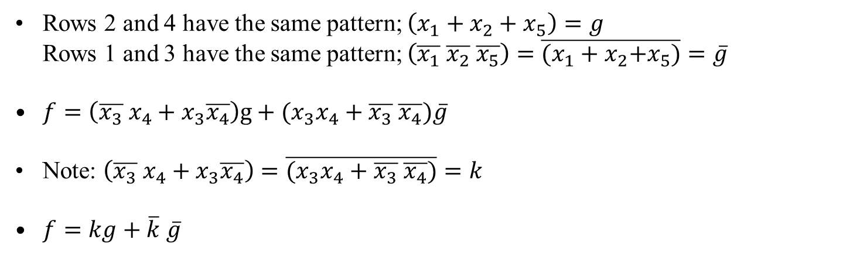
Cover: C = {p₂, p₄, p₇} = {0x10, x00x, x1x1}
$f= \overline{x_{1}}x_{3}\overline{x_{4}}+\overline{x_{2}}$ $\overline{x_{3}}+x_{2}x_{4}$

Slide 42
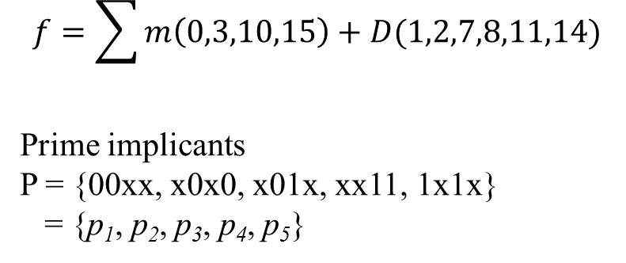
Example 10
x₁ | x₂ | x₃ | x₄ | f
0 | 0 | 0 | 0 | 1 | m0
0 | 0 | 0 | 1 | d | m1
0 | 0 | 1 | 0 | d | m2
0 | 0 | 1 | 1 | 1 | m3
0 | 1 | 0 | 0 | 0 | m4
0 | 1 | 0 | 1 | 0 | m5
0 | 1 | 1 | 0 | 0 | m6
0 | 1 | 1 | 1 | d | m7
1 | 0 | 0 | 0 | d | m8
1 | 0 | 0 | 1 | 0 | m9
1 | 0 | 1 | 0 | 1 | m10
1 | 0 | 1 | 1 | d | m11
1 | 1 | 0 | 0 | 0 | m12
1 | 1 | 0 | 1 | 0 | m13
1 | 1 | 1 | 0 | d | m14
1 | 1 | 1 | 1 | 1 | m15
$$f=\sum{m\left(0,3,10,15\right)+D(1,2,7,8,11,14)}$$
Prime implicants
P = {00xx, x0x0, x01x, xx11, 1x1x}
= {p₁, p₂, p₃, p₄, p₅}

Slide 43
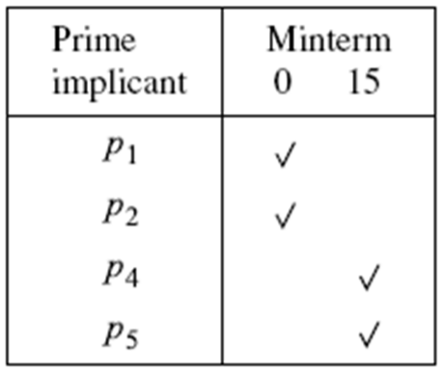
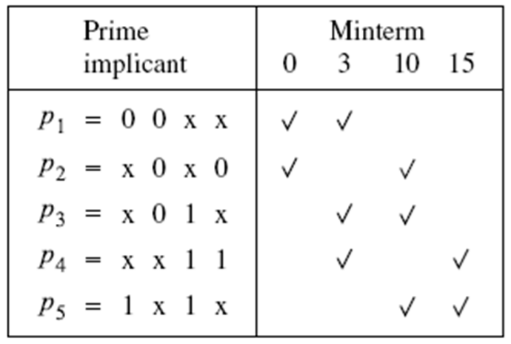
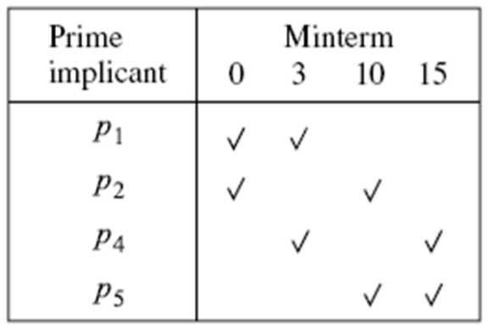
Branching with P₃
After including p₃
Initial implicant cover table
No essential primes;
No dominating rows;
No dominating columns;
After excluding p₃

Slide 44
Alternatives:
A₁ = {P₁, P₃, P₄} ; cost = 3+3+3+4 = 13
A₂ = {P₁, P₃, P₅} ; cost = 3+3+3+4 = 13
A₃ = {P₂, P₃, P₄} ; cost = 3+3+3+4 = 13
A₄ = {P₂, P₃, P₅} ; cost = 3+3+3+4 = 13
A₅ = {P₁, P₅} ; cost = 3+3+3 = 9
A₆ = {P₂, P₄} ; cost = 3+3+3 = 9
We choose the cover with minimal cost

Slide 45
Summary of Quine-McCluskey
Start with a list of minterms for which f=1 or f=x;
Generate prime implicants by pairwise comparison of the cubes:
Derive a cover table;
Repeat
Include the essential prime implicants;
Use the concept of row and column dominance;
until no further progress is possible
If table is not empty use a branching approach to determine the remaining prime implicants at minimal cost.

