Slide 1

LEARN TRANSFORMER ARCHITECTURE AND APPLICATIONS TO ANSWERING PROBLEMS
HCMC UNIVERSITY OF TECHNOLOGY AND EDUCATION
FACULTY OF INFORMATION TECHNOLOGY
TEACHER:
Master. QUACH DINH HOANG
STUDENTS:
TRAN QUOC TUAN 19133064
NGUYEN LAM SON 19133050
School year: 2019 - 2023

Slide 2
CONTENTS
Transformer architecture
BERT model
Building a model to apply Transformer architecture to the question-answering problem
Create a website to Q&A

Slide 3
Section 1: TRANSFORMER ARCHITETURE

Slide 4
What is Transformer?
Transformer is a deep learning model introduced in 2017
Language processing (NLP) & computer vision (CV)
Process sequential data
Do not require sequential data to be processed in order
⇒ Performed many calculations in parallel

Slide 5
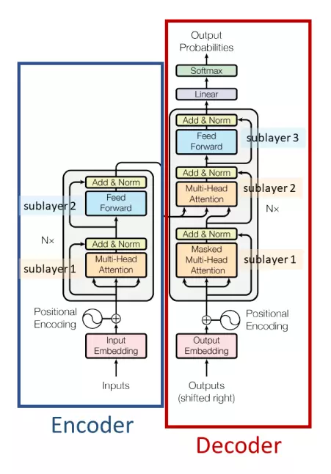
Architecture of Transformer

Slide 6
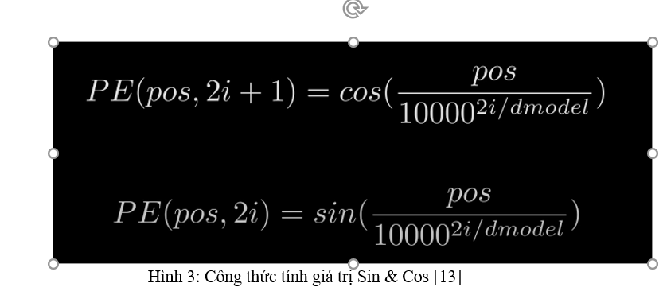
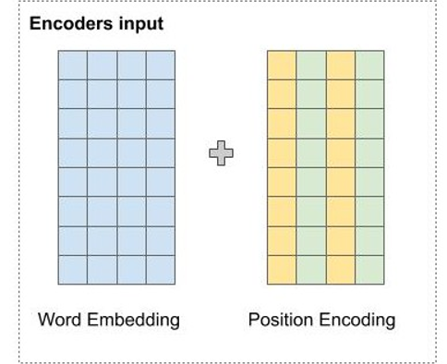
Input Embedding: transform words to vector with Word Embedding matrix
Positional Encoding: show information about position of word

Slide 7
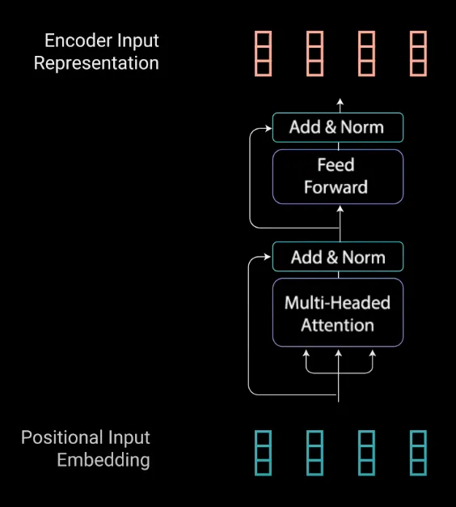
ENCODER
Map all input to a continuous performance and contain all trained information

Slide 8
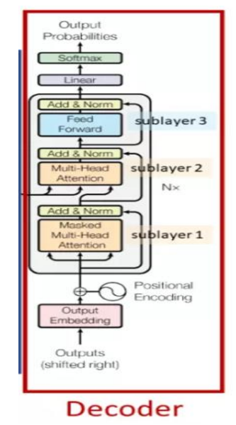
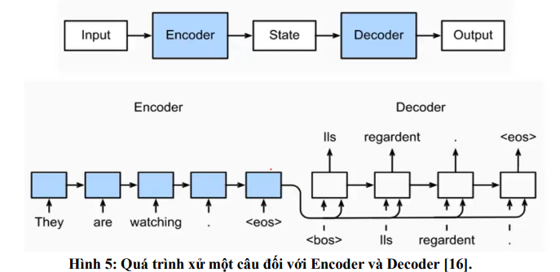
DECODER
Mapping all sequences from input then convert

Slide 9
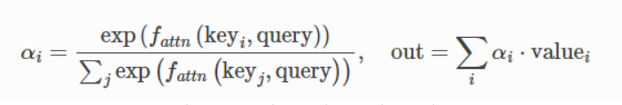
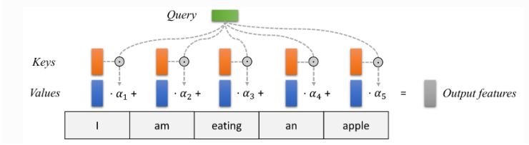
ATTENTION

Slide 10
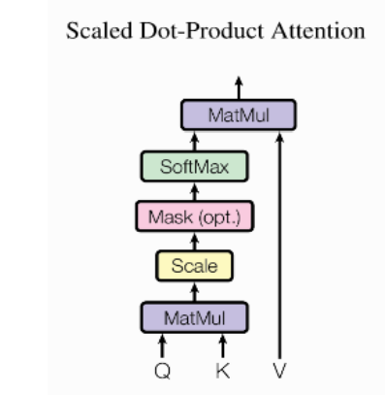
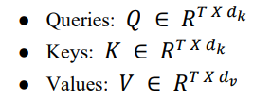
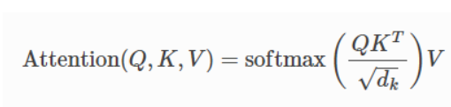
Scaled Dot Product Attention
Figure:1
Figure:2

Slide 11
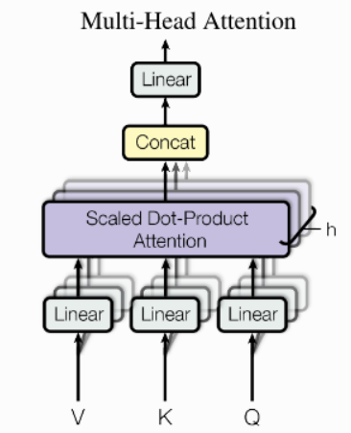

Multi-Head Attention
Figure:1​
Figure:2​
11

Slide 12

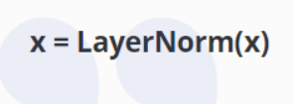
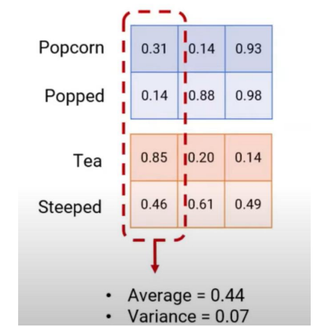
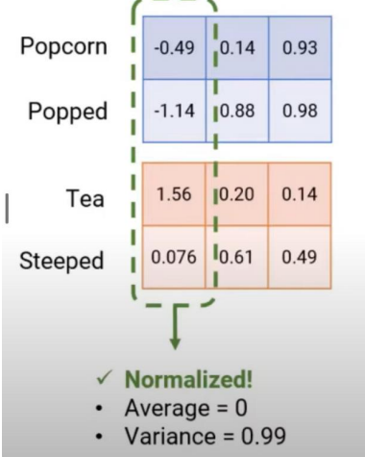
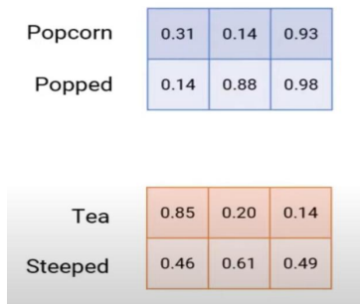
Add & Normalize
Add
Normalize

Slide 13
Feed Forward Network
Feed Forward is also known as Position-Wise Feed-Forward Network forward by position) this is another important element in the block transformer
Feed Forward mechanism is used to optimize data
That is why the Fully-Connected Feed Forward and Self-Attention classes selected for use in Transformer without using networks like CNN (Convolutional Neural Network) or RNN (Recurrent Neural Network) traditional.

Slide 14

Masked Multi-Head Attention
Input consists of 3 vectors: key(K), query(Q), value(V)
Process with 3 steps:
- Create mask: this component will create a square matrix with size equal length of the input sequence.
- Calculate Attention Scores:
- Apply Mask: element-wise multiplication between Attention scores and the mask matrix
- Calculate Weighted Sum: Attention scores x Value matrix + the values
a vector weighted sum.

Slide 15
Section 2: BERT MODEL

Slide 16
BERT
BERT stands for Bidirectional Encoder representations from Transformers.
A new architecture for the Language Representation class of problems was announced by Google in 2018
BERT is trained with SQuAD which has 1000 couples Q&A. Input a question and a context and output is an answer

Slide 17
BERT model architecture
There are now many different versions of the BERT model. But the versions all have the common feature that they all focus on three parameters:
L: quantity of Transformer’s Sublayer
H: size of Embedding vector
A: Number of Heads in the Multi-Head Floor
It has two main architectures:
- BERT base with 110 millions parameters
- BERT large with 340 millions parameters

Slide 18
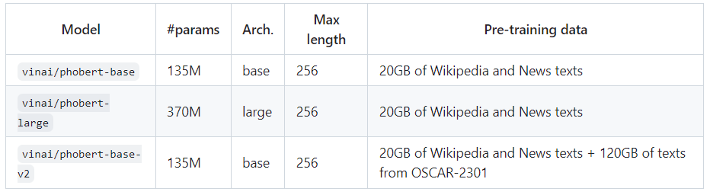
PhoBERT
The model is trained by Vietnamese dataset with 20GB data
PhoBERT use RDRSegmenter in VnCoreNLP to separate tokens, with data is trained: 145 million sequences and about 3 billion tokens

Slide 19
Section 3: Building a model to apply Transformer architecture to the question-answering problem

Slide 20
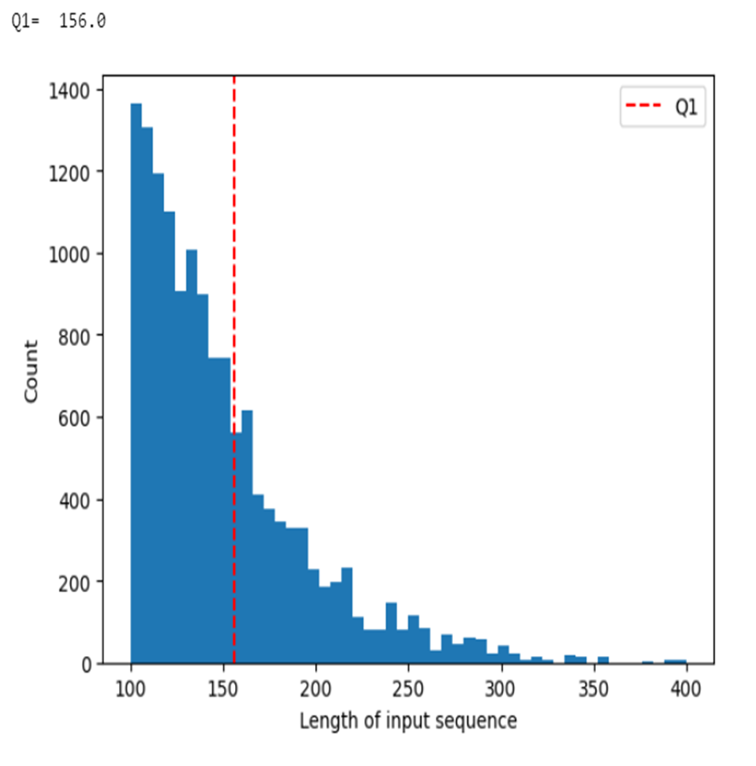
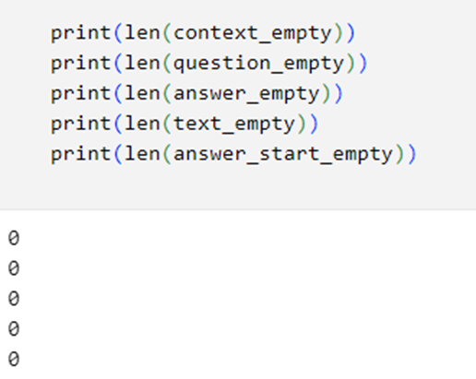
DATASET
We use the UIT-ViSquAD v1.0 dataset
This dataset consists of 19240 question and answer pairs. The data is gathered into a dictionary-like form of Key and Value
1. id: identifier for each question, its value is a string. 2. question: User's question, whose value is a string. 3. context: the text related to the user's question, whose value is a string. 4. text: the answer to the question corresponds to the text, the value of which is a string. 5. start position: the first position of the answer in the text has a value of a number.
Split data set 8:2

Slide 21
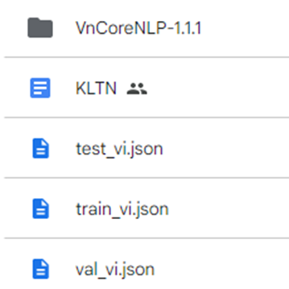
Tranining model
1. Manage Source
2. Library
Transformer
Touch
Vncorenlp
Phobert-large of VinAI

Slide 22
Tranining model
Download Phobert model from Hugging Face
Use VnCoreNLP to analyze and extract the necessary information from the input text. This function will return a context is normalized and remove whitespace.

Slide 23
1. checkAns function
Check and determine input context if the text mentioned in the answer matches the text in the paragraph:
If match it return position and text
If no match, the function searches around the position of the answer in the text and returns the approximate answer and its location.

Slide 24
2. checkTemAns function
Check and repair the answer: If the answer is cut off (because of being split into two parts or missing words at the beginning or the end of the answer). the function will check from the beginning of the answer to see:
if there is a word that matches the first word of the answer function returns the corrected answer and its position in the text.
if the function doesn't find a match, it returns the original answer

Slide 25
3. Class VnCoreSquad
Preprocess the data for the dataset for Vietnamese
Generate examples for training and testing, it takes input data and data set types as input and returns a list of examples.
createExample returns a list of SquadExample objects used to train the model and with dev dataset will returns a list of objects used to evaluate the model

Slide 26
FINE-TUNING MODEL PHOBERT
Length input sequence: 256
Max length query: 81
Doc stride: 81
Is Trainning: true with train, and false with test
Epoch: 4
Epsilon: 1e-8
Learning rate: 3e – 5
Batch size: 16
Thread: 10

Slide 27
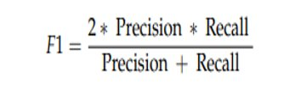
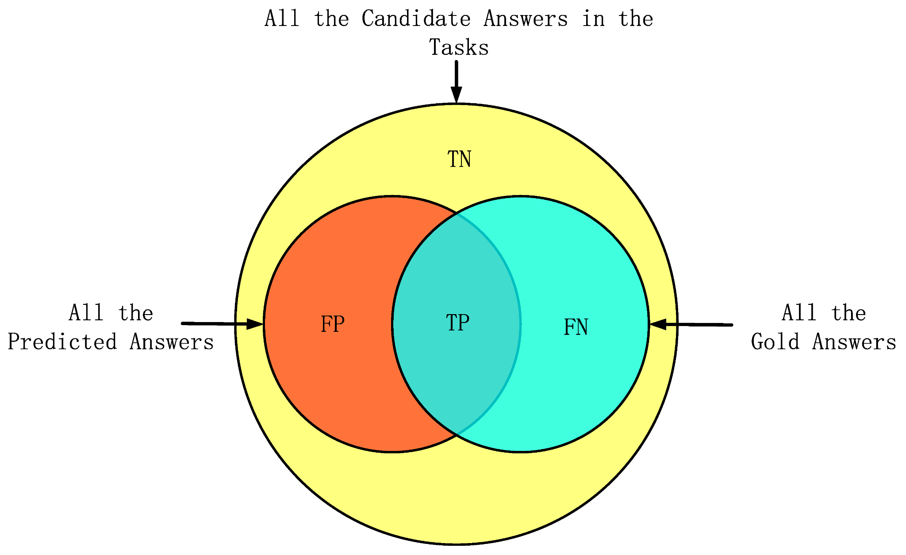

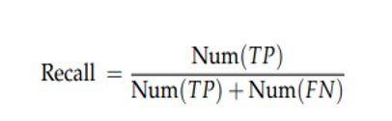
Evaluation Method
F1-Score: measures the overlap between the prediction and the correct answer
Precision: Shows the percentage of overlap between the word in the correct answer and the predicted answer
Recall: Represents the percentage of words in the correct answer that were correctly predicted in a question.

Slide 28

Exact Match (EM)
Exact Match represents the percentage of questions where the system-generated answer completely matches the correct answer, meaning every word is the same.

Slide 29
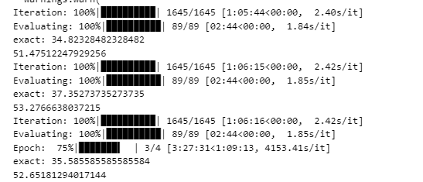
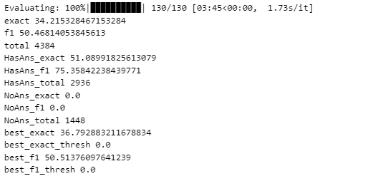
Result of evaluation
Đối với tập validate kết quả như hình trên:
F1 = 52.65
Ex = 35.58
Đối với tập test kết quả như hình trên:
F1 = 50.5
Ex = 34.2

Slide 30
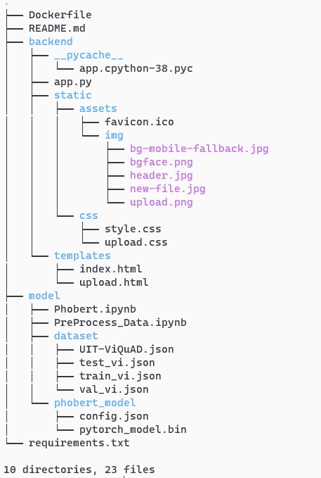
TECH STACK
Python 3.8
Flask
Docker
Google Azue

Slide 31
Section 4: WEBSITE Question & Answering

Slide 32


