Slide 1

OOP & Java lab Demonstration of types of COVID-19 virus and its mechanism
Team 06
Bui Tran Hai Quan - 20194821
Nguyen Minh Quan - 20194823
Tran Quang Thai - 20194836

Slide 2


1. Assignment
Bui Tran Hai Quan | Nguyen Minh Quan | Tran Quang Thai
Search information of Virus about: structure, infecting stages, symptoms, infecting method HIV, COVID-19, Herpes, Rota, Astro, Adeno virus Main Screen and Help Screen | Virus class: General virus, Enveloped and Non-enveloped virus Attributes of virus The Element of virus Virus Structure Screen: HIV, COVID-19, Herpes, Rota, Astro, Adeno | Refactor Structure of Virus Infecting screen: Virus with/without envelope Other element, make relationship composition and aggregation Design Polymorphism Merging all features to finish application

Slide 3

2. Problem Statement
As we all know, COVID-19 pandemic has been affected deeply to our lives all over the world: fallen-down economy, millions of people has died,… Thus, there is a necessary requirement of understanding the different types of the virus, as well as the way they infect to have the basic knowledge to prevent them.
Every virus has 2 basic elements: acid nucleic and capsid. Based on their structure, viruses are divided into 2 categories: Enveloped virus and Non-enveloped virus. Our application, which contains 6 viruses (HIV, COVID-19, Herpes, Rota, Astro and Adeno virus), will concentrate on what the viruses are constructed from and how they attack host-cells.

Slide 4
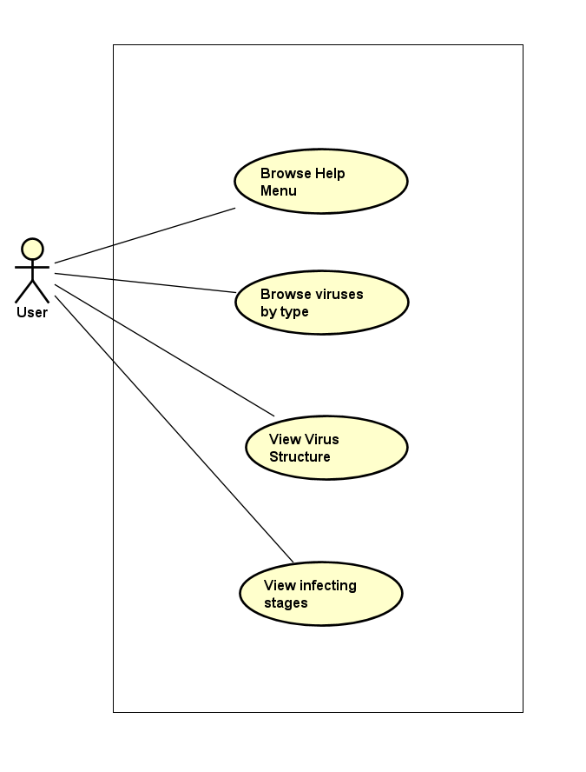
Use-case diagram
Click at “Help” button: introducing about this project and instructions for use
Pick up the type of virus:
+ “Virus with envelope”: HIV, COVID-19, Herpes.
+ “Virus without envelope”: Rota, Astro and Adeno virus.
Observe the particular structrure of each virus .
View the infecting stages step by step.

Slide 5
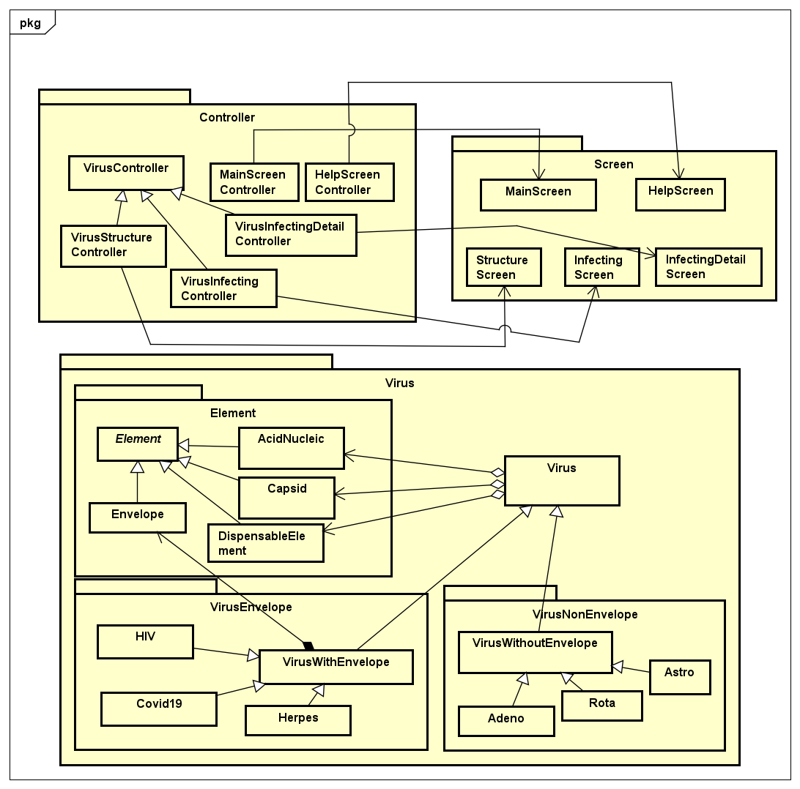
General class diagram
MVC Model
Package Controller/Screen
Virus package: Element, VirusWithEnvelope, VirusWithoutEnvelope
Enveloped virus: HIV, COVID-19, Herpes
Non-enveloped virus: Rota, Astro, Adeno
Element: Essential Biological components of each virus

Slide 6
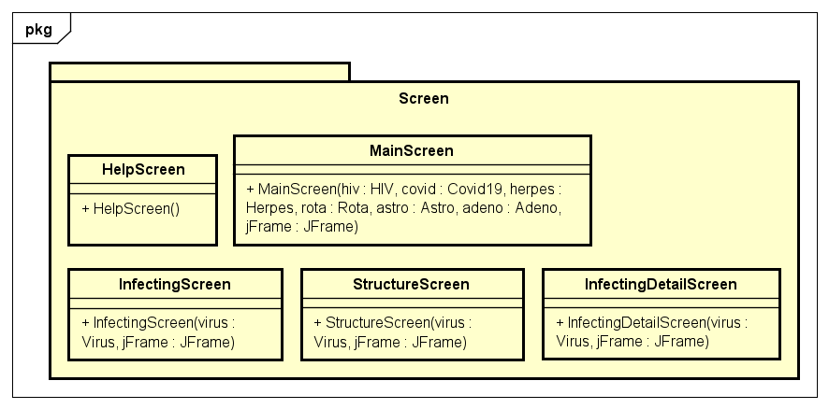
Detail screen package
Title
Main Screen
Help Screen
Structure Screen
Infecting Screen and InfectingDetailScreen

Slide 7
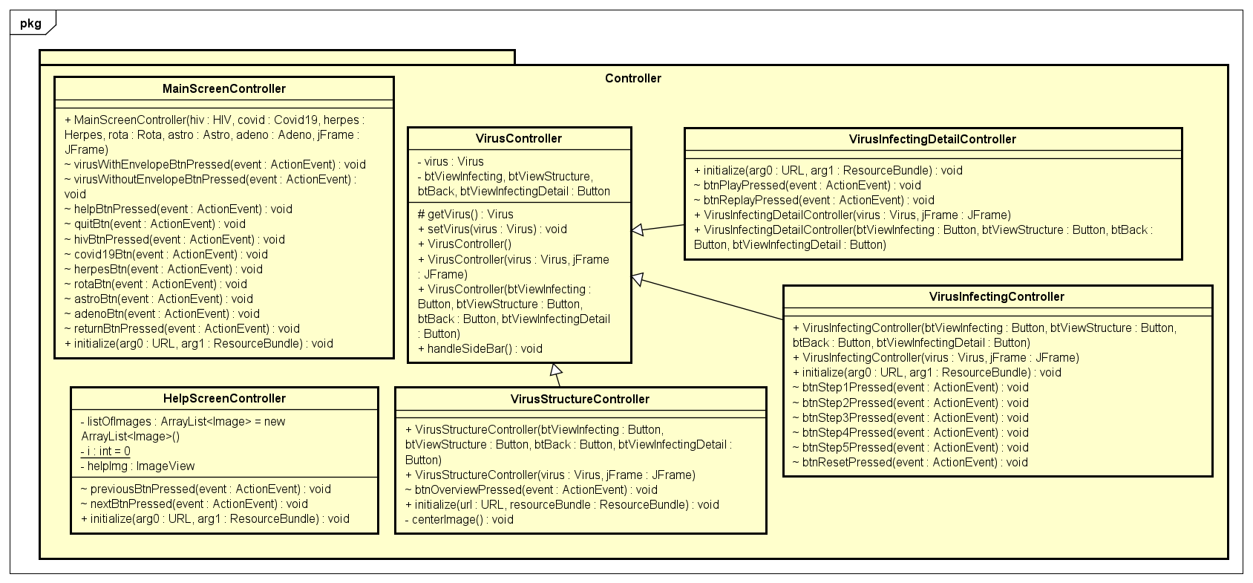
Controller package

Slide 8
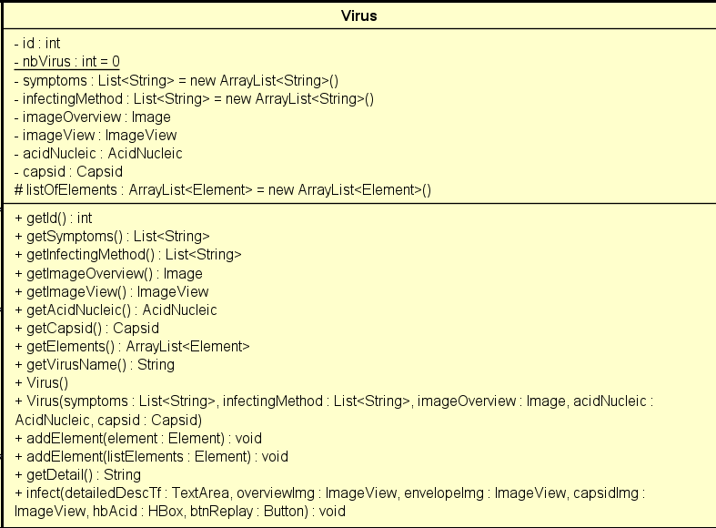
VIRUS CLASS

Slide 9
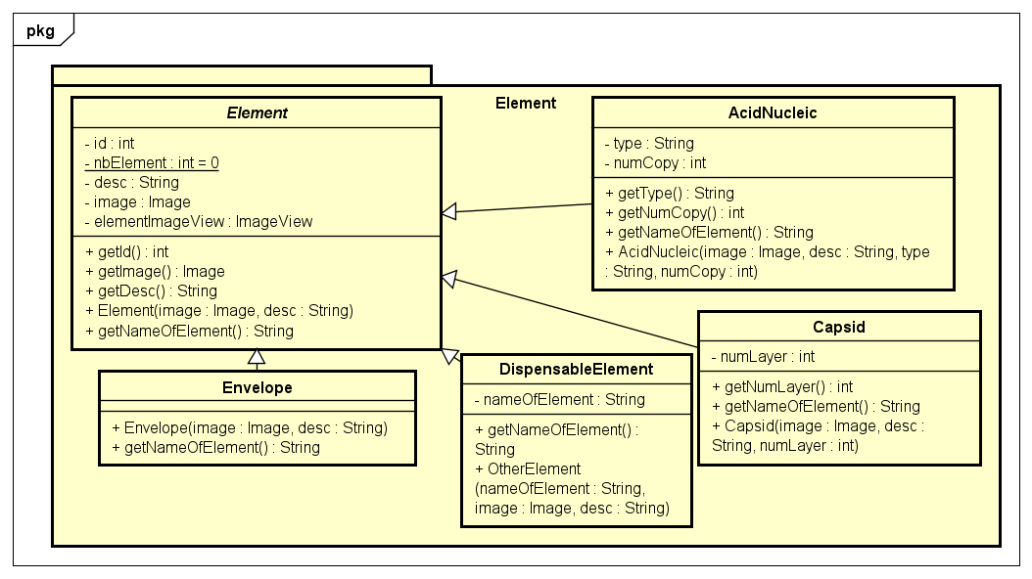
ELEMENT PACKAGE

Slide 10
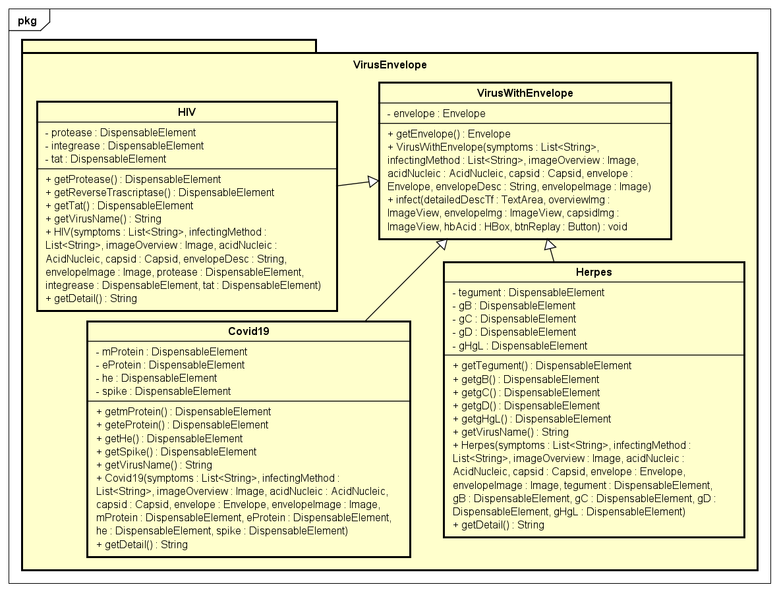
VIRUS With ENVelope pack

Slide 11
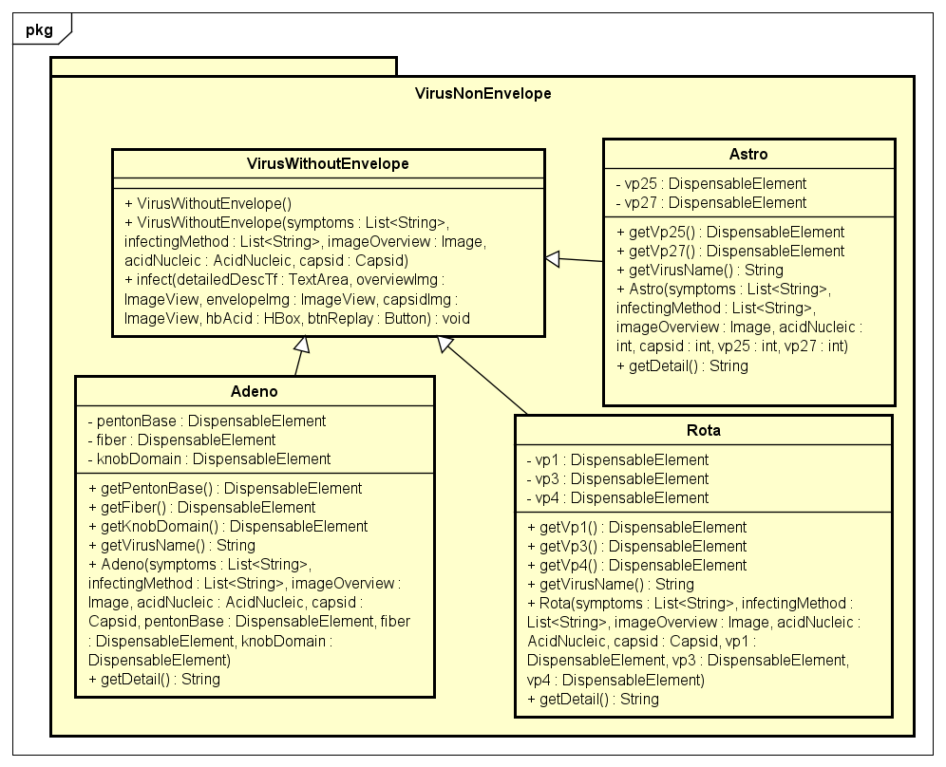
VIRUS Without ENVelope pack

Slide 12

Title:
Inheritance: Enveloped Virus, Non-enveloped virus inherit Virus class; HIV, COVID-19, Herpes inherit Enveloped Virus; Rota, Astro, Adeno inherit Non-Enveloped Virus …
Encapsulation: method getters, setters in each virus class: getTegument(); getmProtein(); getFiber();…
Abstraction: abstracted class Element: describe biological components of a virus
Polymorphism: getDetail() method; Downcasting from Virus class to VirusWithEnvelope, infect() method
Virus class has aggregation relationship with Capsid class and Acid Nucleic because all viruses must have this 2 element but when the virus attack host-cell, virus took away capsid and re-contruct the Acid, which means they are Has-a relation and independent.
VirusEnvelope has composition relationship with Envelope class because envelope is compulsory for us to discriminate between Enveloped virus and Non-enveloped virus. Enveloped virus can’t live without their “shell”.

Slide 13
THANK YOU
Link video: https://drive.google.com/file/d/1MoCF9JB-14fV6zoEqFWExfYZVU5Y6Mvk/view?usp=sharing

