Slide 1
After School Hours
Group 3: Aman, Andrew, Dan, James, Paul, Ryan, Stephen, Tim

Slide 2
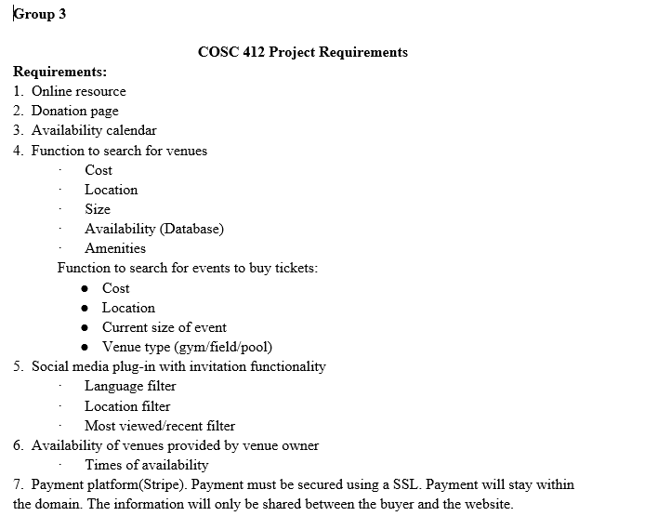
Functionalities – Part 1

Slide 3
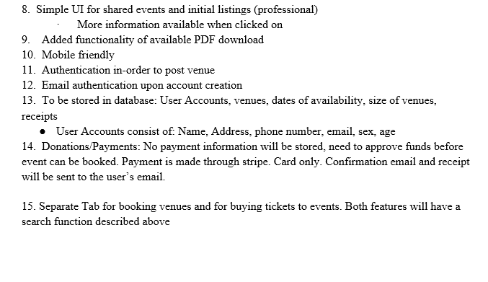
Functionalities – Part 2

Slide 4
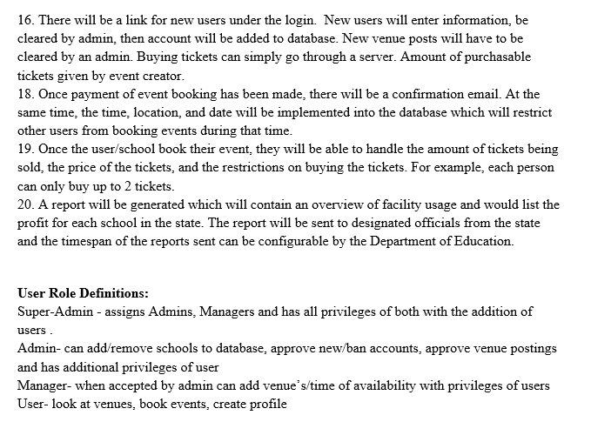
Functionalities – Part 3

Slide 5
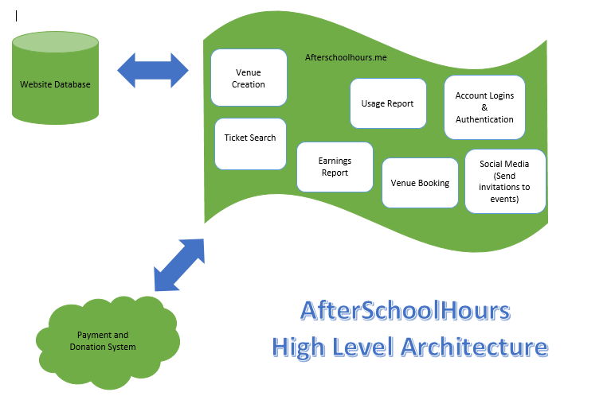
High Level Diagram

Slide 6
Let’s Visit the Website
http://www.afterschoolhours.me/

