Slide 1
HTML
HTML is the standard markup language for Web pages.
With HTML you can create your own Website.
Notes:
hiii

Slide 2
About Your HTML Webpage
Header
Menu with an active state
Show Case Area
Add to Your LinkedIn Profile
Your Projects
Footer

Slide 3
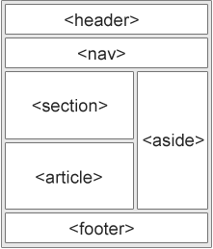
HTML Semantics
A semantic element clearly describes its meaning to both the browser and the developer.
Notes:
Metadata is data (information) about data.
The <meta> tag provides metadata about the HTML document. Metadata will not be displayed on the page, but will be machine parsable.
Meta elements are typically used to specify page description, keywords, author of the document, last modified, and other metadata.
The metadata can be used by browsers (how to display content or reload page), search engines (keywords), or other web services.

Slide 4
Body Tag
<html>
<head>
<title>Title of the document</title>
</head>
<body>
The content of the document......
</body>
</html>
Notes:
The <body> tag defines the document's body.
The <body> element contains all the contents of an HTML document, such as text, hyperlinks, images, tables, lists, etc.
##take to the code and add div and we will add container.
Will define a class and we can id as well but The difference between an ID and a class is that an ID can be used to identify one element, whereas a class can be used to identify more than one.

