Slide 1
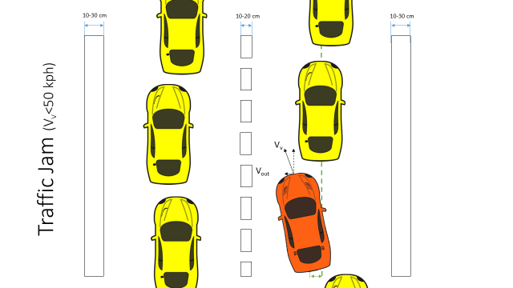
Active Lane Centering Status meeting
A nshuman Singh
D avide Occello
R A ymond Wouters
S harad Bhadgaonkar, January 27th 2017

Slide 2
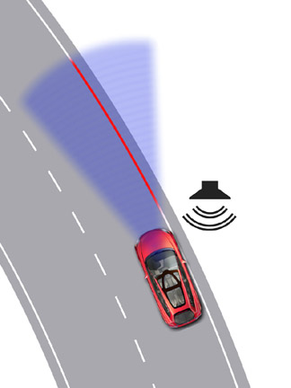
Agenda
Project Timeline
Status from the last meeting
Milestones and progress: phase 2
Future Work

Slide 3
Project Timeline
Phase 1: Functional Safety
Phase 2:
Design
23 days
Phase 3: Implementation
25/11/16 – 13/01/17
26 days
12 days
43 days
55 days
1st Presentation to NXP
Status meeting:NXP
Meeting
with Arash
06.01.17
2016
Nov
Dec
Holidays
Jan
2017
Today
Feb
Mar
20.01.17
25.11.16
13.01.17
16.01.17
27.01.17
30.01.17
28.03.17
Project Kick Off
Project End

Slide 4
Status at the end of first phase
Euro-NCAP requirements.
Functional safety
Hazard Analysis and Risk Assessment
Safety goal and ASIL assignment
Functional safety concept
ASIL Decomposition and Decomposed FSR
Functional architecture
Document delivery

Slide 5
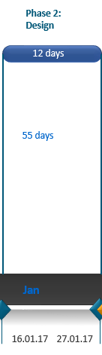
Milestones and progress: phase 2
Milestones:
Use of CAFCR framework for system architecting
Analysis of existing Hardware
Study hardware components
Study communication networks
Hardware architecture proposals
Update safety concept
Document delivery
Progress

Slide 6
Functional Architecture
VISION
LOW LEVEL CONTROL
INPUTS
SUPERVISORY
CONTROL
WARNINGS

Slide 7
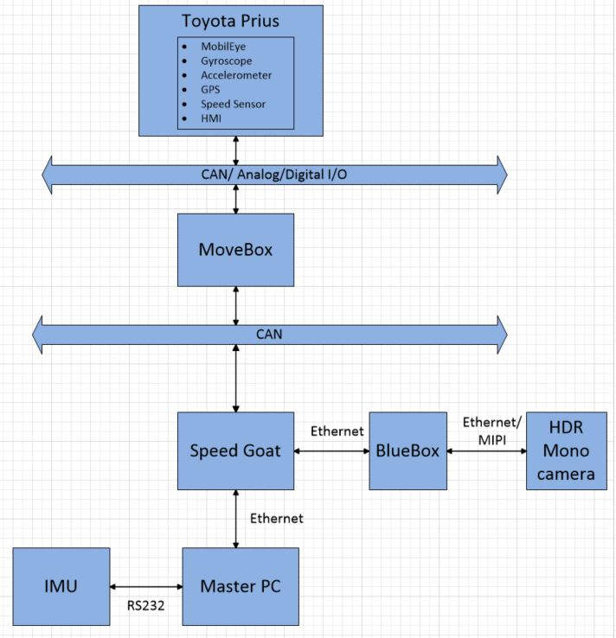
Hardware architecture: Proposal 1
Alternate concept
Vision Processing
Control strategy

Slide 8
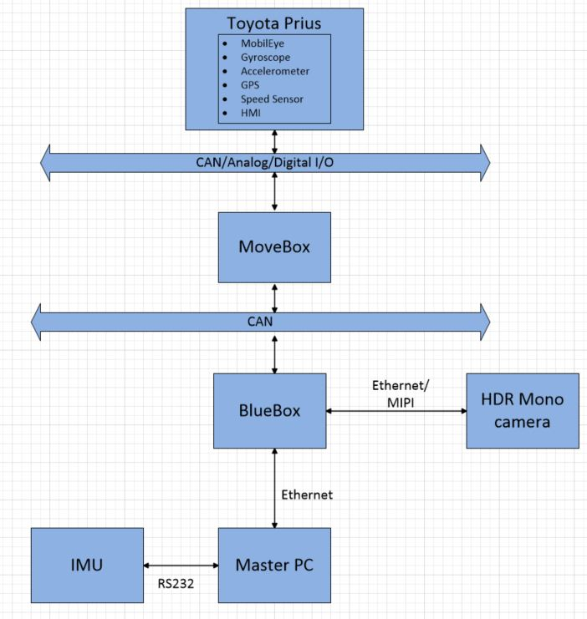
Hardware architecture : Proposal 2
Vision Processing
Control Strategy

Slide 9
Future Work
Short term goals ( next 2 weeks)
Interpretation of MobilEye data
Literature research on current lateral control strategies
Set up vehicle model in Matlab/Simulink
Research on real time prototyping environment
Long term goals
Develop lateral control strategy for ALC
Design and implement ALC software in car
Testing and validation with basic test cases
Update System Design Document
Presentation and demonstration
Running low level control algorithm on BlueBox
Implementation for switching between MobilEye
and HDR Mono camera

Slide 10
Questions
?

