Slide 1
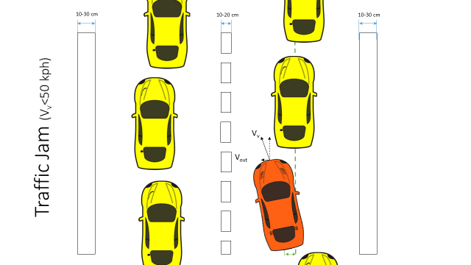
Active Lane Centering Status Update
A nshuman Singh
D avide Occello
R A ymond Wouters
S harad Bhadgaonkar, January 27th 2017

Slide 2
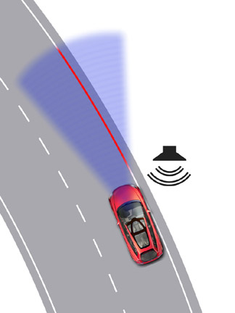
Agenda
Team Update
Project Timeline
Status from the last lesson
Planning for next phase
Scope limitation

Slide 3
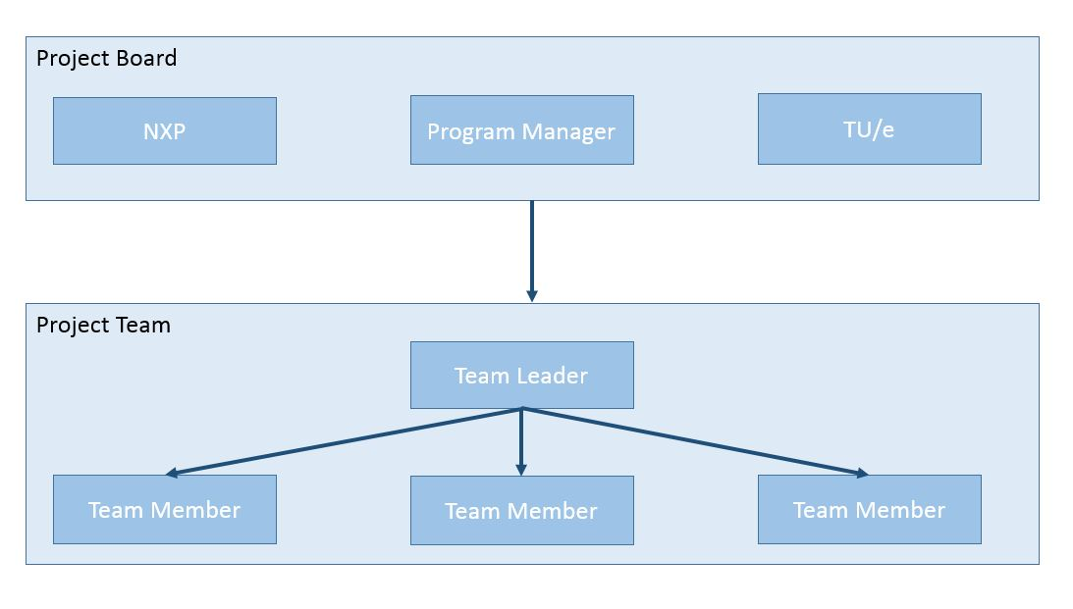
Project Management Team Structure
Updated!
Sharad
Anshuman
Davide
Raymond

Slide 4
Project Timeline (Phase 1)
Phase 1:
Functional Safety
25/11/16 – 13/01/17
26 days
NCAP Requirements
2nd Dec
Documentation
12th Jan
CAFCR
9th Dec
HARA
14th Dec
FSR
20th Dec
2016
Nov
Today
Dec
Holidays
Jan
2017
25.11.16
13.01.17
End – Phase 1
Project Kick Off

Slide 5
Status at the end of first phase
Euro-NCAP requirements.
Functional safety
Hazard Analysis and Risk Assessment
Safety goal and ASIL assignment
Functional safety concept
ASIL Decomposition and Decomposed FSR
Functional architecture
Document delivery

Slide 6
Project Timeline
Phase 1: Functional Safety
Phase 2:
Design
23 days
Phase 3: Implementation
25/11/16 – 13/01/17
26 days
12 days
43 days
55 days
1st Presentation to NXP
Status meeting:NXP
Meeting
with Arash
06.01.17
2016
Nov
Dec
Holidays
Jan
2017
Today
Feb
Mar
20.01.17
25.11.16
13.01.17
16.01.17
27.01.17
30.01.17
28.03.17
Project Kick Off
Project End

Slide 7
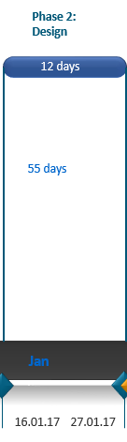
Status at the end of second phase
Milestones:
Use of CAFCR framework for system architecting
Analysis of existing Hardware
Study hardware components
Study communication networks
Hardware architecture proposals
Update safety concept
Document delivery
Progress
 | Delayed

Slide 8
Planning for Phase 3
Short term goals ( next 2 weeks)
Interpretation of MobilEye data
Literature research on current lateral control strategies
Set up vehicle model in Matlab/Simulink
Research on real time prototyping environment
Long term goals
Develop lateral control strategy for ALC
Design and implement ALC software in car
Testing and validation with basic test cases
Update System Design Document
Presentation and demonstration
Running low level control algorithm on BlueBox
Implementation for switching between MobilEye
and HDR Mono camera

Slide 9
Planning for Phase 3
Phase 3:
Implementation
43 days
26 days
Vehicle Model
Literature Review
Improvement
Controller Design
Testing
Comunication Setup
Demonstration & Presentation
28th March
Simulation phase
Predicted Arrival of Speedgoat
15nd Feb
Prototype phase
Finalization phase
Documentation Delivery
28th March
2016
Jan
Today
Feb
March
2017
30.01.17
28.03.17
Project End
Start Phase 3

Slide 10
Limitation of Scope
Limitation of driving scenarios
Highway, within specific restrictions (speed, road radius… etc)
Design Phase of the ISO26262
not enough time, the time allocated for functional safety was used fully
Vision algorithm development
Focus on control algorithm, and preparation for integration
Use of Mobileye vision system for implementation
Development only on NXP Bluebox
The Bluebox is not ready for the full system
Reserve time for 1 integration test and error logging

Slide 11
Risks
Uncertainity in the availability of hardware
Estimated arrival of Real-Time target machine 15 Feb 2017
Reliance on Mobileye for vision

Slide 12
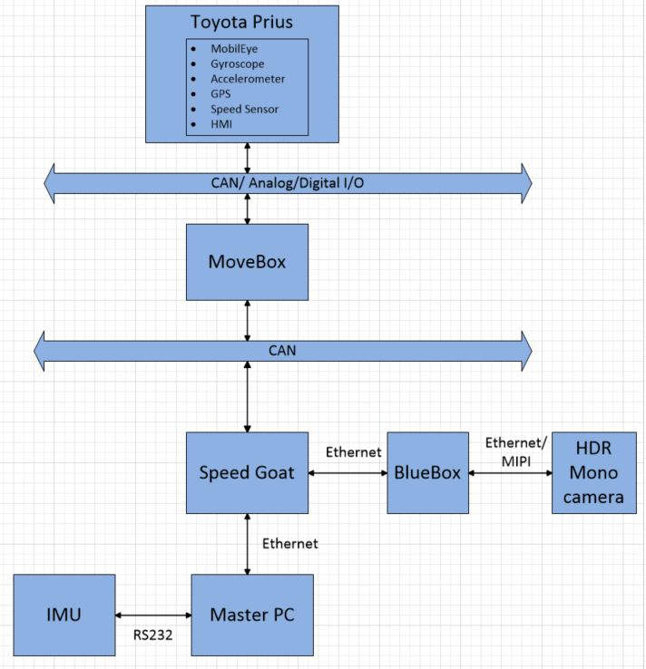
Hardware architecture (To be implemented)
Alternate concept
Vision Processing
Control strategy

Slide 13
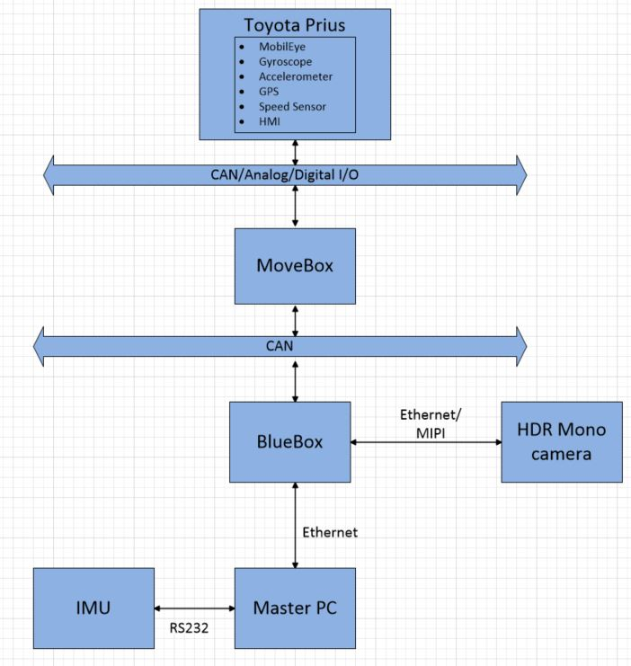
Hardware architecture : Test and Error Log
Vision Processing
Control Strategy

Slide 14
Questions
?

