Slide 1
Lecture 12 – Introduction to parallel computation, MPI & OpenMP
Omer Bromberg
omerbr@tauex.tau.ac.il
Winter 2025/6

Slide 2
Why parallelize?
Data parallelism
Partition the data used in solving the problem among the cores.
Each core carries out similar operations on it’s part of the data.
Task parallelism
Partition various tasks carried out solving the problem among the cores.

Slide 3

Example 1: Grading
15 questions
300 exams

Slide 4

Three teaching assistants
TA#1
TA#2
TA#3

Slide 5
Division of work – data parallelism
Each does the same type of work (task), but working on different sheet (data)
TA#1
TA#3
100 exams
100 exams
TA#2
100 exams

Slide 6
Division of work – task parallelism
Each does different type of work (task), but working on same sheets (data)
TA#1
TA#3
Questions 11 - 15
or
Questions 12 - 15
Questions 1 - 5
or
Questions 1 - 7
TA#2
Partitioning strategy:
- either by number
- or by workload
Questions 6 - 10
or
Questions 8 - 11

Slide 7
Summary
Data: 300 copies of exam
Task: grade total 300*15 questions
Data parallelism
– Distributed 300 copies to three TAs
– They work independently
Task Parallelism
– Distributed 300 copies to three TAs – Each grades 5 questions of 100 copies
– Exchange copies – Grade 5 questions again – Exchange copies – Grade 5 questions
The three TAs can do in parallel, we can achieve 3 time speedup theoretically

Slide 8
Challenges
Are the three TAs grading in the same performance?
– One TA (CPU) may be slower than the other – They may not work on grading the same time
How the TAs communicate?
– Do they sit on the same table? Or each take copies and grade from home?
– How they share intermediate results (task parallelism)?
Where the solutions are stored so they can refer to when grading
– Remember answers to 5 questions vs to 15 questions
– Cache and Memory issues

Slide 9
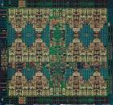
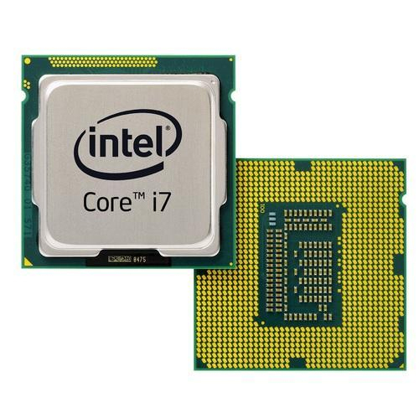
Basic system architecture and memory sharing
The basic computing unit is the processor (CPU)
Processors are usually composed of several cores (intel i3, 2-4 cores; i7, 6-8 cores; i9. 8-16 cores).
When a program is executed it runs on processes, where each process is assigned to a specific core.
A process has its own virtual memory space that cannot be accessed by other processes.
A process can create several threads, which can work independently executing different codes.
All threads created by a process share the virtual address space of that process. They read and write to the same address space in memory.

Slide 10
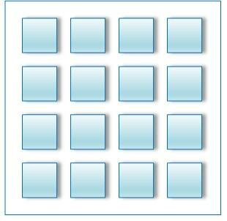
Basic system architecture and memory sharing
The basic computing unit is the processor (CPU)
Processors are usually composed of several cores (intel i3, 2-4 cores; i7, 6-8 cores; i9. 8-16 cores).
When a program is executed it runs on processes, where each process is assigned to a specific core.
A process has its own virtual memory space that cannot be accessed by other processes.
A process can create several threads, which can work independently executing different codes.
All threads created by a process share the virtual address space of that process. They read and write to the same address space in memory.

Slide 11
Basic system architecture and memory sharing
The basic computing unit is the processor (CPU)
Processors are usually composed of several cores (intel i3, 2-4 cores; i7, 6-8 cores; i9. 8-16 cores).
When a program is executed it runs on processes, where each process is assigned to a specific core.
A process has its own virtual memory space that cannot be accessed by other processes.
A process can create several threads, which can work independently executing different codes.
All threads created by a process share the virtual address space of that process. They read and write to the same address space in memory.
proc
proc
proc
proc
proc
proc
proc
proc
proc
proc
proc
proc
proc
proc
proc
proc

Slide 12
Basic system architecture and memory sharing
The basic computing unit is the processor (CPU)
Processors are usually composed of several cores (intel i3, 2-4 cores; i7, 6-8 cores; i9. 8-16 cores).
When a program is executed it runs on processes, where each process is assigned to a specific core.
A process has its own virtual memory space that cannot be accessed by other processes.
A process can create several threads, which can work independently executing different codes.
All threads created by a process share the virtual address space of that process. They read and write to the same address space in memory.

Slide 13
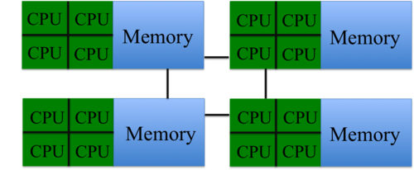
Basic system architecture and memory sharing
Two major classes of parallel programming models:
Shared Memory
Distributed Memory

Slide 14
Shared Memory Architecture
Threads
Threads
Threads
CPU core #1
CPU core #2
CPU core #3
…
Cache ($)
Cache ($)
Cache ($)
Memory bus
All threads can see a single shared address space. Therefore, they can see each other’s data.
Memory (Shared address space)
Compute node
I/O bus
Each compute node has 1-2 CPUs each with 10-96 cores
disk
Notes:
Ask jeff to add in notes about the standard compute node architecture

Slide 15
Multi-Threading (for shared memory architectures)
Threads are contained within processes
One process => multiple threads
All threads of a process share the same address space (in memory).
Threads have the capability to run concurrently (executing different instructions and accessing different pieces of data at the same time)
But if the resource is occupied by another thread, they form a queue and wait.
For maximum throughput, it is ideal to map each thread to a unique/distinct core
Threads
CPU cores
Cache ($)
Memory (Shared address space)

Slide 16
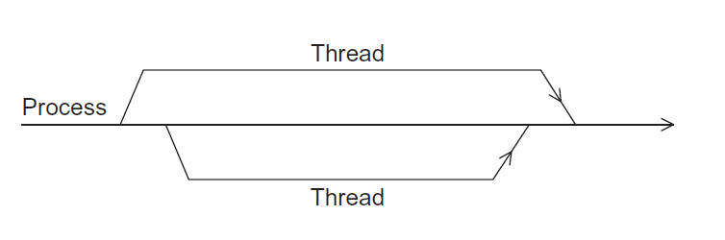
A process and two threads
the “master” thread
terminating a thread
Is called joining
starting a thread
Is called forking

Slide 17
Distributed Memory Architecture
Compute node 1
Compute node 2
Compute node m
Processes running on cores
Processes running on cores
Processes running on cores
………
Local Memory
Local Memory
Local Memory
Internal network / Interconnect
Processes cannot see each other’s memory address space.
They have to send inter-process messages (using MPI).

Slide 18
Distributed Memory System
Clusters (most popular)
A collection of commodity systems.
Connected by a commodity interconnection network.
Nodes of a cluster are individual computers joined by a communication network.
Nodes communication the nodes are connected with each other, either via Ethernet (regular internal network, 👎) or via fast connection e.g. infiniband (💪🏻) or omnipath (🤮)

Slide 19
Single Program Models: SIMD vs. MIMD
SP: Single Program
Your parallel program is a single program that you execute on all threads (or processes)
SI: Single Instruction
Each thread should be executing the same line of code at any given clock cycle.
MI: Multiple Instruction
Each thread (or process) could be independently running a different line of your code (instruction) concurrently
MD: Multiple Data
Each thread (or process) could be operating/accessing a different piece of the data from the memory concurrently

Slide 20
Single Program Models: SIMD vs. MIMD
SIMD
MIMD
// Begin: parallel region of the code
…
..
..
..
..
..
..
..
..
..
// End: parallel region of the code
// Begin: parallel region of the code
…
..
..
..
..
..
..
..
..
..
// End: parallel region of the code
All threads executing the same line of code. They may be accessing different pieces of data.
Thread 1
Thread 2
Thread 3

Slide 21
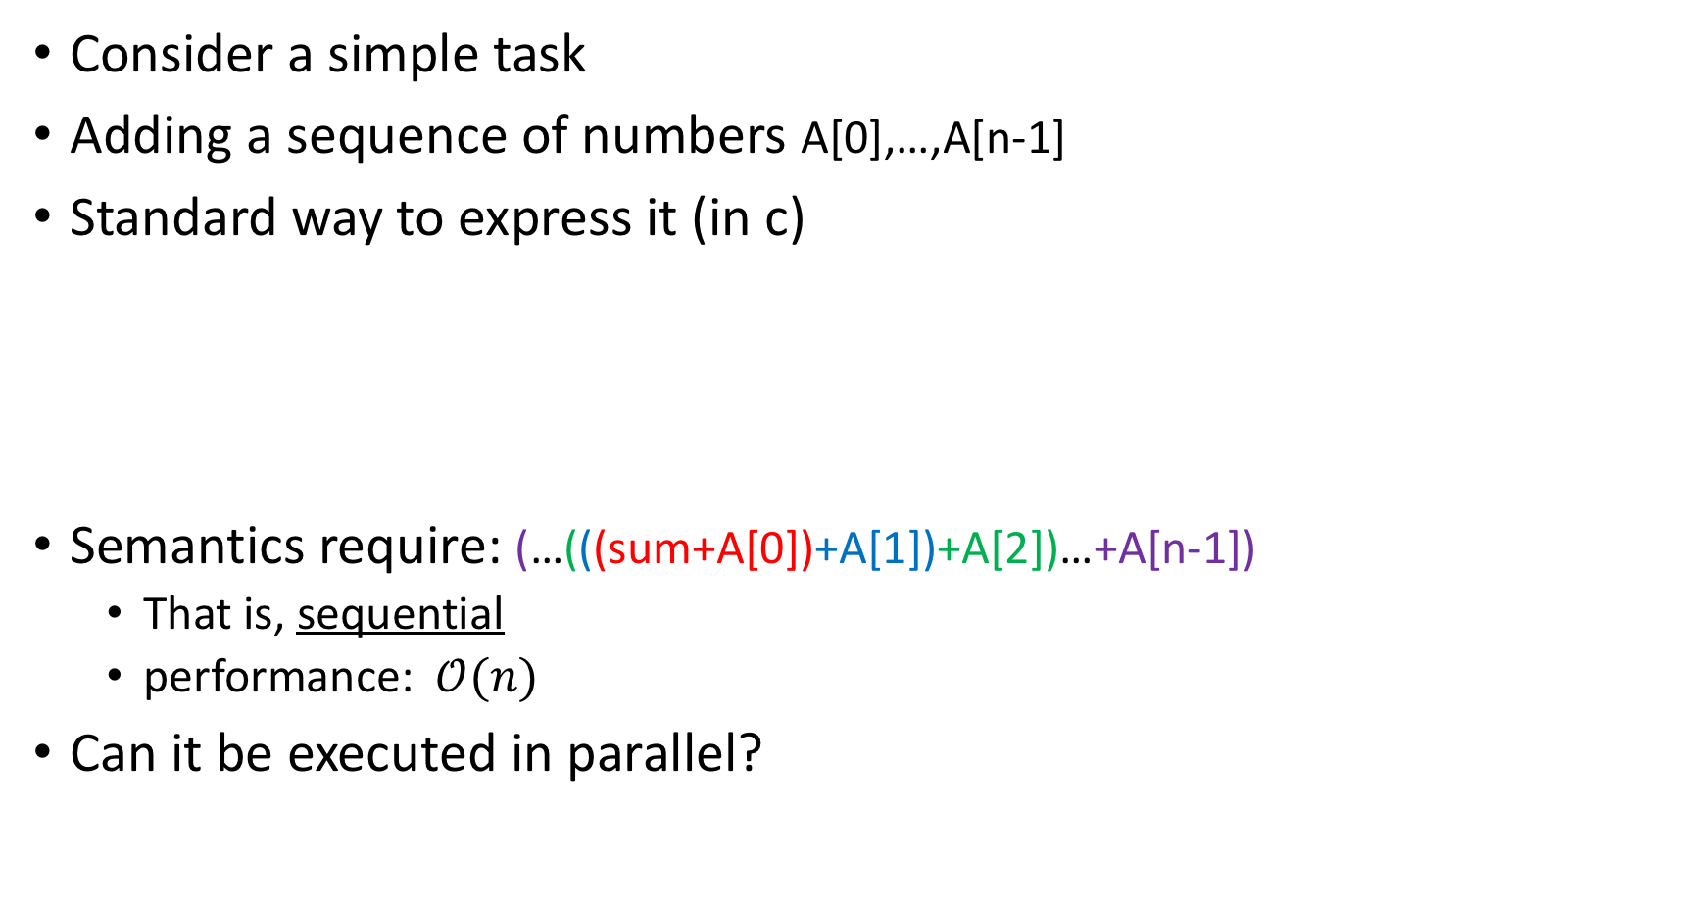
Example: summation
Consider a simple task
Adding a sequence of numbers A[0],…,A[n-1]
Standard way to express it (in c)
Semantics require: (…(((sum+A[0])+A[1])+A[2])…+A[n-1])
That is, sequential
performance: $𝒪(n)$
Can it be executed in parallel?
sum = 0;
for (i=0; i<n; i++) {
sum += A[i];
}

Slide 22
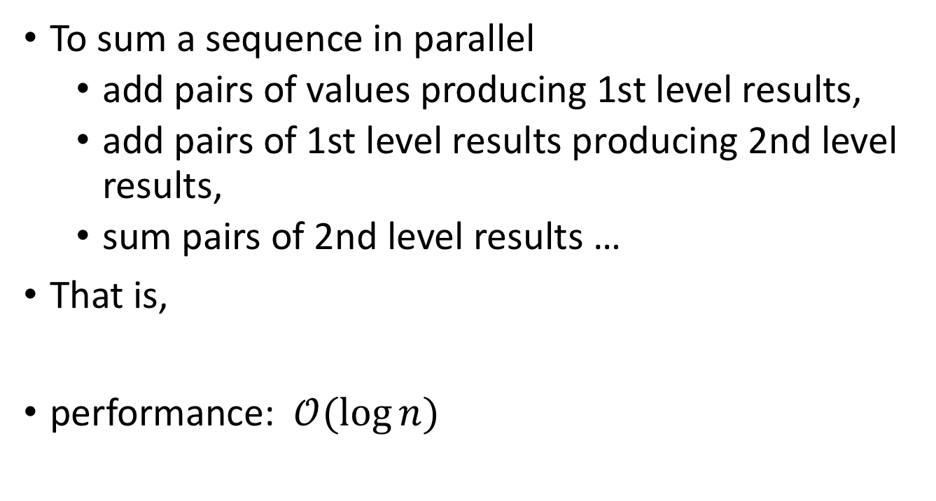
Parallel Summation
To sum a sequence in parallel
add pairs of values producing 1st level results,
add pairs of 1st level results producing 2nd level results,
sum pairs of 2nd level results …
That is,
performance: $𝒪(\log{n})$
(…((A[0]+A[1]) + (A[2]+A[3])) + ... +((A[n-4]+A[n-3]) + (A[n-2]+A[n-1]))…)

Slide 23
Express the Two Formulations
Graphic representation makes difference clear
68
76
76
66
52
36
40
36
26
10
26
30
10
10
6
4
16
10
16
14
2
8
6
4
16
10
16
14
2
8
Single processor
Multiple processors

Slide 24
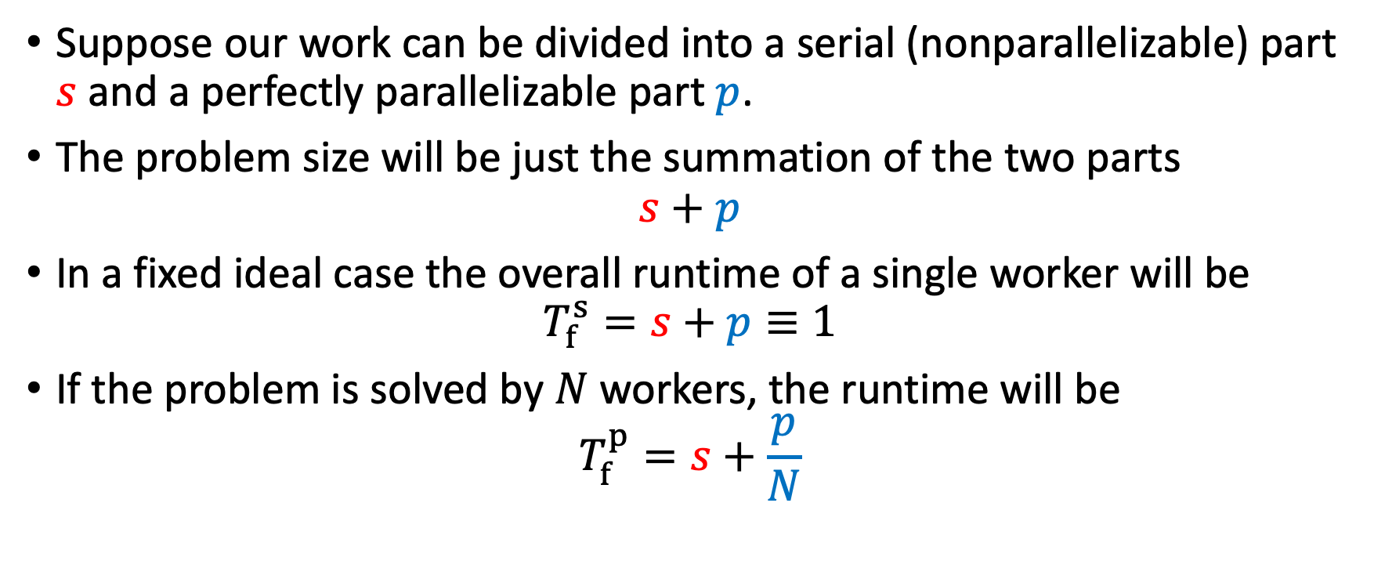
How fast can my program get: Amdahl’s law
Suppose our work can be divided into a serial (nonparallelizable) part $s$ and a perfectly parallelizable part $p$.
The problem size will be just the summation of the two parts
$$s+p$$
In a fixed ideal case the overall runtime of a single worker will be
$$T_{f}^{s}=s+p≡1$$
If the problem is solved by $N$ workers, the runtime will be
$$T_{f}^{p}=s+\frac{p}{N}$$
This is called strong scaling because the amount of work stays constant no matter how many workers are used.

Slide 25
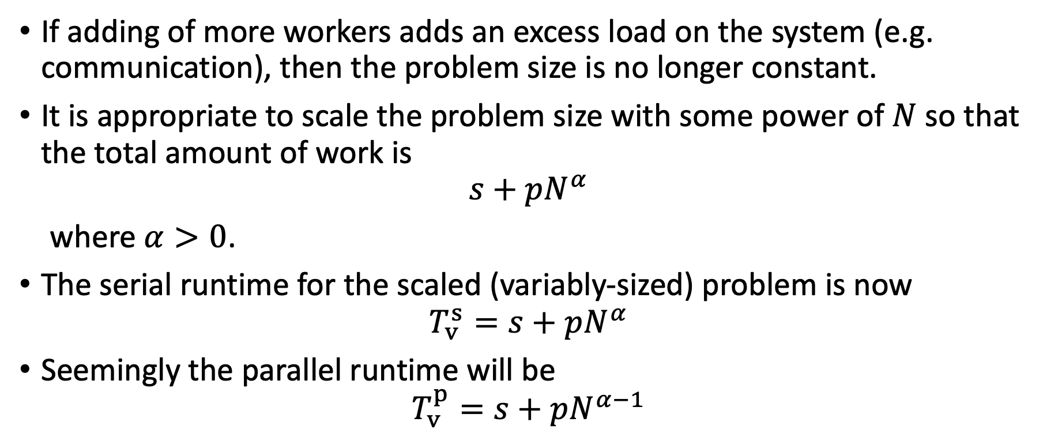
How fast can my program get: Amdahl’s law
If adding of more workers adds an excess load on the system (e.g. communication), then the problem size is no longer constant.
It is appropriate to scale the problem size with some power of $N$ so that the total amount of work is
$$s+pN^{α}$$
where $α>0$.
The serial runtime for the scaled (variably-sized) problem is now
$$T_{v}^{s}=s+pN^{α}$$
Seemingly the parallel runtime will be
$$T_{v}^{p}=s+pN^{α−1}$$
This is called weak scaling.

Slide 26
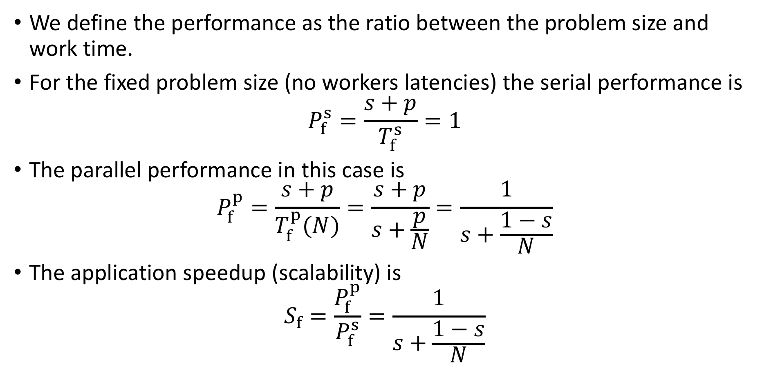
Scalability of strong scaling
We define the performance as the ratio between the problem size and work time.
For the fixed problem size (no workers latencies) the serial performance is
$$P_{f}^{s}=\frac{s+p}{T_{f}^{s}}=1$$
The parallel performance in this case is
$$P_{f}^{p}=\frac{s+p}{T_{f}^{p}(N)}=\frac{s+p}{s+\frac{p}{N}}=\frac{1}{s+\frac{1−s}{N}}$$
The application speedup (scalability) is
$$S_{f}=\frac{P_{f}^{p}}{P_{f}^{s}}=\frac{1}{s+\frac{1−s}{N}}$$
Amdahl’s Law

Slide 27
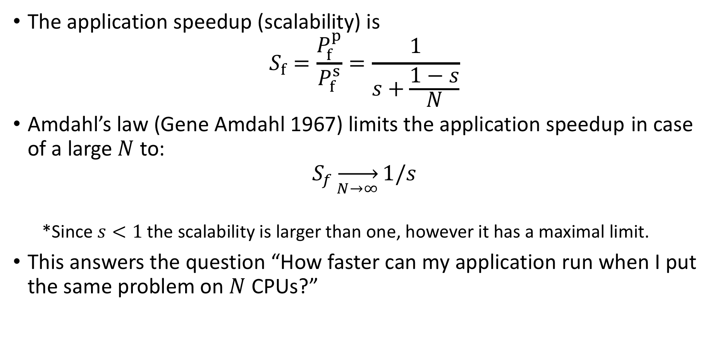
Scalability of strong scaling
The application speedup (scalability) is
$$S_{f}=\frac{P_{f}^{p}}{P_{f}^{s}}=\frac{1}{s+\frac{1−s}{N}}$$
Amdahl’s law (Gene Amdahl 1967) limits the application speedup in case of a large $N$ to:
$$S_{f}\overset{→}{N→∞}1/s$$
*Since $s<1$ the scalability is larger than one, however it has a maximal limit.
This answers the question “How faster can my application run when I put the same problem on $N$ CPUs?”
Amdahl’s Law
The answer depends on our definition of the “work”

Slide 28
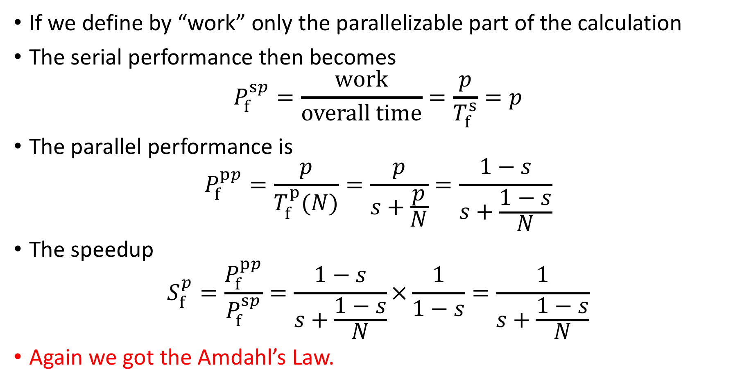
Scalability of the parallel part
If we define by “work” only the parallelizable part of the calculation
The serial performance then becomes
$$P_{f}^{sp}=\frac{work}{overall time}=\frac{p}{T_{f}^{s}}=p$$
The parallel performance is
$$P_{f}^{pp}=\frac{p}{T_{f}^{p}(N)}=\frac{p}{s+\frac{p}{N}}=\frac{1−s}{s+\frac{1−s}{N}}$$
The speedup
$$S_{f}^{p}=\frac{P_{f}^{pp}}{P_{f}^{sp}}=\frac{1−s}{s+\frac{1−s}{N}}×\frac{1}{1−s}=\frac{1}{s+\frac{1−s}{N}}$$
Again we got the Amdahl’s Law.
Notes:
In both serial performance and parallel performance the work is the same so it cancels out in the sopeedup.

Slide 29
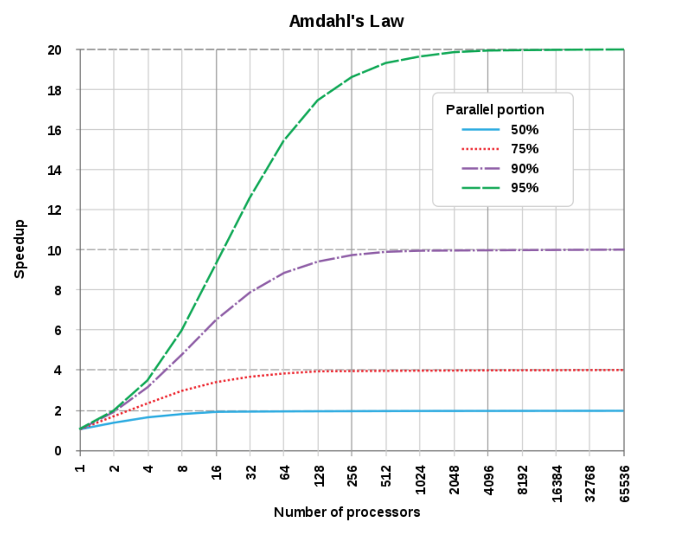
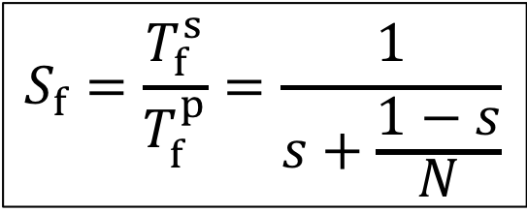
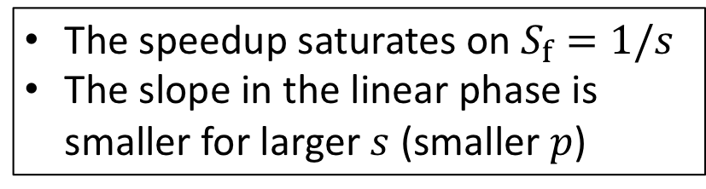
Amdahl’s law
$$S_{f}=\frac{T_{f}^{s}}{T_{f}^{p}}=\frac{1}{s+\frac{1−s}{N}}$$
The speedup saturates on $S_{f}=1/s$
The slope in the linear phase is smaller for larger $s$ (smaller $p$)

Slide 30
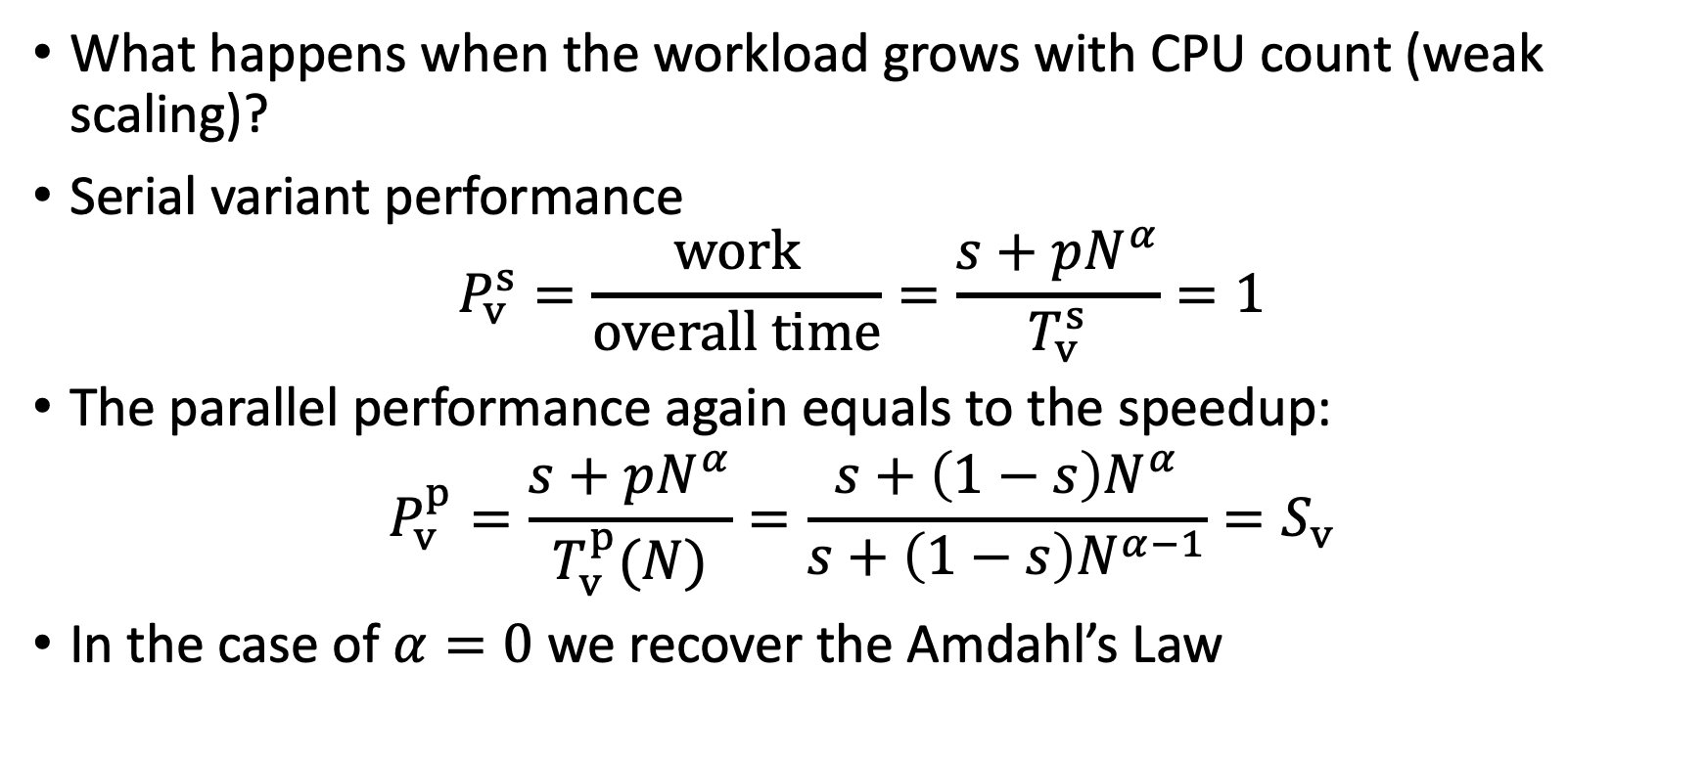
Scalability of weak scaling
What happens when the workload grows with CPU count (weak scaling)?
Serial variant performance
$$P_{v}^{s}=\frac{work}{overall time}=\frac{s+pN^{α}}{T_{v}^{s}}=1$$
The parallel performance again equals to the speedup:
$$P_{v}^{p}=\frac{s+pN^{α}}{T_{v}^{p}(N)}=\frac{s+\left(1−s\right)N^{α}}{s+\left(1−s\right)N^{α−1}}=S_{v}$$
In the case of $α=0$ we recover the Amdahl’s Law

Slide 31
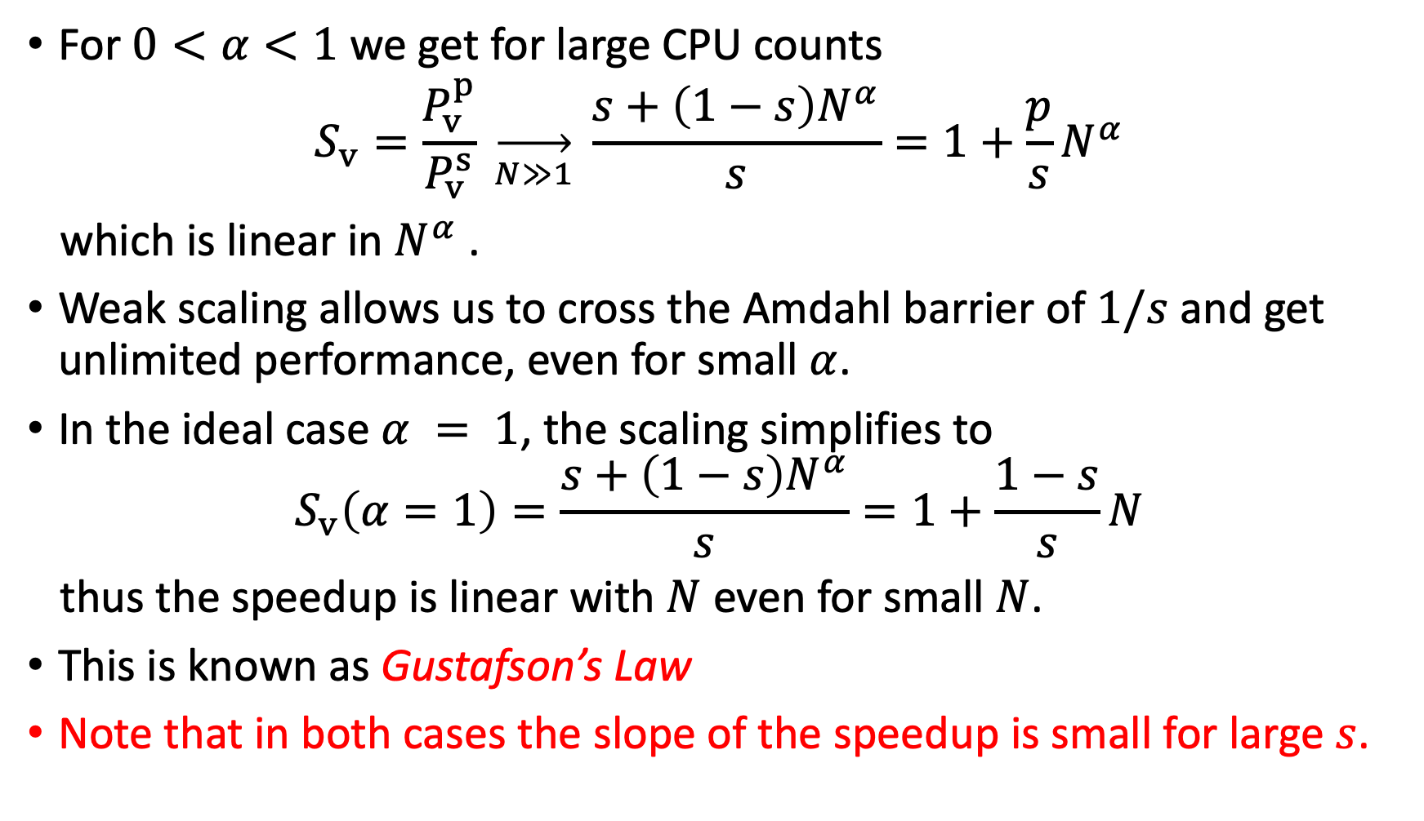
Scalability of weak scaling
For $0<α<1$ we get for large CPU counts
$$S_{v}=\frac{P_{v}^{p}}{P_{v}^{s}} \overset{→}{N≫1} \frac{s+\left(1−s\right)N^{α}}{s}=1+\frac{p}{s}N^{α}$$
which is linear in $N^{α}$.
Weak scaling allows us to cross the Amdahl barrier of $1/s$ and get unlimited performance, even for small $α$.
In the ideal case $α = 1$, the scaling simplifies to
$$S_{v}\left(α=1\right)=\frac{s+\left(1−s\right)N^{α}}{s}=1+\frac{1−s}{s}N$$
thus the speedup is linear with $N$ even for small $N$.
This is known as Gustafson’s Law
Note that in both cases the slope of the speedup is small for large $s$.

Slide 32
Weak vs. strong scalability
When working with new codes it is recommended to do scalability tests to examine how well the code performs on the system we work on.
Two kind of scalability tests are usually presented for codes:
Strong scaling tests – The problem size (e.g. grid size) is kept constant while the number of processors increases (Amdahl’s law)
Weak scaling tests – Both the problem size (grid size) and the number of processors grow proportional to each other (Gustafson’s Law)

Slide 33
Studying Scalability
Table records the parallel runtime (in seconds) for varying values of n and p.
Input size (n) | Number of threads (p)
 | 1 | 2 | 4 | 8 | 16
1,000
2,000
4,000
8,000
16,000
It is conventional to test scalability in powers of two (or by doubling n and p).
Notes:
Have animation on these slides

Slide 34
Studying Scalability
Table records the parallel runtime (in seconds) for varying values of n and p.
Input size (n) | Number of threads (p)
 | 1 | 2 | 4 | 8 | 16
1,000 | 800 | 410 | 201 | 150 | 100
2,000 | 1,601 | 802 | 409 | 210 | 120
4,000 | 3,100 | 1,504 | 789 | 399 | 208
8,000 | 6,010 | 3,005 | 1,500 | 758 | 376
16,000 | 12,000 | 6,000 | 3,001 | 1,509 | 758
Strong scaling behavior
Weak scaling behavior
It is conventional to test scalability in powers of two (or by doubling n and p).
Notes:
Have animation on these slides

Slide 35
Studying Scalability
Speedup
Time (sec)
p
p

Slide 36

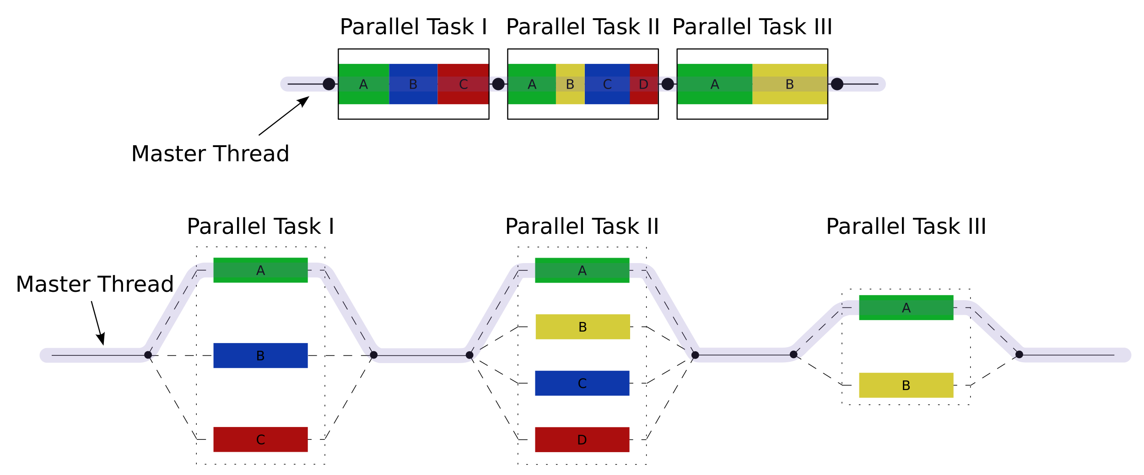

Slide 37

OpenMP
A shared memory patronization protocol.
It can run on multiple languages including c, c++, Fortran (77, 90, 95)
Provide capability to incrementally parallelize a serial program by forking and terminating threads.
The original thread is called master, while the additional threads are called workers.
The original thread and the new threads are called a team

Slide 38
OpenMp programing: Pragmas
All OpenMP instructions start with the keyword
# pragma
Special preprocessor instructions.
Typically added to a system to allow behaviors that aren't part of the basic C specification.
Compilers that don’t support the pragmas ignore them.

Slide 39
OpenMp programing: Pragmas
# pragma omp parallel
Initiates parallel threading.
The number of threads that run the following structured block of code is determined by the run-time system.

Slide 40
OpenMp programing: clause
# pragma omp parallel num_threads ( thread_count )
Text that modifies a directive.
The num_threads clause can be added to a parallel directive.
It allows the programmer to specify the number of threads that should execute the following block.

Slide 41
OpenMp programing: clause
# pragma omp parallel num_threads ( thread_count )
Text that modifies a directive.
The num_threads clause can be added to a parallel directive.
It allows the programmer to specify the number of threads that should execute the following block.
directive
clause

Slide 42
OpenMp programing: loading the omp lib
# include <omp.h>
#ifdef _OPENMP
# include <omp.h>
#endif

Slide 43
OpenMp programing: getting the thread num
# ifdef _OPENMP
int my_rank = omp_get_thread_num ( );
int thread_count = omp_get_num_threads ( );
# e l s e
int my_rank = 0;
int thread_count = 1;
# endif

Slide 44
Example: Serial vs. parallel “hello world”
#include <stdio.h>
int main()
{
printf("Hello world\n");
return 0;
}
Compile it: gcc hello.c

Slide 45

Example: Serial vs. parallel “hello world”
#include <stdio.h>
int main()
{
printf("Hello world\n");
return 0;
}
Compile it: gcc hello.c
Exersise: invoke omp to parallelize hello.c each thread $n$should output “hello world from thread #n”
https://www.onlinegdb.com/?utm_source=chatgpt.com

Slide 46
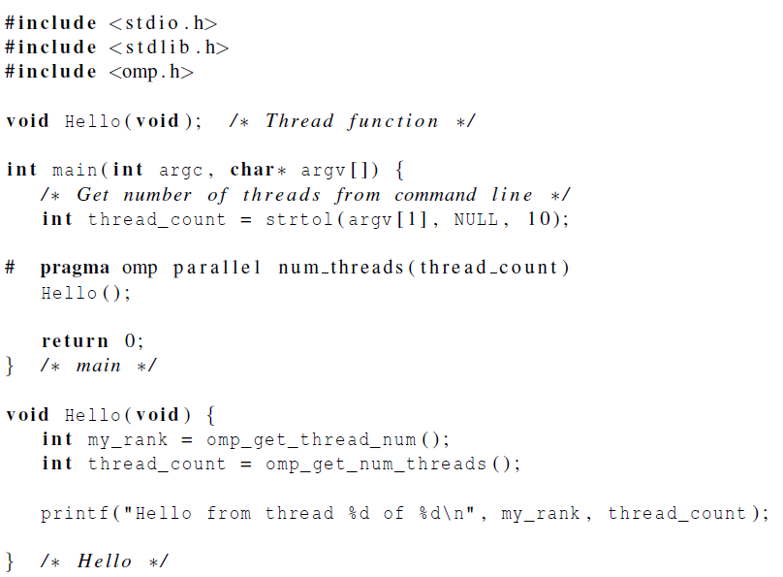
Loading
omp Library
After invoking omp
invoking
omp
only this line
is parallelized
printf(“Hello world… from thread = %d\n”, my_rank)
Compile it: gcc –fopenmp hello.c

Slide 47
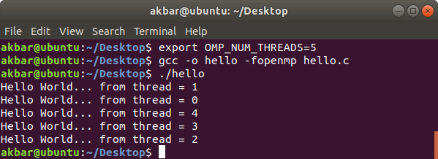
Output:
Threads appear in random order

Slide 48
Parallel Code Template (OpenMP)
#include <omp.h>
main(…) {
int var1, var2, var3; Serial code . .
Beginning of parallel section. Fork a team of threads.
Specify variable scoping
#pragma omp parallel private(var1, var2) shared(var3)
{
Parallel section executed by all threads . . .
All threads join master thread and disband
}
Resume serial code . . .
}

Slide 49
Parallel Region Construct
A parallel region is a block of code that will be executed by multiple threads. This is the fundamental OpenMP parallel construct.
When a thread reaches a PARALLEL directive, it creates a team of threads and becomes the master of the team. The master is a member of that team and has thread number 0 within that team.
Starting from the beginning of this parallel region, the code is duplicated and all threads will execute that code.
There is an implied barrier at the end of a parallel section. Only the master thread continues execution past this point.

Slide 50
Scope
In serial programming, the scope of a variable consists of those parts of a program in which the variable can be used.
In OpenMP, the scope of a variable refers to the set of threads that can access the variable in a parallel block.

Slide 51
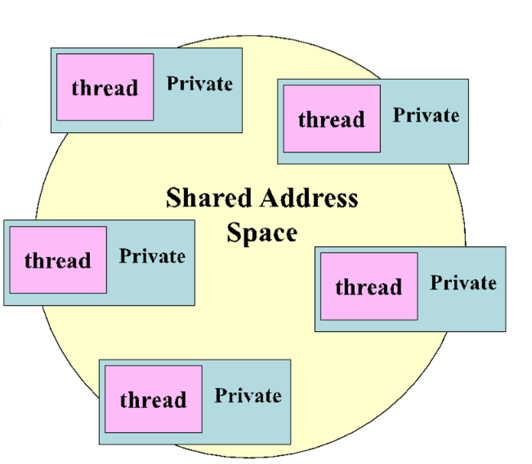
Scope in OpenMP
A variable that can be accessed by all the threads in the team has shared scope.
A variable that can only be accessed by a single thread has private scope.
The default scope for variables declared before a parallel block is shared.

Slide 52
Format of parallel construct
# pragma omp parallel [ clauses ]
Optional clauses :
private(list)
shared(list) default(shared | none)
firstprivate(list)
reduction(operator : variable-list)
copyin(list)
if(scalar_expression)
num_threads(scalar_integer_expression)

Slide 53
Format of parallel construct
Private: Each thread has its own instance of a variable. The variable is not initialized.
Firstprivate: Each thread has its own instance of a variable. The variable is initialized with the value of the master variable, because it exists before the parallel construct.
Shared: The variable is shared by all threads
Default: Specifies the behavior of unscoped variables in the parallel region.
Reduction (operator : variable-list) : A private copy for each list variable is created for each thread. At the end of the reduction, the reduction variable is applied to all private copies of the variable, and the final result is written to the global shared variable.
Notes:
Reduction: takes the list of variables and doing something with them according to the operator (e.g. summing) and the result is transmitted to the master thread.

Slide 54
Format of parallel construct
Copyin: copy the value of of the private variable in the main thread to all working threads in the team.
if(scalar_expression): If present, it must evaluate to non-zero (C/C++) in order for a team of threads to be created. Otherwise, the region is executed serially by the master thread.
num_threads(scalar_integer_expression): sets the number of threads in the team.

Slide 55
loops: Format of for construct
#pragma omp for [clause ...]
{ for-loop }
Optional clauses :
schedule (type [,chunk]) private(list) firstprivate(list)
lastprivate(list) shared(list) reduction(operator : variable-list)
nowait

Slide 56
loops: Format of for construct
The for statement specifies that the iterations of the loop immediately following it must be executed in parallel by the team. This assumes a parallel region has already been initiated, otherwise it executes in serial on a single processor.
The clauses:
schedule (type [,chunk]): Describes how iterations of the loop are divided among the threads in the team, where chunk is the number of iterations.
static Each loop chunk is statically assigned to a thread. When chunk is not specified, the iterations are evenly divided among the threads.
dynamic: Loop iterations are dynamically scheduled among the threads. When a thread finishes a chunk it is dynamically assigned another. The default chunk size is 1.
guided: Each thread chunk size is exponentially reduced after each iteration.
auto: decision delegated to compiler or runtime system

Slide 57
loops: Format of for construct
private / share / firstprivate / reduction: same as before
lastprivate: A copy of the private variable from the last iteration is kept in the original variable at the end of the parallel section.
nowait: If specified, then the threads do not synchronize at the end of the parallel loop. Threads proceed directly to the next statements after the loop.

Slide 58
Loop.c example
#pragma omp parallel for schedule(static/dynamic/guided) private(a)
//creates N threads to run the next enclosed block
for(i = 0; i < loops; i++)
{
a = 6+7*8;
}

Slide 59
schedule types can prevent load imbalance
Static schedule
vs.
Dynamic schedule
Thread finishing first
3
7
Idle time
3
4
2
6
2
5
Threads
1
5
1
6
0
4
0
7
Time
Time
Thread finishing last

Slide 60
Static: default
Static, n: set chunksize
chunksize
0
Static, default
N-1
Thread 0
Thread 1
Thread 2
Thread 3
0
Static, n
N-1
Thread 0
Thread 1
Thread 2
Thread 3
Thread 0
Thread 1
Thread 2
Thread 3
Thread 0
Thread 1
T2
0
Dynamic
N-1
Thread 0
Thread 1
Thread 2
Thread 3
Thread 1
Thread 0
Thread 2
Thread 1
Thread 3
Thread 1
T0
0
Guided
N-1
Thread 0
Thread 1
Thread 2
Thread 3
Thr0
Thr1
Thr2
Thr3
T 0
T 1
T 2
T 3
T0
T1
2
iteration number

Slide 61
Dynamic: thread executes a chunk
when done, it requests another one
0
Static
N-1
Thread 0
Thread 1
Thread 2
Thread 3
0
Static, n
N-1
Thread 0
Thread 1
Thread 2
Thread 3
Thread 0
Thread 1
Thread 2
Thread 3
Thread 0
Thread 1
T2
0
Dynamic
N-1
Thread 0
Thread 1
Thread 2
Thread 3
Thread 1
Thread 0
Thread 2
Thread 1
Thread 3
Thread 1
T0
0
Guided
N-1
Thread 0
Thread 1
Thread 2
Thread 3
Thr0
Thr1
Thr2
Thr3
T 0
T 1
T 2
T 3
T0
T1
2
iteration number

Slide 62
Guided: thread executes a chunk. When done, it requests another one
new chunks decrease in size (until chunksize is met)
0
Static
N-1
Thread 0
Thread 1
Thread 2
Thread 3
0
Static, n
N-1
Thread 0
Thread 1
Thread 2
Thread 3
Thread 0
Thread 1
Thread 2
Thread 3
Thread 0
Thread 1
T2
0
Dynamic
N-1
Thread 0
Thread 1
Thread 2
Thread 3
Thread 1
Thread 0
Thread 2
Thread 1
Thread 3
Thread 1
T0
0
Guided
N-1
Thread 0
Thread 1
Thread 2
Thread 3
Thr0
Thr1
Thr2
Thr3
T 0
T 1
T 2
T 3
T0
T1
2
iteration number

Slide 63
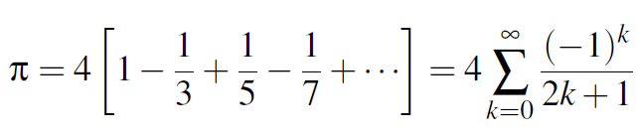
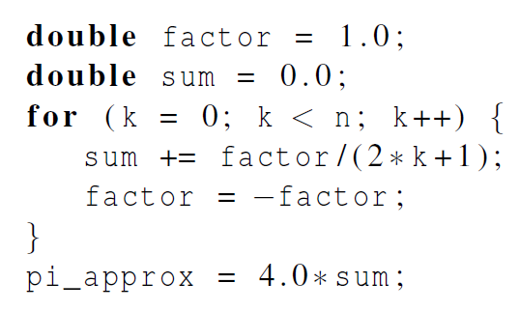

Exercise: Estimating $π$

Slide 64
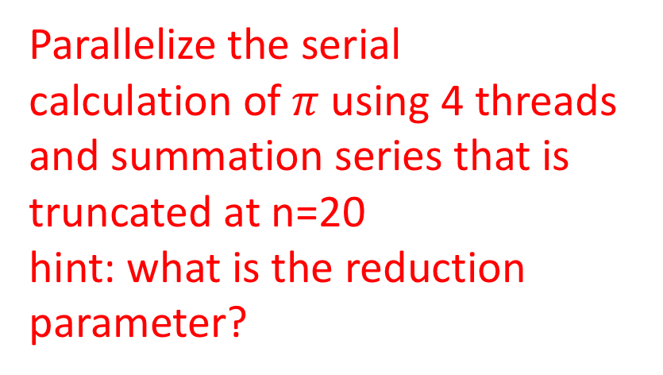
Exercise: Estimating $π$
Parallelize the serial
calculation of $π$ using 4 threads
and summation series that is truncated at n=20
hint: what is the reduction parameter?
To program use the webpages in the following links:
https://www.codingame.com/playgrounds/54443/openmp/playground
https://www.onlinegdb.com/?utm_source=chatgpt.com

Slide 65
OpenMP Solution #1
#include <stdio.h>
#include <stdlib.h>
#include <omp.h>
int main()
{
double sum=0.0;
double pi_approx;
int k, n=20;
#pragma omp parallel for num_threads(4) reduction(+:sum)
for (k=0;k<n;k++){
double factor = (k & 1) ? -1.0 : 1.0;
sum+= factor /(2*k+1);
}
pi_approx=4.0*sum;
printf("%f",pi_approx);
}
Notes:
If sum is used for reduction it is automatically gets the scope private
factor was declared in the loop it is automatically private

Slide 66
OpenMP Solution #1
#include <stdio.h>
#include <stdlib.h>
#include <omp.h>
int main()
{
double factor=1.0;
double sum=0.0;
double pi_approx;
int k, n=20;
#pragma omp parallel for num_thread(4) reduction(+:sum)
{
for (k=0;k<n;k++){
sum+= factor/(2*k+1);
factor=-factor;
}
}
pi_approx=4.0*sum;
printf("%f",pi_approx);
}
Notes:
If sum is used for reduction it is automatically gets the scope private

Slide 67
OpenMP solution #2
#include <stdio.h>
#include <stdlib.h>
#include <omp.h>
int main()
{
double factor=1.0, sum=0.0, pi_approx;
int k, n=20, thread_count=4;
#pragma omp parallel for num_threads(thread_count) reduction(+:sum) private(factor)
for (k=0;k<n;k++){
if (k % 2 ==0)
factor = 1.0;
else
factor = -1.0;
sum+= factor/(2*k+1);
}
pi_approx=4.0*sum;
printf("%f",pi_approx);
}
Insures factor has private scope.
Notes:
Now factor was declared outside needs a scope

Slide 68

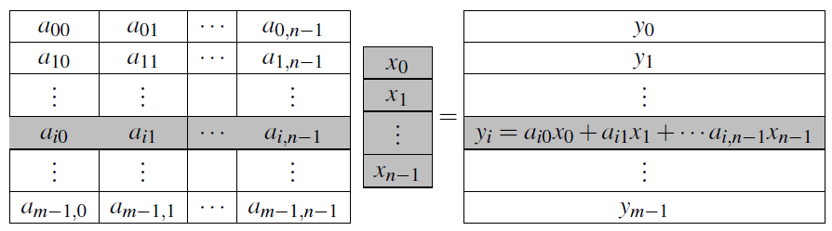
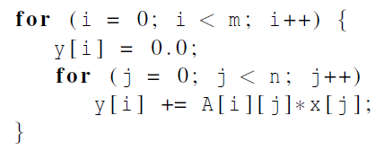
Matrix-vector multiplication
Notes:
Please refer to the detailed slides on cache coherence and thread-safety in Chapter 4.

Slide 69
M x V = X: Parallelization Strategies
Row Decomposition
m x n
n x 1
m x 1
Thread 0
Thread 0
Thread 1
Thread 1
x
=
Parallelizes inner loop
Thread 2
Thread 2
Thread 3
Thread 3
Each thread gets m/p rows
Time taken is proportional to: (mn)/p : per thread
No need for any synchronization (static scheduling will do)

Slide 70
M x V = X: Parallelization Strategies
Column Decomposition
x0 + x1 + x2 + x3
m x n
n x 1
m x 1
Thread 0
Thread 1
Thread 2
Thread 3
Reduction
x
=
X [i]
Parallelizes outer loop
Each thread gets n/p columns
Time taken is proportional to: (mn)/p + time for reduction : per thread
Try that!

Slide 71

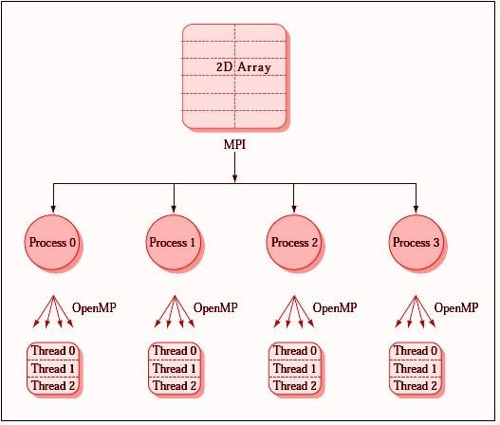

Slide 72
MPI – Message Passing Interface
A distributed memory patronization communication protocol.
Each processor has its own memory and cannot access the memory of other processors
A copy of the same executable runs on each MPI process (processor core)
Any data to be shared must be explicitly transmitted from one to another
An MPI library exists on ALL parallel computing platforms so it is highly portable.
Uses a single program multiple data (SPMD) model
Each processor executes the same set of instructions
Parallelization is achieved by letting each processor operate on a different piece of data
Not to be confused with SIMD: Single Instruction Multiple Data a.k.a vector computing

Slide 73
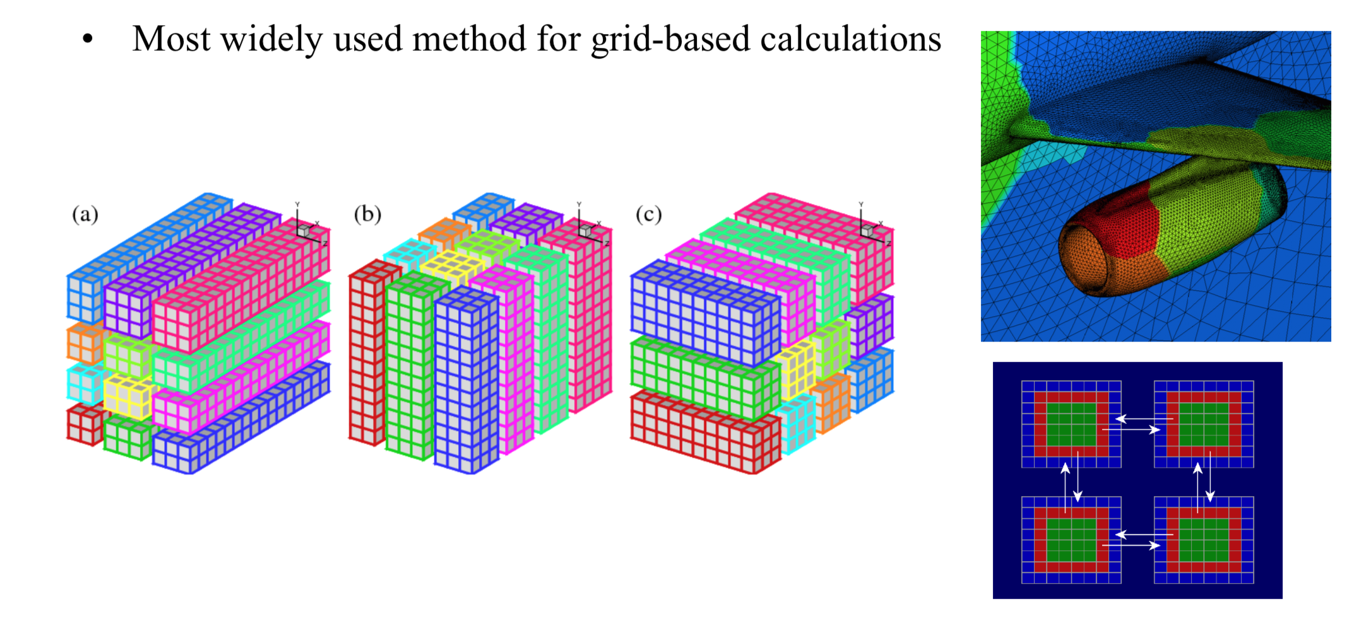
Usage: Domain decomposition

Slide 74
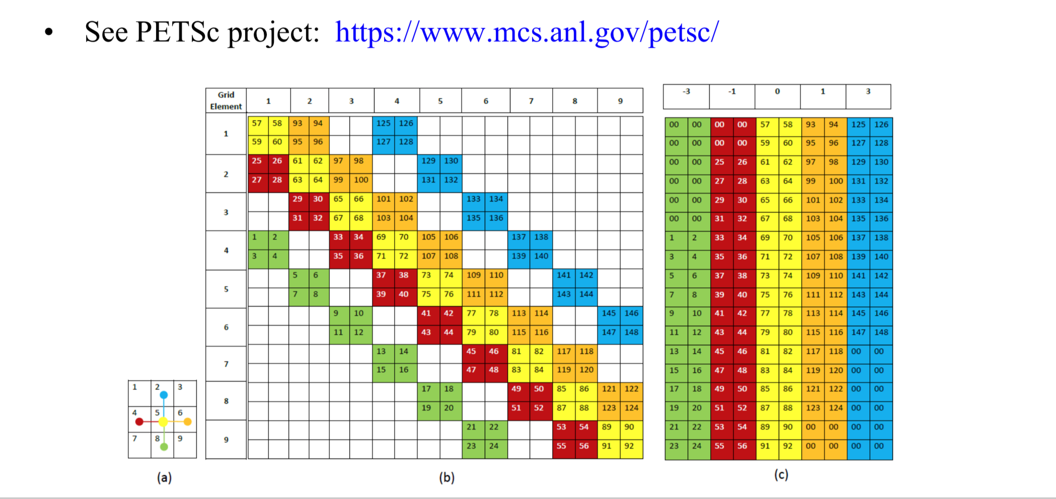
Usage: split matrix elements in PDE solvers
See PETSc project: https://www.mcs.anl.gov/petsc/

Slide 75
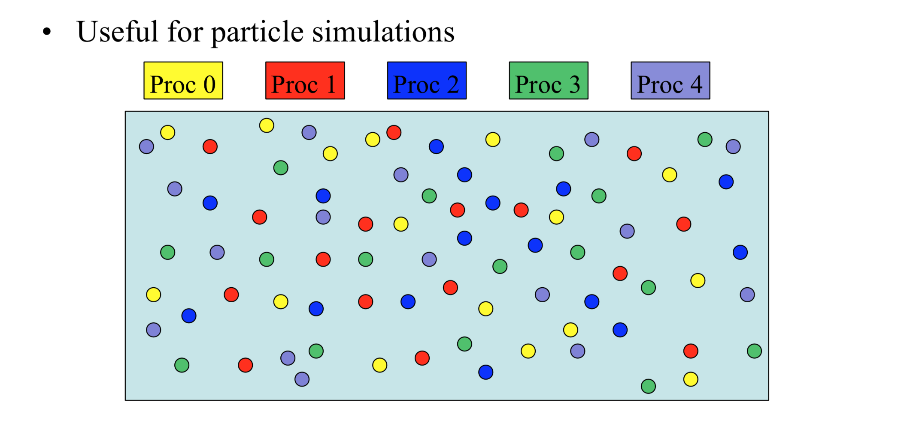
Usage: Coloring
Notes:
Needs redistribution

Slide 76
MPI standard
MPI standard is a specification of what MPI is and how it should behave. Vendors have some flexibility in the implementation (e.g. buffering, collectives, topology optimizations, etc.).
This tutorial focuses on the functionality introduced in the original MPI-1.
MPI-2 introduces additional support for
Parallel I/O (many processes writing to a single file). Requires a parallel filesystem to be efficient
One-sided communication: MPI_Put, MPI_Get
Dynamic Process Management
MPI-3 starting to be implemented by compilers vendors
Non-blocking collectives
Improved one-sided communications
Improved Fortran bindings for type check
And more (see http://www.mpi-forum.org/docs/mpi-3.0/mpi30-report.pdf)
Notes:
mpi libraries exist in matlab and python

Slide 77
How much should we know?
MPI has over 125 functions/subroutines
Can actually do everything with about 6 of them although I would not recommend it
Collective functions are highly useful since they simplify the coding and vendors optimize them for their interconnect hardware
One can access flexibility when it is required.
One need not master all parts of MPI to use it.

Slide 78
MPI Communicators
A communicator is an identifier associated with a group of processes
Each process has a unique rank within a specific communicator (the rank starts from 0 and has a maximum value of (nprocesses-1) ).
Internal mapping of processes to processing units
Always required when initiating a communication by calling an MPI function or routine.
Default communicator MPI_COMM_WORLD, which contains all available processes.
Several communicators can coexist
A process can belong to different communicators at the same time, but has a unique rank in each communicator

Slide 79
Example for MPI program in C
#include "mpi.h"
int main( int argc, char *argv[] )
{
int nproc, myrank;
/* Initialize MPI */
MPI_Init(&argc,&argv);
/* Get the number of processes */
MPI_Comm_size(MPI_COMM_WORLD,&nproc);
/* Get my process number (rank) */
MPI_Comm_rank(MPI_COMM_WORLD,&myrank);
Do work and make message passing calls...
/* Finalize */
MPI_Finalize();
return 0;
}

Slide 80
Header file
• Defines MPI-related parameters and functions • Must be included in all routines calling MPI
functions
• Can also use include file:
#include mpif.h
#include "mpi.h"
int main( int argc, char *argv[] )
{
int nproc, myrank;
/* Initialize MPI */
MPI_Init(&argc,&argv);
/* Get the number of processes */
MPI_Comm_size(MPI_COMM_WORLD,&nproc);
/* Get my process number (rank) */
MPI_Comm_rank(MPI_COMM_WORLD,&myrank);
Do work and make message passing calls...
/* Finalize */
MPI_Finalize();
return 0;
}

Slide 81
Initialization
#include "mpi.h"
int main( int argc, char *argv[] )
{
int nproc, myrank;
/* Initialize MPI */
MPI_Init(&argc,&argv);
/* Get the number of processes */
MPI_Comm_size(MPI_COMM_WORLD,&nproc);
/* Get my process number (rank) */
MPI_Comm_rank(MPI_COMM_WORLD,&myrank);
Do work and make message passing calls...
/* Finalize */
MPI_Finalize();
return 0;
}
Must be called at the beginning of the code before any other calls to MPI functions
Sets up the communication channels between the processes and gives each one a rank.

Slide 82
Number of processors
Returns the number of processes available under MPI_COMM_WORLD communicator
This is the number used on the mpiexec (or mpirun)
command: mpiexec –n nproc a.out
#include "mpi.h"
int main( int argc, char *argv[] )
{
int nproc, myrank;
/* Initialize MPI */
MPI_Init(&argc,&argv);
/* Get the number of processes */
MPI_Comm_size(MPI_COMM_WORLD,&nproc);
/* Get my process number (rank) */
MPI_Comm_rank(MPI_COMM_WORLD,&myrank);
Do work and make message passing calls...
/* Finalize */
MPI_Finalize();
return 0;
}

Slide 83
What’s my rank?
Get my rank among all of the nproc processes under MPI_COMM_WORLD
This is a unique number that can be used to distinguish this process from the others
#include "mpi.h"
int main( int argc, char *argv[] )
{
int nproc, myrank;
/* Initialize MPI */
MPI_Init(&argc,&argv);
/* Get the number of processes */
MPI_Comm_size(MPI_COMM_WORLD,&nproc);
/* Get my process number (rank) */
MPI_Comm_rank(MPI_COMM_WORLD,&myrank);
Do work and make message passing calls...
/* Finalize */
MPI_Finalize();
return 0;
}

Slide 84
Termination
#include "mpi.h"
int main( int argc, char *argv[] )
{
int nproc, myrank;
/* Initialize MPI */
MPI_Init(&argc,&argv);
/* Get the number of processes */
MPI_Comm_size(MPI_COMM_WORLD,&nproc);
/* Get my process number (rank) */
MPI_Comm_rank(MPI_COMM_WORLD,&myrank);
Do work and make message passing calls...
/* Finalize */
MPI_Finalize();
return 0;
}
Must be called at the end of the properly close all communication channels
No more MPI calls after finalize

Slide 85
Point-to-point communication
communication between pairs of processes at a time.
MPI_Send(buf, count, datatype, #dest, tag, comm, ierr)
MPI_Recv(buf, count, datatype, #source, tag, comm, status, ierr)
MPI_Sendrecv(sendbuf,sendcount,sendtype,dest,sendtag,
recvbuf,recvcount,recvtype,source,recvtag,comm,status,ierr)
data types:
MPI_INT, MPI_LONG, MPI_SHORT, MPI_FLOAT, MPI_DOUBLE, etc...
Predefined Communicator:
MPI_COMM_WORLD
Notes:
The processor senting the message has MPI_Send, the processor receiving the message must have MPI_Recv.
buf - the buffer into which message is copied.
count - the number of data cells
datatype - char, int, double …
#dest - rank or destination processor
# source - rank of the sending processor
comm - the communication database (MPI_COMM_WORLD)

Slide 86
Exercise – hello MPI world
Complete the code given in
https://www.codingame.com/playgrounds/349/introduction-to-mpi/hello-world
run it so see what you get.

Slide 87
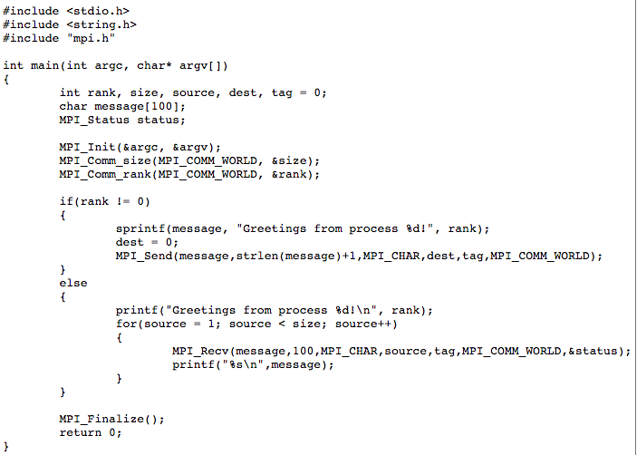
Example: hello world from root
Notes:
The first if statement is what we really want to take a look at here. If rank does not equal zero the program will put our message into a variable called message and then send it to process 0. This if statement will be run on all processes that do not have a rank of 0. The else statement tells us what to do if the process does equal zero. Here the process 0 will receive the variable message from each process and then display the contents of it. So in this program each process that is not 0 will send messages to process 0, it is then the job of process 0 to receive and use the information. As you can see this is where MPI will get its speed. We can have each process do computations and then send the results back to a receiving master process to display a result.

Slide 88

Example: hello world from root
Notes:
The first if statement is what we really want to take a look at here. If rank does not equal zero the program will put our message into a variable called message and then send it to process 0. This if statement will be run on all processes that do not have a rank of 0. The else statement tells us what to do if the process does equal zero. Here the process 0 will receive the variable message from each process and then display the contents of it. So in this program each process that is not 0 will send messages to process 0, it is then the job of process 0 to receive and use the information. As you can see this is where MPI will get its speed. We can have each process do computations and then send the results back to a receiving master process to display a result.

Slide 89
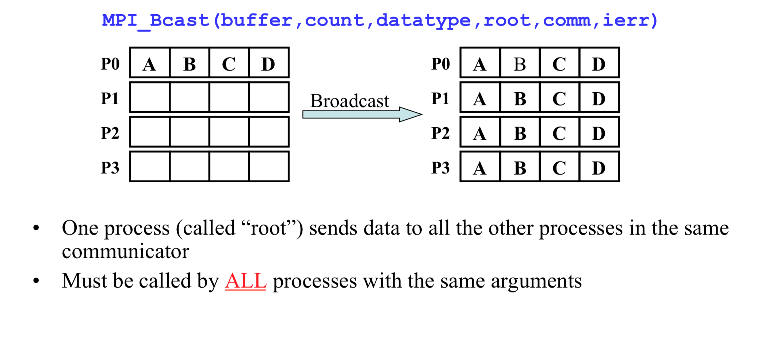
Collective communication: Broadcast
Notes:
MPI_Bcast is a blocking collective operation: This means that the call on the root process will not return until the message buffer is safe to reuse. The specifics depend on the underlying implementation, but generally, the operation is considered complete when the data has been sent [1].
Sender vs. Receiver Blocking: The root (sender) typically returns once the data has been sent out, not necessarily when every single receiver has fully received and processed the data [1]. The receiving processes, however, will block until they have received the data from the root.
Execution Order:
The root process calls MPI_Bcast.
All other processes call MPI_Bcast.
The data transfer occurs.
Once the root process's data has been sent (or at least handed off to the system buffers), the MPI_Bcast function on the root returns.
The root process immediately proceeds to execute the print statement.

Slide 90
#include <mpi.h>
#include <stdio.h>
int main(int argc, char** argv)
{
int rank, buf=0;
const int root=0;
MPI_Init(&argc, &argv);
MPI_Comm_rank(MPI_COMM_WORLD, &rank);
if(rank == root) {
buf = 777;
}
printf("[%d]: Before Bcast, buf is %d\n", rank, buf);
/* everyone calls bcast, data is taken from root and ends up in everyone's buf */
MPI_Bcast(&buf, 1, MPI_INT, root, MPI_COMM_WORLD);
printf("[%d]: After Bcast, buf is %d\n", rank, buf);
MPI_Finalize();
return 0;
}
To program use the webpages in the following links:
https://www.codingame.com/playgrounds/47058/have-fun-with-mpi-in-c/take-the-first-steps-hello-world

Slide 91
#include <mpi.h>
#include <stdio.h>
int main(int argc, char** argv)
{
int rank, buf=0;
const int root=0;
MPI_Init(&argc, &argv);
MPI_Comm_rank(MPI_COMM_WORLD, &rank);
if(rank == root) {
buf = 777;
}
printf("[%d]: Before Bcast, buf is %d\n", rank, buf);
/* everyone calls bcast, data is taken from root and ends up in everyone's buf */
MPI_Bcast(&buf, 1, MPI_INT, root, MPI_COMM_WORLD);
printf("[%d]: After Bcast, buf is %d\n", rank, buf);
MPI_Finalize();
return 0;
}
Output:
[0]: Before Bcast, buf is 777
[0]: After Bcast, buf is 777
[1]: Before Bcast, buf is 0
[1]: After Bcast, buf is 777
[2]: Before Bcast, buf is 0
[2]: After Bcast, buf is 777
[3]: Before Bcast, buf is 0
[3]: After Bcast, buf is 777
To program use the webpages in the following links:
https://www.codingame.com/playgrounds/47058/have-fun-with-mpi-in-c/take-the-first-steps-hello-world

Slide 92
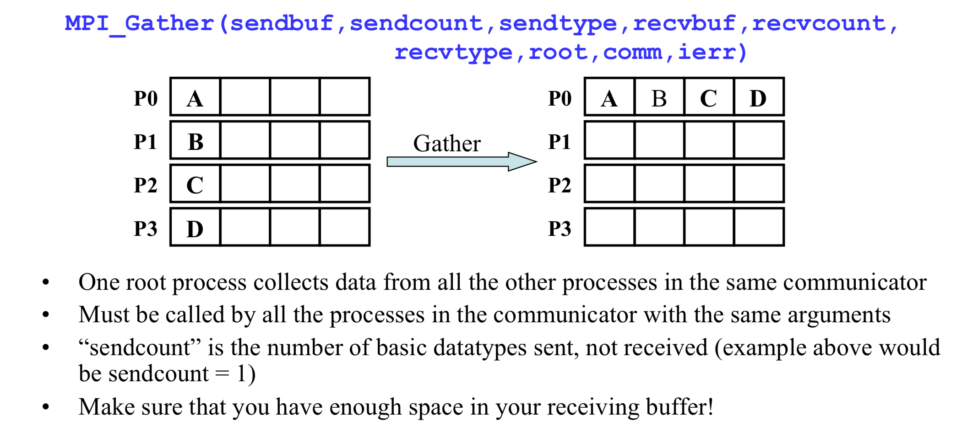
Collective communication: Gather
Rank of the receiving proc.
Notes:
Sendbuff here is 1, receivebuff is 4
root - the rank of the processor receiving the message

Slide 93
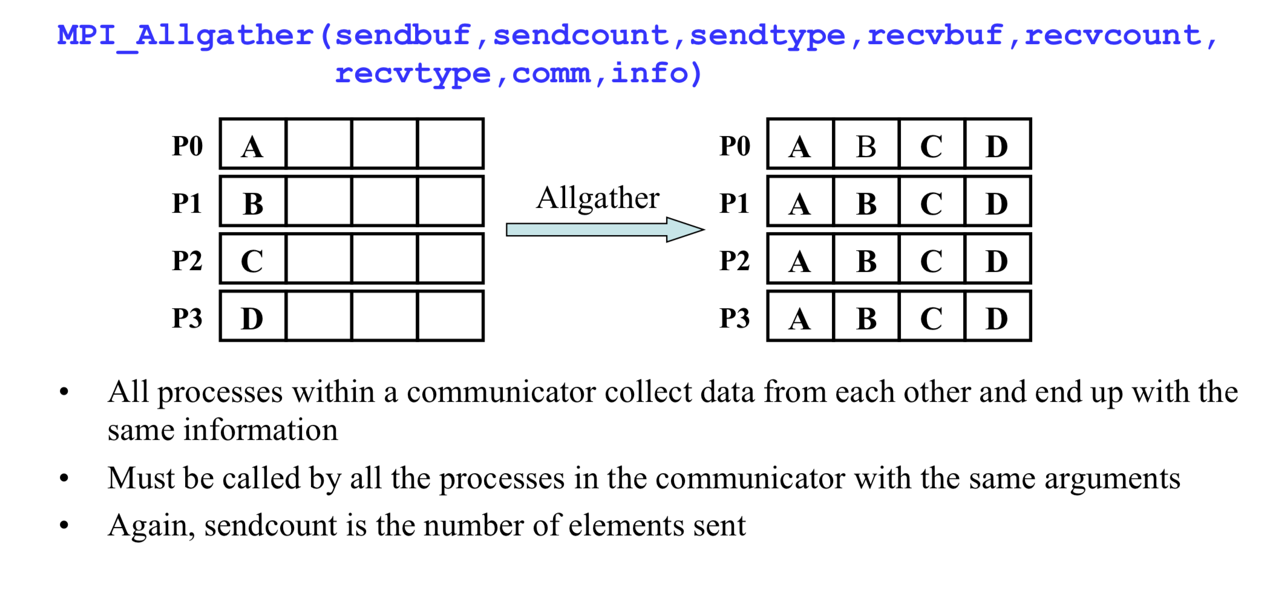
Collective communication: Gather to all

Slide 94
Process 0, my value = 0.
Values collected on process 0: 0, 100, 200.
Process 1, my value = 100.
Values collected on process 1: 0, 100, 200.
Process 2, my value = 200.
Values collected on process 2: 0, 100, 200ץ
Process 3, my value = 300.
Values collected on process 3: 0, 100, 200.
#include <stdio.h>
#include <stdlib.h>
#include <mpi.h>
int main(int argc, char* argv[])
{
MPI_Init(&argc, &argv);
// Get number of processes int size;
MPI_Comm_size(MPI_COMM_WORLD, &size);
// Get my rank
int my_rank;
MPI_Comm_rank(MPI_COMM_WORLD, &my_rank);
// Define my value
int my_value = my_rank * 100;
printf("Process %d, my value = %d.\n", my_rank, my_value);
int buffer[size];
MPI_Allgather(&my_value, 1, MPI_INT, buffer, 1, MPI_INT,MPI_COMM_WORLD);
printf("Values collected on process %d: %d, %d, %d.\n", my_rank, buffer[0], buffer[1], buffer[2]);
MPI_Finalize();
return EXIT_SUCCESS;
}

Slide 95
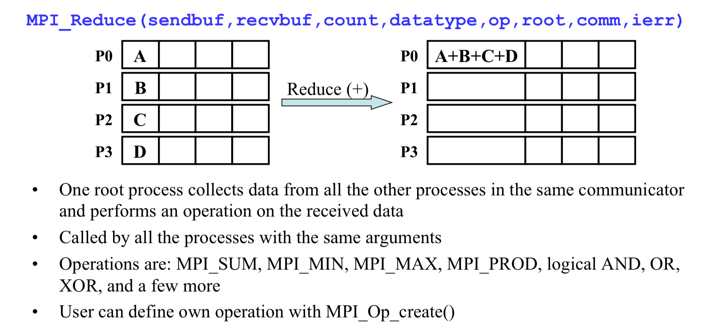
Collective communication: Reduction

Slide 96
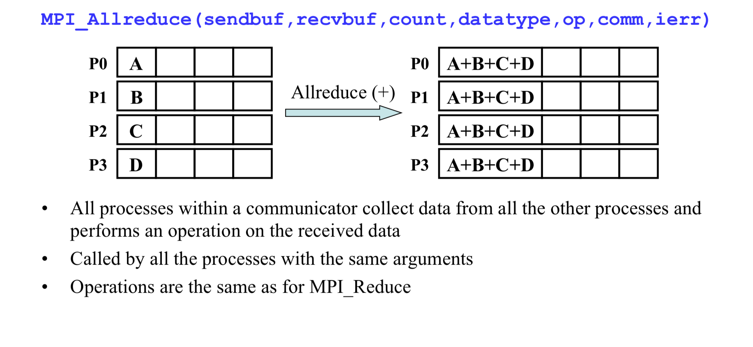
Collective communication: Reduction to all

Slide 97
#include <stdio.h>
#include <stdlib.h>
#include <mpi.h>
#include <time.h>
int main(int argc, char** argv) {
int rank, size;
MPI_Init(&argc, &argv);
MPI_Comm_size(MPI_COMM_WORLD, &size);
MPI_Comm_rank(MPI_COMM_WORLD, &rank);
// Seed the random number generator and generate a number
srand(time(NULL) * rank);
int local_value = rand() % 100;
// Print the local value from each process
printf("Process %d has local value: %d\n", rank, local_value);
int global_sum;
int root_process = 0;
// Reduce all local values into the global_sum on the root process
MPI_Reduce(&local_value, &global_sum, 1, MPI_INT, MPI_SUM, root_process, MPI_COMM_WORLD);
// Only the root process will have the final, correct result
if (rank == root_process) {
printf("\nRoot process (%d) calculated the global sum: %d\n", root_process, global_sum);
}
MPI_Finalize(); return 0;
}
Process 0 has local value: 83
Root process (0) calculated the global sum: 133
Process 1 has local value: 33
Process 2 has local value: 5
Process 3 has local value: 12
Notes:
The order of print doesn’t necessarily reflects the order of work.

Slide 98
Some more MPI calls
One “root” process send a different piece of the data to each one of the other Processes (inverse of gather)
MPI_Scatter(sendbuf, sendcnt, sendtype, recvbuf, recvcnt,
recvtype, root, comm, ierr)
Each process performs a scatter operation, sending a distinct message to all the processes in the group in order by index.
MPI_Alltoall(sendbuf, sendcount, sendtype, recvbuf, recvcnt,
recvtype, comm, ierr)
Synchronization: When necessary, all the processes within a communicator can be forced to wait for each other although this operation can be expensive
MPI_Barrier(comm,ierr)
Notes:
MPI_Scatter:
On the root: sendbuf holds P contiguous blocks (where P = size of comm), each of length sendcount. Block r (0…P−1) is delivered to rank r.
On every rank (including root): recvbuf receives exactly recvcount items. Usually recvcount == sendcount and recvtype == sendtype.
Non-root ranks ignore sendbuf/sendcount/sendtype.
All ranks must call the routine (it’s a collective).
So if P=4, sendbuf = [A0 A1 … A_{k-1} | B0 … | C0 … | D0 …], then rank 0 gets A*, rank 1 gets B*, etc. The root’s own piece is moved (often just copied) into its recvbuf.

Slide 99
MPI_SEND communication modes
The send call has several options of communication modes.
The communication mode is indicated by a one letter prefix: B for buffered, R for ready and S for synchronous.
MPI_SENS: Message may be buffered or not. If buffered, the send call may complete before a matching receive is invoked (non-blocking). If not the send call will not complete until a matching receive has been posted (blocking).
MPI_BSEND: The programmer can guarantee that space is available for messages by specifying a buffer space. This allows a send to complete without have to have a matching receive posted yet.
MPI_RSEND: The send will start only if the matching receive is already posted. Otherwise, the operation is erroneous and its outcome is undefined.
MPI_SSEND: The send will complete successfully only if a matching receive is posted, and the receive operation has started to receive the message sent by the synchronous send.
Notes:
There are many different modes that we can use to communicate messages in MPI:
Standard Mode: In this mode we initiate a send to a process but it is not always sure if the matching receive is started and no assumption should be made in the application program about whether the out-going data is buffered by MPI. If a send is buffered then the send will complete before a receive is called, if buffer space is unavailable then the message will not be buffered by MPI and a matching receive will have to be posted for the send to complete.
Buffered Mode: The programmer can guarantee that space is available for messages by specifying a buffer space. The programmer must do this inside of the application program, if the buffer is unavailable then the send will fail. This allows a send to complete without have to have a matching receive posted yet.
Synchronous Mode: A send can be posted without having a matching receive. When a receive is posted the send will not complete until the matching receive has started to receive the message that was started by the synchronous send operation.
Ready Mode: A ready mode send may only start is a matching receive has first been posted. This can remove the slow down of the handshake between communication and increase performance. The send will contain extra information about the receiving process.
All four of these modes can be either blocking or non-blocking communications.
http://www.rc.usf.edu/tutorials/classes/tutorial/mpi/chapter4.html

Slide 100
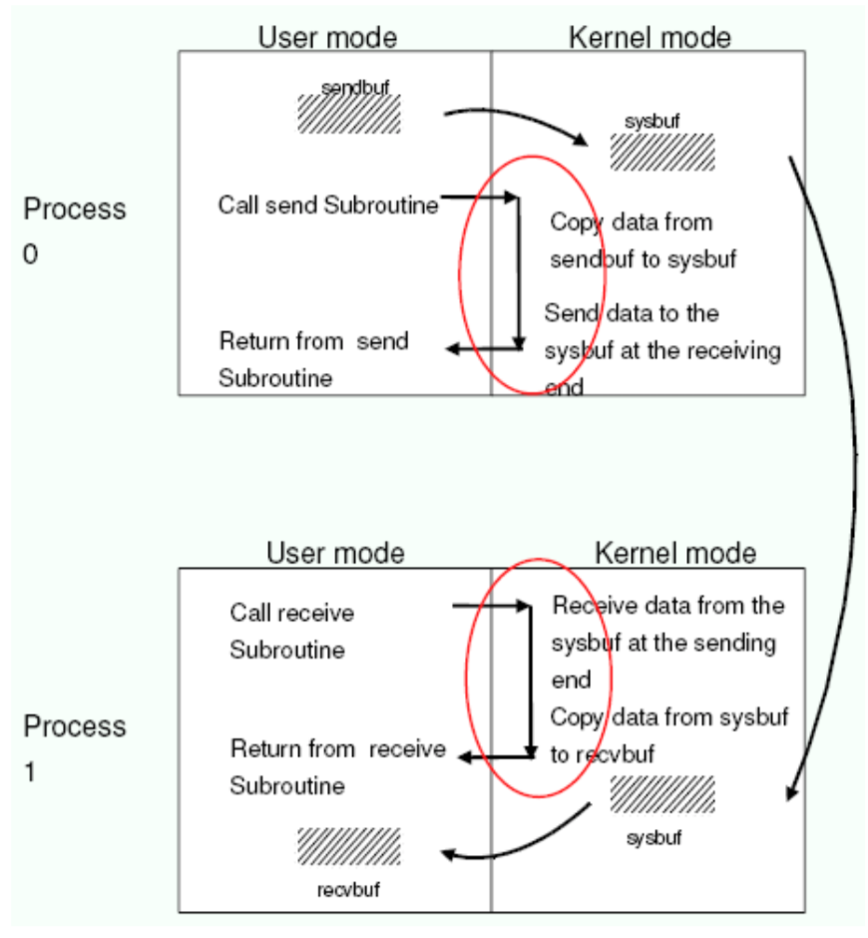
Blocking communications
The call waits until the data transfer is done
The sending process waits until all data are transferred to the system buffer
The receiving process waits until all data are transferred from the system buffer to the receive buffer
All collective communications are blocking

Slide 101
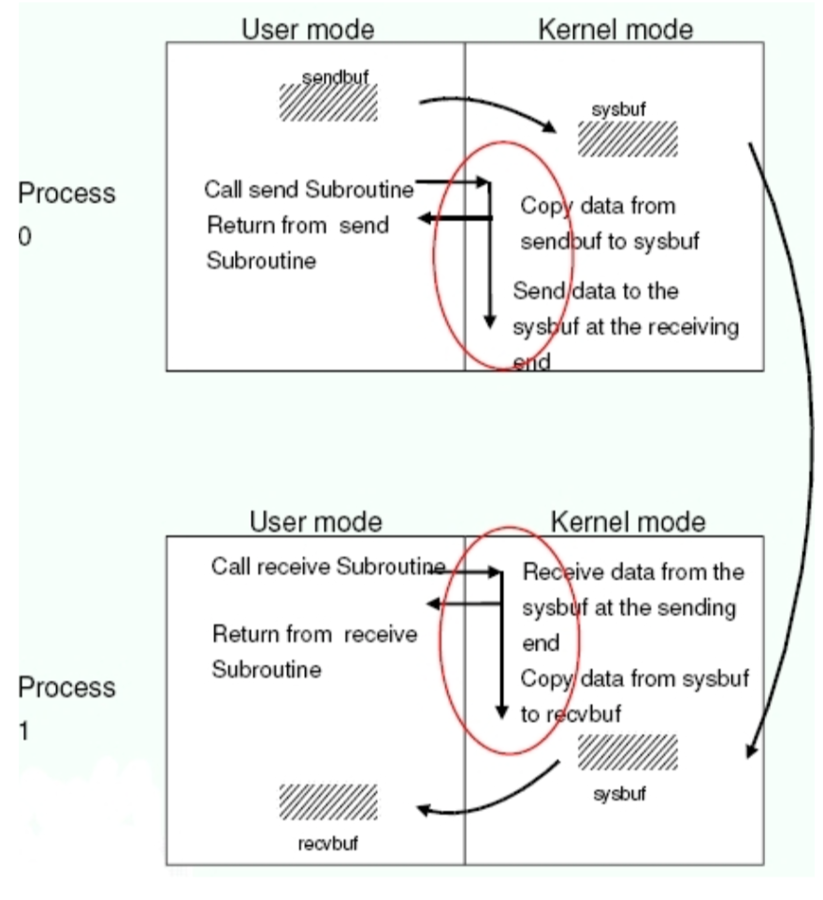
Non-blocking
Returns immediately after the data transferred is initiated
Allows to overlap computation with communication
Need to be careful though
When send and receive buffers are updated before the transfer is over, the result will be wrong

Slide 102
Non-blocking send and receive
Point-to-point
MPI_Isend(buf,count,datatype,dest,tag,comm,request,ierr)
MPI_Irecv(buf,count,datatype,source,tag,comm,request,ierr)
The functions MPI_Wait and MPI_Test are used to complete a nonblocking communication
MPI_Wait(request,status,ierr)
MPI_Test(request,flag,status,ierr)
MPI_Wait returns when the operation identified by “request” is complete. This is a non-local operation.
MPI_Test returns “flag = true” if the operation identified by “request” is complete. Otherwise it returns “flag = false”. This is a local operation.
Notes:
MPI-3 standard introduces “non-blocking collective calls”

Slide 103
Timing an MPI code
MPI provides an easy to use function called “MPI_Wtime()”.
It returns the number of seconds since an arbitrary point of time in
the past.
Usage:
double MPI_Wtime()
Example:
starttime=MPI_WTIME()
... program body ...
endtime=MPI_WTIME()
elapsetime=endtime-starttime

Slide 104
Compiling and linking MPI code
Need to download an MPI compiler.
In Linux clusters, two popular MPI implementations are:
MPICH(http://www-unix.mcs.anl.gov/mpi/mpich)
OPENMPI (http://www.openmpi.org)
On windows you can use the official Microsoft version MS-MPI
(https://learn.microsoft.com/en-us/message-passing-interface/microsoft-mpi)
or OPENMPI
On mac type:
brew install open-mpi
To compile (c code) just type:
mpicc mpi_code.c –o a.out

Slide 105
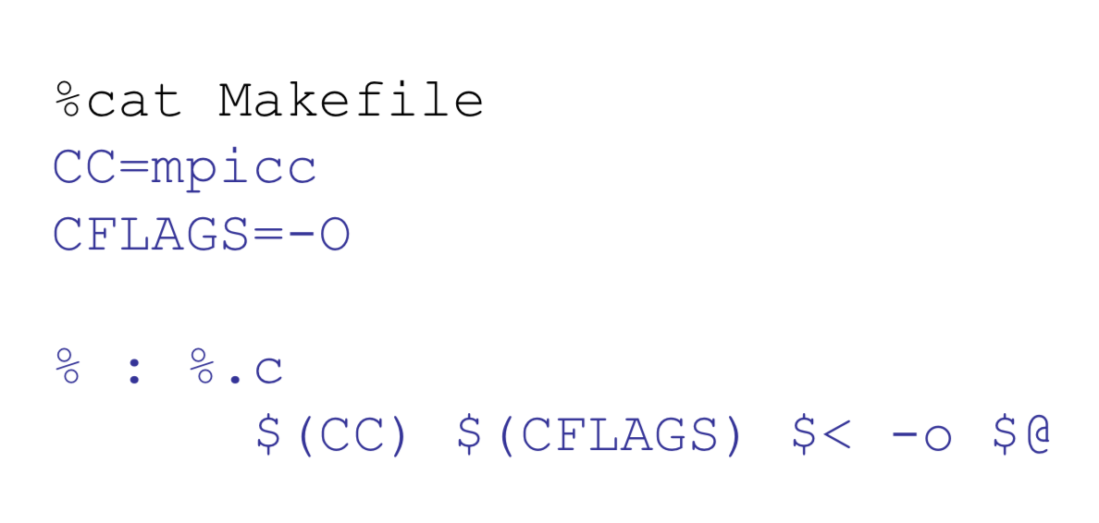
Makefile
It is always a good idea to have a makefile

Slide 106
Running an MPI executable
The implementation supplies scripts to launch the MPI parallel calculation, for example (in MPICH and OPENMPI):
mpirun –np #proc a.out
mpiexec –n #proc a.out
A copy of the same program runs on each processor core within its own process (private address space).
Each process works on a subset of the problem.
Exchange data when needed
Can be exchanged through the network interconnect
Or through the shared memory on SMP machines (Bus?)

Slide 107

Exercise: Estimating $π$ with MPI
Using the following link, implement parallelize the series to calculate $π$ with MPI
https://www.codingame.com/playgrounds/47058/have-fun-with-mpi-in-c/take-the-first-steps-hello-world
hint: you will need to use MPI_reduce and MPI_Barrier

Slide 108
#include <mpi.h>
#include <stdio.h>
int main(int argc, char** argv) {
int rank, size, factor, i, N=20;
double pi=0.0, begin=0.0, end=0.0, result=0.0, sum=0.0;
// Initialisation, Reading size and rank
MPI_Init(&argc,&argv);
MPI_Comm_size(MPI_COMM_WORLD, &size);
MPI_Comm_rank(MPI_COMM_WORLD, &rank);
//Synchronize all processes get start time MPI_Barrier(MPI_COMM_WORLD);
begin = MPI_Wtime();
for (i=rank; i<N; i+=size)
{
if (i % 2 ==0)
factor = 1.0;
else
factor = -1.0;
result+=factor/(2.0*i+1);
}
//Sum up all results
MPI_Reduce(&result, &sum, 1, MPI_DOUBLE, MPI_SUM, 0, MPI_COMM_WORLD);
//Synchronize all processes & get end time
MPI_Barrier(MPI_COMM_WORLD);
end = MPI_Wtime();
//Caculate and print PI
if (rank==0)
{
pi=4*sum;
printf(”N=%d; np=%2d; Time=%fs; PI=%lf\n", N, size, end-begin, pi);
fflush(stdout);
}
// Finalisation
MPI_Finalize();
return 0;
}

Slide 109
#include <mpi.h>
#include <stdio.h>
int main(int argc, char** argv) {
int rank, size, factor, i, N=20;
double pi=0.0, begin=0.0, end=0.0, result=0.0, sum=0.0;
// Initialisation, Reading size and rank
MPI_Init(&argc,&argv);
MPI_Comm_size(MPI_COMM_WORLD, &size);
MPI_Comm_rank(MPI_COMM_WORLD, &rank);
//Synchronize all processes get start time MPI_Barrier(MPI_COMM_WORLD);
begin = MPI_Wtime();
for (i=rank; i<N; i+=size)
{
if (i % 2 ==0)
factor = 1.0;
else
factor = -1.0;
result+=factor/(2.0*i+1);
}
//Sum up all results
MPI_Reduce(&result, &sum, 1, MPI_DOUBLE, MPI_SUM, 0, MPI_COMM_WORLD);
//Synchronize all processes & get end time
MPI_Barrier(MPI_COMM_WORLD);
end = MPI_Wtime();
//Caculate and print PI
if (rank==0)
{
pi=4*sum;
printf(”N=%d; np=%2d; Time=%fs; PI=%lf\n", N, size, end-begin, pi);
fflush(stdout);
}
// Finalisation
MPI_Finalize();
return 0;
}
Result:
N=4; np= 4; Time=0.000615s; PI=3.091624
N=400; np= 4; Time=0.000582s; PI=3.139093
N=4000; np= 4; Time=0.000021s; PI=3.141343

