Slide 1


AgroPlus
Soil- and Weather-Aware Crop Recommendation & Farm Profitability Platform
SE 801 · SOFTWARE PROJECT LAB–III
Md. Touhidur Rahman
Registration: 2021011373 • Exam Roll 2322144
Supervised by
Dr. Zerina Begum, Professor
Institute of Information Technology, University of Dhaka

Slide 2
OVERVIEW
Agenda
1
Problem Statement
5
Feature Deep-Dives — Recommendation, Profit, Rotation, AI Assistant
2
Our Solution
6
Live App Walkthrough (Screenshots)
3
Feature Overview
7
Data Model, Testing & Verification
4
Tech Stack & System Architecture
8
Known Limitations & Future Work
AgroPlus — SE 801 Final Presentation
2

Slide 3
THE PROBLEM
Why Bangladeshi Farmers Need This
🧪
💸
🔄
No Accessible Soil-to-Crop Link
No Transparent Economics
No Rotation Discipline
A soil test gives N/P/K/pH numbers, but translating that into “which crop will actually do well here” needs agronomic expertise most farmers don't have on hand.
Even an agronomically sound crop can be a financial mistake without an itemized, sourced cost estimate against the farmer's own land size and budget.
Back-to-back repetition of the same crop depletes soil nutrients and builds up pests — yet nothing remembers a land's cropping history when suggesting what's next.
AgroPlus — SE 801 Final Presentation
3

Slide 4
THE SOLUTION
What AgroPlus Does
A mobile app that turns a short soil sample into a grounded crop recommendation —
with real costs, real profit, and an AI assistant that never guesses.
✦ Soil → Recommendation. ML-ranked top-3 crops (or a full season plan) from a tiered soil sample and live weather.
✦ Itemized economics. Seed, per-nutrient fertilizer, and other costs — sourced from BAMIS, DAM, and BADC, not guessed.
✦ Rotation-safe by default. A crop is never suggested a third time in a row on the same land.
✦ Grounded AI chat. Every number the assistant states comes from a real tool call against the land's own data.
✦ Bilingual. Full English and Bangla localization, with the assistant replying in the farmer's language.
AgroPlus — SE 801 Final Presentation
4

Slide 5
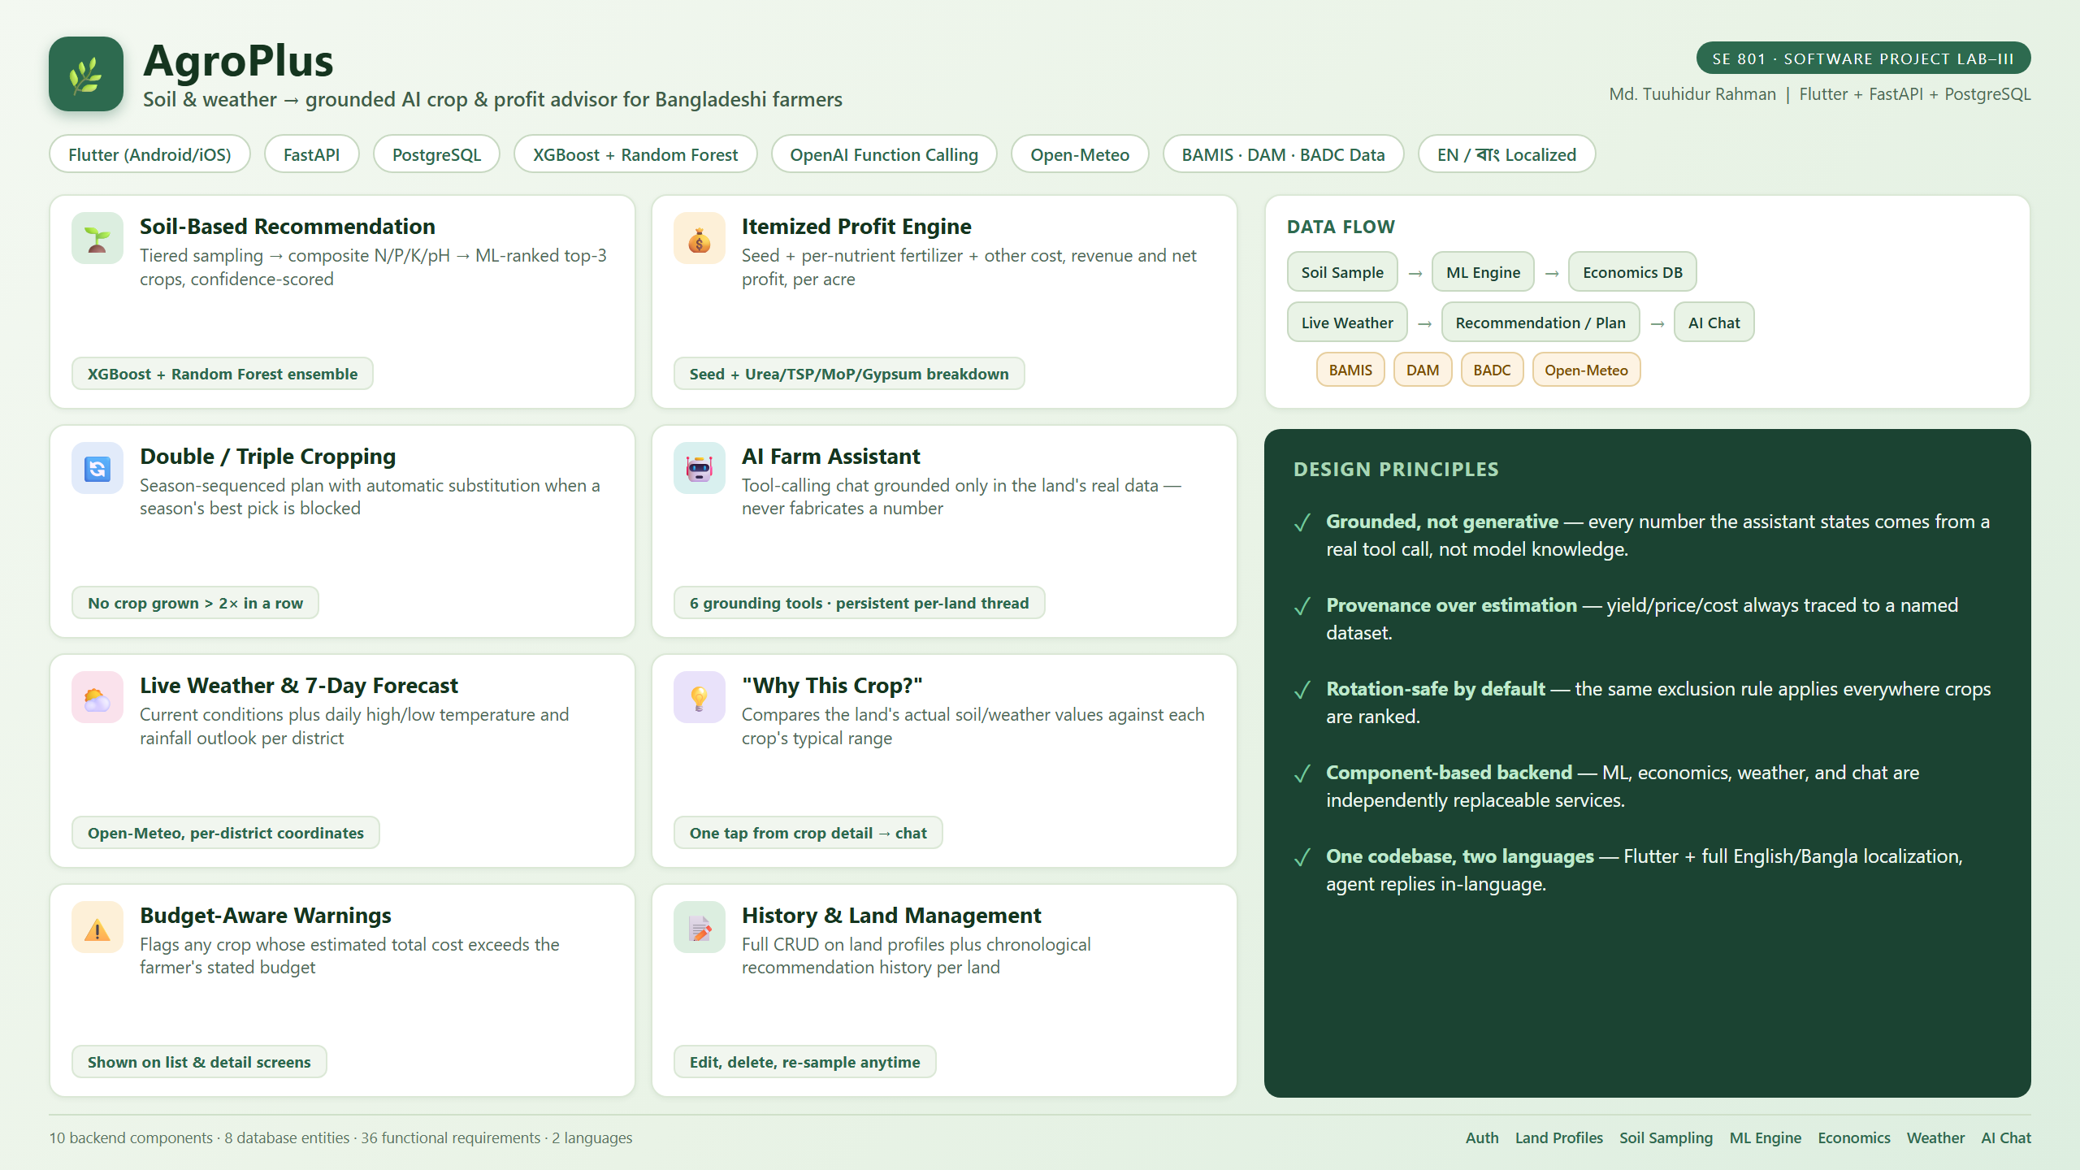
AgroPlus — SE 801 Final Presentation
5

Slide 6
UNDER THE HOOD
Technology Stack
Frontend
Backend
📱
⚙️
Flutter (Dart) — Android & iOS from one codebase, English + Bangla
FastAPI (Python) — REST API, JWT auth, Alembic migrations
Database
ML Engine
🗄️
🧠
PostgreSQL via SQLAlchemy ORM
XGBoost + Random Forest ensemble, trained on the Kaggle Crop Recommendation dataset
AI Assistant
Weather
🤖
☁️
OpenAI function-calling (gpt-4o-mini) with 6 grounding tools
Open-Meteo — live conditions + 7-day forecast
AgroPlus — SE 801 Final Presentation
6

Slide 7
ARCHITECTURE
System Design
Flutter Mobile Client
Android / iOS
REST / JWT
FastAPI API Layer
auth · farms · recommendations · chat
ML Recommendation
Engine
XGBoost + Random Forest
Crop Economics
Knowledge Base
BAMIS · DAM · BADC
Weather Service
Open-Meteo API
AI Farm Assistant
OpenAI function calling
Persistence
SQLAlchemy / PostgreSQL
Each service is independently replaceable — swapping the ML model or the chat provider never touches the others.
AgroPlus — SE 801 Final Presentation
7

Slide 8
CORE FLOW
From Soil Sample to Recommendation
1
Create a land
District, area, soil type, water availability, budget, target season, cropping pattern.
2
Sample the soil
1 / 3 / 5 points depending on area — N, P, K, pH at each.
3
Composite reading
Once every required point is saved, AgroPlus averages them automatically.
4
ML scoring
XGBoost + Random Forest score every supported crop against soil + live weather.
5
Rotation filter
Any crop grown twice in a row on this land is excluded before ranking.
6
Result
Single mode: top-3 ranked. Double/Triple mode: a season-sequenced plan.
AgroPlus — SE 801 Final Presentation
8

Slide 9
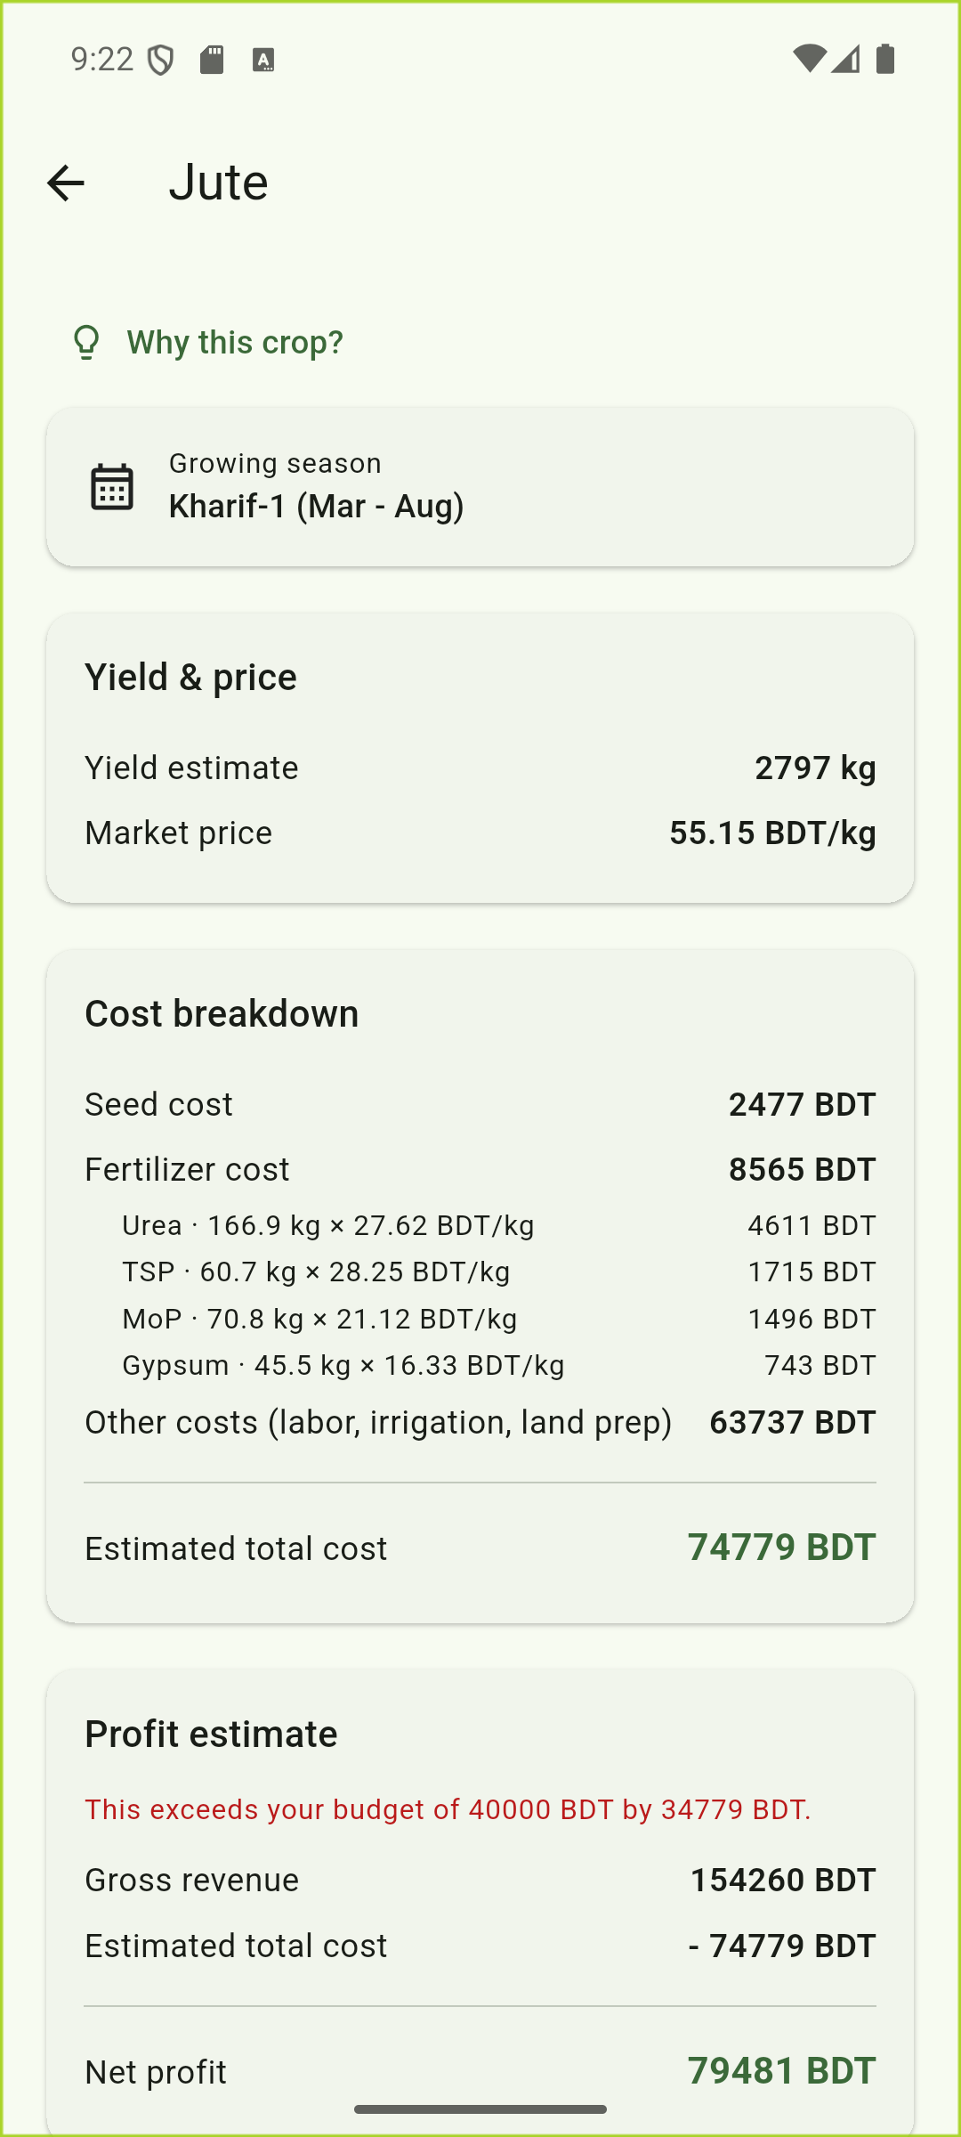
FEATURE DEEP-DIVE
Itemized Harvest Economics
✦ Seed cost BADC/DAM seed price × BAMIS recommended seeding rate.
✦ Fertilizer cost BAMIS's per-crop recipe (Urea, TSP, MoP, Gypsum…) priced against real DAM market rates, itemized per nutrient.
✦ Other costs Labor, irrigation, land prep — the remainder of BAMIS's bundled total after seed + fertilizer.
✦ Always reconciles seed + fertilizer + other = total cost, exactly, for every crop.
✦ Profit estimate Gross revenue − total cost = net profit, plus a warning if cost exceeds the farmer's budget.
AgroPlus — SE 801 Final Presentation
9

Slide 10
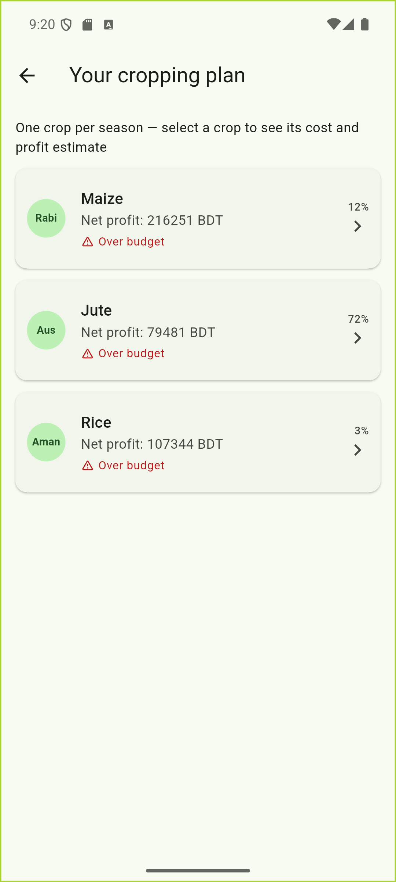
FEATURE DEEP-DIVE
Multi-Cropping & the Rotation Rule
✦ Single / Double / Triple Chosen per land — one crop at a time, or a season-sequenced plan across Rabi / Aus / Aman.
✦ Season classification BAMIS's cultivation-season text is classified into Rabi/Aus/Aman once, at data-seeding time.
✦ The rotation rule A crop can't be picked if it would be grown a 3rd time in a row — counting the land's recorded history plus the plan being built.
✦ Automatic substitution If a season's top pick is blocked, the next-best rotation-safe crop steps in, with a human-readable note explaining why.
✦ Mango is excluded A perennial tree crop doesn't fit a within-year seasonal rotation — it stays single-cropping only.
AgroPlus — SE 801 Final Presentation
10

Slide 11
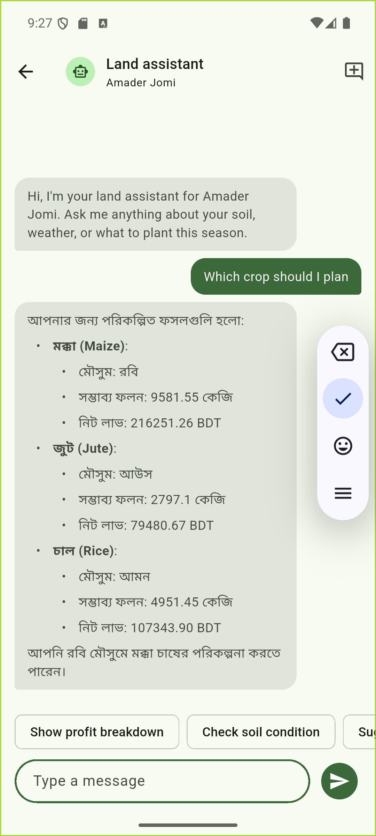
FEATURE DEEP-DIVE
AI Farm Assistant
✦ Grounded, not generative Every number the assistant states comes from a real tool call against the land's own data — never the model's general knowledge.
✦ Six grounding tools Soil reading, live weather, 7-day forecast, current recommendation, crop detail, other crop options, and “why this crop?” explanation.
✦ Honest about gaps If a soil reading doesn't exist yet, the assistant says so — it never fabricates a plausible-looking answer.
✦ Persistent per land One ongoing conversation per land, restored automatically; a “new conversation” action clears it.
✦ Replies in-language English question in, Bangla answer out — matching however the farmer writes.
AgroPlus — SE 801 Final Presentation
11

Slide 12
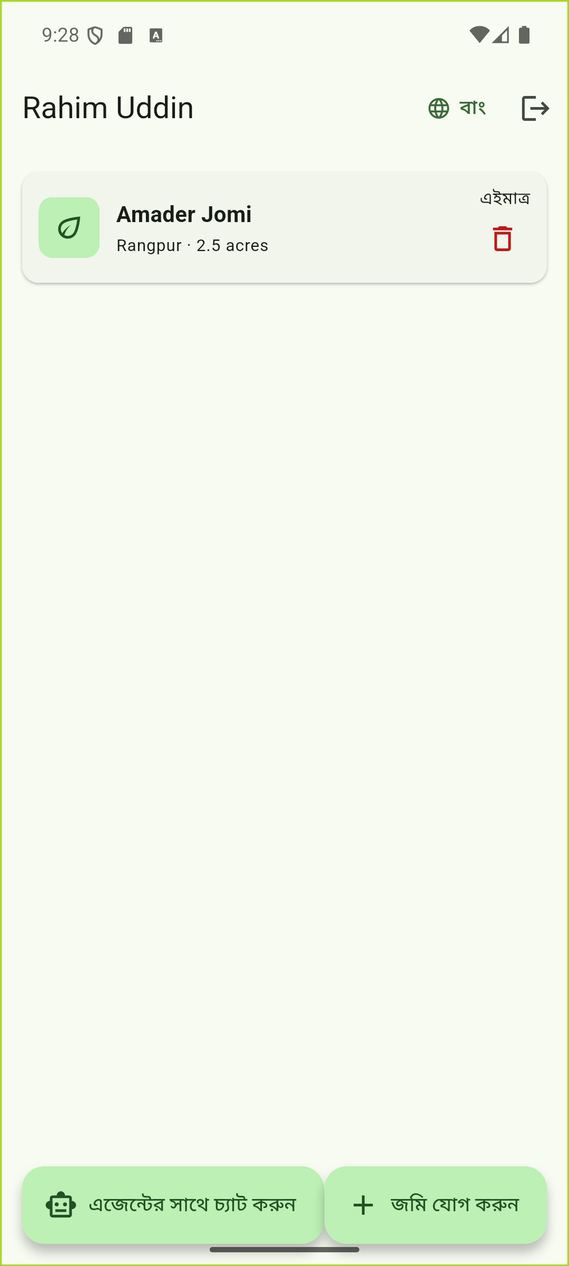
FEATURE DEEP-DIVE
Weather, Budget Awareness & Localization
✦ Live conditions Current temperature, humidity, and rainfall for the land's district, refreshable on demand.
✦ 7-day forecast Daily high/low temperature and precipitation, so timing decisions aren't based on a single snapshot.
✦ Budget-aware warnings Any crop whose estimated cost exceeds the farmer's stated budget is flagged — on both the list and the detail screen.
✦ Full Bangla localization Every screen, every label, every chat reply — switchable at any time, persisted across restarts.
AgroPlus — SE 801 Final Presentation
12

Slide 13
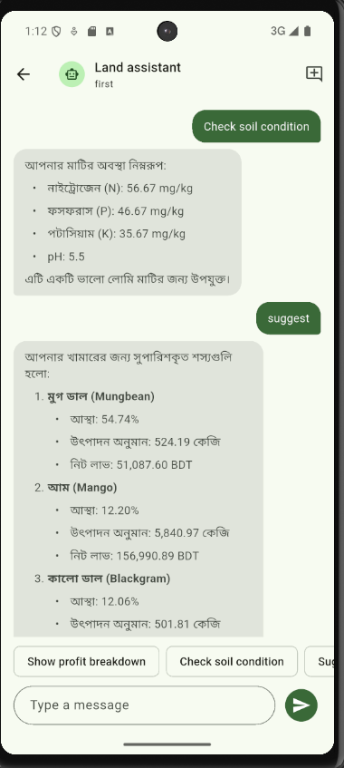
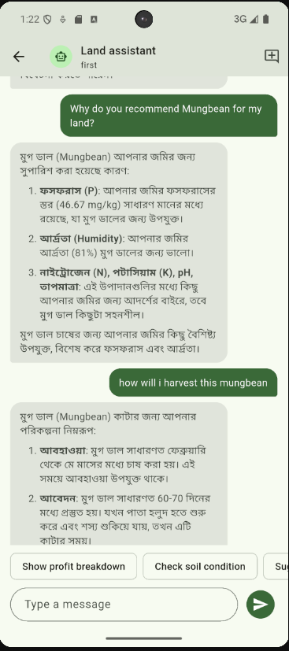
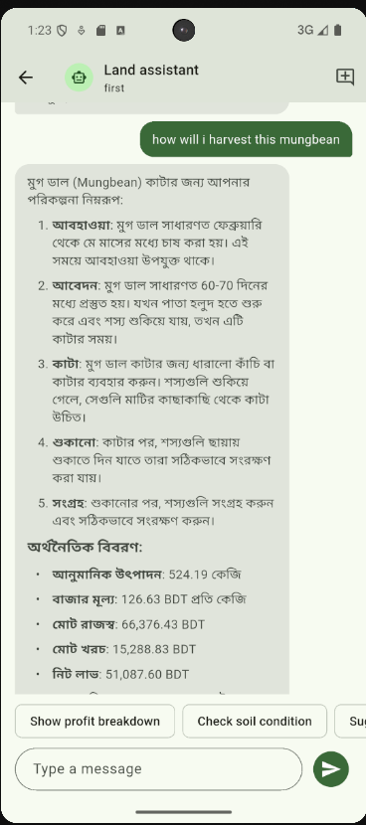
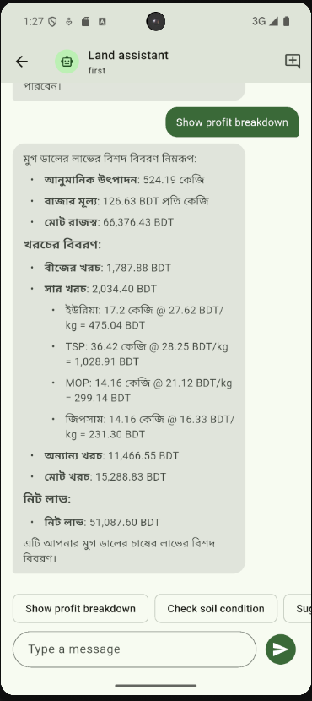
FEATURE DEEP-DIVE
Agentic Chat Flow
AgroPlus — SE 801 Final Presentation
12

Slide 14
UNDER THE HOOD
Data Model at a Glance
Farmer
District
Account, credentials
64 districts, seeded with coordinates
Farm (Land)
Recommendation
Profile, budget, cropping pattern, rotation history
One per completed soil reading
SamplePoint
RecommendationCrop
N/P/K/pH per sampling point
Ranked crops or a season plan
CropEconomics
ChatMessage
Government-sourced yield/price/cost reference data
Persistent per-land conversation
AgroPlus — SE 801 Final Presentation
13

Slide 15
QUALITY
Testing & Verification
✦ Scripted API testing Every endpoint exercised directly with Python HTTP scripts — happy paths, ownership checks, validation errors.
✦ Real on-device verification Every feature walked through live on an Android emulator, not just asserted from backend responses.
✦ Invariant checks seed + fertilizer + other = total cost, verified numerically after every pipeline change.
✦ Rotation-rule testing Verified a 3rd-in-a-row crop is actually excluded, with the right substitution and note.
✦ Regression discipline Backend restarted and re-verified after every schema or logic change throughout development.
AgroPlus — SE 801 Final Presentation
14

Slide 16
🌱
Thank You
Questions & Discussion
AgroPlus — Md. Touhidur Rahman
SE 801 · Software Project Lab–III

