Slide 1
Overview to Navigation Patterns in HCI
Navigation patterns in HCI help users efficiently interact with digital systems.
Two important navigation patterns are:
Breadcrumbs
Pagination

Slide 2
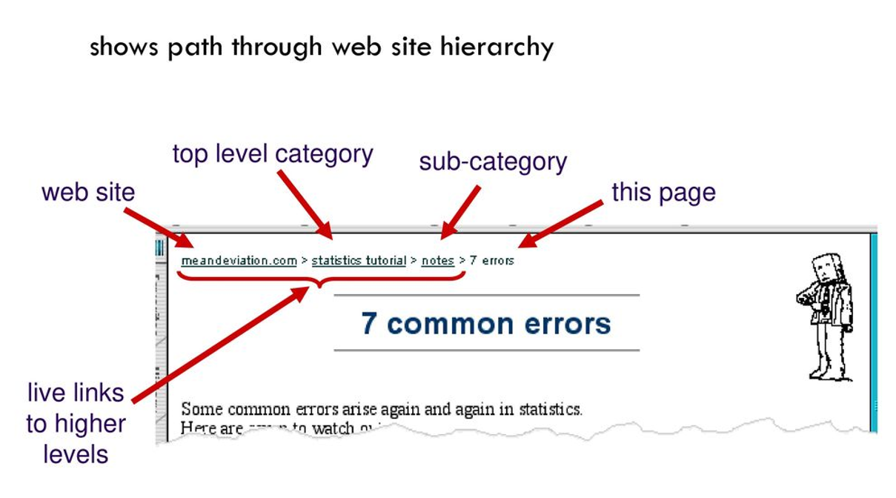
Breadcrumbs

Slide 3
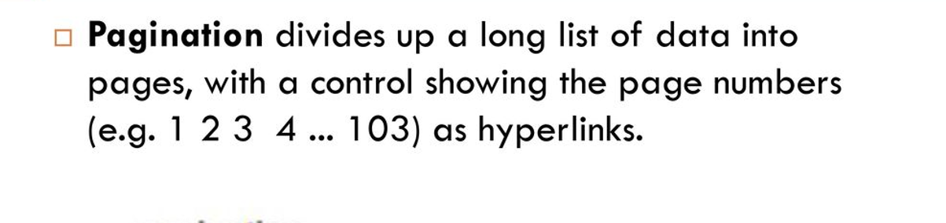

Pagination

Slide 4
Top-Level vs Sub-Categories Navigation
Top-Level Navigation:
• Definition: Primary menu displaying major sections.
• Characteristics: Immediate access, visually prominent, suitable for simple content.
• Examples: E-commerce websites, corporate sites.
Sub-Categories Navigation:
• Definition: Nested categories for detailed options within top-level sections.
• Characteristics: Hierarchical, suitable for complex, in-depth content.
• Examples: E-commerce filters, knowledge bases.

Slide 5
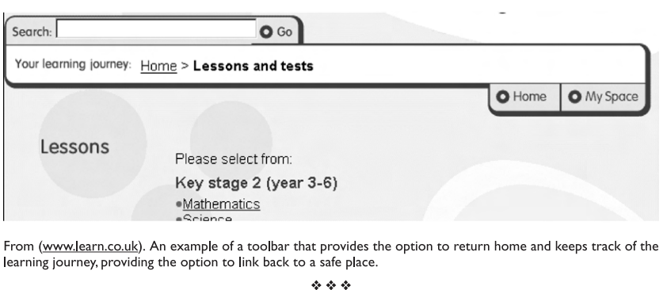
Real World Example of HCI pattern – Tidwell’s Common Ground collection
Users don't always remember their navigation history and may lose track of where they've been, especially if they are interrupted while browsing the site.
You are more likely to explore a website if you are sure that you can easily get out of an undesired state or space; that assurance engenders a feeling of security.
Backtracking out of a long navigation path can be very tedious. Therefore always include a way back to a place that acts as a 'vantage point' from where you can reorientate yourself.

