Slide 1
Breast cancer detection using deep learning model
Nguyen Trung Hieu

Slide 2
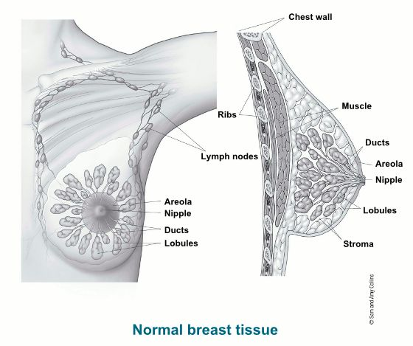
I) Breast cancer overview:
- Breast cancer is a type of cancer starts at the breast
- Breast cancer can start at different parts of the breast:
+ Lobules
+ Nipple
+ Ducts
+ Stroma
+ Blood vessels and lymph vessels

Slide 3
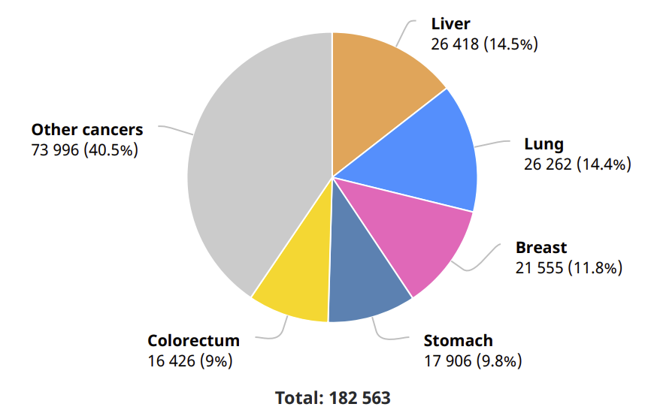
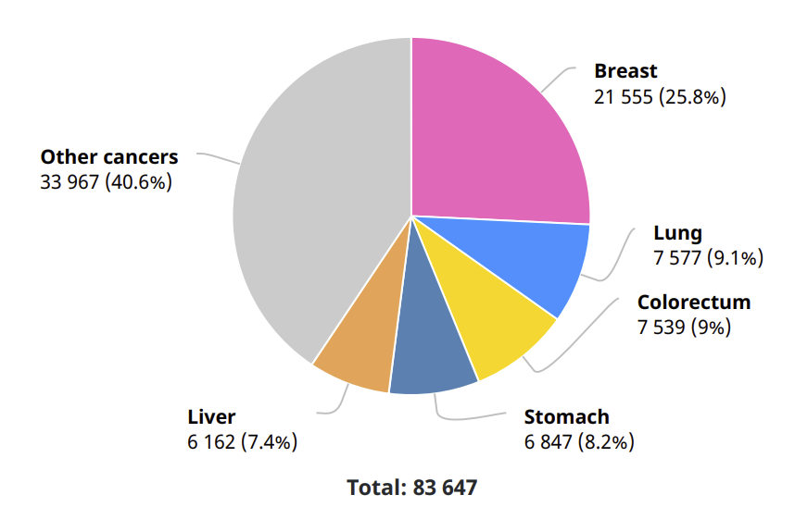
I) Breast cancer overview:
Number of new cases in 2020, both sexes, all ages
Source: Globocan 2020
Number of new cases in 2020, females, all ages
Source: Globocan 2020

Slide 4
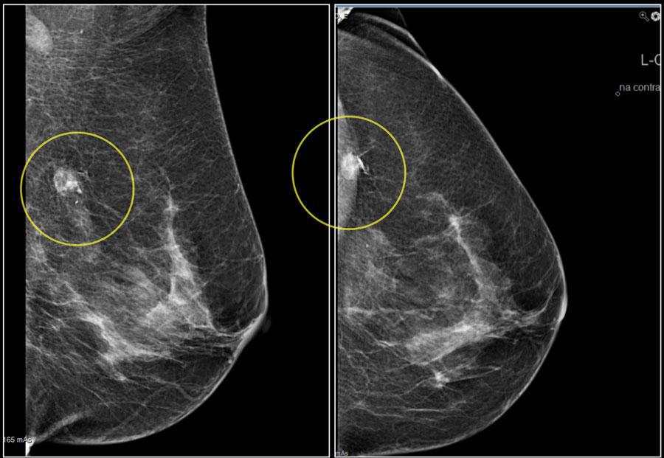
I) Breast cancer overview:
- To treat breast cancer detection, early detection is crucial - Breast cancer can be detected early through mammograms

Slide 5
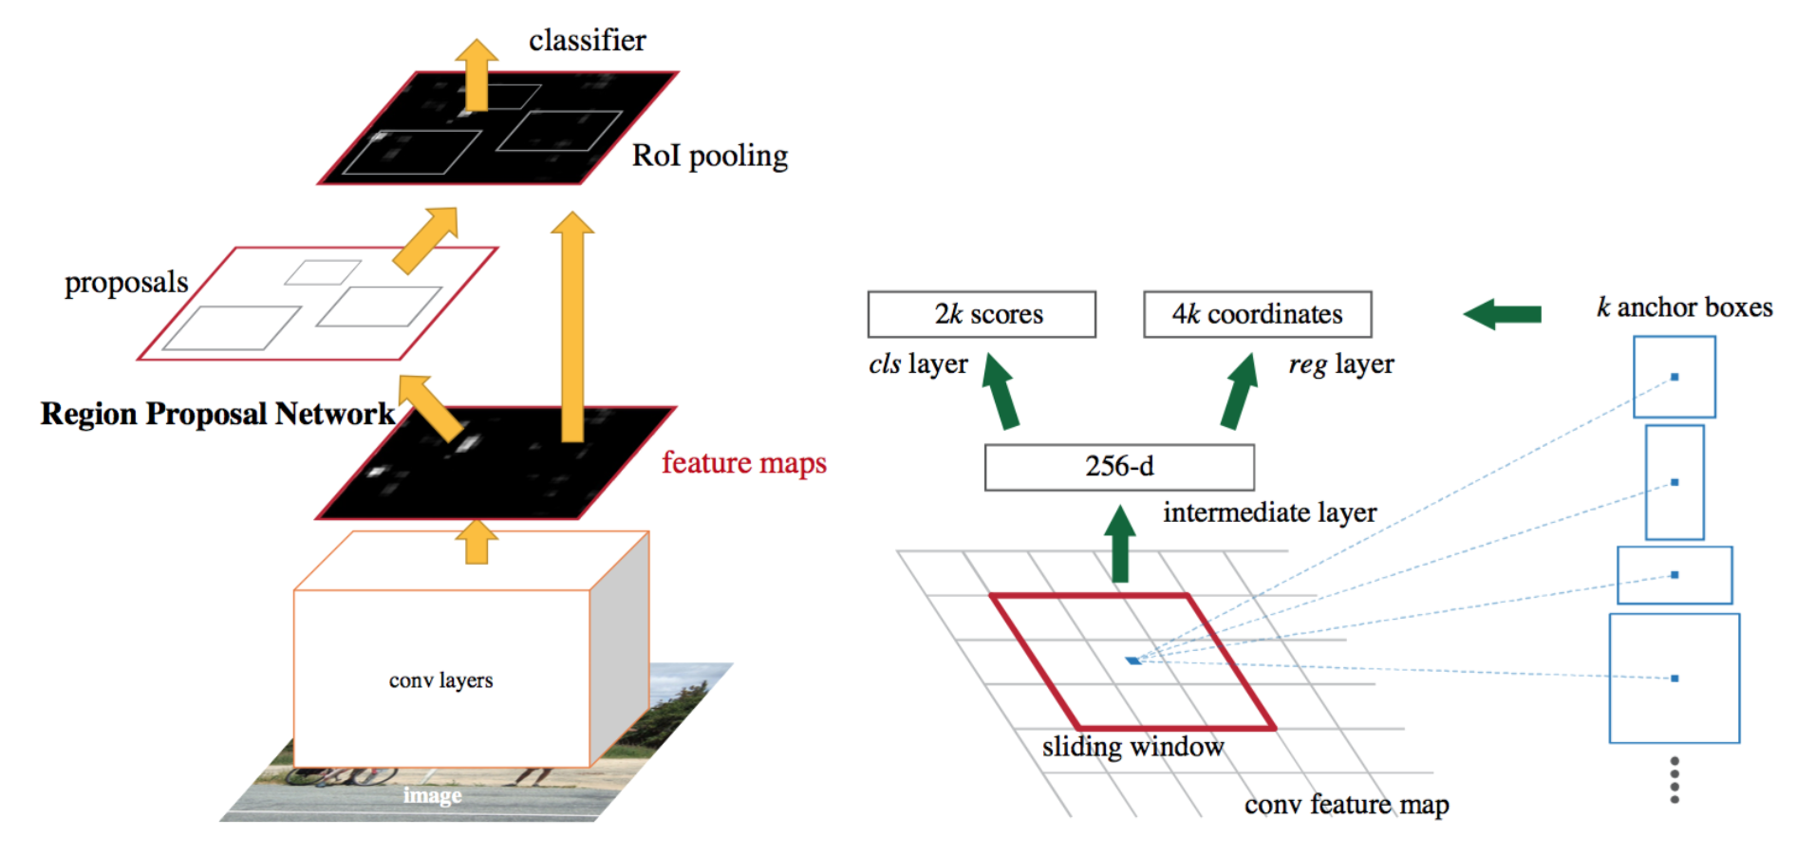
II) Faster R-CNN with Feature pyramid network:
1. Faster R-CNN:
Faster R-CNN architecture

Slide 6
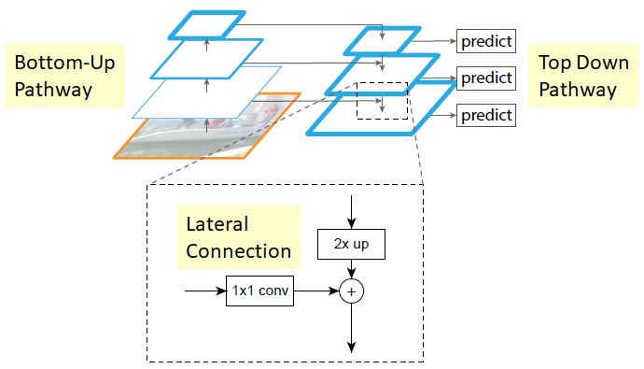
II) Faster R-CNN with Feature pyramid network:
2. Feature pyramid network:
Feature pyramid network architecture

Slide 7
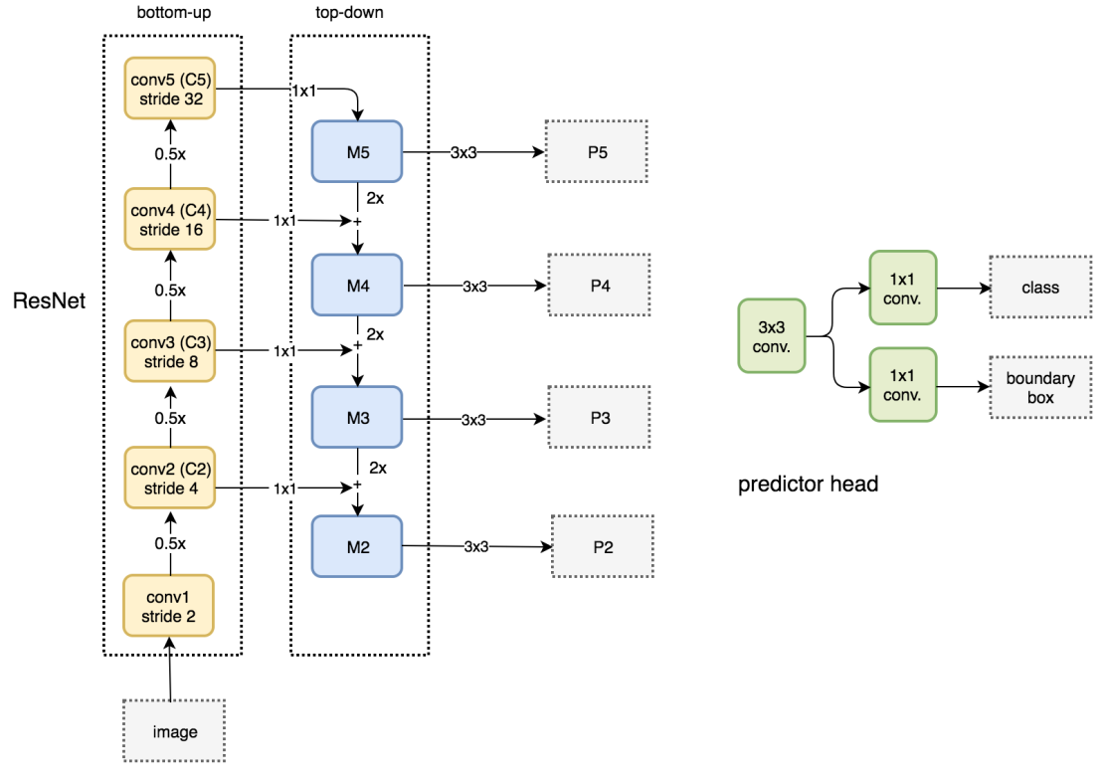

II) Faster R-CNN with Feature pyramid network:
2. Feature pyramid network:
RPN with feature pyramid network

Slide 8
III) Experiment:
1. Dataset: mini MIAS dataset
Dataset with 322 mammograms from 161 patients
115 images with abnormality
Size 1024 x 1024
Store in pgm file

Slide 9
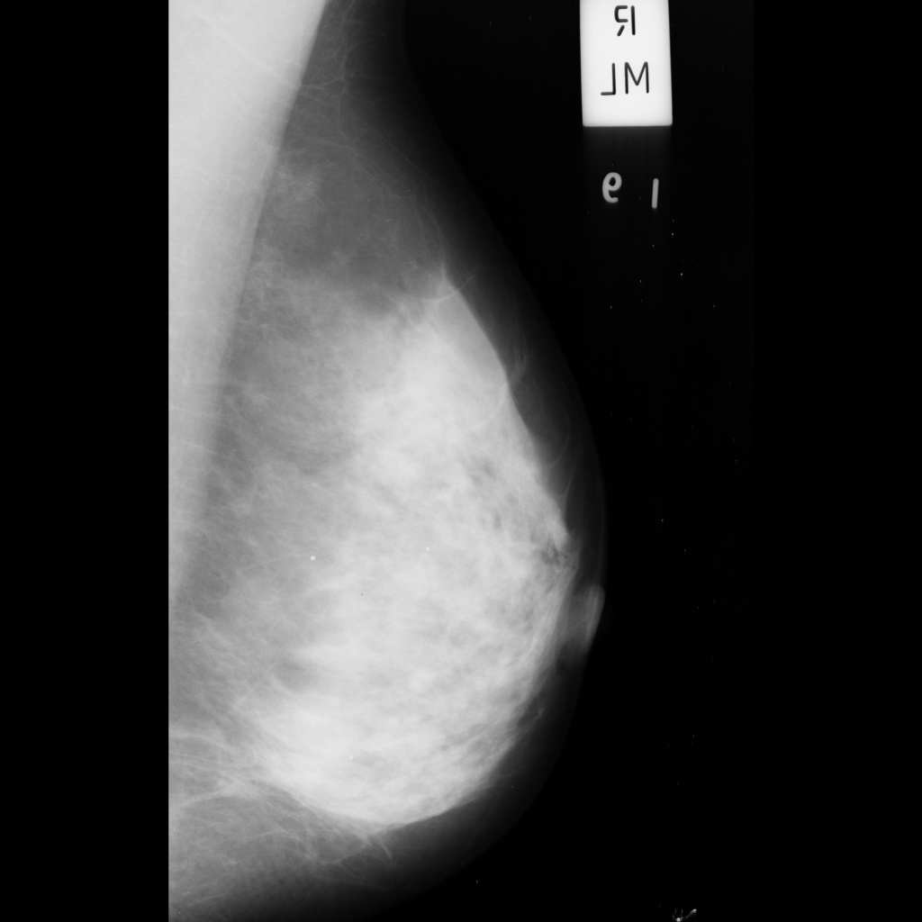
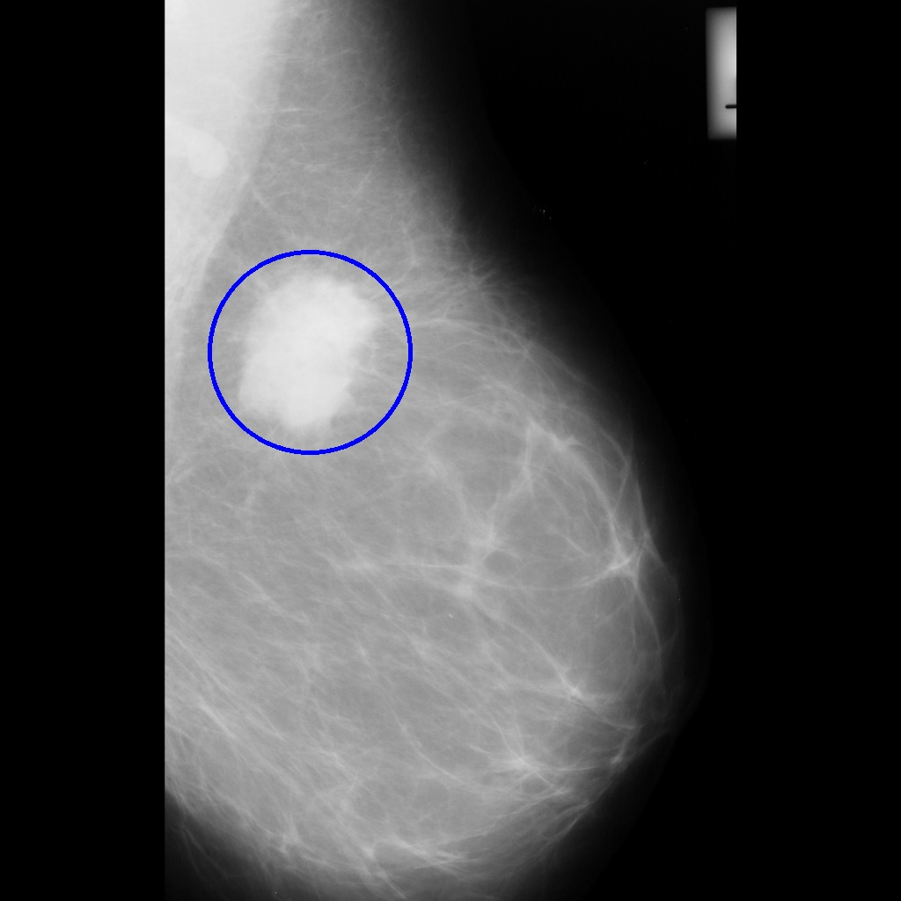
III) Experiment:
1. Dataset: mini MIAS dataset

Slide 10
III) Experiment:
2. Results
The mean Average precision all IoU from 0.5 to 0.95: mAP = 13.4%
Average precision with IoU = 0.5 is AP = 26.4%
Average precision with IoU = 0.75 AP = 13.8%
The mAP looks bad:
Small datasets
Lots of training images with no abnormality
Noisy data

Slide 11
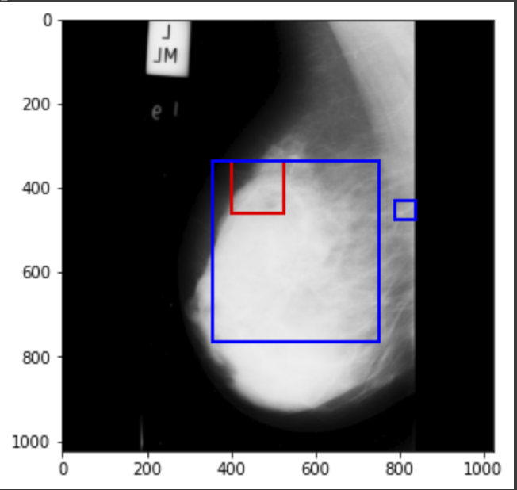
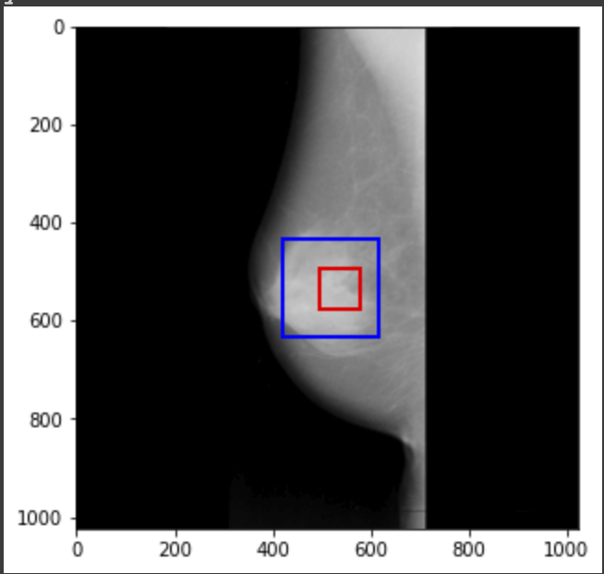
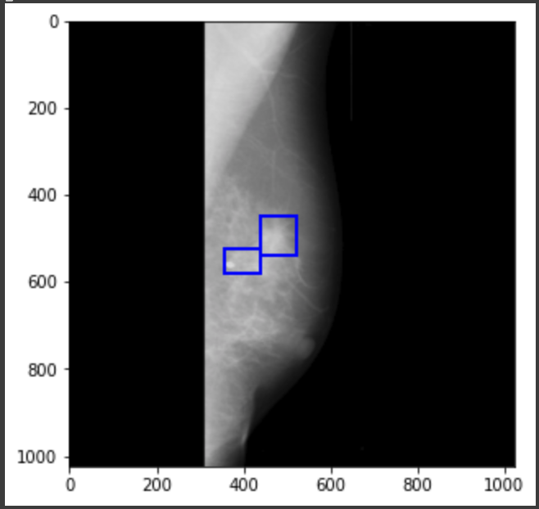
III) Experiment:
2. Results

Slide 12
IV) References:
Girshick R, Donahue J, Darrell T, Malik J. Rich feature hierarchies for accurate object detection and semantic segmentation
Girshick R. Fast R-CNN. 2015
Ren S, He K, Girshick R, Sun J. Faster R-CNN: Towards real-time object detection with region proposal networks 2015
Lin T-Y, Dollár P, Girshick R, He K, Hariharan B, Belongie S. Feature pyramid networks for object detection. 2016
Tsochatzidis L, Costaridou L, Pratikakis I. Deep learning for breast cancer diagnosis from mammograms-A comparative study.
What is breast cancer? [Internet]. Cancer.org
Hui J. Understanding Feature Pyramid Networks for object detection (FPN) [Internet]. Medium. 2018.

