Slide 1

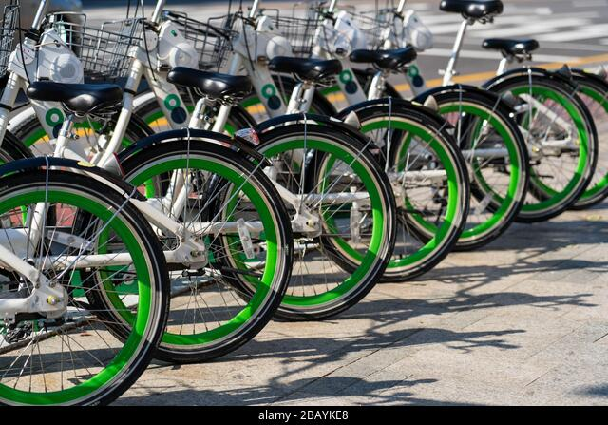
Python Final Project
Seoul Bike Sharing Demand
GUICHARD Tristan

Slide 2

Summary
Introduction/study context
The DataSet
Data Analysis
Data Modelling
API (Flask)
Conclusion

Slide 3




Introduction/study context
Many countries have bike sharing system, such as Ddareungi a bike sharing system in South Korea, which started in the year 2015, known as Seoul bike in English. It was started to overcome issues like greater oil prices, congestion in traffic and pollution in the environment and to develop a healthy environment for citizen of Seoul to live.
With this kind of smart technology and convenience, the use of Rental bike is increasing every day. So, there is a need to manage the bike rental demand and manage the continuous and convenient service for the users. This study proposes a data mining-based approach including weather data to predict whole city public bike demand. A rule-based model is used to predict the number of rental bikes needed at each hour.
Project challenges :
- Predict the number of bicycles rented according to time and weather.
- Improve the availability of bikes.
- Improve the planning of the company's economy.

Slide 4














B. The DataSet
Data Set Information (cf UCL):
Currently Rental bikes are introduced in many urban cities for the enhancement of mobility comfort. It is important to make the rental bike available and accessible to the public at the right time as it lessens the waiting time. Eventually, providing the city with a stable supply of rental bikes becomes a major concern. The crucial part is the prediction of bike count required at each hour for the stable supply of rental bikes. The dataset contains weather information (Temperature, Humidity, Windspeed, Visibility, Dewpoint, Solar radiation, Snowfall, Rainfall), the number of bikes rented per hour and date information.
Data Set extract from: https://archive.ics.uci.edu/ml/datasets/Seoul+Bike+Sharing+Demand
Statistics :
8760 Row
14 Col
14 variables :
Date -year-month-day
Hour -Hour of he day
Seasons-Winter, Spring, Summer, Autumn
Holiday-Holiday/No holiday
Fonctioning Day- NoFunc(Non Functional Hours), Fun(Functional hours)
Rented Bike Count-Count of bikes rented at each hour
Temperature-Temperature in Celsius
Humidity-%
Wind Speed-m/s
Visibility -10m
Dew Point Temperature-Celsius
Solar Radiation-MJ/m2
Rainfall-mm
Snow fall-cm

Slide 5
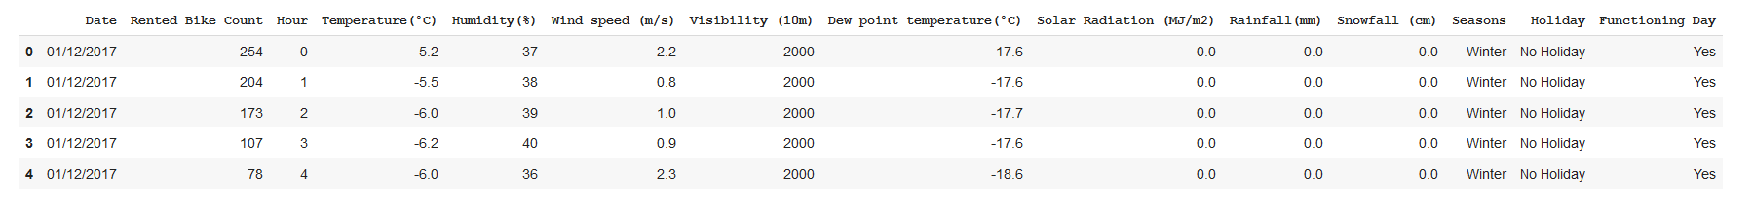
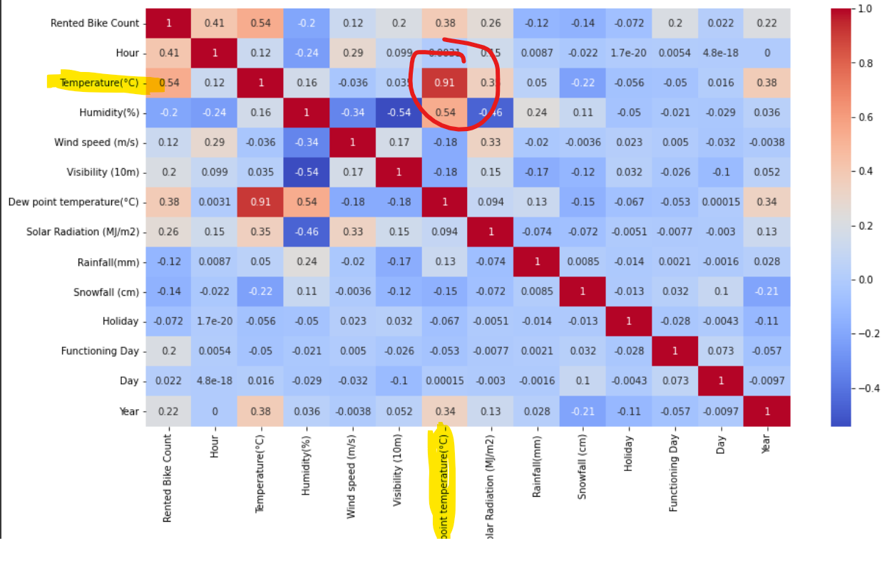

C. Data Analysis
Head of the dataset :
Heat Map :
Temperature and Dew Point Temperature are very similar

Slide 6
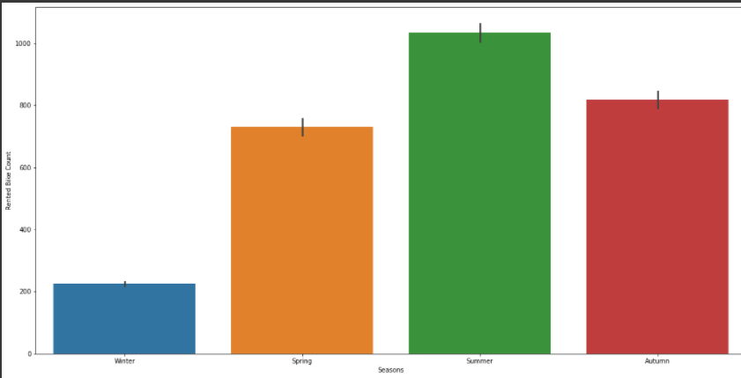
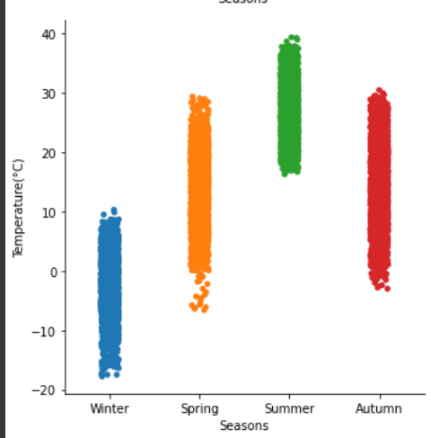








C.
SEASONLY
Barplot of the seasons:
Rather similar results except for the winter which is significantly lower.
Low temperature explains well the number of rented bikes.

Slide 7
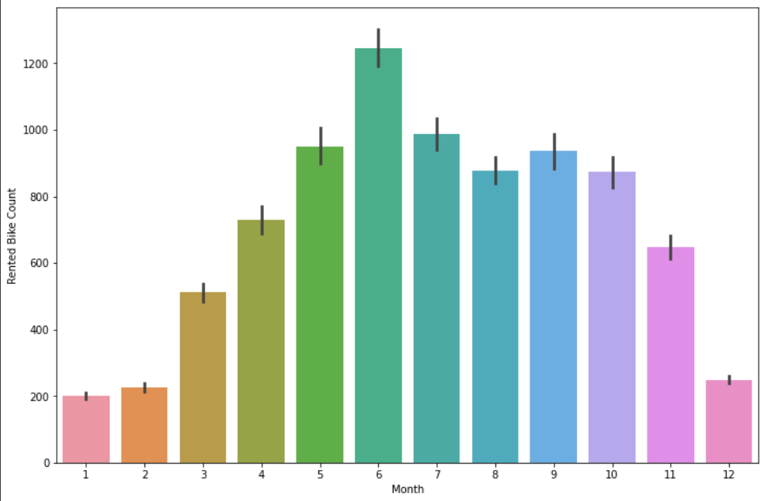
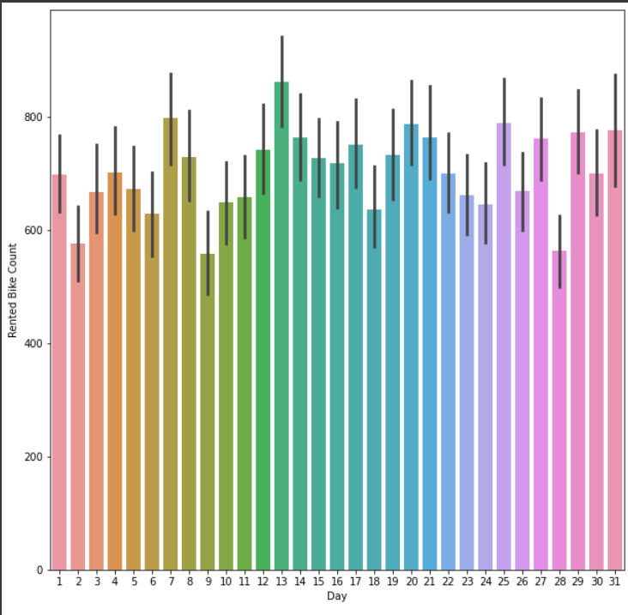












C.
MONTHLY
DAILY

Slide 8
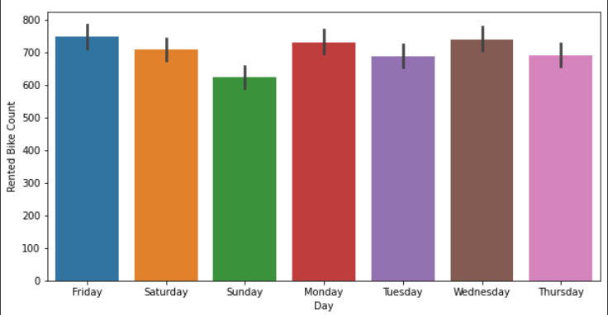
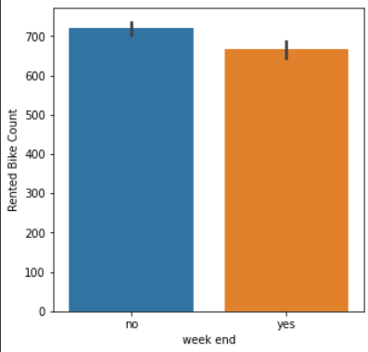









C.
WEEKLY

Slide 9
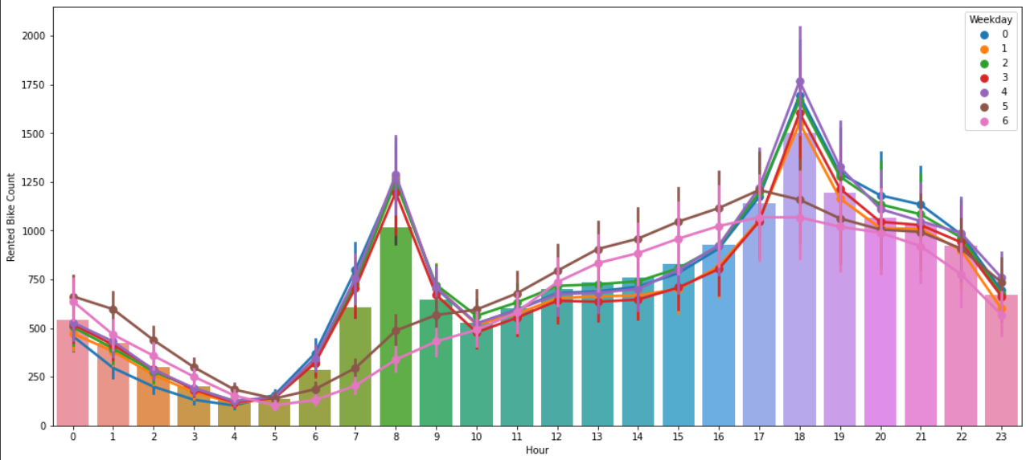













C.
HOURLY

Slide 10
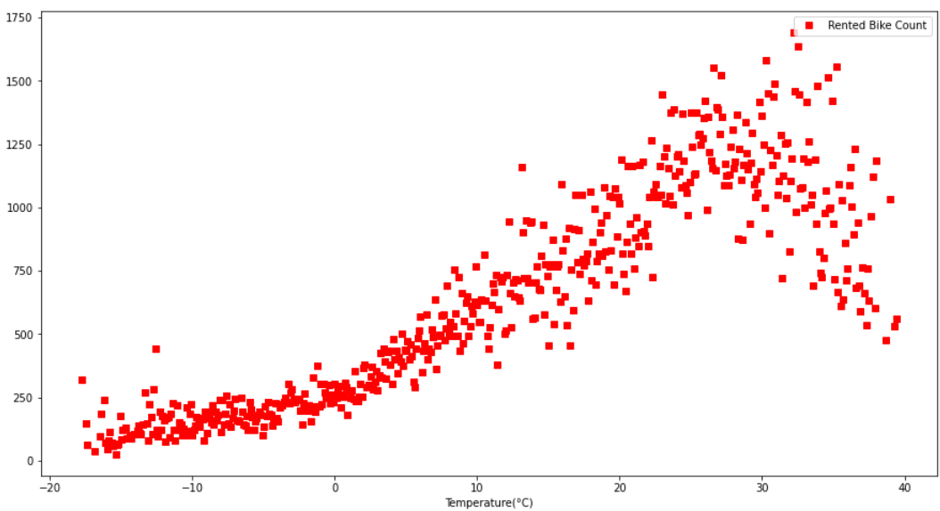
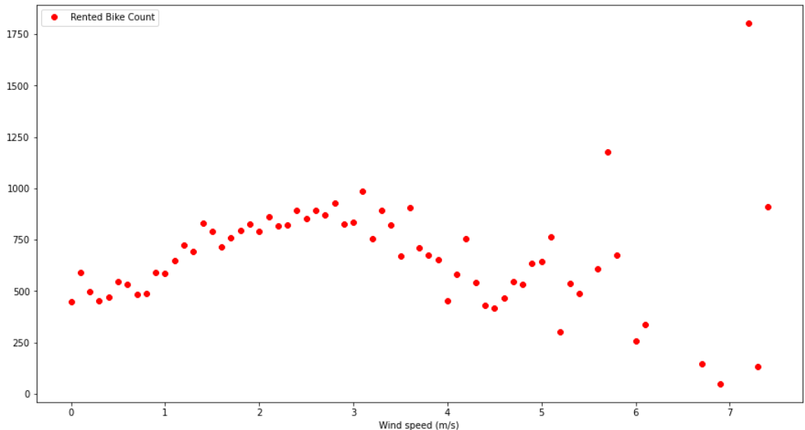


C.
Meteorological

Slide 11
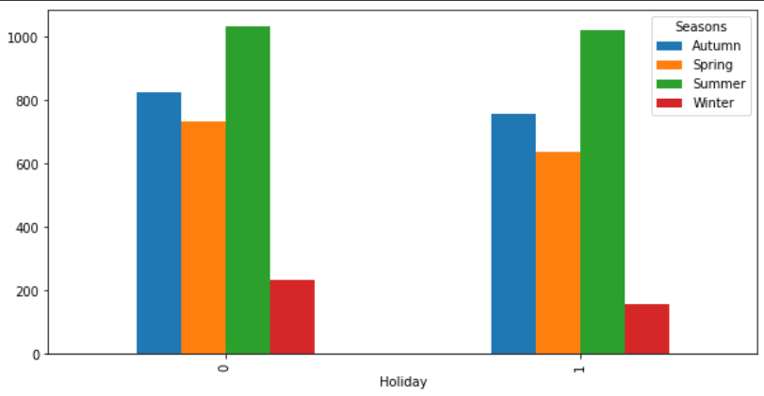
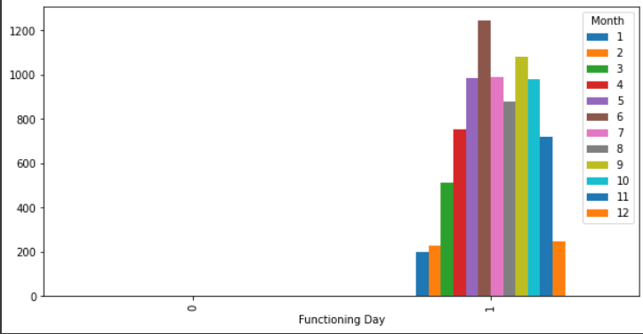
















C.
HOLIDAY X FUNCTIONING DAY

Slide 12
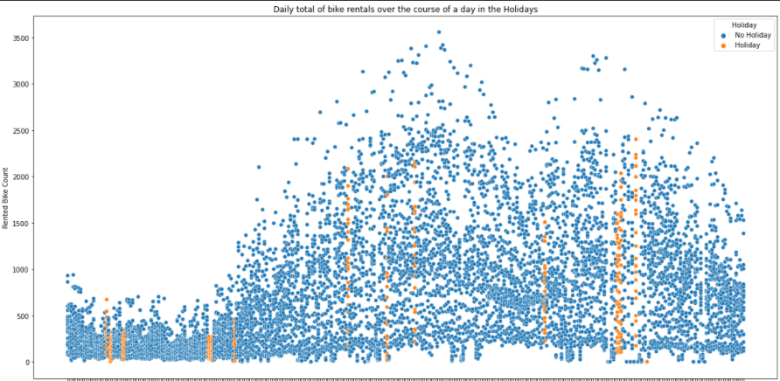




C.
HOLIDAYS INFLUENCE

Slide 13
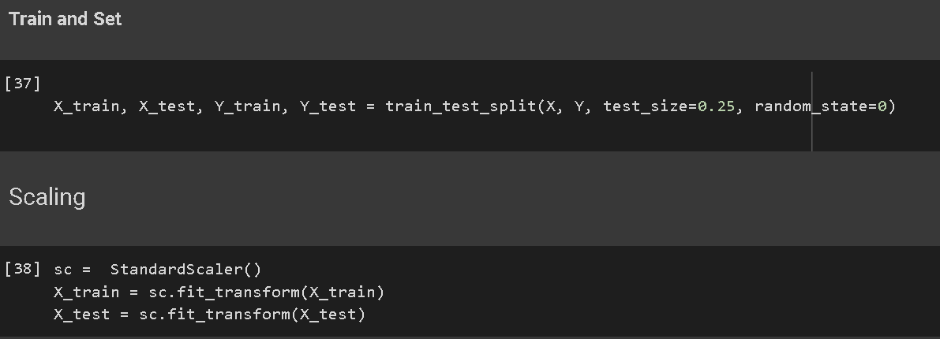
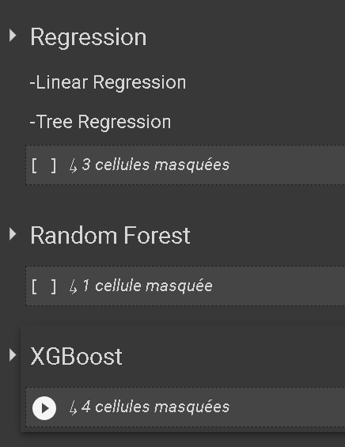











D. Data Modelling

Slide 14
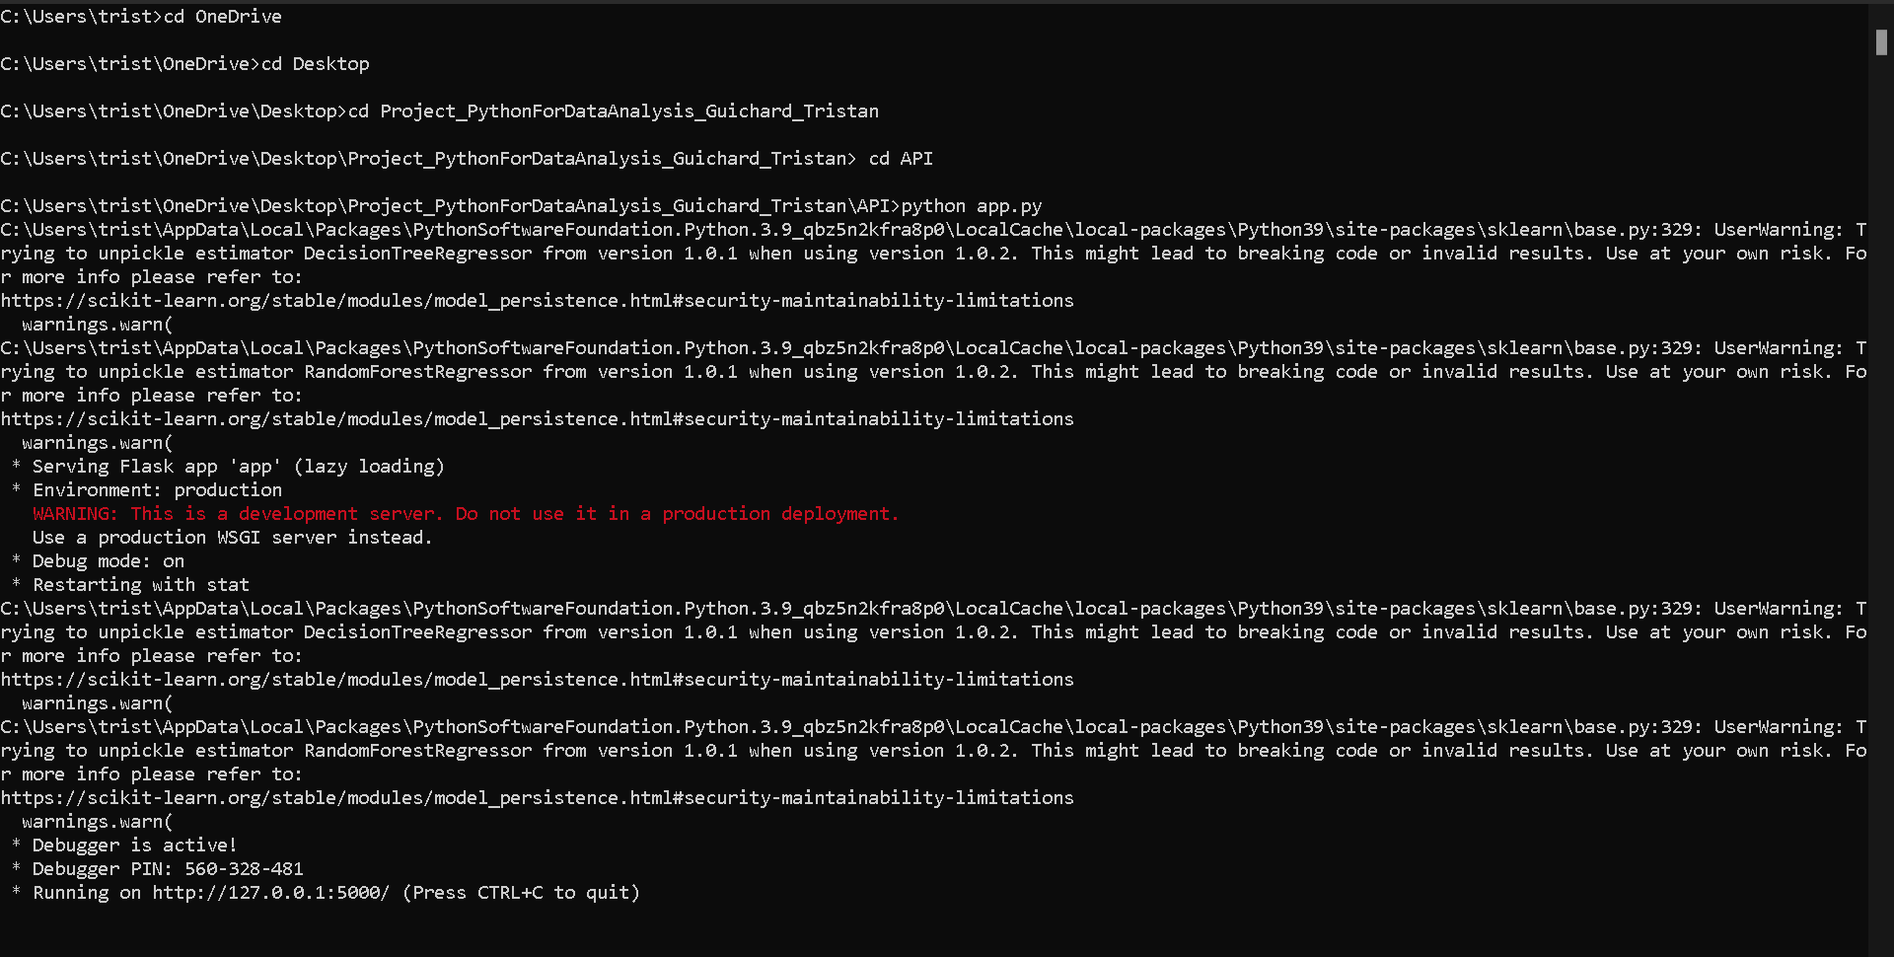
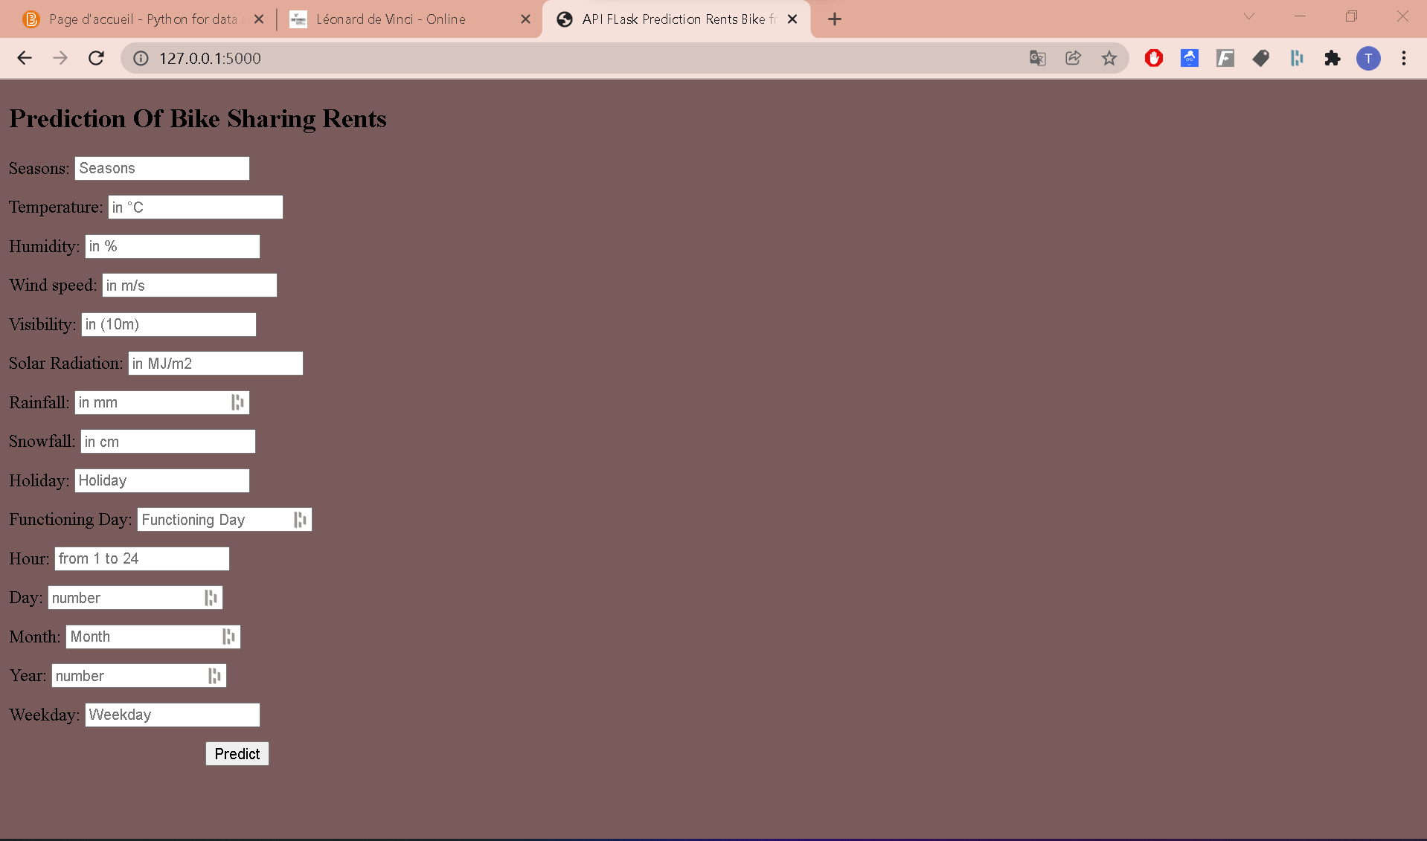
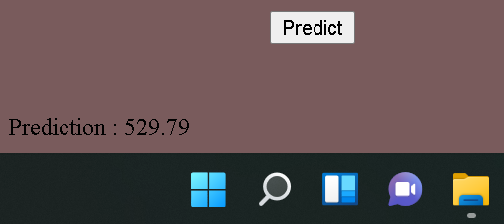







E. API - FLASK

Slide 15
F. CONCLUSION
The exploitation of the bike rental dataset in Seoul highlighted the importance of the weather and behavioral conditions of the day of a potential renter.
In addition, data modeling now allows us to predict and anticipate bike rentals in order to perfectly match customer expectations with rental services.
Nevertheless, other possible prediction models exist and would be more accurate with a more precise data set, with additional features and especially with larger numbers of data.

