Slide 2
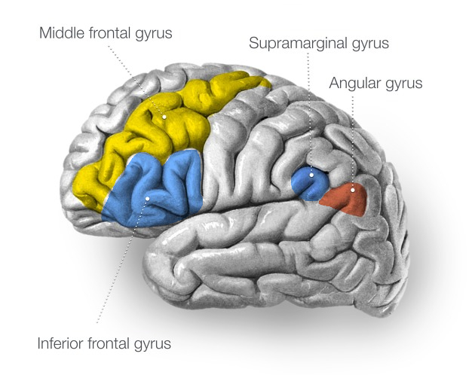
Project Summary
Stroke patient with chronically implanted electrode array
Spikes sorted into units and sampled at 30kHz
Four recorded cortical regions
Frontal:
MFG & IFG
Parietal
SMG & AG
Middle frontal gyrus
Supramarginal gyrus
Angular gyrus
Inferior frontal gyrus

Slide 3
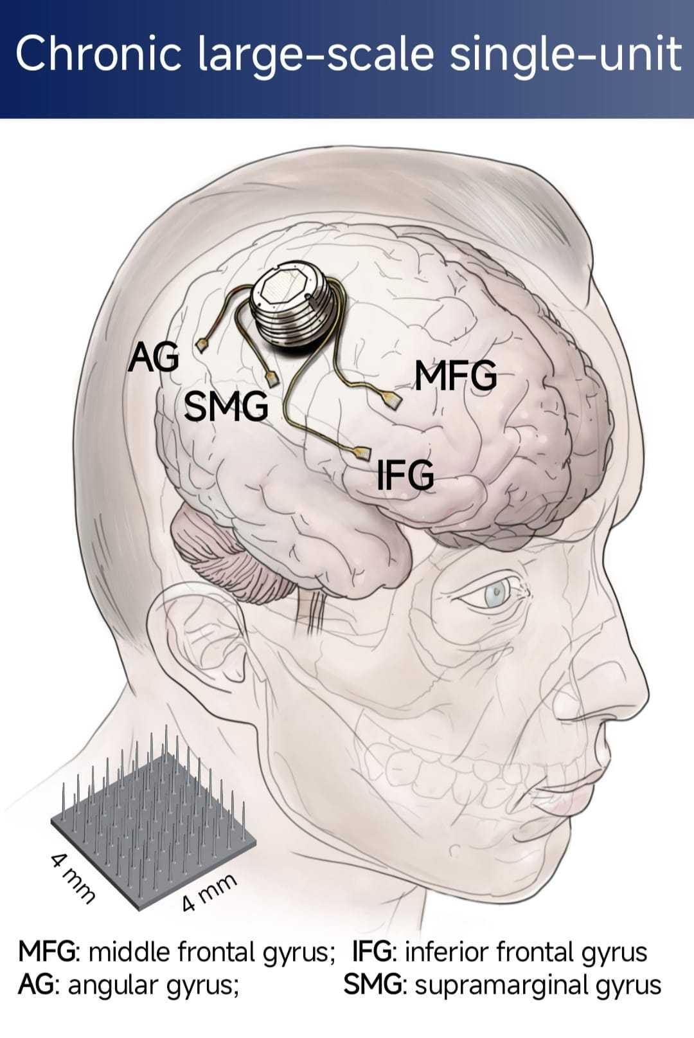
Project Summary
Stroke patient with chronically implanted electrode array
Spikes sorted into units and sampled at 30kHz
Four recorded cortical regions
Frontal:
MFG & IFG
Parietal
SMG & AG
Image: Simon Jacob Lab; Chen Hongbiao

Slide 4
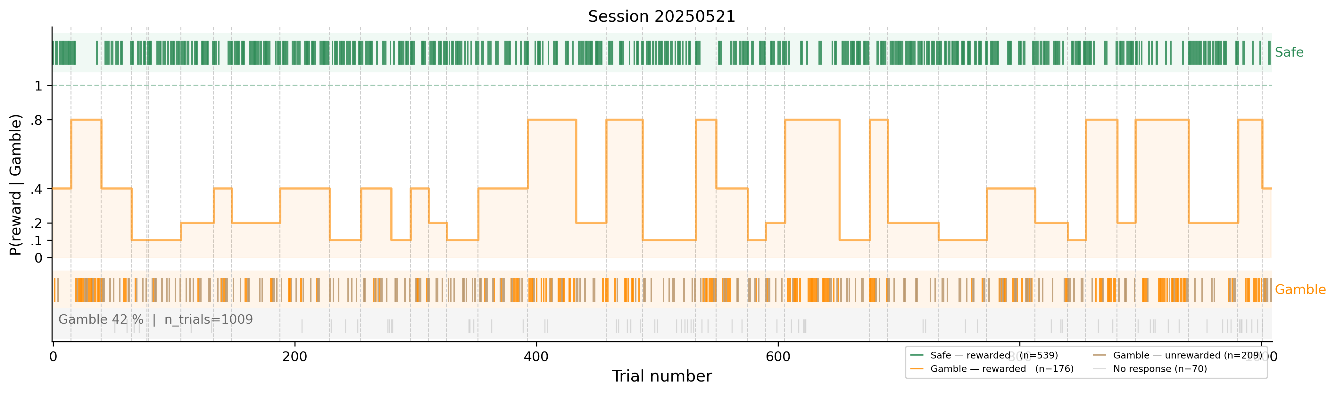
Project Summary
Choice Behaviour – Session 21.05.2025
Safe Side | Gamble Side
1x reward | 4x reward
guaranteed probability | varying probability: {0.1, 0.2, 0.4, 0.8}
~3 seconds trial start to trial end
~2h per session duration
randomized probability schedule per session

Slide 5
8
sessions
6,627
responding trials
37%
Gamble rate
Session | Trials (resp.) | Units (su/mu) | Rec. (min) | Gamble | Reward
20250521 | 1009 (939) | 252 (180/72) | 116 | 0.42 | 0.77
20250602 | 1018 (947) | 214 (152/62) | 118 | 0.36 | 0.81
20250605 | 1037 (962) | 241 (167/74) | 143 | 0.35 | 0.82
20250703 | 635 (507) | 215 (165/50) | 70 | 0.33 | 0.81
20250707 | 911 (772) | 220 (167/53) | 129 | 0.38 | 0.81
20250709 | 694 (639) | 225 (184/41) | 105 | 0.37 | 0.81
20250710 | 984 (902) | 249 (191/58) | 135 | 0.36 | 0.81
20250714 | 1006 (959) | 229 (180/49) | 116 | 0.40 | 0.80
Total | 7294 (6627) | 1845 (1386/459) | — | 0.37 | 0.80
check these values

Slide 6
Research Questions
1 · Selectivity
Are there neurons that respond differently to reward vs no reward in the gamble arm?
2 · Latent Variable encoding
Do neuronal firing rates encode prediction errors estimated from a computational model of behaviour?

Slide 7
Z
E
T
A
enith of
vent-based
ime locked
nomalies

Slide 8
ZETA test for time-locked spiking
Pool spike times relative to the event across all trials.
Build their cumulative distribution.
Compare to the flat line expected if spikes were uniformly spread (no time-locking).
The largest deviation from that line is ZETA; its timing is the zenith.
Significance from jittered resampling of event times.
More visual

Slide 9
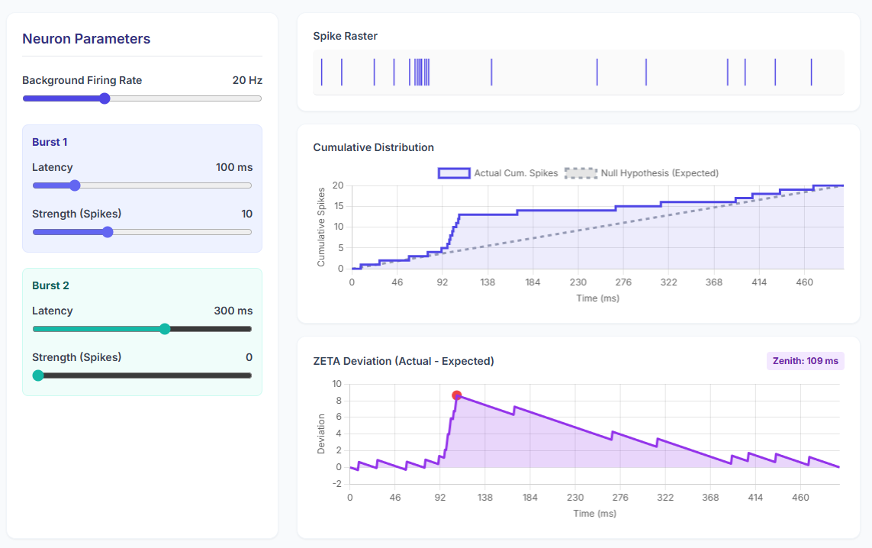
ZETA visualization

Slide 10
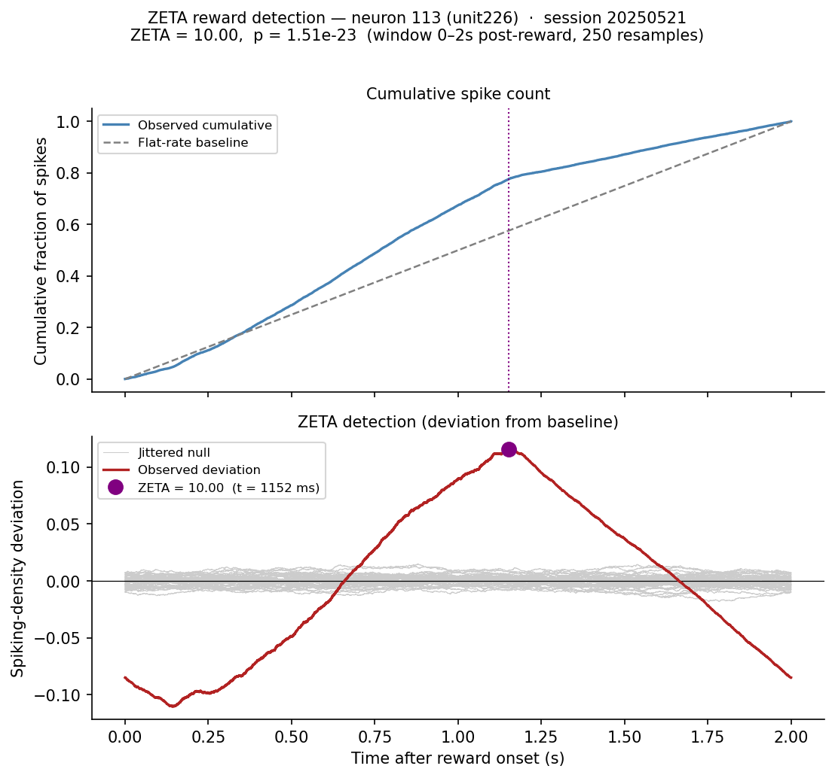
ZETA visualization
⇦ Normalized cumulative spike count
⇦ Mean-subtracted spike density deviation
rasterplot

Slide 11
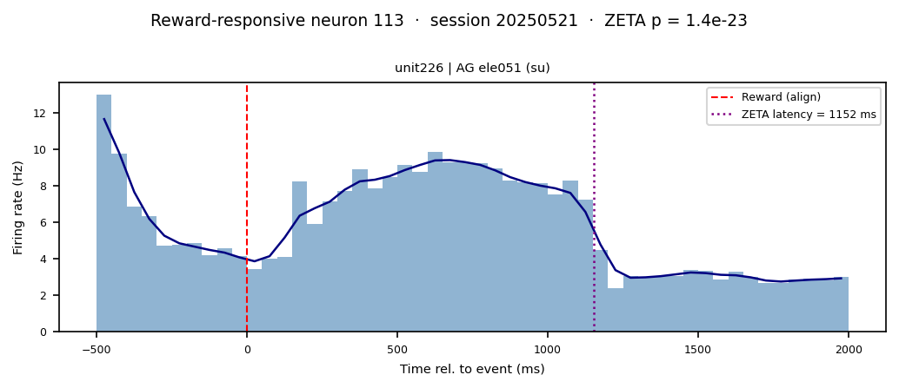
ZETA visualization

Slide 12
ZETA visualization

Slide 13
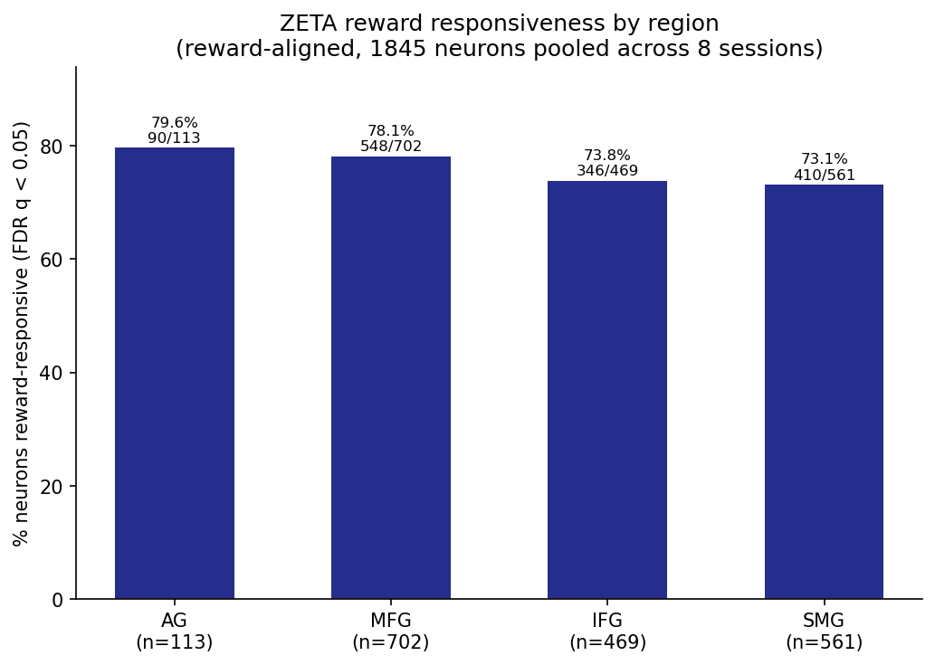
ZETA Results
most neurons come out as „responsive“
Possible reasons:
ZETA is more sensitive than binned t-test/ANOVA
ZETA asks: Is the spike timing after the event anything other than constant/flat?

Slide 14
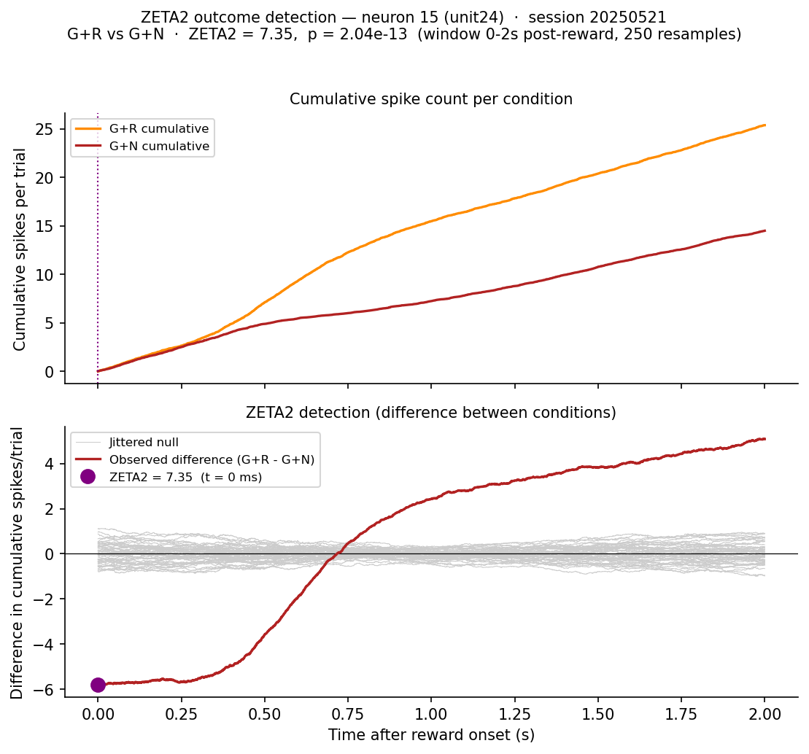
ZETA2 visualization
⇦ Cumulative Spikes/Trial
⇦ Mean-subtracted difference in cumulative spikes/trial
what exactly is the meaning of the ZETA value?

Slide 15
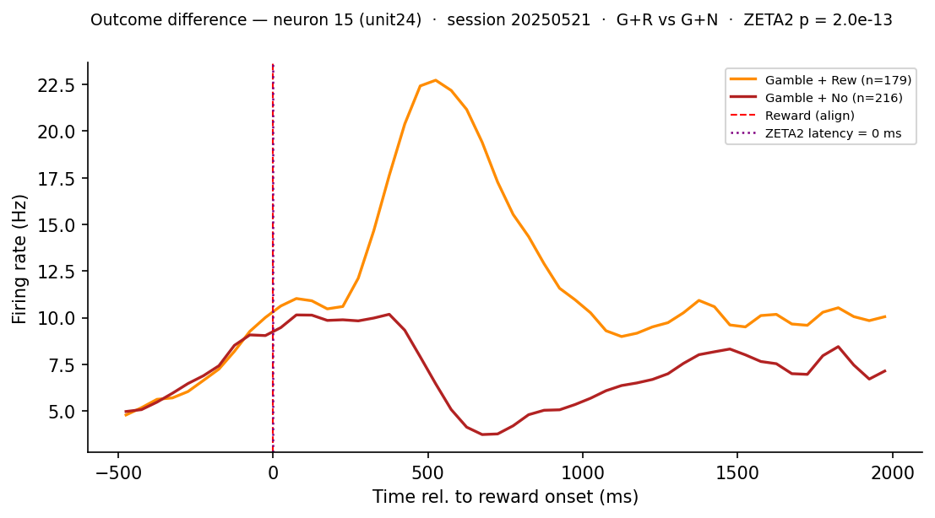
ZETA2 visualization
rasterplot

Slide 16
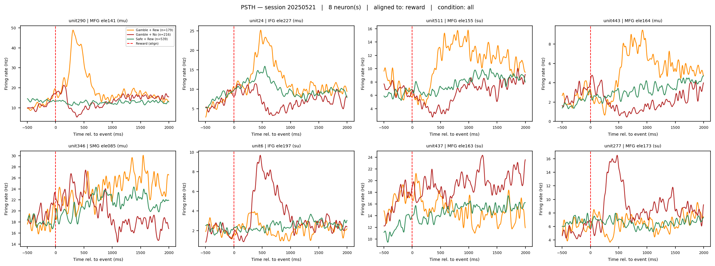
ZETA2 visualization
Bigger legend

Slide 17
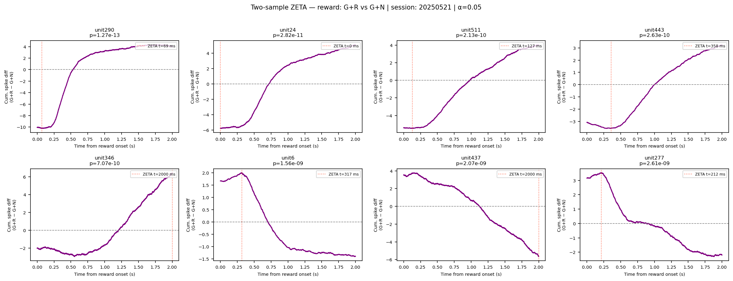
ZETA2 visualization

Slide 18
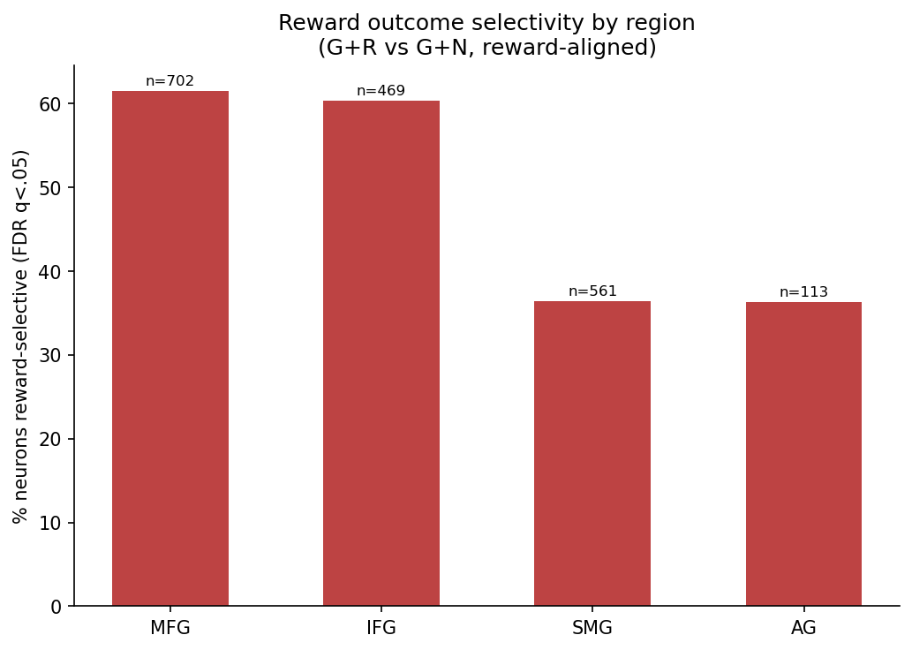
ZETA2 results
Percentage?
reward outcome selectivity is primarily frontal

Slide 19
Research Questions
1 · Selectivity
Are there neurons that respond differently to reward vs no reward in the gamble arm?
Yes

Slide 20
Why behavioural modelling?
We can only observe the choices made and their outcomes but not the cognitive variables that drive them:
Belief about probability
Prediction error
Expected Reward
...
A behavioural model is a generative rule fit to the participants choice
out-come
latent variables
choice

Slide 21
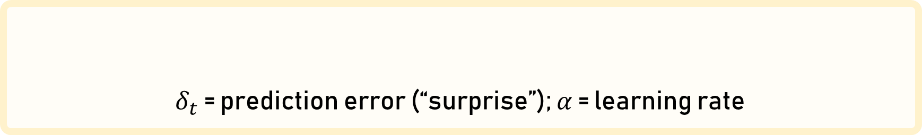


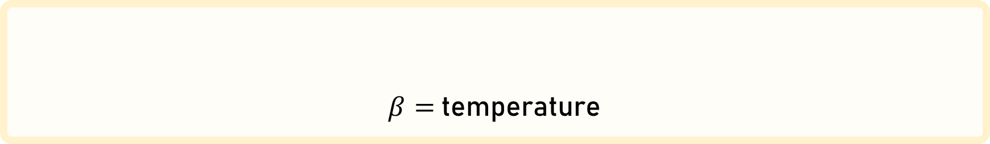


Rescorla wagner/ Q-learning
For each side:
Their difference is used to calculate the probability to gamble:
$δ_{t}$ = prediction error (“surprise”); $α$ = learning rate
$$δ_{t}\text{ = }r_{t} − V_{t}$$
$$V_{t+1}=V_{t}+αδ_{t}$$
$$=1\frac{1}{1+e^{−β(∆V_{t})}}$$
$β=$ temperature
$${P(gamble)}_{t}=σ(β∆V_{t})$$

Slide 22
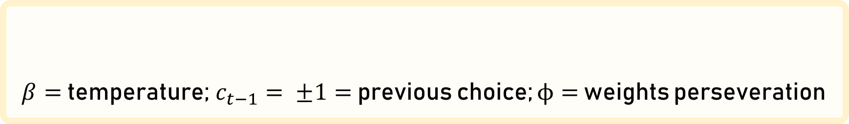
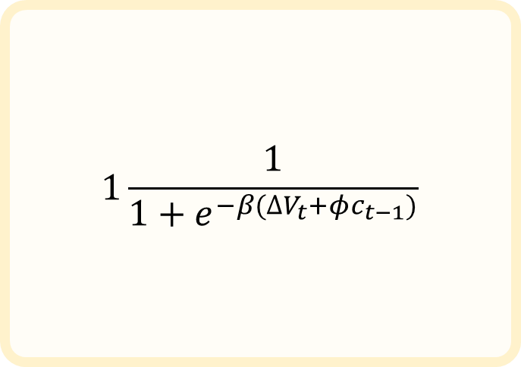
Rescorla wagner/ Q-learning
For each side:
Their difference is used to calculate the probability to gamble:
$δ_{t}$ = prediction error (“surprise”); $α$ = learning rate
$$1\frac{1}{1+e^{−β(∆V_{t}+φc_{t−1})}}$$
$$δ_{t}\text{ = }r_{t} − V_{t}$$
$$V_{t+1}=V_{t}+αδ_{t}$$
$β=$ temperature; $c_{t−1}= ±1=$ previous choice; $ϕ=$ weights perseveration
$${P(gamble)}_{t}=σ(β∆V_{t}+φc_{t−1})$$

Slide 23
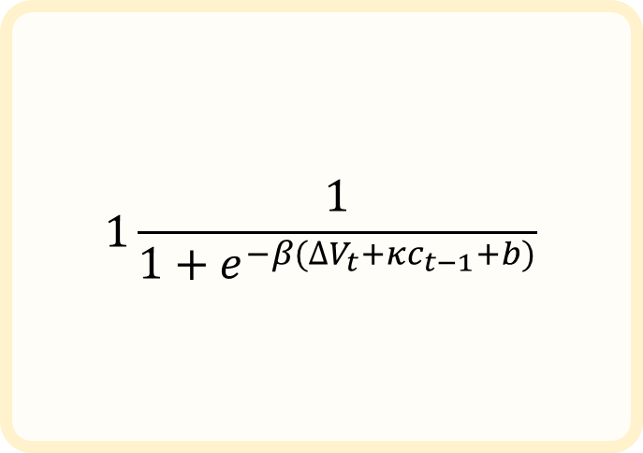
Rescorla wagner/ Q-learning
$$1\frac{1}{1+e^{−β(∆V_{t}+κc_{t−1}+b)}}$$
This allows us to simulate what the model would do and see how well it would match the participants choices, but this is not what we want.
Instead the model shadows the participants choices and at each step determines how likely their choices are using the model weights.

Slide 24
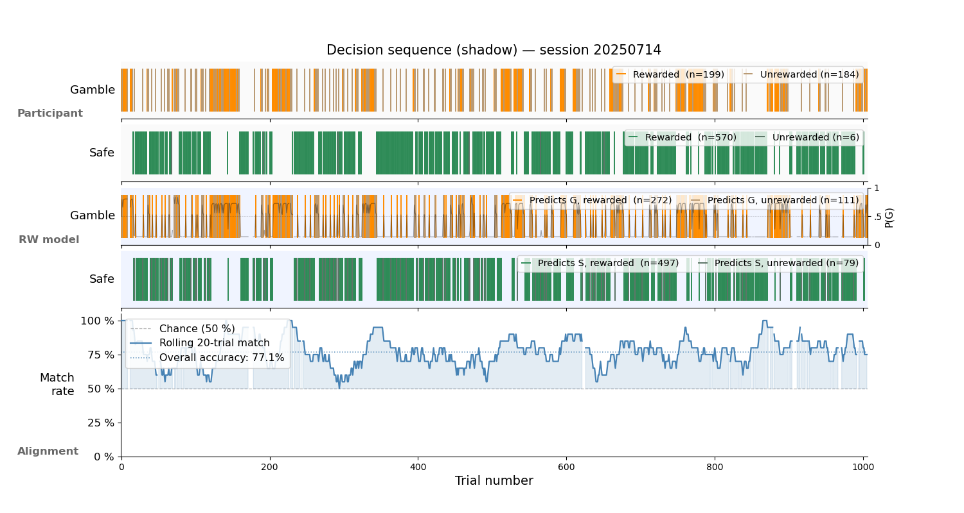
Show less

Slide 25
Hierarchical Gaussian Filter
What is it?
A Bayesian observer that infers both:
the hidden, drifting reward probability
how fast the probability is changing: the volatility

Slide 26
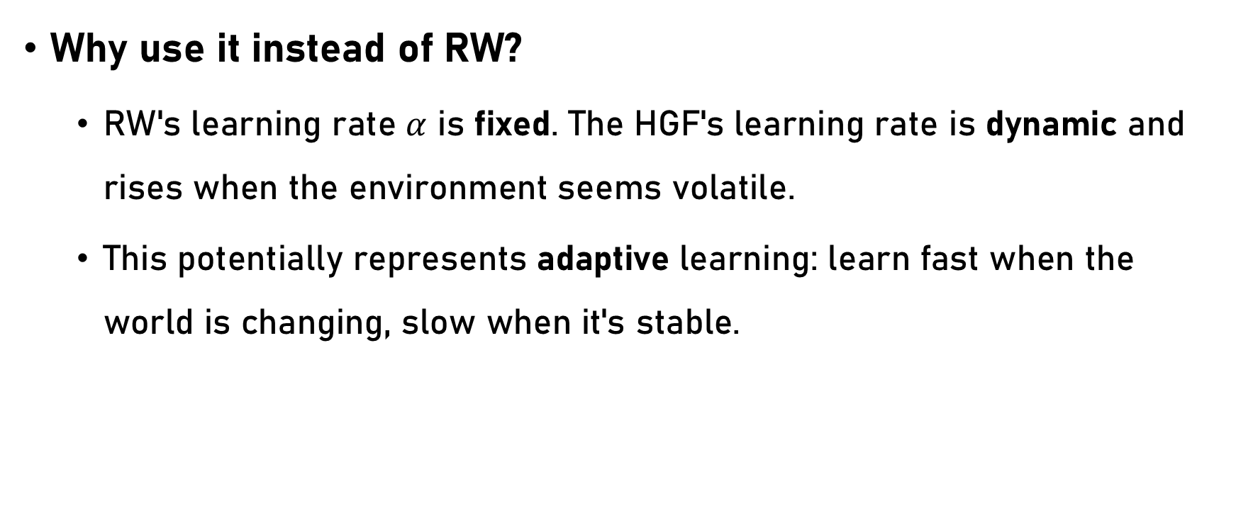
Hierarchical Gaussian Filter
Why use it instead of RW?
RW's learning rate $α$ is fixed. The HGF's learning rate is dynamic and rises when the environment seems volatile.
This potentially represents adaptive learning: learn fast when the world is changing, slow when it's stable.

Slide 27
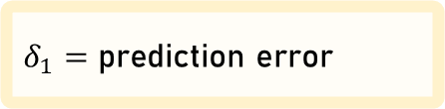
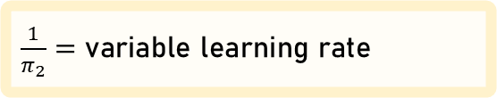
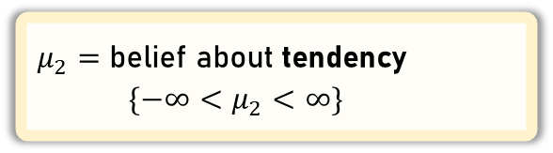
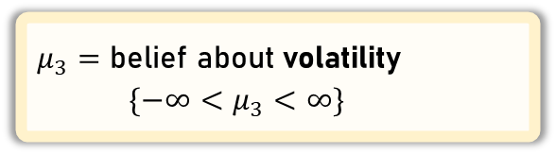
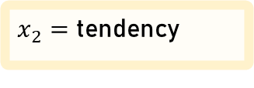
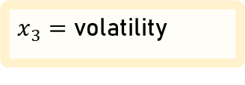
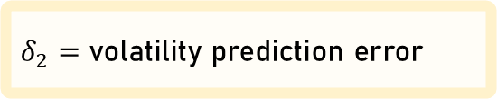
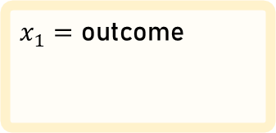
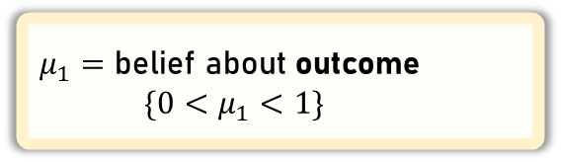
Hierarchical Gaussian Filter
“Real World”
$x_{1}=$ outcome
= 1 = 0
$x_{2}=$ tendency
$x_{3}=$ volatility
“Belief”
Level 1
Level 2
Level 3
$μ_{2}=$ belief about tendency
$\{−∞<μ_{2}<∞\}$
$μ_{1}=$ belief about outcome
$\{0<μ_{1}<1\}$
$\frac{1}{π_{2}}=$ variable learning rate
$μ_{3}=$ belief about volatility
$\{−∞<μ_{3}<∞\}$
$δ_{1}=$ prediction error
$δ_{2}=$ volatility prediction error

Slide 28
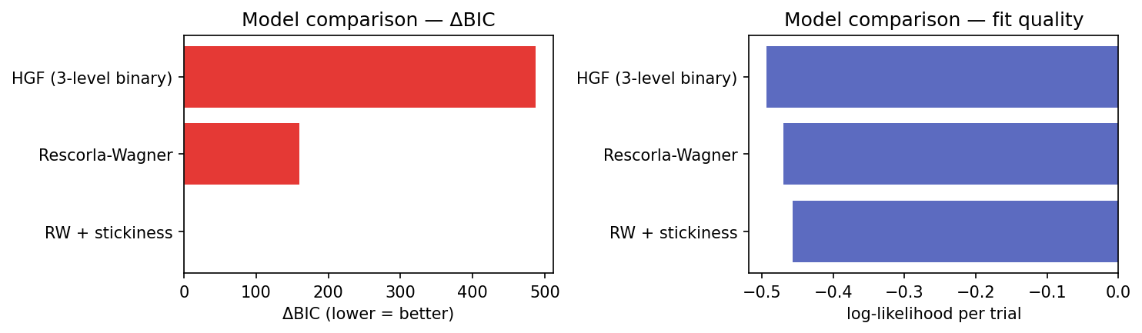
Model comparison
simple beats complicated

Slide 29
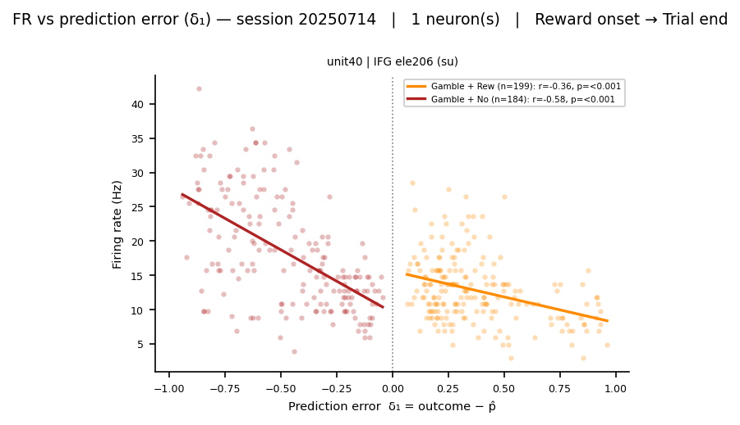

Slide 30
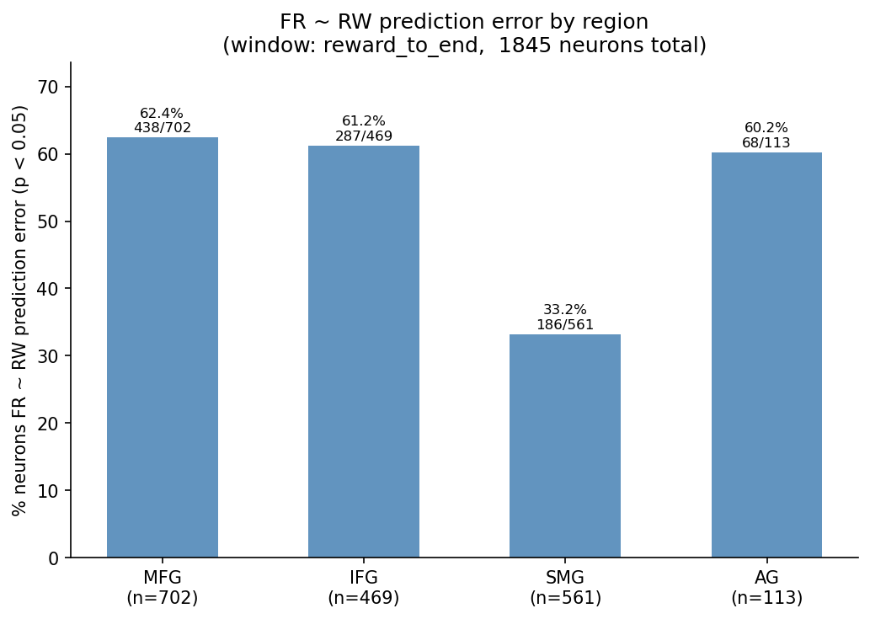

Slide 31
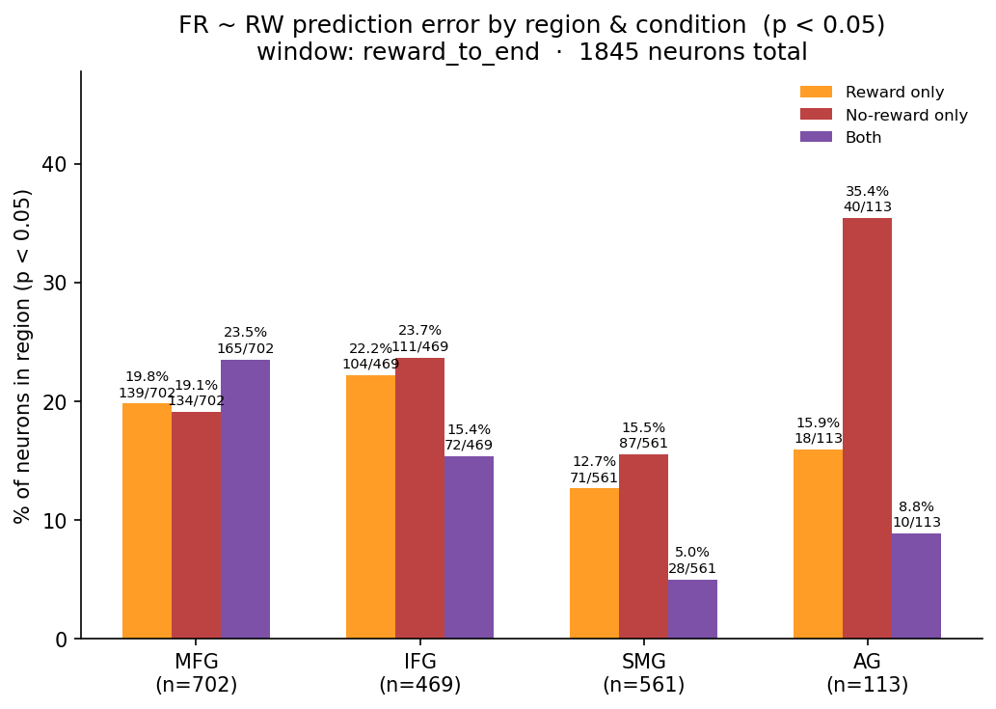

Slide 32
Research Questions
2 · Latent Variable encoding
Do neuronal firing rates encode prediction errors estimated from a computational model of behaviour?
Probably?

Slide 33
Future Direction
Sign of prediction error vs firing rate correlation
Timing of firing rate changes after events
Choice selectivity
Research Angual Gyrus

Slide 34
Conclusions
Reward-selective neurons exist and are predominantly frontal
ZETA analysis across 8 sessions (6,627 trials) shows time-locked spiking responses to reward outcomes, with outcome selectivity concentrated in MFG/IFG rather than parietal regions (SMG/AG).
Simple reinforcement learning best captures behaviour
Model comparison favours Rescorla-Wagner/Q-learning over the Hierarchical Gaussian Filter — participants' choices are well described by a basic prediction-error update rule.
Neuronal firing rates tentatively track prediction errors
Firing rates correlate with trial-by-trial RW prediction errors, suggesting frontal neurons may represent the learning signal — but direction, timing, and choice selectivity remain to be characterised.

