Slide 1
Reward Encoding during a two-armed bandit task

Slide 2
Project summary

Slide 3
Introduction to me
Bachelor
Master

Slide 4
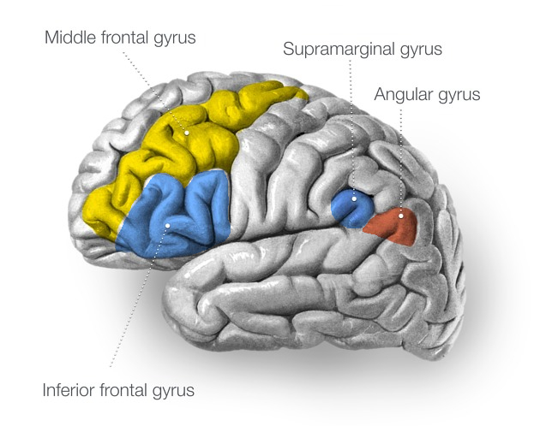
Project Summary
Stroke patient with chronically implanted electrode array
Spikes sorted into units and sampled at 30kHz
Four recorded cortical regions
Frontal:
MFG & IFG
Parietal
SMG & AG
Middle frontal gyrus
Supramarginal gyrus
Angular gyrus
Inferior frontal gyrus

Slide 5
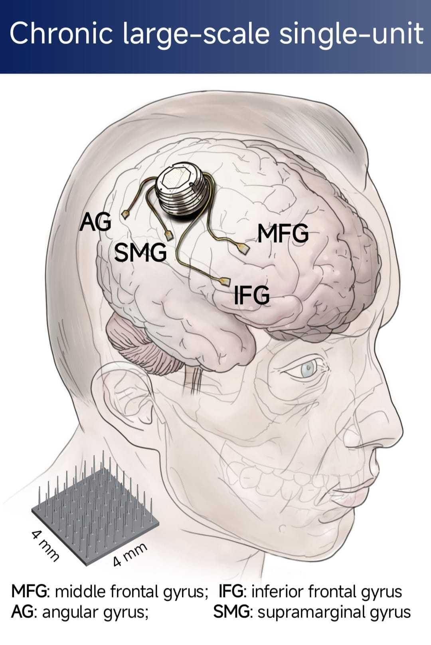
Project Summary
Stroke patient with chronically implanted electrode array
Spikes sorted into units and sampled at 30kHz
Four recorded cortical regions
Frontal:
MFG & IFG
Parietal
SMG & AG

Slide 6
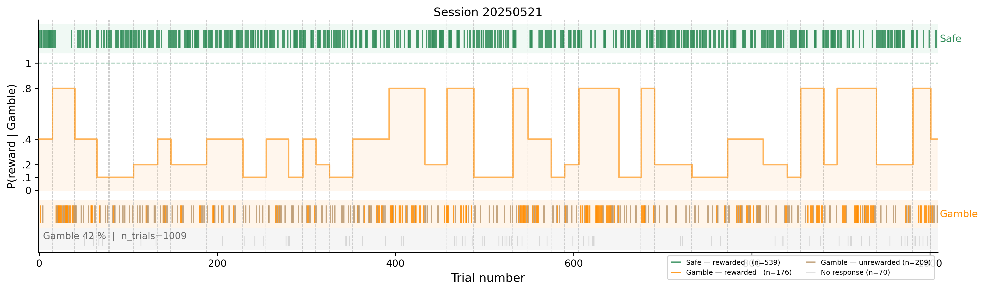
Project Summary
Choice Behaviour – Session 21.05.2025
Safe Side | Gamble Side
1x reward | 4x reward
guaranteed probability | varying probability: {0.1, 0.2, 0.4, 0.8}
~3 seconds trial start to trial end
~2h per session duration
randomized probability schedule per session

Slide 7
8
sessions
6,627
responding trials
37%
Gamble rate
Session | Trials (resp.) | Units (su/mu) | Rec. (min) | Gamble | Reward
20250521 | 1009 (939) | 252 (180/72) | 116 | 0.42 | 0.77
20250602 | 1018 (947) | 214 (152/62) | 118 | 0.36 | 0.81
20250605 | 1037 (962) | 241 (167/74) | 143 | 0.35 | 0.82
20250703 | 635 (507) | 215 (165/50) | 70 | 0.33 | 0.81
20250707 | 911 (772) | 220 (167/53) | 129 | 0.38 | 0.81
20250709 | 694 (639) | 225 (184/41) | 105 | 0.37 | 0.81
20250710 | 984 (902) | 249 (191/58) | 135 | 0.36 | 0.81
20250714 | 1006 (959) | 229 (180/49) | 116 | 0.40 | 0.80
Total | 7294 (6627) | 1845 (1386/459) | — | 0.37 | 0.80

Slide 8
Research Questions
1 · Selectivity
Are there neurons that respond differently to reward vs no reward in the gamble arm?
2 · Latent Variable encoding
Do neuronal firing rates encode prediction errors estimated from a computational model of behaviour?

Slide 9
Z
E
T
A
enith of
vent-based
ime locked
nomalies

Slide 10
ZETA test for time-locked spiking
Pool spike times relative to the event across all trials.
Build their cumulative distribution.
Compare to the flat line expected if spikes were uniformly spread (no time-locking).
The largest deviation from that line is ZETA; its timing is the zenith.
Significance from jittered resampling of event times.

Slide 11
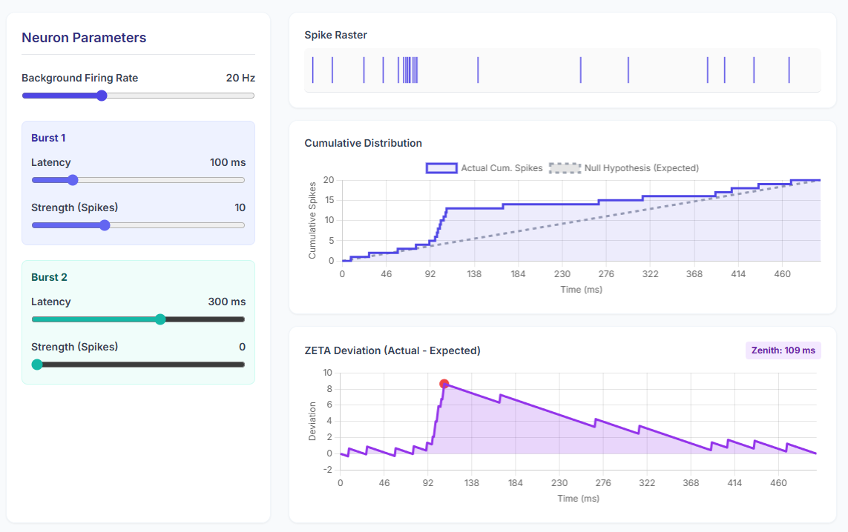
ZETA visualization

Slide 12
Zeta Examples
PSTHs showing selective neurons
Limitations of ZETA?

Slide 13
Behavioural modelling
What is it?
What is the point of it = extraction of latent variables.

Slide 14
Rescorla wagner q learning
Equation
How and when is it updated
Why is it good?

Slide 15
Rescorla wagner with stickiness factor
What is added
How good is the match?

Slide 16
Hierarchical Gaussian Filter
What is it?
Why use it instead of RW?
Equations explained?

Slide 17
HGF visualization

Slide 18
HGF results – prediction error vs firing rates
Figures

