Slide 1
Reward Encoding during a two-armed bandit task
CNB Lab · Manuel Stammler · 01.07.2026
- Preliminary Findings -

Slide 2
Project summary
to do: what is zenith value
how exactly does zeta 2 work
correct colors for zeta demo
better arguments for modelling
stickiness
example to go through with modelling
https://doi.org/10.1523/JNEUROSCI.4225-09.2010

Slide 3
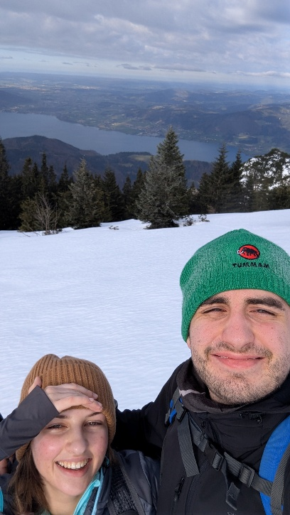
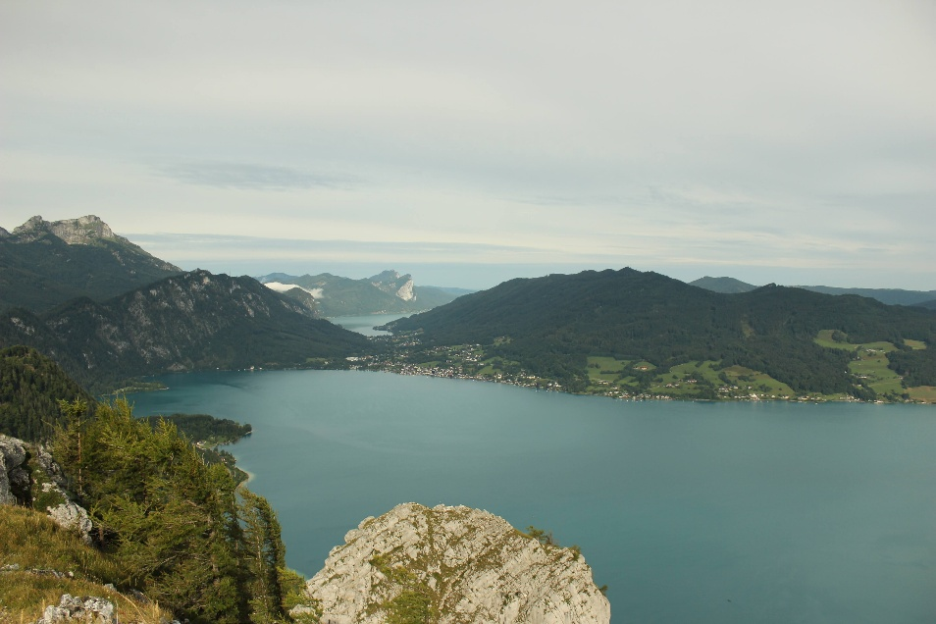

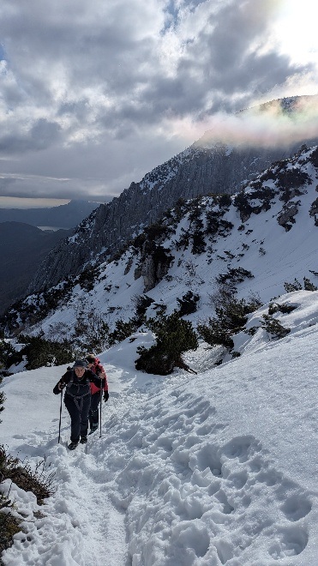
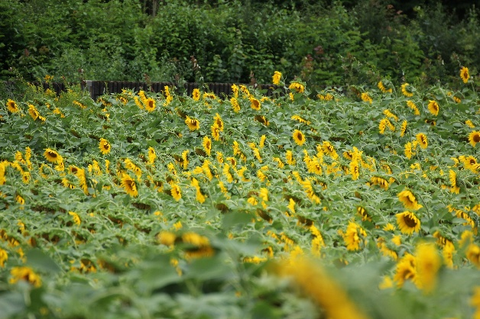
Who is this guy even?
Salzkammergut
Budweis
Linz
Vienna

Slide 4
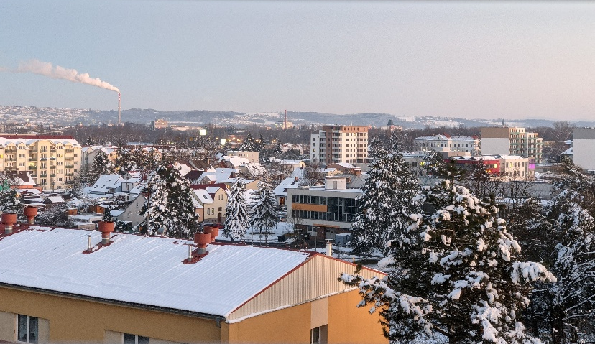


Who is this guy even?
Salzkammergut
Budweis
Linz
Vienna
double degree in Biological Chemistry
thesis on probiotic treatment of carp endoparasite infection

Slide 5
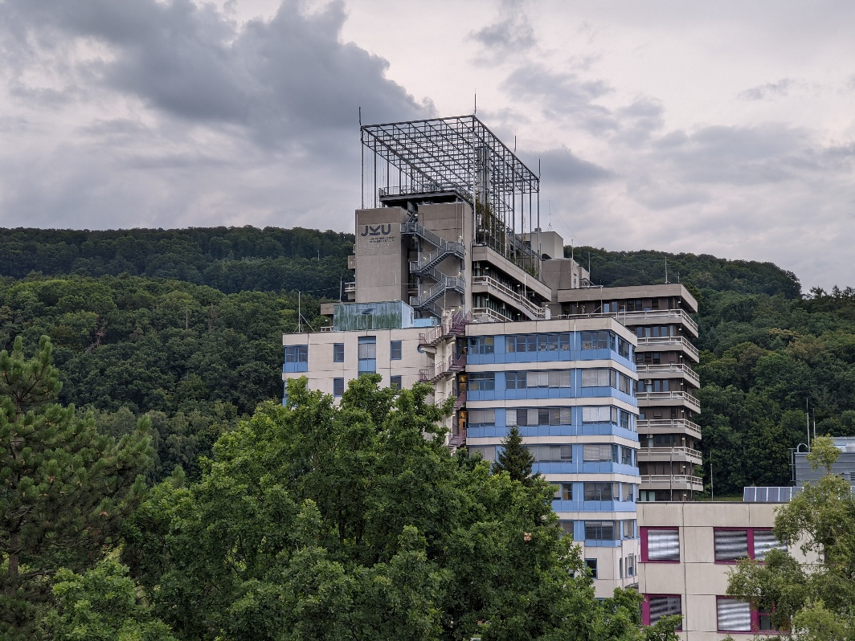
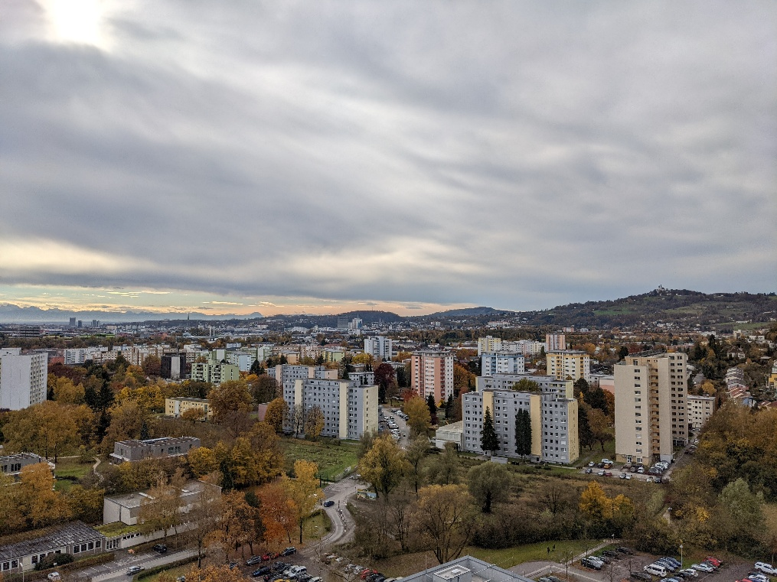
Who is this guy even?
Salzkammergut
Budweis
Linz
Vienna
double degree in Biological Chemistry
thesis on HPLC Analysis of CBD-Oil compounds

Slide 6
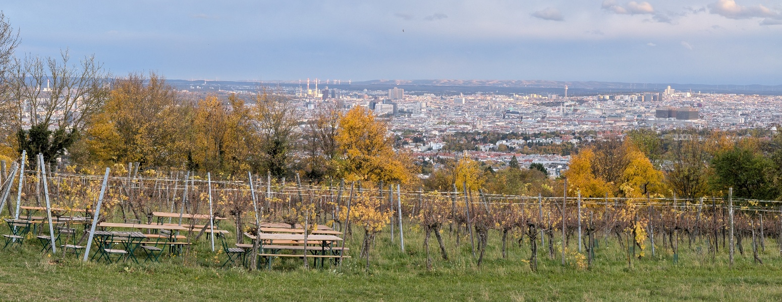
Who is this guy even?
Salzkammergut
Budweis
Linz
Vienna
Master‘s programm Neuroscience
thesis on prediction error encoding?

Slide 7
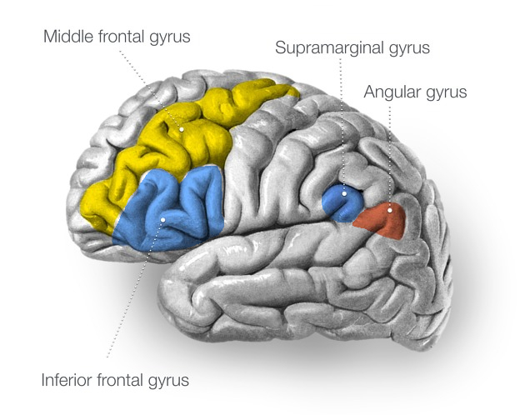
Project Summary
Stroke patient with chronically implanted electrode array
Spikes sorted into units and sampled at 30kHz
Four recorded cortical regions
Frontal:
MFG & IFG
Parietal
SMG & AG
Middle frontal gyrus
Supramarginal gyrus
Angular gyrus
Inferior frontal gyrus

Slide 8
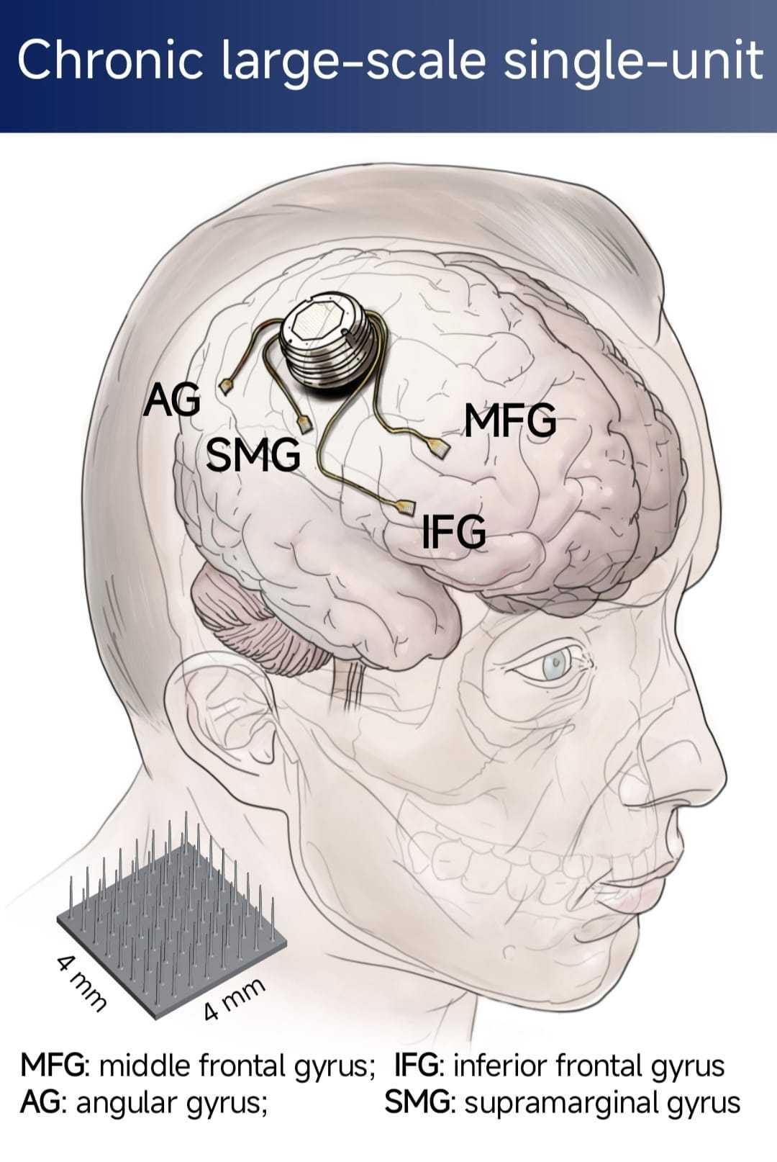
Project Summary
Stroke patient with chronically implanted electrode array
Spikes sorted into units and sampled at 30kHz
Four recorded cortical regions
Frontal:
MFG & IFG
Parietal
SMG & AG
Image: Simon Jacob Lab; Chen Hongbiao

Slide 9
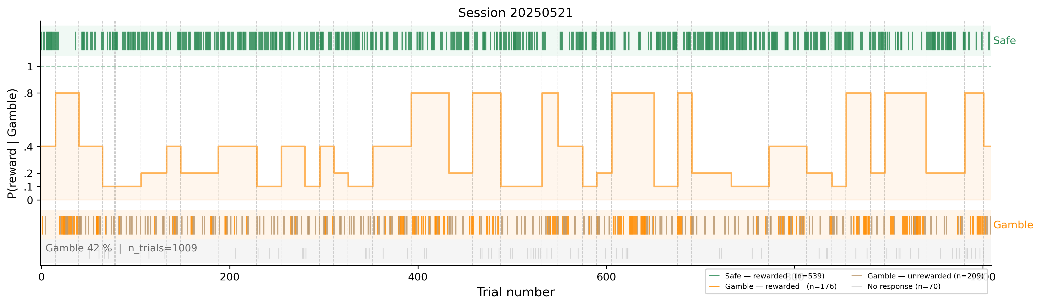
Project Summary
Choice Behaviour – Session 21.05.2025
Safe Side | Gamble Side
1x reward | 4x reward
guaranteed probability | varying probability: {0.1, 0.2, 0.4, 0.8}
~3 seconds trial start to trial end
~2h per session duration
randomized probability schedule per session

Slide 10
8
sessions
6,627
responding trials
37%
Gamble rate
Session | Trials (resp.) | Units (su/mu) | Rec. (min) | Gamble | Reward
20250521 | 1009 (939) | 252 (180/72) | 116 | 0.42 | 0.77
20250602 | 1018 (947) | 214 (152/62) | 118 | 0.36 | 0.81
20250605 | 1037 (962) | 241 (167/74) | 143 | 0.35 | 0.82
20250703 | 635 (507) | 215 (165/50) | 70 | 0.33 | 0.81
20250707 | 911 (772) | 220 (167/53) | 129 | 0.38 | 0.81
20250709 | 694 (639) | 225 (184/41) | 105 | 0.37 | 0.81
20250710 | 984 (902) | 249 (191/58) | 135 | 0.36 | 0.81
20250714 | 1006 (959) | 229 (180/49) | 116 | 0.40 | 0.80
Total | 7294 (6627) | 1845 (1386/459) | — | 0.37 | 0.80

Slide 11
Research Questions
1 · Selectivity
Are there neurons that respond differently to reward vs no reward in the gamble arm?
2 · Latent Variable encoding
Do neuronal firing rates encode prediction errors estimated from a computational model of behaviour?

Slide 12
Z
E
T
A
enith of
vent-based
ime locked
nomalies

Slide 13
ZETA test for time-locked spiking
Pool spike times relative to the event across all trials.
Build their cumulative distribution.
Compare to the flat line expected if spikes were uniformly spread (no time-locking).
The largest deviation from that line is ZETA; its timing is the zenith.
Significance from jittered resampling of event times.

Slide 14
ZETA test for time-locked spiking
Pool spike times relative to the event across all trials.
Build their cumulative distribution.
Compare to the flat line expected if spikes were uniformly spread (no time-locking).
The largest deviation from that line is ZETA; its timing is the zenith.
Significance from jittered resampling of event times.

Slide 15
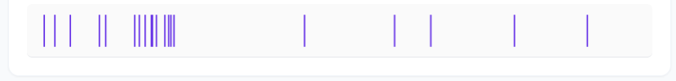
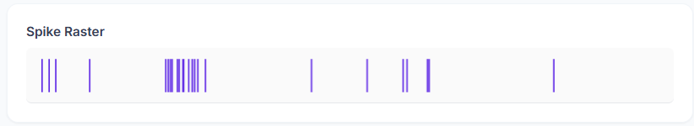
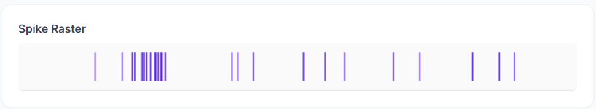
ZETA visualization
Pool spike times relative to the event across all trials.
Reward

Slide 16
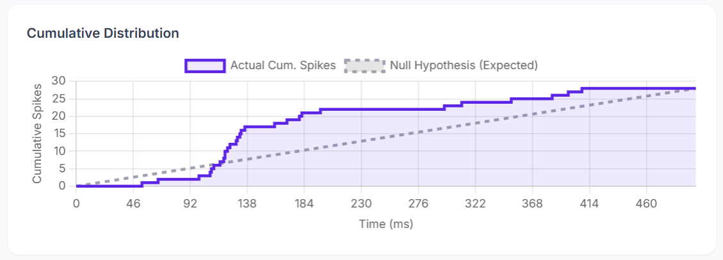
ZETA visualization
Build their cumulative distribution.
Compare to the flat line expected if spikes were uniformly spread (no time-locking).

Slide 17
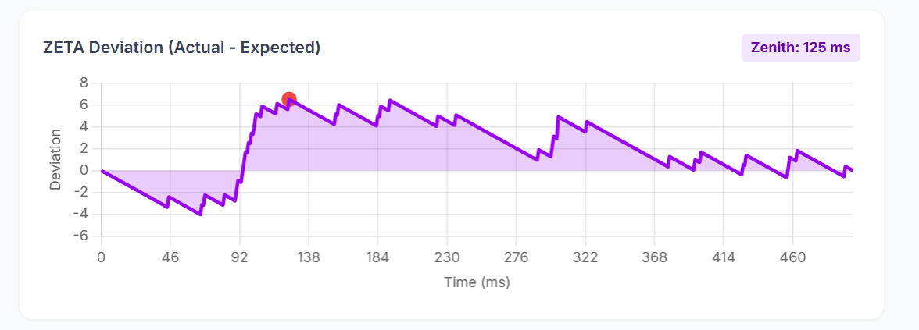
ZETA visualization
The largest deviation from that line is ZETA; its timing is the zenith.

Slide 18
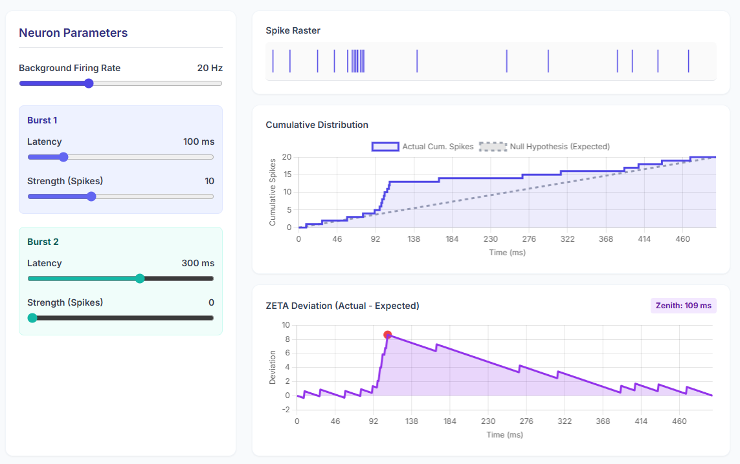
ZETA visualization

Slide 19
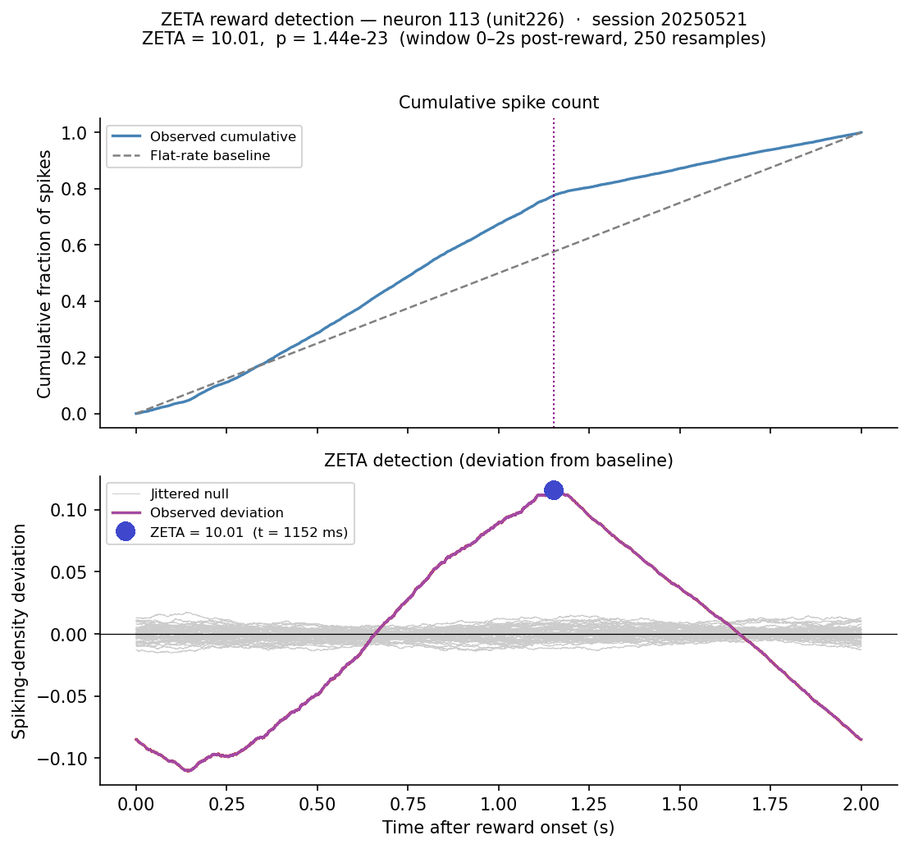
ZETA visualization
Significance from jittered resampling of event times.
⇦ Normalized cumulative spike count
⇦ Mean-subtracted spike density deviation

Slide 20

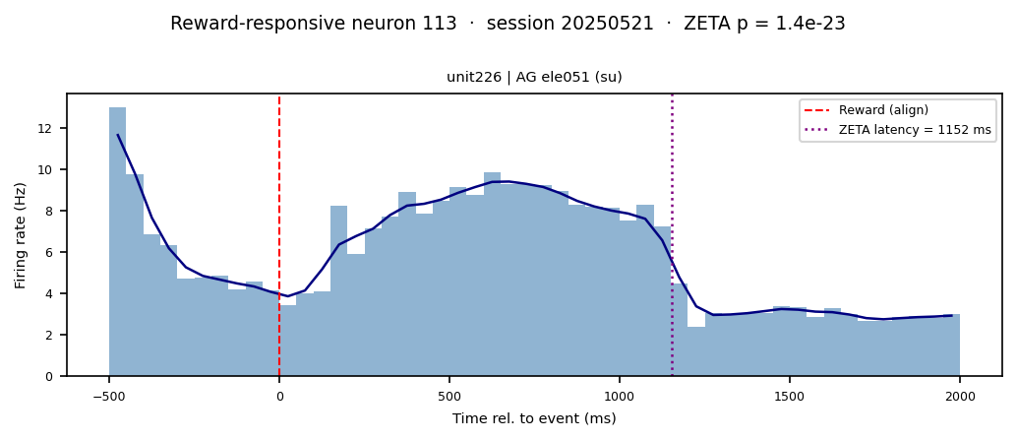
ZETA visualization

Slide 21
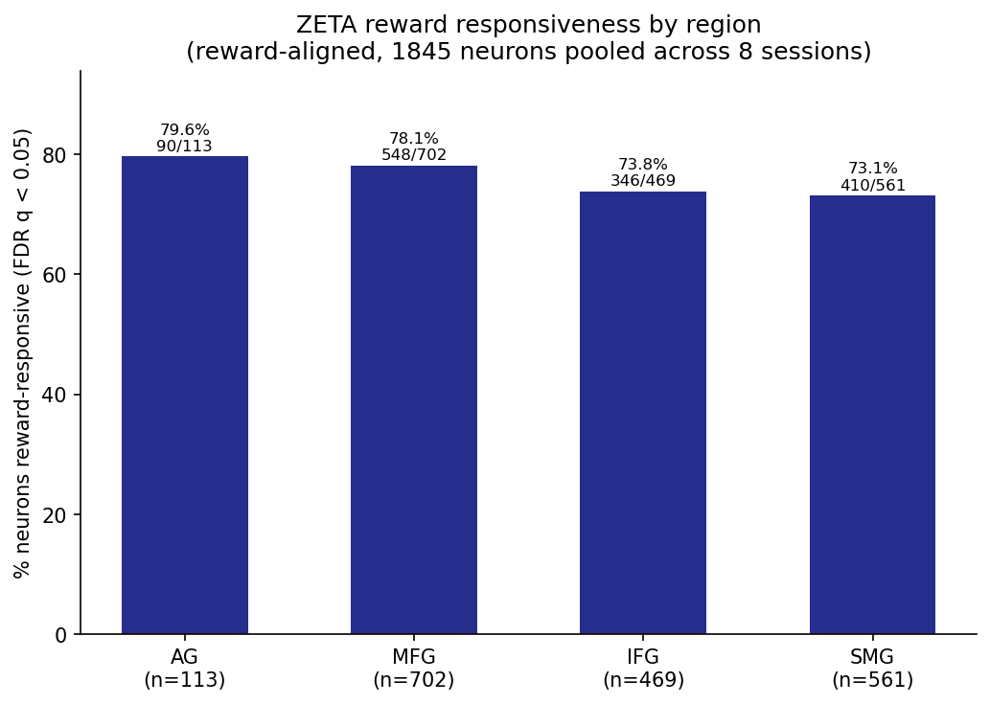
ZETA Results
most neurons come out as „responsive“
Possible reasons:
ZETA is more sensitive than binned t-test/ANOVA
ZETA asks: Is the spike timing after the event anything other than constant/flat?

Slide 22
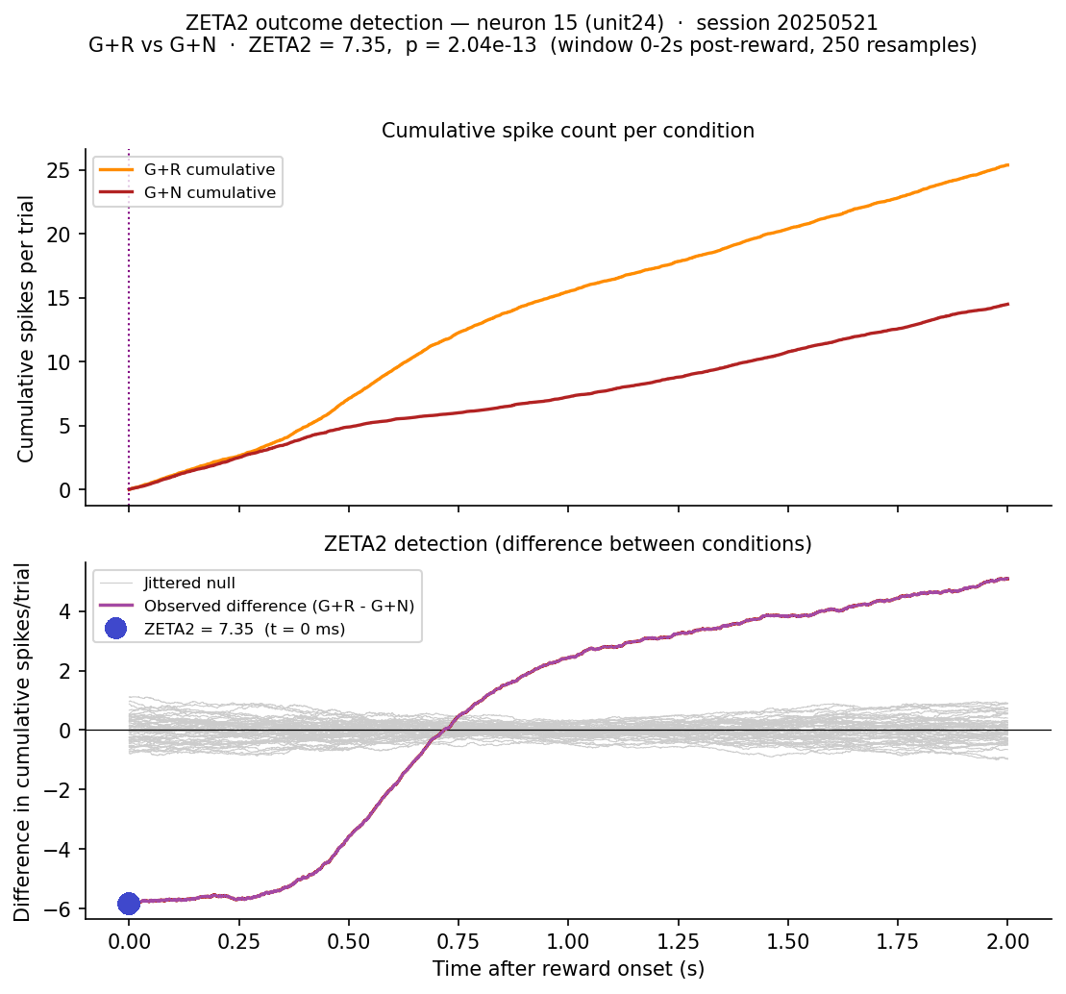
ZETA2 visualization
⇦ Cumulative Spikes/Trial
⇦ Mean-subtracted difference in cumulative spikes/trial

Slide 23
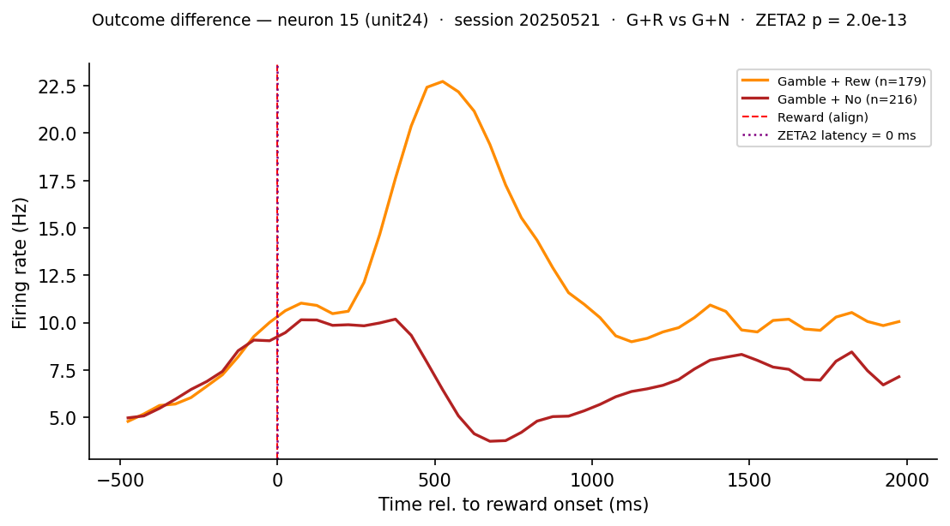

ZETA2 visualization

Slide 24
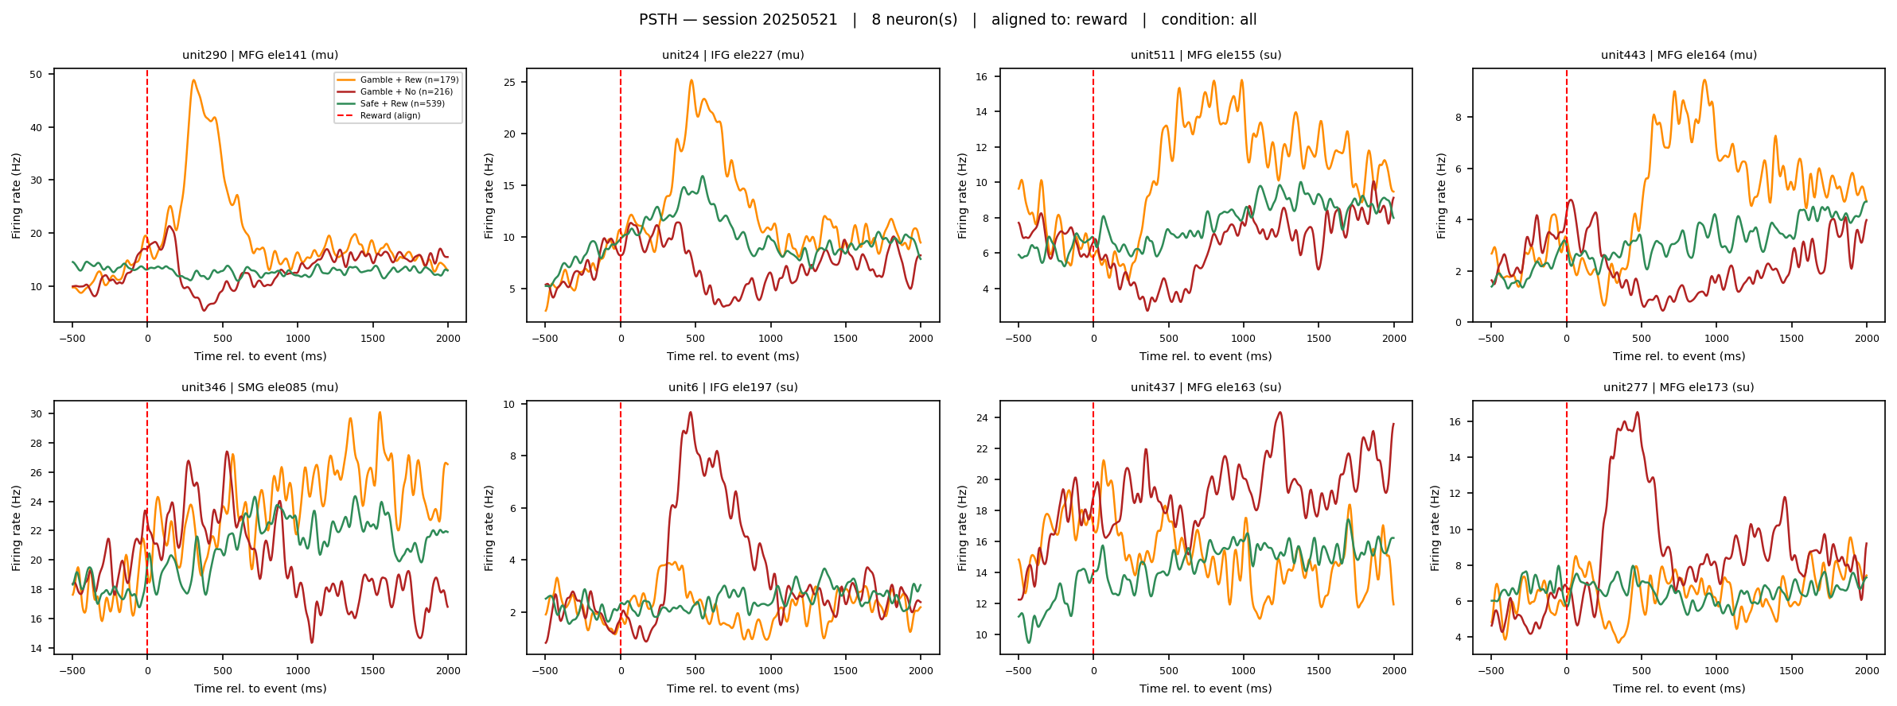
ZETA2 visualization
— Gamble + Rew; — Gamble + No Rew; — Safe + Rew; --- Reward

Slide 25
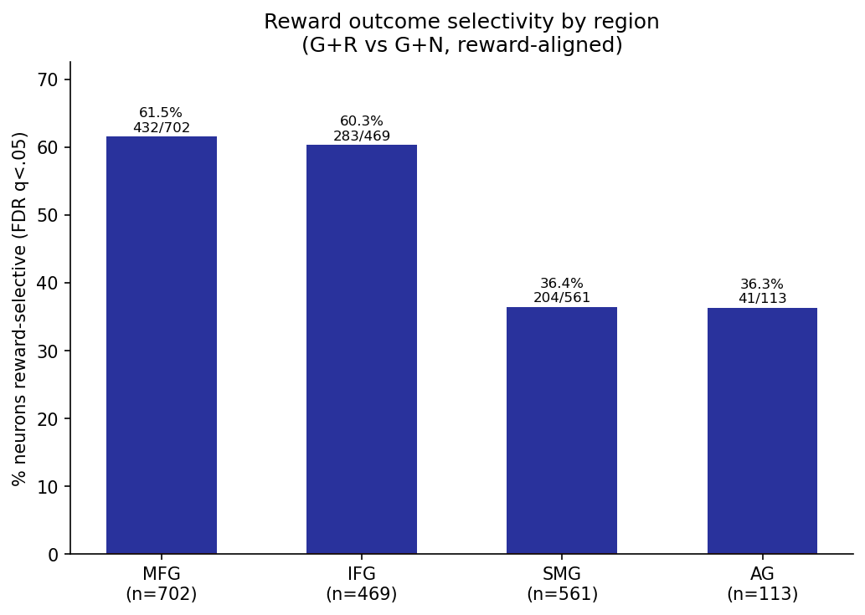
ZETA2 results
Percentage?
reward outcome selectivity is primarily frontal

Slide 26
Research Questions
1 · Selectivity
Are there neurons that respond differently to reward vs no reward in the gamble arm?
Yes

Slide 27
Why behavioural modelling?
We can only observe the choices made and their outcomes but not the cognitive variables that drive them:
Belief about probability
Prediction error
Expected Reward
...
A behavioural model is a generative rule fit to the participants choice
out-come
latent variables
choice

Slide 28


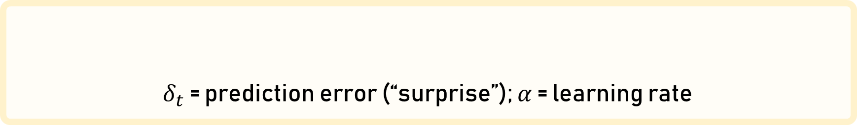

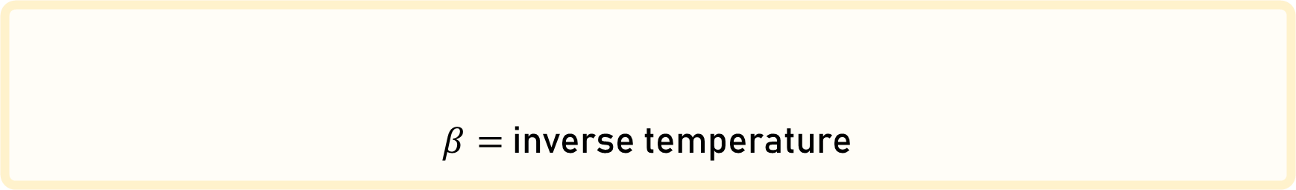

Rescorla wagner/ Q-learning
For each side:
Their difference is used to calculate the probability to gamble:
$δ_{t}$ = prediction error (“surprise”); $α$ = learning rate
$$δ_{t}\text{ = }r_{t} − Q_{t}$$
$$Q_{t+1}=Q_{t}+αδ_{t}$$
$$=1\frac{1}{1+e^{−β(∆Q_{t})}}$$
$β=$ inverse temperature
$${P(gamble)}_{t}=σ(β∆Q_{t})$$

Slide 29




Rescorla wagner/ Q-learning
$δ_{t}$ = prediction error (“surprise”); $α$ = learning rate
$$δ_{t}\text{ = }r_{t} − Q_{t}$$
$$Q_{t+1}=Q_{t}+αδ_{t}$$
Gamble arm update:
$$δ_{t}\text{ = }0 −3$$
$$Q_{t+1}^{g}=3+(0.5∗−3)$$
$$δ_{t}\text{ = }−3$$
$$Q_{t+1}^{g}=1.5$$

Slide 30




Rescorla wagner/ Q-learning
$δ_{t}$ = prediction error (“surprise”); $α$ = learning rate
$$δ_{t}\text{ = }r_{t} − Q_{t}$$
$$Q_{t+1}=Q_{t}+αδ_{t}$$
Safe arm update:
$$δ_{t}\text{ = }1 −0.8$$
$$Q_{t+1}^{s}=0.8+(0.5∗0.2)$$
$$δ_{t}\text{ = }0.2$$
$$Q_{t+1}^{s}=0.9$$

Slide 31







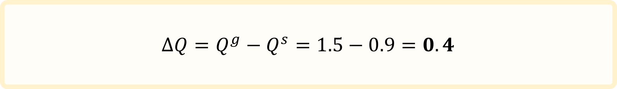


Rescorla wagner/ Q-learning
Safe arm update:
$$δ_{t}\text{ = }1 −0.8$$
$$Q_{t+1}^{s}=0.8+(0.5∗0.2)$$
$$δ_{t}\text{ = }0.2$$
$$Q_{t+1}^{s}=0.9$$
Gamble arm update:
$$δ_{t}\text{ = }0 −3$$
$$Q_{t+1}^{g}=3+(0.5∗−3)$$
$$δ_{t}\text{ = }−3$$
$$Q_{t+1}^{g}=1.5$$
$$P\left(gamble\right)=1\frac{1}{1+e^{−β(∆Q_{t})}}$$
$$∆Q=Q^{g}−Q^{s}=1.5−0.9=0.4$$

Slide 32
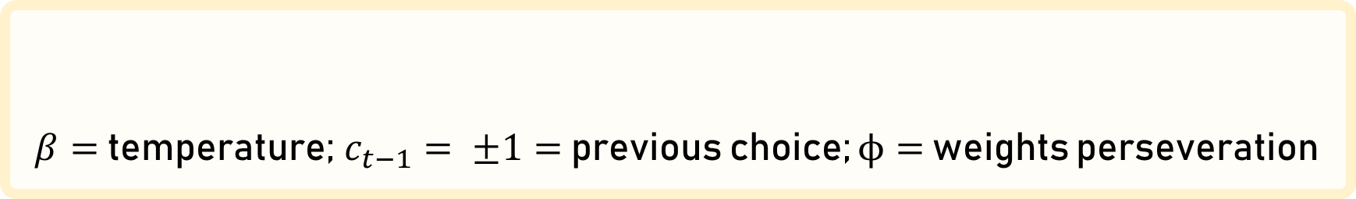
Rescorla wagner/ Q-learning + „stickiness“
For each side:
Their difference is used to calculate the probability to gamble:
$δ_{t}$ = prediction error (“surprise”); $α$ = learning rate
$$δ_{t}\text{ = }r_{t} − Q_{t}$$
$$Q_{t+1}=Q_{t}+αδ_{t}$$
$β=$ temperature; $c_{t−1}= ±1=$ previous choice; $ϕ=$ weights perseveration
$${P(gamble)}_{t}=σ(β∆Q_{t}+φc_{t−1})$$

Slide 33
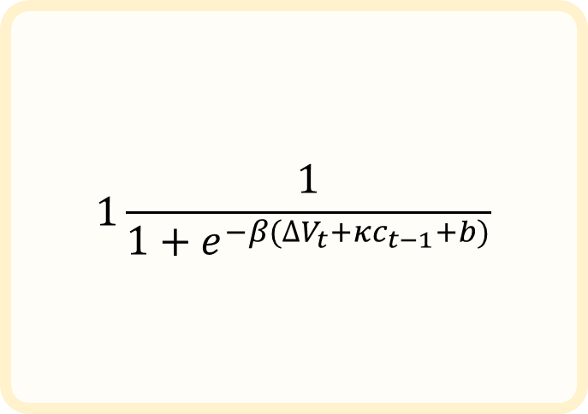
Rescorla wagner/ Q-learning
$$1\frac{1}{1+e^{−β(∆V_{t}+κc_{t−1}+b)}}$$
This allows us to simulate what the model would do. We can observe how well it would match the participants choices, but this is not what we actually want.
Instead the model must shadow the participants choices and at each step determine how likely their choices are using the model weights and given the trial history.
Doing this gives us the quality of the fit.

Slide 34
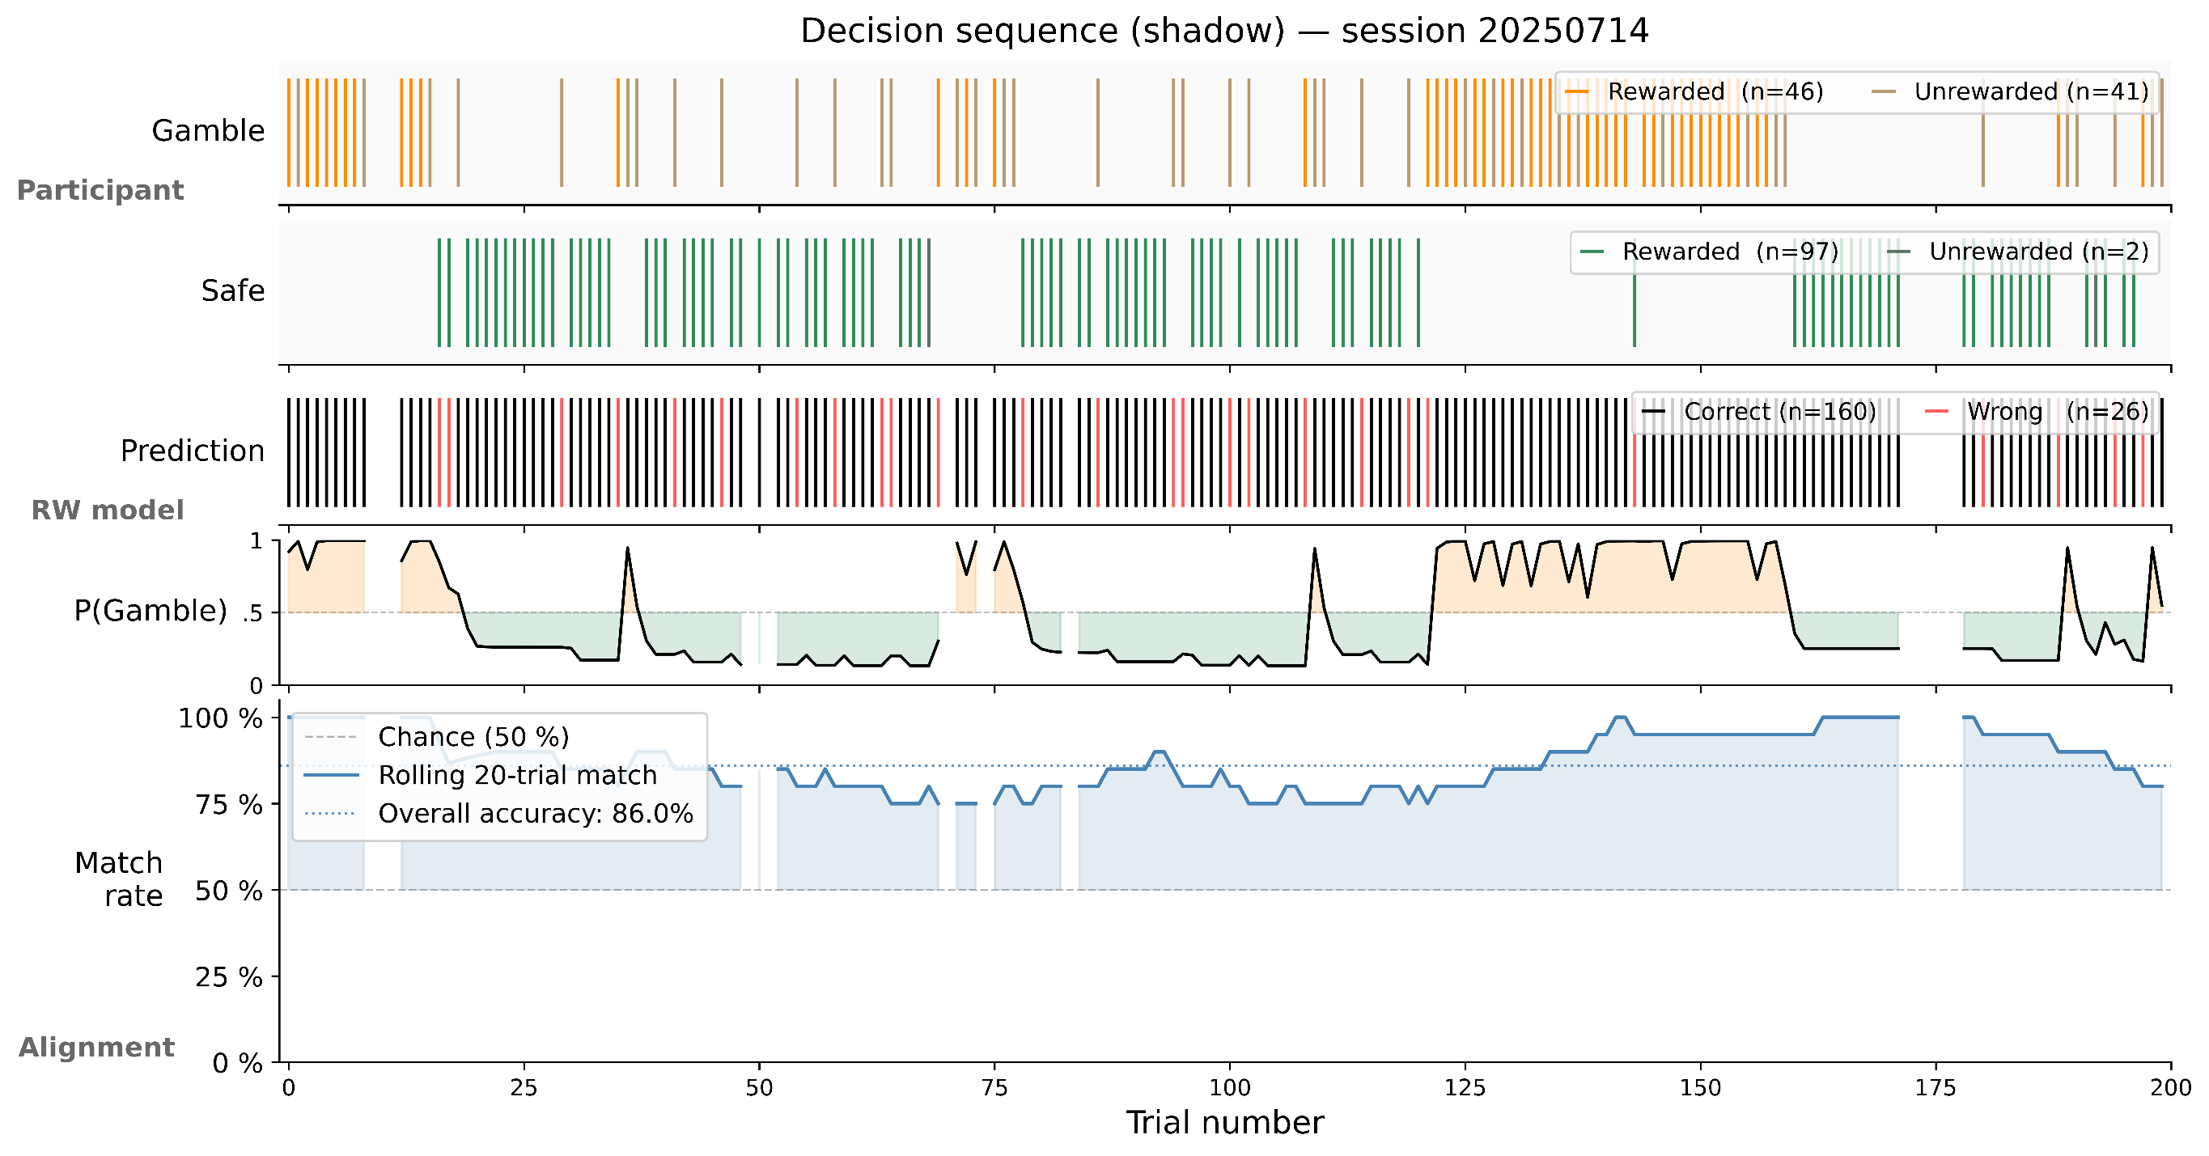

Slide 35
Hierarchical Gaussian Filter
What is it?
A Bayesian observer that infers both:
the hidden, drifting reward probability
how fast the probability is changing: the volatility

Slide 36
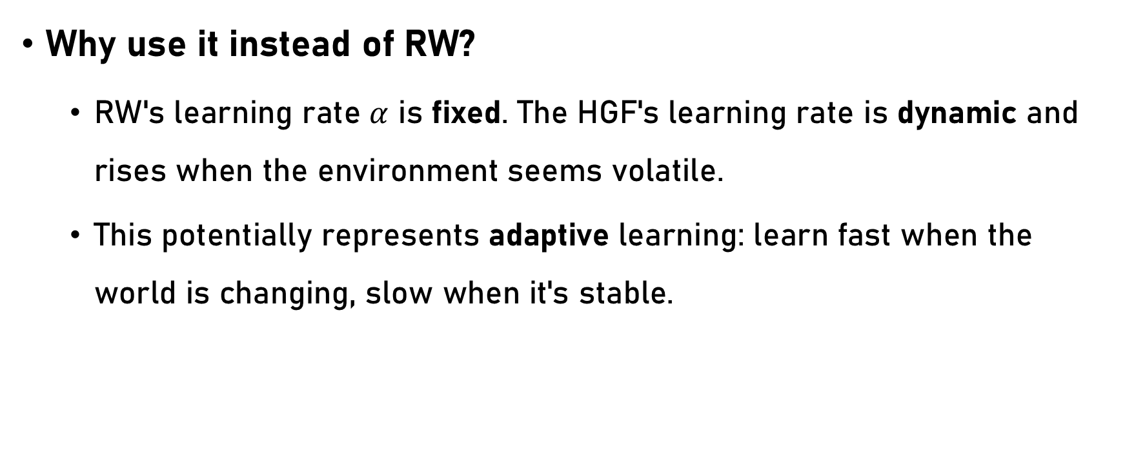
Hierarchical Gaussian Filter
Why use it instead of RW?
RW's learning rate $α$ is fixed. The HGF's learning rate is dynamic and rises when the environment seems volatile.
This potentially represents adaptive learning: learn fast when the world is changing, slow when it's stable.

Slide 37
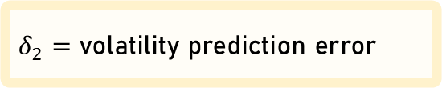
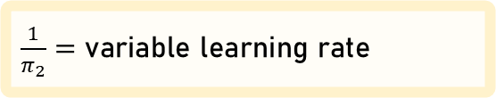
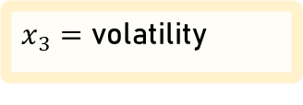
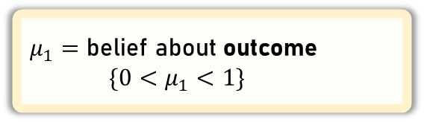
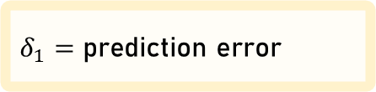
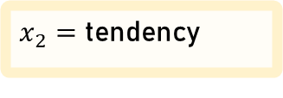
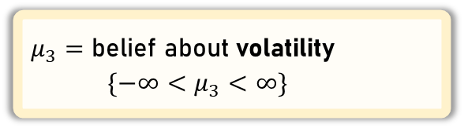
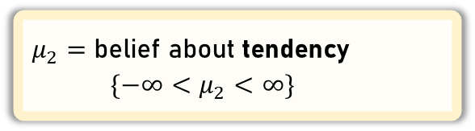
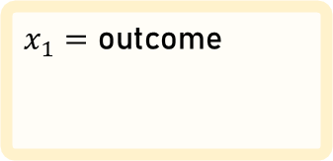
Hierarchical Gaussian Filter
“Real World”
$x_{1}=$ outcome
= 1 = 0
$x_{2}=$ tendency
$x_{3}=$ volatility
“Belief”
Level 1
Level 2
Level 3
$μ_{2}=$ belief about tendency
$\{−∞<μ_{2}<∞\}$
$μ_{1}=$ belief about outcome
$\{0<μ_{1}<1\}$
$\frac{1}{π_{2}}=$ variable learning rate
$μ_{3}=$ belief about volatility
$\{−∞<μ_{3}<∞\}$
$δ_{1}=$ prediction error
$δ_{2}=$ volatility prediction error

Slide 38
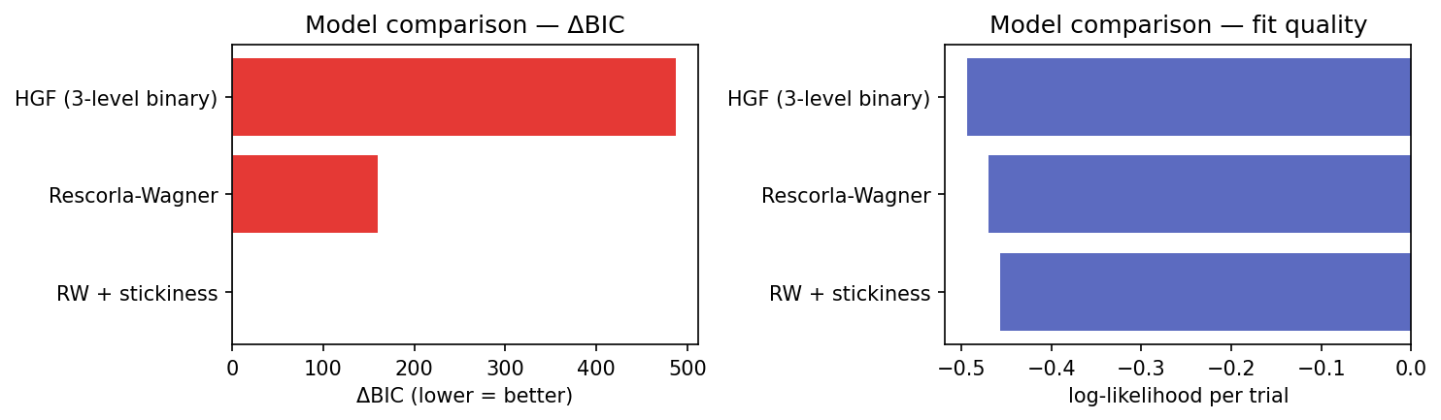
Model comparison
BIC = Bayesian Information Criterion. Measures model fit quality
simple beats complicated

Slide 39
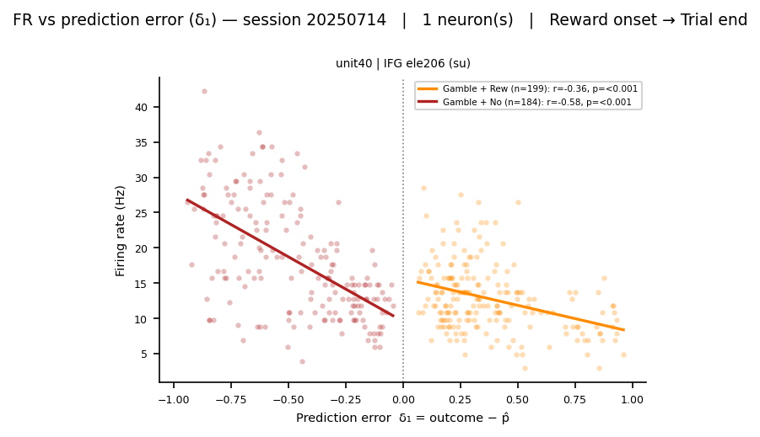

Slide 40
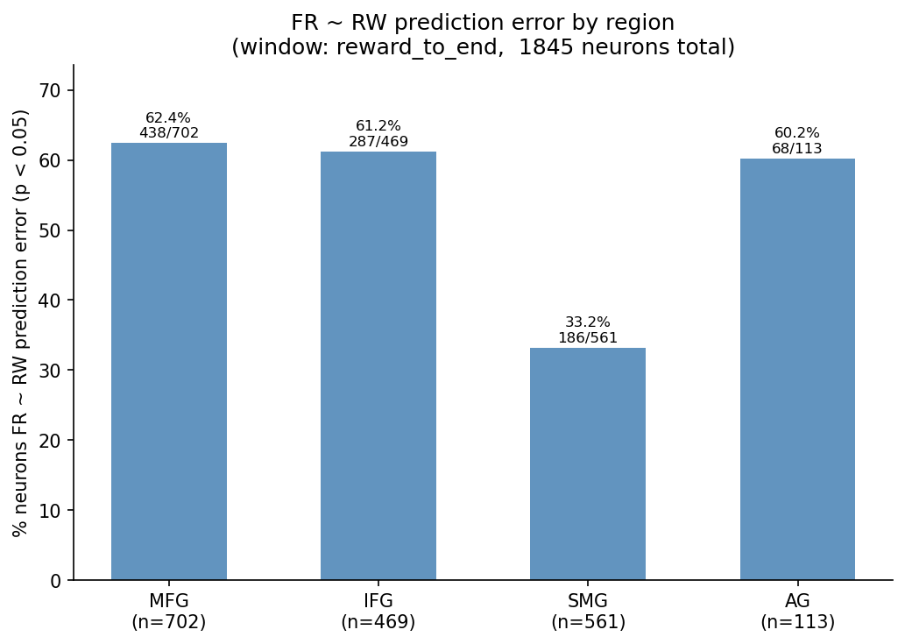

Slide 41
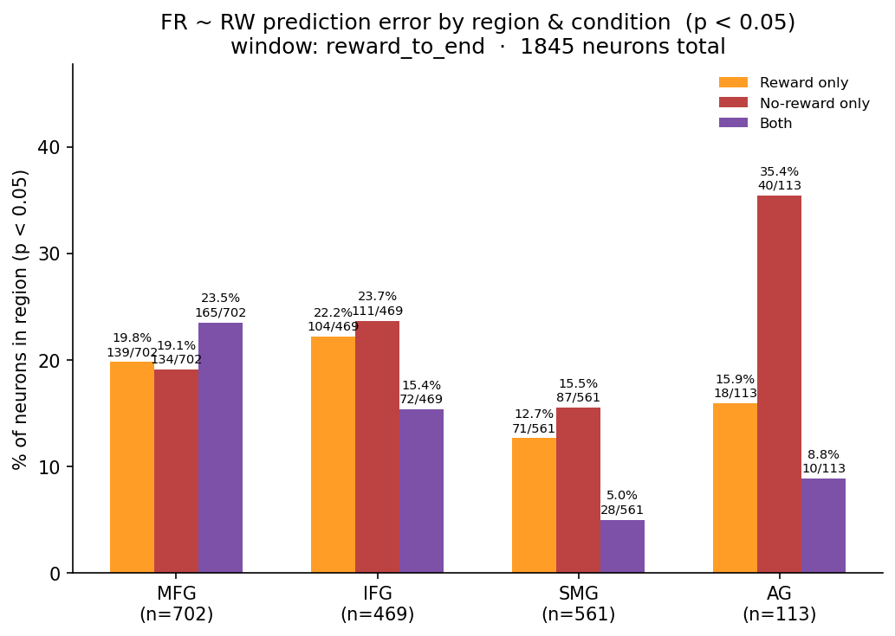

Slide 42
Research Questions
2 · Latent Variable encoding
Do neuronal firing rates encode prediction errors estimated from a computational model of behaviour?
Probably?

Slide 43
Conclusion
Reward-selective neurons exist and are predominantly frontal
ZETA analysis across 8 sessions (6,627 trials) shows time-locked spiking responses to reward outcomes, with outcome selectivity concentrated in MFG/IFG rather than parietal regions (SMG/AG).
Simple reinforcement learning best captures behaviour
Model comparison favours Rescorla-Wagner/Q-learning over the Hierarchical Gaussian Filter — participants' choices are well described by a basic prediction-error update rule.
Neuronal firing rates tentatively track prediction errors
Firing rates correlate with trial-by-trial RW prediction errors, suggesting frontal neurons may represent the learning signal — but direction, timing, and choice selectivity remain to be characterised.

Slide 44
Future Direction
Sign of prediction error vs firing rate correlation
Find a better model
Timing of firing rate changes after events (LatenZy)
Choice selectivity
Research Angual Gyrus

Slide 45
Acknowledgements
Hugo, Dimitris and everyone in the lab giving me much needed advice and direction
Simon Jacob Lab
Chen Hongbiao
coffee

Slide 46
Bonus
Dopamine Prediction Error | https://www.science.org/doi/10.1126/science.275.5306.1593
Angular Gyrus Prediction Error | https://doi.org/10.1523/JNEUROSCI.4225-09.2010
 | Base (a,b) | Full (a,b,phi)
alpha | 0.6349 | 0.6374
beta | 1.8134 | 1.6303
phi | -- | 0.2474

