Slide 1
The 2nd Review of Final Project Team 2
2023/12/14
Charlie Qiu zq2220
Xinyuan Zhang xz3257
Ruojun Li rl3390
Weili Wang ww2685
Yue Wu yw4131

Slide 2
Cross-sectional Data
Consider factors influence life expectancy at birth
We propose a comprehensive research inquiry into the determinants of life expectancy at birth, encompassing micro and macro levels. Our investigation spans socio-economic status, healthcare accessibility, genetics, and environmental, cultural, and lifestyle factors, aiming to provide holistic insights into this vital demographic metric.
Micro-level factors (individual):
Alcohol Consumption, Drug Use
Macro-level factors (socioeconomic):
GDP per capita, Pollution, Hospital Beds, Security Apparatus
Therefore the research question:
Is life expectancy at birth related to the forementioned factors?
Let life expectancy at birth be the dependent variable and those factors be the independent variables.

Slide 3
Descriptive Statistics
 | Life Expectancy | Alcohol Consumption | GDP per capita | Pollution | Hospital Beds per capita | Drug Use | Security Apparatus
Mean | 76.3066 | 5.5251 | 428.9214 | 20.4597 | 3.0009 | 0.7579 | 4.9144
Standard Error | 0.5794 | 0.4259 | 88.7428 | 1.5888 | 0.2368 | 0.0413 | 0.2578
Median | 76.2850 | 5.7350 | 89.0235 | 14.4000 | 2.4600 | 0.6871 | 5.0000
Standard Deviation | 5.4970 | 4.0405 | 841.8881 | 15.0724 | 2.2462 | 0.3918 | 2.4453
Kurtosis | 1.0737 | -1.4057 | 13.7844 | 1.3954 | 3.3374 | 4.5926 | -0.9621
Skewness | -0.9514 | 0.0312 | 3.4630 | 1.5187 | 1.5046 | 1.7519 | 0.1429
Minimum | 56.4700 | 0.0000 | 1.2130 | 5.4700 | 0.3300 | 0.2993 | 0.7000
Maximum | 84.2600 | 13.2000 | 5117.9950 | 64.0800 | 12.9800 | 2.4637 | 10.0000

Slide 4
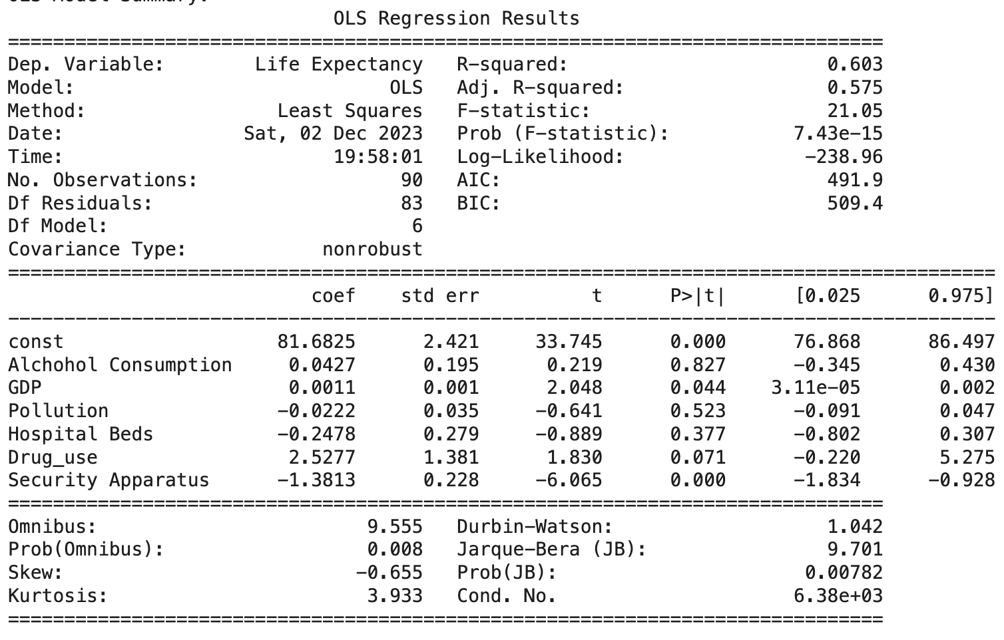
OLS Regression
R-squared (0.603) indicates that approximately 60.3% of variance in life expectancy can be explained by our independent variables.
Adjusted R-square (0.575) is slightly lower than R-squared; it measures goodness of fit more accurately.
F-statistic is 21.05 with probability extremely close to 0.
Our model is statistically significant significance level of 0.05 and even 0.01.
Coefficients:
GDP per capita, Drug Use, and Security Apparatus are statistically significant,
Alcohol Consumption, Pollution, Hospital Beds are not statistically significant.

Slide 5
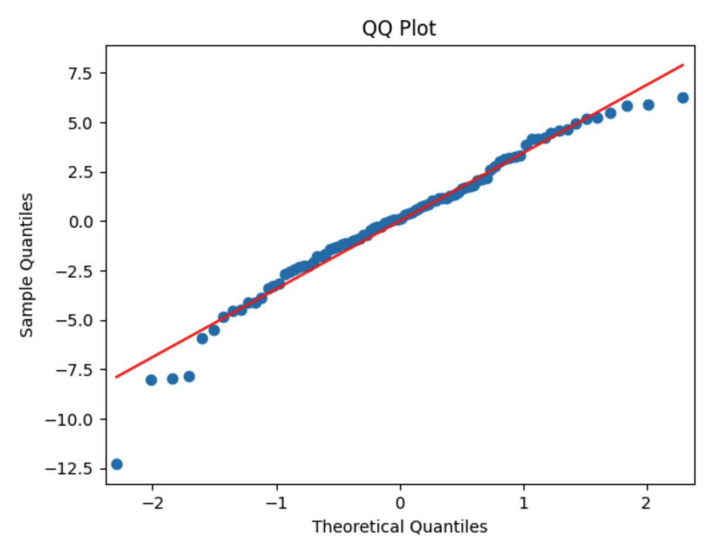
Diagnostic tests
 | test statistics | p-value | check | result
Jarque-Bera Test | 9.7012 | 0.0078 | normality | rejected
Shapiro-Wilk Test | 0.9693 | 0.0313 | normality | rejected
Breusch-Pagan | 17.1907 | 0.0086 | homoscedasticity | rejected
White Test | 47.1711 | 0.0095 | homoscedasticity | rejected
Durbin-Watson Test | 1.0415 | 0 | no autocorrelation | rejected
After running the diagnostic tests, we notice that the OLS assumptions are violated. Therefore, we need to introduce WLS, penalized regressions to fix the issue.
Normality: In the Q-Q plot, there are some deviations from the red line in the tails, indicating the existence of outliers. Consistent with the J-B test, the residuals are not normally distributed.

Slide 6
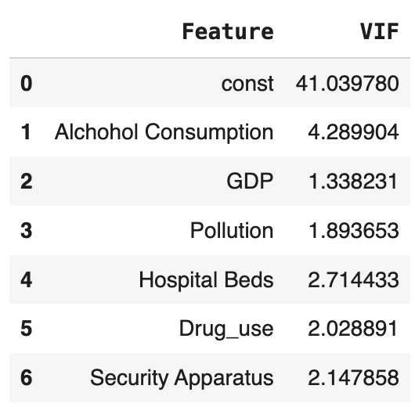
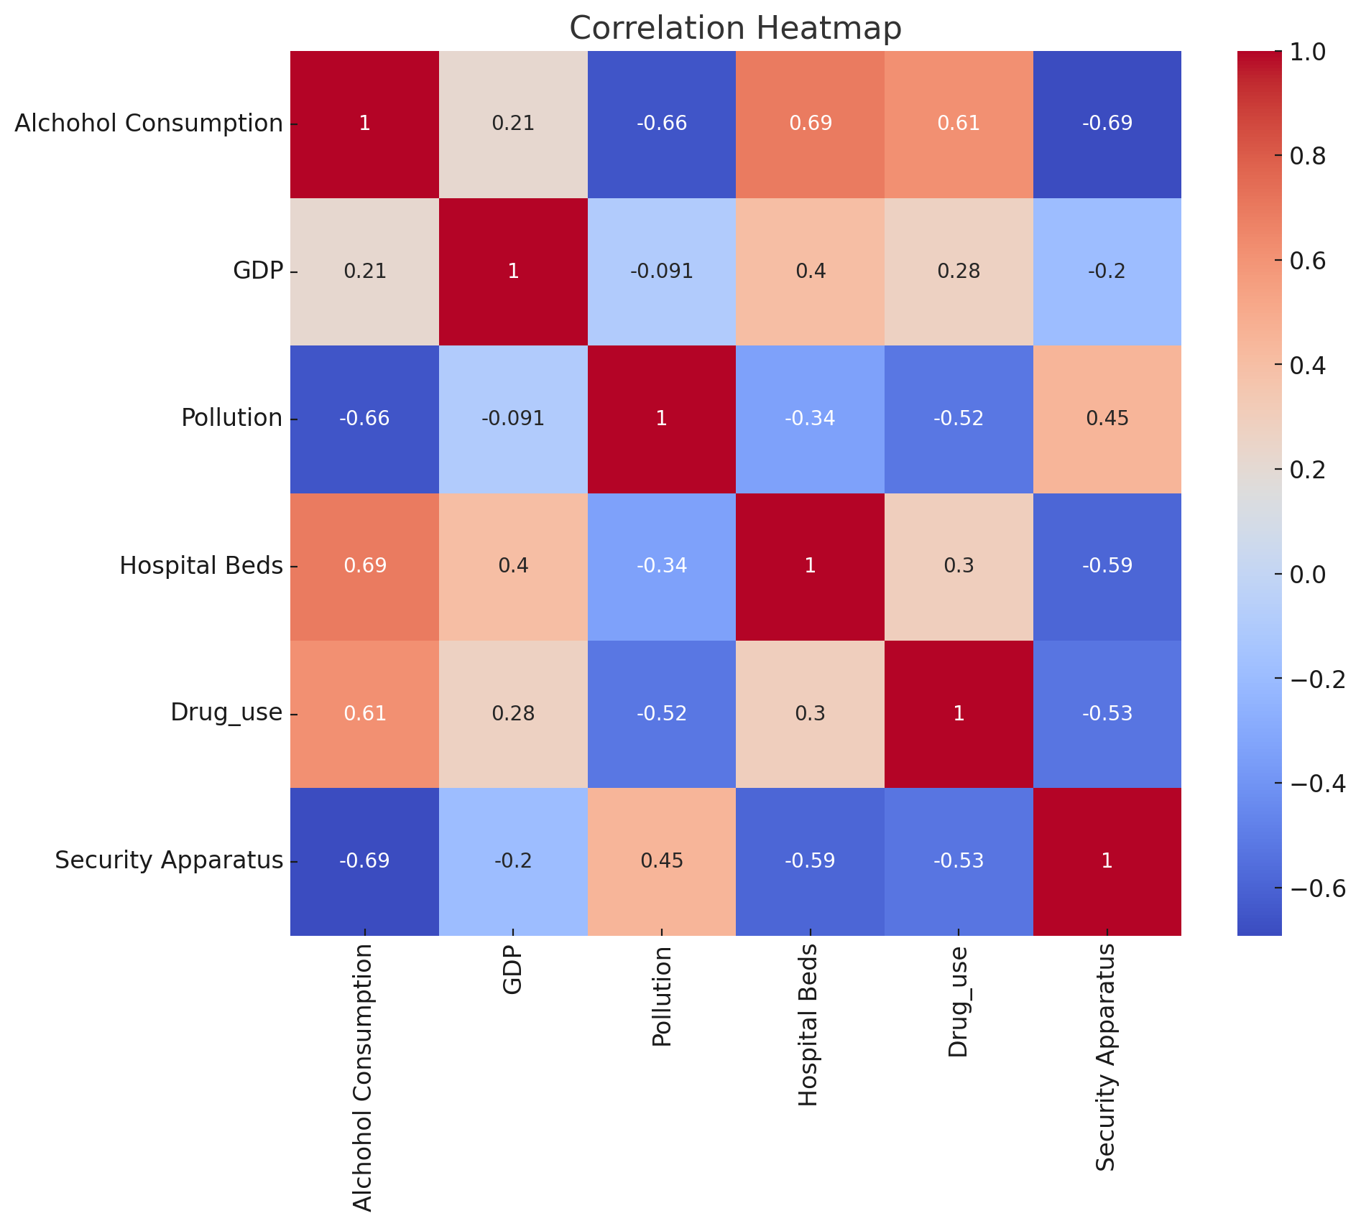
Diagnostic tests
Multicollinearity:
Alcohol Consumption has VIF > 4, indicates mild multicollinearity that should be further investigated.
GDP per capita, Pollution, Hospital Beds, Drug Use, and Security Apparatus have a low level of multicollinearity.

Slide 7
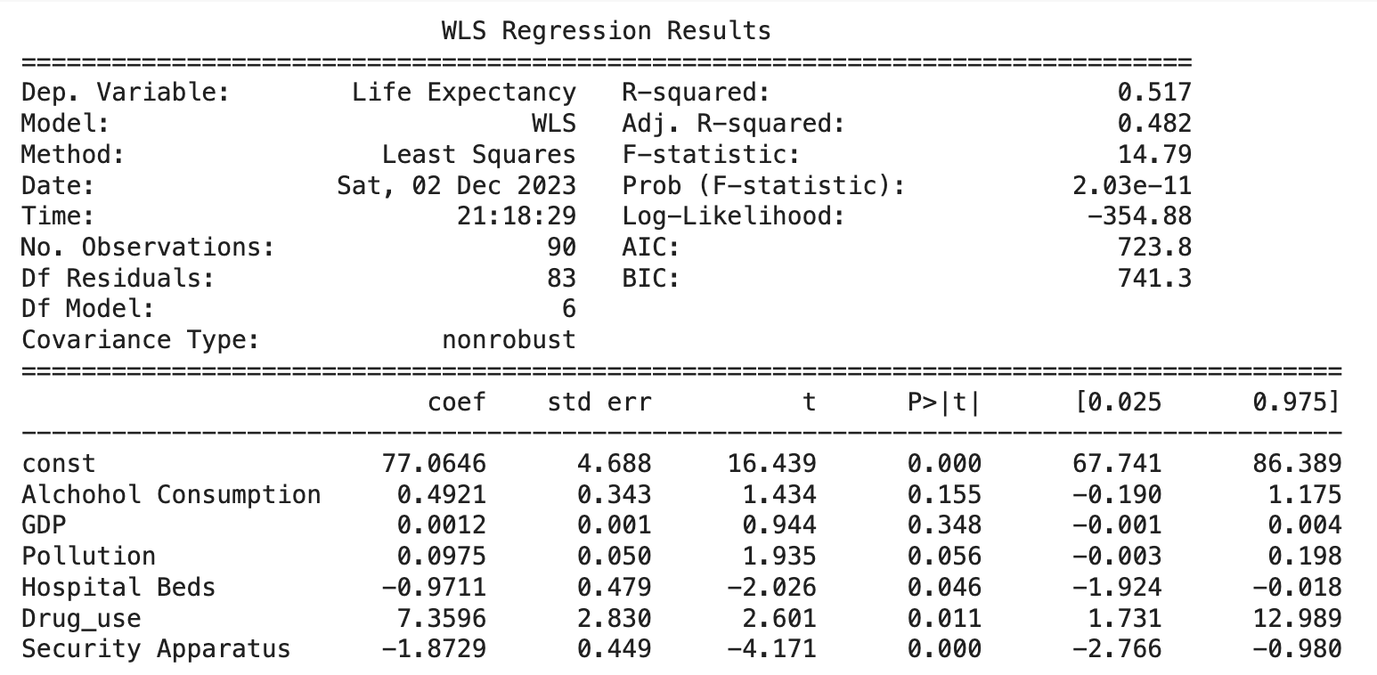
WLS Regression
 | test statistics | p-value | result
Jarque-Bera Test | 10.3337 | 0.0057 | no normality
Breusch-Pagan | 16.7624 | 0.01019 | heteroscedasticity
White Test | 47.2446 | 0.0093 | heteroscedasticity
Durbin-Watson Test | 1.0293 |  | autocorrelation
Using WLS, there is no clear improvement of the test-results.
We introduce three penalized regressions in the following part.

Slide 8
Penalized regression: Lasso
 | coefficient
Alcohol Consumption | 0.0000
GDP per capita | 0.08298
Pollution | -0.0831
Hospital Beds | 0.0000
Drug Use | 0.1889
Security Apparatus | -0.4881
 | test statistics | p-value | result
Jarque-Bera Test | 3.1627 | 0.2057 | normality
Breusch-Pagan Test | 10.9004 | 0.0915 | homoscedasticity
Durbin-Watson Test | 2.0107 |  | no autocorrelation
R-squared is 0.5527
We reduced Alcohol Consumption and Hospital Beds as independent variables, which are the two with highest VIF, so we significantly improve the multicollinearity issue.
In this regression, we make sure that normality, homoscedasticity, and no autocorrelation in our data set.

Slide 9
Penalized regression: RIGDE
 | coefficient
Alcohol Consumption | 0.1165
GDP per capita | 0.2042
Pollution | -0.1010
Hospital Beds | -0.1738
Drug Use | 0.1610
Security Apparatus | -0.5508
 | test statistics | p-value | result
Jarque-Bera Test | 0.5797 | 0.7484 | normality
Breusch-Pagan Test | 17.0734 | 0.0090 | heteroscedasticity
Durbin-Watson Test | 1.9857 |  | no autocorrelation
R-squared is 0.5574
In this regression, we make sure that normality and no autocorrelation in our data set.
There is still heteroscedasticity in our sample.
Ridge does not improve the multicollinearity issue significantly as Lasso does.

Slide 10
Penalized regression: Elastic Net
 | coefficient
Alcohol Consumption | 0.02696
GDP per capita | 0.09515
Pollution | -0.0894
Hospital Beds | 0.0000
Drug Use | 0.1877
Security Apparatus | -0.4501
 | test statistics | p-value | result
Jarque-Bera Test | 2.3971 | 0.3016 | normality
White Test | 12.7442 | 0.0473 | heteroscedasticity
Durbin-Watson Test | 2.0684 |  | no autocorrelation
R-squared is 0.5430
We reduced Hospital Beds as independent variable.
In this regression, we make sure that normality and no autocorrelation in our data set.
There is still heteroscedasticity in our sample; We improve the multicollinearity issue, but not significantly.

Slide 11
CONCLUSION
Overall, Lasso regression outperforms all other regressions as having normality, homoscedasticity, no autocorrelation, and no perfect multicollinearity.
Even though Lasso has relatively smaller R-squared than the one of OLS, we still consider Lasso as the best fitted model to our data set.
Consider omit variable Alcohol Consumption and Hospital Beds

Slide 12
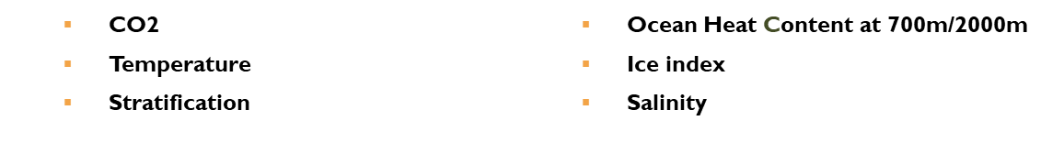
TIME SERIES DATA
Propose a research inquiry into the determinants of sea level rise
This research aligns with ESG principles, offering insights into the drivers of sea level changes, aiding sustainable decision-making and enhancing our understanding of global environmental challenges.
Considering a range of key factors…
The overarching research question:
Is sea level rise related to the aforementioned factors?
Sea level is the dependent variable, while environmental and climatic factors serve as independent variables.

Slide 13
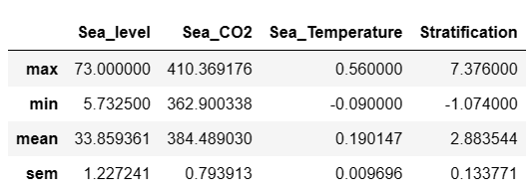
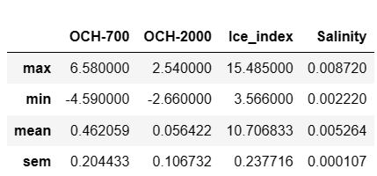
DESCRIPTIVE STATISTICS
↑ sem is the standard error of the mean.

Slide 14
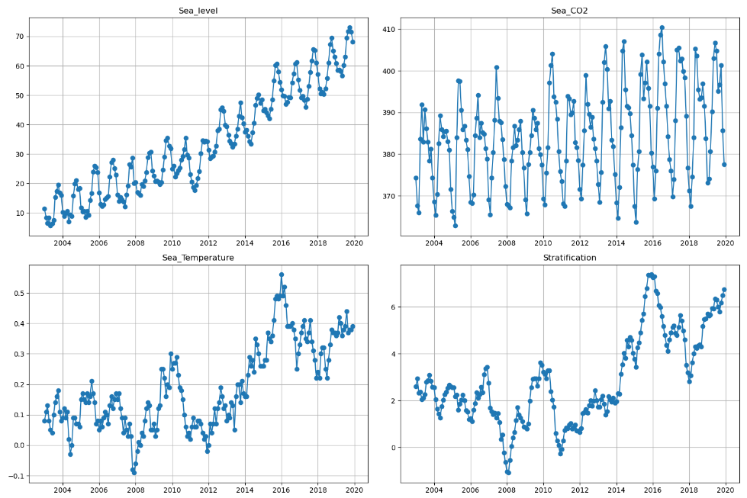
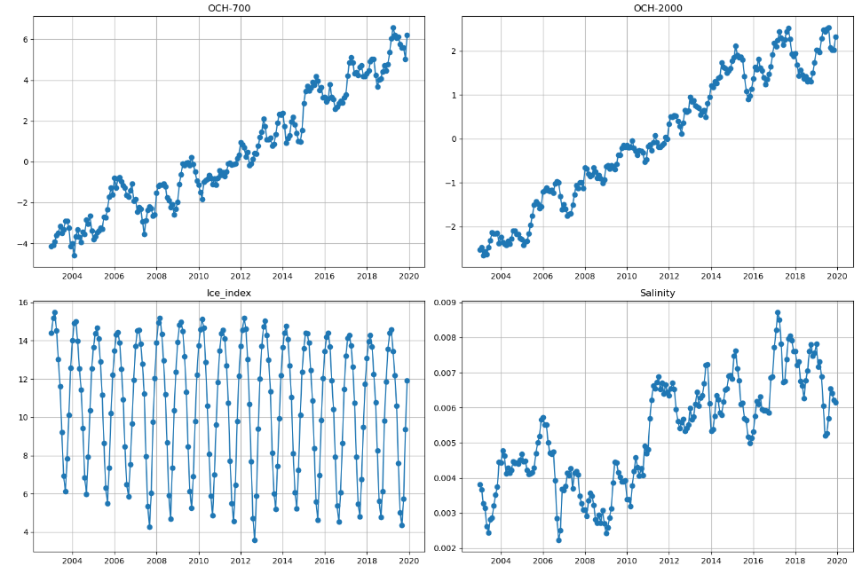
DESCRIPTIVE STATISTICS

Slide 15
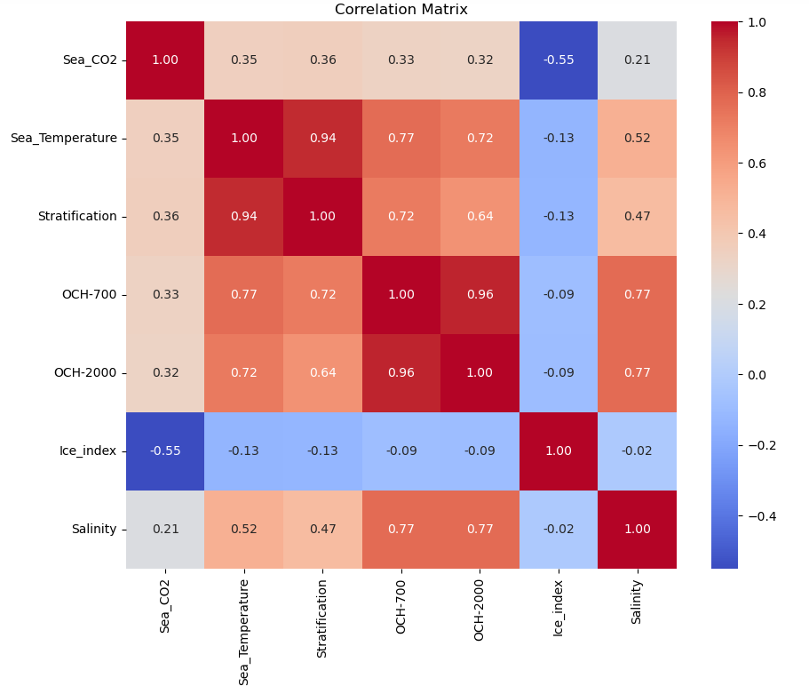
OLS Regression
At first, seven independent variables are taken into consideration.
According to the plot of correlation matrix, there is serious multicollinearity in our data.
Therefore, we try to eliminate some of the independent variables.
Anyway, let’s fit a OLS linear regression model!

Slide 16
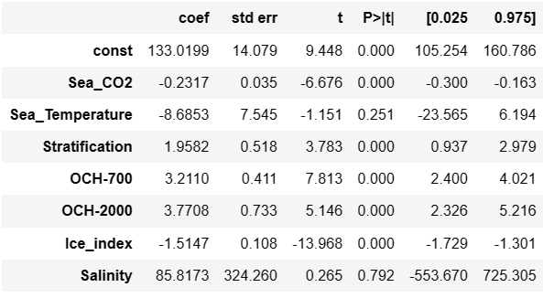
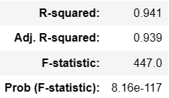
OLS Regression
The result shows good R-squared and indicates that approximately 94.1% of variance in sea level can be explained by our independent variables
Some coefficients are not significant.
Also, a reminder told us severe multicollinearity may exist, which matches our previous judgment.

Slide 17
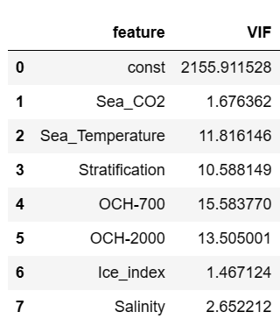
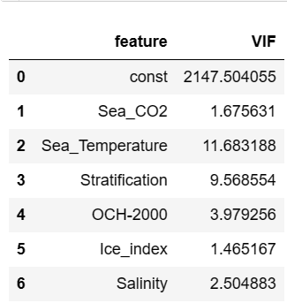
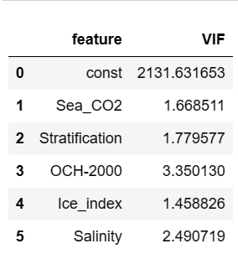
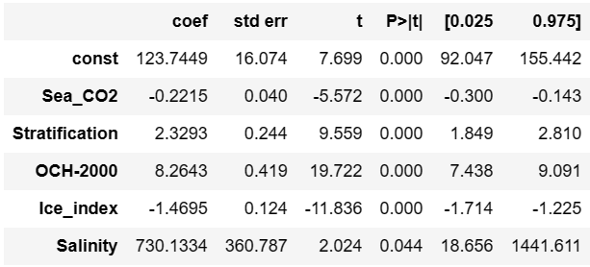

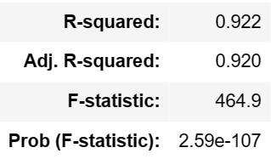
OLS Regression
We remove the variable with the highest VIF and fit a new OLS based linear regression model.
After eliminating “OCH-700” and “Sea_Temperature”, the remaining variables have acceptable VIFs (all less than 4) and the re-fitted model still has good performance (good R-squared and more significant coefficients).
But the result of Durbin-Watson test shows possible positive autocorrelation here (close to 0).

Slide 18

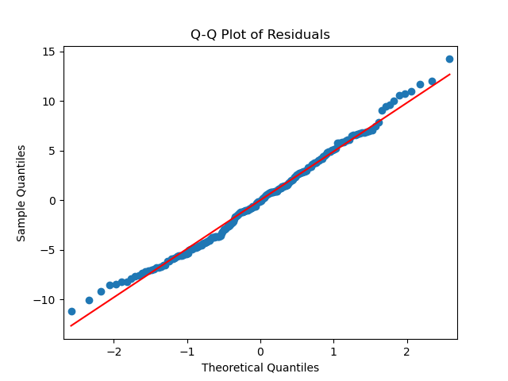
Diagnostic tests
According to the Q-Q plot, it is reasonable to believe in the normality of our model.
The p-value also indicate that we don’t have enough evidence to reject the null hypothesis that the residuals are normally distributed.

Slide 19

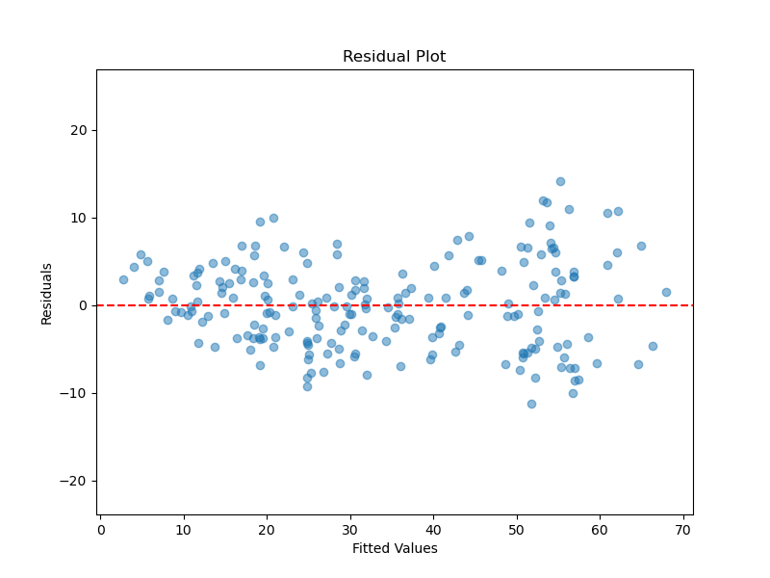
Diagnostic tests
From the residual plot, it seems that the variance of residuals tends to increasing as fitted values become larger, so we doubt heteroscedasticity might exist.
The result of the White test supports our suspicion about heteroscedasticity, since it significantly rejects the null hypothesis of homoscedasticity.
But the result of Durbin-Watson test shows possible positive autocorrelation here (close to 0).

Slide 20

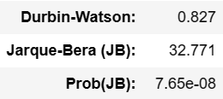
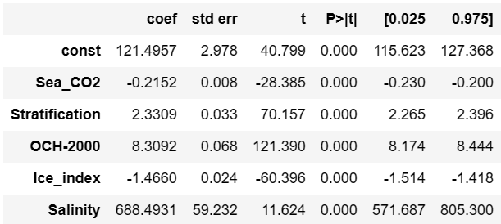
WLS Regression: Diagnostic tests
 | value
R-squared | 0.995
Adj. R-squared | 0.995
F-statistic | 8645
Prob (F-statistic) | <1e-10
To fix the heteroscedasticity and autocorrelation issues, we try to use GLS method. Before that, we’d like to show the results of WLS.
We can see that the WLS model fits the data very well (high R-squared). However, the Durbin-Watson statistic still indicates possible positive autocorrelation. Also, Jarque-Bera test rejects the hypothesis that the residuals are normally distributed. Moreover, the White test rejects the hypothesis that the residuals have homoscedasticity.

Slide 21
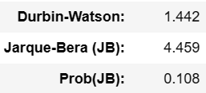
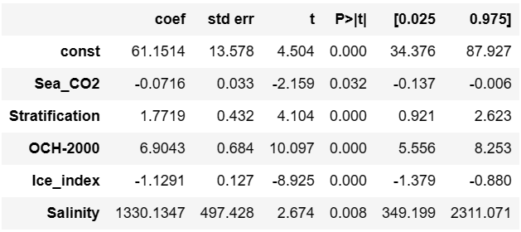
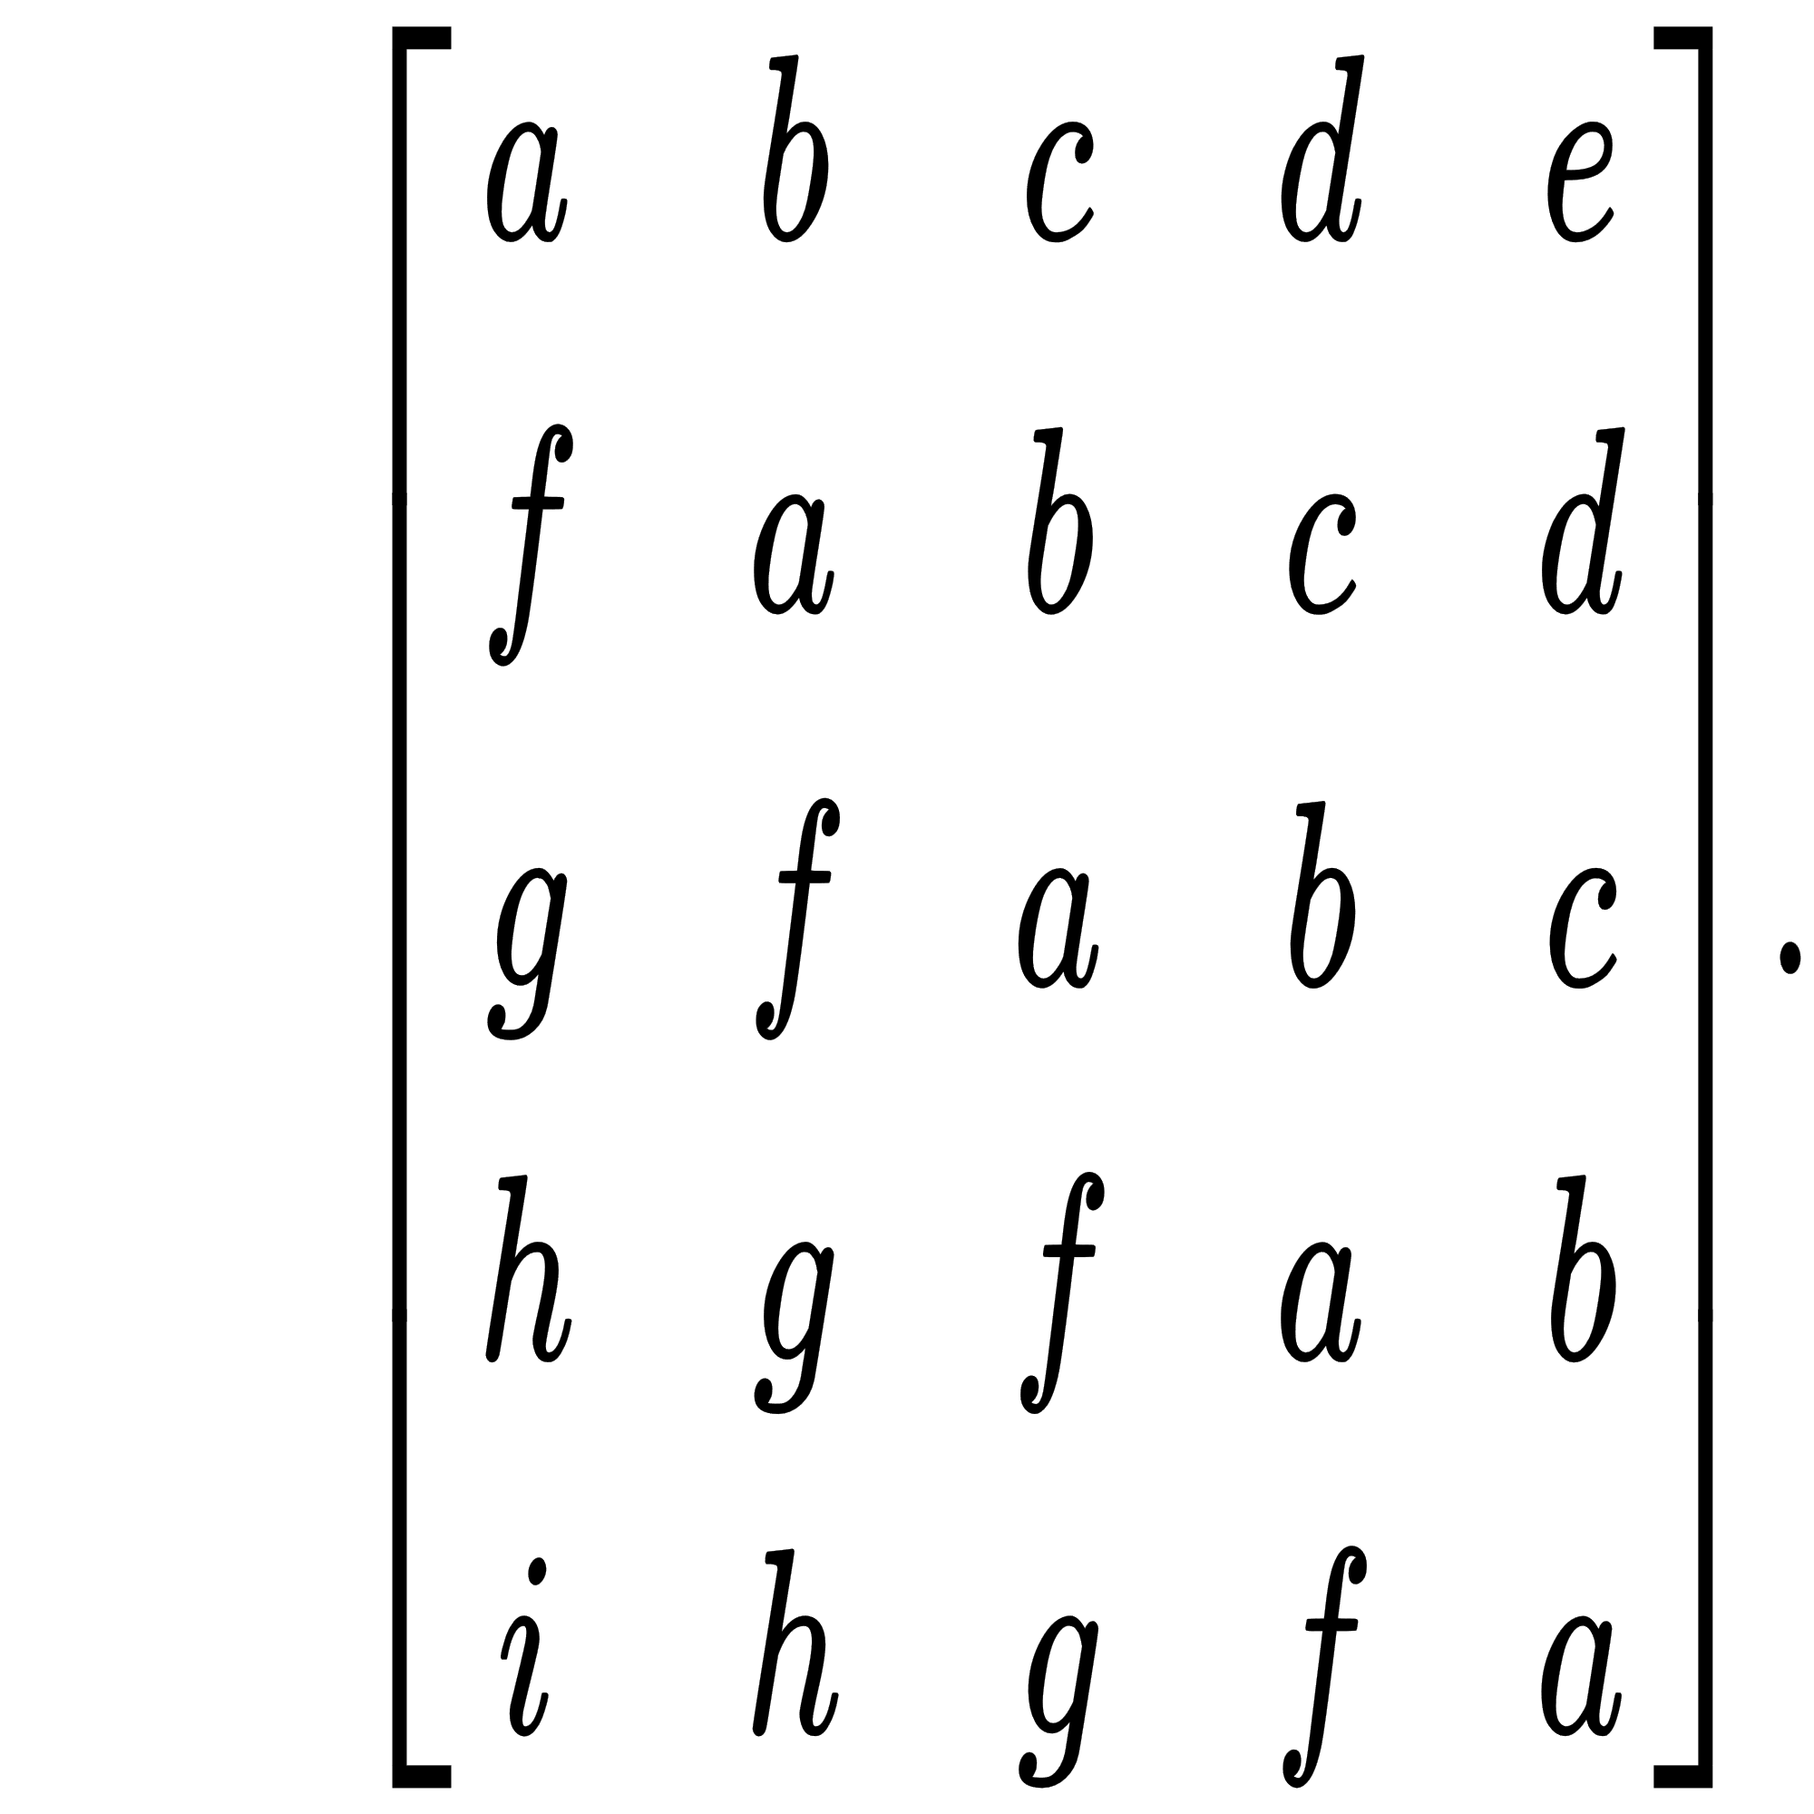
GLS Regression: Diagnostic tests
Now let’s turn to GLS.
The GLS model does not fit the data that well (R-squared = 0.677) but still acceptable. But GLS model has its advantages statistically.
First, the Durbin-Watson statistic is much more close to 2 than OLS and WLS models are, which indicates less possibility of autocorrelation.
Also, Jarque-Bera test cannot reject the hypothesis that the residuals are normally distributed at a small significance level.
Ω will have a form like this →
(Toeplitz matrix)
 | value
R-squared | 0.677
Adj. R-squared | 0.669
F-statistic | 83.09
Prob (F-statistic) | <1e-10

Slide 22

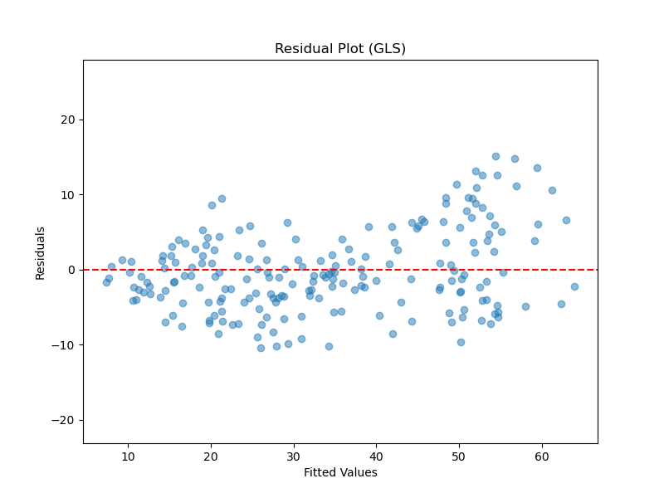
GLS Regression: Diagnostic tests
However, the White test still rejects the hypothesis that the residuals have homoscedasticity.
The heteroscedasticity issue is not fixed.
We can read the tendency from the residual plot of GLS.

Slide 23
BACKTESTING
To further check the performance of the model, we also did backtesting with data from 1993 to 2002.
We choose RMSE (root mean square error) to measure the goodness of fit. The RMSE when applying the GLS model to the data from 1993 to 2002 is 5.74.
For comparison, we also did backtesting with the OLS model.
The RMSE when applying the OLS model to the same dataset is 5.80.
Two RMSE’s are almost the same.
Although the GLS model has a smaller R-squared compared to the OLS model in training dataset, it performs no worse than the OLS model when in backtesting.

Slide 24
CONCLUSION
The WLS model fits the data better than OLS model does, but it fails in all diagnostic tests.
The GLS model doesn’t fit the training data that well, but it does almost equally well as the OLS model does. Also, it may fix the issue of autocorrelation and it passes the test of normality.
We may choose the GLS model finally.

Slide 25
Thank you

