Slide 1
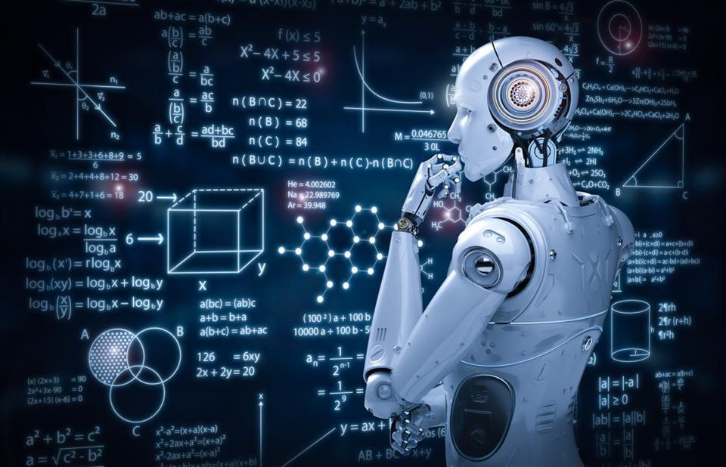

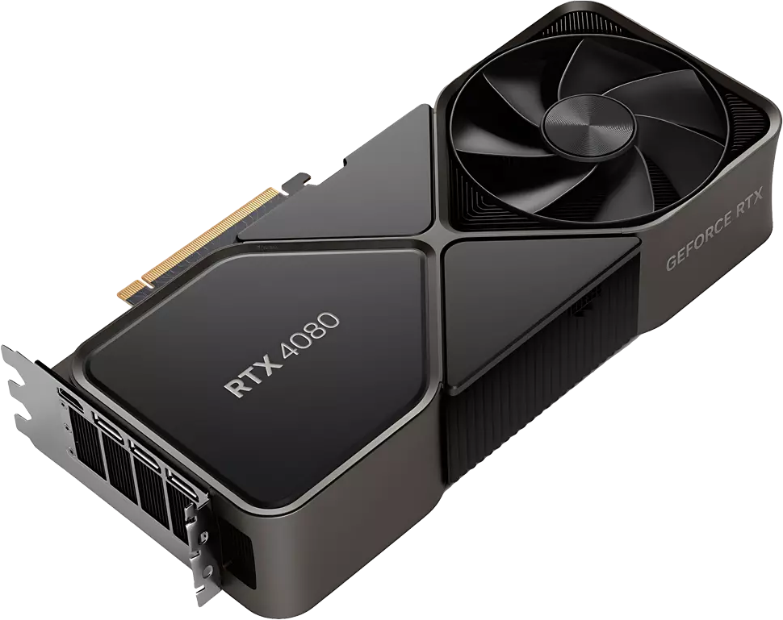
Machine Learning and Big Data Processing: Lab sessions
Part 1: introduction
Esther Rodrigo Bonet esther.rodrigo.bonet@vub.be (PL9.2.27) Leandro Di Bella leandro.di.bella@vub.be (PL9.2.36)

Slide 2
Course methodology
6 lab sessions (3h each)
Tuesday 15:00-18:00
Brief theory review
Python exercises
Quick recap of the exercises
No full solutions will be shared
How?
Offline mode
Lab sessions are on-campus
Could belive-streamed through Teams
If questions:
Ask your colleagues
E-mail us or come at our office
1 project
Evaluation of your competences
30% of total score
In groups of up to 3 students
Working Python project + Report
All guidelines + possible topics in ‘ML_projects_2025.pdf’
READ the guidelines!

Slide 3
Project timeline
Project submission deadline:
1st of June
Submit python project + report by e-mail
Read guidelines for details
Deadline + 24h -> -2
Deadline + >24h -> not accepted
Topic and group selection:
Friday 28th March at 20:00
Exact procedure on next slide
Now
Deadline for topic and group selection:
Sunday 30th March at 23:59
Project defense:
June (TBD)
Oral defense, in groups

Slide 4
Topic and group selection
Friday 28th March around 20:00, a notification will be posted on Canvas. From that moment on, one person per group can send us an e-mail (leandro.di.bella@vub.be, esther.rodrigo.bonet@vub.be ) with your top 6 of the projects (please order them from the most preferred to the least preferred). The mail that has arrived first in my mailbox, will also be processed firstly and this group will receive their first choice. (First come, first served)
The second mail that I have received will receive their most preferred choice, if this topic has not yet been chosen, otherwise the next project from their list will be selected.
Important to notice is that you must wait until our notification has been posted to start the procedure. Each mail that arrives before the sending time of our notification will be put in the back of the line and thus loses their favourable spot.
If you have any questions or remarks about this procedure, please let us know during the labs.

Slide 5
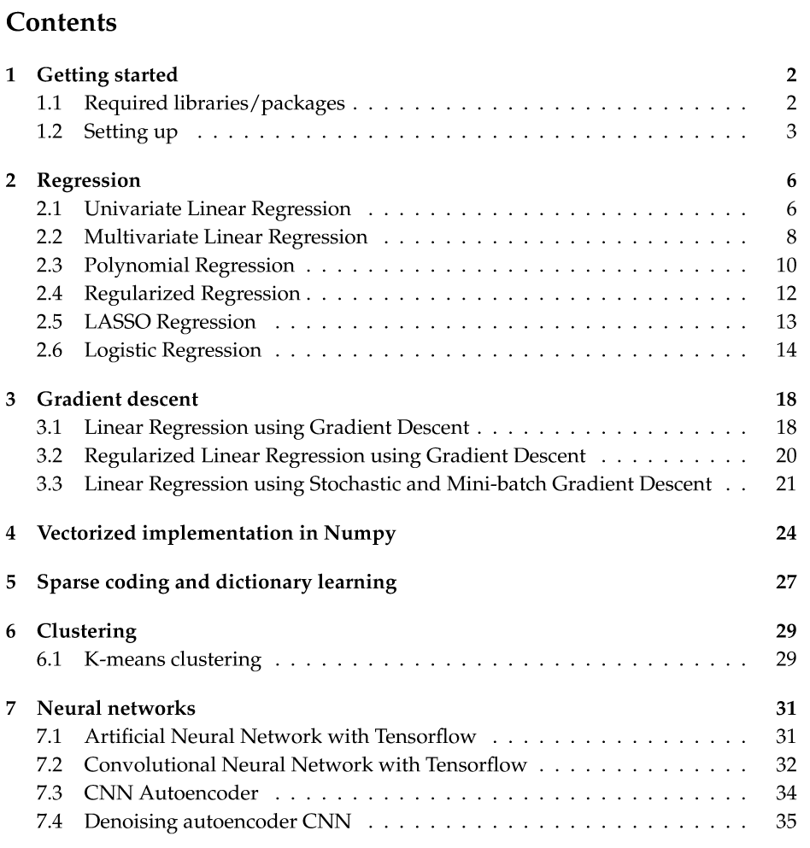
Lab sessions: content

Slide 6
Getting started

Slide 7
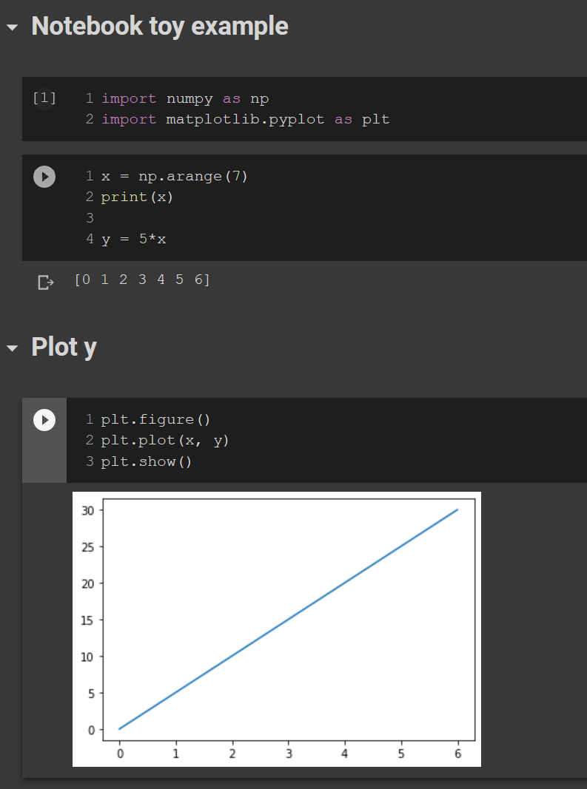
What is a Python Notebook?
Python notebook integrates code and its output into a single document
Visualizes formulas, charts together with your Python code.
Very useful for quick prototyping, directly visualizing results.
Also handy to communicate/share your results

Slide 8



How to get a working Python environment?
Google Colaboratory (“Colab”)
Completely online
No need to install libraries/packages on your machine
Only requirement is Google account
Most common libraries are already available
You can enable the usage of GPUs
Difficult when specific library/dataset is not available in Colab
Dataset should be stored on Google Drive and library installed every runtime.
Anaconda + Jupyter Notebook
Will install a local Python environment on your machine.
You need to install all required libraries/packages (Anaconda handles dependencies)
Almost all available libraries are easily installable
You don’t need internet connection once it’s installed
You can store dataset on your machine

Slide 9
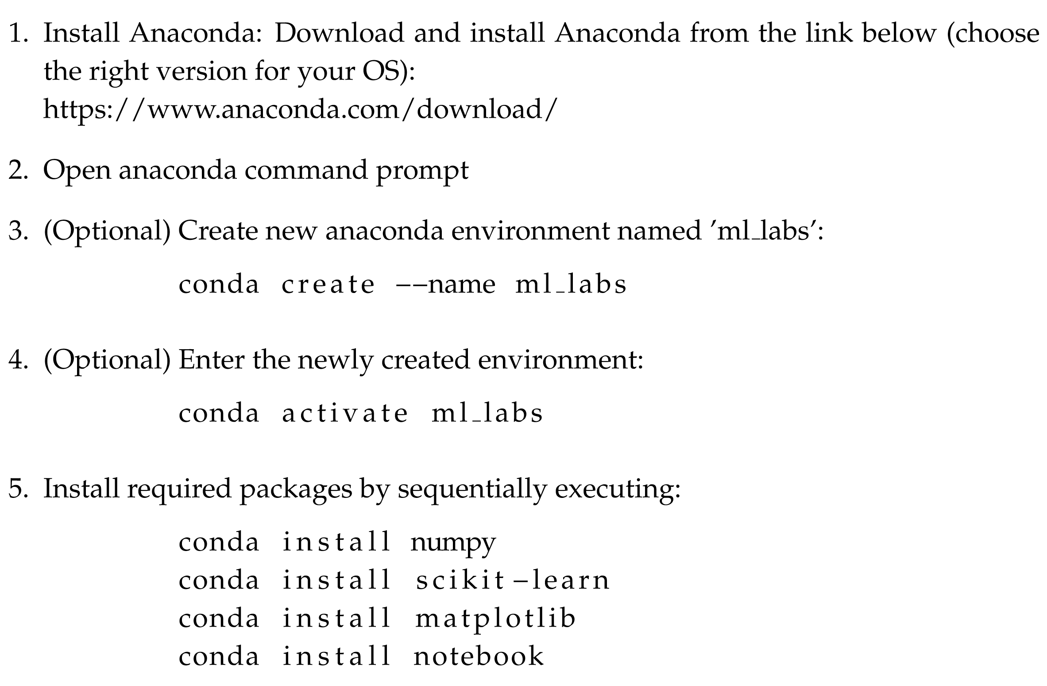
Anaconda + Jupyter
Anaconda is a popular package manager for data scientists
Allows easy package installation
Creation and management of different environments
A change in one environment won’t break another one
How to install Anaconda + necessary packages
Explained in detail in ‘GettingStarted.pdf’ on Canvas

Slide 10
Project
Not recommended to use notebooks -> normal Python project
Recommended (but not obliged) working environment:
Anaconda as package manager
IDE (such as Pycharm, VS code, Spyder, etc) to write code (can be linked with Anaconda)

