Slide 1


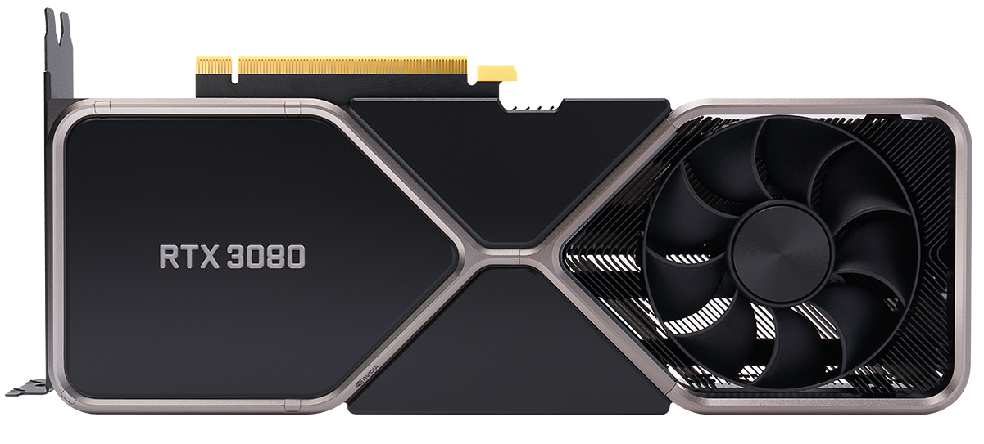
Machine Learning and Big Data Processing: Lab sessions
Lab1: Exercises
Esther Rodrigo Bonet esther.rodrigo.bonet@vub.be (PL9.2.27) Leandro Di Bella leandro.di.bella@vub.be (PL9.2.36)

Slide 2
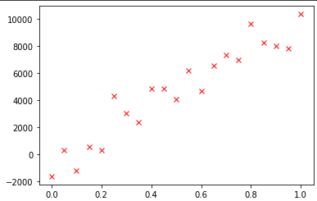
Univariate Linear Regression
Imagine you want to empirically determine the resistance
U = R * I
Experimental error
Univariate regression is trying to model a relation between two variables by a straight line
Y = θ₁X₁ + θ₀
Or in matrix notation: Y = θ^{T}X with θ^{T} = (θ₀, θ₁) and X^{T} = (1, X₁)
x_{i} is an instantiation of the variable X
x_{i} = (1, x_{i,1})
y_{i} is the associated output variable
y_{i} = θ₁x_{i,1} + θ₀ + ε_{i} for i Є [1, n]
Notes:
Microcontroller is a System on Chip: CPU, RAM, ROM, Timers, Peripherals all on a single chip.
Thousands of different models with different architectures, clock frequencies, power consumption, memory sizes, # of pins, …

Slide 3
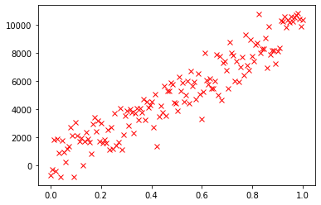
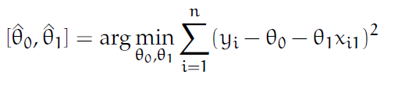
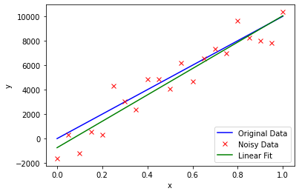
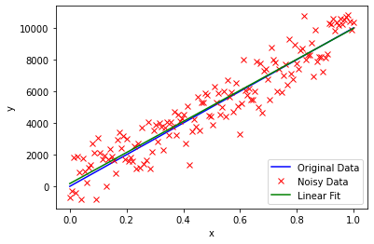
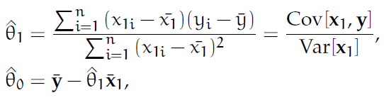
Univariate Linear Regression
y_{i} = θ₁x_{i,1} + θ₀ + ε_{i} for i Є [1, n]
Optimization problem: what is the ‘best’ fit?
Linear regression -> Least Squares Fitting
Has been solved in theory
heory lecture:
Notes:
Microcontroller is a System on Chip: CPU, RAM, ROM, Timers, Peripherals all on a single chip.
Thousands of different models with different architectures, clock frequencies, power consumption, memory sizes, # of pins, …

Slide 4
Exercises
Exercises are explained in more detail in exercise pdf: ‘1_regression.pdf’
Partly solved Notebook on Canvas ‘ex1_simple_linear_regression.ipynb’
Generate and plot data for Y = θ₁X₁ + θ₀ with θ₁=2 and θ₀=1 for x₁Є[0, 1]
Add random error from normal distribution with zero mean and std = 0.1 and plot it over the original graph
Calculate parameters of simple linear regression model
Using the aforementioned formulas
Or using the LinearRegression module from sklearn.linear_model
Plot the regression line
Notes:
Microcontroller is a System on Chip: CPU, RAM, ROM, Timers, Peripherals all on a single chip.
Thousands of different models with different architectures, clock frequencies, power consumption, memory sizes, # of pins, …

Slide 5
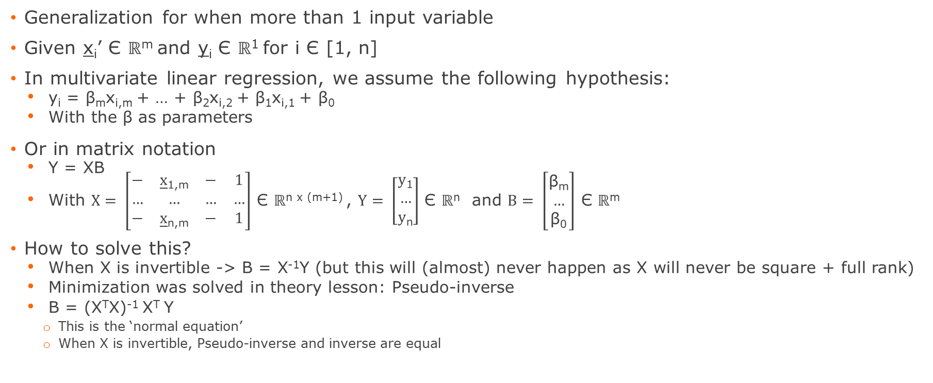
Multivariate Linear Regression
Generalization for when more than 1 input variable
Given x_{i}’ Є ℝ^{m} and y_{i} Є ℝ¹ for i Є [1, n]
In multivariate linear regression, we assume the following hypothesis:
y_{i} = β_{m}x_{i,m} + … + β₂x_{i,2} + β₁x_{i,1} + β₀
With the β as parameters
Or in matrix notation
Y = XΒ
With $X= \left[\begin{matrix}− & \underline{x}\text{1,}\text{m} & − & 1 \\ … & … & … & … \\ − & \underline{x}\text{n}\text{,}\text{m} & − & 1\end{matrix}\right]$ Є ℝ^{n x (m+1)} , $Y= \left[\begin{matrix}\text{y}\text{1} \\ … \\ \text{y}\text{n}\end{matrix}\right]$ Є ℝ^{n} and $B= \left[\begin{matrix}\text{β}\text{m} \\ … \\ \text{β}\text{0}\end{matrix}\right]$ Є ℝ^{m}
How to solve this?
When X is invertible -> Β = X⁻¹Y (but this will (almost) never happen as X will never be square + full rank)
Minimization was solved in theory lesson: Pseudo-inverse
Β = (X^{T}X)⁻¹ X^{T} Y
This is the ‘normal equation’
When X is invertible, Pseudo-inverse and inverse are equal
Notes:
Microcontroller is a System on Chip: CPU, RAM, ROM, Timers, Peripherals all on a single chip.
Thousands of different models with different architectures, clock frequencies, power consumption, memory sizes, # of pins, …

Slide 6
Exercises
Exercises are explained in more detail in exercise pdf: ‘1_regression.pdf’
Partly solved Notebook on Canvas
Load provided data (‘ex2x.dat’, ‘ex2y.dat’)
How to load data in Colab: https://neptune.ai/blog/google-colab-dealing-with-files
Use the normal equation to estimate the parameters B
Evaluate model by calculating the predictions and SSE
Repeat the above for synthetical data you generate yourself
Notes:
Microcontroller is a System on Chip: CPU, RAM, ROM, Timers, Peripherals all on a single chip.
Thousands of different models with different architectures, clock frequencies, power consumption, memory sizes, # of pins, …

Slide 7

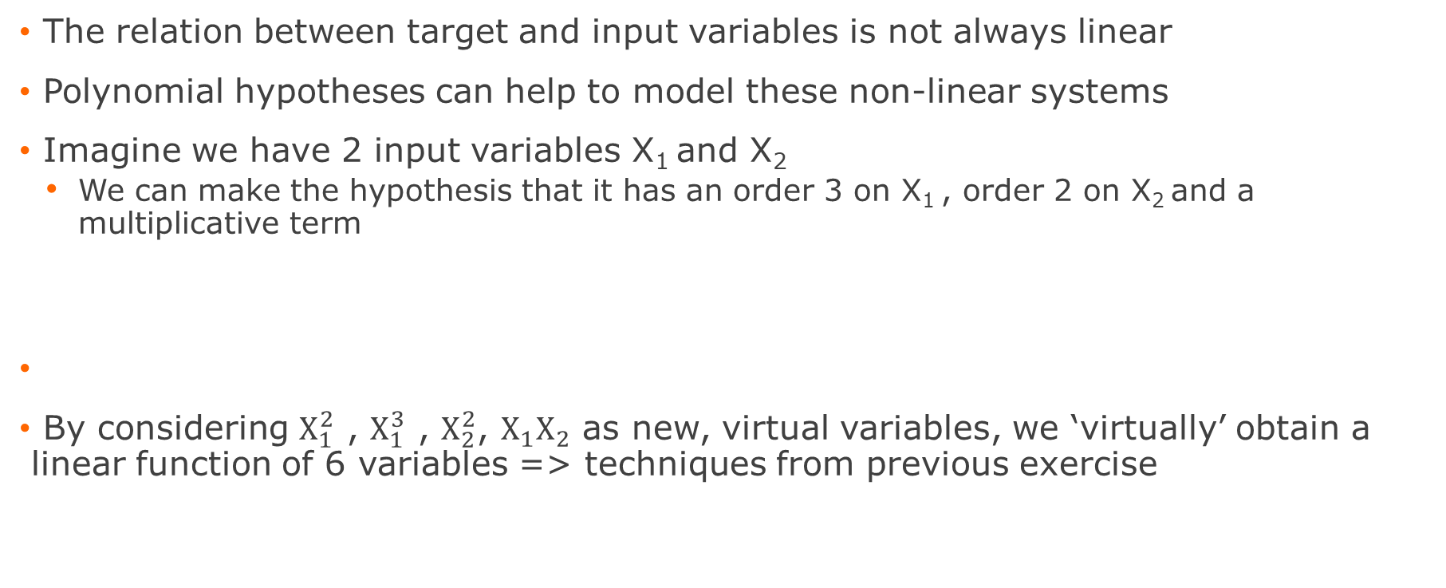
Polynomial Regression
The relation between target and input variables is not always linear
Polynomial hypotheses can help to model these non-linear systems
Imagine we have 2 input variables X₁ and X₂
We can make the hypothesis that it has an order 3 on X₁ , order 2 on X₂ and a multiplicative term
By considering $X_{1}^{2}$ , $X_{1}^{3}$ , $X_{2}^{2}$, $X_{1}X_{2}$ as new, virtual variables, we ‘virtually’ obtain a linear function of 6 variables => techniques from previous exercise
Notes:
Microcontroller is a System on Chip: CPU, RAM, ROM, Timers, Peripherals all on a single chip.
Thousands of different models with different architectures, clock frequencies, power consumption, memory sizes, # of pins, …

Slide 8
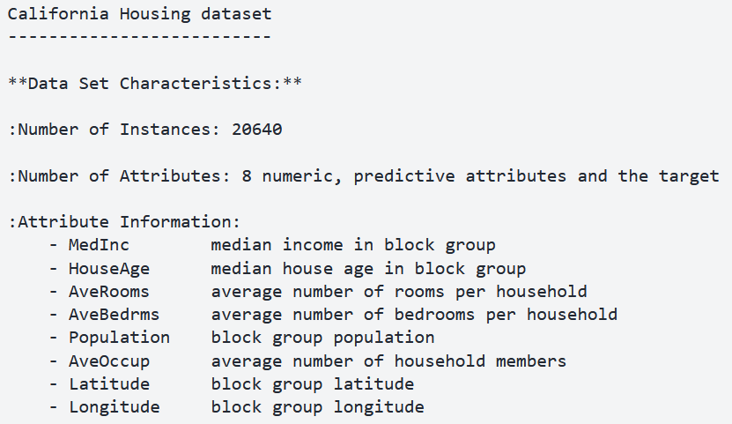
Exercises
Exercises are explained in more detail in exercise pdf: ‘1_regression.pdf’
Partly solved Notebook on Canvas
Real public dataset: ‘California housing Dataset’
Notes:
Microcontroller is a System on Chip: CPU, RAM, ROM, Timers, Peripherals all on a single chip.
Thousands of different models with different architectures, clock frequencies, power consumption, memory sizes, # of pins, …

Slide 9
Exercises
Load data
Split in training and test data
Make hypothesis and ‘virtual’ features
Fit the model
Make predictions and evaluate
MSE and MAE
Notes:
Microcontroller is a System on Chip: CPU, RAM, ROM, Timers, Peripherals all on a single chip.
Thousands of different models with different architectures, clock frequencies, power consumption, memory sizes, # of pins, …

