Slide 1


Machine Learning and Big Data Processing: Lab sessions
Lab3: pRESENTATION
Esther Rodrigo Bonet esther.rodrigo.bonet@vub.be (PL9.2.27) Leandro Di Bella leandro.di.bella@vub.be (PL9.2.36)

Slide 2
Content
Regression 2.0
Lasso Regression
Logistic Regression
Notes:
Microcontroller is a System on Chip: CPU, RAM, ROM, Timers, Peripherals all on a single chip.
Thousands of different models with different architectures, clock frequencies, power consumption, memory sizes, # of pins, …

Slide 3
Lasso Regression
Notes:
This VEDIO is used to help you review lasso regression.

Slide 4
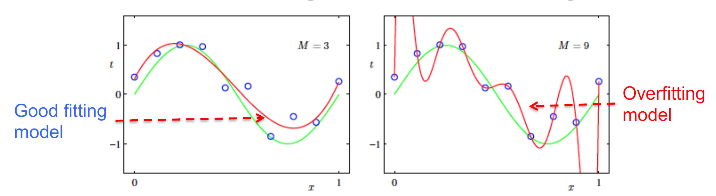
Regularized Regression
The problem of overfitting
True model
Dealing with overfitting
Reduce number of features
Disadvantage: lose some information
Regularization
Advantage: keep all features
Notes:
as methned before, we know the regularized regression can be used to solve the problem of overfittiing
and last tiime we introduced L-2 norm regularized method, we also can call it as ridge regression, and

Slide 5
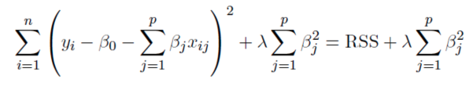
Lasso Regression
Ridge (L2 Regularized) Regression:
the square of coefficient
Notes:
in ridge regression, if we want to solve the problem, we need to minimize the equation as follows. where λ is a complexity parameter that controls the amount of shrinkage, it is regularization parameter.
toady, we want to introduce another regularized regression, named lasso regression.

Slide 6
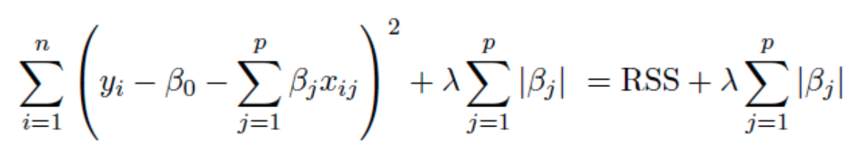

Lasso Regression
Ridge (L2 Regularized) Regression:
the square of coefficient
λ $≥ 0$
Lasso Regression:
the absolute value of coefficient
Notes:
Lasso regression is very very similar to ridge regression.
the function in ridge regression is the sum of the squared residuals plus lambda multiple the sum of the square of coefficients
if, instead of squaring the coefficients, we take the absolute value of coefficients, then we get lasso regression
there is a Note that use like ridge regression, lamda in lasso regression can be any value from 0 to positive infinity.
however the lasso regression is similar to ridge regression, but it has some very very important differences

Slide 7
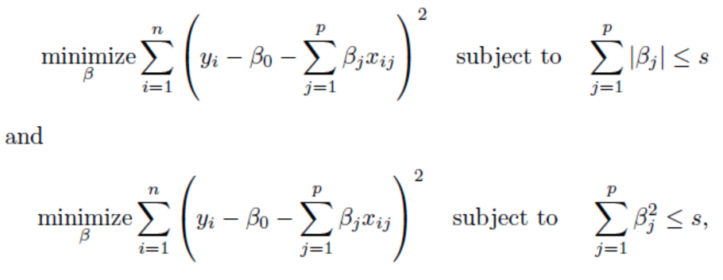
Lasso Regression
The Lasso and Ridge regression coefficient estimates solves the problems:
Notes:
oka, in last slide, we've seen how ridge and Lasso regression are similar, now let's talk about the big difference bettwen them
in this slides, there are two equivalent ways to respectively wirte the lasso problem and ridege problem. obviously, they subject to different limitations.

Slide 8
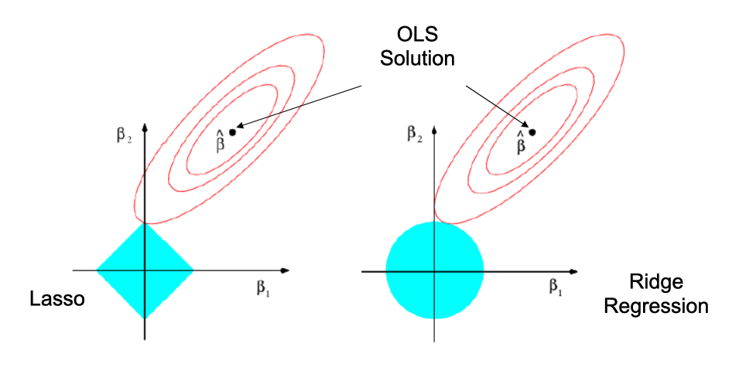
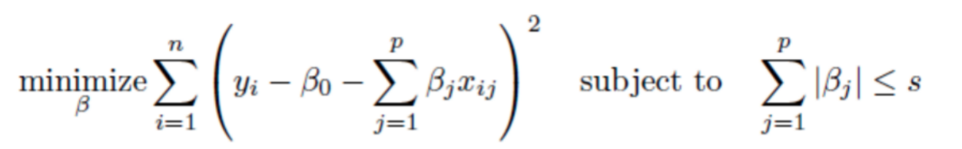
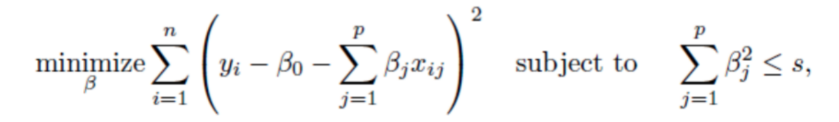
Lasso Regression
Notes:
From the diagram of this slide, we can get a more vivid explanation of the limitaion for coeffeients
The LASSO and ridge regression coefficient estimates are given by the first point at which an ellipse contacts the constraint region.
When s increases, the constraint region, that is, the blue area in the figure, will also increase
left side, In lasso regression, The value range of coefficient is square area, but that in ridge regression, on the right side, is circular area.

Slide 9
Lasso Regression
Ridge regression: coefficients asymptotically close to zero
Logistic regression: coefficients can be exactly equal to zero
Notes:
so by this diagram we can get a big difference between ridge and lasso regression is that ridge regression can only shrink the slope asymptotically close to 0 while Lasso regression can shrink the slope all the way to 0. this means lasso regression can exclude useless variables from equations, it is a little better than ridge regression at reducing the variance in models that contain a lot of uesless variables.

Slide 10
Lasso Regression
Ridge regression: coefficients asymptotically close to zero
Logistic regression: coefficients can be exactly equal to zero
Thus, the lasso performs variable/feature selection and shrinkage at the same time.
Notes:
Thus,

Slide 11
Logistic Regression
Notes:
This VEDIO is used to help you review logistic regression.

Slide 12
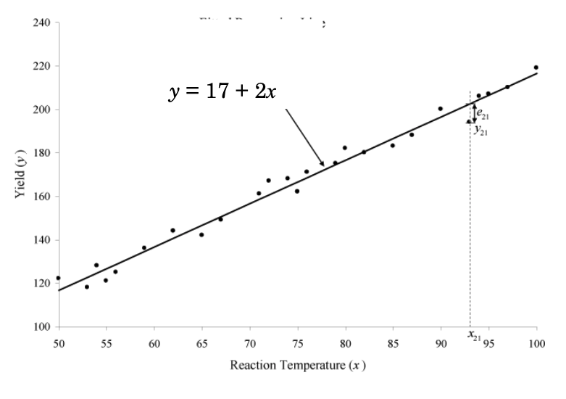
Linear Regression
Use the model to predict Yield given reaction tempreture
Notes:
before we dive into logistic regression, let's take a step back and review linear regression.
if we have some data, reaction temperature and yield, then we can fit a line as the model. with this model, we can do a lot of things, especially, we can use this model to do prediction by giving reaction tempreture,
actually, using data to predict something falls under the category of machine learning, so plain the linear regression is a form of ML

Slide 13
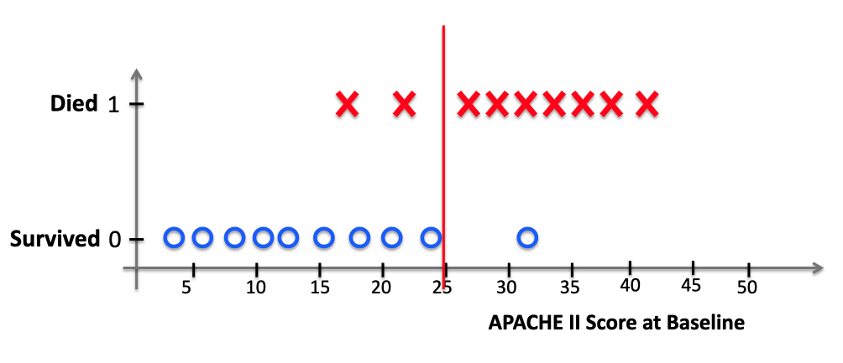
Logistic Regression
Notes:
okay, now, let talk about logistic regression.
logistic regression is similar to linear regression, except, logistic regression predicts whether somthing is Ture or false, instead of predictiong something continuous.

Slide 14
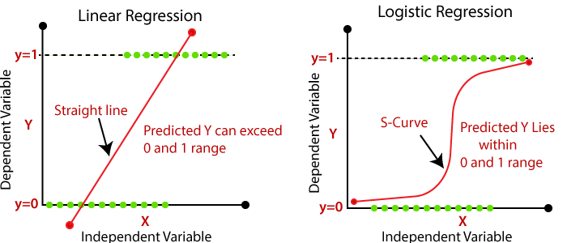
Logistic Regression
Notes:
also, instead of fitting a line to the date, logistic regression fits an “s”shaped logistic function
Obviously, the curve of logistic regression, in the right side, goes from 0 to 1, and that means the curve tells us the probabiliy that y equal to 1 based on the value of x

Slide 15

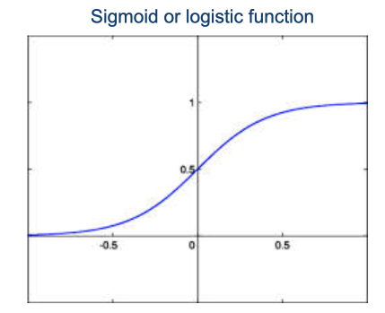



Logistic Regression
Notes:
so, it can be expressed as the probability between 0 and 1, fit it to logistic function and finally, we can get a model to calculate the probabiliy that y equal to 1.

Slide 16
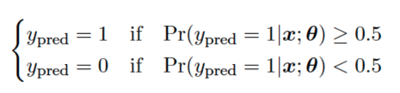
Logistic Regression
provide probabilities
classify new samples
Notes:
although logistic regression can calcute propbability, it is usually used for classification
for example, if the probability y equal to 1 is greater than 0.5, then we classify it equal to 1, otherwise we will classify it as equal to 0.
so logistic regression's ability to provide probabilities and classify new samples using continuous and discrete measuremnets makes it a popular machine learning method.

Slide 17
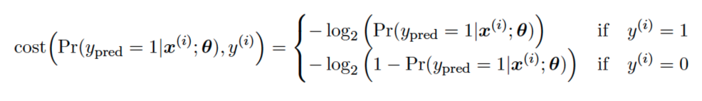
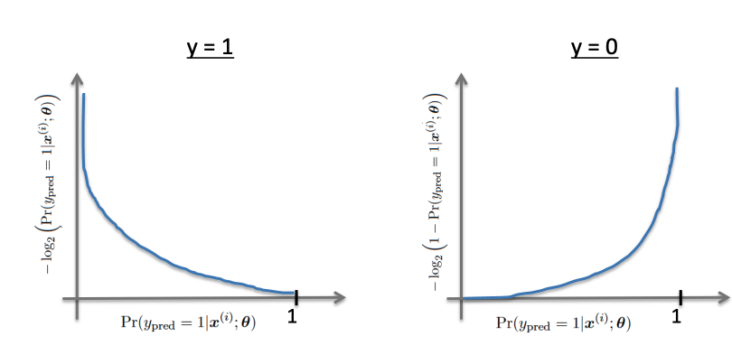
Gradient Descent in Logistic Regression
Cost Function
Notes:
in the Linear regression, We learnt about the cost function, we know the cost function represents optimization objective, in other words, we create a cost function and minimize it so that we can develop an accurate model with minimum error.
however, The cost function used in linear regression won't work in the logistic regression, and the cost function of the logistic regressionis is defined as :
by use this function, we will grant the convexity to the function the gradient descent algorithm has to process
In case 𝑦=1, the output (i.e. the cost to pay) approaches to 0 as probality that y =1 approaches to 1. Conversely, the cost to pay grows to infinity as the probality approaches to 0. You can clearly see it in the diagram below, left side. This is a desirable property: we want a bigger penalty as the algorithm predicts something far away from the actual value. If the label is 𝑦=1 but the algorithm predicts probality that = 0, the outcome is completely wrong.
Conversely, the same intuition applies when 𝑦=0, depicted in the diagram below, right side. Bigger penalties when the label is 𝑦=0 but the algorithm predicts probability = 1.

Slide 18
Gradient Descent in Logistic Regression
Cost Function
Notes:
We can make the cost more compact into a one-line expression, replace 𝑦 with 0 and 1 the logistic regression cost function can be rewritten as:

Slide 19
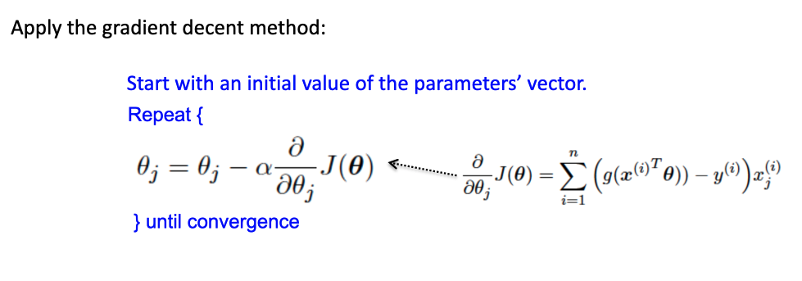
Gradient Descent in Logistic Regression
Cost Function
Notes:
now we have cost function and apply the gradieent decent method, we can train model and use the trained model to do prediction.

