Slide 1


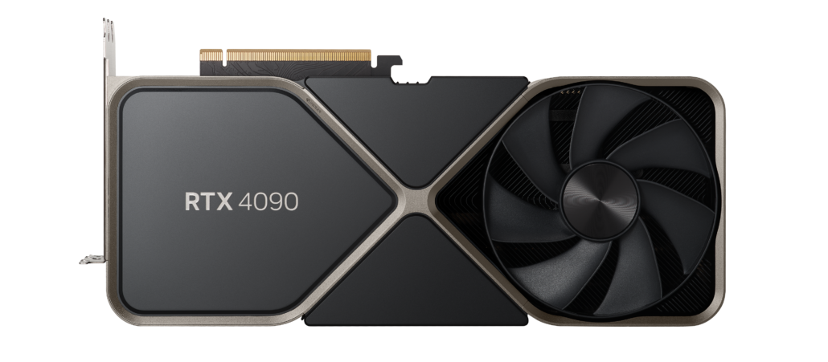
Machine Learning and Big Data Processing: Lab sessions
Lab5: Exercises
Leandro Di Bella leandro.di.bella@vub.be (PL9.2.36)

Slide 2
Outline
Recap of neural network theory
Small theoretical exercise (Ex1)
Some starting points
Available Python Libraries
PyTorch introduction
Numpy arrays vs PyTorch tensors (Ex2)
How to implement training loop in PyTorch
Classify MNIST dataset (Ex3)

Slide 3





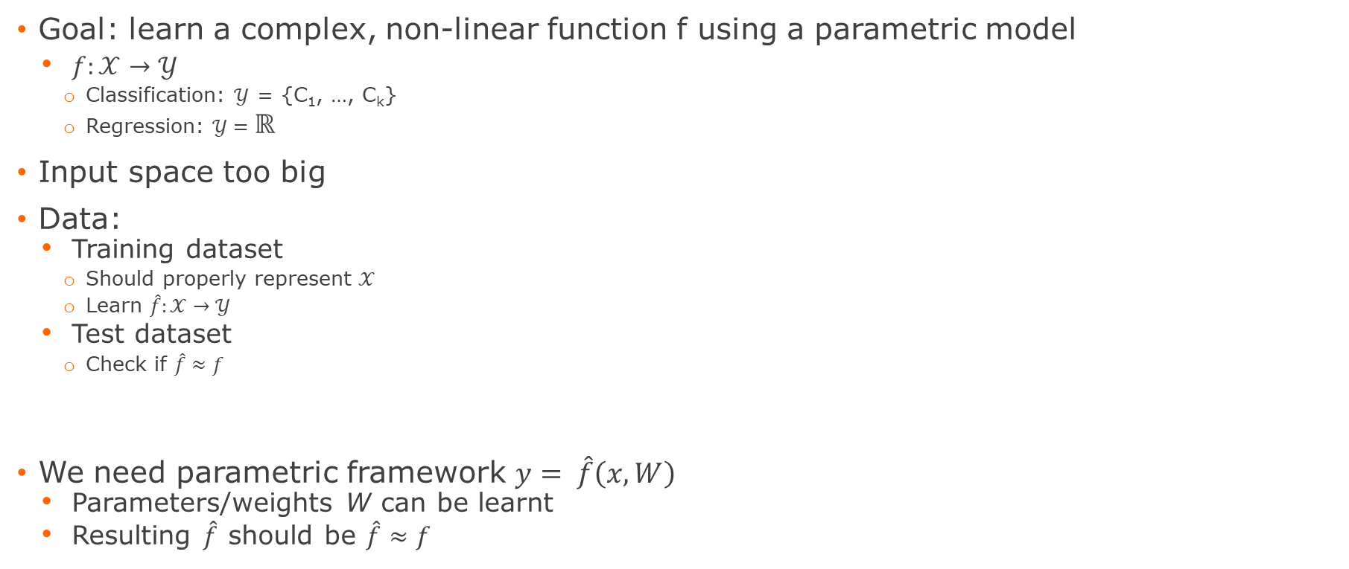





Artificial Neural Networks (ANN’s)
Goal: learn a complex, non-linear function f using a parametric model
$f:𝒳→𝒴$
Classification: $𝒴$ = {C₁, …, C_{k}}
Regression: $𝒴=ℝ$
Input space too big
Data:
Training dataset
Should properly represent $𝒳$
Learn $\hat{f}:𝒳→𝒴$
Test dataset
Check if $\hat{f}≈f$
We need parametric framework $y= \hat{f}\left(x, W\right)$
Parameters/weights W can be learnt
Resulting $\hat{f}$ should be $\hat{f}≈f$
$𝒳$_{tr}
$$\hat{f}$$
● Dog
f
● Cat
$𝒳$_{test}
$$𝒳$$
$$𝒴$$
* Images are from the CIFAR10 dataset
* Theoretical part slideset has been inspired by ML-slideset by Prof. Luca Iocchi (La Sapienza Università di Roma)

Slide 4
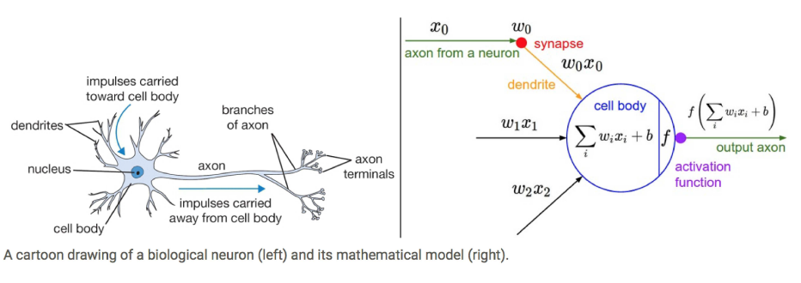
Artificial Neural Networks (ANN’s)
Get inspiration from the structure of a brain
Very powerful when such units/nodes/neurons are stacked
Non-linear activation function allows approximation of non-linear functions
Results in an ‘Neural Network’
* Image from Isaac Changhau: https://isaacchanghau.github.io

Slide 5
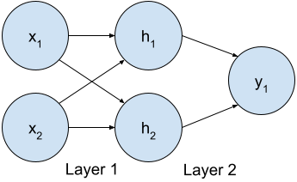
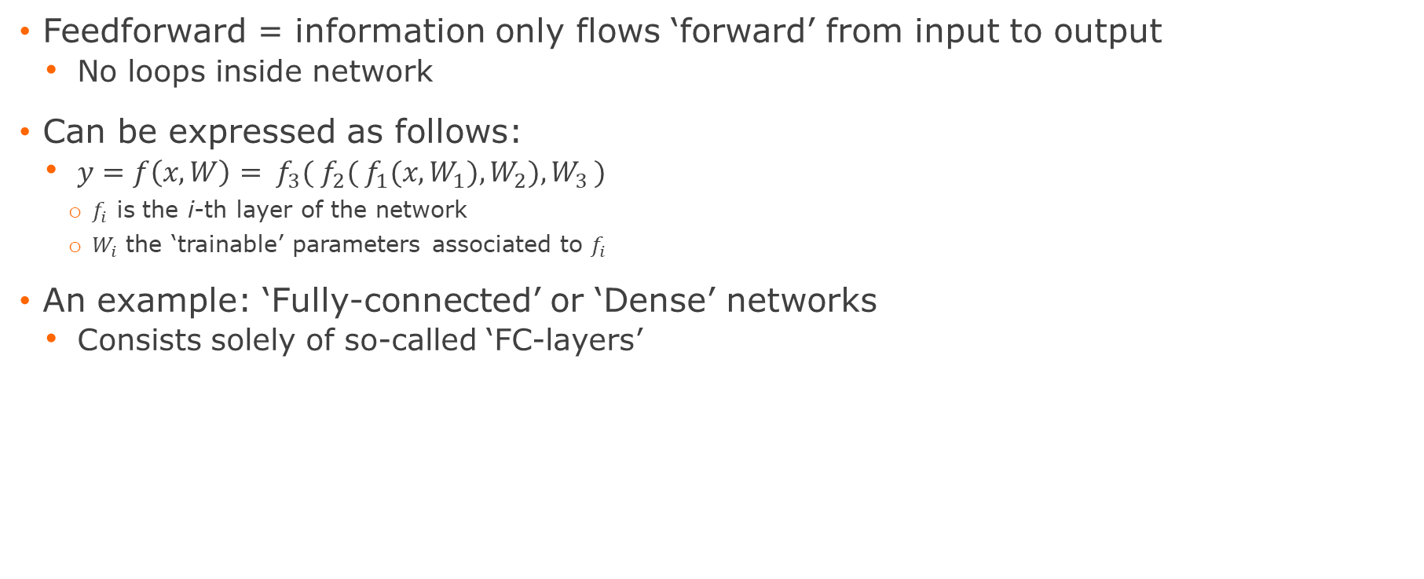
Feedforward Networks
Feedforward = information only flows ‘forward’ from input to output
No loops inside network
Can be expressed as follows:
$y=f\left(x, W\right)= f_{3}({ f}_{2}( f_{1}(x,W_{1}),W_{2}),W_{3 })$
$f_{i}$ is the i-th layer of the network
$W_{i}$ the ‘trainable’ parameters associated to $f_{i}$
An example: ‘Fully-connected’ or ‘Dense’ networks
Consists solely of so-called ‘FC-layers’

Slide 6
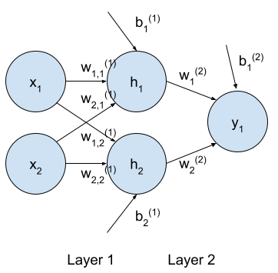

Fully-connected network
Also called ‘dense’ network
Notation:
$\underline{x}={[x_{1},x_{2}]}^{T}∈ℝ^{2x1}$ the input vector
$W^{(1)}∈ℝ^{2x2}$ the weight matrix of the first layer
${\underline{b}}^{(1)}∈ℝ^{2x1}$ the bias vector of the first layer
$\underline{h}={[h_{1},h_{2}]}^{T}∈ℝ^{2x1}$the vector of ‘hidden’ values
${\underline{w}}^{(2)}∈ℝ^{2x1}$ the weight matrix of the second layer
$b^{(2)}∈$ $ℝ$ the bias term of the second layer
$y_{1}$ the output value
Uses the neurological-inspired node model
$\underline{h}=g(W^{\left(1\right) T}\underline{x}+{\underline{b}}^{(1)})$
Where g is an element-wise activation function
$y_{1}=g_{output}({\underline{w}}^{\left(2\right) T}\underline{h}+b^{(2)})$
Full-model:
$y_{1}=g_{output}({\underline{w}}^{\left(2\right) T} g(W^{\left(1\right) T}\underline{x}+{\underline{b}}^{(1)})+b^{(2)})$

Slide 7
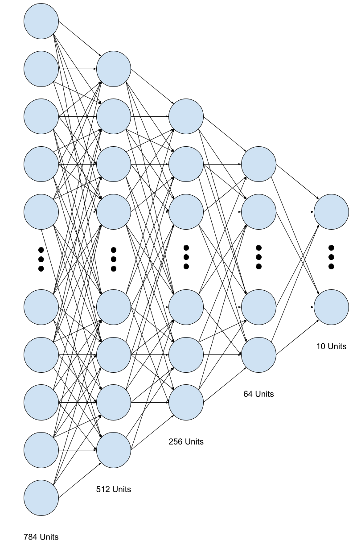
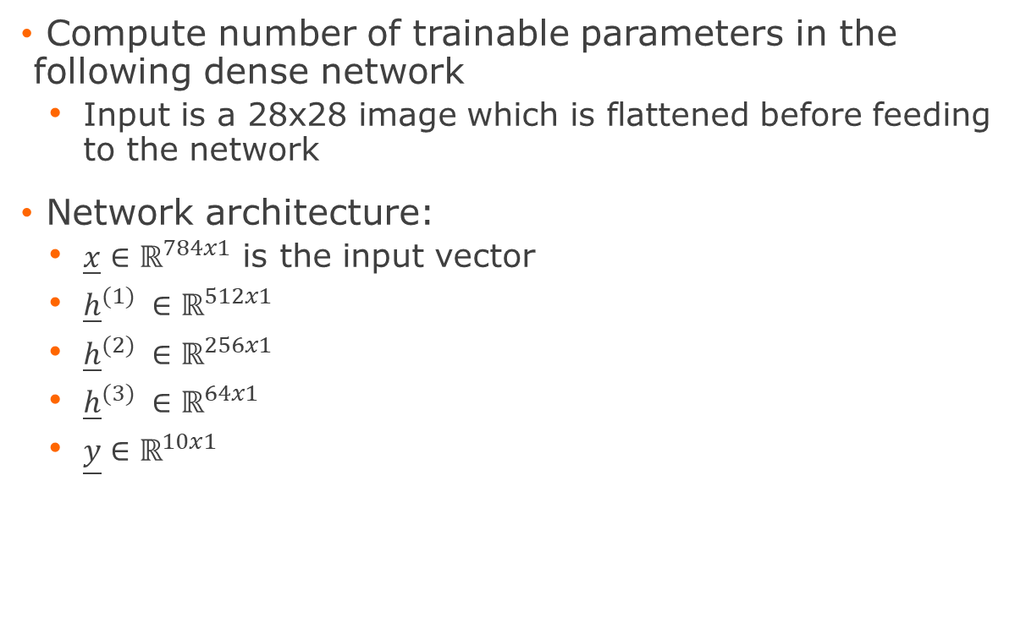
Exercise 1
Compute number of trainable parameters in the following dense network
Input is a 28x28 image which is flattened before feeding to the network
Network architecture:
$\underline{x}∈ℝ^{784x1}$ is the input vector
${\underline{h}}^{(1)} ∈ℝ^{512x1}$
${\underline{h}}^{(2)} ∈ℝ^{256x1}$
${\underline{h}}^{(3)} ∈ℝ^{64x1}$
$\underline{y}∈ℝ^{10x1}$
Notes:
NumWeights = (784*512+512) + (512*256+256) + (256*64+64) + (64*10+10) = 550,346

Slide 8
Network architecture design
Network design parameters:
Depth = number of layers
Width = number of units in each layer
Universal approximation theorem
Describes theoretical relation between depth and width
“Any FFN with a linear layer + activation function
can approximate any Borel measurable function with
any desired non-zero amount of error, provided
enough hidden units”
Would require an enormous amount of units
Narrow but deeper networks are easier to train and are generally preferred.
No clear, general answer exists (yet) -> Testing
Width
Depth

Slide 9
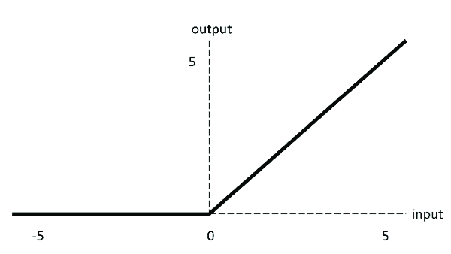
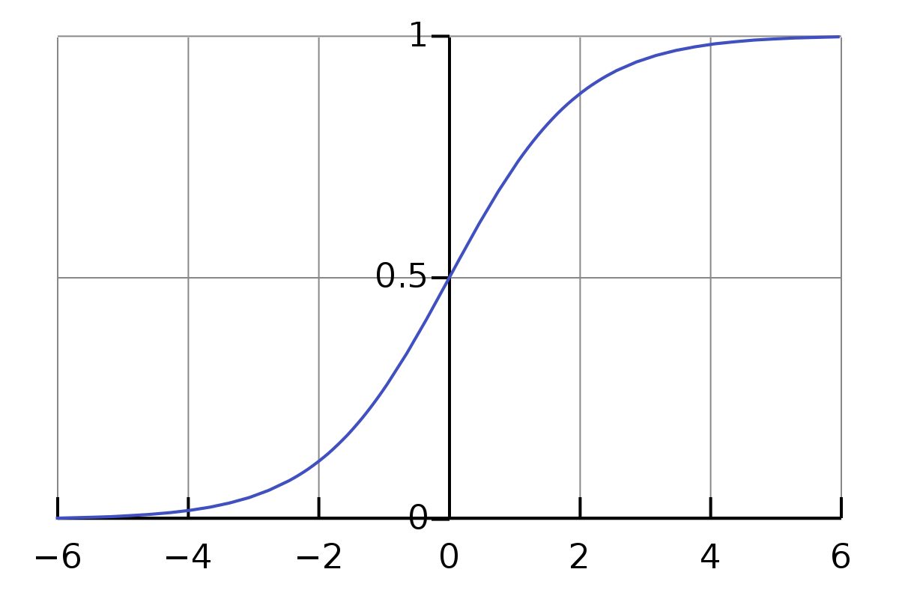
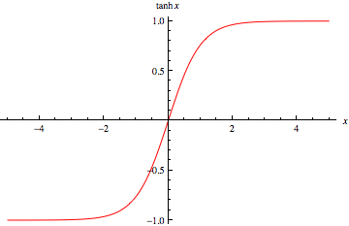
Activation function
Non-linear activation function allows approximation of non-linear functions
Popular activation functions:
ReLU (most popular): y = max(x, 0)
Sigmoid
Tanh

Slide 10
What else do we need to train a network?
Loss-function
Depends on task
Backpropagation
Nothing more than the chain rule to compute gradients for each weight
Optimizer
Different optimizers exist, each with specific properties
Adam
SGD
AdaMax
RMSprop
Etc.
No general consensus about best
-> Test (Adam often good starting point)

Slide 11
Starting point
Output activation function and loss function are dependent of task and each other
Can be derived with Bayesian logic
Good starting point but not always best solution -> test
 | Loss function | Output activation function
Regression | MSE | Identity
Binary classification | Binary cross-entropy | Sigmoid
Multi-class classification | Categorical cross-entropy | Softmax

Slide 12
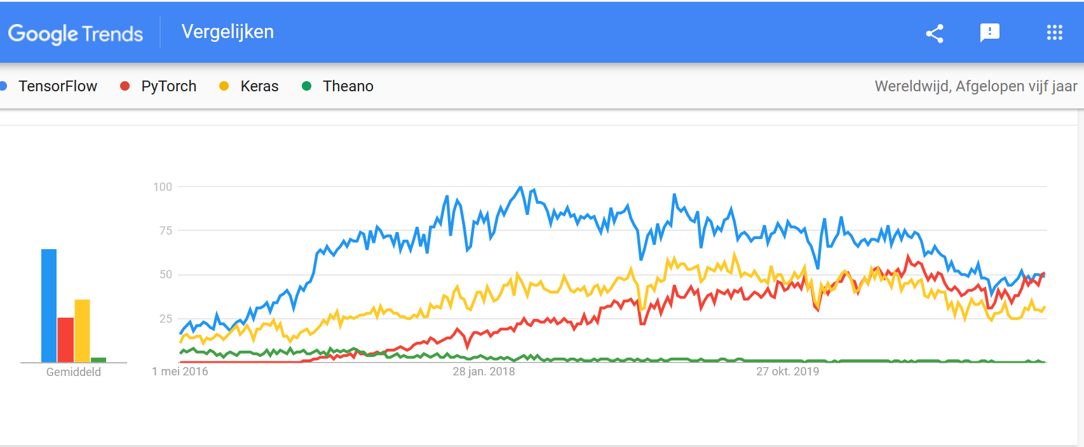
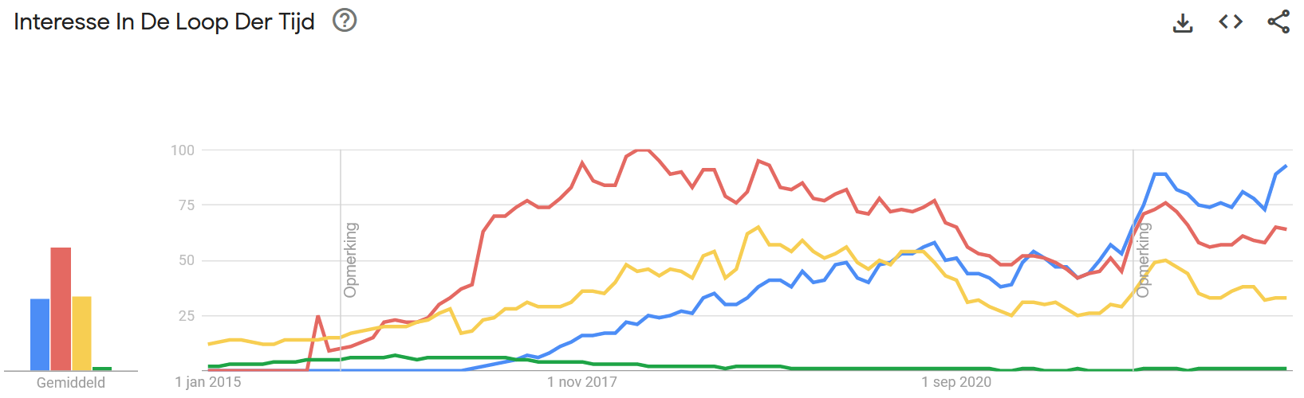
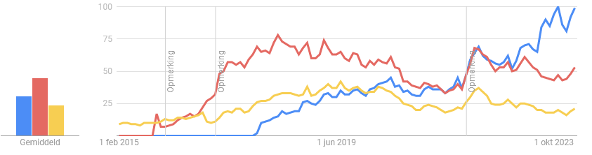
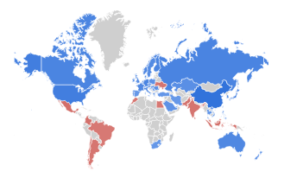
Python libraries for deep learning
https://thenextweb.com/news/why-tensorflow-for-python-is-dying-a-slow-death?fbclid=IwAR1FS42KO4kMyYV1r8-WpQXa5Kx98aTqFR8fkL2O1luXZWR0LyTbSJlRMw8

Slide 13
Getting Started: PyTorch
Colab:
No need for new packages, already pre-installed
Make sure you enable GPU-usage
Conda + Jupyter Notebook
‘conda install pytorch pytorch-cuda=11.8 -c pytorch -c nvidia’
OR look on www.pytorch.org what command is necessary for you
If you don’t have GPU -> Use cpu-version (will be quite slow) (check website for command) or Colab
PyTorch has a very good online documentation and active community

Slide 14
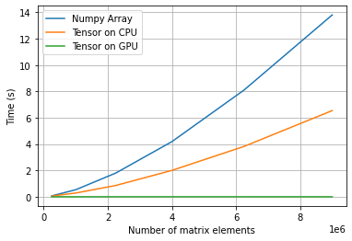
Tensors
Conceptually identical to Numpy arrays
n-dimensional array
Many PyTorch functions specialized for tensors
But Tensor != Numpy Array
Tensors can keep track of computational graph
Tensors can use GPU to accelerate computations (a lot!)
Example:
x = torch.ones(18, 16).to(‘cuda:0’).type(torch.int32)
OR x = torch.ones(18, 16, dtype=torch.int32, device='cuda:0’)

Slide 15
Exercise 2: Numpy arrays vs tensors
Compare required computational time between Numpy Array and Tensors
Steps:
1) Initialize a numpy array / tensor on cpu / tensor on gpu from uniform random distribution [0, 1)
2) Use given function ‘time_matmul’ that does 10 matrix multiplications and returns required time
3) Append the resulting time to a list that stores the obtained values
4) Plot the results

Slide 16
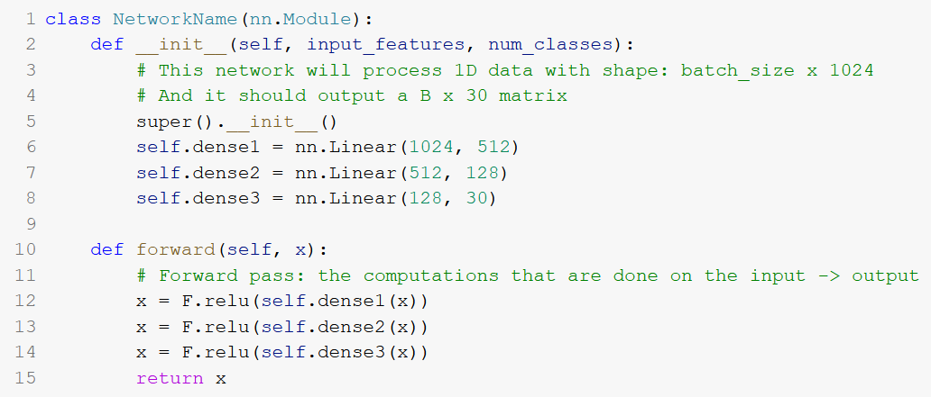
Implement a NN-model
A network model can be implemented as a class
Init phase: declaration of variables and creation of trainable parameters
Forward phase: the computations that are done at each forward pass
This network != the network that you’ll have to implement in exercise 3

Slide 17
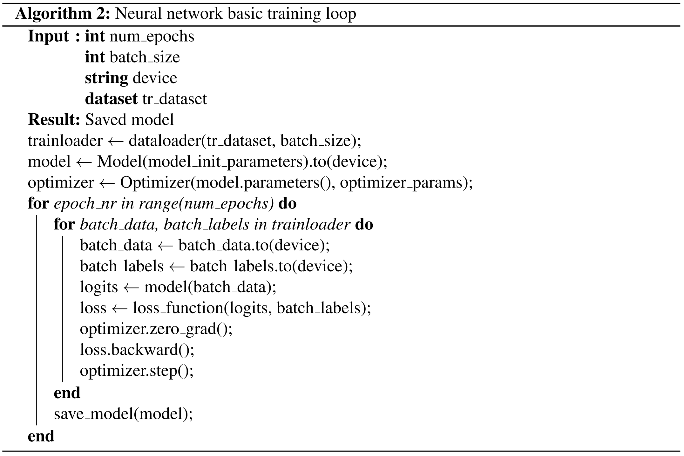
How to implement training loop?

Slide 18
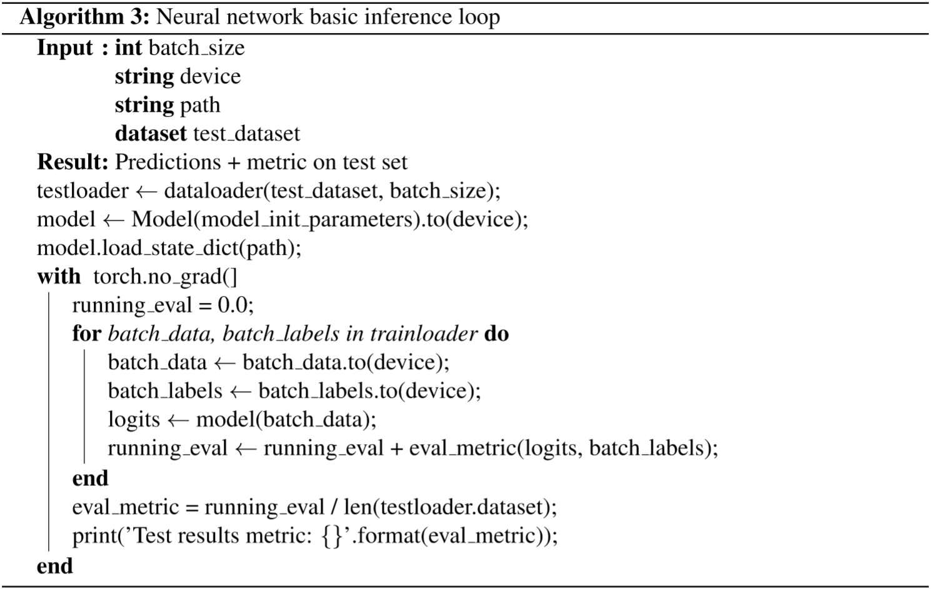
How to implement inference loop?

Slide 19
Exercise 3: Make a NN-classifier
Small demo of dataloader
Implement the model: Same model as in exercise 1
Flatten the input data
Dense layers (784-512-256-64-10)
A ReLU activation after each dense layer (except the output layer)
No activation function should be specified on last layer as ‘nn.CrossEntropyLoss()’ already incorporates a logSoftMax
Complete the training loop
Create the optimizer (SGD with lr=0.001 and momentum = 0.9)
Put the data on device (preferably gpu)
Predict and get loss
Update model
Use the code to print training metrics each epoch and save last model
Complete inference loop
Get test metrics

Slide 20
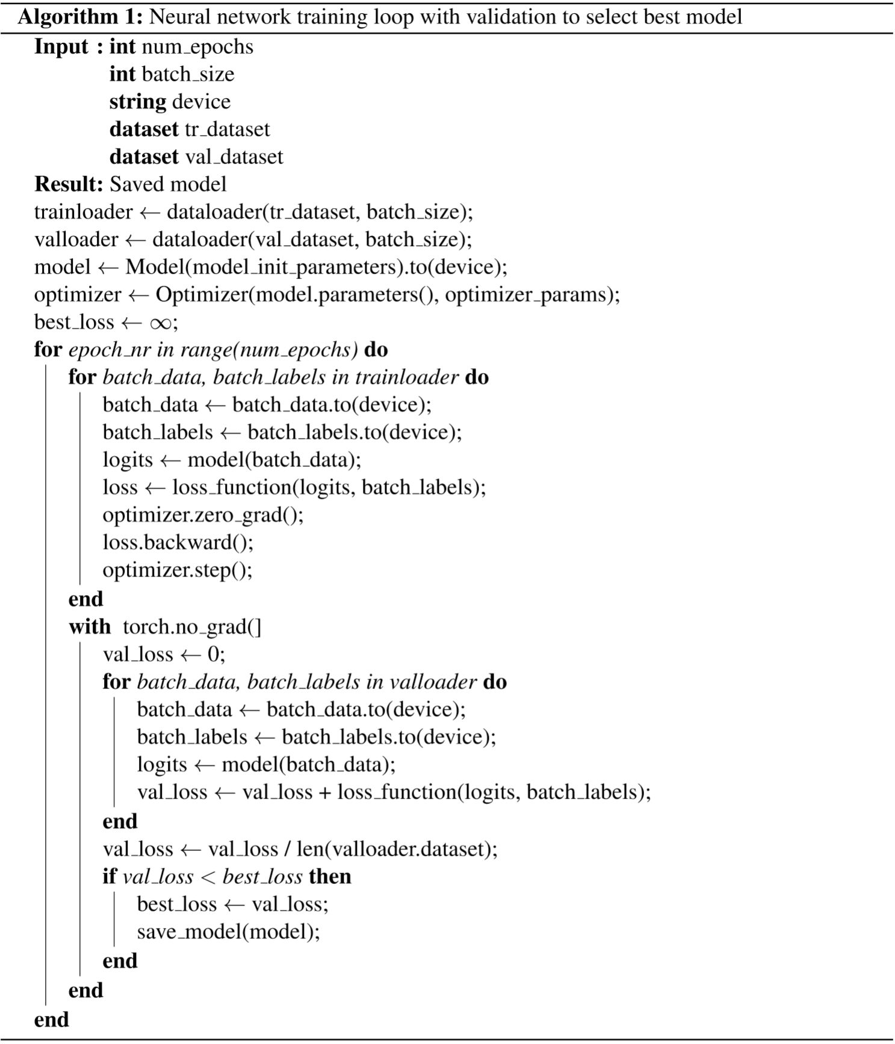
Exercise 3 – part 2
But last epoch not always the best
Divide dataset in 3 parts
Training dataset
Validation dataset
Test dataset
Use Validation dataset to find ‘best epoch’
In this exercise we’ll use the test set again

Slide 21
Why non-linearity?
XOR-example

