Slide 1
CLAUDE CODE HARNESS · PLUGIN · v2.9.0
Agentic SDLC
An AI-SDLC framework built from delivery experience
4 agents · 17 skills · spec-first · test-first · evidence-gated
Every claim carries one of these grades:
VERIFIED
CASE STUDY
RATIONALE
PLANNED
github.com/trac41799/claude-code-agentic-sdlc
Notes:
Condensed deck: rationale, workings, both diagrams, outputs, benchmarks, strengths & weaknesses.

Slide 2
RATIONALE
Why a team-shaped framework
Agents changed the bottleneck. The product is the process.
Context loss
Handoff tax
Agents shift it
Every session starts cold.
Every handoff loses fidelity.
Bottleneck is process, not code.
Requirements
→
Design
→
Implement
→
Test
→
Deploy
→
Maintain
v2 principles: nothing installs globally · no hooks · no auto-approve · all change via PR · the operator gates every decision.
RATIONALE
Notes:
The v2 model corrects v1's pipeline assumption; v1's overnight autonomy became drift (slide 8).

Slide 3
WORKINGS
Principle · team · commands
SDD decides, TDD proves — every gate is a human decision.
PRINCIPLE
TEAM · 4 AGENTS
COMMANDS
• One request → PDCA-ish chain: spec → plan → TDD → QA → PR
product-manager
/asdlc-project
specs · epics · status
scaffold a new client project + team
• Spec before code — the plan is the contract
developer
/asdlc-adopt
impl. · publishing
install the team into an existing repo
• Test-first: RED → GREEN → REFACTOR per task
/asdlc-doctor
qa
setup check — prerequisites, layout
strategy · triage
• Done = gates passed with evidence
/asdlc-tools
devops
status-first CLI + Supabase MCP installer
CI/CD · guardrails
/asdlc-memory-cleanup
• Two phases: spec phase + build phase — each gated
Per project · installed by
human-in-the-loop memory tidy
/asdlc-project · /asdlc-adopt
Notes:
Plugin ships 5 commands; workflow skills live per project (stage-lane per the cycle diagram).

Slide 4
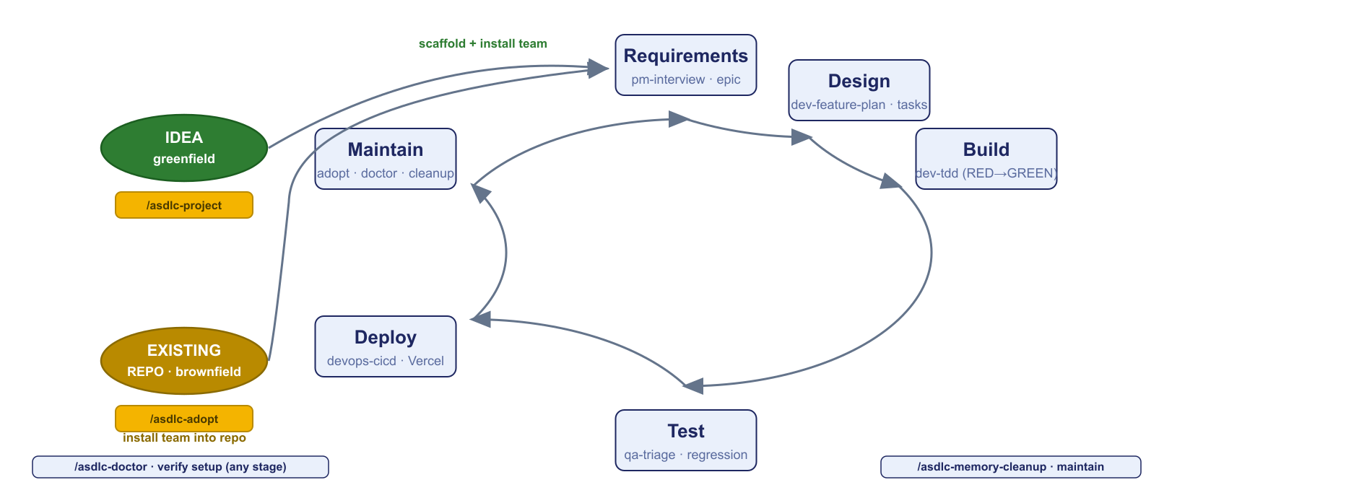
THE MODEL
One SDLC cycle, two entry points
Greenfield · brownfield · a skill lane per stage.
Every stage has a skill; every entry has a command — /asdlc-project (new) · /asdlc-adopt (existing) · /asdlc-doctor verifies anytime.
Notes:
The cycle is standard SDLC; the framework only owns the lanes.

Slide 5
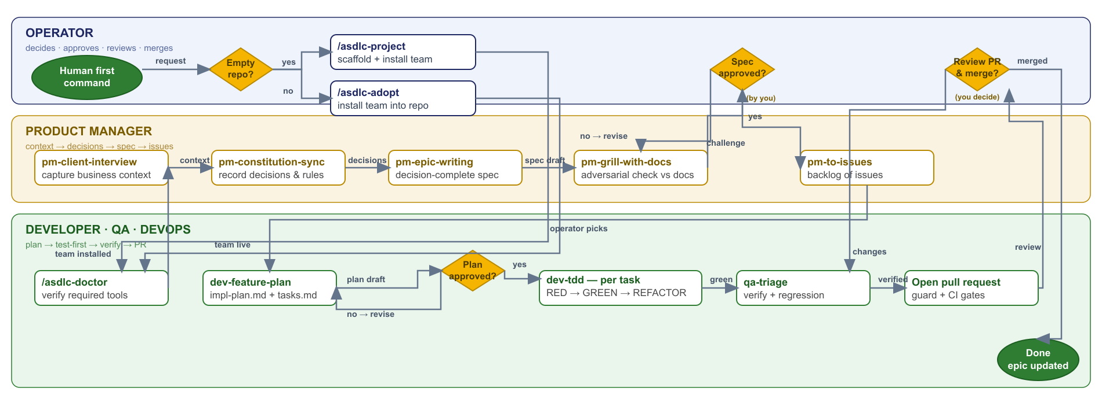
THE FLOW
One request → merged PR
Spec gate · plan gate · TDD per task · QA before merge.
Three lanes, two approvals, one PR — the human decides, the team executes, gates hold.
Notes:
The human gates are where trust is built: spec, plan, merge.

Slide 6
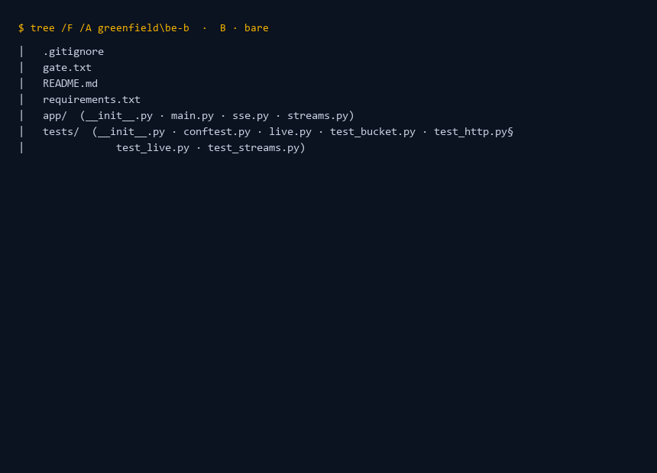
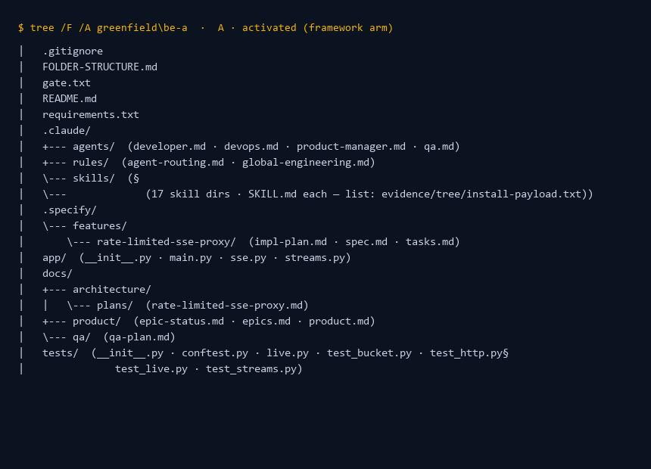
OUTPUTS
What a run leaves behind
Same frozen task (BE SSE proxy): bare vs framework arm.
B · BARE
A · ACTIVATED
Bare: code + tests only. Framework arm: code + tests + .claude/ team + .specify/ (spec · plan · tasks) + docs/product + docs/qa — the traceability trail.
All 12 projects + session JSONs + trees are in evidence/ · python evidence/validate.py reruns every gate — 12/12 claims reproduce.
Notes:
Point at evidence/validate.py — it reproves the whole bench.

Slide 7
BENCHMARKS · SAME MODEL, FROZEN TASKS
Measured: bare vs passive vs activated
R1–R4 incremental + greenfield suite — metered, non-merge, one pin.
TASK
B · BARE
A′ · PASSIVE
A · ACTIVATED
R1 · add-tests (trivial)
$0.63 · 6 tests
$0.62 · 7 tests
$0.47 · 10 tests · 2.5× turns
R2 · DB + RLS
$0.22 · 11 tests
$0.27 · 11 tests
$0.67 · 11 tests + plan/QA
R3 · vertical FE+BE
$0.94 · 4 tests
n/a
$0.98 · 4 tests + plan/tasks
R4 · fragile refactor
refused · restraint pass
n/a
guardrail advisory violated · prod-correct when approved
HARD CASE · GREENFIELD-3 (rate-limited SSE proxy): B 27.4 min · $2.84 · 22 tests — A 6.5 min · $1.08 · 24 tests + spec/plan/tasks/QA. 4.2× faster.
Honest poles: passive ≈ bare (placebo) · N=1 per cell · cost basis provider-unknown (GAP-ANALYSIS.md) · devops lanes unmeasured offline.
4 frozen cases · E2E pipeline · FE virtualized feed · BE SSE proxy (hard) · DB+ETL 1M rows — repro: bench/greenfield.py --task bench/tasks/... · details: deck slide 13 + docs/benchmarks/BENCHMARK-SUMMARY.md
Notes:
Value concentrates where difficulty lives: plan-first discipline beats churn on hard engineering; simple tasks are parity-to-small-tax.

Slide 8
HONEST YARDSTICKS
Strengths · weaknesses · deliberate cuts
Measured first — then what we left out by design.
STRENGTHS (VERIFIED)
DELIBERATELY NOT INCLUDED
• Value where difficulty lives — 4.2× faster on the hard case
• No hooks / auto-runtime / silent telemetry — v1 lesson
• Traceability in 8/8 A-runs; zero in bare
• No auto-approve — every gate is a human decision
• Clean install · marketplace updates · CLI-first stack
• No marketing agent lanes — removed v2.6.0 (unmeasured)
• Reproducible: evidence/ + validate.py (12/12)
• No permissions grants — Bash(*) killed v1
• No global memory — repo artifacts ARE the memory
WEAKNESSES (VERIFIED)
• Cost loop missing — no trusted metering/budgets (GAP-ANALYSIS G1)
• Guardrails advisory, not mechanical (R4 inversion)
• N=1 per bench cell · devops lanes offline-unmeasurable
FOCUS LIST: trusted cost loop · CI plan-vs-PR enforcement · N≥3 headlines · devops staging smoke · second-model matrix.
Notes:
Say the cost gap first, before they ask. The exclusions are design choices, not defects.

Slide 9
ROADMAP · NEXT MOVES
Open points → committed moves
Seven gaps we admit, seven fixes we're building — the post-meeting commitment list.
OPEN POINTS
NEXT MOVES
COST
No trusted metering, no budget
GOVERNOR
Hard USD cap per run + banner
COMPARISON
No arm vs another SDLC framework
BENCH ARM
Mass real-world set + comparison arm
METRICS
N=1 cells, variance unmeasured
N≥3
Variance + context-read metrics
EVIDENCE
Handoffs lean on tests; thin for UI/UX
GATES
5-tier chain → manifest per PR
QUALITY
TDD + human review only
MUTATION
Mutation/contract/BDD tiers + freezer
AGENTS
Model/effort inherited from parent
AGENTS
TBD — candidate: model pin, reject wrong
HUMANS
No brownfield onboarding path
BRIEF
Onboarding map · commands · risks
PLANNED
Seven gaps, seven committed moves — tracked in docs/demo/open-points.md · evidence in GAP-ANALYSIS.md.
Notes:
One-to-one mapping of the post-meeting open points to committed moves (docs/demo/open-points.md). Row 6 (AGENTS) is the only one without a decided fix — candidate: per-agent model pin with wrong-pin rejection (GAP-ANALYSIS G1 fix path).

Slide 10
WHAT WE KNOW
Built from experience. Graded by evidence.
The framework's value concentrates on hard engineering — measured, reproducible, labeled.
Gaps are shown, not hidden (cost metering, advisory guardrails, N=1 cells).
Fork first: experiments live on the fork; the official ex-company repo stays read-only.
Everything ships in the repo: github.com/trac41799/claude-code-agentic-sdlc (evidence/ · docs/demo/live-demo-guide.md · docs/benchmarks/BENCHMARK-SUMMARY.md)
Not a solved discipline — a repeatable, honest one.
Notes:
Close on honesty: we grade our own claims and show the gaps.

